Slide 1



Voice Annotation

Slide 2

Students:
Enas Asmar 11715507
Farah Zubdeh 11714922
Saja Salahat 11716324
Supervisor:
Dr. Amjad Hawash
An-Najah National University
2020

Slide 3
Overview
Abstract
Introduction
System Architecture
Interface
Experimental Test
Conclusions and Future Work

Slide 4
Abstract
Several methods have been established to enhance users' discussions and collaboration over the Internet. in which users attaché their notes (annotations) to websites components (texts, images and videos).
However, although the textual annotations are very famous, voice annotations have become a widespread activity through which users add their own voice notes to the components of an HTML web documents as a method of having different discussions and thoughts exchange.

Slide 5
Introduction
Textual annotation is the most famous technique used (and still)to express ideas by annotating contents of websites.
Users are able to express their thoughts by adding textual contents of the websites .
Like Review Area for the advertisement page for a specific product where users are allowed to provide reviews about some products.
and also add comments or replies to comments on social media pages about specific subjects.

Slide 6
recently, creating voice annotations became very famous and preferable by most of the users due to the simplicity of annotations creation and the ability of expressing emotions more than textual ones.

Slide 7
In this work, a user can create voice annotations associated to selected texts appear in HTML pages on the Internet .
When the users revisit previously annotated websites, they can see the annotated parts with a highlight for each annotated part. In order to see and hear the annotations of any part.

Slide 8
Vocal annotations in this work are of three types :Public and Private and custom.
users can add textual tags.
By using a searching facility, the user can search for these tags (from his portal) and a list of public annotations appear.

Slide 9
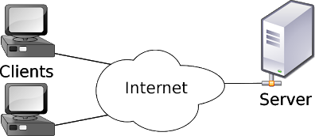
System Architecture
Google extension is used to implement the interaction part with the users.
A special extension is programmed that contains set of JavaScript functions that are injected in each visited website in order to execute the functionality of text selection and vocal annotations recording.
Figure 1 depicts the components of the tool. The figure shows the different components of the implemented tool where credentials of users are implemented using the sign-up and login com-ponents. Whereas the activities related to annotation process are implemented in the Google Extension and database components.

Slide 10
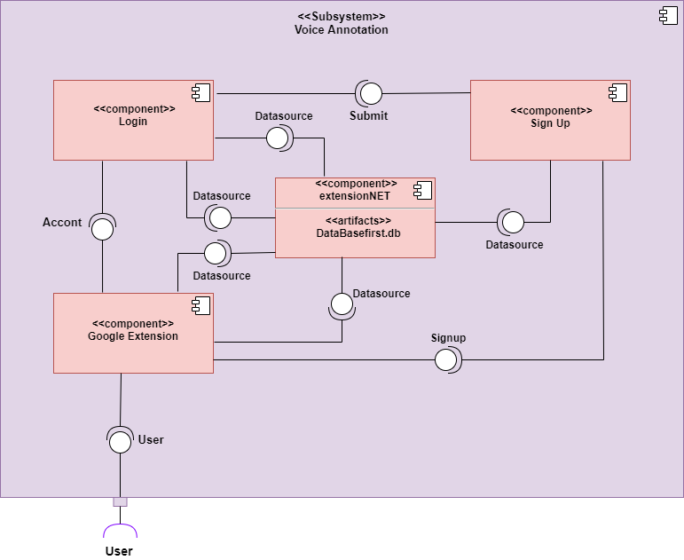
Fig. 1. Component Diagram.

Slide 11
Figure 2 below represents the logical schema of the database represented by an Entity-Relationship diagram.
The diagram contains3 different entities : User ,Voice and Text along side the entity relationships between them.
The user entity reflects all attributes related to users (Annotators), Text is used to save data about annotated text and Voice entity is to save data about the vocal annotation itself.

Slide 12
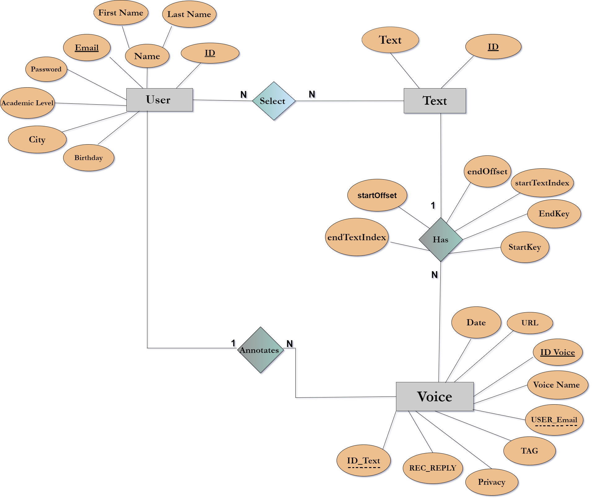
Fig. 2. ER Diagram.

Slide 13
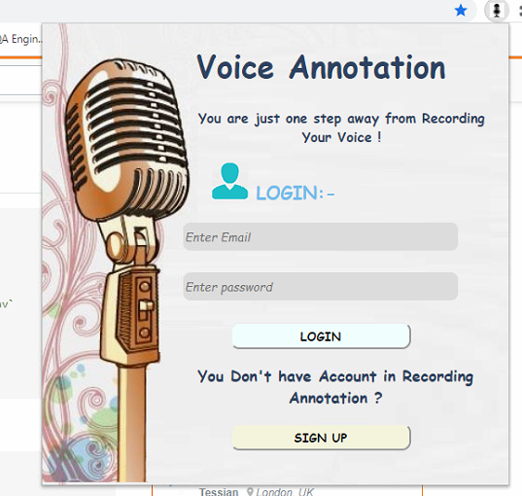
Interface
Users can create a voice annotation by selecting words “ Create voice annotation” And clicking on extension (on the voice annotation system) at the top of the web page and a popup window appears To put the comment through it as shown in the Figure 4, but the user must have an account on the voice annotation system for the popup window to appear.

Slide 14
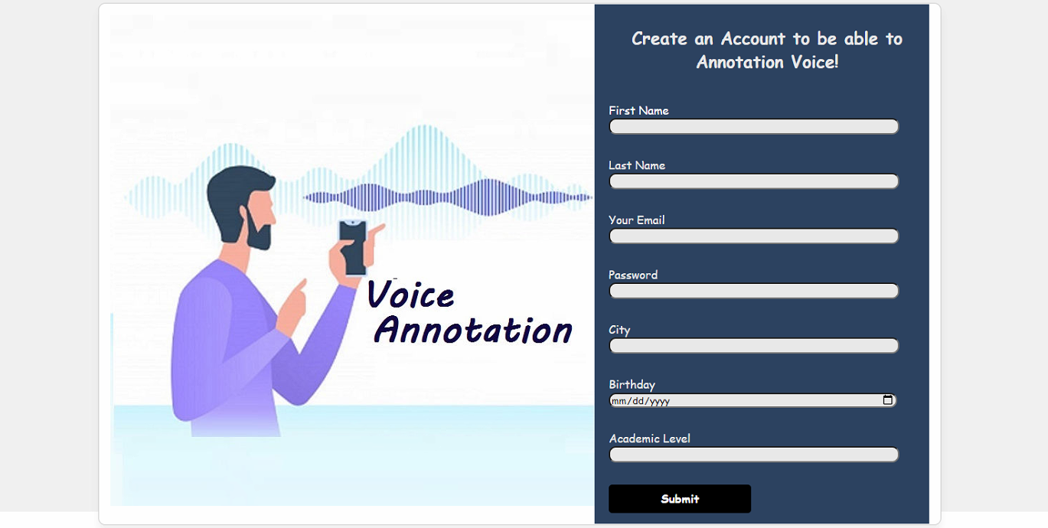
Sign Up process in Voice Annotation Extensions

Slide 15
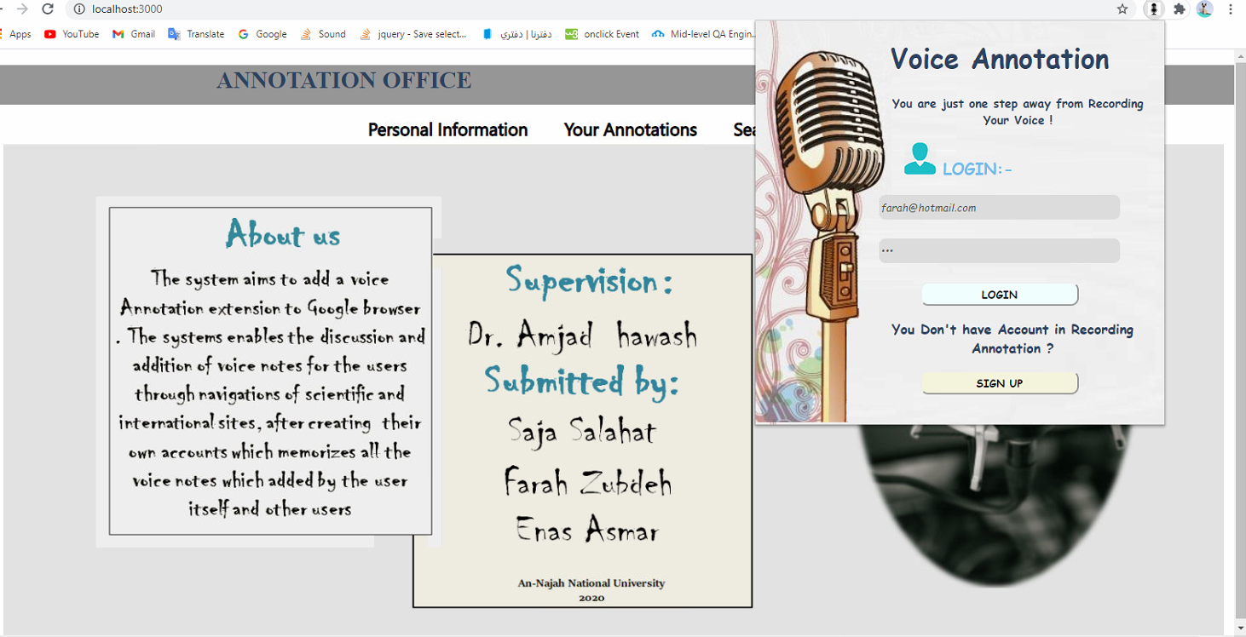
The personal page of each user

Slide 16
After that, all information is placed and included in the user ’s file in the (Voice Annotation) system in login page inside (your annotation), which is including the text that was commented on in addition to the recorded voice and The URL of the commented page is and tag of audio. User can search for a specific audio using tag of audio inside his (login) page inside Search. He can also look at his information on the inside his (login) page inside Personal Information It can also be modified.

Slide 17
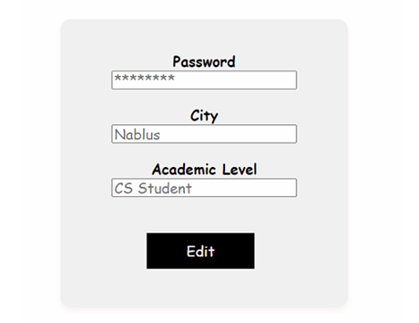
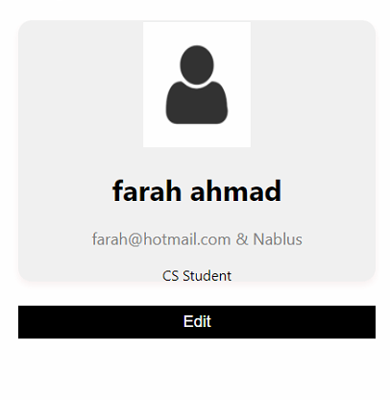
Modify personal information
The user can only modify his personal important information such as Academic level and City and Password

Slide 18
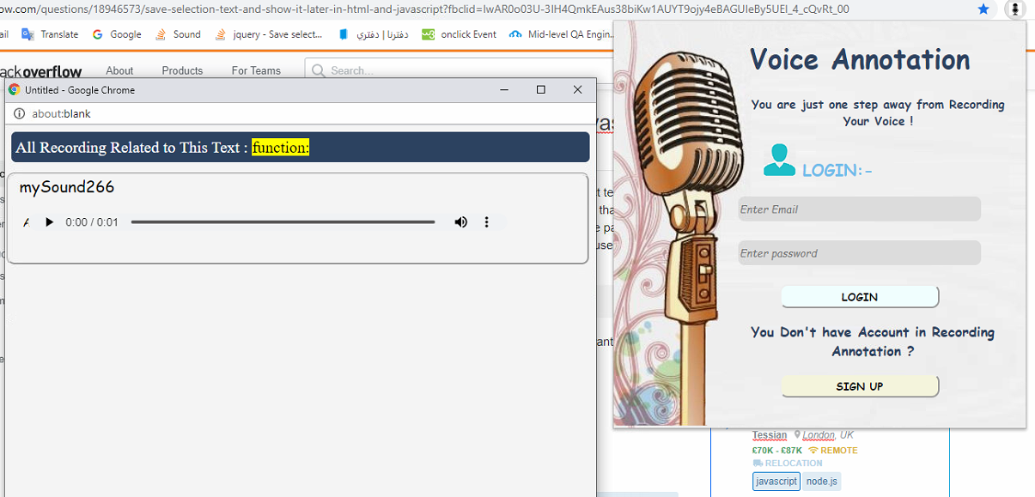
View without logging in to Google extension Voice Annotation
He cannot add Annotation or make a conversation about a specific word ,Only show existing Annotations

Slide 19
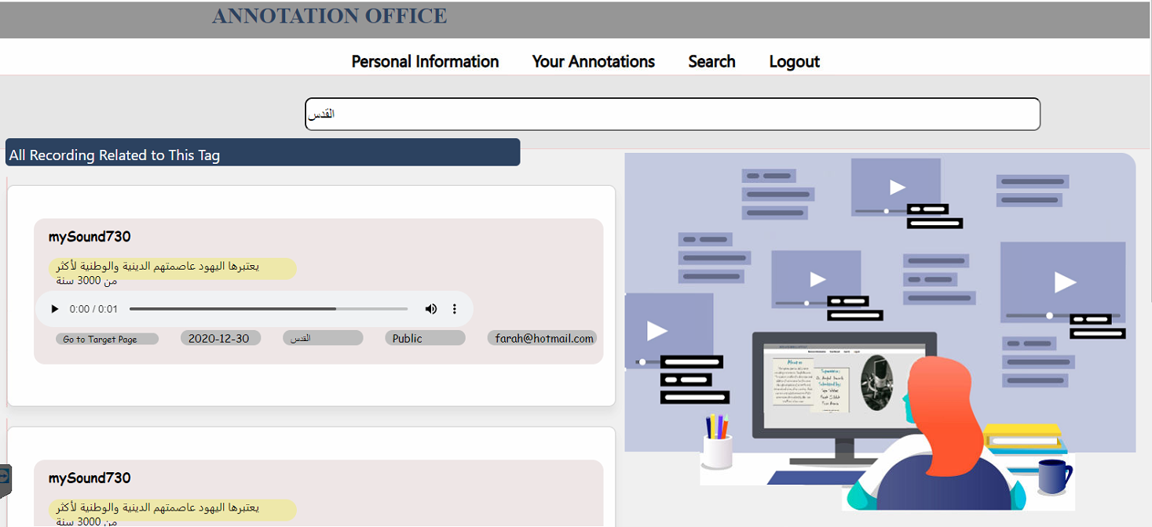
The search for Vocal Annotation using TAG

Slide 20
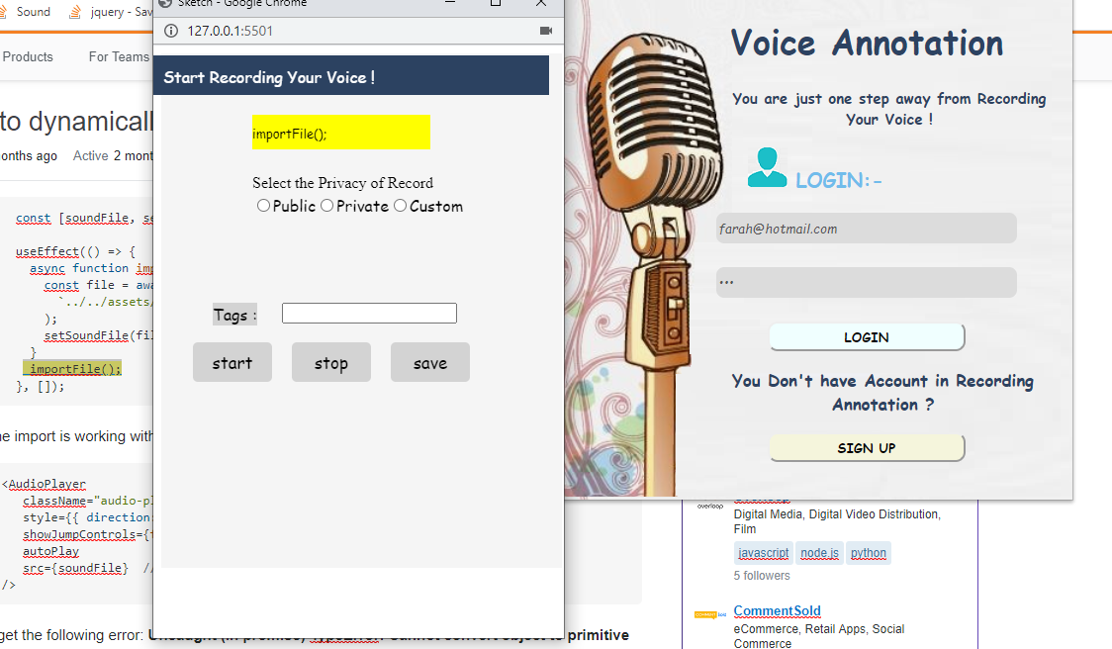
Vocal Annotation process
In this work, a user can create voice annotations associated to selected texts appear in HTML pages on the Internet .It allows each user to attach his own notes and the rest of the users can view these notes and communicate with each others. If the computer equipped with a microphone, the user can record his comments orally instead of writing them

Slide 21
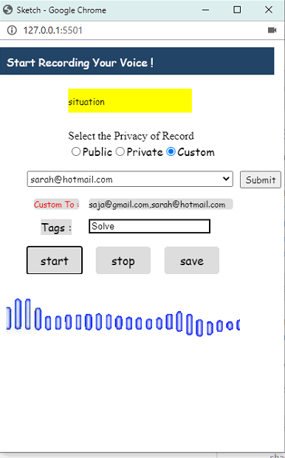
Privacy Vocal Annotation
Sound quality (private, public, or custom):
If the user chooses a special feature, it means that he does not want anyone to see his comment and that he will return it to himself only. If he chooses a public feature as he wants to make his comment visible to all, any person can see his comment, but if he chooses a custom property, he means that he wants his record to be visible to some people who Chooses them .

Slide 22
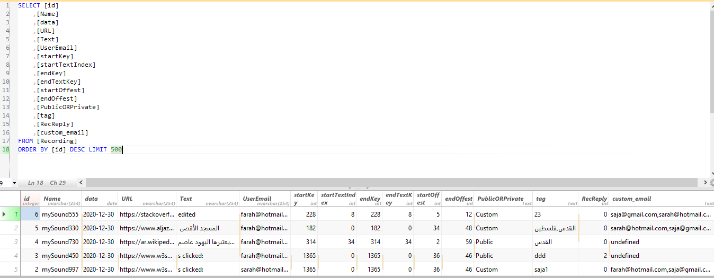
When “Create voice annotation” is selected, a recording starts . The recording can be stopped manually by clicking the “Stop recording ” button. When the recording stops , than click save is sent a local data file containing the audio quality ( private or public or custom ), and text and audio and tag of audio is sent to the Data Base .

Slide 23
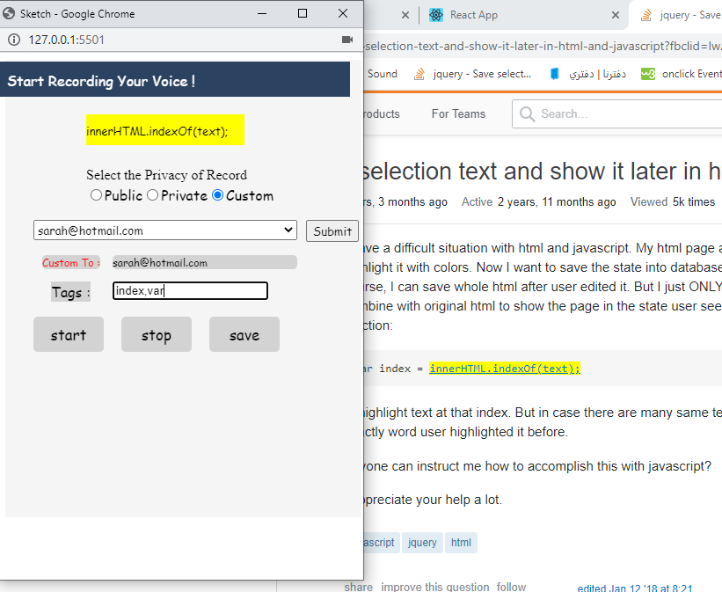
In order to increase the collaboration between users using vocal annotation, it is important for users to search for annotations of their interests. To make this feasible, users can add some textual tags (separated by commas) in a text box and these tags are attached with each vocal annotation and saved in the database as well. By using a simple searching facility, the user can search for these tags (from his portal) and a list of public clickable annotations appear in which s/he can visit the websites where they have been created and participate in the discussions corresponding the clicked annotations

Slide 24
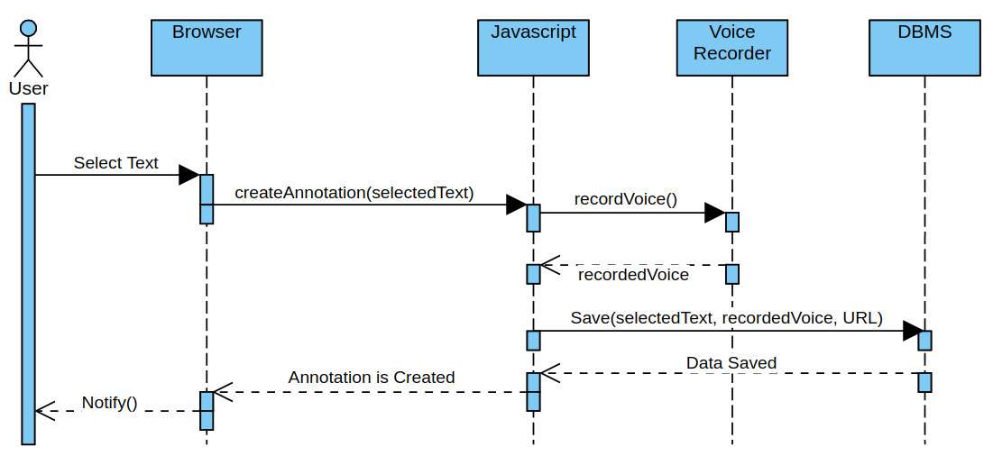

Slide 25
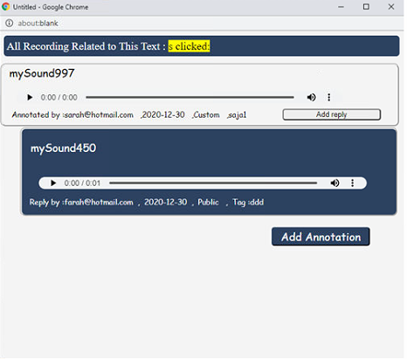
Conversation with Vocal Annotations
When the users revisit previously annotated websites, they can see the annotated parts with a highlight for each annotated part. In order to see and hear the annotations of any part, they can click the highlighted part and then a special popup window appears containing all recorded annotations (the original one and all its replies) and he can also make a reply or Annotations .

Slide 26
Experimental Test
In order to compare between Vocal and Textual annotations, we conducted an experimental test.
Participants are of different ages (88% are over 18 years old) and from different educational backgrounds.

Slide 27
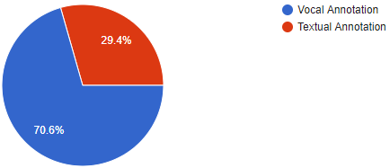
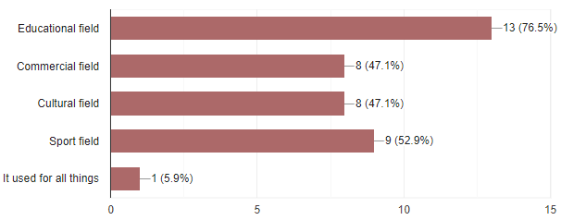
Fig. 7. Which is better for you?
Fig. 8. what are the fields in which the Vocal Annotation used?

Slide 28
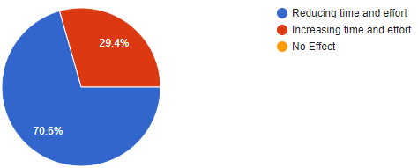
Fig. 9. In terms of time and effort, What is the Effect of Vocal Annotations for Google extension compared to Textual Annotation?

Slide 29
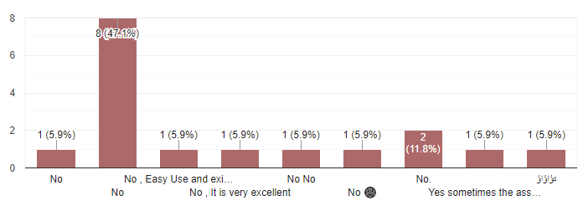
Fig. 10. Have you ever encountered a problem using the Vocal Annotation? If the answer is yes, explain what are the problems ?

Slide 30
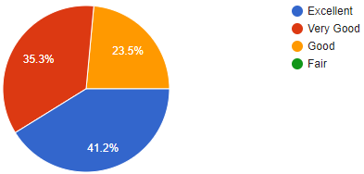
Fig. 11. How do you find the collaboration using Vocal Annotation?

Slide 31
Conclusions and Future Work
A vocal-based annotations is implemented and tested in this work.
Users are able to conduct a collaborative sessions using voice annotations in order to discuss some shared interests issues over the web.
For future works, we plan to implement visual annotations by recording video instead of recording voice.

