Slide 1

The interruption of finical support and its impact on construction sector and infrastructure in Palestine
By
Osayd Jabe supervised
Basil Aydi Dr.Mohammad Abu Ne`meh
Mahmoud Dwekat
Odai Essam

Slide 2
outline
Review
Methodology
Data analysis
Result and conclusion
Recommendation

Slide 3
Review
Palestine is one of the developing countries that depend on externally funded support
The interruption of this support from some countries in 2017-2021 caused problems in the construction sector To study these problems, we set indicators to facilitate the study process
The work mechanism focused on conducting interviews and studying previous studies to find indicators
A questionnaire was built and distributed to engineers and general contracting companies

Slide 4
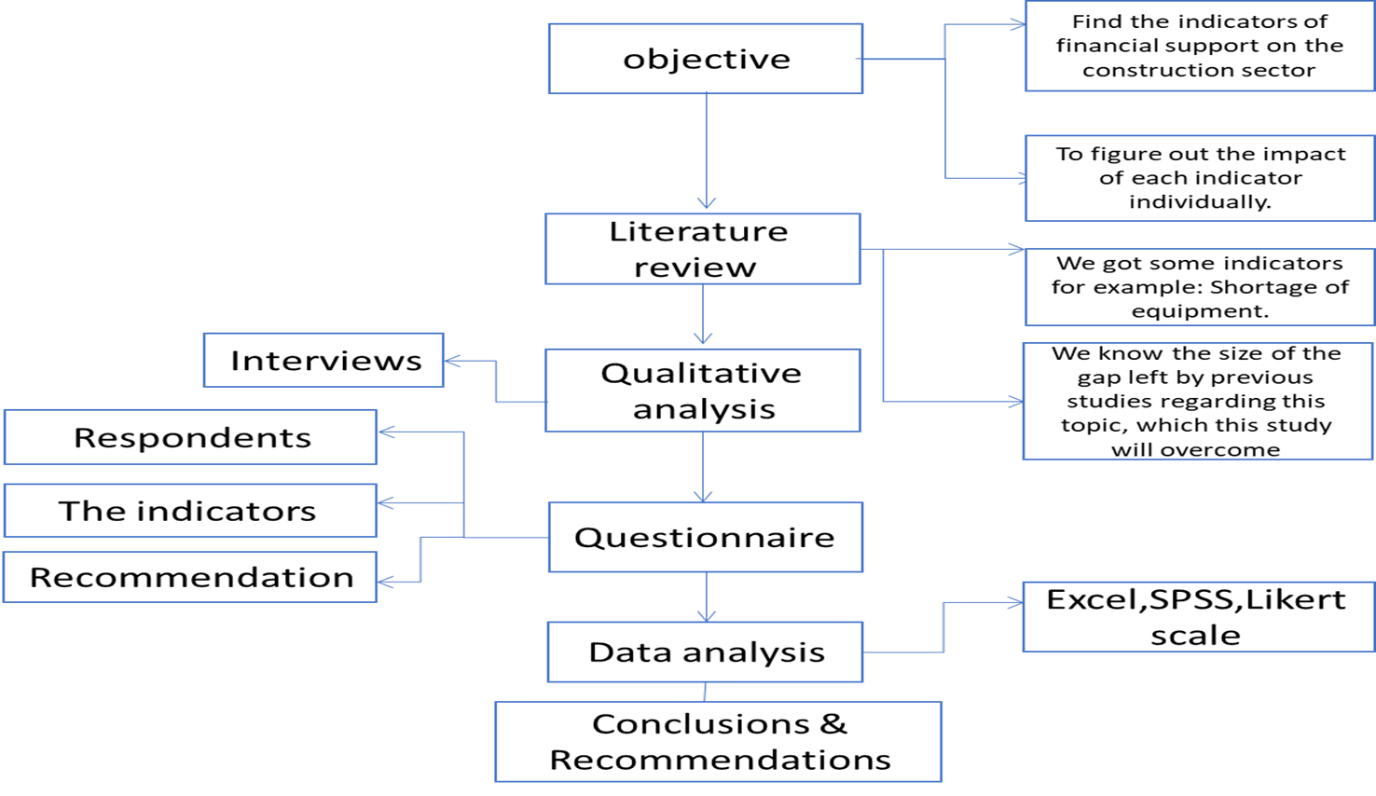
Methodology

Slide 5
Methodology
interviews
previous studies
Distribute a questionnaire

Slide 6
Methodology
interviews
Interviews were conducted with specialized persons, whether they were engineers, statistical analysts, or contractors
Many of the indicators that we relied on in this study were extracted from these interviews

Slide 7
Methodology
previous studies
From the studies we extracted some of the indicators
And compare results from previous studies from the results of this research

Slide 8
Methodology
Questionnaire
This questionnaire targeted workers in the construction sector, whether they are engineers or contractors
This questionnaire contained two main parts, the first includes information for the respondent to the questionnaire, and the second part consists of indicators that will be studied later.
The questionnaire was distributed using Google Survey

Slide 9
Questionnaire part one
The first part consists of questions that are interested in information for the respondent of this questionnaire.
Example:
Experience
The company evaluates
number of employees (etc.)

Slide 10

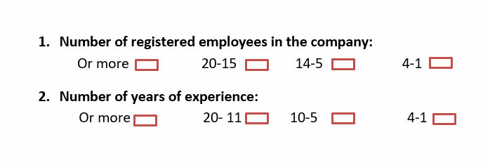
Questionnaire part one

Slide 11
Questionnaire part two
The second part deals with the indicators that have been adopted and studied using the Likert scale.
The second part was divided into 7 main axes based on the type of indicators, whether they are related to workers or projects.

Slide 12
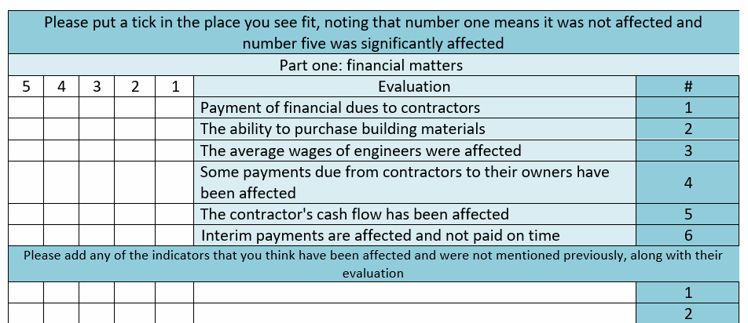
Questionnaire part two

Slide 13
Data analysis
After obtaining the results from the questionnaire
These results were sent to a specialized statistical analyst to obtain the results of this questionnaire

Slide 14
Data analysis
In his analysis, he relied on SPSS to perform the following tests:
1.Means, frequencies, standard deviations, and percentages in order to estimate the relative percentage of every item.
2.T-tests for Independent Samples to test the assumptions related to the variable of classification.
3.One-Way Analysis of Variance (ANOVA) to test the variables of qualification, employees and experience.
4.Cronbach Alpha is used to test the consistency of the items in the questionnaire.

Slide 15
Result
In the statistical analysis to extract the results, the questionnaire was divided into two main parts to complete this process

Slide 16
Result and conclusion part one
Variable | Class | Frequency | Percentage %
Executed projects in the last 5 years | 1-6 | 5 | 9.6
 | 7-10 | 11 | 21.2
 | More | 36 | 69.2
Failed projects in the last 5 years | 1-5 | 37 | 71.2
 | 6-8 | 6 | 11.5
 | More | 9 | 17.3
External funds projects in the last 5 years | 1-5 | 31 | 59.6
 | 6-8 | 13 | 25.0
 | More | 8 | 15.4
Work | Office Engineer | 13 | 25.0
 | Consultant | 16 | 30.8
 | Contractor | 17 | 32.7
 | Sub- contractor | 6 | 11.5
Total |  | 52 | 100.0
In this part of the questionnaire, the objective was to find out the percentage of each answer to the multiple choice questions

Slide 17
Result and conclusion part one
Statistical analysis of questions that can choose more than one answer
Variable | Class | Frequency | Percentage %
Criteria for responses | Previous experience | 51 | 98.1
 | Work market | 1 | 1.9
 | Political subjects | __ | ___
 | Palestinian indicators | ___ | ____
Does financial support cause developing or deterioration of infrastructure in Palestine? | Yes | 47 | 90.4
 | No | 5 | 9.6
Does the cut of financial support weaken the Palestinian economy? | Yes | 46 | 88.5
 | No | 6 | 11.5

Slide 18
Result and conclusion part two
In the second part of the questionnaire, he analyzed the results related to the indicators that we relied on in this research
The second part of the questionnaire was divided into seven main themes:
Workers
Project duration
Financial affairs
The contractor
The project
Social and services affairs
Equipment`s and construction supplies

Slide 19
Result and conclusion part two
Statistical analysis of the seven axes
Rank | No. in the Questionnaire | Indicator | Means | Standard Deviations | Percentage % | Estimated level
1 | 2 | workers | 4.14 | .60 | 82.8 | Very High
2 | 5 | project duration | 3.91 | 0.78 | 78.2 | High
3 | 1 | financial affairs | 3.89 | 0.64 | 77.8 | High
4 | 6 | the contractor | 3.87 | 0.81 | 77.4 | High
5 | 4 | the project | 3.71 | 0.81 | 74.2 | High
6 | 7 | social and services affairs | 3.65 | 0.80 | 73.0 | High
7 | 3 | equipment's and construction supplies | 3.38 | 0.85 | 67.6 | Moderate
Total |  |  | 3.79 | 0.56 | 75.8 | High

Slide 20
conclusion
After completing the statistical analysis of the variables, their results are presented in one table under each of their axis
In the whole questionnaire, his score was great
The most affected axis is the workers axis
The least affected focus is the suppliers of materials and equipment
As it was clear from the answers, the viewpoints of both the engineers and the contractors were close

Slide 21
conclusion
The highest effected indicator (workers)
No. | Item | Means | standard deviations | Percentage % | Estimated level
1. | High unemployment rate in the engineering sector | 4.09 | 0.84 | 81.4 | Very High
2. | The reluctance of workers to work in internal and regional projects | 4.40 | 0.84 | 88.0 | Very High
3. | Skills migration in all disciplines | 4.01 | 1.09 | 80.2 | Very High
4. | The reluctance of engineers to work in works far from engineering | 4.07 | 0.88 | 81.4 | Very High

Slide 22
conclusion
The less effected indicator (equipment's and construction supplies)
No. | Item | Means | standard deviations | Percentage % | Estimated level
1. | Availability of the necessary equipment for the project | 3.15 | 1.12 | 63.0 | Moderate
2. | Choosing the types of materials and their specifications | 3.42 | 1.12 | 68.4 | Moderate
3. | Damage to some materials on the ground | 3.40 | 1.19 | 68.0 | Moderate
4. | The possibility of providing equipment with modern and advanced technology | 3.26 | 1.28 | 65.2 | Moderate

Slide 23
recommendation
Some of the suggested solutions:
research department
Raise the wages of engineers
Create social security for workers
Flexibility in dealing with changes that occur in the project from all sides
Provide motivation to the contractor
Raising awareness about legal contracts and the consequences of anyone who violates them
Increasing control over projects, especially in the three main stages (before starting, during implementation, and handing over)
Involving private companies in government projects to assist the government in covering the project financially
Producing government projects aimed at strengthening the state’s financial fund to create an independent economy that will help it in the future

Slide 24
Thank you all for listening
Don't be shy to ask questions

