Slide 1
Automated Home System
Mohammad Ghazal
Asim Saleh

Slide 2
Introduction
Smart Automated Home Systems also known commercially as “Smart Homes”
Swedish research stated that there will be 63m Smart Homes in US in 2022
The human race is taking more steps into giving machines more control, for easier life

Slide 3
Introduction
Following the advancement in technologies the trend has become more approachable
We can agree that these systems are pretty much the future of home improvements

Slide 4
Objectives
Create a smart, secure, user-friendly system for the house residents
Help reduce accidents that happen due to forgotten working devices (Lights, Heaters… etc)
Keep the user connected to their house even if they’re miles away

Slide 5
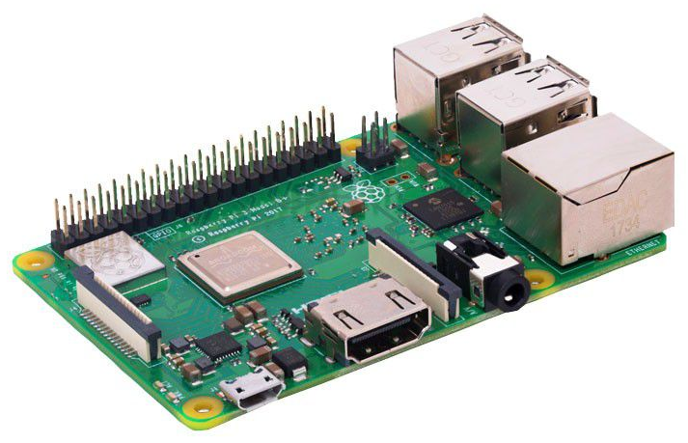
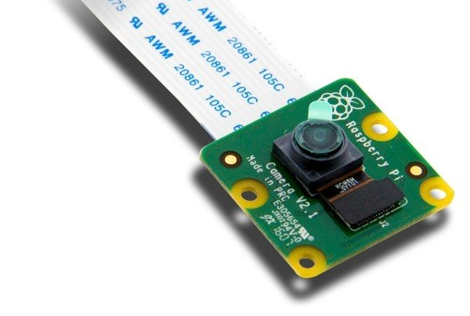
Structure
Raspberry Pi 3
Camera Module

Slide 6
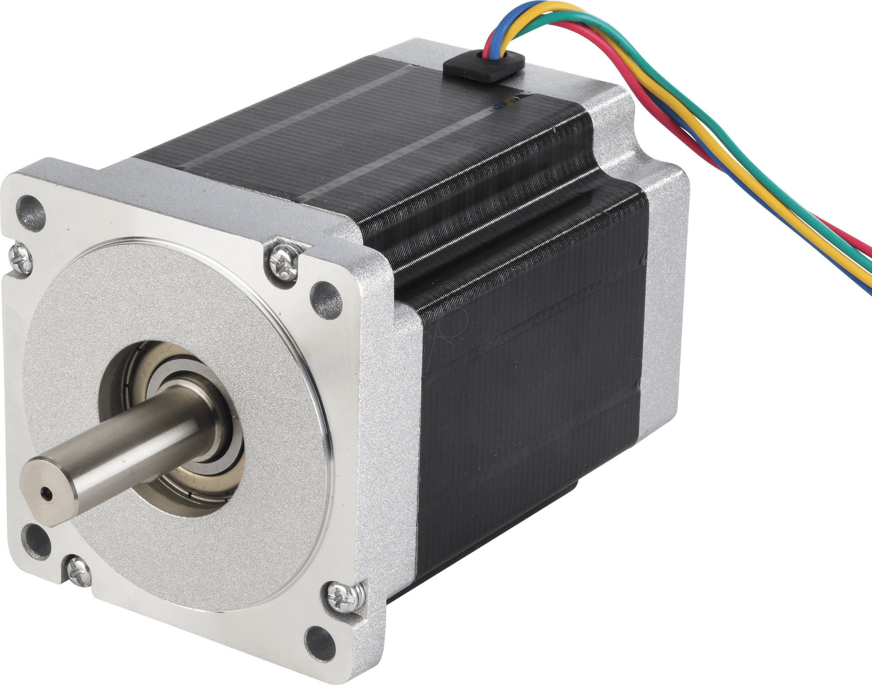
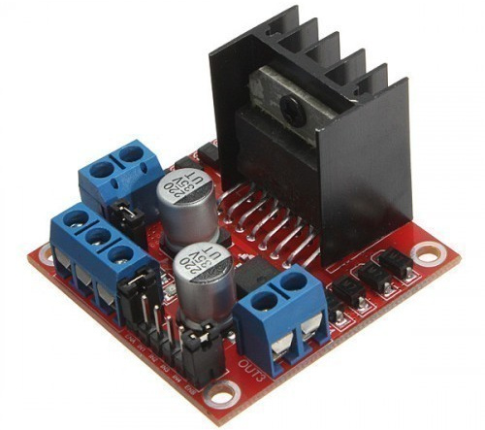
Structure
Stepper Motors
Stepper Motor Drivers

Slide 7
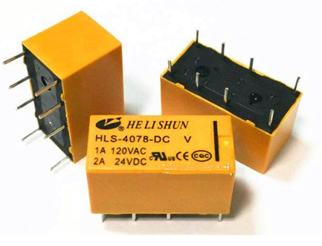
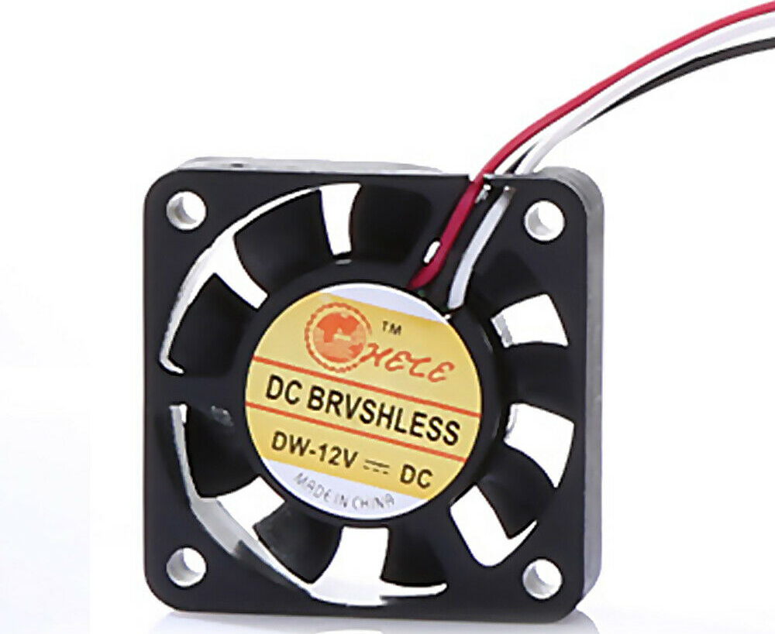
Structure
12v Fan
Relay

Slide 8
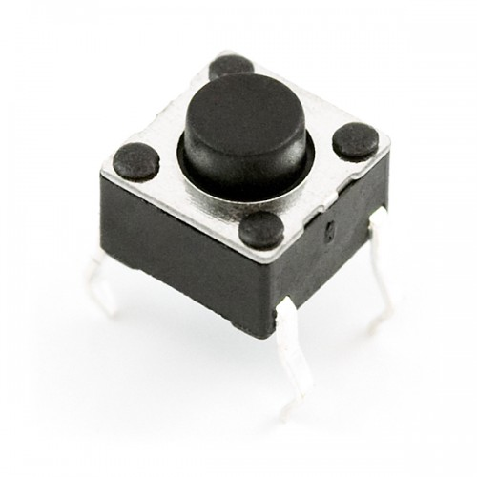
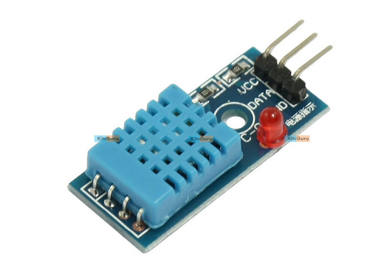
Structure
DHT11 Sensor
Push Button

Slide 9
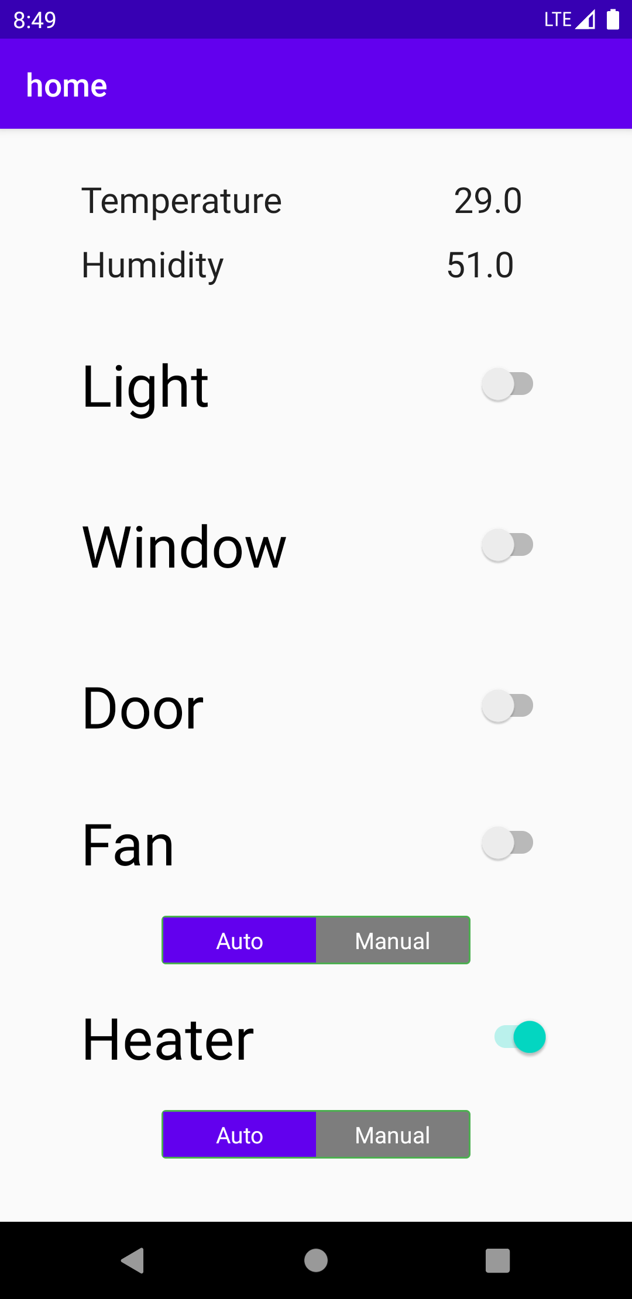
Structure
Android Application

Slide 10



Softwares used

Slide 11


How does it work?
Read data
Read data
Modified data
Modify data

Slide 12
Future Work
Add support for more devices in the everyday-household
Improve the application’s UI
Add an even more improved functionality to the system

