Slide 1
GEODOM
By:
Amjad Khalil
Karmel Zaidan
Supervised by:
Dr. Samer Arandi

Slide 2
Outline
What is GeoDom ?
Motivation
GeoDom Structure
Tools & Technologies
How is it implemented ?
Demo
Challenges overcame
Future Work

Slide 3
Motivation
We felt an urge to fulfil our passion in games by creating a 3D game, but with VR and real GPS location to make the player feel more involved in the game.

Slide 4
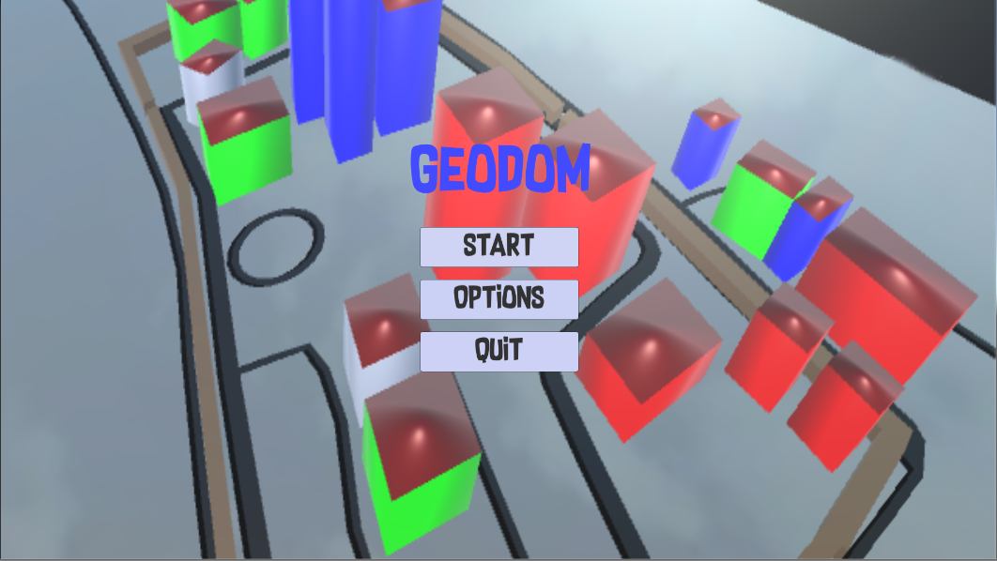
What is GeoDom ?
The word GeoDom comes from two words: Geographical Domination.
3D - First person shooter game using Android platform.
Notes:
What does domination mean ?
GPS location
FPS VS TPs

Slide 5
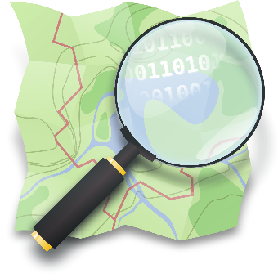




Tools & Technologies?
Unity Game Engine 5.4.2F
Open Street Maps
Blender
OSM2World
Android SDK
GitHub

Slide 6
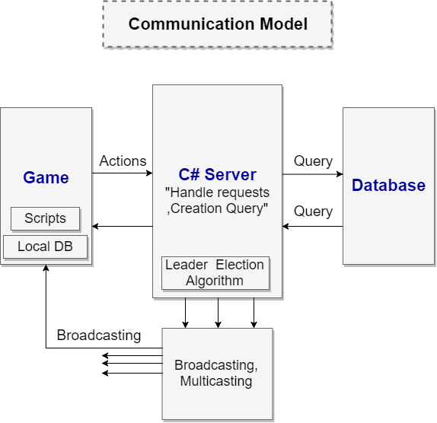
GeoDom structure

Slide 7
GeoDom game system
Server module.
Database module.
Initialization module.
Health module.
Memory module.
Core module.
Notes:
هلأ بنحكي عن المكونات الاساسية الي ضفناها عاللعبة وتعتبر هي جوهر اللعبة
عنا 6 موديول

Slide 8
Server module
Setting up the connections with the players.
Works as an intermediate between the players and the database.
Sending and receiving actions to and from the players.
Broadcast to all players at the same time.
Respond to single player or to a group of players.

Slide 9
Database module
Responsible for setting up the connections with the server.
Sending and receiving actions to and from the server.
Stores critical information in the local database.

Slide 10
Initialization module
Prepare the buildings and environment before the game starts.
Give correct heights of the buildings and real colour of the terrains and textures (water, grass, trees).
Set up the geometry and the boundaries of each building.

Slide 11
Health module
Handle the impact of the rocket with the building.
Calculate the damage caused to that building
Display how much health is left for each building.

Slide 12
Memory module
Saves all the information about the player during runtime.
Pass information between game modules.

Slide 13
Core module
Switch between cameras.
Assign buildings to their leaders
Color them with the right team color.
Convert GPS location to unity coordinates.

Slide 14
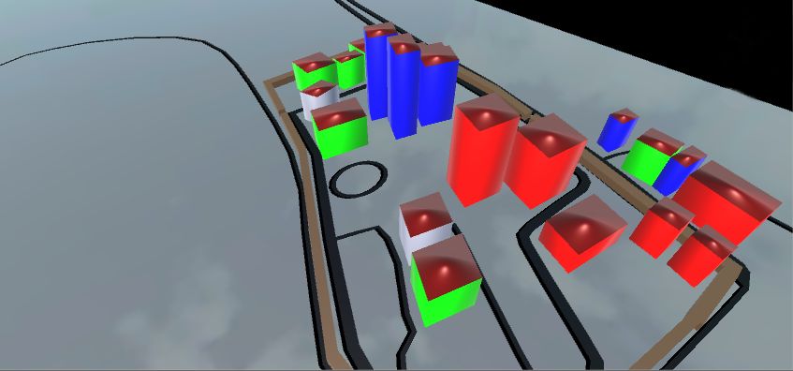
How is it played ?
The main idea of GeoDom is to control as much buildings as possible to dominate your territory.
Notes:
3 Teams + details
to control => change(health + color)
Team leader
GPS real locations

Slide 15
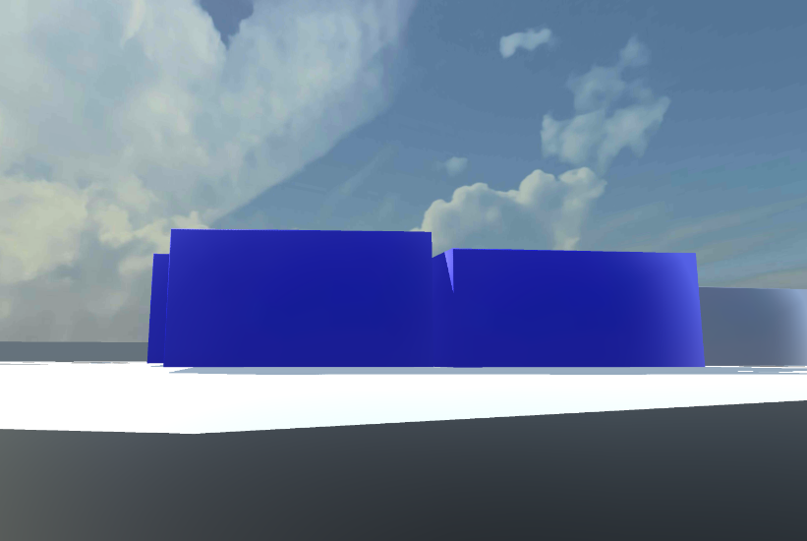
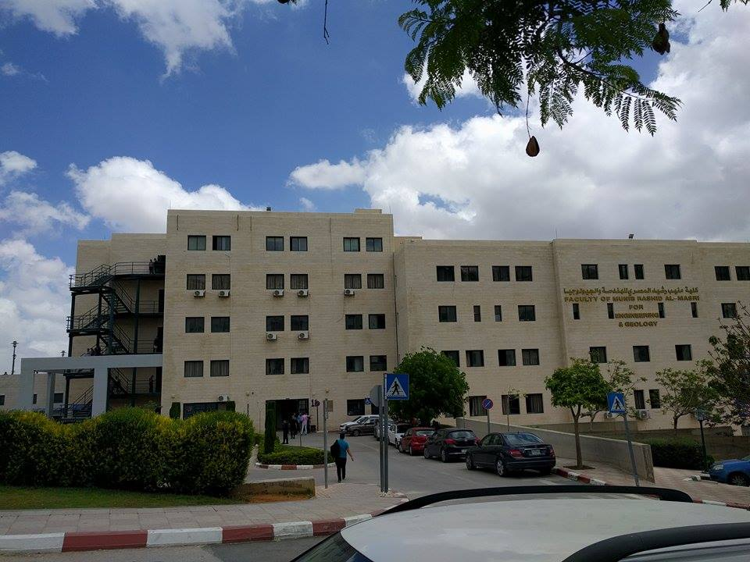
Real GPS locations
Notes:
3 Teams + details
to control => change(health + color)
Team leader
GPS real locations

Slide 16
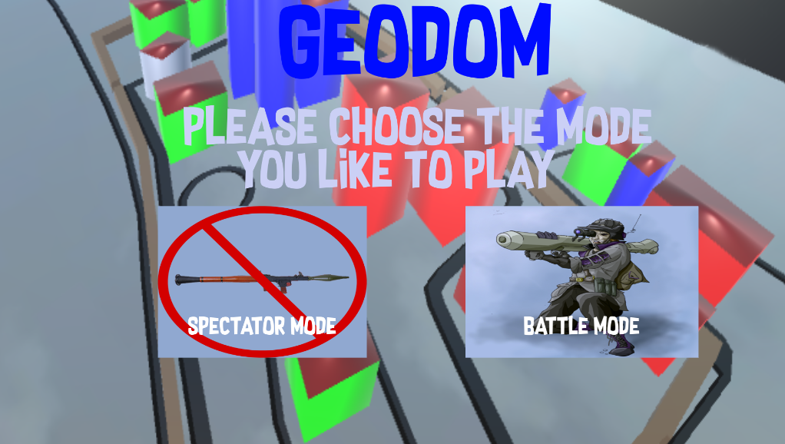
Modes of GeoDom

Slide 17

Demo..

Slide 18
Challenges
Problem: Unity could not identify objects Coordinates from (.obj).
Solution: Used blender to export the map in (.blend) extension.

Slide 19
Challenges
Problem: How to map the GPS location with the coordinates in unity?
Solution: Wrote an algorithm that calculates the angle and exact coordinates by accessing the raw mesh of the map.
Notes:
GPS location (long + lat)
Because the earth is not flat
spherical earth
had to find the angle using mathematical equations with sin and cos taking in consideration the radius of the earth

Slide 20
Unsolved Challenges
Not all areas support 3D-Maps and terrains.

Slide 21
Future Work
Simulate the real world movement in the game.
Develop an algorithm that can insert the area automatically.
Improve the defence of the buildings by deploying shields.
Global and local scoreboards.
Notes:
Improve the defence of the buildings by deploying shields.
Global and local scoreboards.

Slide 22

Questions!

Slide 23


