Slide 1

Graduation Project 2
Structural Analysis And Dynamic Design
Of Bonyan Building
An-Najah National University
Faculty of Engineering
Civil Engineering Department
By:
Fu’ad AL-Khalde
Ramzi Droobi
Mahmoud Hmedat
Mohanad Johar
Supervisor:
Dr . Mahmoud Dwaikat

Slide 2
Outline
Introduction.
Dynamic Analysis And Verifications.
Dynamic Design.
Discussion & Conclusion.

Slide 3
Introduction
Project description
Design Code
Materials
Loads
Load Combination

Slide 4
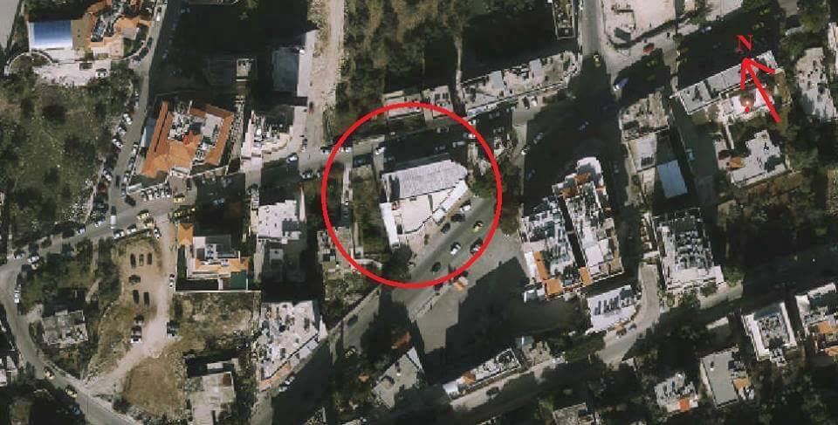

Slide 5

Introduction
PROJECT DESCRIPTION
Commercial building
Rafedia-Nablus
Area of land = ${1500 m}^{2}$
Total area of the building : ${13011 m}^{2}$

Slide 6
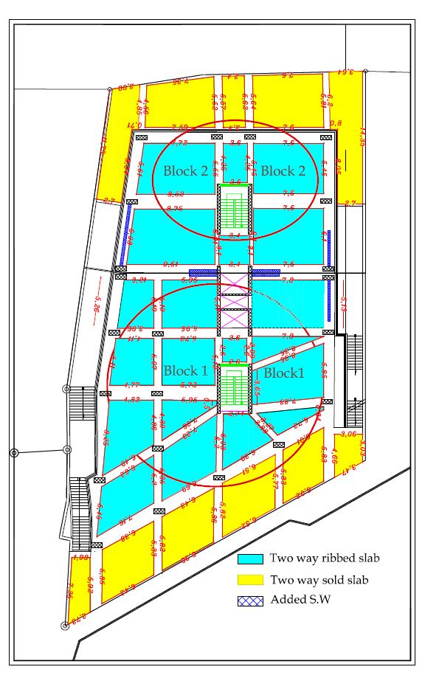

Slide 7
Introduction
PROJECT DESCRIPTION
Floor number | Function
Basement three & two | Parking
Basement one | Stores ( warehouse )
Ground floor | Stores ( commercial stores )
First, Second & Third floors | Exhibitions
Fourth, Fifth, Sixth & Roof floors | Offices
Notes:
The project consists of three floors with a total area about 360 m².The first floor has residence for the imam 56 m², center for learning Holy Quran 120 m² , bathrooms 30 m² , place to ablutions 21 m² and place to special case 64 m². The second floor has place for men to pray 292 m². The third floor has place for woman to pray 135 m² . In addition , it contains minaret has 36 m high from ground and its base area about 10m² and dome has 12.2 m high from ground and its base area about 13 m² .

Slide 8
Introduction
DESIGN CODES
ACI 318-14
ASCE07-10
UBC 97
Notes:
The project consists of three floors with a total area about 360 m².The first floor has residence for the imam 56 m², center for learning Holy Quran 120 m² , bathrooms 30 m² , place to ablutions 21 m² and place to special case 64 m². The second floor has place for men to pray 292 m². The third floor has place for woman to pray 135 m² . In addition , it contains minaret has 36 m high from ground and its base area about 10m² and dome has 12.2 m high from ground and its base area about 13 m² .

Slide 9
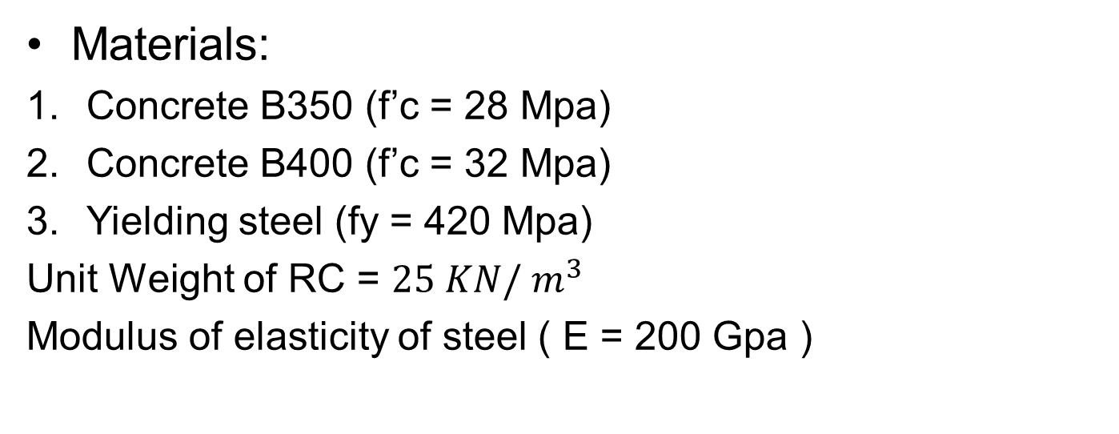
Introduction
Materials
Materials:
Concrete B350 (f’c = 28 Mpa)
Concrete B400 (f’c = 32 Mpa)
Yielding steel (fy = 420 Mpa)
Unit Weight of RC = ${25 KN/ m}^{3}$
Modulus of elasticity of steel ( E = 200 Gpa )
Notes:
The project consists of three floors with a total area about 360 m².The first floor has residence for the imam 56 m², center for learning Holy Quran 120 m² , bathrooms 30 m² , place to ablutions 21 m² and place to special case 64 m². The second floor has place for men to pray 292 m². The third floor has place for woman to pray 135 m² . In addition , it contains minaret has 36 m high from ground and its base area about 10m² and dome has 12.2 m high from ground and its base area about 13 m² .

Slide 10
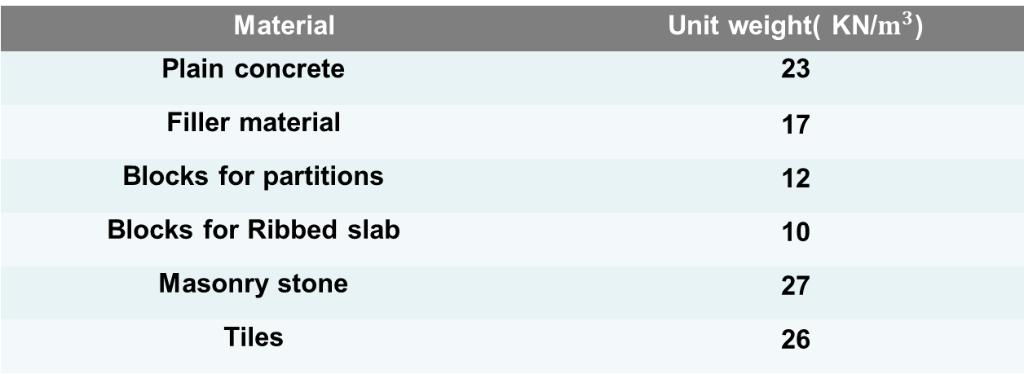
Introduction
Materials
Materials:
Material | Unit weight( KN/$m^{3}$)
Plain concrete | 23
Filler material | 17
Blocks for partitions | 12
Blocks for Ribbed slab | 10
Masonry stone | 27
Tiles | 26

Slide 11
Introduction
LOADs
Live Loads
4 KN/m^2 | Garages (Parking)
2.5 KN/m^2 | Offices
6 KN/m^2 | Storage
5 KN/m^2 | Exhibition
10 KN/m^2 | Roof
Notes:
The project consists of three floors with a total area about 360 m².The first floor has residence for the imam 56 m², center for learning Holy Quran 120 m² , bathrooms 30 m² , place to ablutions 21 m² and place to special case 64 m². The second floor has place for men to pray 292 m². The third floor has place for woman to pray 135 m² . In addition , it contains minaret has 36 m high from ground and its base area about 10m² and dome has 12.2 m high from ground and its base area about 13 m² .

Slide 12
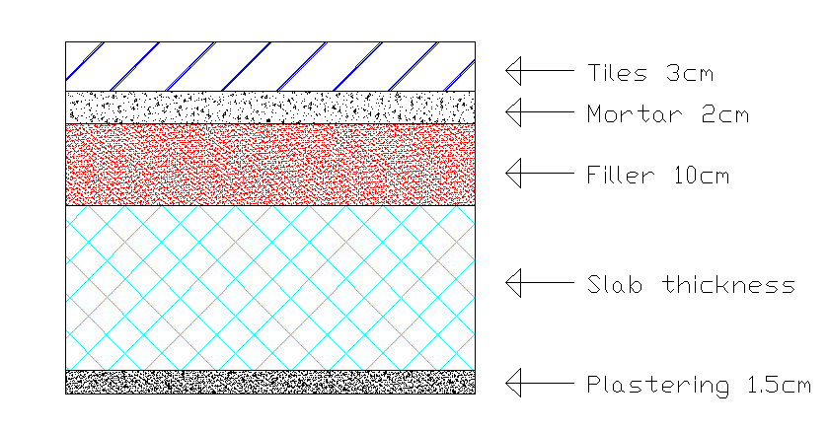
Introduction
LOADs
Super imposed dead load = 4.5 KN/m^2
Walls weight:
1. Masonry wall = 25 KN/m
2. Block wall = 11 KN/m
Typical cross section in R.C. slab

Slide 13
Introduction
LOAD COMBINATIONs
According to “UBC 97" The ultimate load combinations are:
1.4D
1.2D + 1.6L + 0.5 (Lr or S)
1.2D + 1.6 (Lr or S) + (f1 L or 0.8W)
1.2D + 1.3W + f1 L + 0.5 (Lr or S)
1.2D + 1.0E + (f1 L + f2 S)
0.9D + (1.0E or 1.3W)
Where:
D: Dead load.
L: Live load.
E = ρ Eh + Ev

Slide 14
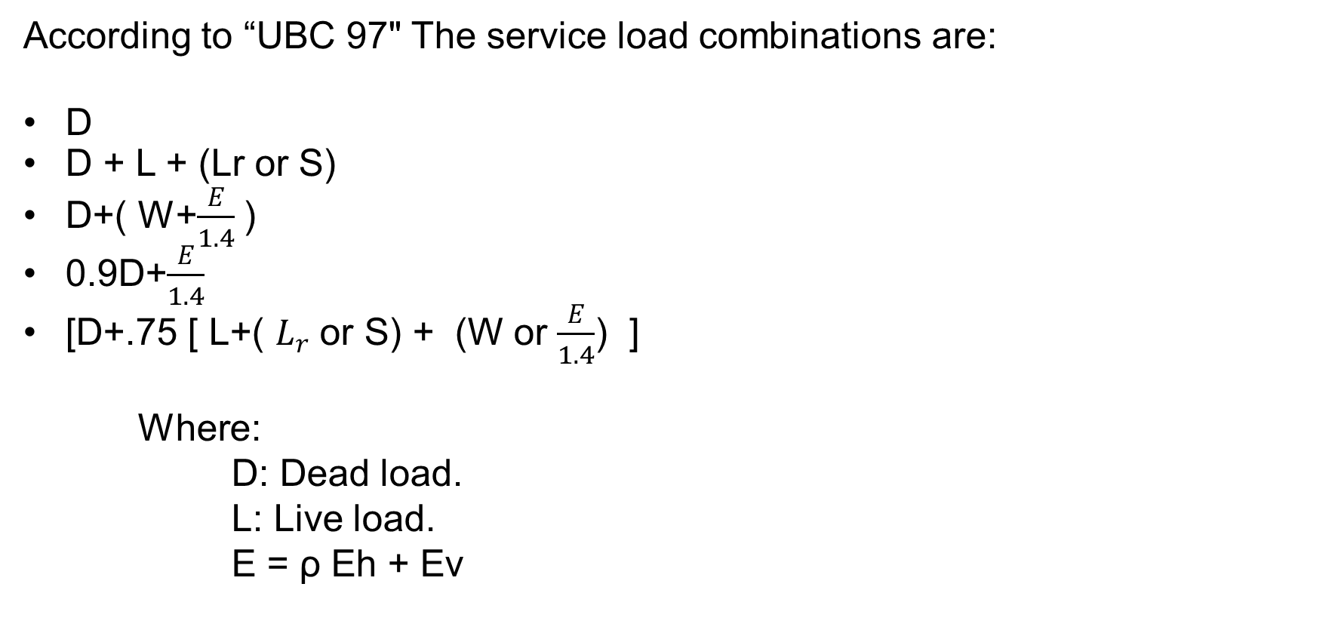
Introduction
LOAD COMBINATIONs
According to “UBC 97" The service load combinations are:
D
D + L + (Lr or S)
D+( W+$\frac{E}{1.4}$ )
0.9D+$\frac{E}{1.4}$
[D+.75 [ L+( $L_{r}$ or S) + (W or $\frac{E}{1.4}$) ]
Where:
D: Dead load.
L: Live load.
E = ρ Eh + Ev

Slide 16
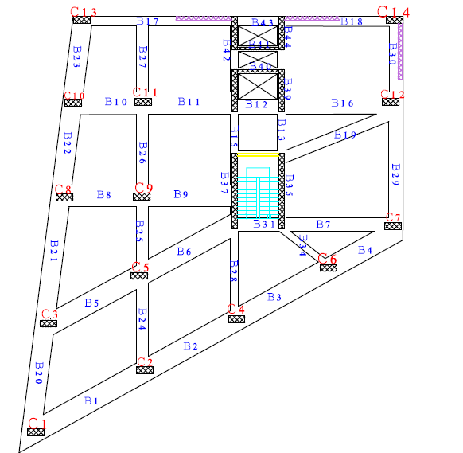
For Block 1:

Slide 17
Beams |  | Columns
Section Dimensions (mm) | Name | Section Dimensions(mm) | Name
400*800 | B1, B2, B3, B4, B5, B6, B7, B8, B9, B10, B11, B12, B16, B17, B18, B19, B20, B21, B22, B23, B24, B25, B26, B27, B28, B29, B30 | 1200*900 | C1,C2,C4,C6, C7, C13, C14.
 |  | 1000*800 | C3, C5, C8,C9, C10, C11, C12
300*320 | B13,B14,B15,B31,B32 ,B33 ,B34, B35, B36, B37, B38, B39, B40, B41, B42, B43, B44

Slide 18
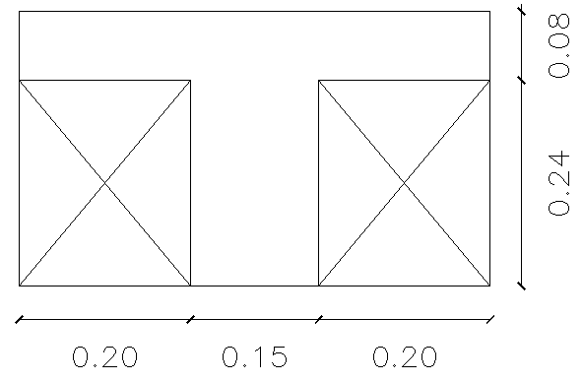
Section In Slab

Slide 19
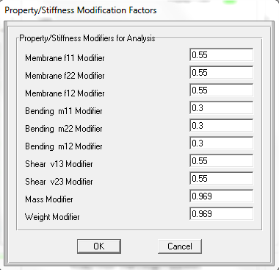
For Ribbed Slab.

Slide 20
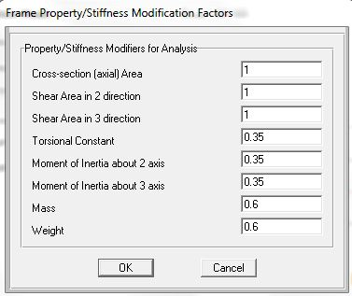
For Beams.

Slide 21
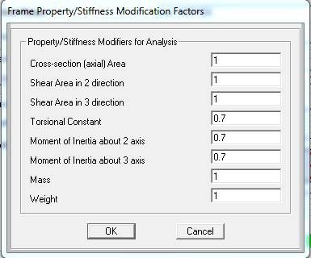
For Column.

Slide 22
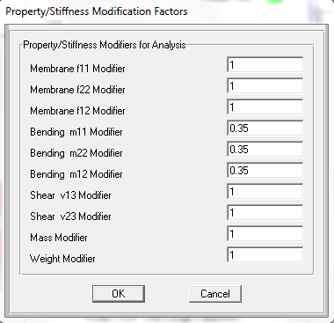
For Roof Column.

Slide 23
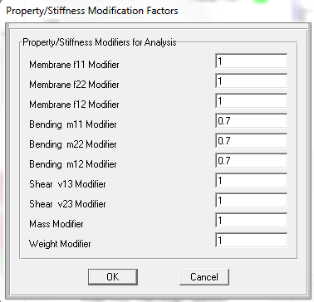
For Shear Walls.

Slide 24
Dynamic Analysis And Verifications

Slide 25
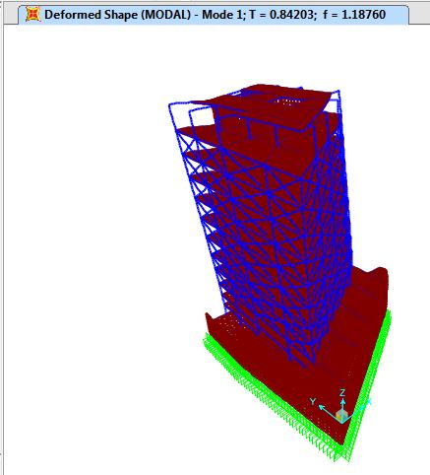
Compatibility Check:

Slide 26
Equilibrium Check:
% of difference | SAP (KN) | Hand (KN) | Load type
0.5 | 88595 | 88186 | Dead
0.04 | 32245.25 | 32233.38 | Live
0.00 | 23767.55 | 23760.00 | S.D.
0.00 | 18864.52 | 18864.46 | Wall

Slide 27
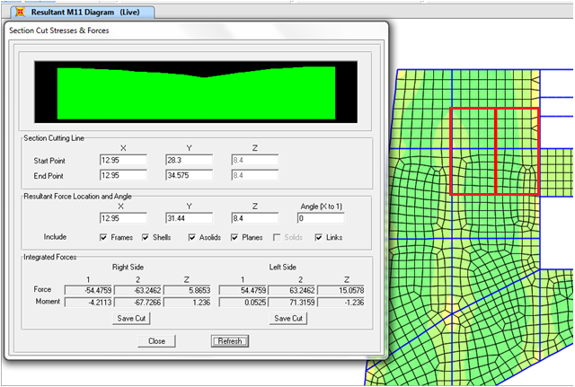
Local Equilibrium Check:
Frame

Slide 28
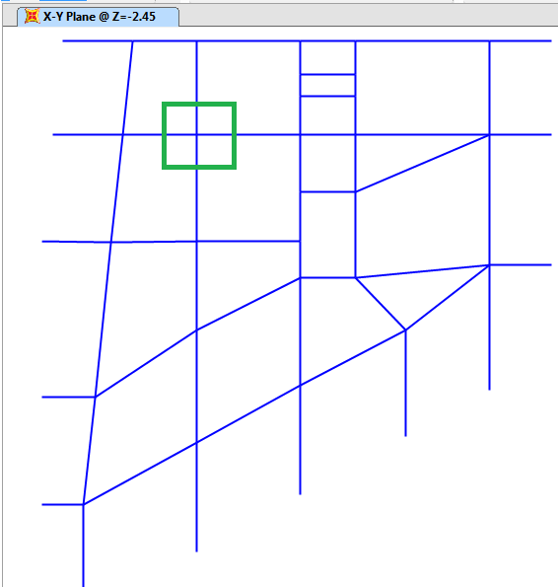
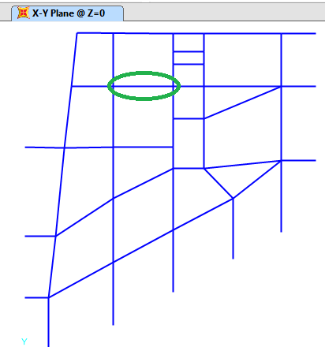
Local Equilibrium Check:
Column
Beam

Slide 29
Local Equilibrium Check:
% of difference | SAP (KN.m) | Hand (KN.m) | Element type
2.7 | 195.2 | 200.7 | Frame
8.0 | 222.8 | 205.3 | Beam
% of difference | SAP (KN) | Hand (KN) | Element type
8.8 | 2030.00 | 2227.5 | Column

Slide 30
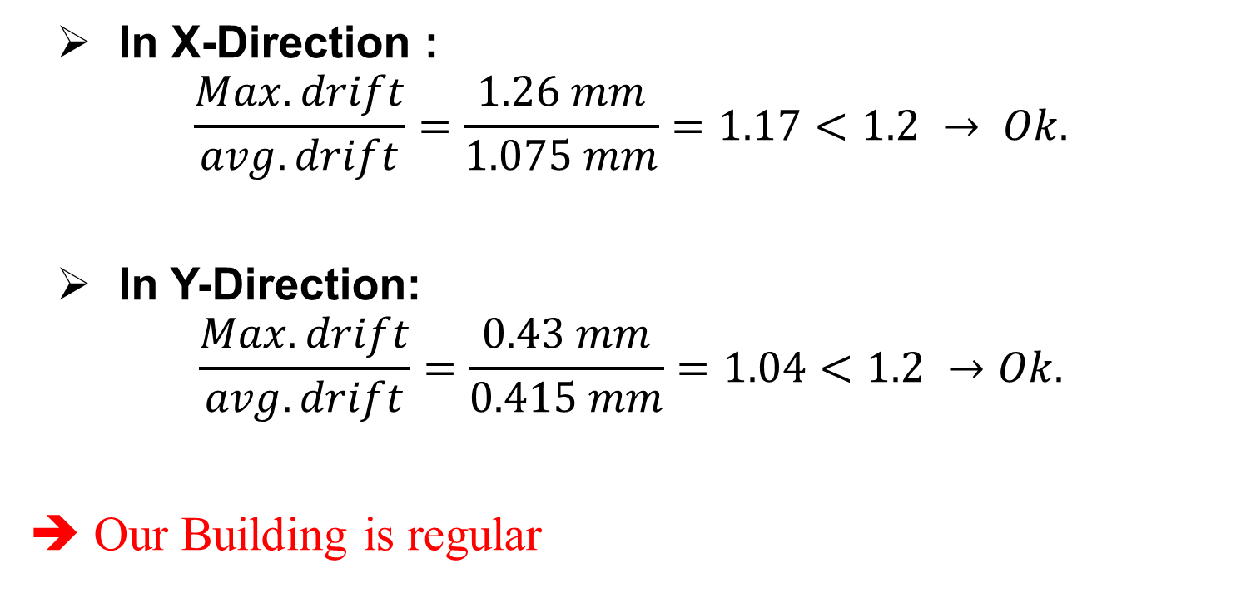
Torsional Irregularity Check:
In X-Direction :
$$\frac{Max. drift}{avg. drift}=\frac{1.26 mm}{1.075 mm}=1.17<1.2 → Ok.$$
In Y-Direction:
$$\frac{Max. drift}{avg. drift}=\frac{0.43 mm}{0.415 mm}=1.04<1.2 →Ok.$$
➔ Our Building is regular

Slide 31
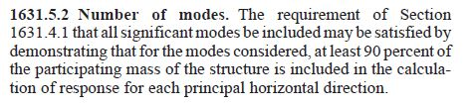
Check Modal Participation Mass Ratio:

Slide 32
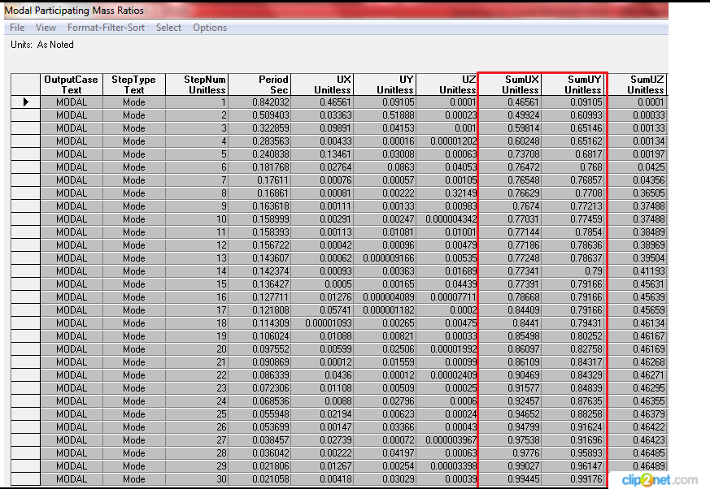

Slide 33
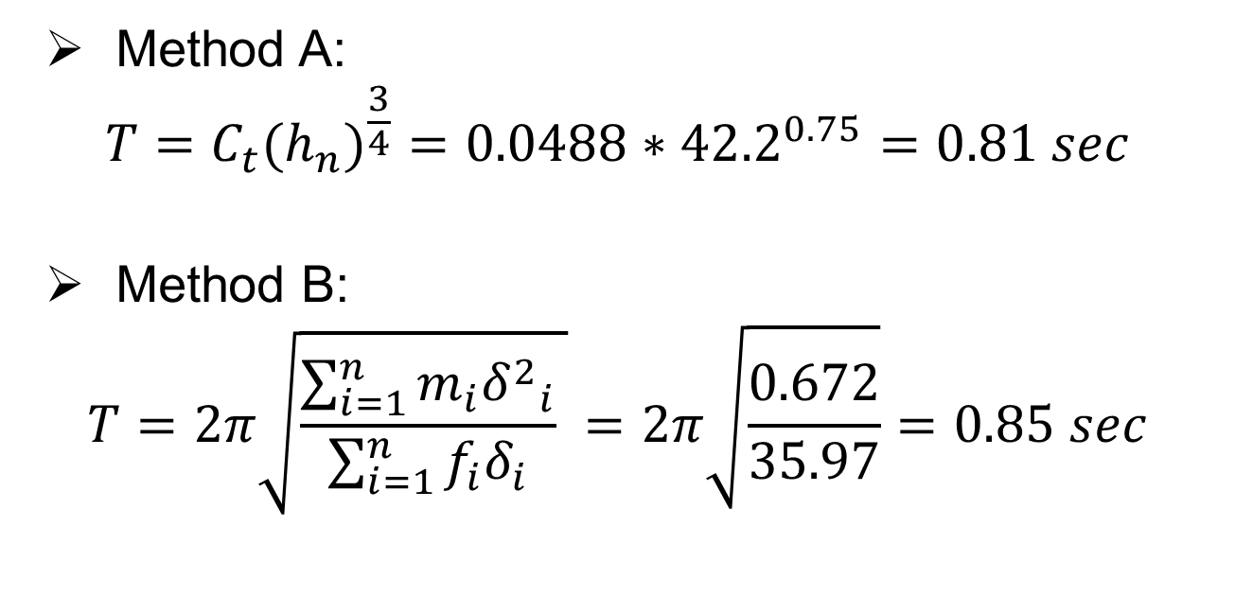
Period Check:
Method A:
$$T=C_{t}{{(h}_{n})}^{\frac{3}{4}}=0.0488∗{42.2}^{0.75}=0.81 sec$$
Method B:
$$T=2π\sqrt{\frac{\sum_{i=1}^{n}{m_{i}{δ^{2}}_{i}}}{\sum_{i=1}^{n}{f_{i}δ_{i}}} }=2π\sqrt{\frac{0.672}{35.97}}=0.85 sec$$

Slide 34
T_{SAP} = 0.84 sec ≈ T_{method B} ➔ OK.
T_{method B} Should be less than 1.4 T_{method A}
0.85 < 1.4*0.81= 1.13 sec ➔ OK.

Slide 35
Define Response Spectrum Function

Slide 36
Response Spectrum Parameters
Seismic Zone factor ( Z )
Soil classification
Seismic coefficients ( Ca , Cv )
Seismic Importance Factor ( I )
Structural System Coefficient ( R )

Slide 37
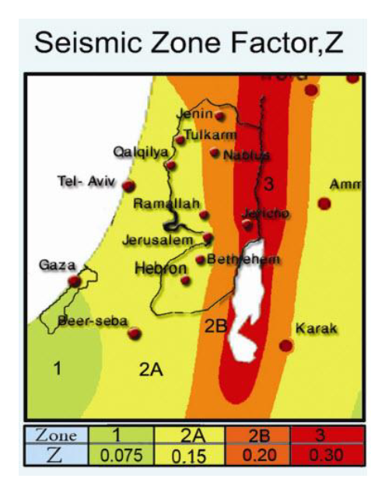
Seismic Zone Factor:
Nablus city
Zone 2B
Z = 0.2 g

Slide 38
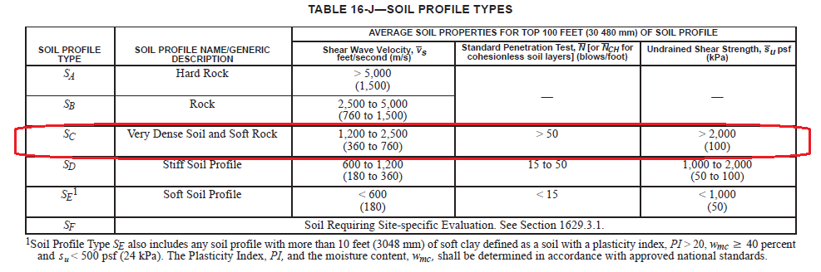
Site Classification:
qall = 250 KN/m^2
Soft Rock
Sc

Slide 39
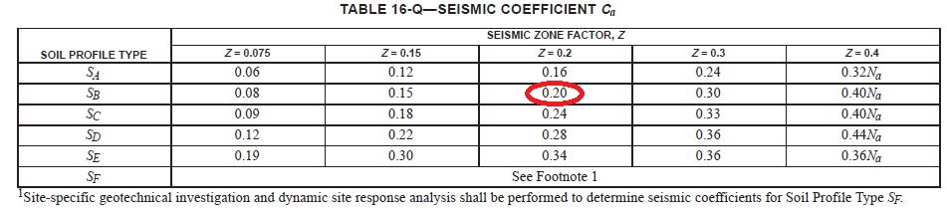
Seismic Coefficient Ca:
Ca = 0.2

Slide 40
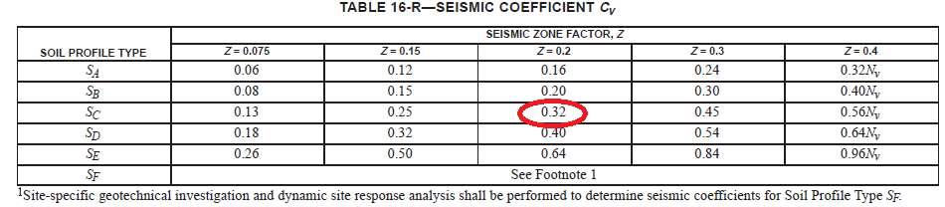
Seismic Coefficient Cv:
Cv = 0.32

Slide 41
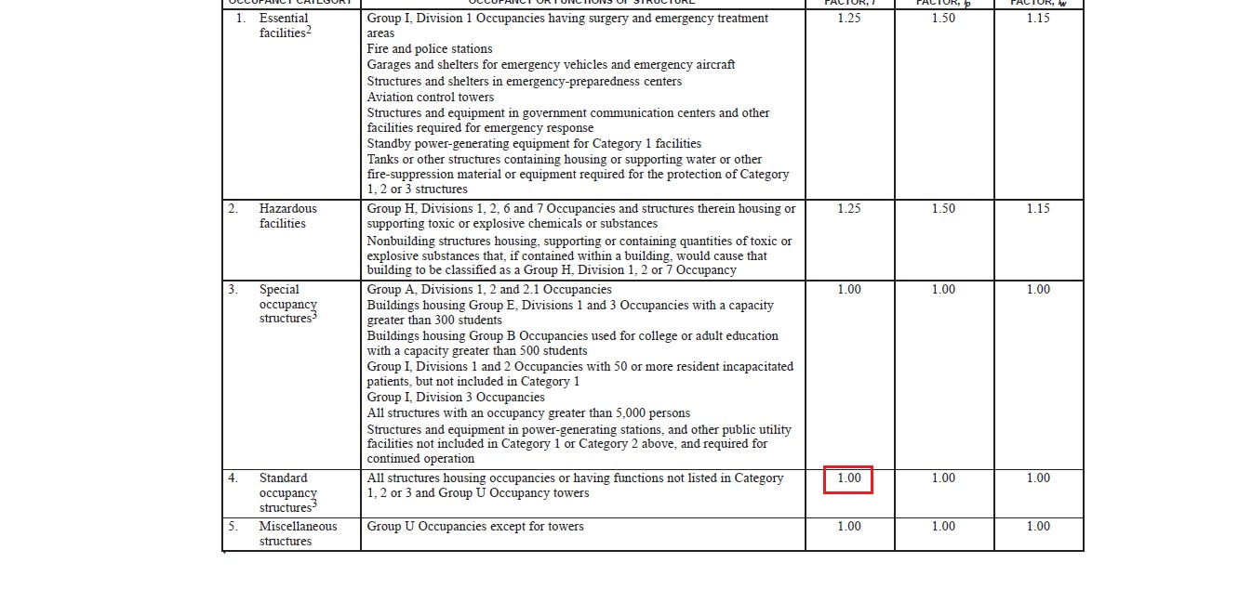
Importance Factor:
Commercial building
I = 1.0

Slide 42
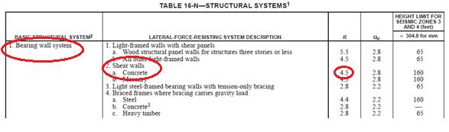
Structural System Coefficient (R):
Shear Wall
Bearing Wall
Bearing Wall System
R = 4.5

Slide 43
Base Shear By ELF method (V):
Z | 0.2
Ca | 0.24
Cv | 0.32
I | 1
R | 4.5
W = D.L + SID + 0.25 L.L = 139288 KN.

Slide 44
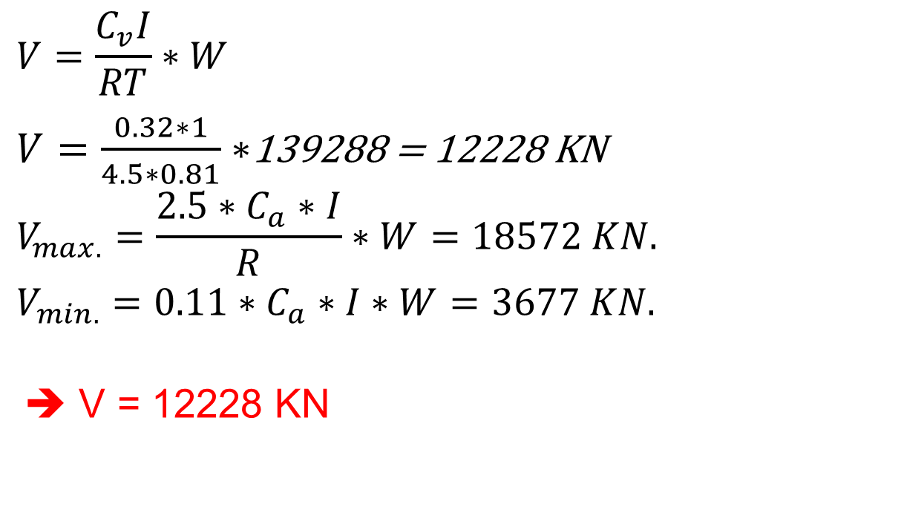
Base Shear (V):
$$V=\frac{C_{v}I}{RT}∗W$$
$V=\frac{0.32∗1}{4.5∗0.81}∗$139288 = 12228 KN
$$V_{max.}=\frac{2.5∗C_{a}∗I}{R}∗W=18572 KN.$$
$$V_{min.}=0.11∗C_{a}∗I∗W=3677 KN.$$
➔ V = 12228 KN

Slide 45
Dynamic Analysis
Define of Response Spectrum Function By SAP program :

Slide 46
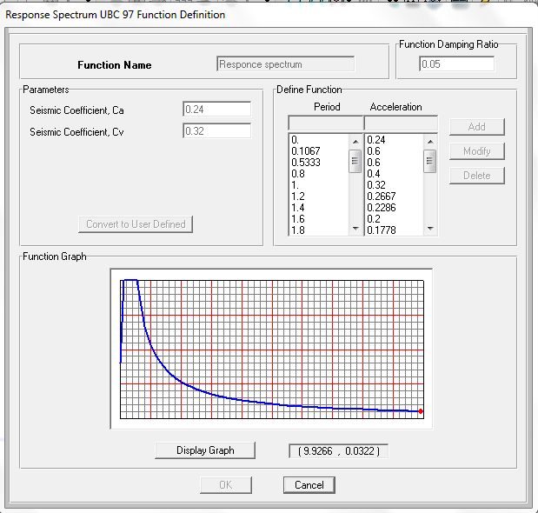

Slide 47
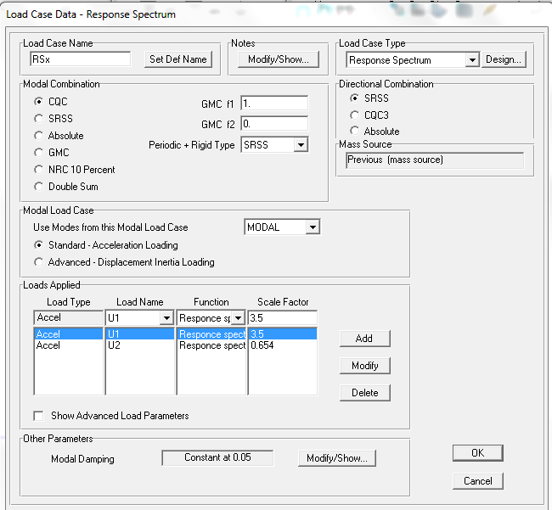
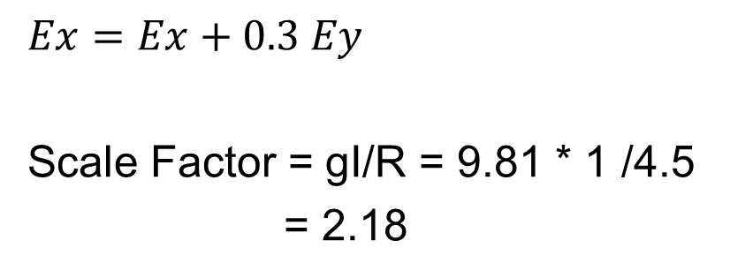
Response Spectrum in
X-Direction:
$$Ex=Ex+0.3 Ey$$
Scale Factor = gI/R = 9.81 * 1 /4.5
= 2.18

Slide 48
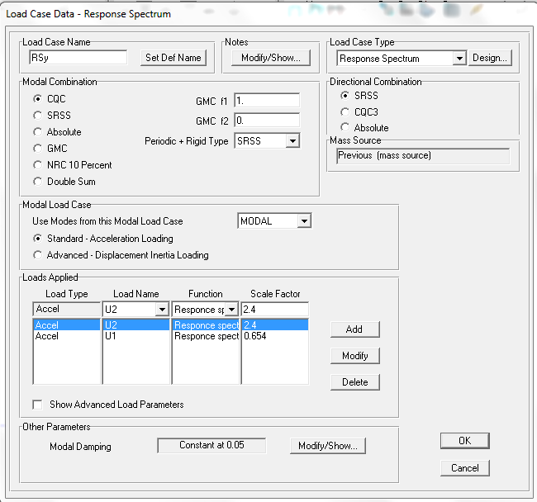
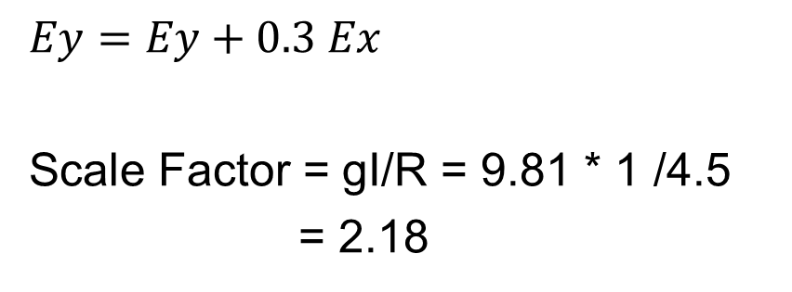
Response Spectrum in
Y-Direction:
$$Ey=Ey+0.3 Ex$$
Scale Factor = gI/R = 9.81 * 1 /4.5
= 2.18

Slide 49
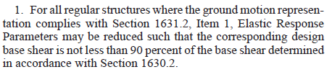

Slide 50
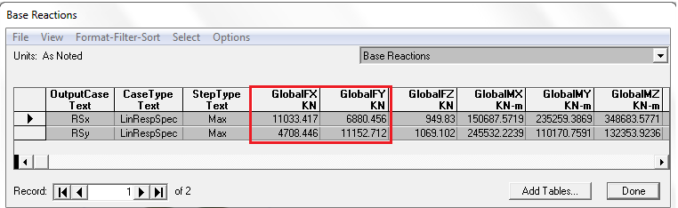
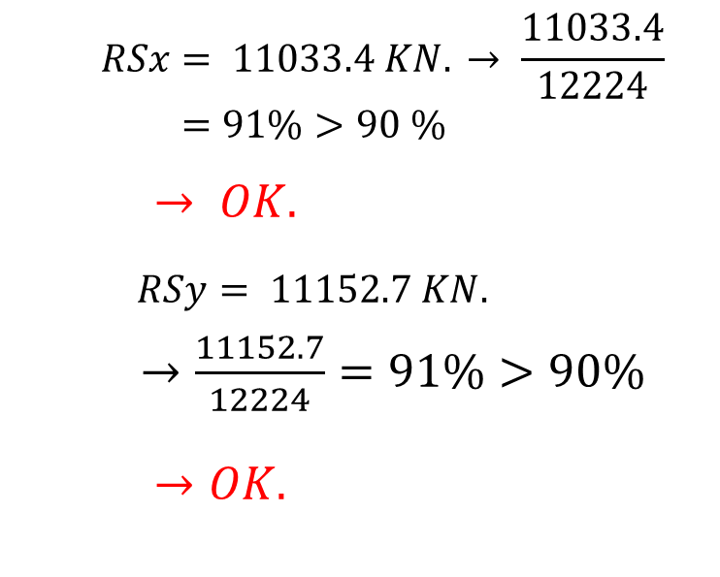
Base Reactions in X And Y-Direction:
$$RSx= 11033.4 KN. → \frac{11033.4}{12224}=91\%>90 \%$$
$→ OK.$
$$RSy= 11152.7 KN.$$
$→\frac{11152.7}{12224}=91\%>90\%$
$→OK.$

Slide 51
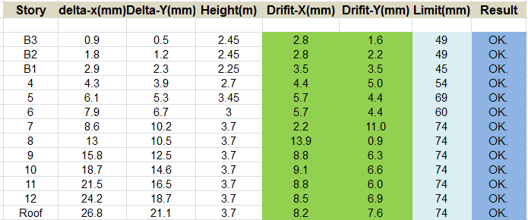
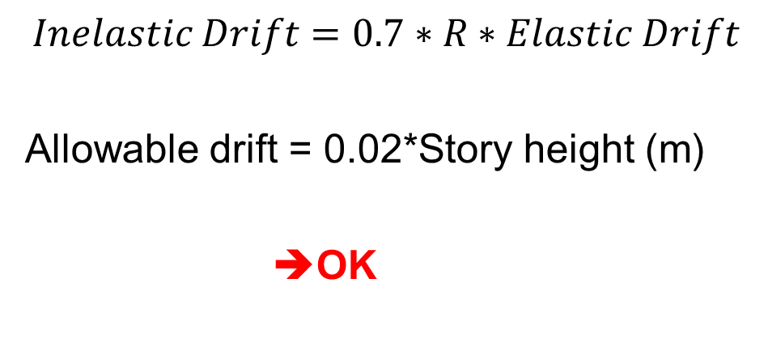
Drift Check:
$$Inelastic Drift=0.7∗R∗Elastic Drift$$
Allowable drift = 0.02*Story height (m)
➔OK

Slide 52
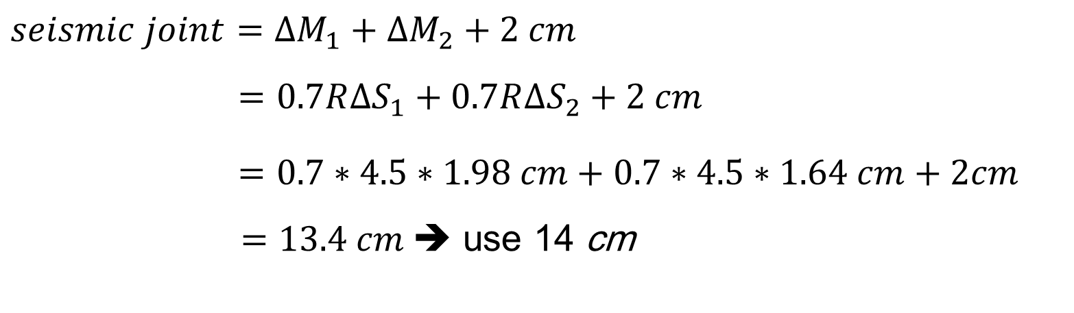
Seismic Joint:
$seismic joint=∆M_{1}+∆M_{2}+2 cm$
$=0.7R∆S_{1}+0.7R∆S_{2}+2 cm$
$=0.7∗4.5∗1.98 cm+0.7∗4.5∗1.64 cm+2cm$ $=13.4 cm$➔ use 14 cm

Slide 53
Structural Elements design
Contents:
Design of slabs.
Design of beams.
Design of columns.
Design Of Shear Wall
Design Of Mat Foundation
Design Of Stairs

Slide 54
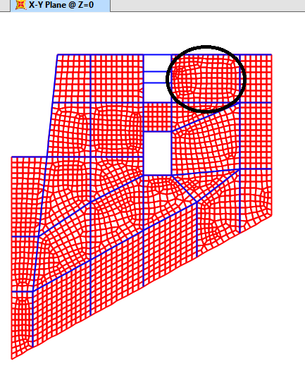
Elements Design
DESIGN OF SLab
Two way ribbed slab:

Slide 55
Deflection Check:
The max immediate deflection due to service load from SAP = 17 mm.
The long term deflection is about twice of immediate deflection = 17*2 = 34 mm.
The allowable deflection = L / 240
= 10.5m / 240 = 44 mm > 34 mm.
➔OK.

Slide 56
Check Shear:
Ok. Or Not Ok | ɸVc (KN) | V23 (KN) | V13 (KN) | Slab Type
OK. | 138.9 | 34.4 | 45.3 | Solid (Roof)
Ok. Or Not Ok | ɸVc (KN/rib) | V23 (KN/rib) | V13 (KN/rib) | Slab Type
OK. | 30.55 | 13.89 | 23.3 | Ribbed

Slide 57
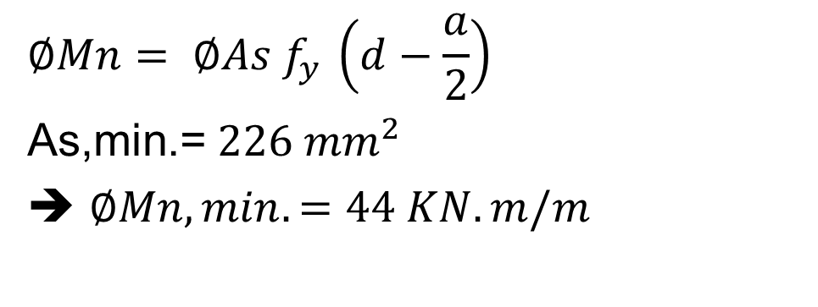
Design For Flexure:
$$∅Mn= ∅As f_{y }\left(d−\frac{a}{2}\right)$$
As,min.=$226 {mm}^{2}$
➔ $∅Mn,min.=44 KN.m/m$

Slide 58
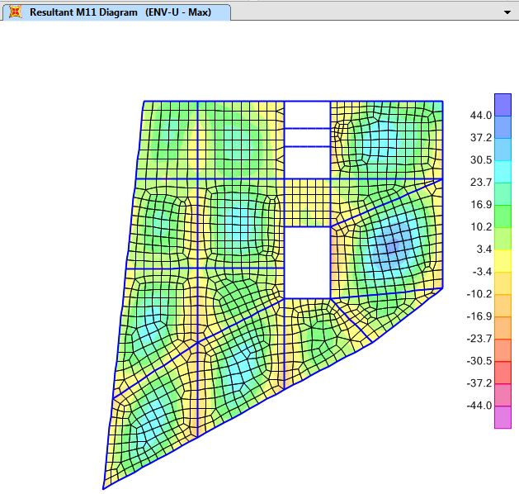

Slide 59
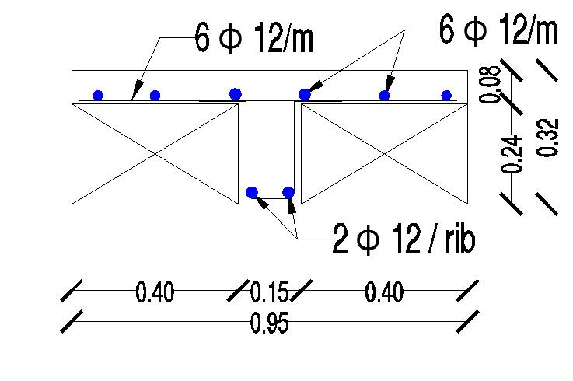
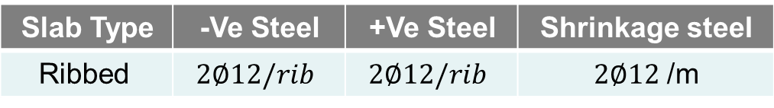
Shrinkage steel | +Ve Steel | -Ve Steel | Slab Type
$2∅12$ /m | $$2∅12/rib$$ | $$2∅12/rib$$ | Ribbed

Slide 60
Elements Design
DESIGN OF beams

Slide 61
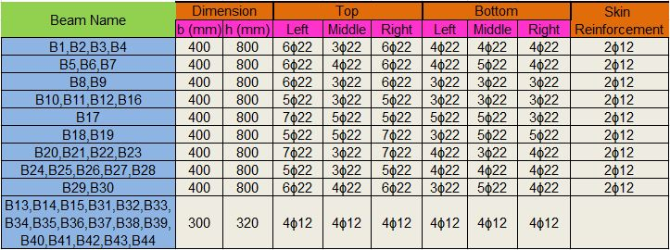
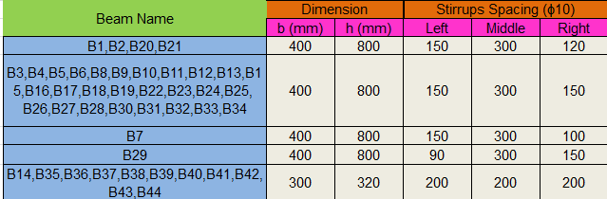

Slide 62
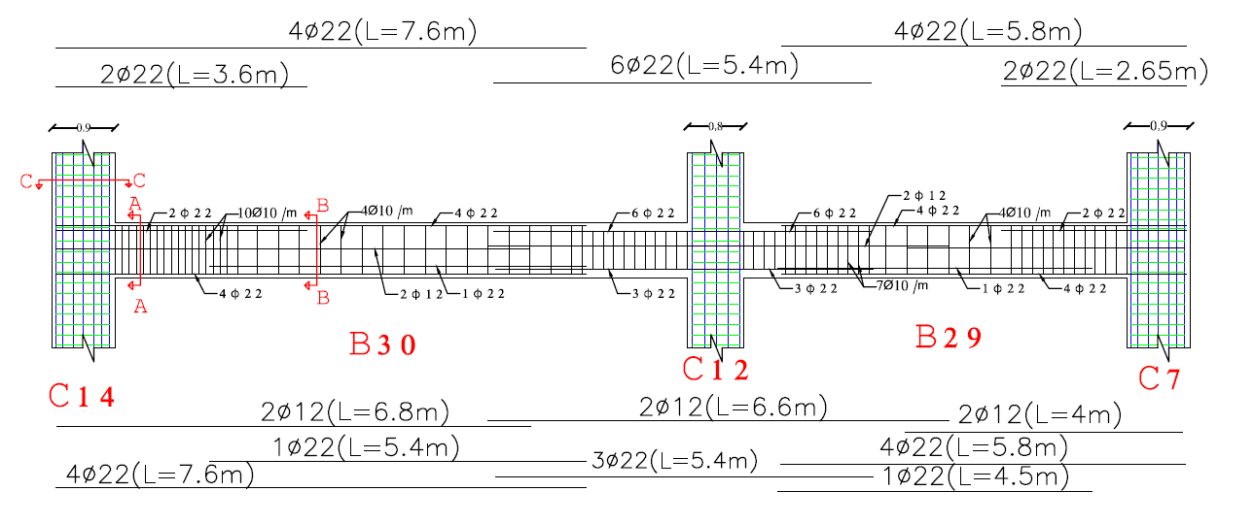
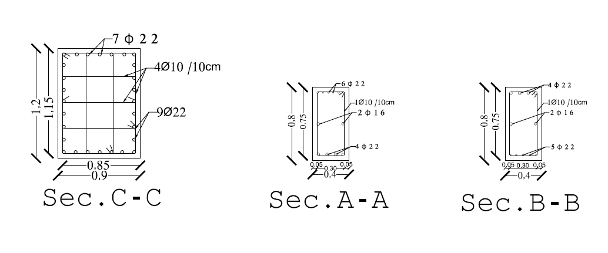

Slide 63
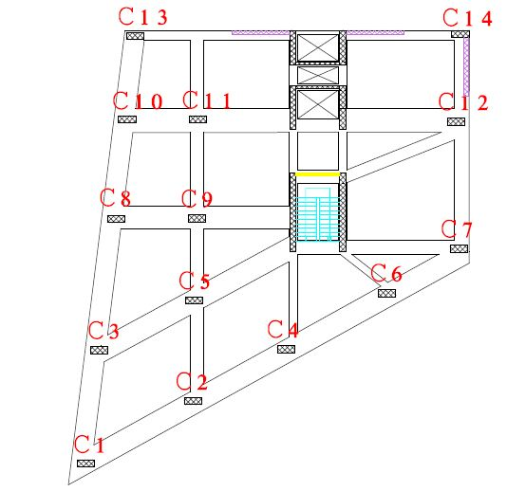
Elements Design
DESIGN OF COLUMNS

Slide 64

Columns Steel Reinforcements:

Slide 65

Detailed Cross Section In Column (C1):

Slide 66


$S_{0}=min.\left\{\begin{aligned}900/2=450 mm \\ 8∗22=176 mm \\ 24∗12=288 mm \\ 300 mm\end{aligned} \right.$ ➔ use $S_{0}=150 mm$
$S_{1}=min.\left\{\begin{aligned}900 mm \\ 16∗22=352 mm \\ 48∗12=576 mm\end{aligned}\right.$ ➔ use $S_{1}=300 mm$
$l_{0}=max.\left\{\begin{aligned}2650/6 =442 mm \\ 1200 mm \\ 450 mm\end{aligned}\right.$ ➔ use $l_{0}=1200 mm$
$$l_{dt}=\frac{0.59∗f_{y}}{\sqrt{f_{c^{′}}}}∗d_{b}=964 mm$$
$$l_{s}=1.3∗l_{dt}=1250 mm →use 1.3 m$$

Slide 67

Detailed Longitudinal Cross
Section In Column:

Slide 68

Design Of Shear Wall:

Slide 69



$$Check shear in X−direction:$$
$$Vx=75KN$$
$$ØVc=955 kN > 75KN ➔ OK$$
$$Check shear in Y−direction:$$
$$VY=830 KN$$
$$ØVc=917kN > 830KN ➔ OK$$

Slide 70

Design For Flexure:
$$\text{Horizontal} \text{steel}\text{ :}$$
$$Use As,min= ρ\min{∗b∗h=0.0025∗1000∗300=750{ mm}^{2}}$$
➔ $750/2=375 {mm}^{2} on each side.$
➔ Use 5 ϕ10 / m in both sides.
Vertical steel :
$$Use As,min = ρ\min{∗b∗h=0.0025∗1000∗300=750 {mm}^{2}}$$
➔ $750/2=375 {mm}^{2} on each side.$
➔ Use 5 ϕ10 / 1m in both sides.

Slide 71

For Pu = 13900
Mux(M2) =4290KN.m

Slide 72

For Pu = 13900
Muy(M3) =56KN.m

Slide 73

Detailed Cross Section In shear wall

Slide 74


Design Of Mat Foundation:
$$depth:1.10 m$$
$$d_{cover}=8 cm$$

Slide 75


Check For Deflection:
$$The maximum differential settlement is:$$
$$10−2.5 mm=7.5 mm<10 mm OK$$
Max Deflection Of Mat Foundation

Slide 76


Check Soil Pressure:
$$\operatorname{Maximum}{allowable stress }is 250 kN/m^{2}$$
Maximum stress on the footing is
244 KN/m² < 250 KN/m² ➔ Safe
Max Pressure Under Mat Fondation

Slide 77


Check Punching Shear:
$${∅V}_{c},punching=0.75×0.33×\sqrt{28} ×bo×d$$
$$=0.75×0.33×\sqrt{28} ×7680×\frac{1020}{1000}=10259KN$$
Pu = 9620KN
${∅V}_{c},punching>Pu$ ➔ OK

Slide 78

Design For Flexure:
Moment Diagram For Column Strip
For M=5000KN.m/column strip
M=5000/4 = 1250KN.m /m ➔5$∅$32/m in X-direction ( bottom steel )
For M=1800 KN.m/column strip
M=1800/4 = 450KN.m /m ➔5$∅$20 /m in X-direction ( Top steel )
As,min /2 = 0.0018*1000*1100 / 2 = 990 mm² ➔ 4$∅$20 /m

Slide 79

Steel Reinforcement In X-direction

Slide 80

Steel Reinforcement In Y-direction

Slide 81


Design Of Stairs:
Thickness of the flight:
$use h=200mm$

Slide 82

Loads On Stairs:
The own weight of stairs $= 0.2∗25m=5kN/m^{2}$
The live load is assumed = 5 KN/$m^{2}$.
The SD load = 3 KN/$m^{2}$.

Slide 83


Check For Shear:
Vu=19.3 KN/m
$$∅ Vc = 0.75×\frac{1}{6}×\sqrt{fc` }=0.75×\frac{1}{6}×\sqrt{28}×1000×\frac{170}{1000} =112 kN/m$$
$Since ∅ Vc=112 kN> Vu=19.3 kN$
➔ there is no need for shear reinforcement.

Slide 84


Check For Deflection:
$$\text{Max}.{ \text{deflection} \text{due} \text{to} \text{service} \text{load} }\text{from} \text{SAP}\left(\text{ ∆} \right) \text{= }\text{6}\text{.}\text{6 }\text{mm}$$
Deflection limitation :
$∆ L,allawable\left( Long term\right)=\frac{l}{240} =\frac{3300}{240} =13.75mm>6.6 mm$ ➔ OK.

Slide 85

Design For Flexure:
Stair station | Positive(left) | Positive(at the middle) | Positive(Right)
Moment 22 (kN.m) | 9 | 23 | 10
Mu = 23 KN.m /m ➔Use (4 $∅$12/ m) for all longitudinal steel ( main steel )
For transverse steel use $As shrinkage = As min =0.0018×200×1000=360 mm^{2}$
➔Use (5 $∅$10/ m ) for each layer

Slide 86
Discussion & Conclusion

Slide 87


