Slide 1

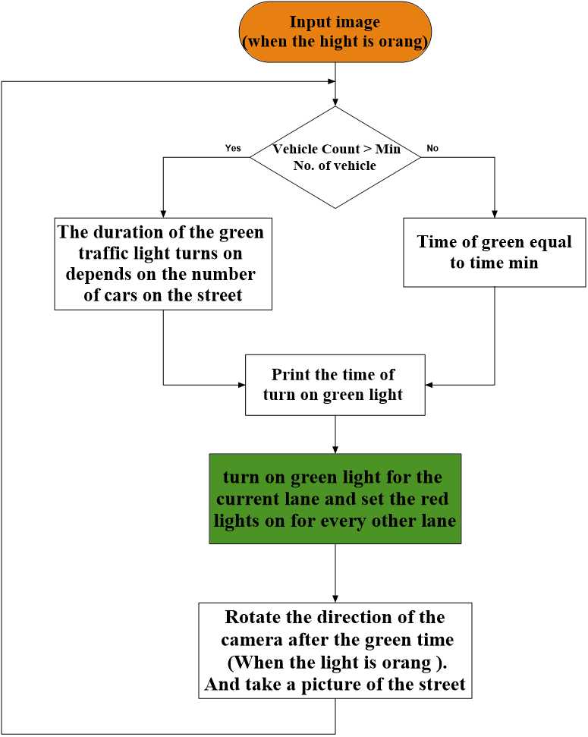
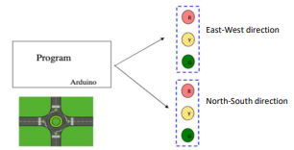
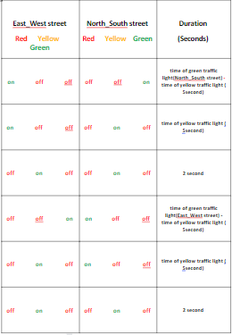
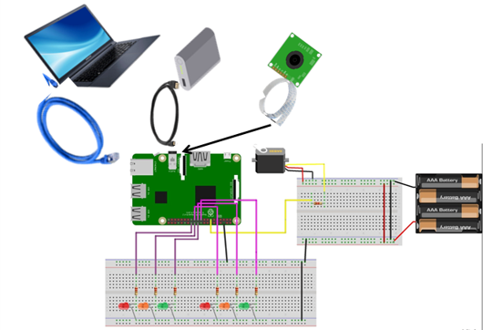
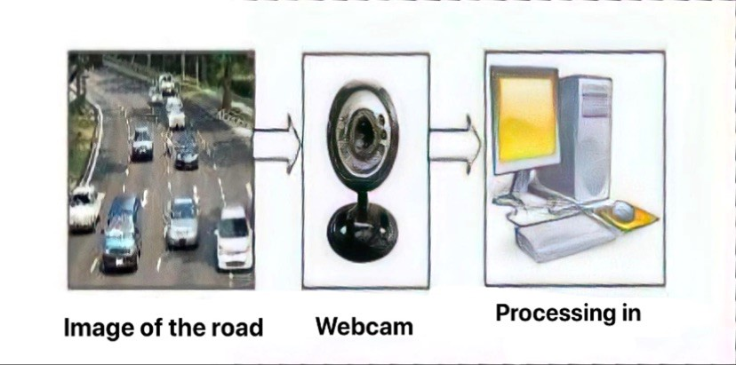
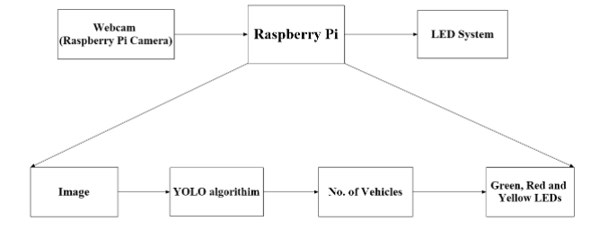
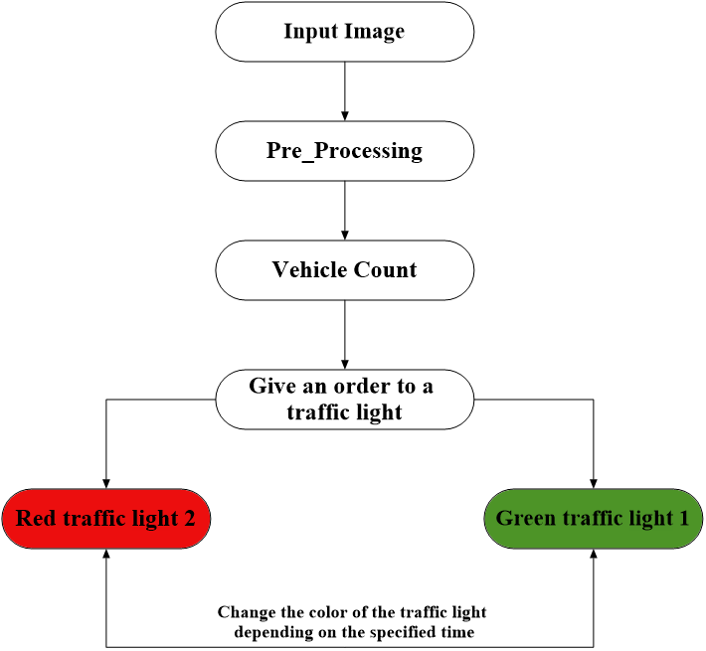
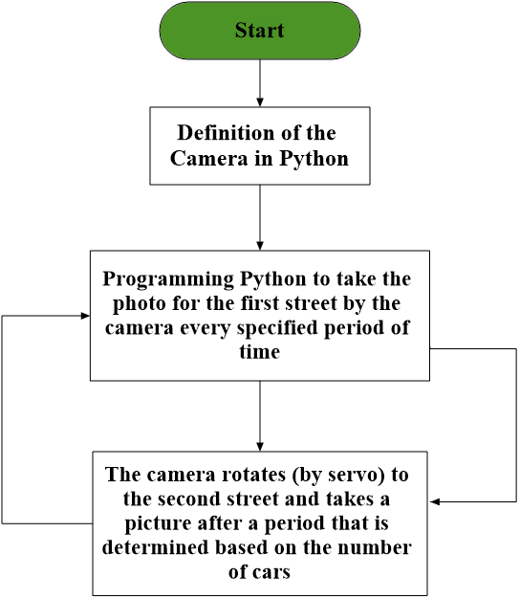
A SVM-3D Based Sensorless Speed Control of a PMSM Fed by a Four-leg Inverter
PEMD 2020 15 - 17 December 2020
K.Saleh , M.Sumner : mark.sumner@nottingham.ac.uk Online Conference
shows the results of the simulation to tracking saliency under the healthy operating conditions as given in table 1 and in cases of single-phase open-circuit fault as given in tables 2, and
Objectives
IOur traffic management solution by owning special intelligence is route feed images from cameras (webcam or IP camera) at traffic intersections to calculate real-time traffic density using image processing. Its aim is:
Reducing traffic congestion on the road which helps reduce the number of accidents, and will provide a safe passage for people
Reducing fuel consumption and waiting time, thus reducing air pollution
Reduce the burden on the police movement.
It will provide important data that will aid in the planning and analysis of routes in the future.
In addition to the speedy provision of emergency services in the event of traffic accidents.
Problem Statement
Fault-Tolerant Inverter
  Traffic congestion is a very big problem in the development of cities, in fact, the increasing nature of day by day makes it difficult to find real-time traffic density, so that you can schedule better traffic light control and effective traffic routing. The root cause of this can be various situations like traffic congestion like insufficient road width, road conditions due to weather, unrestricted demand, big delay of red light etc. Whereas, insufficient capacity and unrestricted demand are interrelated somewhere. In fact, manual control is required and therefore, in order to reduce human power, the need arises to simulate and improve traffic control to meet the increasing demand. Technology in the recent past uses image processing for monitoring and safety, which is widely used in vehicle and traffic management for traveler information. Motion intensity estimation can also be achieved using image processing.
the Flowchart of Traffic Light
if the number of cars is less than or equal to one car (the number of min cars on the street) we take:
time of green traffic light= minimum green time = Tmin =15 . seconds if the number of cars is greater than the number of min cars on the street, we take:
time of green traffic light = max green time = 𝑋 /𝑌 ∗ 𝑇𝑚𝑎x .
Solve the problem
Tracking the saturation saliency of PMSM post an open-circuit fault
In this project, image processing technology was used, which includes issues related to image representation, compression techniques, and various complex operations that can be performed on image data. The traffic density of lanes is calculated using image processing that is done from images of lanes taken with the Raspberry camera.
This project uses a raspberry pi 4 which is a microcomputer with the Python programming language, and the system uses machine learning technology (Yolov3 model and OpenCV) to decide on the presence of a number of cars. On the basis of which the duration of the green signal is determined, the system is designed taking into account criteria such as delay, accuracy, performance, cost and reliability.
The Flowcharts
Fault-tolerant Sensorless Speed Control
Flowchart of main processing
the Flowchart for code using camera
Conclusion
This system makes the traffic light system automatic, by providing vehicle density information to the system. So there are no difficulties in dealing with traffic. This technique is effective in combating the increased pressure of traffic. The system is cost-effective, low cost, easy to set up, does not require the installation of a complex machine traffic control system and has relatively good accuracy and speed. Deploying this system will not only save waiting time at traffic intersections, but also many resources that would otherwise be wasted.

