Slide 1


3D Web-Based Mapping for An-Najah National University’s Campus
By
Ahmad Hamamry – Reg. No: 12114371
Mohammed Abu Lebda – Reg. No: 12112024
Supervisor: Prof. Sameer Shadeed

Slide 2
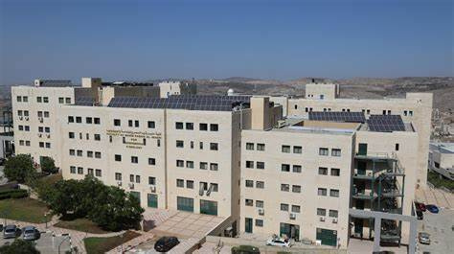


Introduction
The idea of this project:

Slide 3

Background
The importance of 3D models and the advantages of uploading them to the web:
  Realistic 3D rendering of the building
  Easy access to the plan
  Understand and analyze infrastructure.
  Possibility of expansion and development

Slide 4
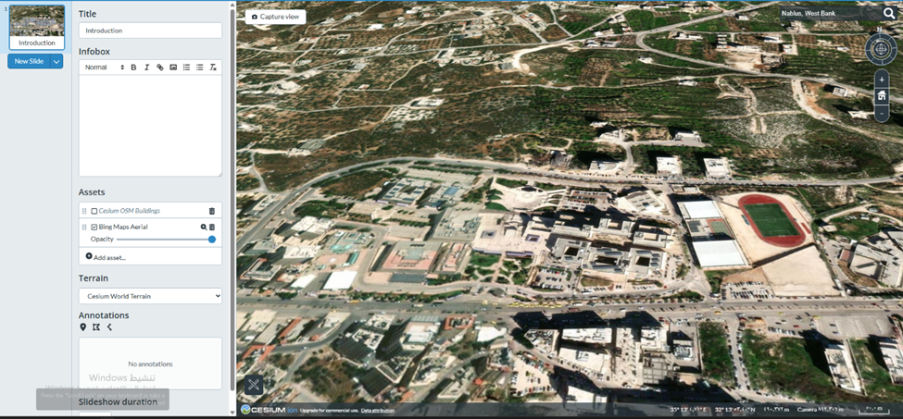
Case study area

Slide 5
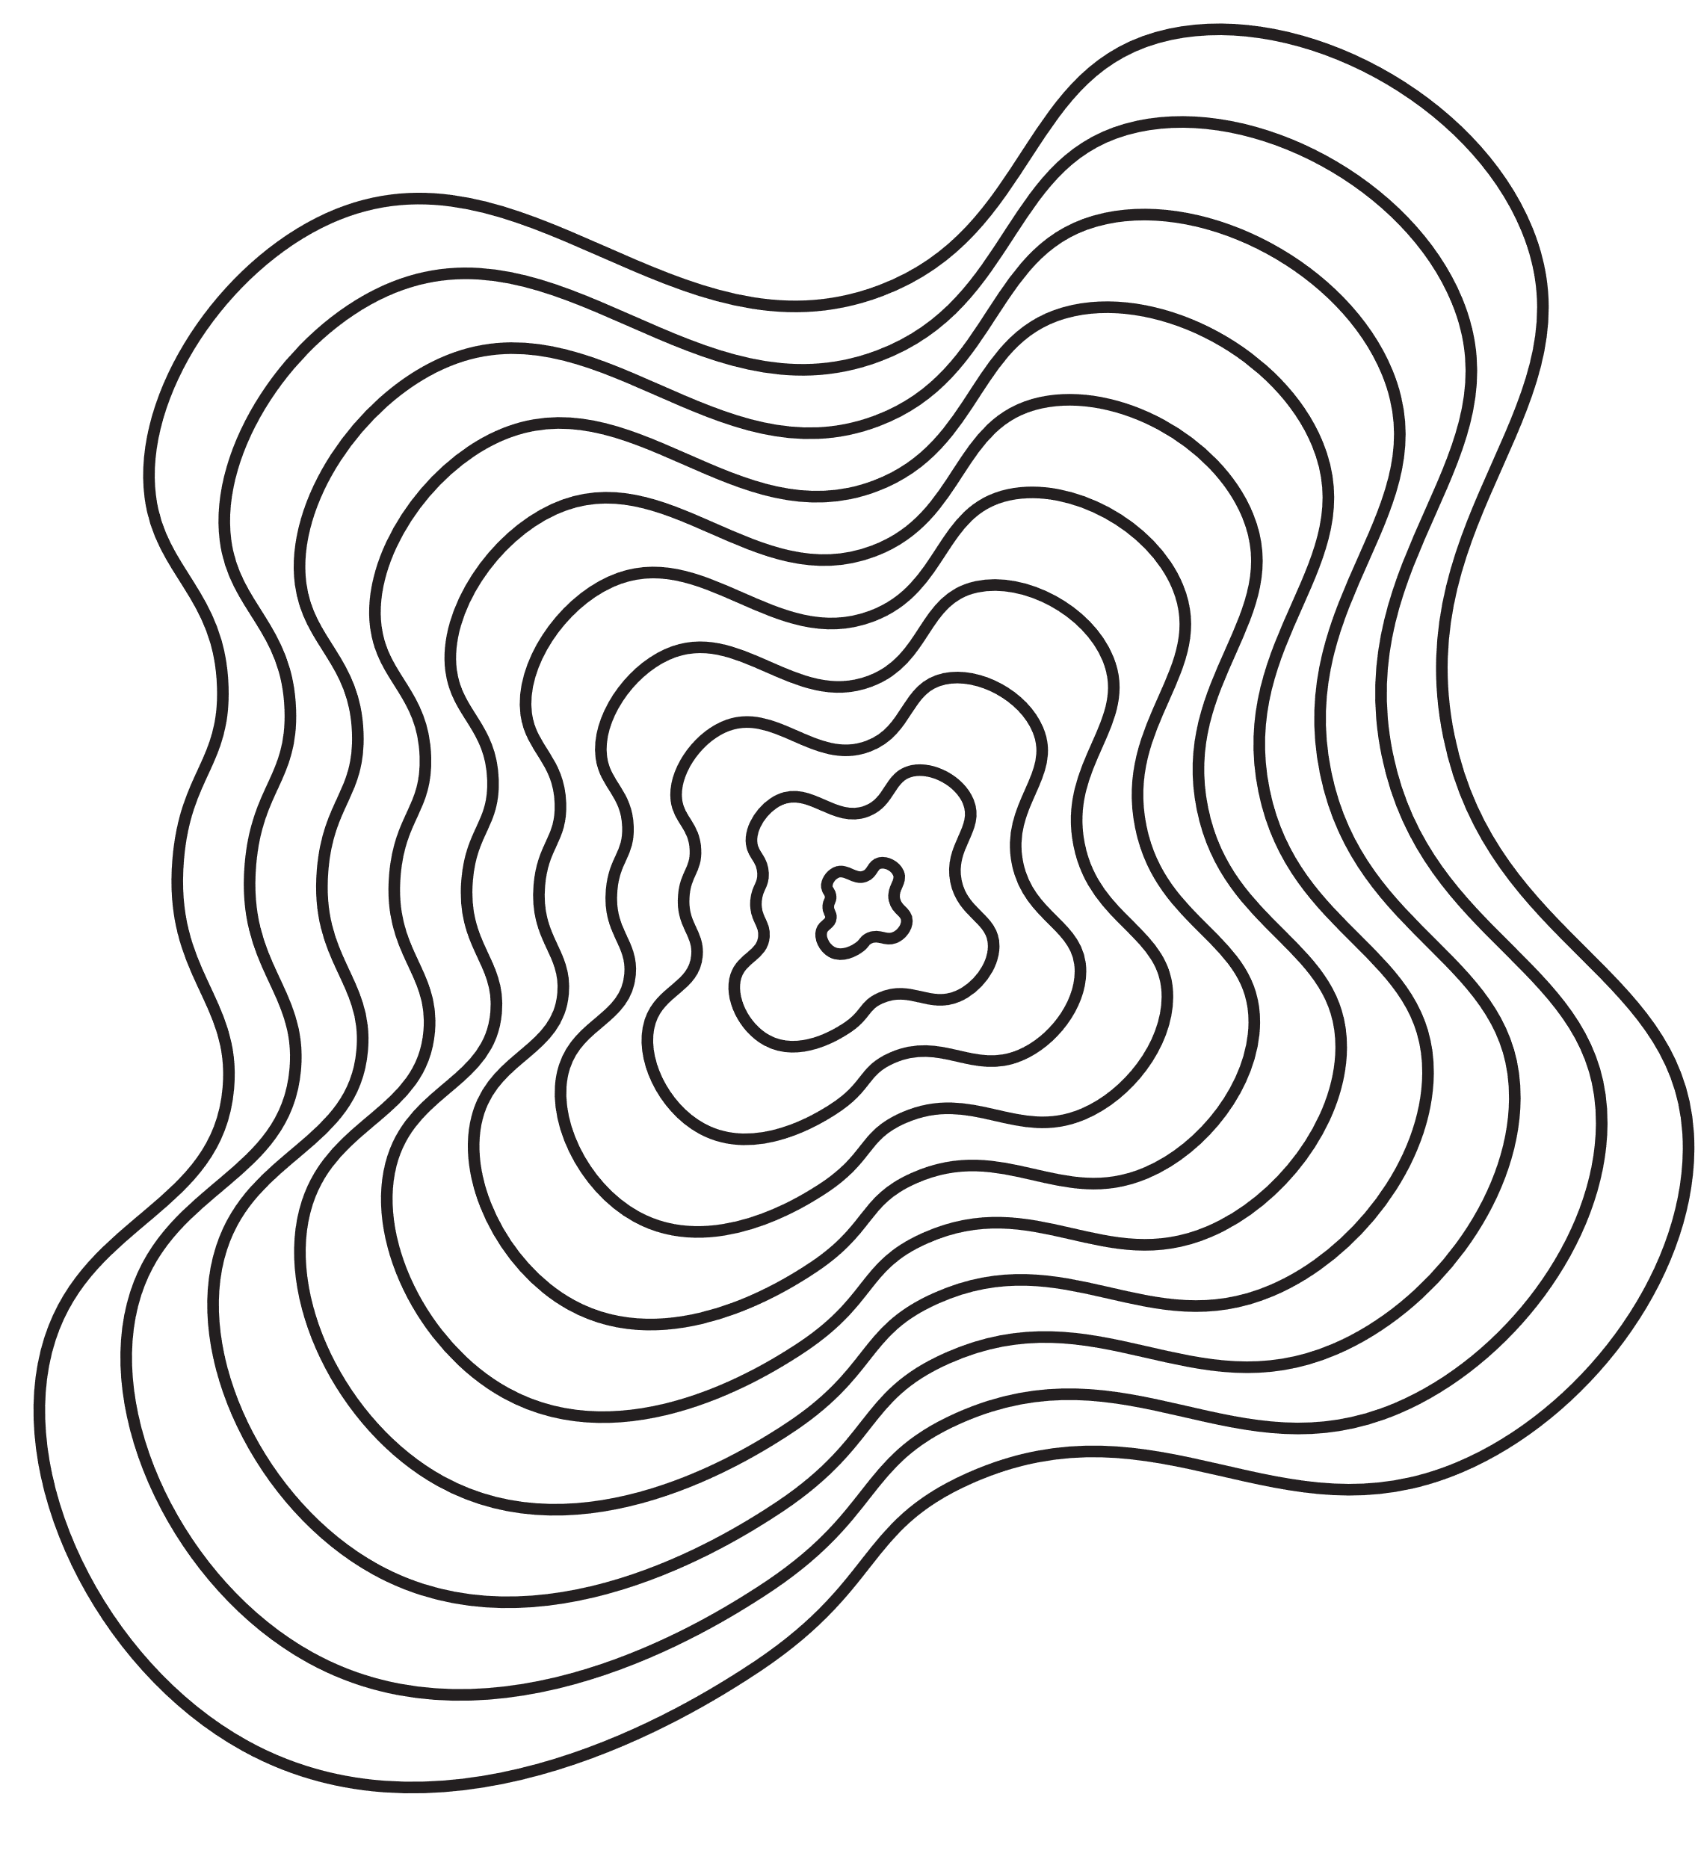
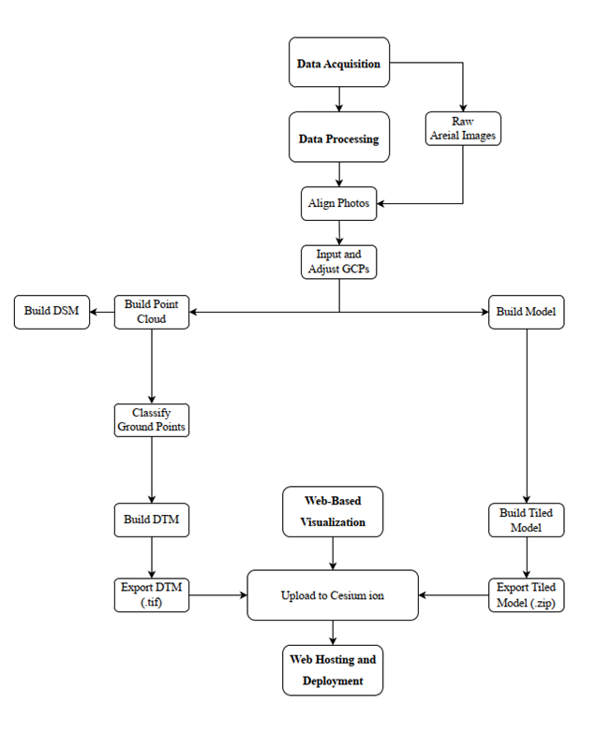
Methodology approach

Slide 6
Data Acquisition
  Ground Control Points (GCPs)
  Raw Images

Slide 7
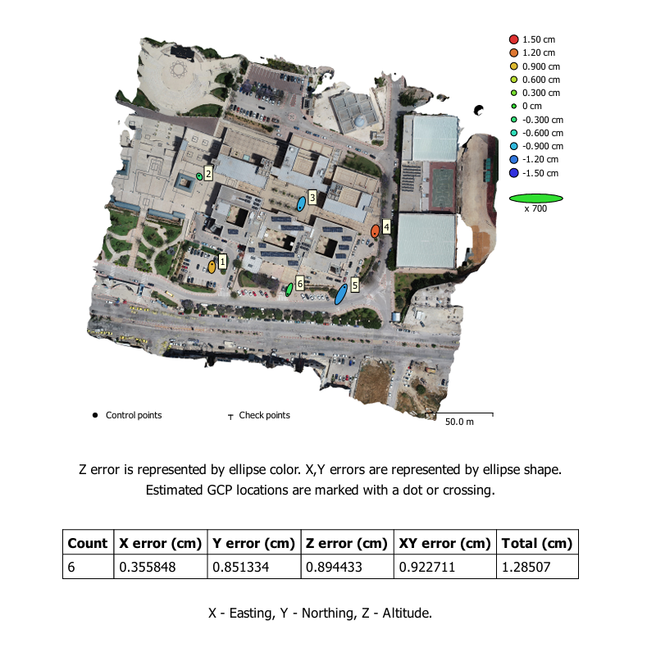
Ground Control Points (GCPs)

Slide 8
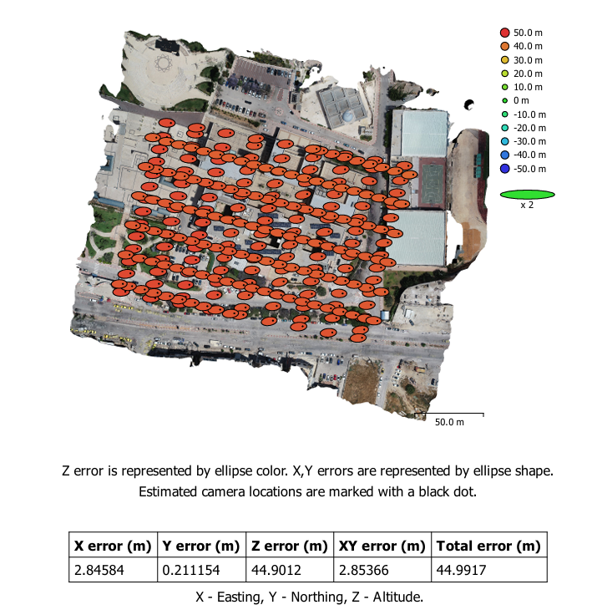
Raw Images

Slide 9
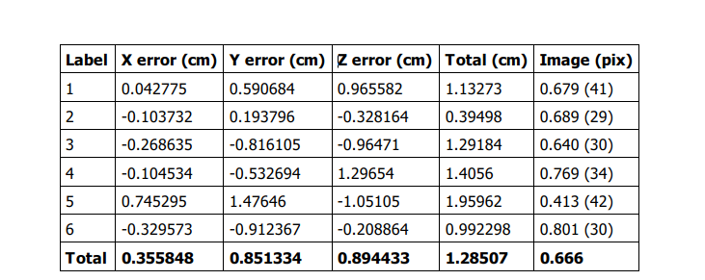
Data Processing
  Ground Control Points (GCPs)

Slide 10
Data Processing
  Align Photo
  Build texture model

Slide 11
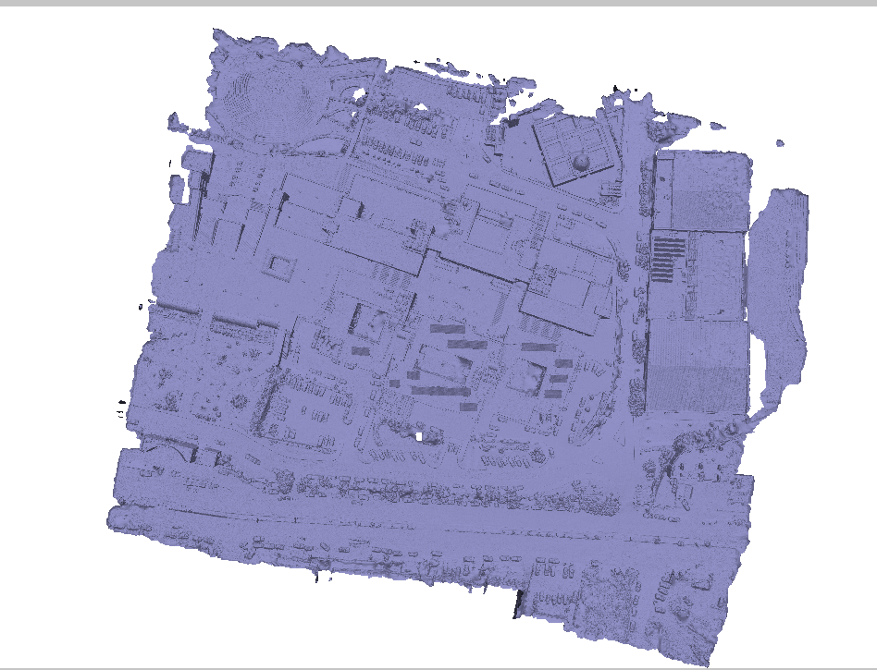

Slide 12
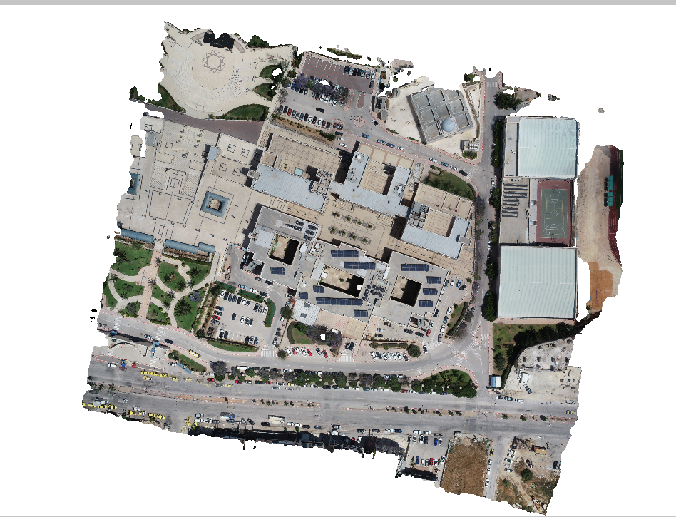

Slide 13
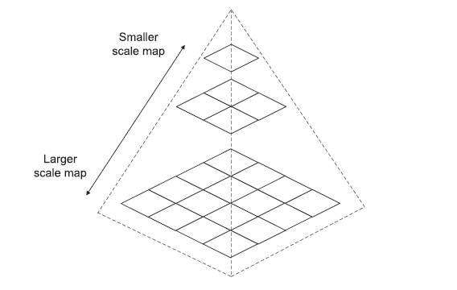
Data Processing
  Tiled map

Slide 14
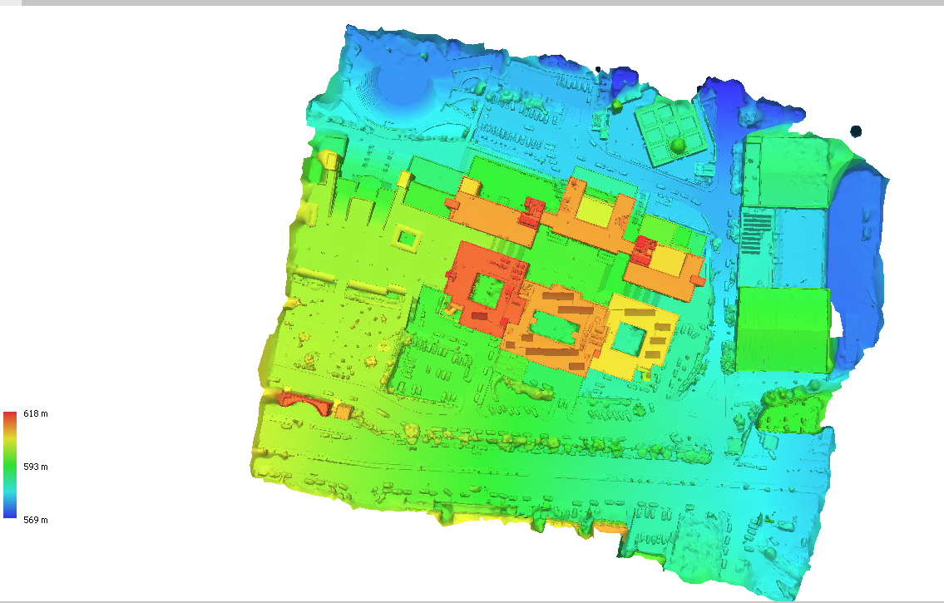
DSM

Slide 15
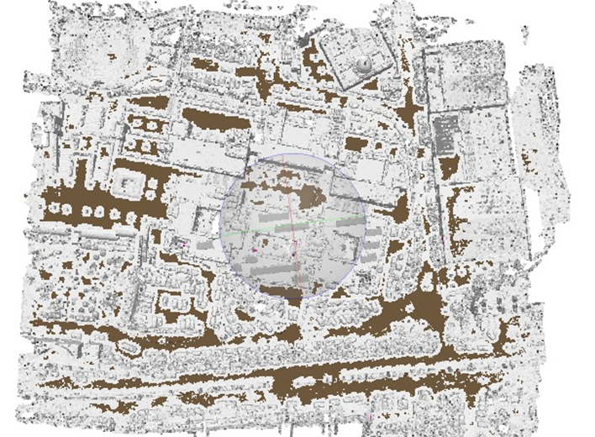
Data Processing
  Classify Ground Points

Slide 16
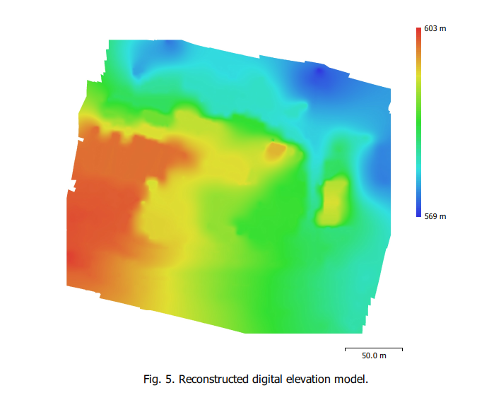
DTM

Slide 17
Web-Based Visualization
  Rename output file from .3tz to .zip
  The model seemed to float around 90 meters above the ground
  fixed by integrating a 30-meter-resolution Digital Elevation Model (DEM) as a custom terrain.

Slide 18
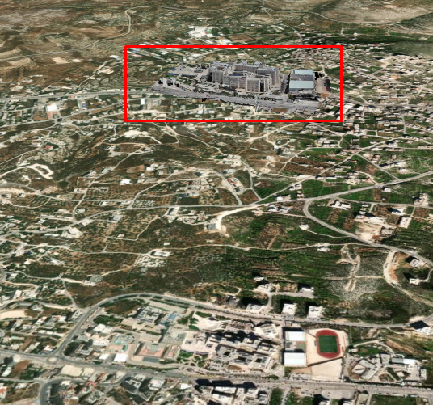
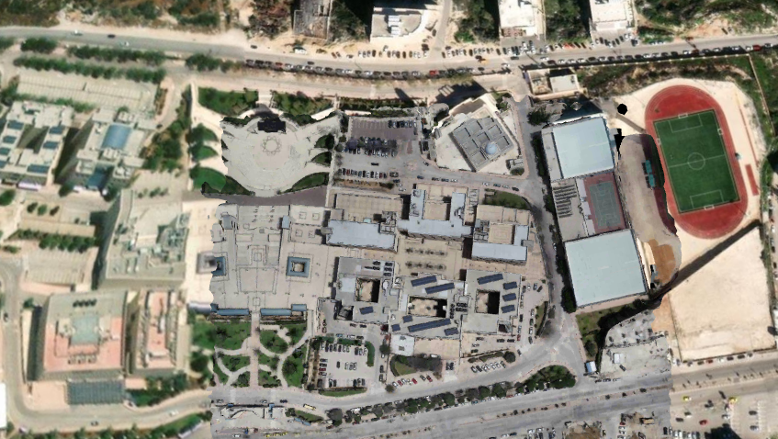
Model floating with default terrain
Model aligned using 30 m DEM

Slide 19
Web Hosting and Deployment
  Access limited problem
  GoDaddy and GitHub hosting platforms
  HTML FILE
  https://www.najah-campus.online/

Slide 20
Results and Discussion
  Summary of 3D Model Accuracy
  Terrain Alignment Issues
  Web Visualization Performance

Slide 21
Conclusions and Recommendations
  Project summary
  Project constraints

Slide 22
THANK YOU

