Slide 1
Graduation Project
Nadeem
By Layan Barq& Rahaf Abualhuda
Supervisor : Dr. Khaled Daoud

Slide 2
TABLE OF CONTENTS
01
02
03
04
Introduction
Tools used
App and Features
Future Work & conclusion

Slide 3
introduction
Why Party Planner app ?

Slide 4
Goals
Allow customers to organize their events with less effort, saving time.
Easily reserve services.
marketing and advertising.
Customer can pay through website
manage party details .
Enhanced a way to find different services

Slide 5

Scope of the Work
Admin
customer
Third party
Owner

Slide 6







Technology used
Postman
Node JS
React.js
Visual studio
Xampp
MySQL

Slide 7
App and Features
Customers
Rate a hall, write feedback
Notification
Owner
Add new hall, edit, delete
Receive message from customer
Third party
View their profile , edit their information
Add new services
Admin
Browse AI recommendation halls
Filter users with their type/ email
Add new user and specify his type

Slide 8
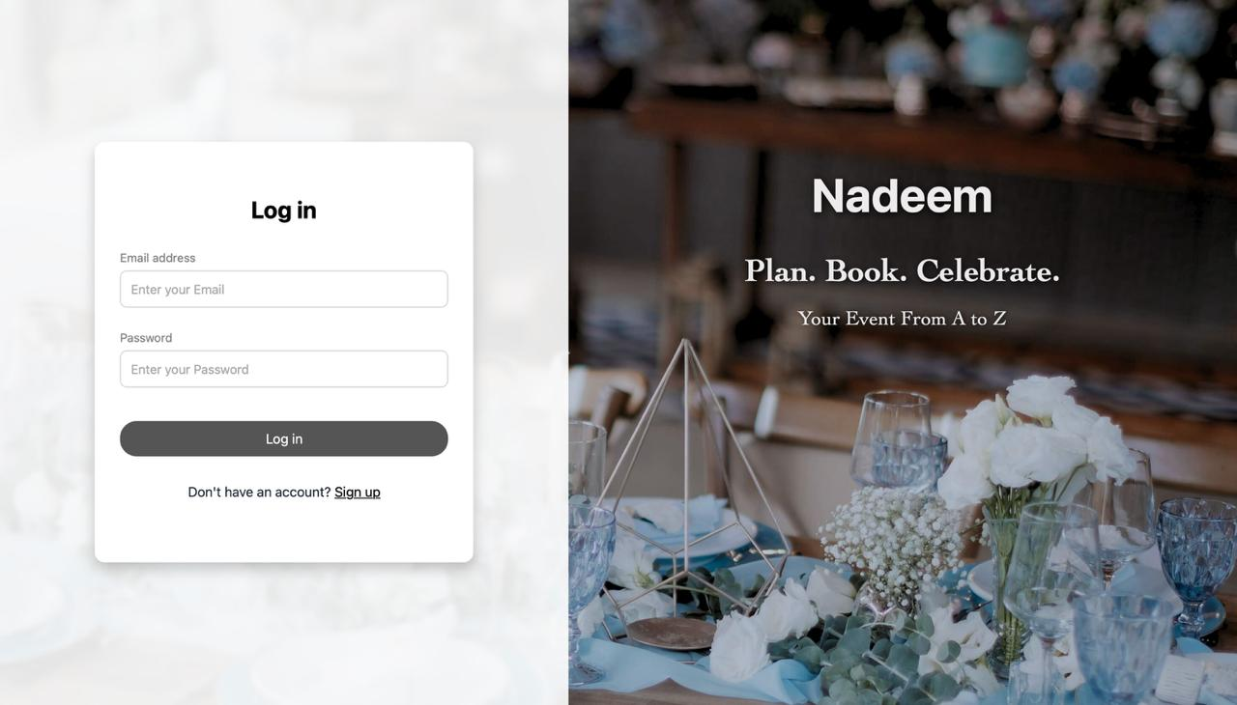
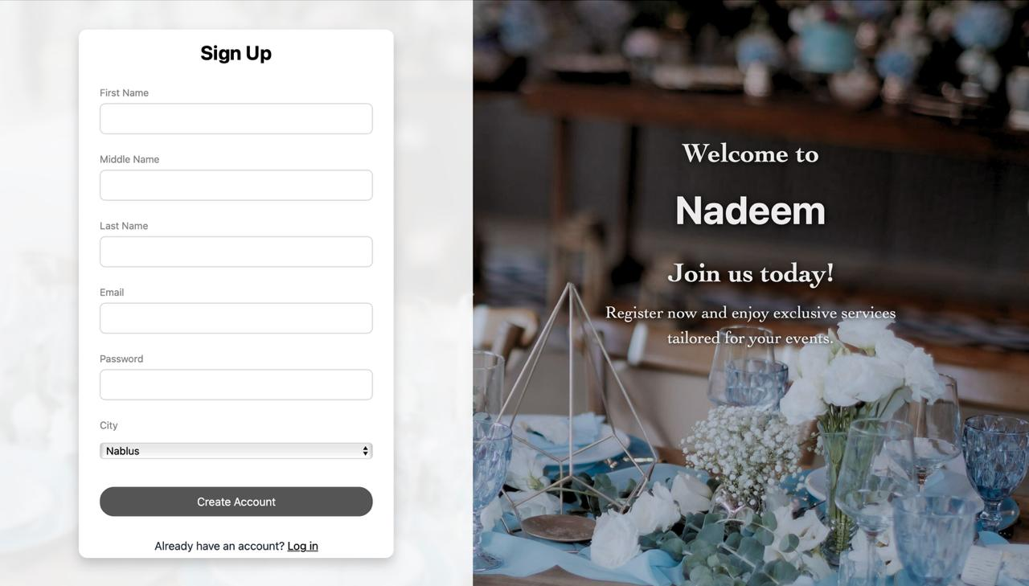
Log in & sign up screen
When choosing sign up,
users register directly as a customer.

Slide 9
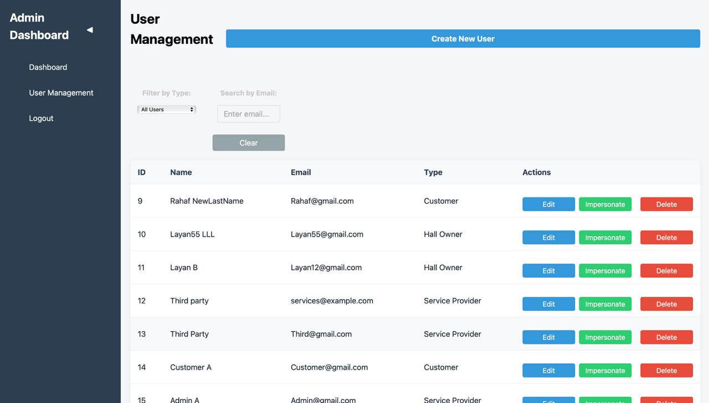
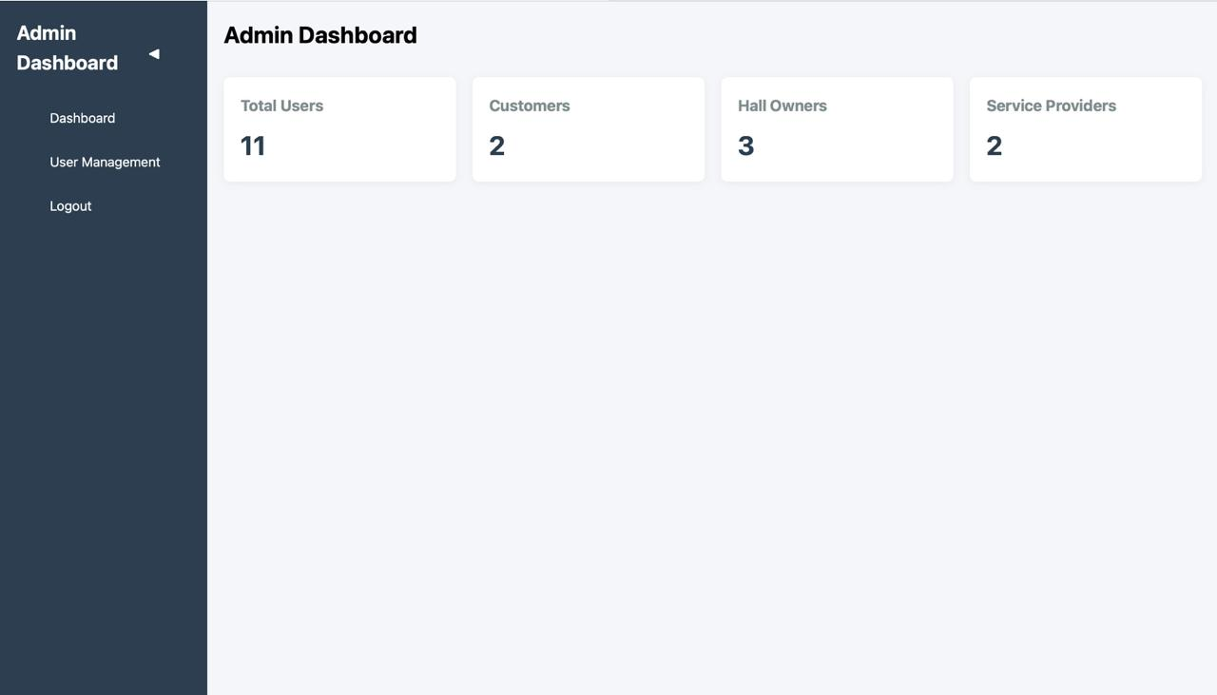
Log in as Admin
When choosing sign up,
users register directly as a customer.

Slide 10
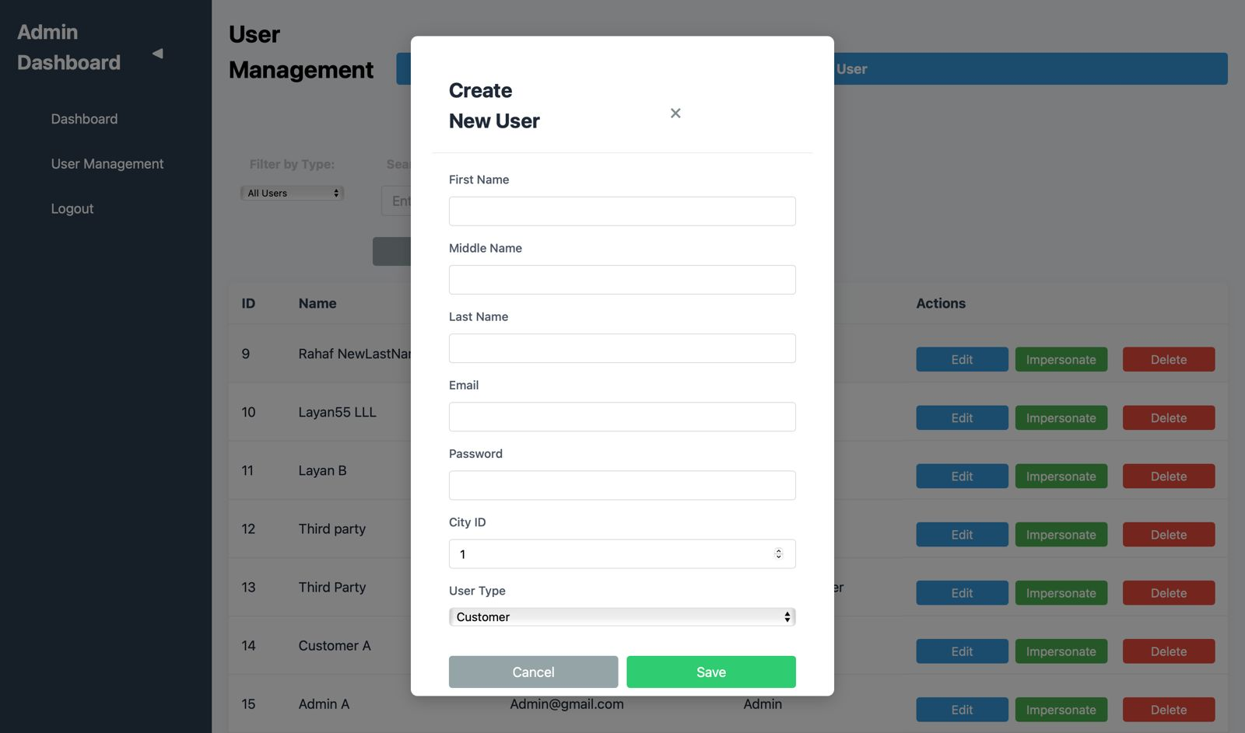
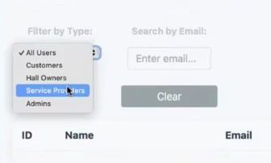
Log in as Admin

Slide 11
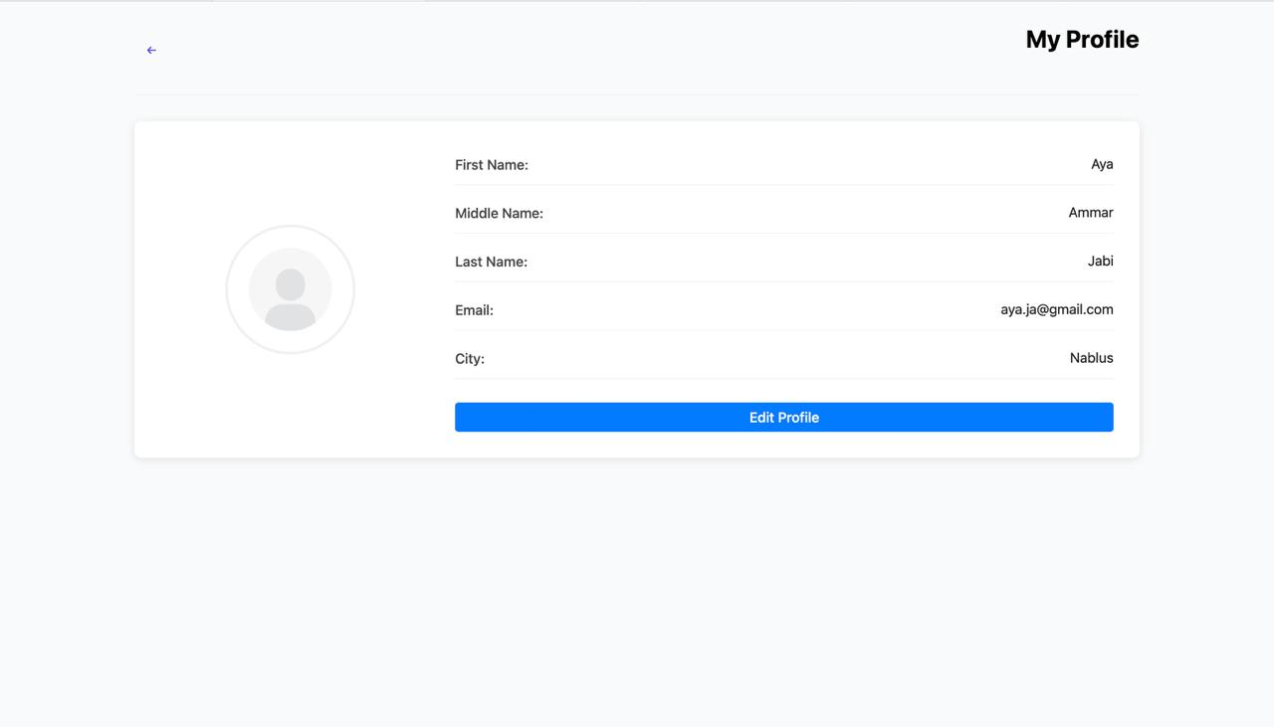
Log in as Owner ( profile)

Slide 12
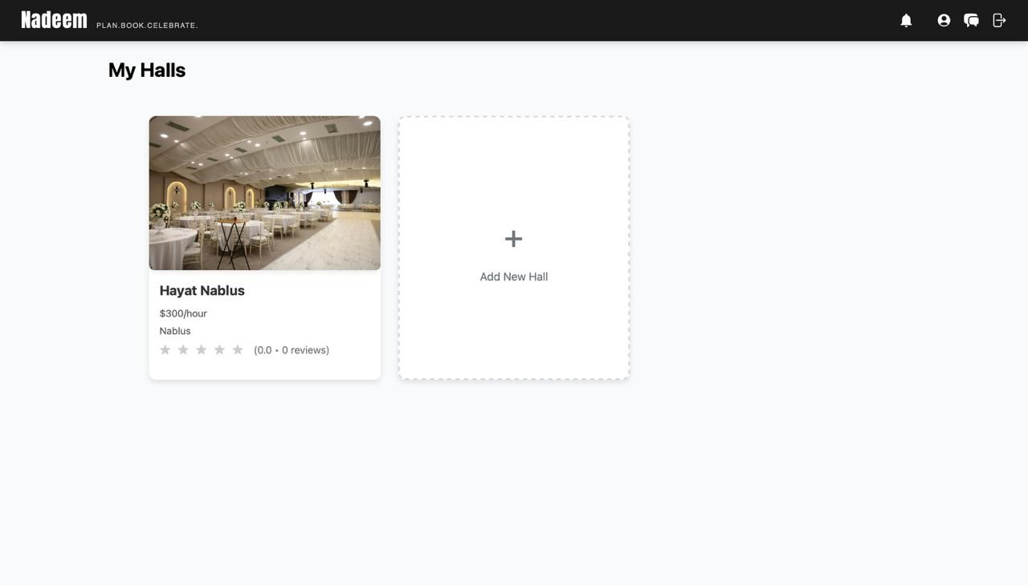
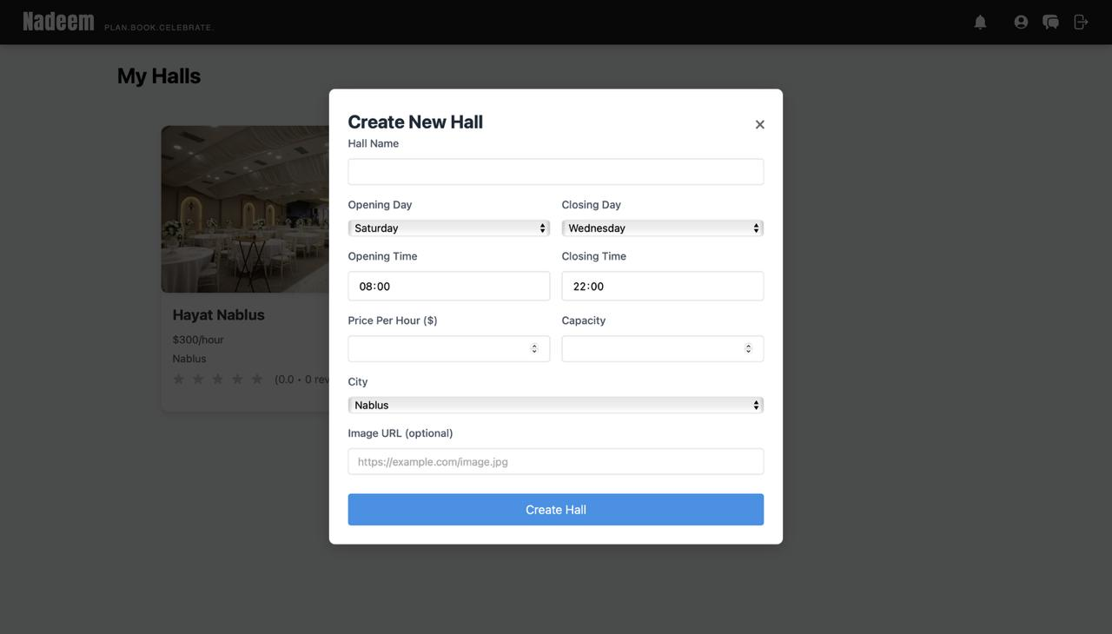
Log in as Owner
When I log in using the owner account , it will show the hall that registered previously and can check some of my hall's information and details also can add a new hall

Slide 13
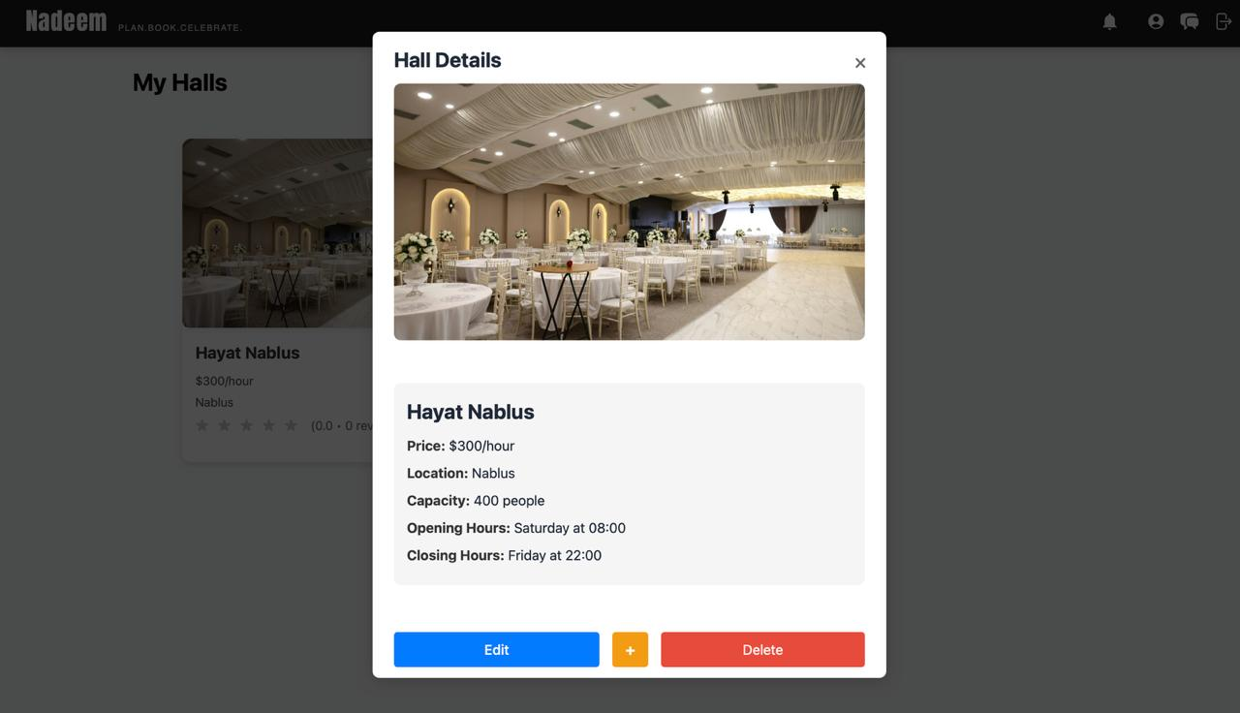
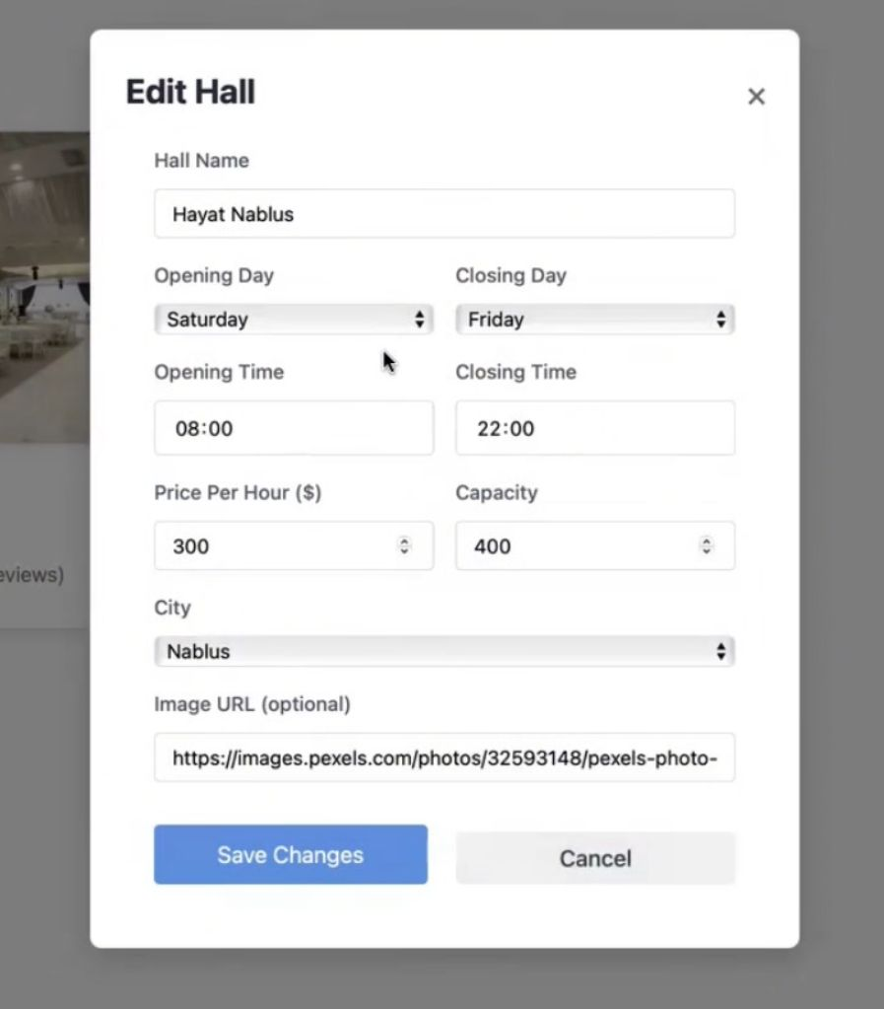
Log in as Owner

Slide 14
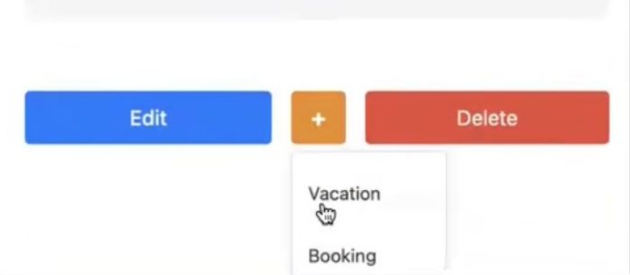
Log in as Owner

Slide 15
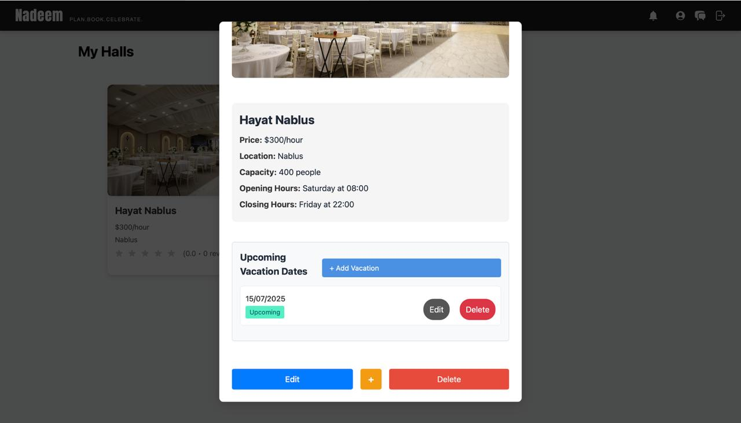
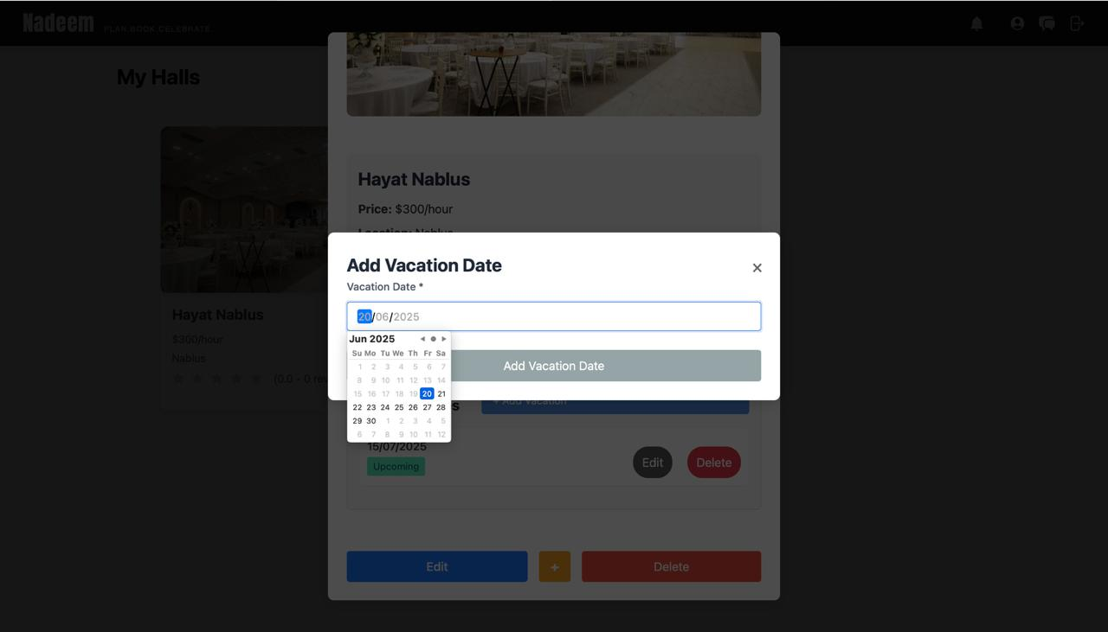
Log in as Owner ( add new vacation)

Slide 16
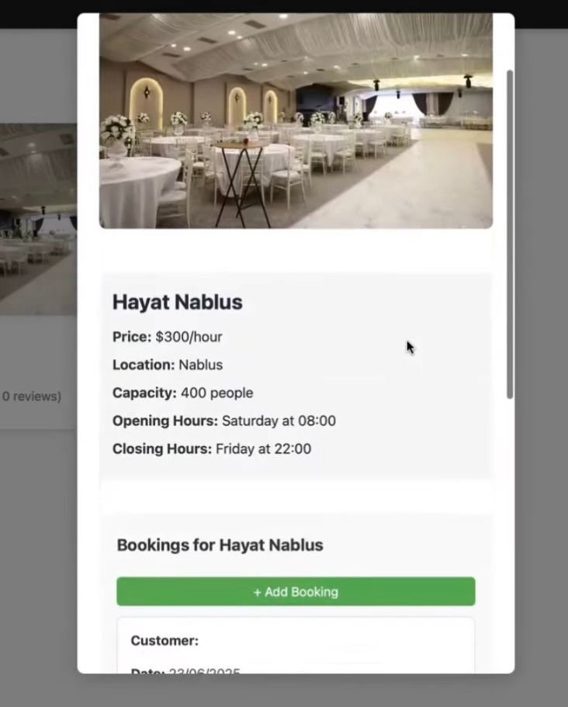
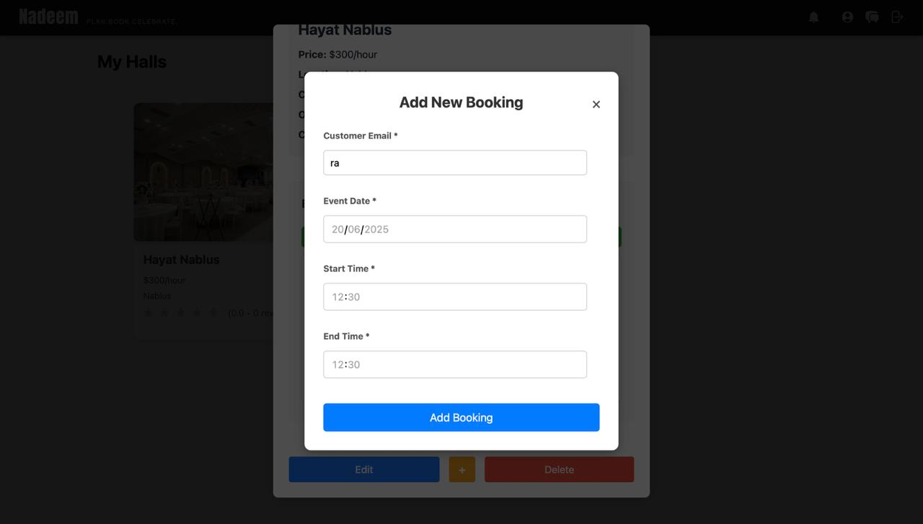
Log in as Owner ( add new booking )

Slide 17
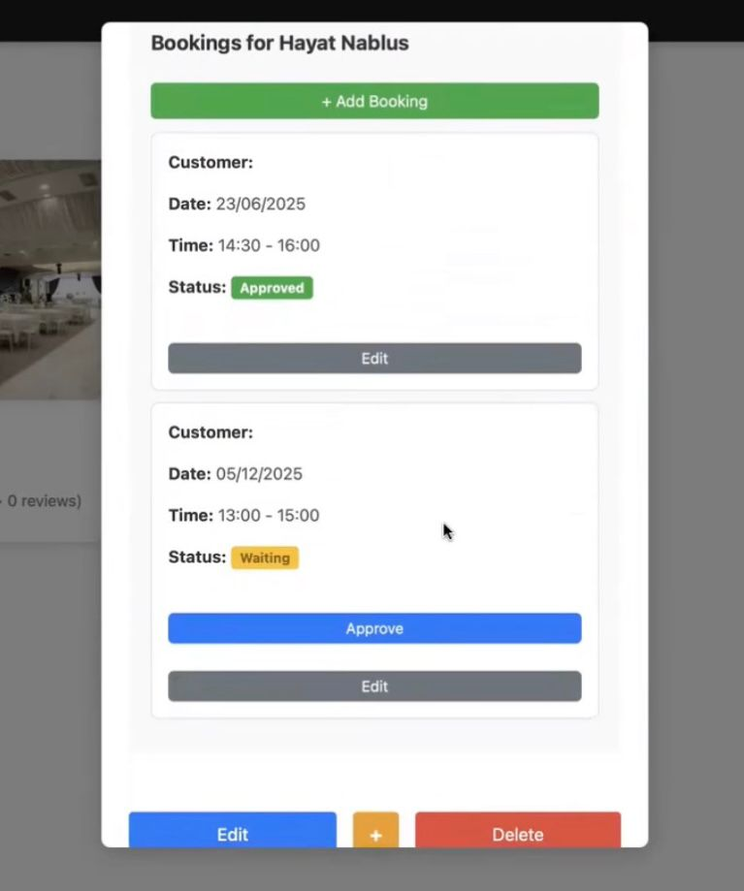
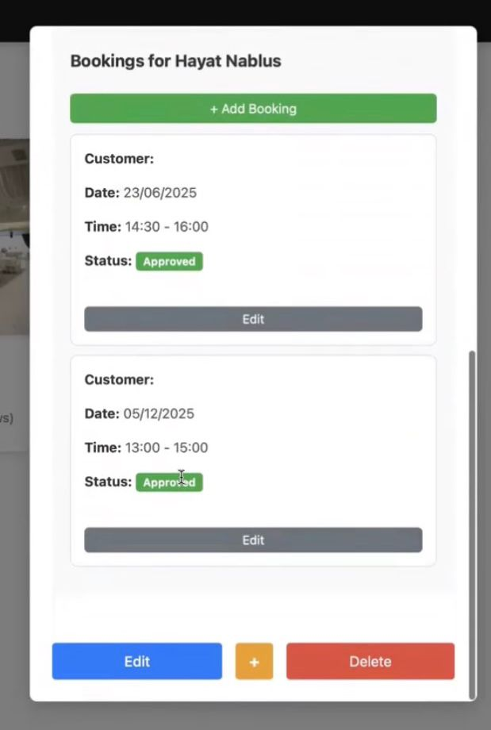
Log in as Owner ( add new booking )

Slide 18
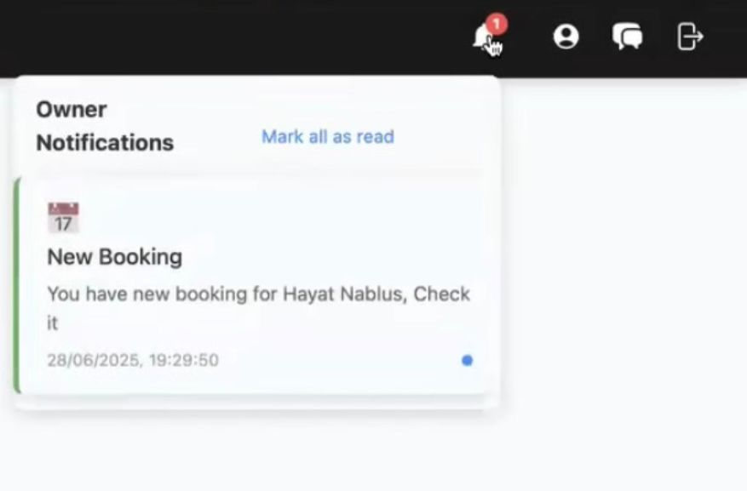
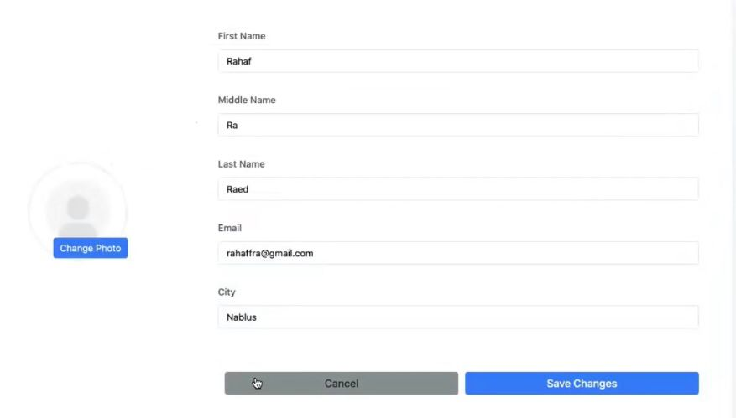
Log in as Owner

Slide 19
Log in as Third party
Catering
Music/DJ
Event Planning
Photography
Decoration

Slide 20
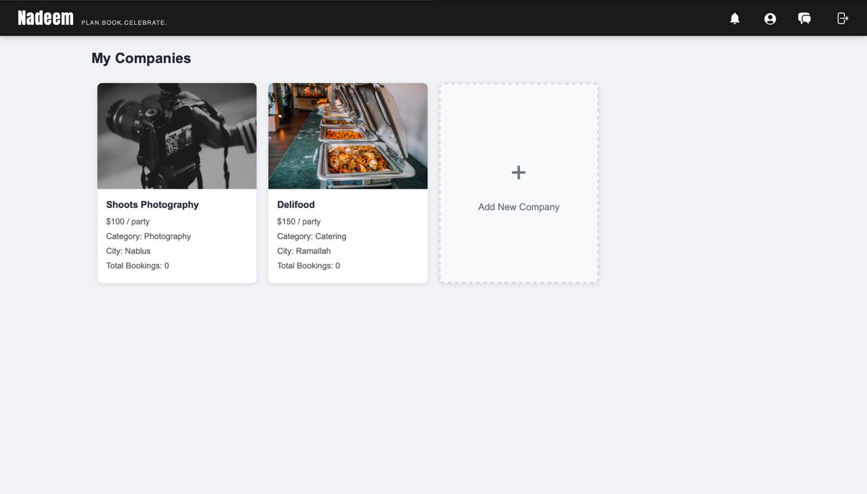
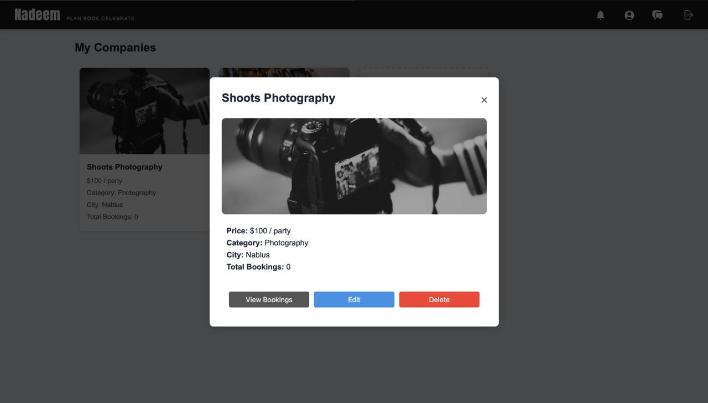
Log in as Third party

Slide 21
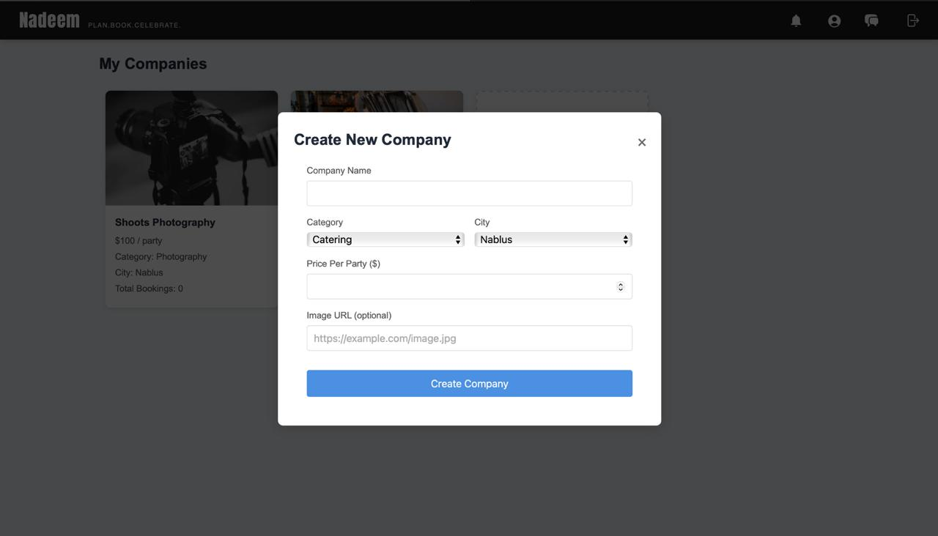
Log in as Third party ( create new company)

Slide 22
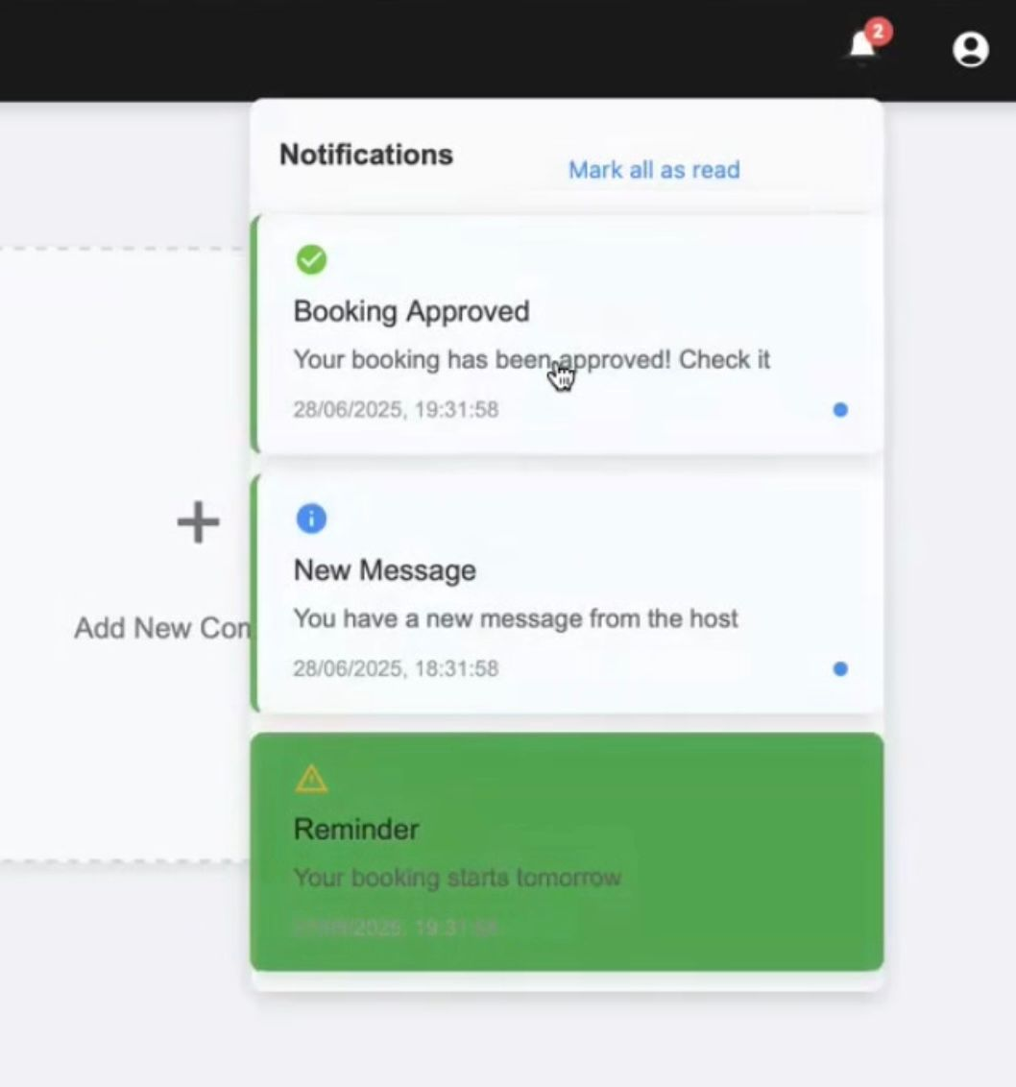
Log in as Third party ( notification)

Slide 23
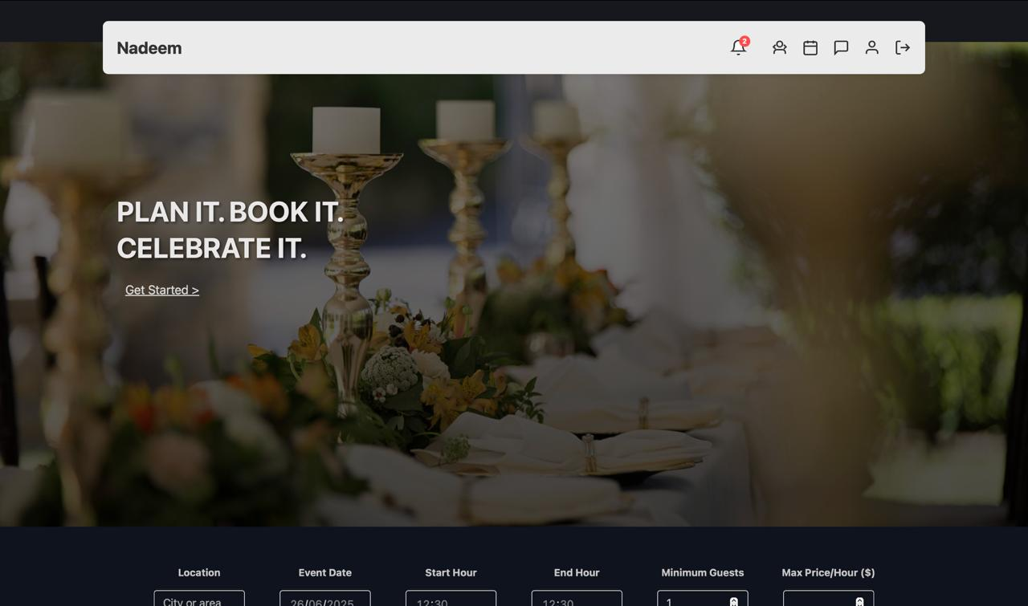
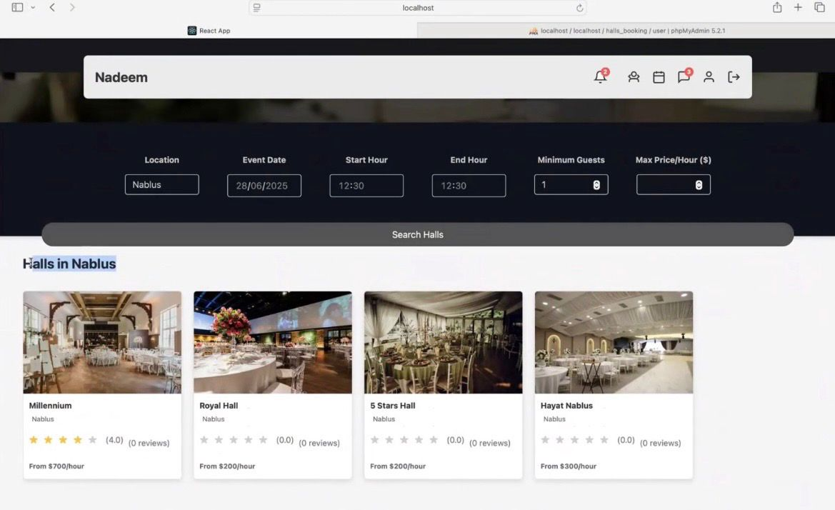
Log in as customer
we can specify the location of the event and the date, maximum price per hour, and minimum number of guests.

Slide 24
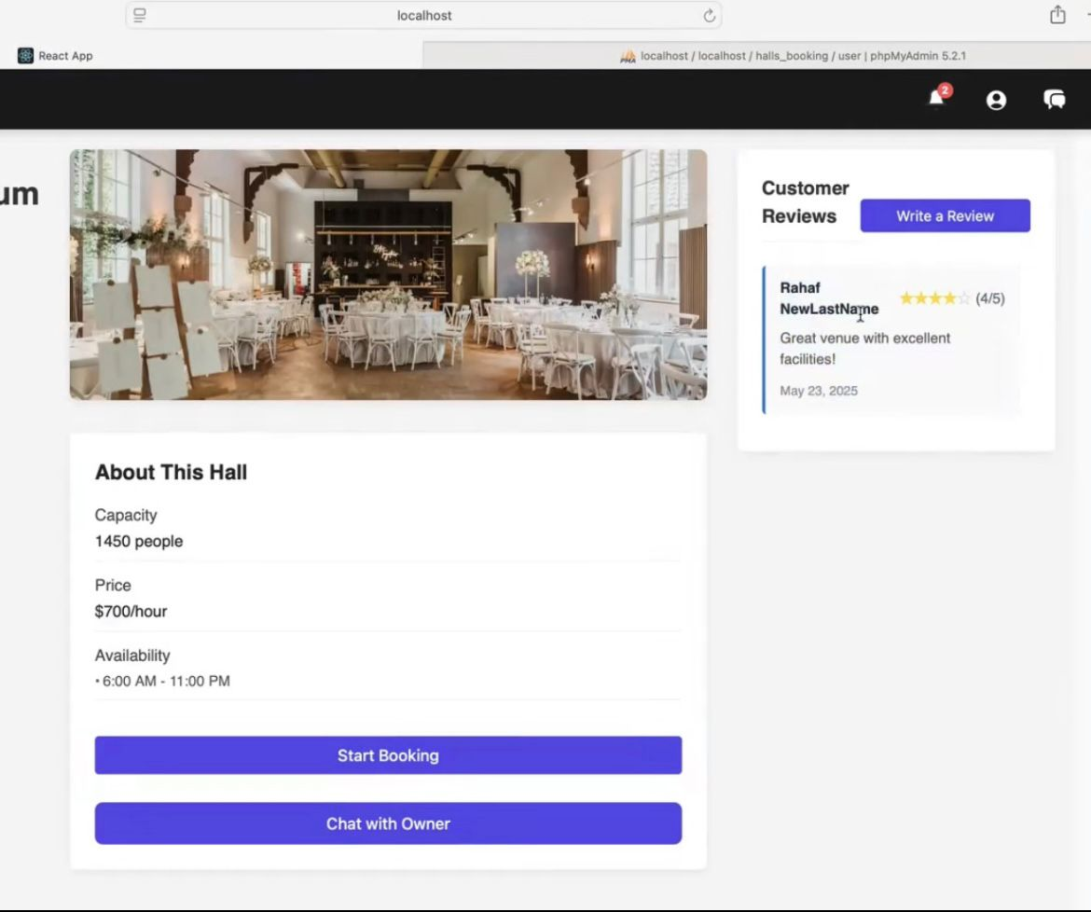
Log in as customer

Slide 25
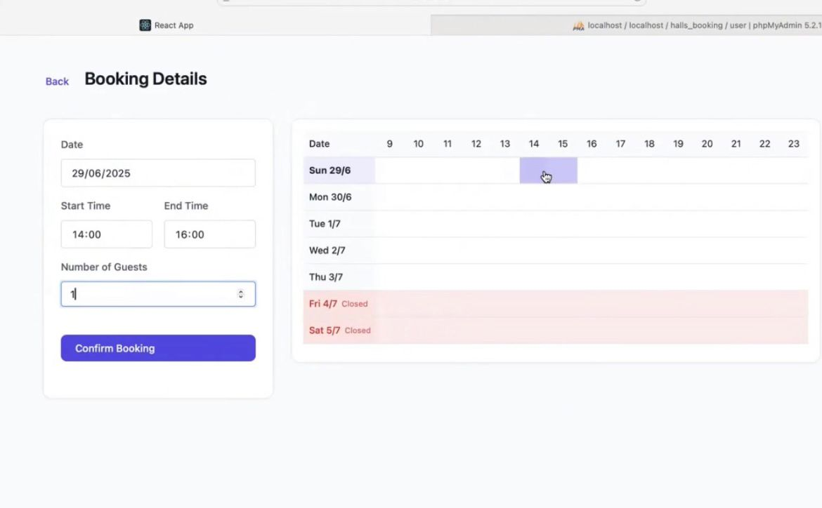
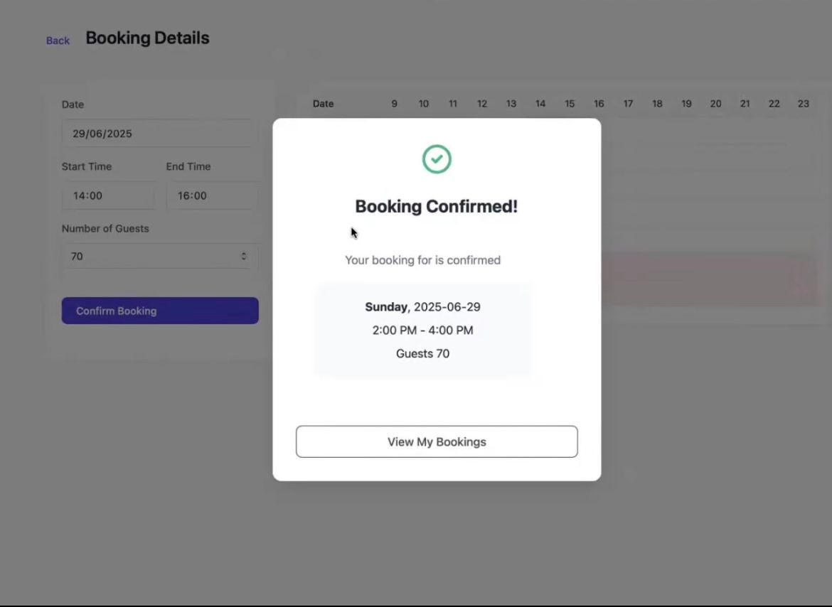
Log in as customer

Slide 26
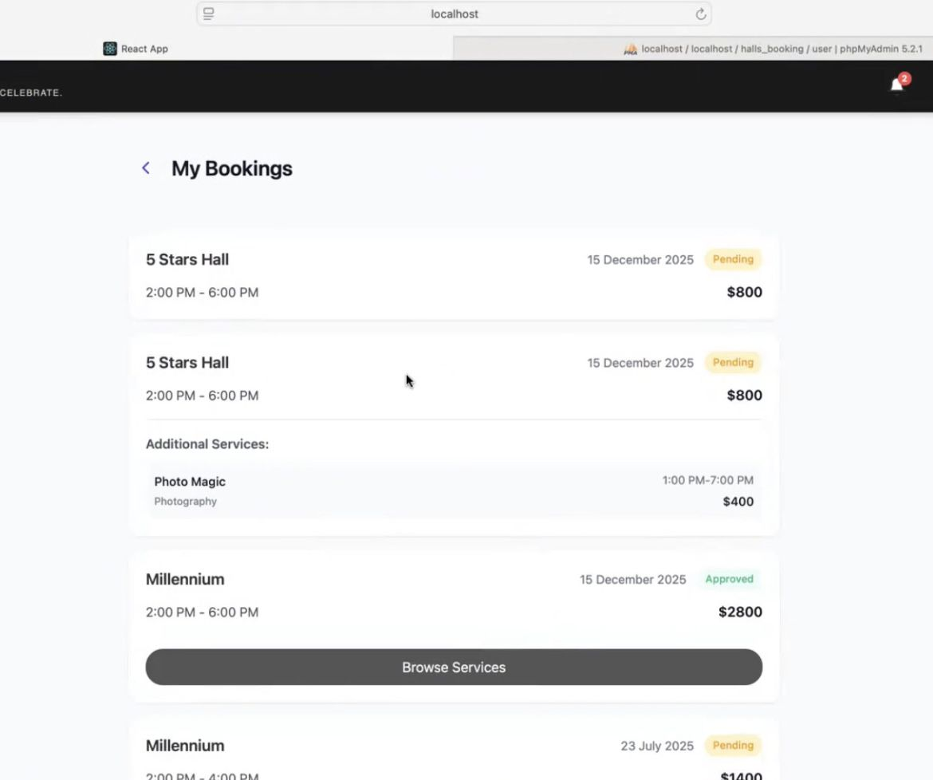
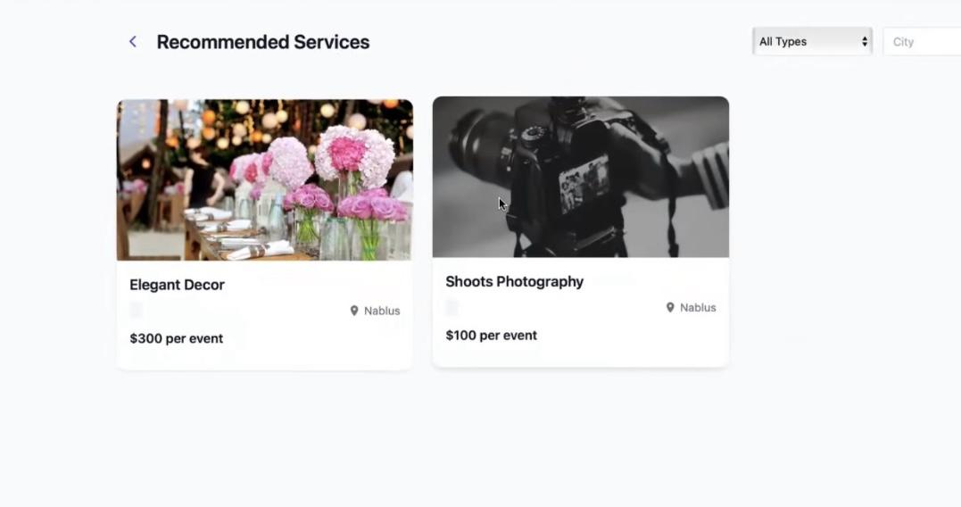
Log in as customer

Slide 27
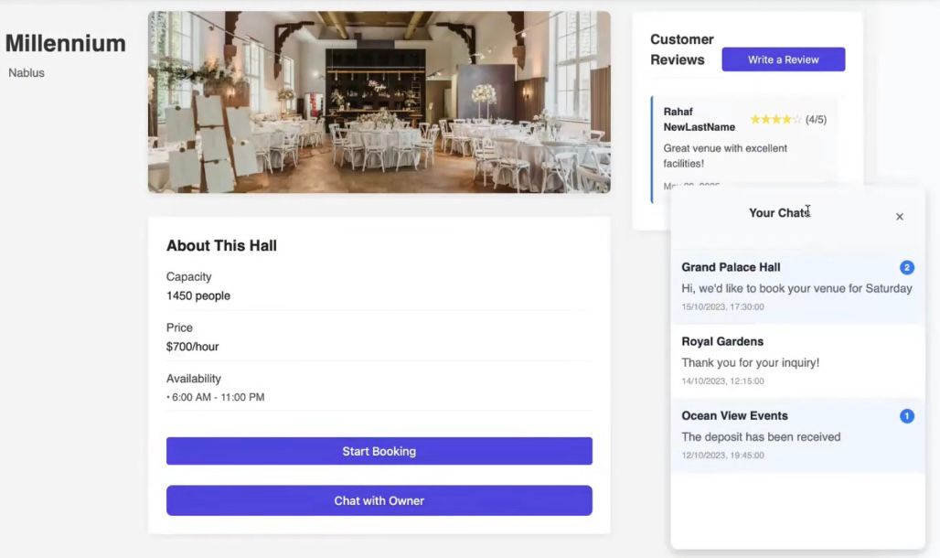
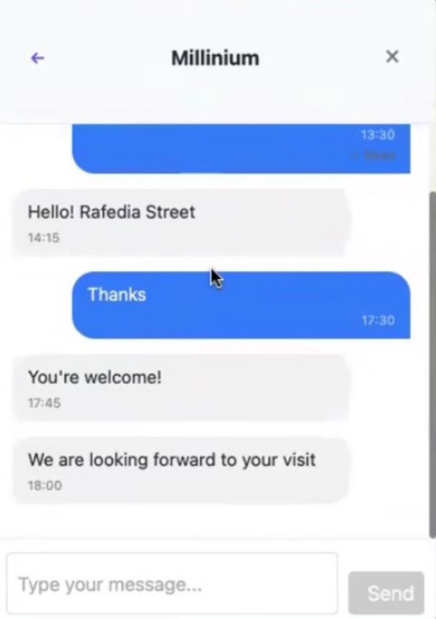
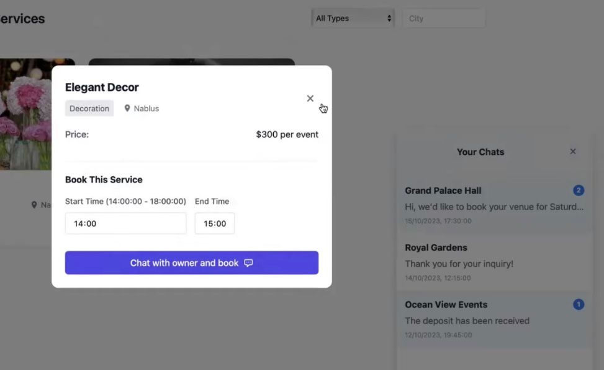
Log in as customer

Slide 28
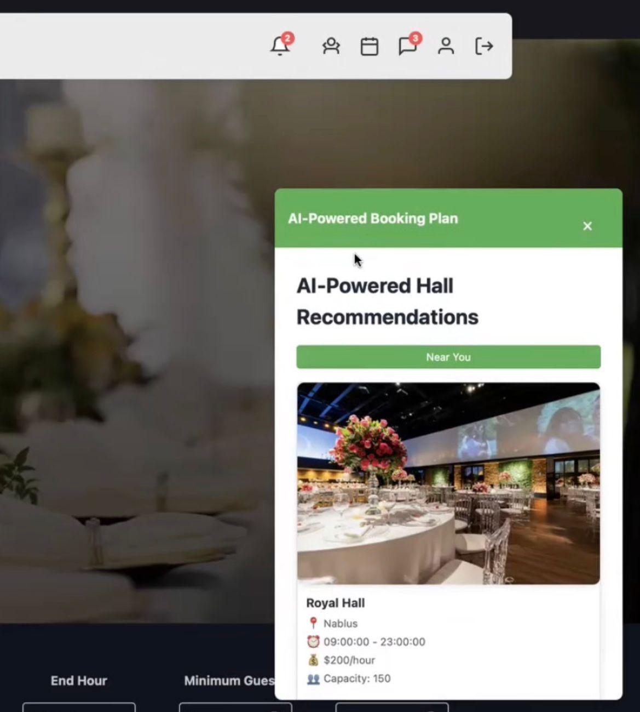
AI recommendations

Slide 29
Future Work
Attach Google maps to the application
Multi language support
add new payment methods

Slide 30
Conclusion

Slide 31
Thank you

