Slide 1
Quantity Survey and Cost Estimate for the building of the Municipality of Aqraba
Naden Maqboul
Mohammad Tbeleh
Qais Najjar

Slide 2
INTRODUCTION
Any construction organization must have a strategic plan and vision that lead them to achieve its goals. Projects in general is the stage that determines the requirements and funds of the stakeholder, and the development of appropriate solutions and designs that satisfy them.
A project is a set of activities and their associated information that constitutes a plan for creating a product or service.

Slide 3
The Project Life Cycle
Initiation Phase
Planning Phase
Implementation (Execution) Phase
Closing Phase

Slide 4
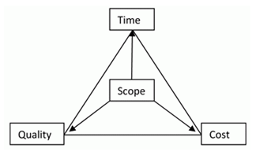
Project Management
Project management is a process that includes planning, putting the project plan into action and measuring progress and performance.
Function of Management:
Planning.
Organizing.
Directing.
Controlling.

Slide 5

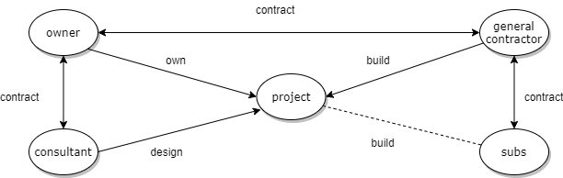


The Three Key Participants of Any Project Are:
Owner
Consultant
Contractor

Slide 6
Delivery System
Project delivery systems refer to the overall processes by which a project is designed, constructed, and/or maintained.
Traditional contract method (Design Bid Build)
Design-build method
Self-performance method
Professional construction management method (PCM)
Separate contracts method (owner as general contractor)

Slide 7
Construction Contract
Formal agreement for construction, alteration, or repair of buildings or structures. A construction contract is distinct from a contract to assemble, fabricate, or manufacture.
Types of Contract
Lump sum.
Unit price.
Cost plus fee.
Guaranteed Maximum Price (GMP).

Slide 8
Quantity Surveying
Work Break Down Structure
Is a key project deliverable that organizes the team's work into manageable sections also it is a hierarchical decomposition of the total scope of work to be carried out by the project team to accomplish the project objectives and create the required deliverables

Slide 9
Importance of Quantity Survey.
Costing
Quantities
Variation

Slide 10
Project Description
Aqraba is located 18 kilometers southeast of Nablus city in the northern West Bank.
The building of Aqraba municipality which has an area of 500 SM for each floor , it consist from two floors. And it contains many offices and rooms.

Slide 11
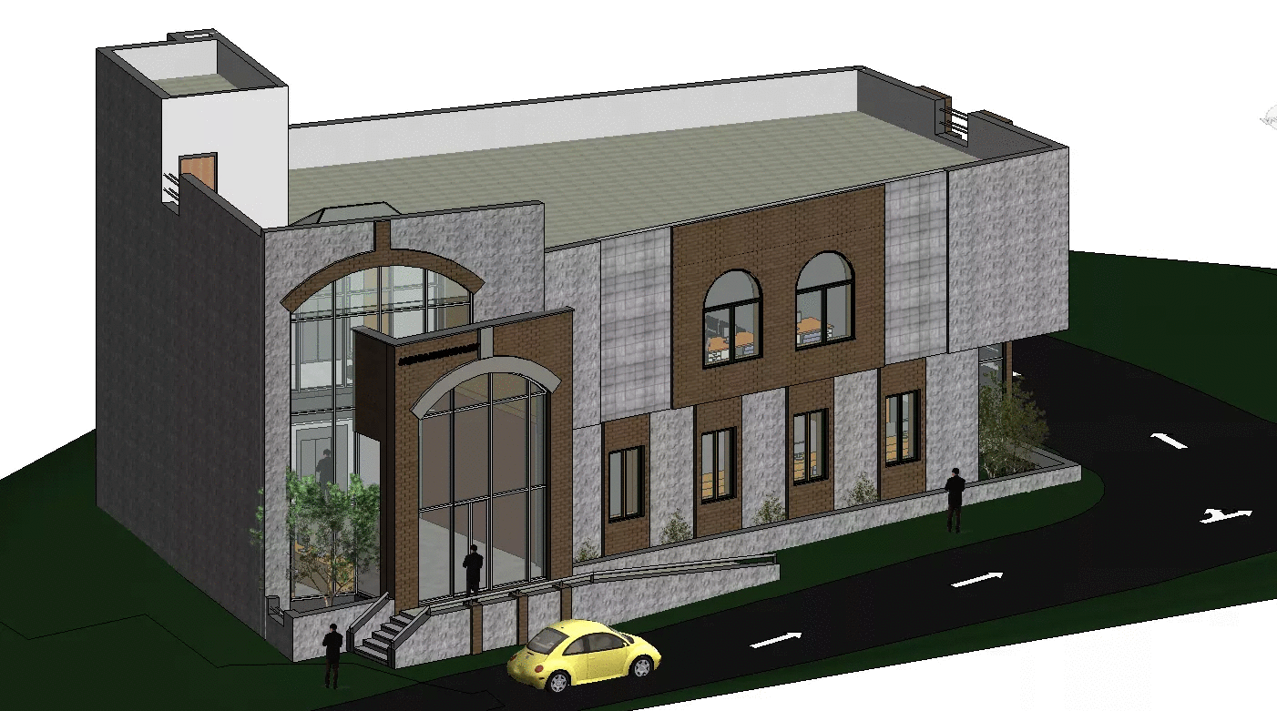

Slide 12
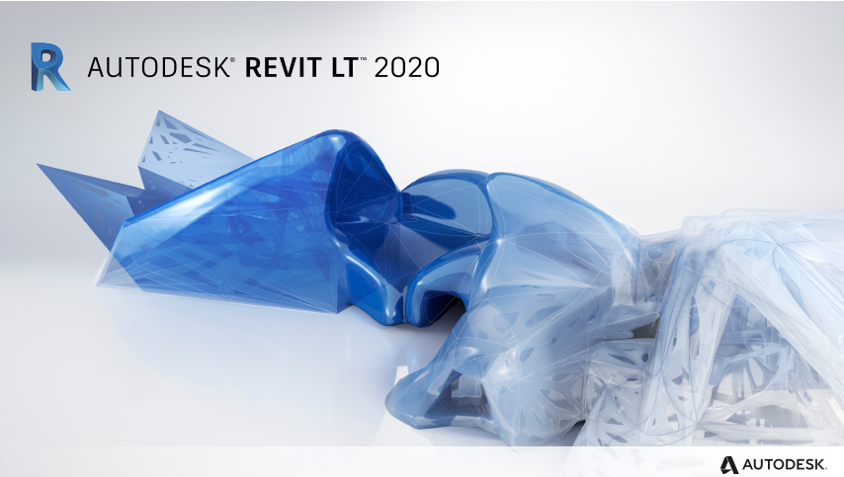
Revit is a comprehensive software and workflow product from Autodesk that helps architects, designers, builders and construction professionals work together.

Slide 13
How we use Revit software in our project?
We draw 3D model for the entire project.
We draw sections and facades.
We calculate architectural quantities.

Slide 14
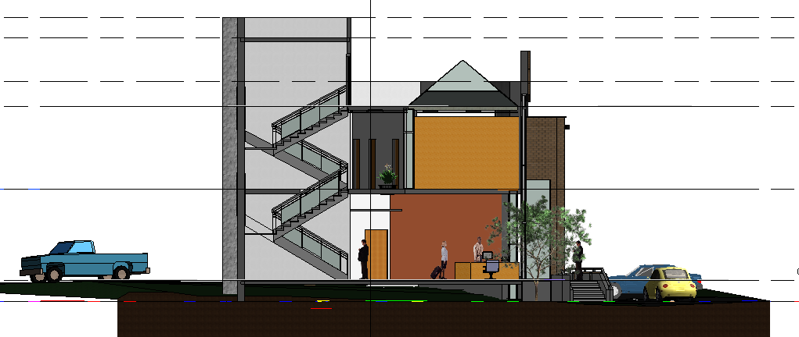

Slide 15

Hand Calculations
1.We calculate the concrete volumes using the equation (Length*Width*Depth).
2.We calculate the steel quantities using the general equation is (diaˆ2 * L* No of Bars/162).

Slide 16
Calculations:
There is some examples how we calculate the Quantities?
Concrete for Foundation
Foundation | Number | Length | Width | Depth | Volume
F1 | 2 | 2.00 | 1.70 | 0.50 | 3.40
F2 | 3 | 2.35 | 2.35 | 0.50 | 8.28
F3 | 1 | 1.75 | 1.75 | 0.50 | 1.53
F4 | 3 | 2.80 | 2.80 | 0.60 | 14.11
F5 | 1 | 2.30 | 1.60 | 0.50 | 1.84
F6 | 1 | 3.00 | 2.00 | 0.50 | 3.00
F7 | 1 | 2.40 | 1.80 | 0.50 | 2.16
F8 | 1 | 3.20 | 2.00 | 0.50 | 3.20
F9 | 1 | 4.00 | 2.80 | 0.55 | 6.16
Section A-A | 1 | 3.20 | 3.20 | 0.50 | 5.12
Section B-B | 1 | 7.55 | 1.20 | 0.50 | 4.53
Section C-C | 1 | 4.60 | 1.20 | 0.50 | 2.76
 |  |  |  | Sum | 56.10

Slide 17
Concrete for Blinding
Footing | Number | Length | Width | Depth | Volume
F1 | 2 | 2.20 | 1.90 | 0.10 | 0.84
F2 | 3 | 2.55 | 2.55 | 0.10 | 1.95
F3 | 1 | 1.95 | 1.95 | 0.10 | 0.38
F4 | 3 | 3.00 | 3.00 | 0.10 | 2.70
F5 | 1 | 2.50 | 1.80 | 0.10 | 0.45
F6 | 1 | 3.20 | 2.20 | 0.10 | 0.70
F7 | 1 | 2.60 | 2.00 | 0.10 | 0.52
F8 | 1 | 3.40 | 2.20 | 0.10 | 0.75
F9 | 1 | 4.20 | 3.00 | 0.10 | 1.26
Section A-A | 1 | 3.40 | 3.40 | 0.10 | 1.16
Section B-B | 1 | 7.75 | 1.40 | 0.10 | 1.09
Section C-C | 1 | 4.80 | 1.40 | 0.10 | 0.67
 |  |  |  | Sum | 12.46

Slide 18
Reinforcement for Footing
Footing | Number of Footing | Number of Bar | Length | Density | Weight | Steel
F1 | 2 | 4 | 2.40 | 1.21 | 23.23 | Top long direction
 | 2 | 12 | 2.40 | 1.21 | 69.69 | Bottom long direction
 | 2 | 4 | 2.10 | 1.21 | 20.33 | Top short direction
 | 2 | 13 | 2.10 | 1.21 | 66.06 | Bottom short direction
F2 | 3 | 4 | 2.75 | 1.21 | 39.93 | Top long direction
 | 3 | 17 | 2.75 | 1.21 | 169.69 | Bottom long direction
 | 3 | 4 | 2.75 | 1.21 | 39.93 | Top short direction
 | 3 | 17 | 2.75 | 1.21 | 169.69 | Bottom short direction
F3 | 1 | 4 | 2.15 | 1.21 | 10.40 | Top long direction
 | 1 | 12 | 2.15 | 1.21 | 31.21 | Bottom long direction
 | 1 | 4 | 2.15 | 1.21 | 10.40 | Top short direction
 | 1 | 12 | 2.15 | 1.21 | 31.21 | Bottom short direction
F4 | 3 | 4 | 3.20 | 1.21 | 46.46 | Top long direction
 | 3 | 22 | 3.20 | 1.21 | 255.53 | Bottom long direction
 | 3 | 4 | 3.20 | 1.21 | 46.46 | Top short direction
 | 3 | 22 | 3.20 | 1.21 | 255.53 | Bottom short direction
F5 | 1 | 4 | 2.70 | 1.21 | 13.07 | Top long direction
 | 1 | 11 | 2.70 | 1.21 | 35.93 | Bottom long direction
 | 1 | 4 | 2.00 | 1.21 | 9.68 | Top short direction
 | 1 | 15 | 2.00 | 1.21 | 36.30 | Bottom short direction
F6 | 1 | 4 | 3.40 | 1.21 | 16.45 | Top long direction
 | 1 | 13 | 3.40 | 1.21 | 53.48 | Bottom long direction
 | 1 | 4 | 2.40 | 1.21 | 11.61 | Top short direction
 | 1 | 20 | 2.40 | 1.21 | 58.07 | Bottom short direction
F7 | 1 | 4 | 2.80 | 1.21 | 13.55 | Top long direction
 | 1 | 12 | 2.80 | 1.21 | 40.65 | Bottom long direction
 | 1 | 4 | 2.20 | 1.21 | 10.65 | Top short direction
 | 1 | 16 | 2.20 | 1.21 | 42.59 | Bottom short direction
F8 | 1 | 17 | 3.60 | 1.58 | 96.71 | Top long direction
 | 1 | 17 | 3.60 | 1.58 | 96.71 | Bottom long direction
 | 1 | 26 | 2.40 | 1.21 | 75.50 | Top short direction
 | 1 | 26 | 2.40 | 1.58 | 98.61 | Bottom short direction
F9 | 1 | 26 | 4.40 | 1.58 | 180.78 | Top long direction
 | 1 | 26 | 4.40 | 1.58 | 180.78 | Bottom long direction
 | 1 | 36 | 3.20 | 1.21 | 139.38 | Top short direction
 | 1 | 36 | 3.20 | 1.58 | 182.04 | Bottom short direction
Section A-A | 1 | 20 | 3.60 | 1.21 | 87.11 | Top long direction
 | 1 | 20 | 3.60 | 1.21 | 87.11 | Bottom long direction
 | 1 | 20 | 3.60 | 1.21 | 87.11 | Top short direction
 | 1 | 20 | 3.60 | 1.21 | 87.11 | Bottom short direction
Section B-B | 1 | 4 | 2.36 | 0.89 | 8.39 | Top long direction
 | 1 | 10 | 2.36 | 0.89 | 20.98 | Bottom long direction
 | 1 | 12 | 1.60 | 0.89 | 17.07 | Top short direction
 | 1 | 12 | 1.60 | 1.58 | 30.34 | Bottom short direction
Section B-B | 1 | 4 | 6.05 | 0.89 | 21.51 | Top long direction
 | 1 | 10 | 6.05 | 0.89 | 53.78 | Bottom long direction
 | 1 | 34 | 1.60 | 0.89 | 48.36 | Top short direction
 | 1 | 34 | 1.60 | 1.58 | 85.97 | Bottom short direction
Section C-C | 1 | 4 | 1.78 | 0.89 | 6.33 | Top long direction
 | 1 | 10 | 1.78 | 0.89 | 15.82 | Bottom long direction
 | 1 | 9 | 1.60 | 0.89 | 12.80 | Top short direction
 | 1 | 9 | 1.60 | 1.58 | 22.76 | Bottom short direction
Section C-C | 1 | 4 | 1.97 | 0.89 | 7.00 | Top long direction
 | 1 | 10 | 1.97 | 0.89 | 17.51 | Bottom long direction
 | 1 | 10 | 1.60 | 0.89 | 14.22 | Top short direction
 | 1 | 10 | 1.60 | 1.58 | 25.28 | Bottom short direction
Section C-C | 1 | 4 | 2.30 | 0.89 | 8.18 | Top long direction
 | 1 | 10 | 2.30 | 0.89 | 20.44 | Bottom long direction
 | 1 | 12 | 1.60 | 0.89 | 17.07 | Top short direction
 | 1 | 12 | 1.60 | 1.58 | 30.34 | Bottom short direction
Section C-C | 1 | 4 | 1.78 | 0.89 | 6.33 | Top long direction
 | 1 | 10 | 1.78 | 0.89 | 15.82 | Bottom long direction
 | 1 | 9 | 1.60 | 0.89 | 12.80 | Top short direction
 | 1 | 9 | 1.60 | 1.58 | 22.76 | Bottom short direction
 |  |  |  | Sum | 3568.57

Slide 19
Formwork for Footing
Footing | Number | Length | Width | Depth | Area
F1 | 2 | 2.00 | 1.70 | 0.50 | 7.40
F2 | 3 | 2.35 | 2.35 | 0.50 | 14.10
F3 | 1 | 1.75 | 1.75 | 0.50 | 3.50
F4 | 3 | 2.80 | 2.80 | 0.60 | 20.16
F5 | 1 | 2.30 | 1.60 | 0.50 | 3.90
F6 | 1 | 3.00 | 2.00 | 0.50 | 5.00
F7 | 1 | 2.40 | 1.80 | 0.50 | 4.20
F8 | 1 | 3.20 | 2.00 | 0.50 | 5.20
F9 | 1 | 4.00 | 2.80 | 0.55 | 7.48
Section A-A | 1 | 3.20 | 3.20 | 0.50 | 6.40
Section B-B | 1 | 7.55 | 1.20 | 0.50 | 8.75
Section C-C | 1 | 4.60 | 1.20 | 0.50 | 5.80
 |  |  |  | Sum | 91.89
Footing
Formwork | SM | 91.89
Steel | Ton | 3.569
Concrete | CM | 56.10
Blinding Concrete | CM | 12.46

Slide 20
Concrete for Columns for Basement Floor
Column | Number | Length | Width | Depth | Volume
C1 | 2.00 | 0.50 | 0.25 | 3.64 | 0.91
C2 | 7.00 | 0.40 | 0.40 | 3.64 | 4.08
C3 | 4.00 | 0.50 | 0.50 | 3.64 | 3.64
C4 | 1.00 | 1.10 | 0.30 | 3.64 | 1.20
C5 | 1.00 | 0.25 | 1.40 | 3.64 | 1.27
C6 | 1.00 | 0.80 | 0.25 | 3.64 | 0.73
SW1 | 1.00 | 0.20 | 14.70 | 3.64 | 10.70
SW2 | 1.00 | 0.25 | 5.95 | 3.64 | 5.41
 |  |  |  | Sum | 27.95

Slide 21
Reinforcement for Columns for Basement Floor
Column | Number of Column | Number of Bar | Length | Density | Weight | Steel
C1 | 2 | 10 | 4.55 | 1.21 | 110.10 | Main Steel
 | 2 | 24 | 1.46 | 0.62 | 43.80 | Dense Stirrup
 | 2 | 8 | 1.46 | 0.62 | 14.58 | Not dense stirrup
C2 | 7 | 14 | 4.55 | 1.58 | 704.63 | Main Steel
 | 7 | 24 | 1.56 | 0.62 | 163.80 | Dense stirrup 1
 | 7 | 8 | 1.56 | 0.62 | 54.51 | Not dense stirrup 1
 | 7 | 24 | 1.26 | 0.62 | 132.30 | Dense Stirrup 2
 | 7 | 8 | 1.26 | 0.62 | 44.03 | Not dense stirrup 2
C3 | 4 | 20 | 4.55 | 1.21 | 440.40 | Main Steel
 | 4 | 24 | 1.96 | 0.62 | 117.60 | Dense stirrup 1
 | 4 | 8 | 1.96 | 0.62 | 39.14 | Not dense stirrup 1
 | 4 | 24 | 1.3 | 0.62 | 78.00 | Dense Stirrup 2
 | 4 | 8 | 1.3 | 0.62 | 25.96 | Not dense stirrup 2
C4 | 1 | 22 | 4.55 | 1.21 | 121.11 | Main Steel
 | 1 | 24 | 1.84 | 0.62 | 27.60 | Dense stirrup 1
 | 1 | 8 | 1.84 | 0.62 | 9.18 | Not dense stirrup 1
 | 1 | 24 | 1.806 | 0.62 | 27.09 | Dense Stirrup 2
 | 1 | 8 | 1.806 | 0.62 | 9.02 | Not dense stirrup 2
 | 1 | 24 | 1.93 | 0.62 | 28.95 | Dense Stirrup 3
 | 1 | 8 | 1.93 | 0.62 | 9.63 | Not dense stirrup 3
C5 | 1 | 28 | 4.55 | 1.21 | 154.14 | Main Steel
 | 1 | 24 | 2.18 | 0.62 | 32.70 | Dense stirrup 1
 | 1 | 8 | 2.18 | 0.62 | 10.88 | Not dense stirrup 1
 | 1 | 24 | 2.18 | 0.62 | 32.70 | Dense Stirrup 2
 | 1 | 8 | 2.18 | 0.62 | 10.88 | Not dense stirrup 2
 | 1 | 24 | 1.93 | 0.62 | 28.95 | Dense Stirrup 3
 | 1 | 8 | 1.93 | 0.62 | 9.63 | Not dense stirrup 3
C6 | 1 | 14 | 4.55 | 1.58 | 100.66 | Main Steel
 | 1 | 24 | 2.14 | 0.62 | 32.10 | Dense stirrup 1
 | 1 | 8 | 2.14 | 0.62 | 10.68 | Not dense stirrup 1
 | 1 | 24 | 2.04 | 0.62 | 30.60 | Dense Stirrup 2
 | 1 | 8 | 2.04 | 0.62 | 10.18 | Not dense stirrup 2
SW1 | 1 | 177 | 4.55 | 1.21 | 974.37 | Vertical
 | 1 | 46 | 14.70 | 0.89 | 601.07 | Horizontal
SW2 | 1 | 72 | 4.55 | 1.21 | 396.36 | Vertical
 | 1 | 46 | 5.95 | 0.89 | 243.29 | Horizontal
 |  |  |  | Sum | 4880.61

Slide 22
Formwork for Columns for Basement Floor
Column | Number | Length | Width | Depth | Area
C1 | 2.00 | 0.50 | 0.25 | 3.64 | 10.92
C2 | 7.00 | 0.40 | 0.40 | 3.64 | 40.77
C3 | 4.00 | 0.50 | 0.50 | 3.64 | 29.12
C4 | 1.00 | 1.10 | 0.30 | 3.64 | 10.19
C5 | 1.00 | 0.25 | 0.80 | 3.64 | 7.64
C6 | 1.00 | 0.80 | 0.25 | 3.64 | 7.64
SW1 | 1.00 | 0.20 | 14.70 | 3.64 | 108.47
SW2 | 1.00 | 0.25 | 5.95 | 3.64 | 45.14
 |  |  |  | Sum | 259.90
Columns
Formwork | SM | 568.15
Steel | Ton | 5.516
Concrete | CM | 59.42

Slide 23
Reinforcement and Stirrups for Beams for Basement and Ground Floor
Beams | Number of Beam | Length | Number of Bar | Density | Weight | Steel
B1 | 2 | 3.58 | 3 | 0.889 | 19.11 | Top
 | 2 | 2.85 | 3 | 1.210 | 20.69 | Bottom
 | 2 | 1.56 | 6 | 0.617 | 12.04 | Stirrups 1
 | 2 | 1.56 | 11 | 0.617 | 20.54 | Stirrups 2
B1 | 2 | 3.40 | 3 | 0.889 | 18.13 | Top
 | 2 | 2.80 | 3 | 1.210 | 20.33 | Bottom
 | 2 | 1.56 | 6 | 0.617 | 11.56 | Stirrups 1
 | 2 | 1.56 | 11 | 0.617 | 20.54 | Stirrups 2
B1 | 2 | 4.00 | 3 | 0.889 | 21.33 | Top
 | 2 | 1.80 | 3 | 1.210 | 13.07 | Bottom
 | 2 | 1.56 | 4 | 0.617 | 7.70 | Stirrups 1
 | 2 | 1.56 | 7 | 0.617 | 12.84 | Stirrups 2
B2 | 2 | 7.30 | 5 | 1.210 | 88.32 | Top
 | 2 | 5.25 | 4 | 0.889 | 37.33 | Middle
 | 2 | 5.25 | 5 | 1.210 | 63.52 | Bottom
 | 2 | 1.76 | 11 | 0.617 | 24.44 | Stirrups 1
 | 2 | 1.48 | 11 | 0.617 | 20.56 | Stirrups 2
 | 2 | 1.76 | 20 | 0.617 | 43.46 | Stirrups 1
 | 2 | 1.48 | 20 | 0.617 | 36.54 | Stirrups 2
B3 | 2 | 9.27 | 4 | 1.210 | 89.69 | Top
 | 2 | 6.15 | 4 | 0.889 | 43.73 | Middle
 | 2 | 6.15 | 5 | 1.580 | 97.19 | Bottom
 | 2 | 1.76 | 19 | 0.617 | 40.74 | Stirrups 1
 | 2 | 1.48 | 19 | 0.617 | 34.26 | Stirrups 2
 | 2 | 1.76 | 16 | 0.617 | 34.77 | Stirrups 1
 | 2 | 1.48 | 16 | 0.617 | 29.23 | Stirrups 2
B4 | 2 | 8.11 | 6 | 1.210 | 117.75 | Top
 | 2 | 6.06 | 4 | 0.889 | 43.09 | Middle
 | 2 | 6.06 | 6 | 1.580 | 114.92 | Bottom
 | 2 | 1.76 | 18 | 0.617 | 39.76 | Stirrups 1
 | 2 | 1.48 | 18 | 0.617 | 33.44 | Stirrups 2
 | 2 | 1.76 | 16 | 0.617 | 34.77 | Stirrups 1
 | 2 | 1.48 | 16 | 0.617 | 29.23 | Stirrups 2

Slide 24
Concrete for Basement Floor Slab
Area | Depth | Volume
215.81 | 0.16 | 34.53
Concrete for Drop Beams for Basement Floor
Beam | Length | Width | Depth | Volume
B2 | 5.25 | 0.6 | 0.34 | 1.07
B3 | 6.15 | 0.6 | 0.44 | 1.62
B4 | 6.06 | 0.6 | 0.44 | 1.60
B17 | 5.65 | 0.6 | 0.44 | 1.49
B17 | 2.90 | 0.6 | 0.44 | 0.77
B22 | 4.95 | 0.4 | 0.44 | 0.87
 |  |  | Sum | 7.42
Beams & Slabs
Formwork | SM | 522.696
Steel | Ton | 10.863
Concrete | CM | 83.91

Slide 25
For Finishing Works
Side | TYPE | Area of side(m²) | Area of opening(m²) | Stone Area(m²)
East | MUFAJAR | 199.9 | 93.079 | 106.821
 | MATABEH | 17.86 | 0 | 17.86
 | TUBZEH | 25.149 | 0 | 25.149
West | MUFAJAR | 212 | 11.332 | 200.668
 | MATABEH | 0 | 0 | 0
 | TUBZEH | 1.941 | 0 | 1.941
North | MUFAJAR | 137.84 | 36.2 | 101.64
 | MATABEH | 9.71 | 0 | 9.71
 | TUBZEH | 9.48 | 0 | 9.48
South | MUFAJAR | 158 | 12.26 | 145.74
 | MATABEH | 5.85 | 0 | 5.85
 | TUBZEH | 5.05 | 0 | 5.05
Stones
Muffajar | SM | 554.87
Matabeh | SM | 33.42
Tubzzeh | SM | 41.62

Slide 26
Here is a table shows all of quantities:
Item Description. | Unit | Quantity
Excavation for Foundation . | CM | 633.66
Backfilling for Foundations and Ground Beams. | CM | 628.64
Supply and Cast Plain Concrete B(200) (10 cm) under Ground Beams and Foundations with a minimum cement content of 250 KG. | CM | 18.59
Supply and Cast Reinforced Concrete B(300) for Stairs and Ramps. | CM | 13.152
Supply and Cast Reinforced Concrete B(300) for Columns Neck. | CM | 24.05
Reinforced Concrete B(250) for Case Stairs. | CM | 3.4
Supply and Cast Reinforced Concrete B(300) for Slabs and Drop Beams without case stairs. | CM | 83.91
Supply and Cast Reinforced Concrete B(300) for Foundations and Ground Beams . | CM | 75.23
Supply and Cast Reinforced Concrete B(300) for Columns and Shear Walls with a minimum cement content of (350 KG). | CM | 59.42
Supply and Cast Reinforced Concrete B(250) with a minimum cement content of (250KG) for Ground Slab. | CM | 24.65
10 , 20 cm Blocks for Internal Walls (partitions). | Number | 3362
15 cm Blocks for Exterior Walls. | Number | 2282
Supply and Build Stone works with different types of stones (Mufajjar, Matabbeh, Tubbzeh). | SM | 629.91
Supply and Install Tiles for floors and stairs , wall tiles for bathroom and kitchen. | SM | 568.4275
Installing works for Windows and Doors wood, steel, glass, aluminum. | SM | 135.1
Supply and Install Marbles for windows and kitchen. | M | 59.95
Painting and Plastering works. | SM | 2384.2

Slide 27
Time Management
Time management is important in any construction project.
Without proper time management, many problems will occur such as extension of time or time overrun.
Delay or time overrun will affect all parties involved in the project.
But due to the time overrun, contractors had to spend more money on labor and may lose the opportunity to get the next project.

Slide 28
Duration:
Forecasting construction duration in a project can be achieved by many means and depends on the stage of construction planning.
Using Primavera in our project:
We divide the project into many activities according to the project sequence, then we forecast the duration for each activity, the relation between activities is finish to start.
After we did that we made calendar of 9-hours per day , and Friday was holiday.
After we run the software , our project duration was 342working days and 409 calendar days.

Slide 29
Delay
It is the amount of the difference among the planned time for the construction project on the actual time of completion.
Types of Delays:
Excusable delays
Non-Excusable Delays
Concurrent delays

Slide 30


Slide 31
Cost and Price Estimate
After we calculate the quantities for the project we multiply the quantities with its unit cost.
The unit cost contains (labor + material).
The direct and indirect cost are calculated.
Making BOQ for the project which will contain the final price for project.

Slide 32
Here an example how to calculate the price:
Direct cost for foundation:
The cost of Foundation Concrete (B300)
Direct Cost= Waste Factor * Concrete Volume * Unit Cost
= 1.1 * 56.1 * 325
= 20060 ILS
The cost of Reinforcement for Foundation
Direct Cost= Waste Factor * Steel Weight * Unit Cost
= 1.057 * 3.569 * 2600
= 9810 ILS
The cost of Formwork for Foundation
Direct Cost= Waste Factor * Area of Formwork * Unit Cost
= 1.25 * 91.89 * 130 * 0.025
= 375 ILS
The cost of labor for Foundation
Direct Cost= Volume * Unit Cost
= 56.1 * 70
= 3930 ILS
The Total Cost for Foundation= 34175 ILS

Slide 33
Indirect cost for foundation:
Assume Job Overhead = 7%
Job overhead cost = 0.07 * 34175 = 2395 ILS
Assume Operating Overhead = 3%
Operating Overhead cost = 0.03 * 36570 = 1100 ILS
Assume profit = 5%
Profit cost = 0.05 * 37670 = 1885 ILS
Total Indirect Cost = 2395 + 1100 + 1885 =5380 ILS
Total Price = Direct cost + Indirect cost = 39555 ILS

Slide 34
Here is BOQ:
Item Description. | Unit | Quantity | Unit Price | Total Price ILS
Excavation for Foundation . | CM | 633.66 | 29 | 18333
Backfilling for Foundations and Ground Beams. | CM | 628.64 | 17 | 10911
Supply and Cast Plain Concrete B(200) (10 cm) under Ground Beams and Foundations with a minimum cement content of 250 KG. | CM | 18.59 | 369 | 6861
Supply and Cast Reinforced Concrete B(300) for Stairs and Ramps. | CM | 13.152 | 1200 | 15781
Supply and Cast Reinforced Concrete B(300) for Columns Neck. | CM | 24.05 | 1357 | 32633
Reinforced Concrete B(250) for Case Stairs. | CM | 3.4 | 567 | 1926
Supply and Cast Reinforced Concrete B(300) for Slabs and Drop Beams without case stairs. | CM | 83.91 | 1341 | 112530
Supply and Cast Reinforced Concrete B(300) for Foundations and Ground Beams . | CM | 75.23 | 756 | 56867
Supply and Cast Reinforced Concrete B(300) for Columns and Shear Walls with a minimum cement content of (350 KG). | CM | 59.42 | 894 | 53106
Supply and Cast Reinforced Concrete B(250) with a minimum cement content of (250KG) for Ground Slab. | CM | 24.65 | 583 | 14376
10 , 20 cm Blocks for Internal Walls (partitions). | Number | 3362 | 6 | 21555
15 cm Blocks for Exterior Walls. | Number | 2282 | 5 | 11379
Supply and Build Stone works with different types of stones (Mufajjar, Matabbeh, Tubbzeh). | SM | 629.91 | 164 | 103222
Supply and Install Tiles for floors and stairs , wall tiles for bathroom and kitchen. | SM | 568.4275 | 61 | 34901
Installing works for Windows and Doors wood, steel, glass, aluminum. | SM | 135.1 | 454 | 61356
Supply and Install Marbles for windows and kitchen. | M | 59.95 | 132 | 7914
Painting and Plastering works. | SM | 2384.2 | 22 | 52690
Total Price |  |  |  | 616450

Slide 35
RESULTS
The total concrete quantity =284 m3
The total steel quantity =29.19 ton
The total cost for project= 616450 ILS
By using primavera the project assumed to begin 1/4/2013 and ends at 14/5/2014.

Slide 36
THANK YOU

