Slide 1
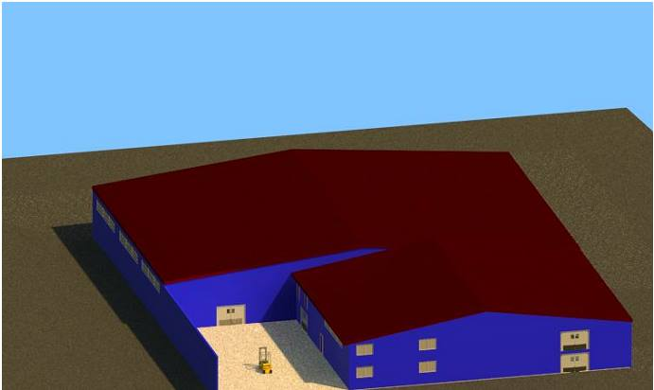
Warehouses Redesign to Al-Zalmout Distribution Co.
Supervisor :
Dr. Ramiz Assaf
Hanan Yamin Hazar Bani-Shamseh
Haneen Rabaya Wafa Zetawi

Slide 2
Outline
introduction
Literature review
Methodology
Results and Recommendation

Slide 3
Introduction
Zalmout Distribution Comp. was established on Nablus as a private company for importing and selling food and food supplies in 1948. It has six main branches distributed on many cities, and employing more than 130 labors. Company's mission is to meet customer needs on the Palestinian Market from different food supplies.

Slide 4
Problem Statement
Poor control and inventory management
Damaged inventory
Inaccurate inventory counts
Lack of modern storage system

Slide 5
Literature review
Inventory accuracy
ABC system
Drive in system
Barcode system

Slide 6
Bar Code System

Slide 7
Canton Port services
Challenge: Canton Port Services experienced decreased productivity and increased the chance for inaccuracies as a result of manual data entry during receiving, load-out, and customs clearing processes
By using barcode system the result was Increased data accuracy and integrity and reduced receiving time per unit from 10 minutes to 30 seconds

Slide 8
Achieving Inventory Accuracy

Slide 9
This study is about ( accessibility) in inventories at general and how We can achieve it .
Result :
Accessibility involves an interaction between item features the location characteristics , therefore , the good system provides higher accessibility , and this would increase efficiency of the work .

Slide 10
Drive in
Case study

Slide 11
Coca-Cola Case Study
Efficient Storage and Retrieval System Decreases Costs for Coca-Cola
challenge for the project was to improve the movement capabilities of product whilst catering for increased load dispatch and daily deliveries.
In using approximately 1500 pallet locations, the drive-in system offered the best means to handle the large quantities of product lines in storage, and batch production of goods held prior to dispatch.

Slide 12
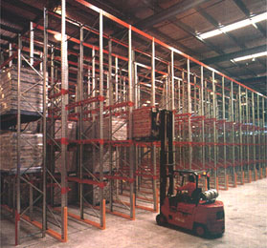
Coca-Cola Warehouse, Queensland

Slide 13
METHODOLOY
Drive In
Steel
Cost
Bare-Code
ABC

Slide 14
Current situation (bulk storage system ):
The bulk storage system is used, a system in which the pallets are stored everywhere in random and unorganized manner inside the warehouse that leads to decrease the throughput and accessibility of the system

Slide 15
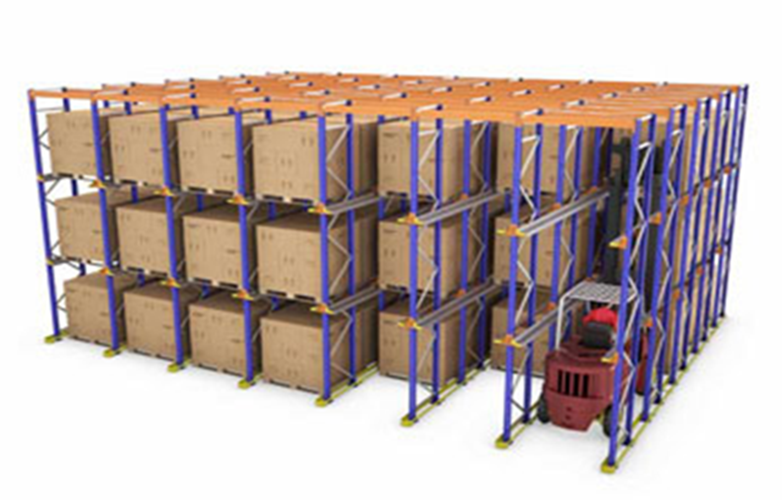
Suggested system (Drive in ):
This system is based on the storage by accumulation principle, which enables the highest use of available space in terms of both area and height.

Slide 16
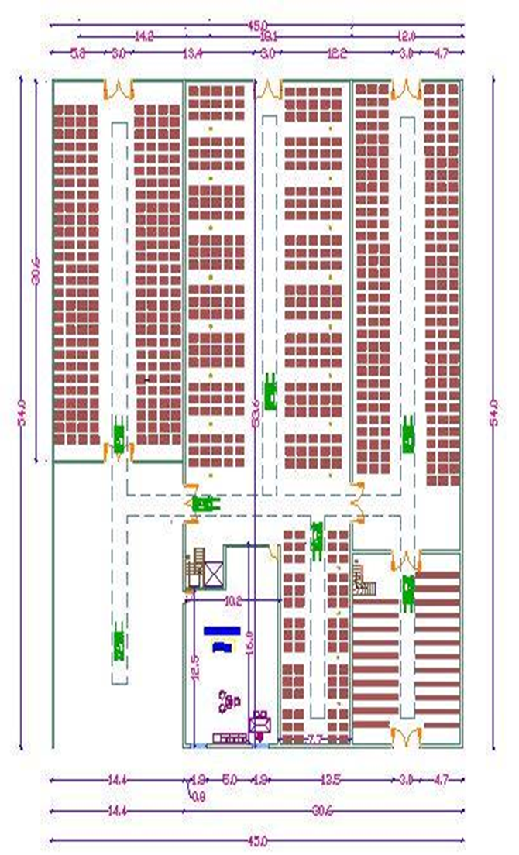
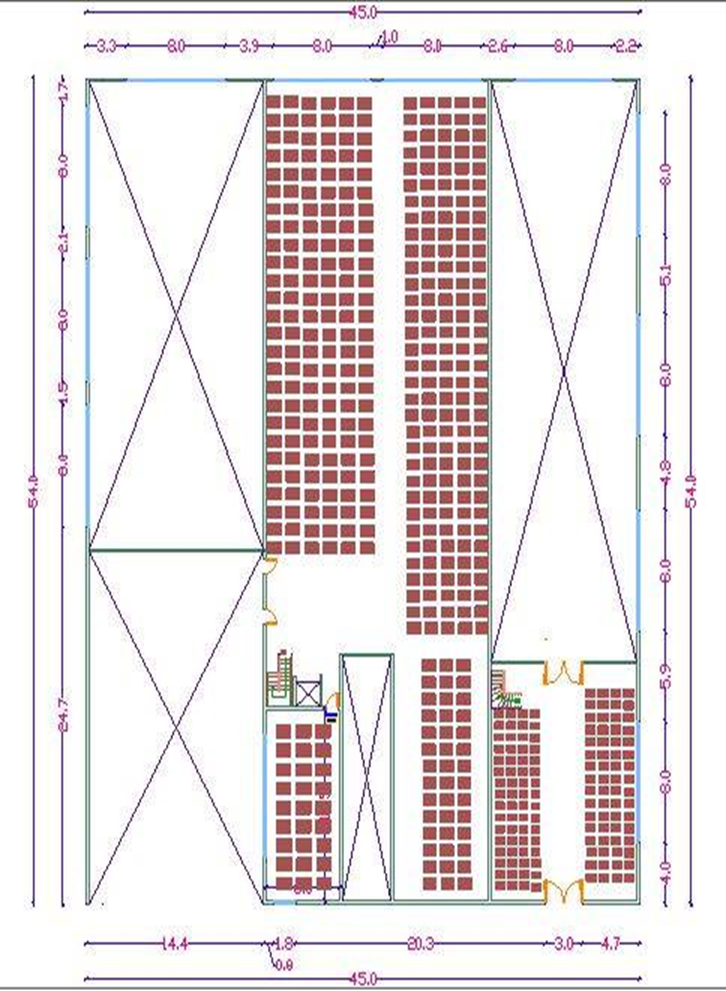

Slide 17
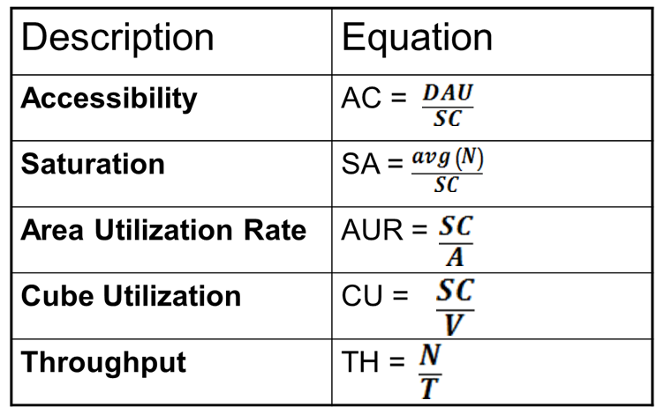
Comparison between Current and Suggested Layout:
Important definitions

Slide 18
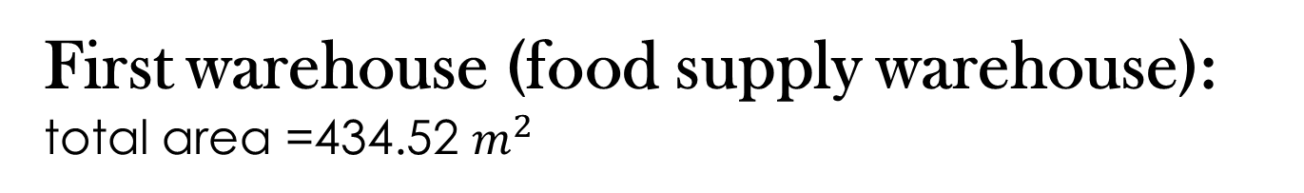
First warehouse (food supply warehouse): total area =434.52 $m^{2}$
 | Current system | Suggested system
 | food supply warehouse
Storage capacity | 468 | 672
Accessibility Index | 8.33% | 25%
Area utilization rate | 1.077 | 1.55
Cube utilization rate | 0.18 | 0.25
Travelling Time | 60 | 60
Throughput | 12 | 13.5
Saturation | 48.60% | 70.00%

Slide 19
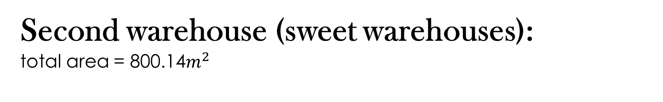
Second warehouse (sweet warehouses): total area = 800.14$m^{2}$
 | Current system | Suggested system
 | sweet warehouse
Storage capacity | 1260 | 792
Accessibility Index | 5.56% | 30%
Area utilization rate | 1.574 | 0.73
Cube utilization rate | 0.3112 | 0.166
Travelling Time | 92 | 92
Throughput | 7 | 8.5
Saturation | 58% | 91%

Slide 20
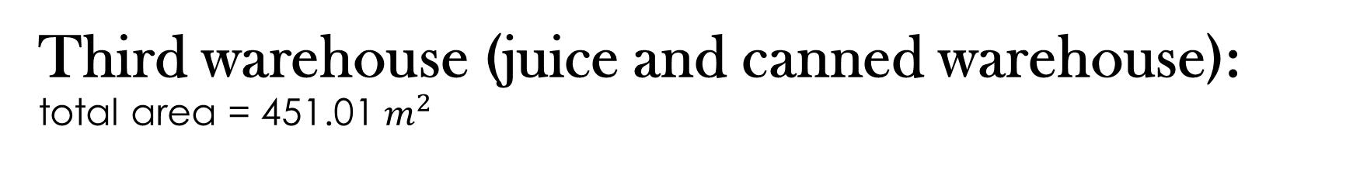
Third warehouse (juice and canned warehouse): total area = 451.01 $m^{2}$
 | Current system | Suggested system
 | juice and canned warehouse
Storage capacity | 564 | 603
Accessibility Index | 8.16% | 32.30%
Area utilization rate | 1.251 | 1.34
Cube utilization rate | 0.192 | 0.206
Travelling Time | 110 | 110
Throughput | 9 | 10
Saturation | 63.40% | 67.80%

Slide 21
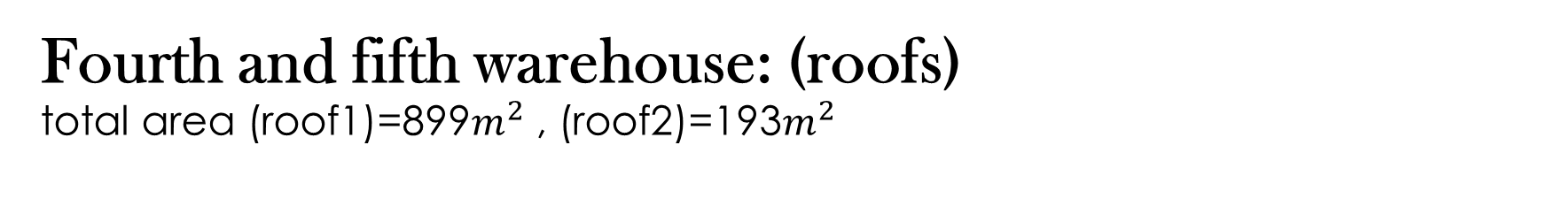
Fourth and fifth warehouse: (roofs) total area (roof1)=899$m^{2}$ , (roof2)=193$m^{2}$
 | Current system | Suggested system
 | roof 1
Storage capacity | 827 | 1122
Accessibility Index | 9.60% | 20%
Area utilization rate | 0.919 | 1.36
Cube utilization rate | 0.25 | 0.37
Travelling Time | 108 | 108
Throughput | 7 | 8.5
Saturation | 56% | 76.00%
 | roof 2
Storage capacity | 104 | 264
Accessibility Index | 26% | 25%
Area utilization rate | 0.54 | 1.78
Cube utilization rate | 0.166 | 0.48
Travelling Time | 97 | 97
Throughput | 15 | 17
Saturation | 29.30% | 74.40%

Slide 22
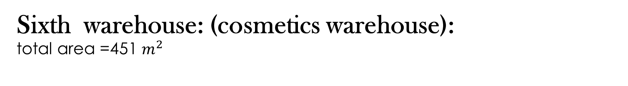
Sixth warehouse: (cosmetics warehouse): total area =451 $m^{2}$
 | Shelves |  | Pallets
Storage capacity | 224 |  | 48
Accessibility | 100 |  | 14
Area utilization rate | 2.3 |  | 0.5
Cube utilization rate | 0.717 |  | 0.15
Traveling time | 92 sec |  | 92 sec
Time required to reach central pallet | 26 sec |  | 70 sec
Throughput |  | 50 | 37

Slide 23
Bulk System
Drive in
TH
Sa
AUR,VUR
SC

Slide 24
Steel amount and cost calculation:
 | Amount of steel | Cost ($) | number of pallets
Supplying food warehouse | 27.43 ton | 10423 | 672
chocolate warehouse | 32.33 ton | 12284 | 792
Juice warehouse | 24.6 ton | 9352.65 | 603
The first roof | 43.3 ton | 16454 | 1122
The second roof | 10.775 ton | 4094.69 | 264
Installation cost | Painting cost
902 $ | 2113$
Total cost =55714.34

Slide 25
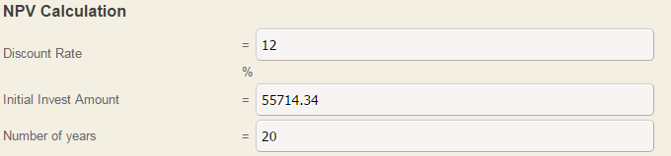
Steel cost calculation
With a passage of time the pallets may exposed to facture and bending so we put a budget for maintenance with 100 NIS.
using useful life (n)=20 years
Using interest rate of return =12%
And using NPV calculator we got.

Slide 26
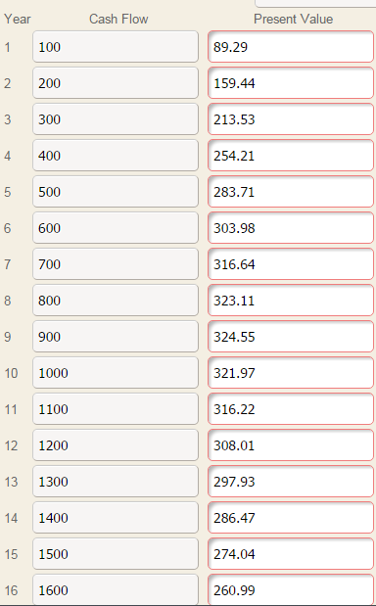
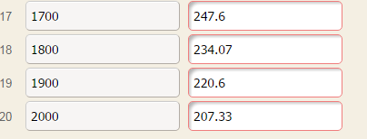
Present value at each year
Net present value is 50470.65

Slide 27
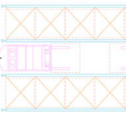
Steel material and dimensions
The type of steel will be used is A-36.
Four pallet support will be used with a right angle shape.
The length of each right angle will be 20cm
The thickness of the pallet support will be 8mm.
the screws will have a diameter with 10mm and Grade-2 type.
130 cm
140 cm

Slide 28
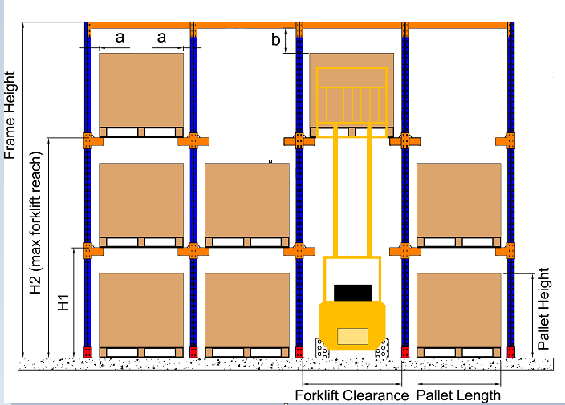
Steel material and dimensions
Such that:
a =10 cm
b = 20cm
H1 = 150cm
H2 =475 cm
Frame Height= 450 cm
Pallet Height= 130 cm
Pallet Length = 100cm
Forklift Clearance = 130 cm

Slide 29
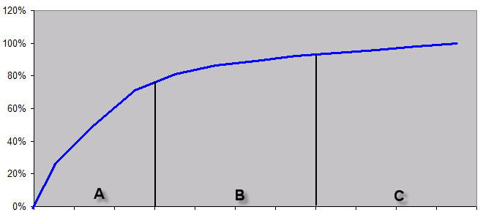
ABC SYSTEM
The ABC inventory system is used in order to focus on the most important items in inventory. Usually a relatively few items will account for a very significant value.
"A" items are
20% of the stock items
80% of the total inventory value
"B' items are
30% of the stock items
15% of the total inventory value
"C" items are
50% of the stock items
5% of the total inventory cost

Slide 30
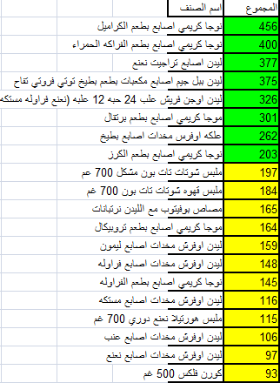
ABC system analyses for Roof1

Slide 31
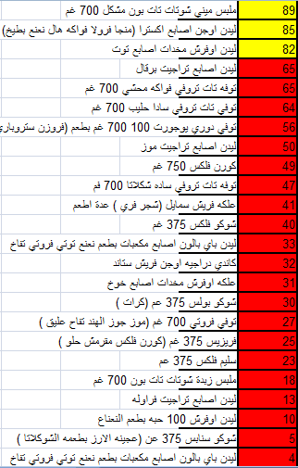

Slide 32
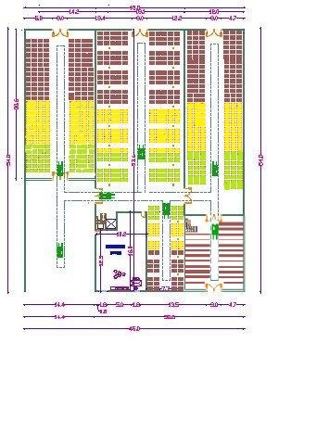
ABC For Warehouses

Slide 33
BARCODE SYSTEM Procedures
Choose the right barcode format
Check out the barcode label’s material and printers
Using a wireless scanner
Dealing with each pallet as a one unit

Slide 34

Suggested Barcode :
# | Description | Boxes No.
0 | Product type | 1
1 | Item No | 3
2 | Size of item | 1
3 | Description of unit | 1
4 | No of units | 2
5 | Expired date | 4
6 | No of Column | 2

Slide 35
Recommendations
In Al-Zalmout warehouses problems, we want to make an improvement in the current situation. To improve storage process, and build improvements inside warehouse.
First, we suggest building a rack system to overcome the storage problems mentioned before.
Drive-In racking systems load and retrieve from the same side, creating Last-In-First-Out (LIFO) inventory retrieval organization.
We suggest using the barcode system, which provides better data. Since one barcode can be used for inventory and pricing information, it is possible to quickly obtain data on both. Furthermore, barcodes can be customized to contain other relevant information as needed. They provide fast, reliable data for a wide variety of applications.

