Slide 1
An-Najah National University
Building Engineering Department
Integrated redesign of Lemon W Na3Na3 Restaurant
Prepared By:
Lama Jarrar
Maryam Abu Taha
Nora Awartani
Supervisor:
Eng. Moayad Salhab.

Slide 2
CONTENTS:
Architectural
Site & Location
Environmental Design
Passive Design
Structural Design
Electro-Mechanical Design
Fire & safety
BOQ
1

Slide 3

Site location

Slide 4
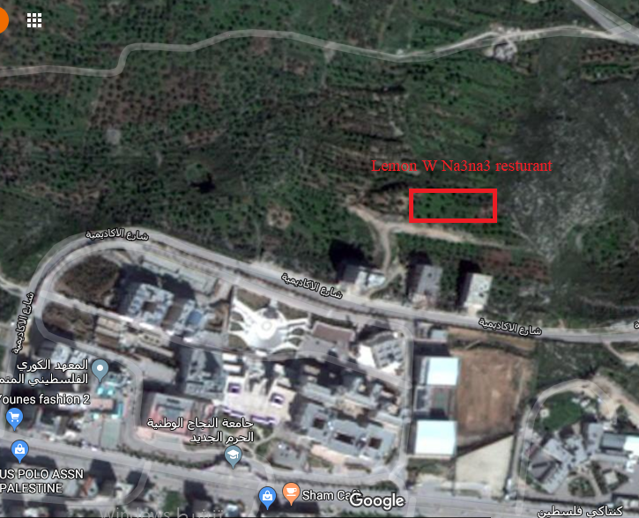
Site Location
Lemon W Na3na3 restaurant is located in the North-East of Nablus city, behind An-Najah-National University.
2

Slide 5
Site location

Slide 6
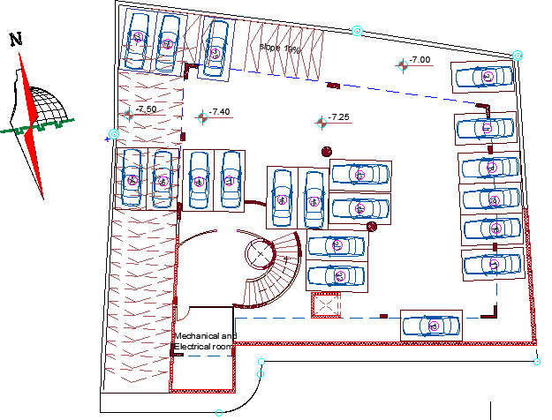
Second basement floor
3

Slide 7
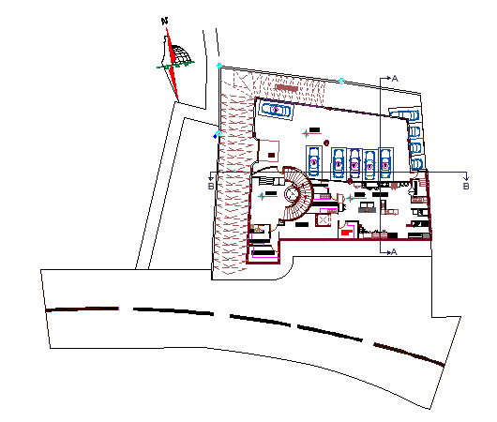
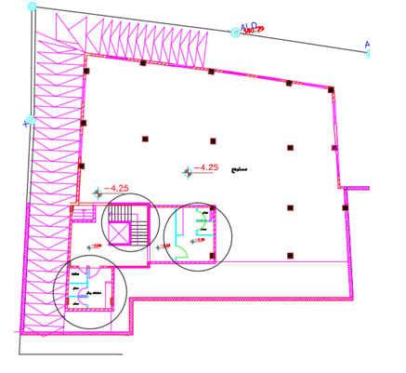
First basement
After
Before
4

Slide 8
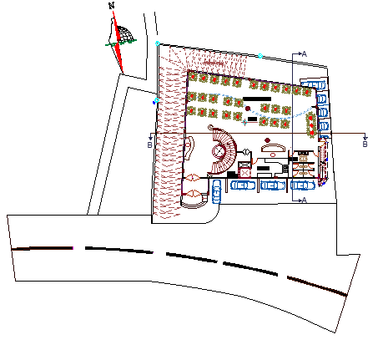
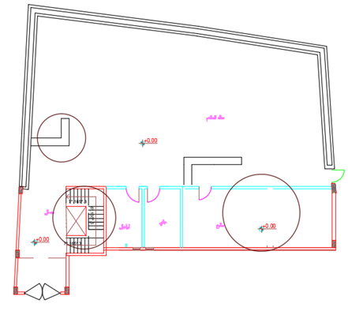
Ground floor
After
Before
5

Slide 9
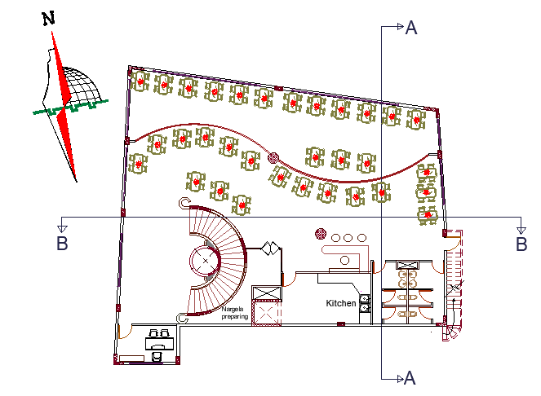
First floor
6

Slide 10
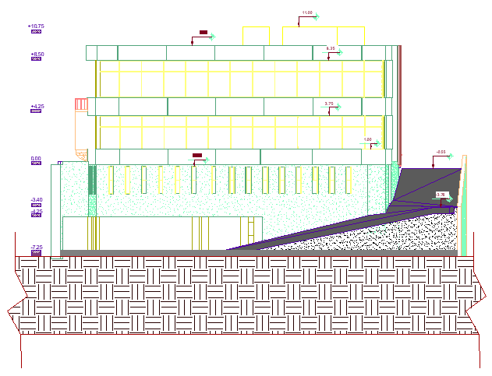
North Elevation
7

Slide 11
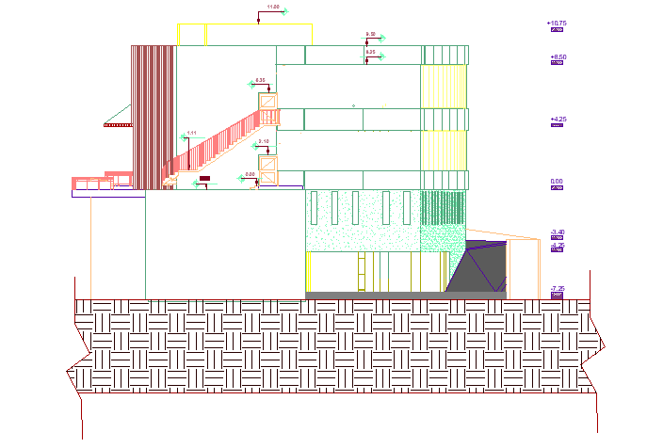
West elevation
8

Slide 12
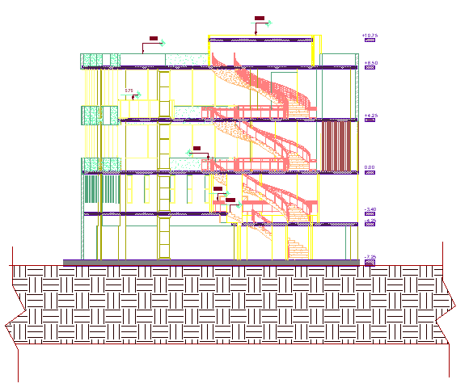
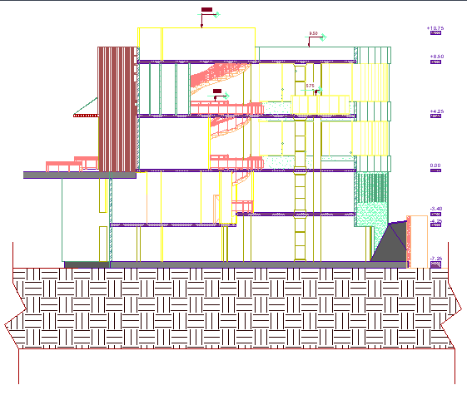
Sections
Section B-B
Section A-A
9

Slide 13
ENVIRONMENTAL DESIGN

Slide 14
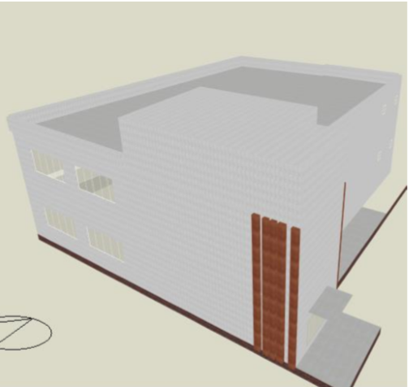
Daylighting
The model of the restaurant from Design Builder is as shown below:
Modifications for day lighting were as shown below:
using drapes inside.
Using low transmission double glass filled with Argon.
10

Slide 15
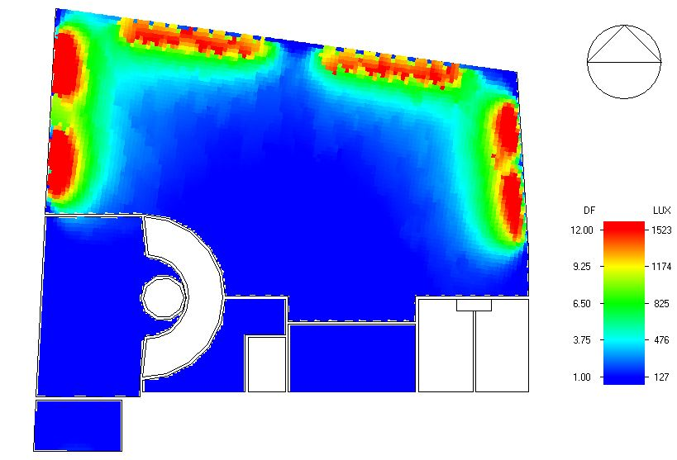
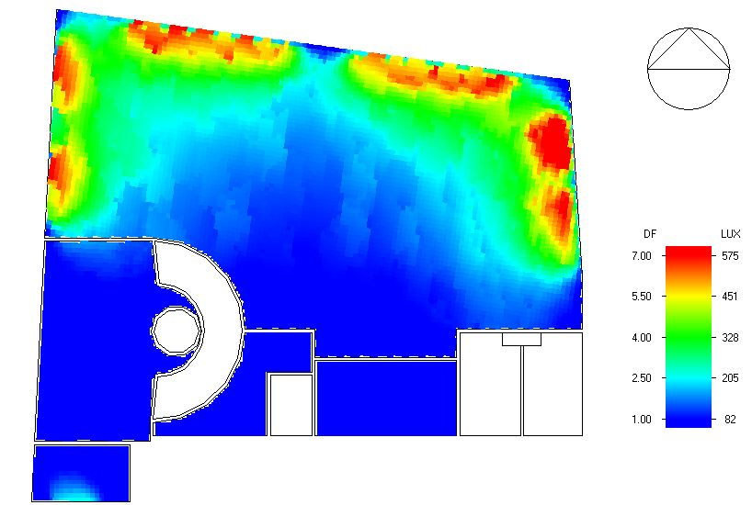
Daylight analysis for Ground floor:
Before
After
11

Slide 16
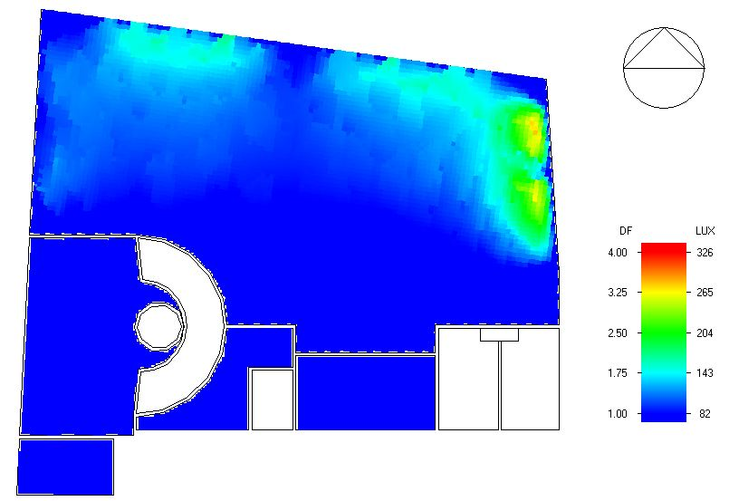
Daylight analysis for first floor:
12

Slide 17
Thermal DESIGN

Slide 18
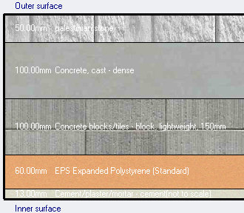
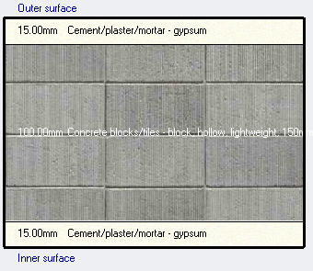

Materials and layers for construction elements in the restaurant:
External walls
Partitions
13

Slide 19
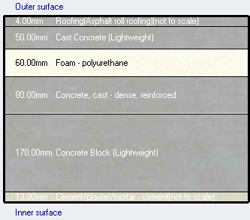
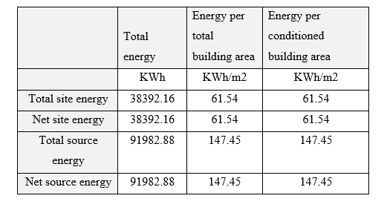
Materials and layers for construction elements in the restaurant:
Flat roof
Site and source energy
The energy = 61.54 KW/m2
14

Slide 20
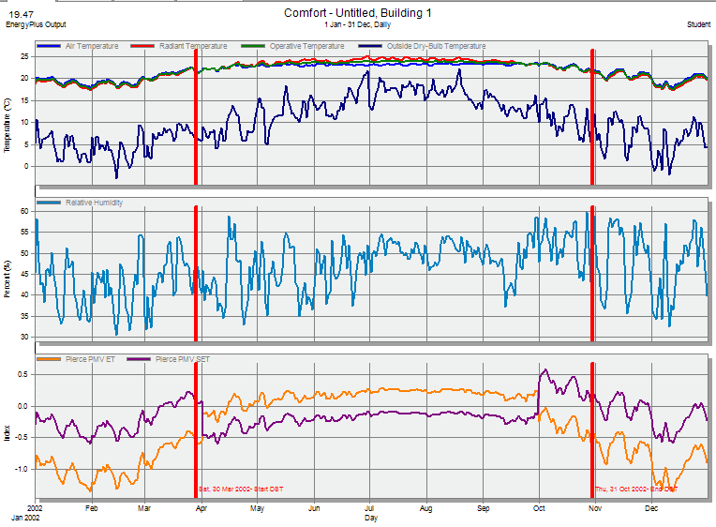
Comfort graph for the restaurant:
15

Slide 21
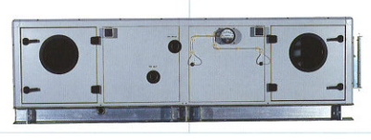
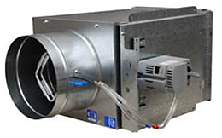
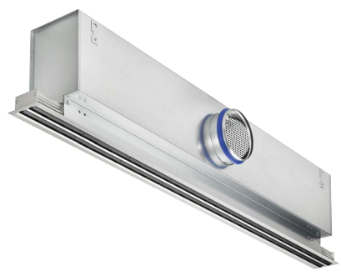
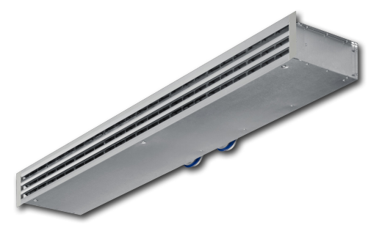
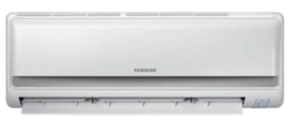
HVAC system:
The used system for HVAC is VRV.
Cooling load for the building = 100.60 KW.
The system components are from TROX and DAIKIN.
Air handling unit from DAIKIN with cooling capacity = 111.70 KW
VAV box from DAIKIN
Split unit from Samsung with an air flow of 0.10 m3/s.
TROX ceiling diffuser with an air flow rate 0.042 m3/s.
TROX wall diffuser with an air flow rate 0.035 m3/s.
16

Slide 22
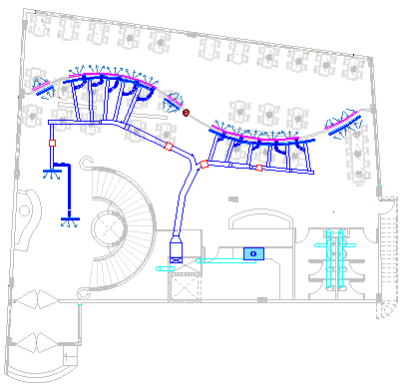
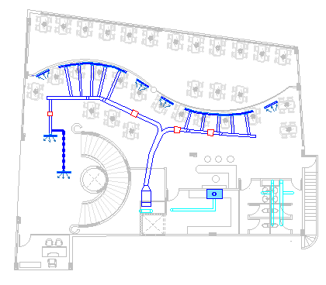
Duct distribution:
Duct distribution for ground floor
Duct distribution for first floor
17

Slide 23
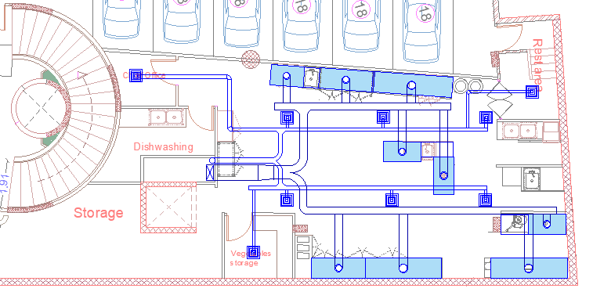
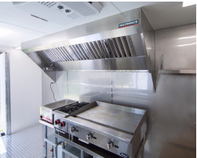
HOODS distribution for the main kitchen:
The used hood with different sizes.
HOODS distribution in the kitchen.
18

Slide 24
Structural design

Slide 25
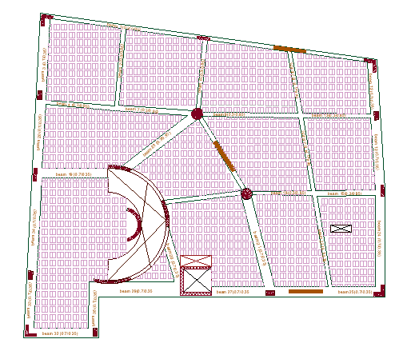
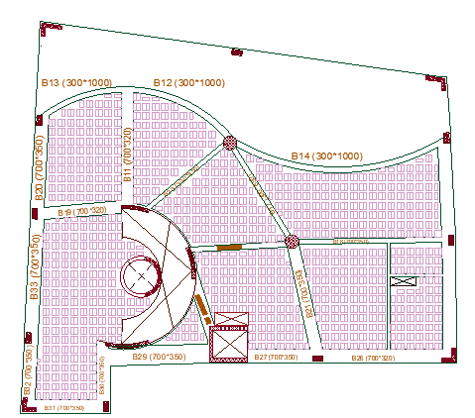
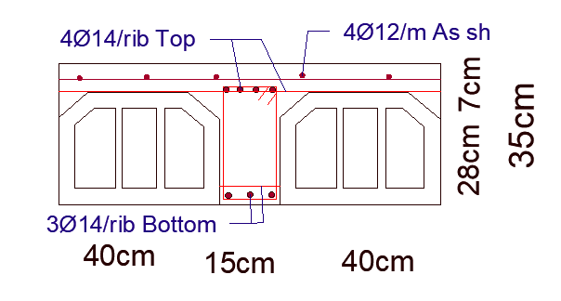
Structural system:
The used structural system for all floors is two-way ribbed slab, except for the parking floor U-BOOT slab was used.
Ribs distribution for second floor
Ribs distribution for first floor
Two-way ribbed slab section
19

Slide 26
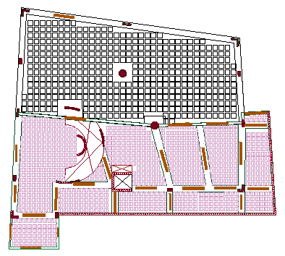
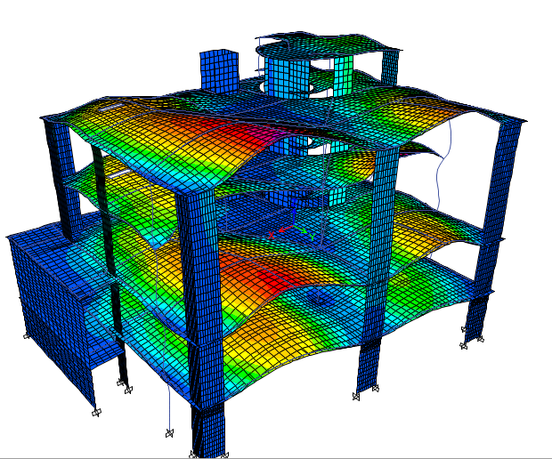
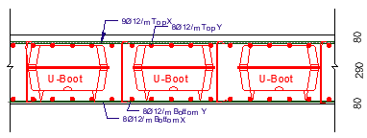
ETABS model
U-BOOT slab
20

Slide 27


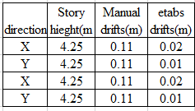
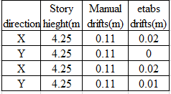
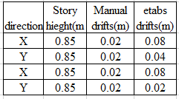
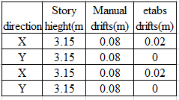
Seismic checks:
1. Period check:
2. Base Shear check:
Base shear
V main | 3207.5 | Old scale factor | 2230
V secondary | 1069 | Old scale factor | 8920
T calculated = 0.65 sec
T ETABS= 0.78 sec
T calculated almost = T ETABS period check is ok.
3. Drift check:
Shear values for the main X from ETABS are greater than the manual values so the shear check is ok.
All drifts from ETABS for all stories < 100 mm so drift check is ok.
21

Slide 28
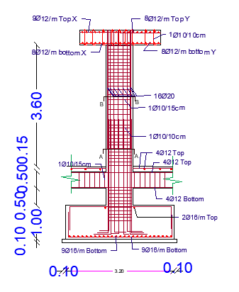
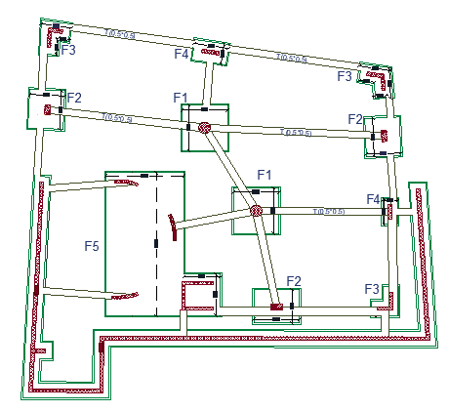
Footing layout:
Critical isolated footing (F1)
22

Slide 29
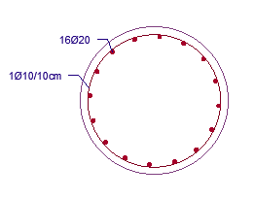
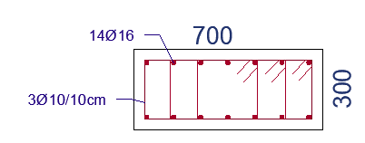
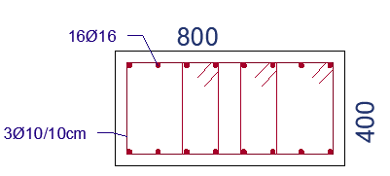
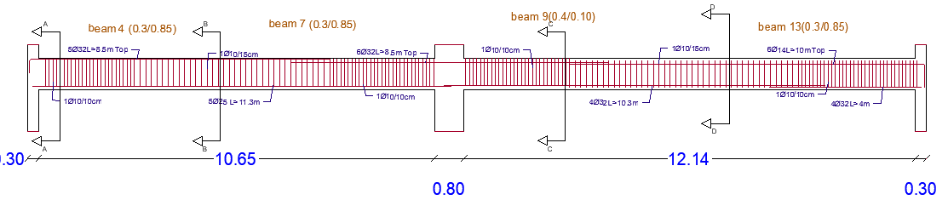
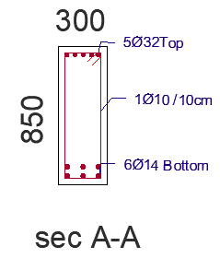
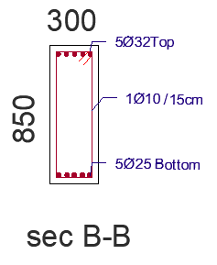
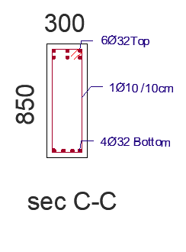
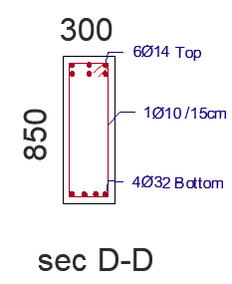
Columns sections:
Beam sections:
23

Slide 30
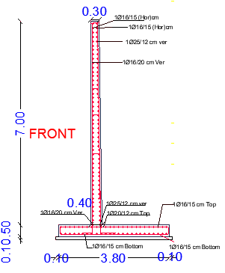

Retaining wall design:
24

Slide 31



Water tank design:
Water tank raft footing
25
Water tank solid slab

Slide 32
ELECTRO-MECHANICAL DESIGN

Slide 33











* Artificial lighting
The Luminaires we used: * Lighting with switches
Rec Rec Mounted on wall Pendant
Rec
Pendant
Sur-mounted
Pendant
26

Slide 34




Results from DIAlux evo for the first basement floor.
Kitchen
Store
Parking
27

Slide 35




Results from DIAlux evo for the ground floor.
Main Dining Hall
WC
Bar
28

Slide 36



For the first floor.
Main Dining Hall
Office
29

Slide 37



Sockets plan for the kitchen and main dining hall:
30

Slide 38


The electrical load of power, lighting and loud speaker system in the ground floor
The electrical load of power, lighting and loud speaker system in the main distribution board
30

Slide 39


Mechanical system
Water tank :
In our project we used a concrete underground water tank.
Water tank capacity = 50 m3, with a dimensions of (4 × 4 × 3.10) m.
Water collector :
31

Slide 40

Total Fu & water demand:
Diameter of pipes on basement : Diameter of pipes on G.F & F.F :
Pipe | Diameter
Vertical pipe | 2.5’’
Horizontal pipe | 1.5’’
Branch pipe | 1.25’’
Pipe | Diameter
Vertical pipe | 2”
Horizontal pipe | 2’’
Branch pipe | 0.5’’
32

Slide 41


Summary for diameter & pipe slope :
33

Slide 42

34

Slide 43

Drainage pipes and manhole on the site:
35

Slide 44
Safety DESIGN

Slide 45




The symbols of the suppression system in the plans
The symbols for the detection
and notification system.
The emergency lights and signs
36

Slide 46

Fire escape plane:
37

Slide 47





Extinguisher type C & K
Wet chemical sprinkler
Emergency sign
Wall sprinkler
Heat detector
38

Slide 48
ACOUSTICAL DESIGN

Slide 49


Used materials with absorption coefficients:
Reverberation time (RT60):
Surface | Finish material | Frequency Hrz
 |  | 63 | 125 | 250 | 500 | 1000 | 2000 | 4000 | 8000 | 16000
Wall 1 | Agenda decoration | 0.05 | 0.05 | 0.10 | 0.17 | 0.34 | 0.61 | 0.83 | 0.60 | 0.60
Wall 2 | Plaster | 0.12 | 0.09 | 0.07 | 0.01 | 0.01 | 0.01 | 0.02 | 0.01 | 0.02
Windows | Double glass | 0.11 | 0.09 | 0.05 | 0.03 | 0.02 | 0.02 | 0.02 | 0.03 | 0.03
Ceiling | Gustaf panels | 0.50 | 0.50 | 0.60 | 0.55 | 0.45 | 0.45 | 0.45 | 0.20 | 0.20
Floor | timber | 0.05 | 0.04 | 0.07 | 0.09 | 0.14 | 0.12 | 0.10 | 0.14 | 0.17
Frequency(Hrz) | RT60
125 | 1.00
250 | 0.80
500 | 0.94
1000 | 1.01
2000 | 0.93
4000 | 0.80
8000 | 0.97
RT60 zero occupied
Frequency(Hrz) | RT60
125 | 1.00
250 | 0.81
500 | 0.94
1000 | 1.04
2000 | 0.99
4000 | 1.00
8000 | 0.96
39
RT60 100% occupied

Slide 50




Sound transmission class (STC):
STC should be > 50 dB.
STC for exterior walls without glazing
STC for glazing
STC for partitions
STC composite
40

Slide 51

Impact insulation class (IIC):
IIC value according to standards should be > 60 dB
IIC for the ceiling
41

Slide 52



Loud speakers:
The used speakers are ACE 1250 that are used in the main dining hall.
SPL for the main dining hall
Frequency | Direct SPL | Average | Maximum | Minimum
125 Hz | 75.10 | 78.20 | 85.07 | 59.72
250 Hz | 74.82 | 78.10 | 83.57 | 60.45
500 Hz | 73.05 | 77.72 | 84.24 | 59.83
1000 Hz | 73.46 | 76.91 | 79.95 | 68.77
2000 Hz | 71.15 | 76.50 | 81.68 | 69.76
4000 Hz | 69.26 | 74.25 | 79.62 | 67.65
8000 Hz | 67.58 | 73.47 | 79.47 | 65.98
ACE 1250
Parameter | Standard value
Sound pressure level (SPL) | (75-90) dB
Back ground noise | (40-45) dB
Speech transmission index(STI) | >= 0.50
Standards
42

Slide 53



STI for the main dining hall
Articulation loss
Frequency | STI | Average | Maximum | Minimum
125 Hz | 0.67 | 0.70 | 0.75 | 0.66
250 Hz | 0.67 | 0.70 | 0.75 | 0.66
500 Hz | 0.67 | 0.70 | 0.75 | 0.66
1000 Hz | 0.67 | 0.70 | 0.75 | 0.66
2000 Hz | 0.67 | 0.70 | 0.75 | 0.66
4000 Hz | 0.67 | 0.70 | 0.75 | 0.66
8000 Hz | 0.67 | 0.70 | 0.75 | 0.66
Frequency | Articulation Loss | Average | Maximum | Minimum
125 Hz | 4.64 | 3.91 | 4.84 | 2.95
250 Hz | 4.64 | 3.91 | 4.84 | 2.95
500 Hz | 4.64 | 3.91 | 4.84 | 2.95
1000 Hz | 10.00 | 10.00 | 10.00 | 10.00
2000 Hz | 13.00 | 13.00 | 13.00 | 13.00
4000 Hz | 16.00 | 16.00 | 16.00 | 16.00
8000 Hz | 19.00 | 19.00 | 19.00 | 19.00
43

Slide 54
Quantity surveying and cost estimation

Slide 55
Quantity Surveying
The total cost of the restaurant is 1,890,651 NIS and the total area of the restaurant is 1850 m2 which means that the
total unit cost per m2 is 1021.97 NIS/ m2.
Structural Work=910533.55NIS
Formwork= 128,065.40 NIS
Finishes Work=348411 NIS
Electrical work=150580 NIS.
Mechanical work=353062NIS

