Slide 1
Evaluation and Redesign Faisal and Amman Streets
By
Ahmad Arayes
Omar Ismail
Mohammed Damiri
Under supervision of: Dr. Khalid Al-Sahili

Slide 2
Introduction
Nablus is one of the largest Palestinian cites with its important sites and commercial centers.
Faisal and Amman Streets are Arterial streets that connects the eastern part of the city with the CBD.

Slide 3
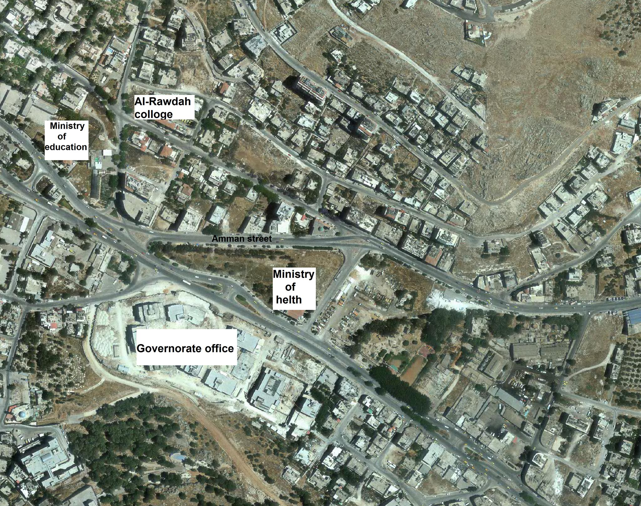
Study Area

Slide 4
Existing Problems
In general, the volume of traffic in Amman/Faisal streets are large and in continuous growth, so many problems exist such as :
Congestion problem
Delay problem
Pedestrian problem
Safety problem

Slide 5
Objective
The main objective of this project is to analyze and develop the Governorate office area in Nablus city.
The study will propose solutions to study area problems.

Slide 6
Methodology
Data collection
Traffic analysis
Geometric evaluation
Conclusions and Recommendations

Slide 7
Data collection
-Sources of Data Collection :
Site visit ( inventory study , traffic counting , pedestrian counting ).
Nablus municipality.
Traffic police (accidents information ).

Slide 8

Traffic counting

Slide 9
Traffic analysis - Synchro Model
The analysis was made using SYNCHRO software with proper coding of links and nodes for the current state of the network and the LOS assessment of each intersection
The unified peak-hour from 7:15-8:15 AM.

Slide 10
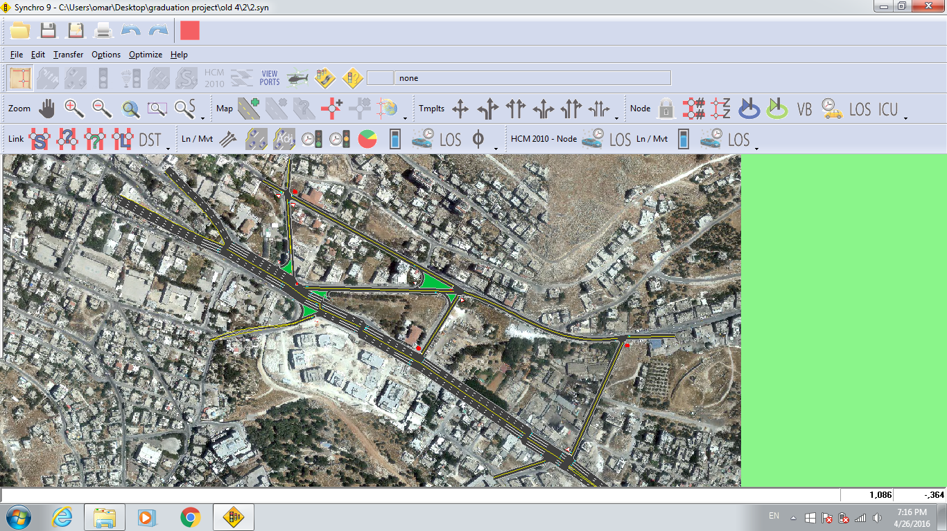
Synchro Model

Slide 11
(HCM) LOS | (ICU) LOS | Intersection Name | No.
A | C | Ministry of Education | 1
A | F | Governorate | 2
A | A | Ministry of Health | 3
A | C | Faisal street U-turn | 4
A | A | Balattah | 5
C | F | Al-Matorate | 6
F | D | Amman St. – Al-Rawdah St. | 7
 | E | Faisal St.-Amman St. | 8
B | B | Al-Rawdah college | 9

Slide 12
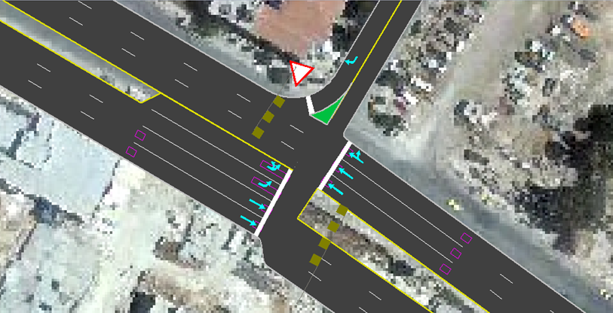
First Alternative:
Ministry of health intersection

Slide 13
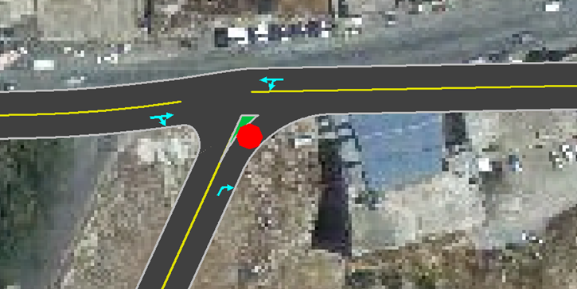
First Alternative:
Amman St. – Almatorat St. intersection

Slide 14
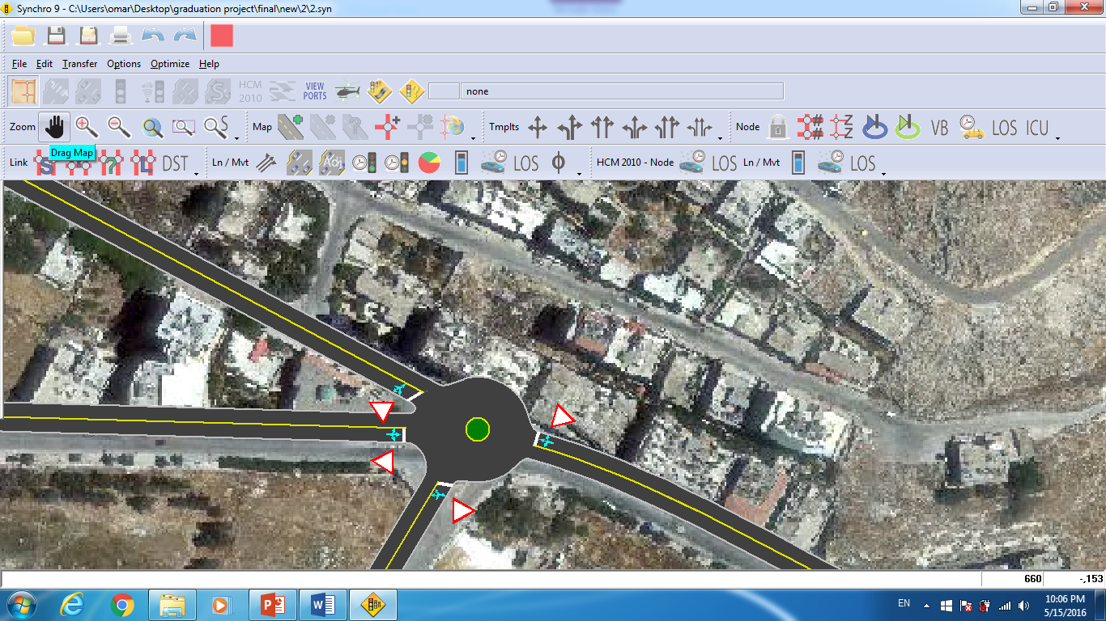
Second Alternative:
Amman St. – Alrawdah St. intersection

Slide 15
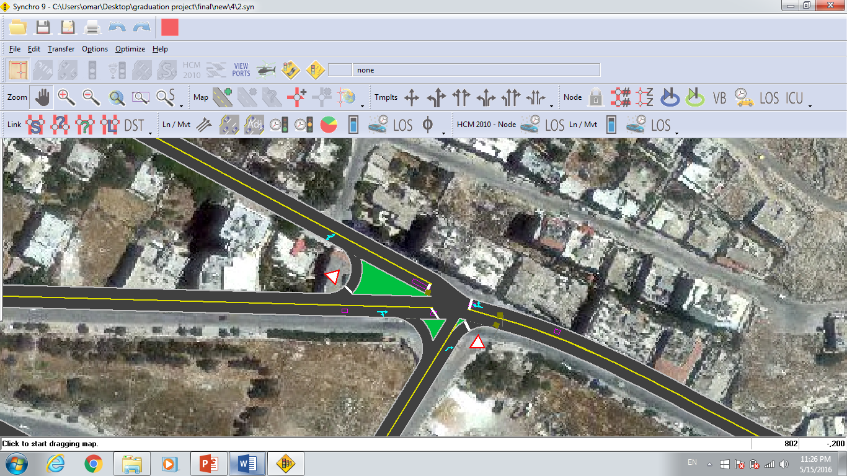
Third Alternative:
Amman St. – Alrawdah St. intersection

Slide 16
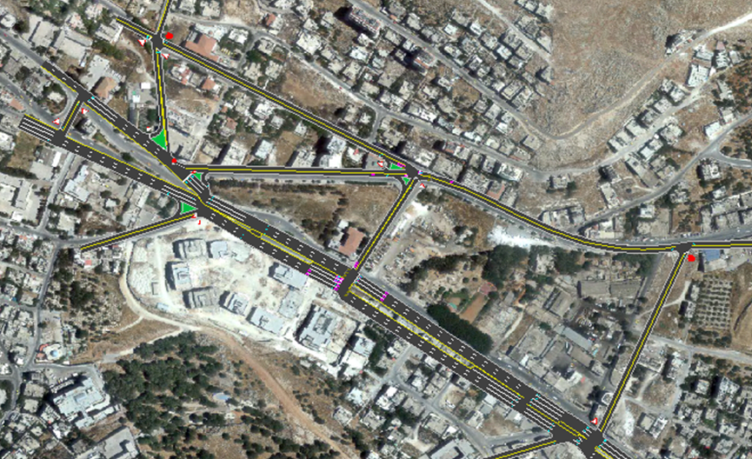
Final Traffic improvement:

Slide 17
Final Traffic improvement:
No. | Intersection Name | Existing condition | Modified condition
1 | Ministry of Education | C | C
2 | Governorate | F | C
3 | Ministry of Health | A
4 | Faisal street U-turn | C | B
5 | Balattah | A | A
6 | Al-Matorate | F | C
7 | Amman St. – Al-Rawdah St. | D | D
8 | Faisal St.-Amman St. | E | D
9 | Al-Rawdah College | B | B
No. | Intersection Name | Existing condition | Modified condition
1 | Ministry of Education | A | A
2 | Governorate | A | B
3 | Ministry of Health | A
4 | Faisal street U-turn | A | A
5 | Balattah | A | A
6 | Al-Matorate | C | B
7 | Amman St. – Al-Rawdah St. | F | C
8 | Faisal St.-Amman St.
9 | Al-Rawdah College | C | C
ICU LOS
HCM LOS

Slide 18
Geometric evaluation
Functional Classification :
(Amman\Faisal streets) are considered to be urban principal arterial streets.
- Design Speed :
A design speed of (70km/hr) is taken.
Design Vehicle :
In our study area we considered (SU-12) as a design vehicle based on the traffic count.
- Lane width:
In our project it varies from (3.0 - 3.6 m).
- Median:
There are different widths for medians.
- Sidewalks:
Generally, fair sidewalks were found in our study area.

Slide 19
Geometric evaluation
- Minimum Turning Radius
a minimum turning radius of (15.6m) and a minimum inside radius of (11.09 m).

Slide 20
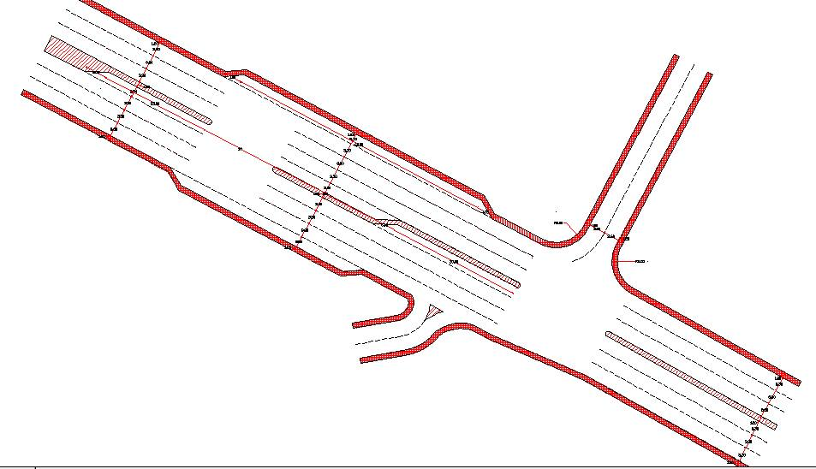
Faisal St. U-turn and Balatah Intersection layout

Slide 21
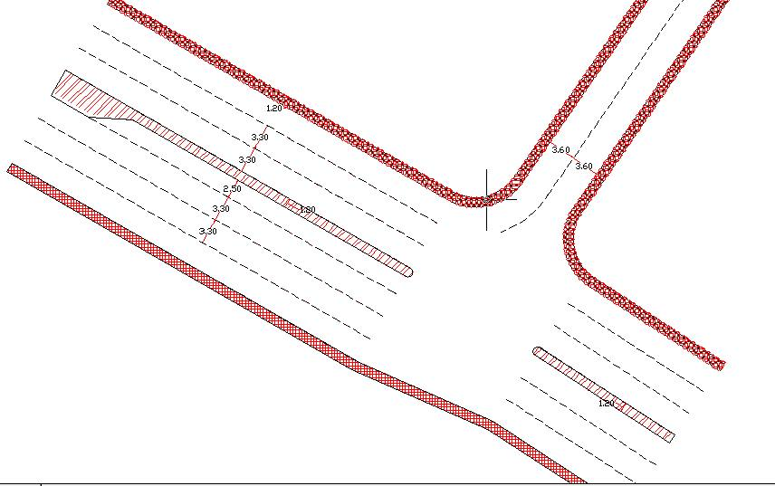
Ministry of Health Intersection layout

Slide 22
Conclusions and Recommendations
The project’s idea is to make an evaluation for this study area and find any problems then find solutions for these problems.
we started collecting the required data, Then the SYNCHRO program was used to establish the model for the network and collected data, there were some problems in level of serves (LOS) and delay, as we have noted in some intersections.

Slide 23
Conclusions and recommendations
On the network level in general, after the modification the LOS , delay ,traveled distances, average speed, emissions, and fuel consumption measures have improved.
The population in the study area has the ability to increase, so we recommend to make a study to determine the effect of this increase on traffic conditions.

Slide 24
Conclusions and recommendations
Also a feasibility study for bridge, tunnel, or interchange in this area should be conducted.
For the pedestrian problem, we recommend to make a detailed study for this area to consider its effect and solutions.

Slide 25
Thank you

