Slide 1

TechSync
Islam Atallah & Ruba Qawareeq
Supervisor: Dr. Raed Qadi

Slide 2
Contents:
1.
4.
Introduction
Tools
2.
5.
Objective
Constrains
3.
6.
Features
Future Work
7.
Conclusion

Slide 3
Introduction
As the number of programming students continues to grow, the need for a comprehensive platform to support their learning journey becomes increasingly essential. Such a platform can provide access to valuable courses for skill enhancement and essential tools like a code editor, collaborative whiteboard, and customizable portfolio.

Slide 4



Project Objectives
Provide Skill-Enhancing Resources
Facilitate Collaboration&
Communication
Support Personal Branding
Offer curated courses and tools to help students improve their programming skills.
Enable collaboration through features like a code editor and a shared whiteboard.And allow communication& interaction with insturcutors and students.
Allow students to create and customize professional portfolios for showcasing their work.

Slide 5
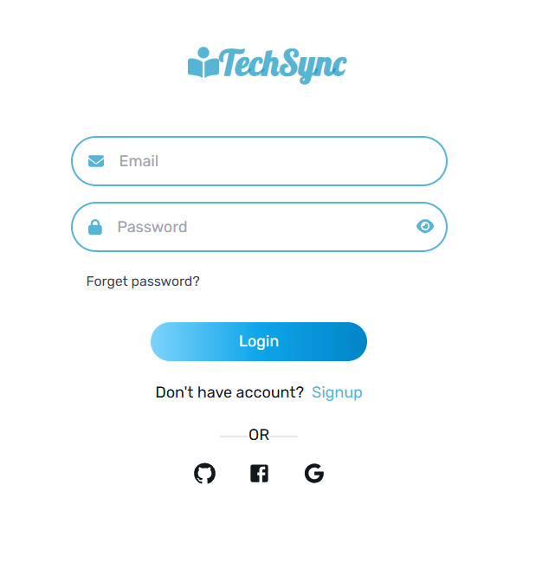
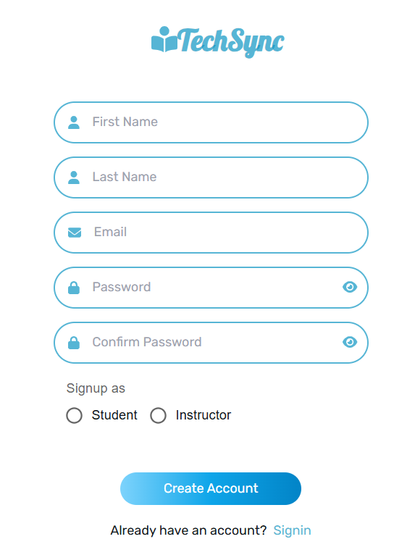
Login & Signup

Slide 6
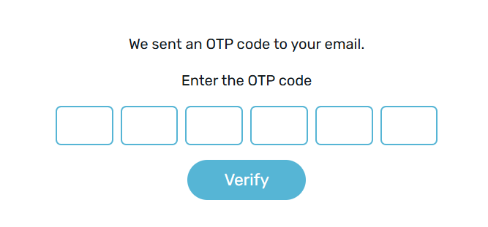
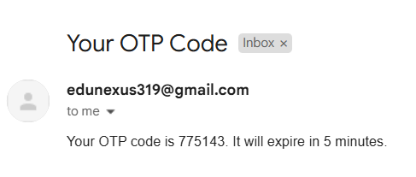
Login & Signup

Slide 7
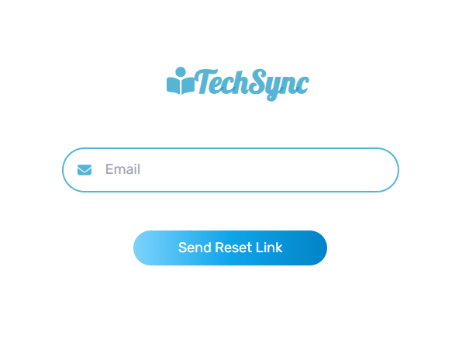
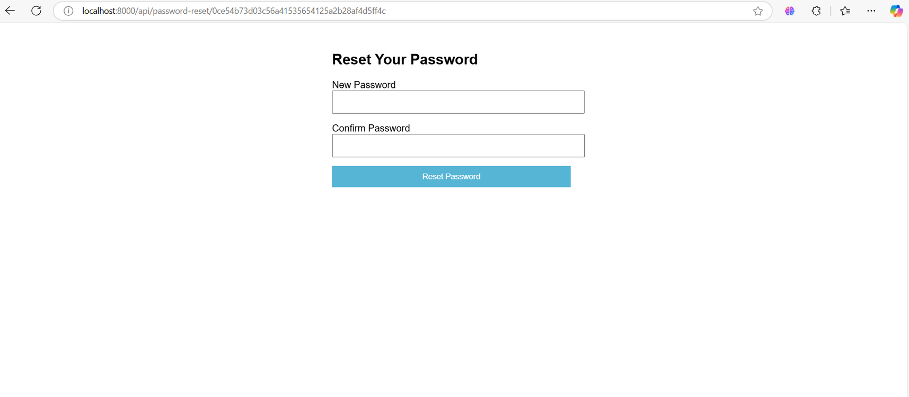
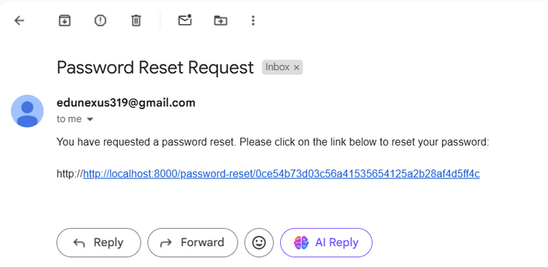
Forget Password

Slide 8
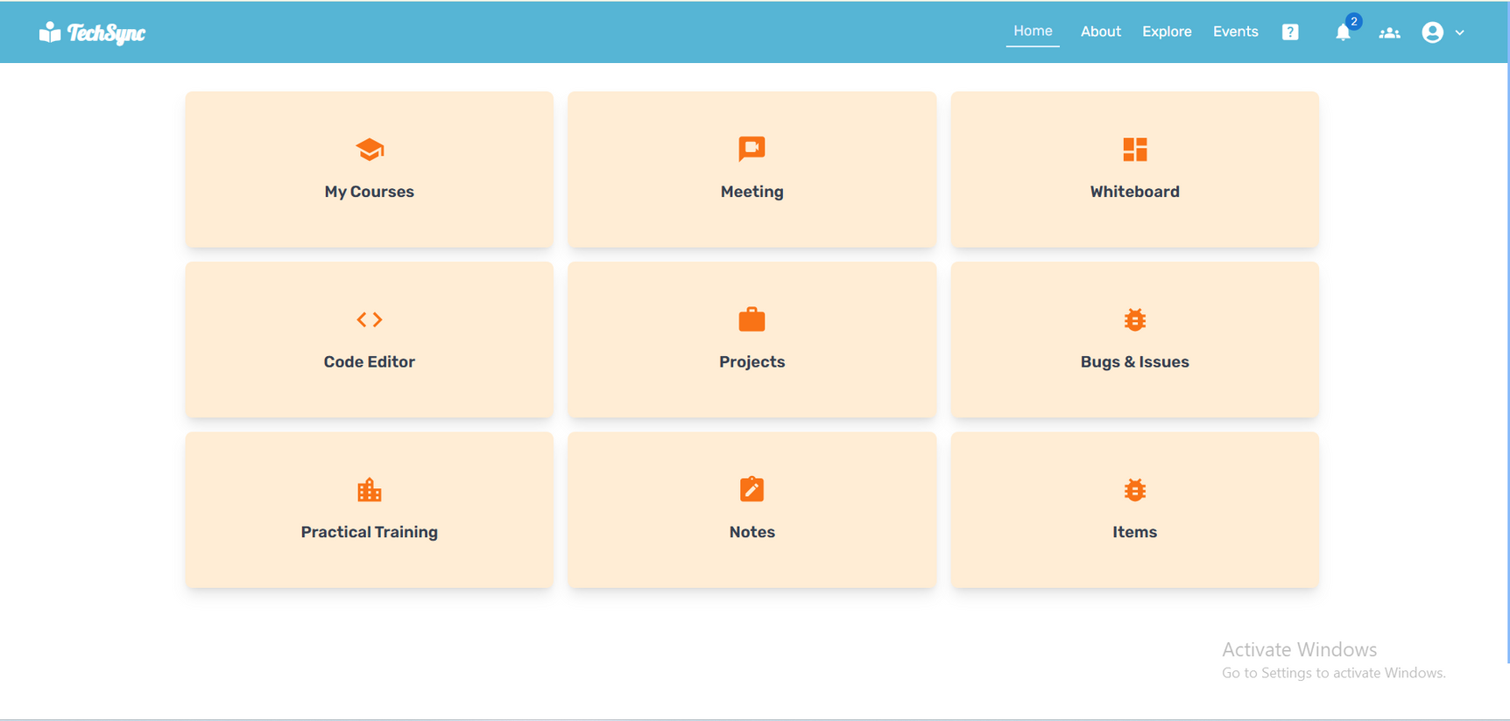
Home Page
After the users login Successfully goes to this home page to enable them access to platform features.

Slide 9
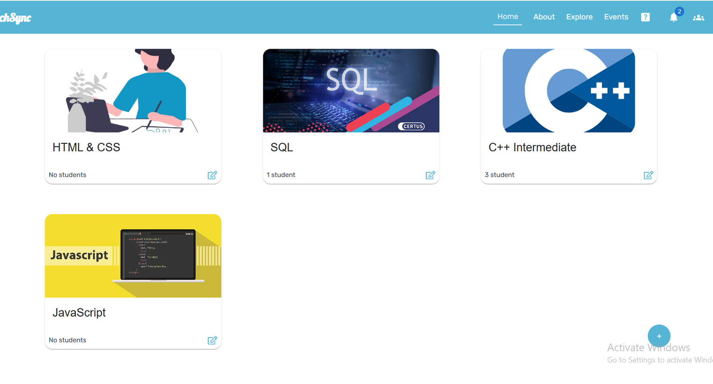
Instructor Courses
This page is for instructors, enabling them to view their added courses and add new ones.

Slide 10
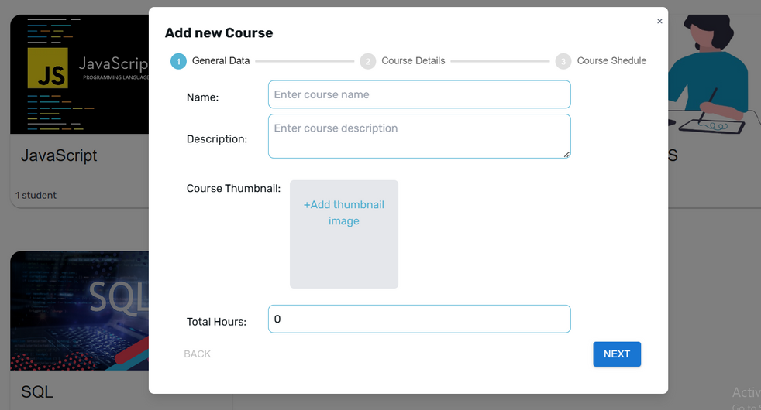
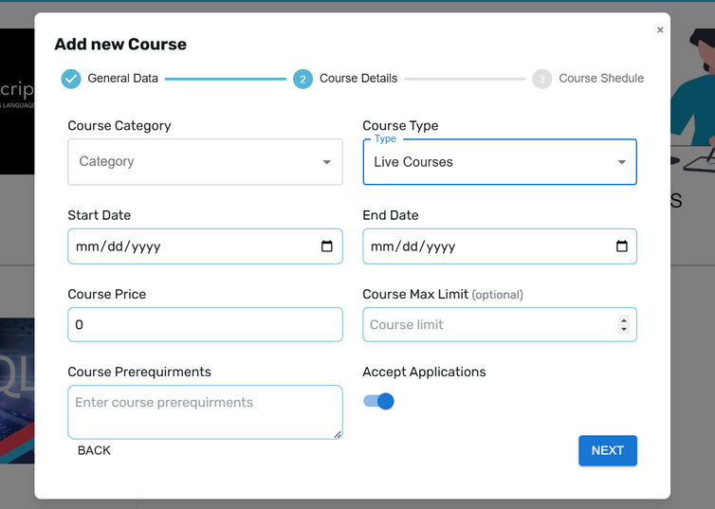
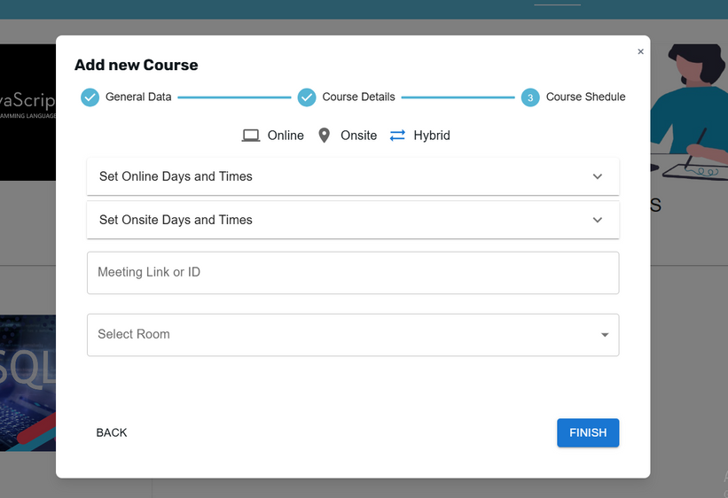
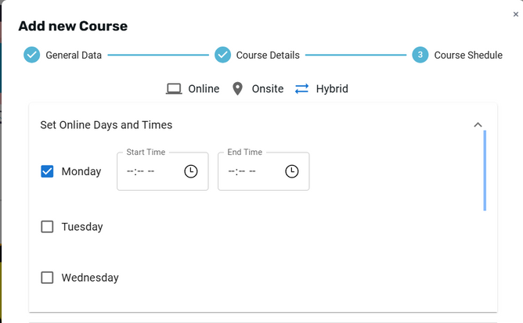
Add Course

Slide 11
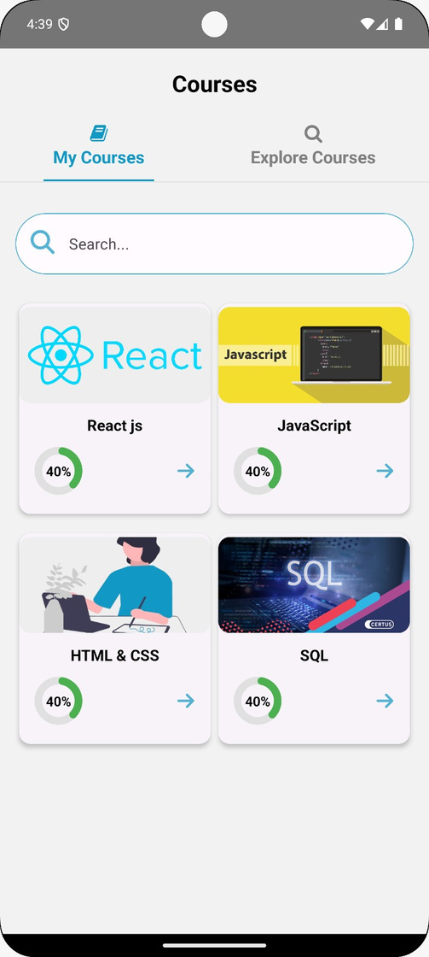
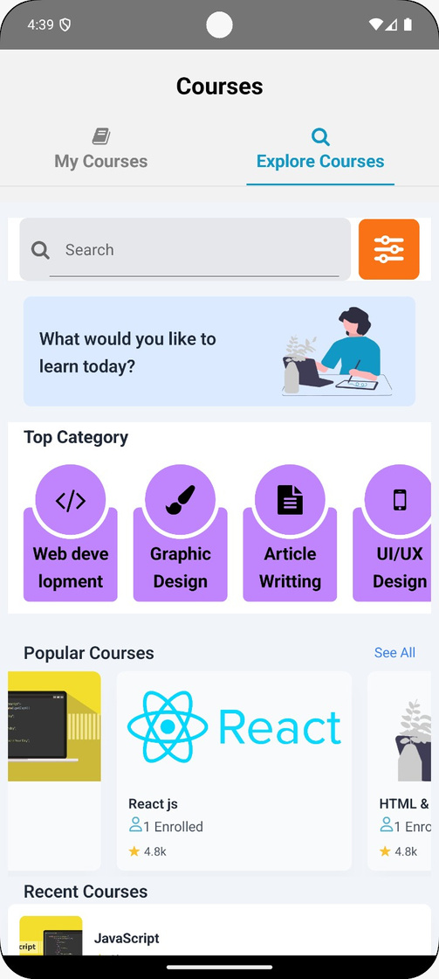
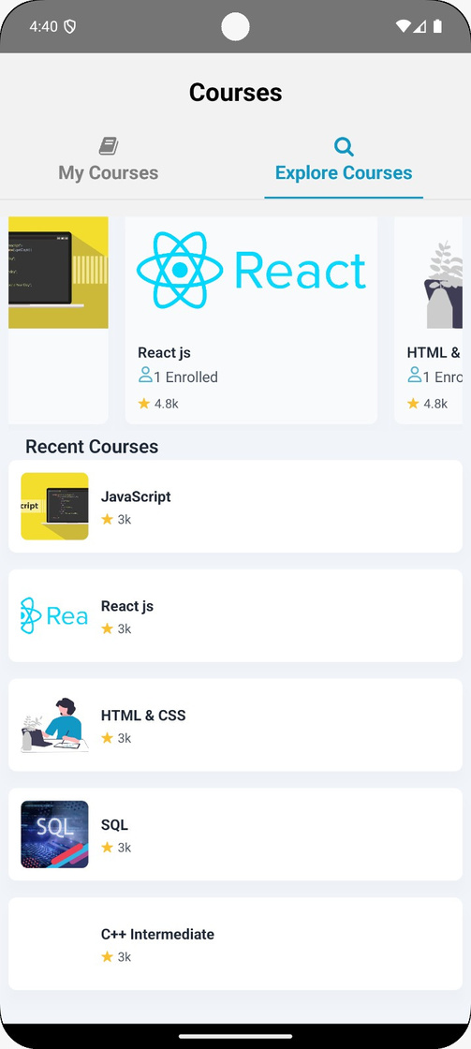
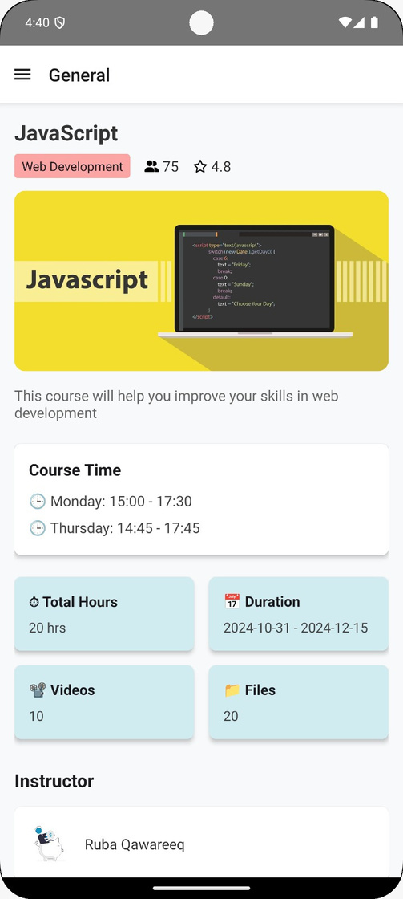
Course - Student Side
This page show all course available ,and specific information of course selected.

Slide 12
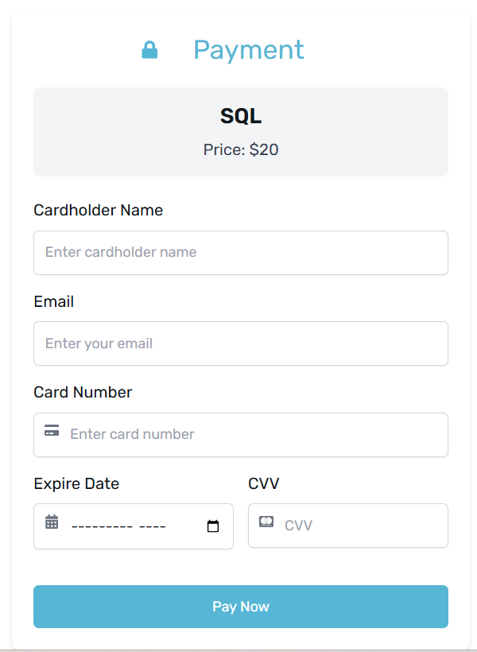
Courses Enrollment
If a student wants to enroll in a paid course, they need to complete the payment process by entering their card details.

Slide 13
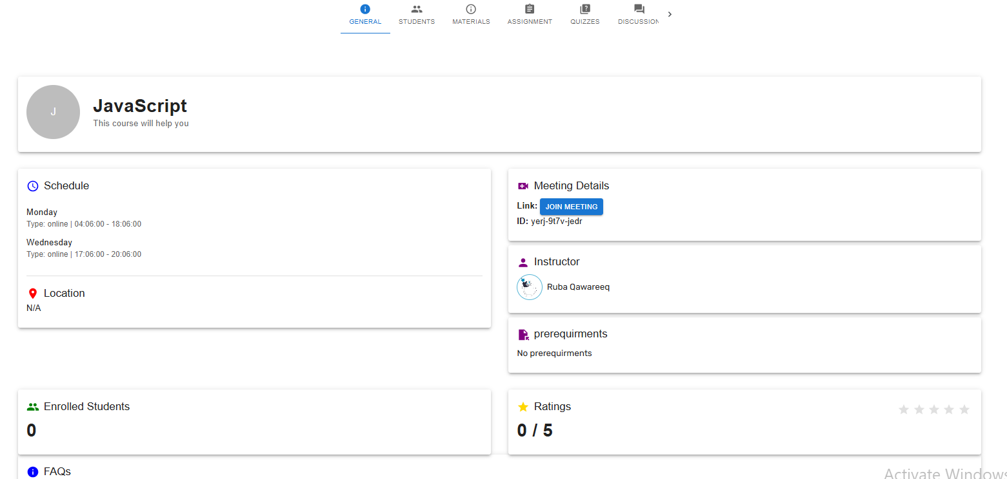
Courses Dashboard
This page shows the course general information, such as name, rate, location, schedule, etc...

Slide 14
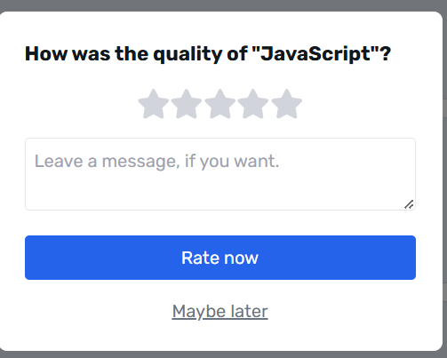
Courses Rating
This component enable students to rate one of the registered courses.

Slide 15
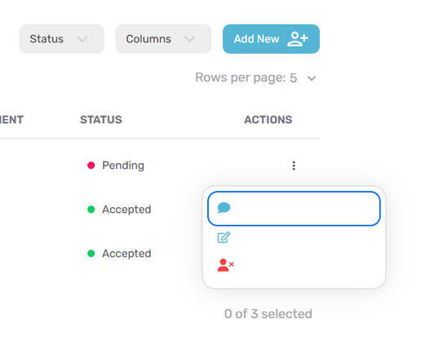
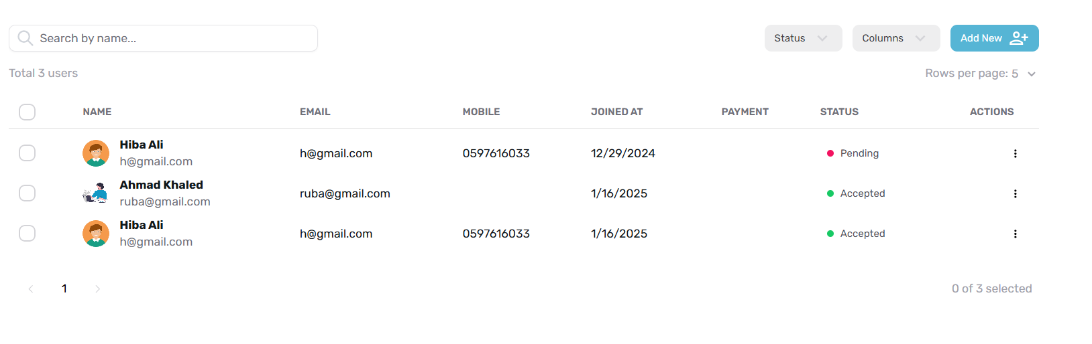
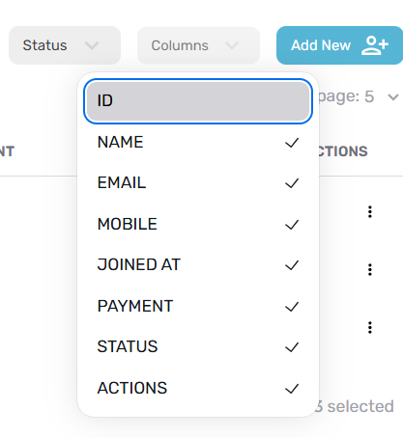
Course Students
This page is for instructors, enabling them to view students enrolled in the course, and see requests to join the course, and can add, delete, or edit student details.

Slide 16
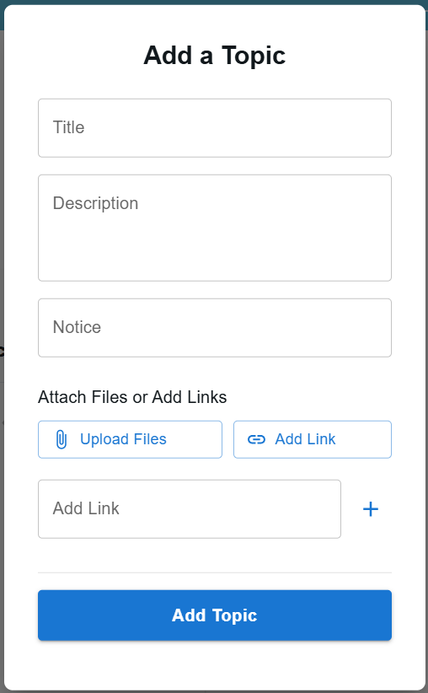
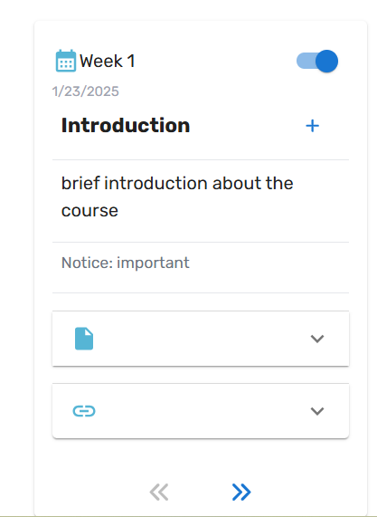
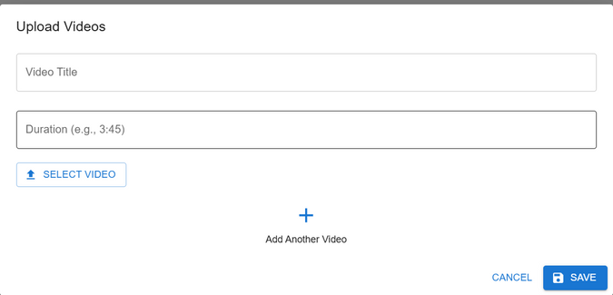
Course Materials
This page enable instructors to add materials for course. So, you can add week, for each week add number of topics, each topic has all details and files.

Slide 17
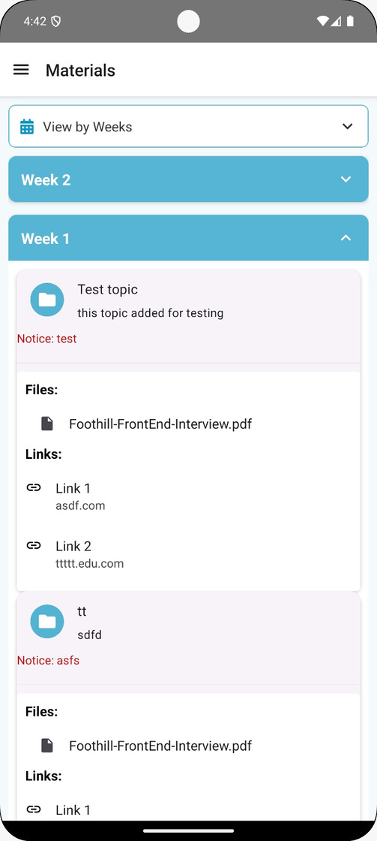
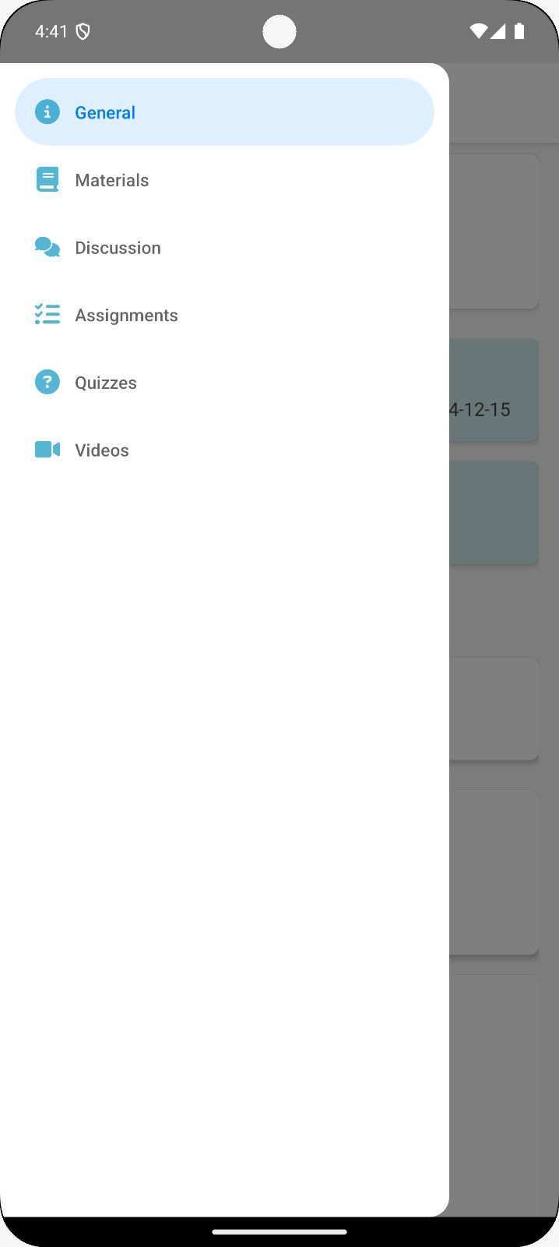
Course Materials - Student Side

Slide 18
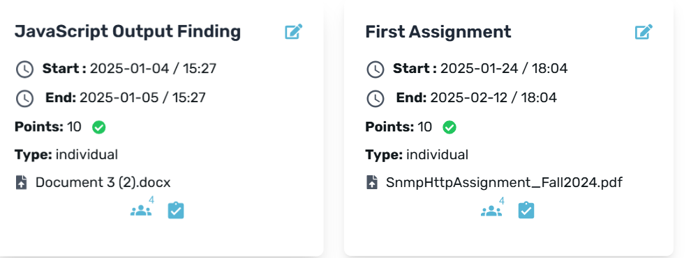
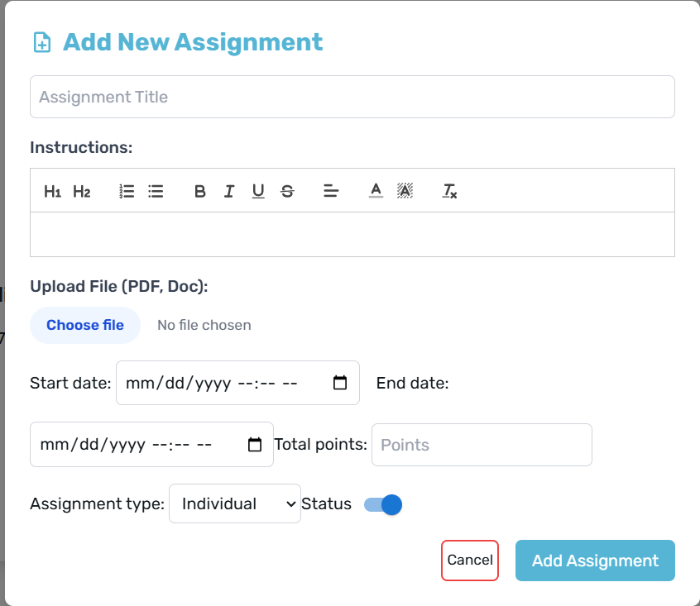
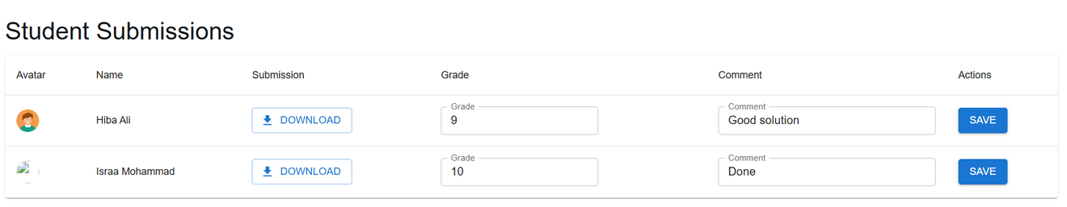
Assignments
This page enble instructors show added assignments or add new assignment with all details and could show added assignments students submissions.

Slide 19
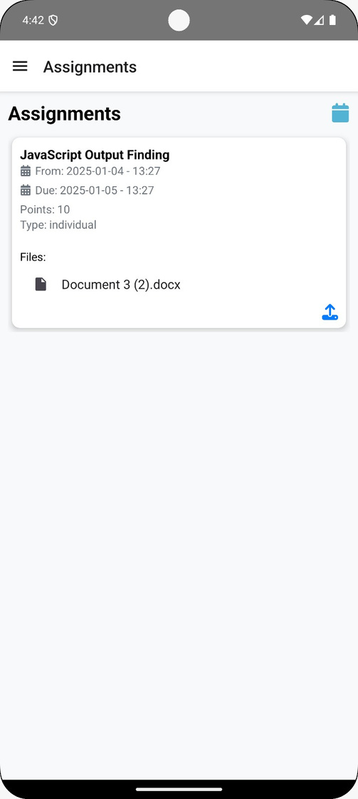
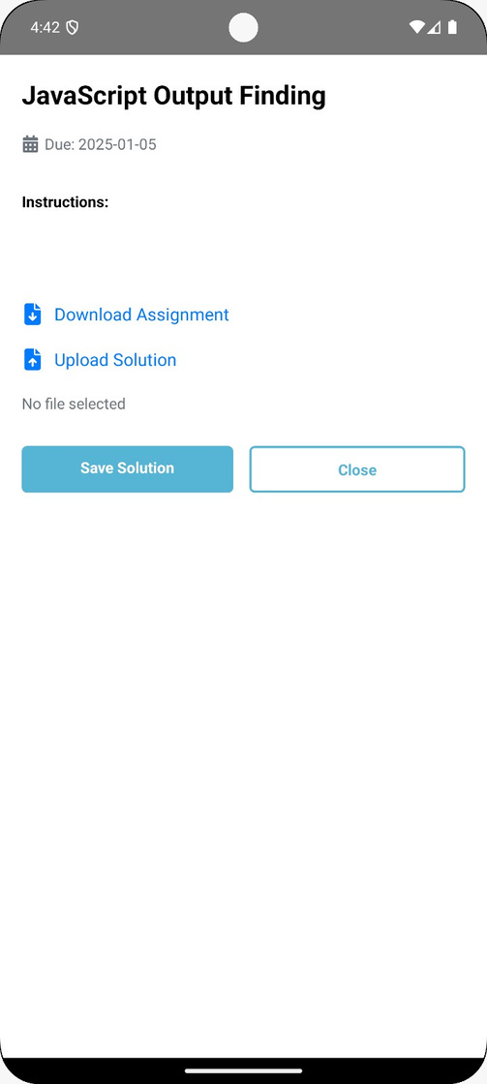
Assignments - Student Side
From this page we show available assigments of specific course with information needed.

Slide 20
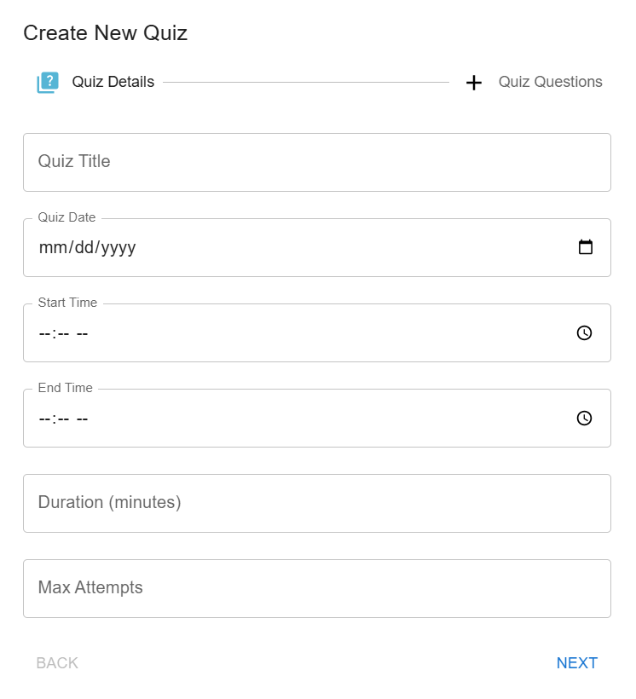
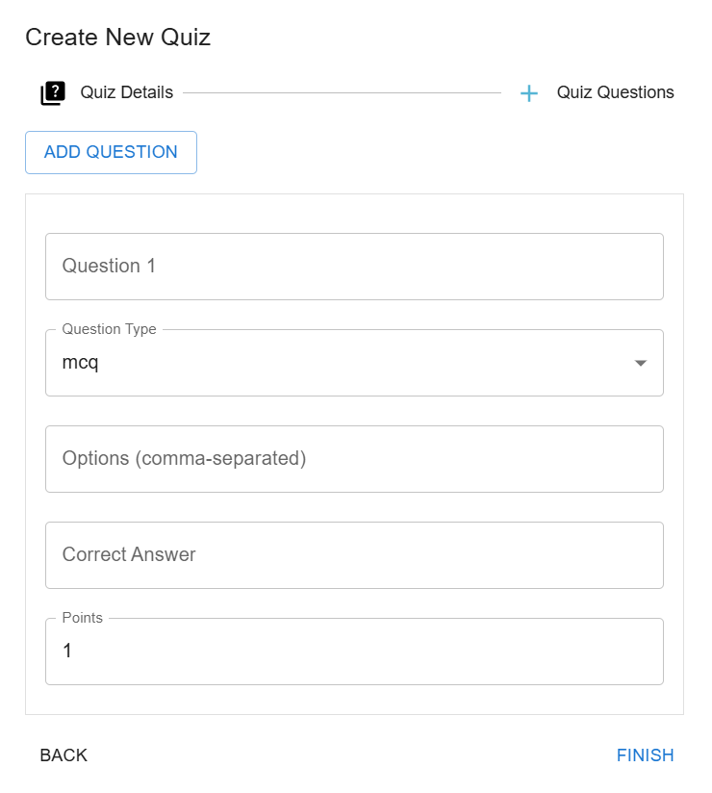
Quizzes
This page enble instructors show added Quizzes or add new Quiz.

Slide 21
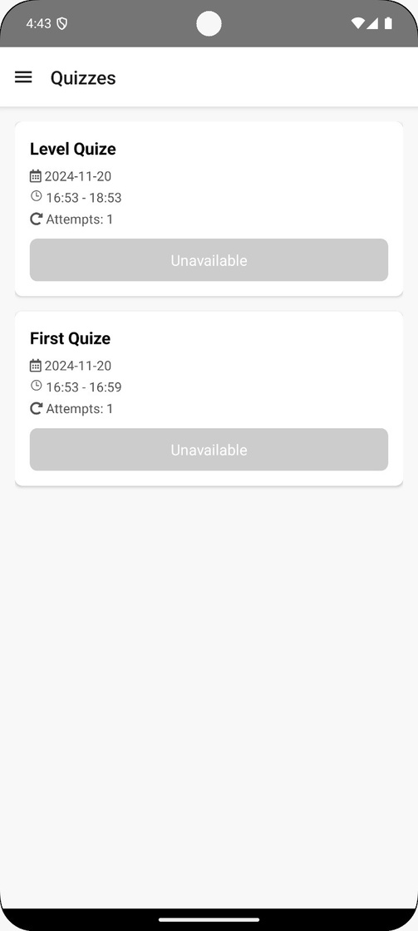
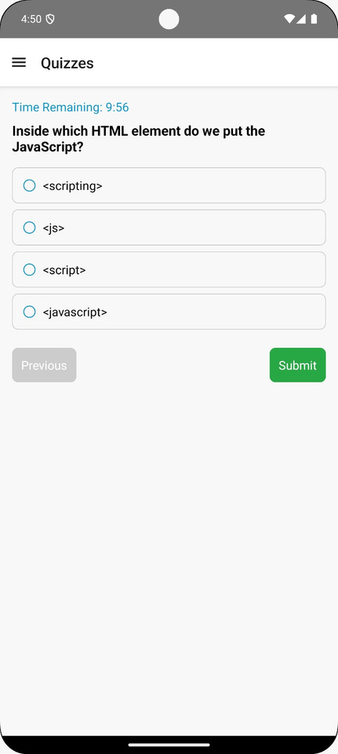
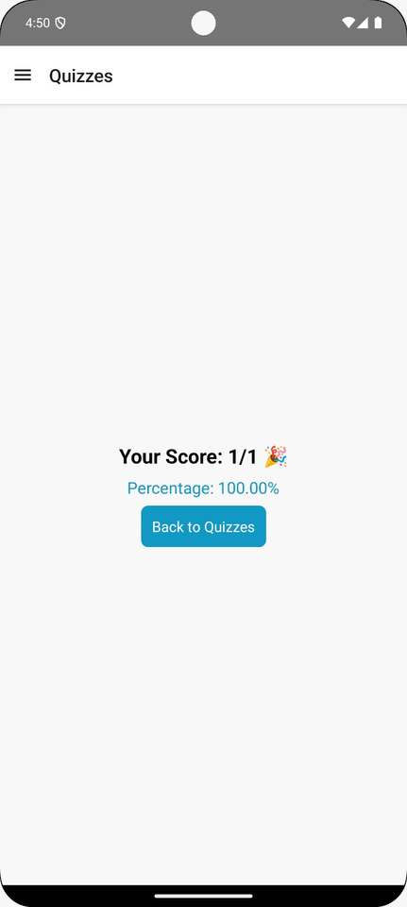
Quizzes - Student Side
From this silde,we show quizess ,and if available or not,when attempted quiz,finally grade gain of quiz.

Slide 22
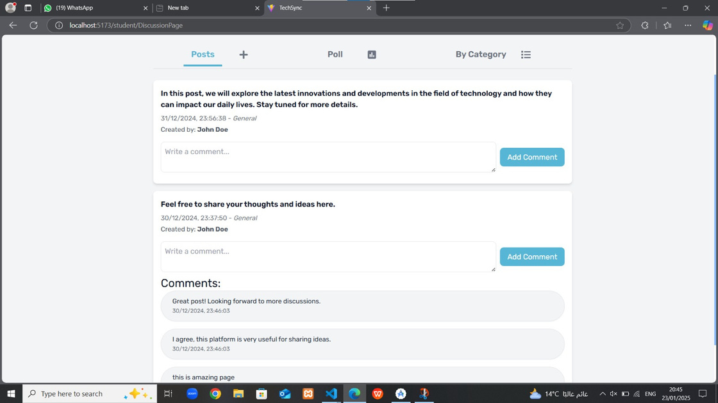
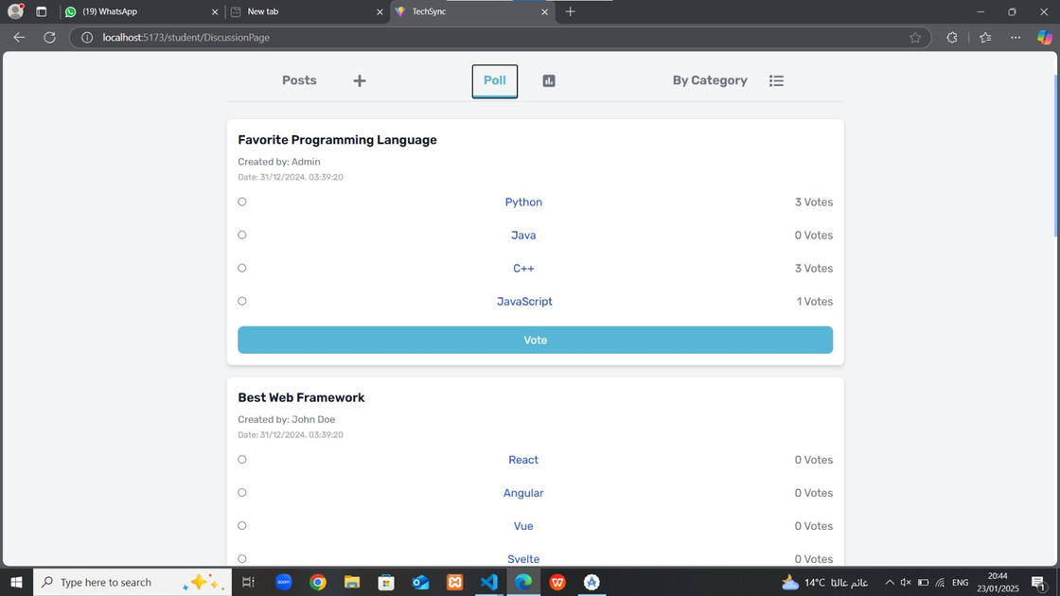
Course Discussion Page
This page is designed to help instructors and students communicate and share ideas. Each course has a discussion page where students can add posts or polls, which must be approved by an admin before being shared with others.

Slide 23
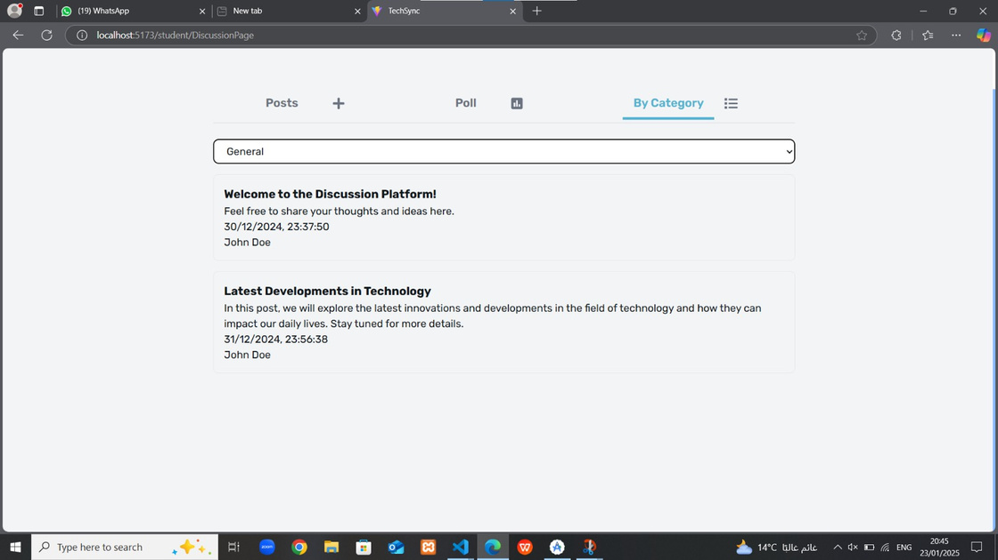
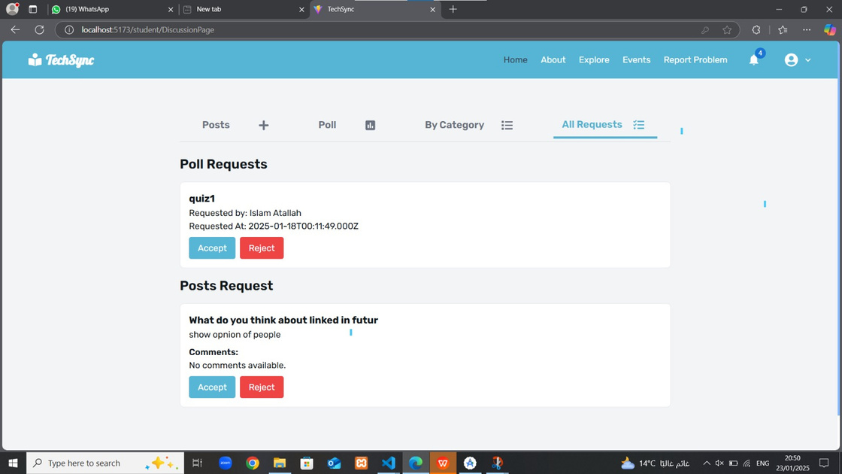
Course Discussion Page
This page is designed to help instructors and students communicate and share ideas. Each course has a discussion page where students can add posts or polls, which must be approved by an admin before being shared with others.

Slide 24
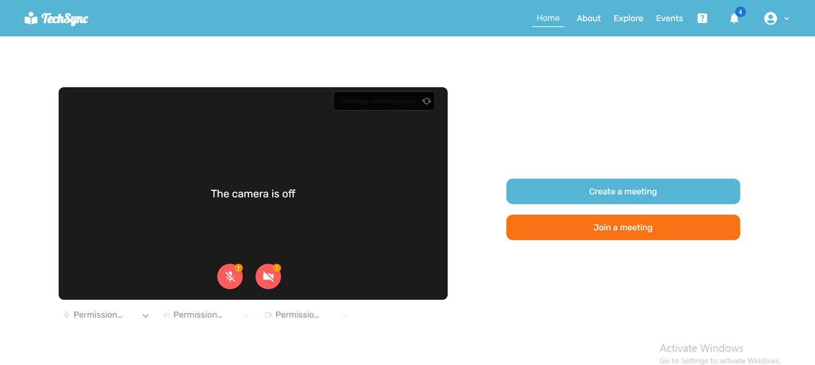
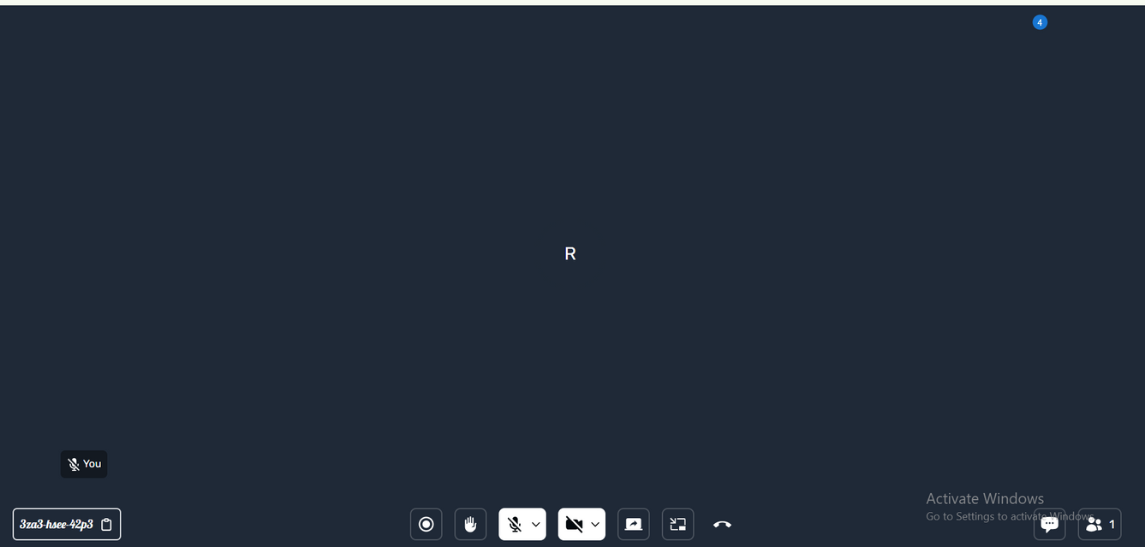
Meeting
This page enables users to create an instance meeting or join already created meetings, with all needed features.

Slide 25
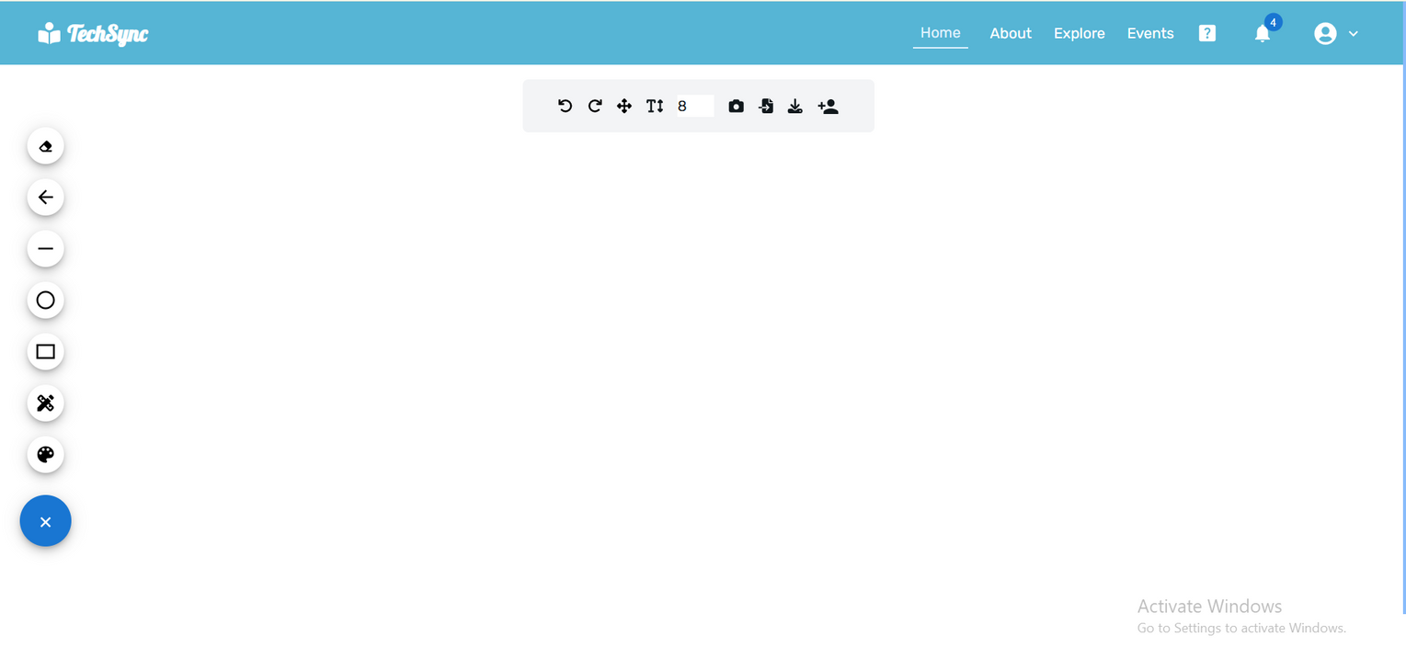
Whiteboard
This page is for a collaborative real-time whiteboard that can be shared among multiple users, displaying changes simultaneously.

Slide 26
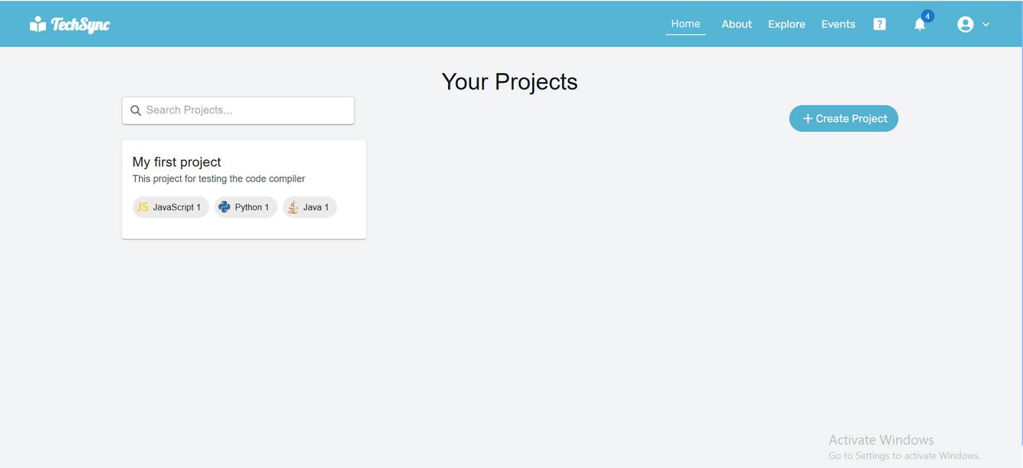
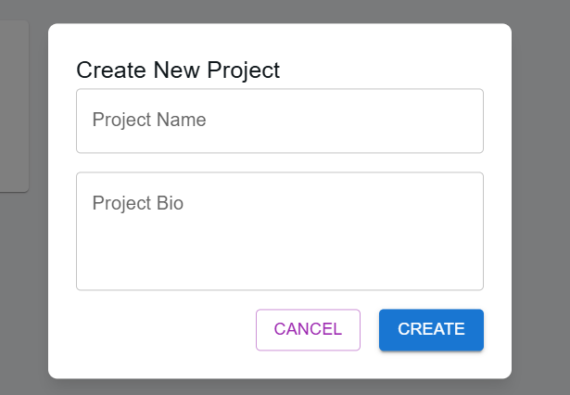
Code Project
This page enable users create new code poject and show already added projects.

Slide 27
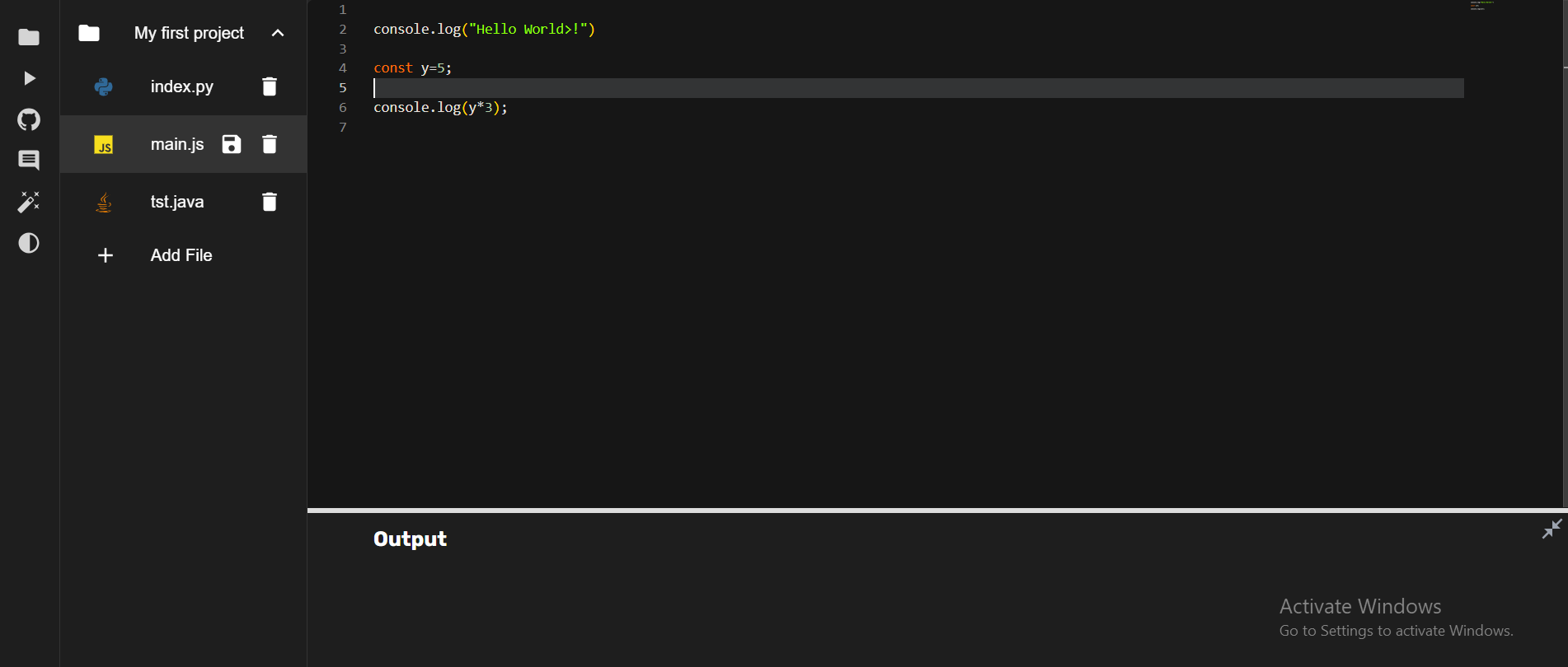
Code Project
This page show project files and contais code editor to test code and compile / run it.

Slide 28
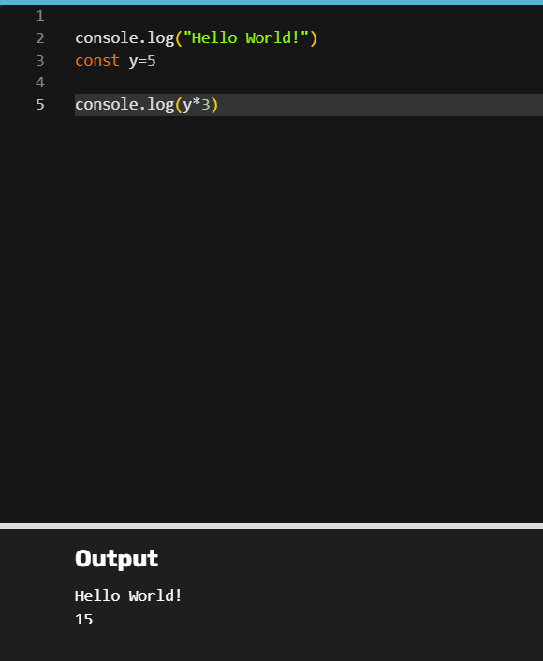
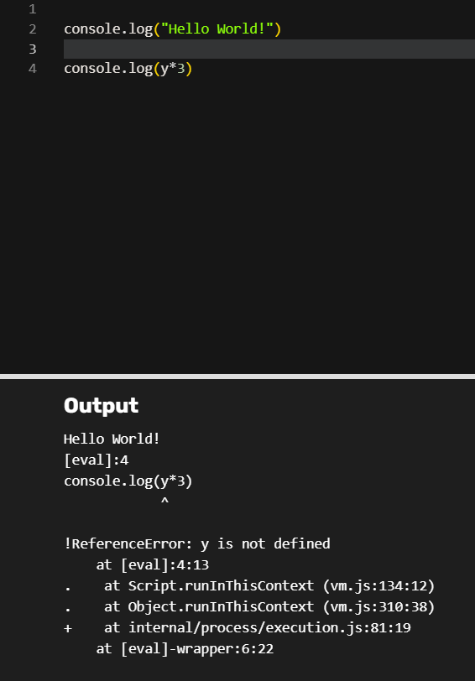
Code Project

Slide 29


Code Project
User Add comments to any line of the code to keep organized

Slide 30


Code Project
This page helps users ask questions about their code. They can send their questions to an AI and attach their code to request assistance.

Slide 31



Code Project
This page enables users to share their code on GitHub. Users must first log in to GitHub, select the repository where they want to save the code, write a commit message, and then push the changes.

Slide 32

Tasks Manager
This page allows users to view a dashboard of their projects and create new ones to either share with others or work on individually.

Slide 33

Tasks Manager
This page allows users to display project tasks on a drag-and-drop board, create new tasks, and assign them to team members.

Slide 34




Tasks Manager
This page enables users to view and edit task details, add comments, mention other members with real-time notifications, and invite new members to the project via email.

Slide 35

Bugs & Issues Page
This page displays the most recent questions about technical problems and allows users to ask their own questions, fostering a collaborative environment for problem-solving and knowledge sharing.

Slide 36


Bugs & Issues Page
Allows users to ask their own questions, and could filter uestions based on available tags.

Slide 37


Bugs & Issues Page
This page displays question details and their answers. Each answer can be upvoted or downvoted, and highly upvoted answers are marked as verified and pinned.

Slide 38


Interviews Guide
This page allows users to share their experiences with interview questions and help others prepare for interviews. Users can filter content by position and share their own experiences as well.

Slide 39


Notes & To-Do list
This page allows users to add, edit, or delete notes. Users can organize their notes for quick access.

Slide 40

Notes & To-Do list
This page allows users to add, edit, or delete tasks on their to-do list. Tasks can be organized by categorizing them based on priority levels and filtered by specific days. Users can also mark tasks as completed, and track progress to stay on top of their schedule.

Slide 41

Calendar & Schedualing
This calendar displays all user events, tasks, courses, and more to provide a well-organized schedule and help users stay on top of their commitments. It also offers multiple viewing options, such as daily, weekly, or monthly views, for better event management.

Slide 42


Calendar & Schedualing

Slide 43

Portfolio page
  Allows users to create a personal portfolio.
  Showcase skills, achievements, and professional experiences.
  Share a professional profile with potential employers or clients.

Slide 44

Portfolio page

Slide 45



Portfolio page

Slide 46

TechSync Users
This page enable user see other platform users and see thier portfolio or communicate with others.

Slide 47


E-commerce
This page allows users to offer their hardware components, books, and slides for sale. It also enables others to reserve items if they are available.

Slide 48


E-commerce

Slide 49

Study Plan:
This features help student from study ,mangment time and accomplish tasks by enter information about exam then Ai generate schedule study plan .

Slide 50

Report a Problem
This feature allows users to report any problems they encounter, which are then sent to the admin for tracking and resolution.

Slide 51

Events Page
This page allows users to announce or showcase the latest events and register for them if registration is required and available

Slide 52

Admin Dashboard
This page show responsible for managing and organizing the system.

Slide 53



Admin Dashboard
Responsible for managing and organizing the system. Adds users, teachers, and materials. Ensures that the system runs smoothly and resolves any issues.

Slide 54

Chatting:
This page show chatting with friends and contact list with there status . Notification when message received.

Slide 55


Mobile Application
This page, upon user login, displays today's events or tasks and recommends courses based on the user's most frequent searches.

Slide 56



Mobile Application

Slide 57



Mobile Application

Slide 58



Mobile Application

Slide 59



Mobile Application

Slide 60








Tools
React
React Native
Node js
MySql Database
Docker
Postman
Firebase
Tailwindcss

Slide 61
Constrins
  Coast Constraints
  Incompatibility between various libraries and versions in react & react native
  Time Constraint
  Version Control Issues

Slide 62
Future Work
  Support more programming language on code editor.
  Integrate Ai with courses so help students more during thier study.
  Add Interactive Debugging Tools.
  Integrate Career Guidance.

Slide 63
Thank you

