Slide 1
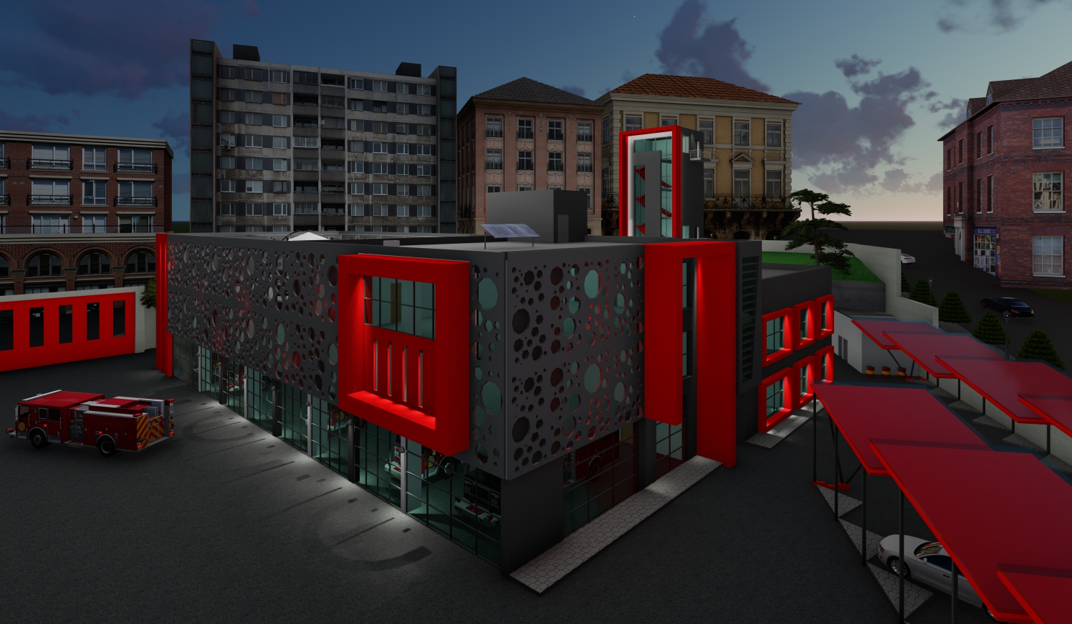
Integrated Redesign of a Fire Station in Nablus City
Prepared by:
Raghad Abu Hatab
Israa Sholi
Jawaher Sweedan
Supervisor:
Dr. Muhannad Haj Hussein

Slide 2
TABLE OF CONTENTS
01
Structural Design
05
02
Electro_Mechanical Design
06
Architectural Design
Fire & Safety Design
Bill of Quantity
Site & Location
03
Thermal Design
07
04
Environmental Design
08

Slide 3
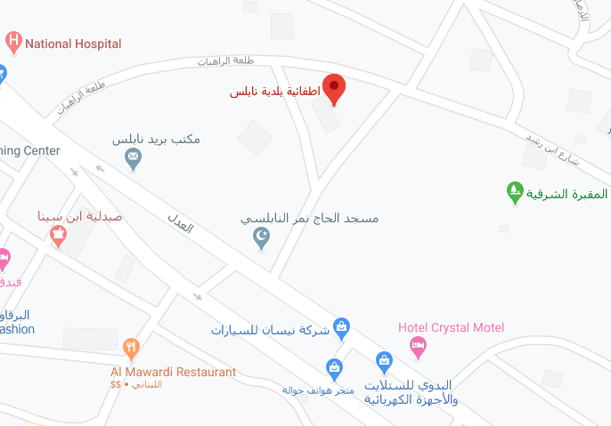
Site & Location
01

Slide 4
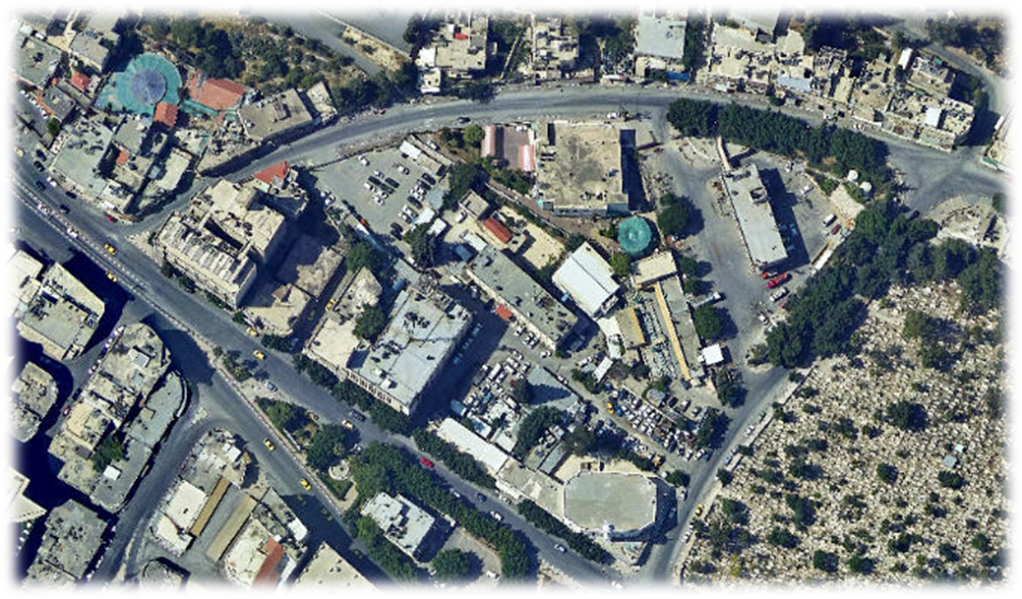

The fire station building is located in northern mountain of Nablus city, which lies in the north of west bank, approximately 30 mile north of Jerusalem. Nablus is about 550 m above sea level, on latitude 32.2$°$ N and longitude 35.2$°$ E.
The nuns building and other buildings surround the site on the north. On the south by AL Shuhada’ Street and the eastern Cemetery. While the east by Ibn Rushd Street and other buildings, finally on the west by the city police station and AL Haji Nimr Nabulsi Mosque.
Fire Station
Police Station
Mosque

Slide 5
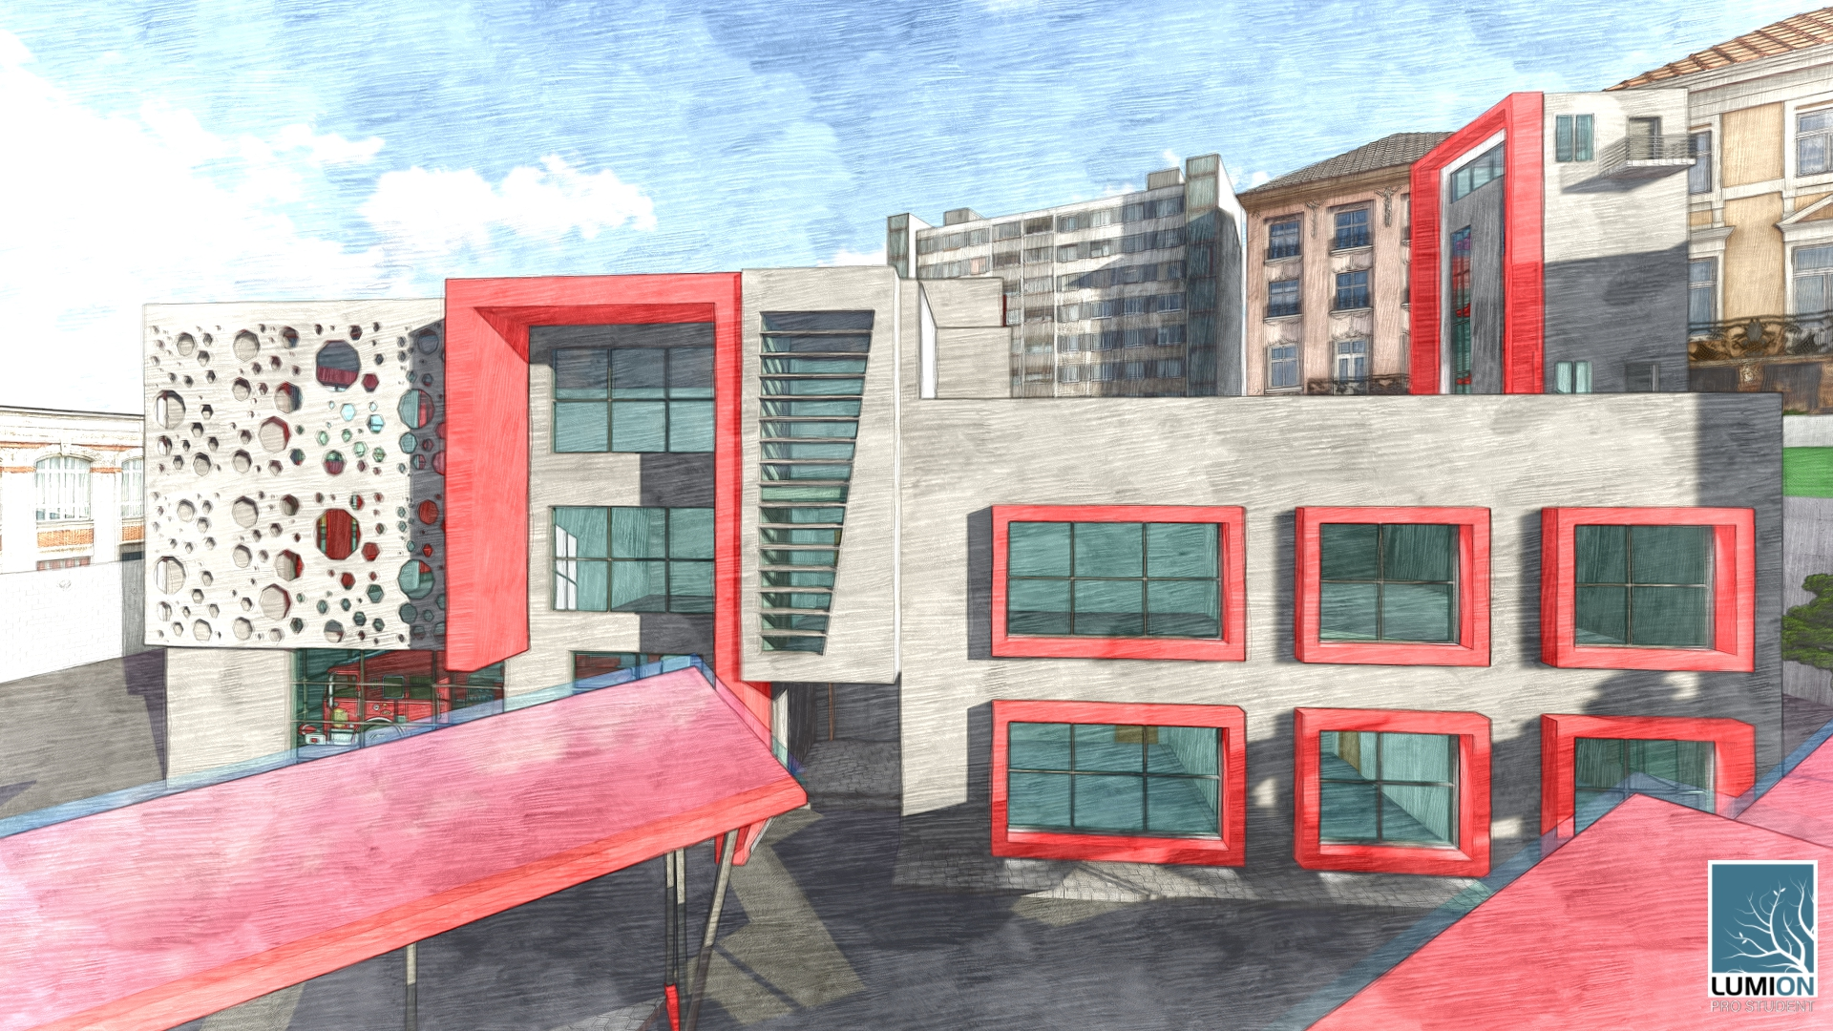
Architectural Design
FIRST CONCEPT
02
Neptune is the fourth-largest planet by diameter in the entire Solar System

Slide 6
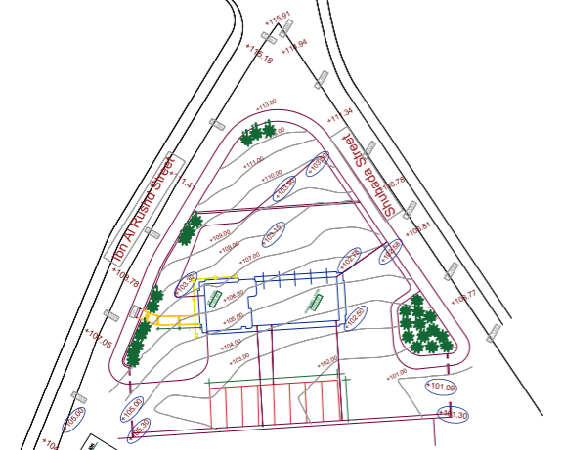
The site-before

Slide 7
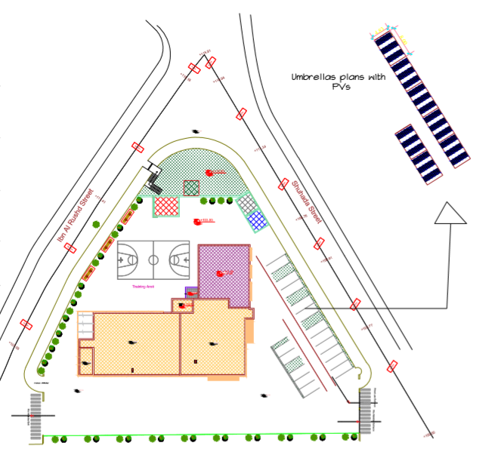
The site-after

Slide 8
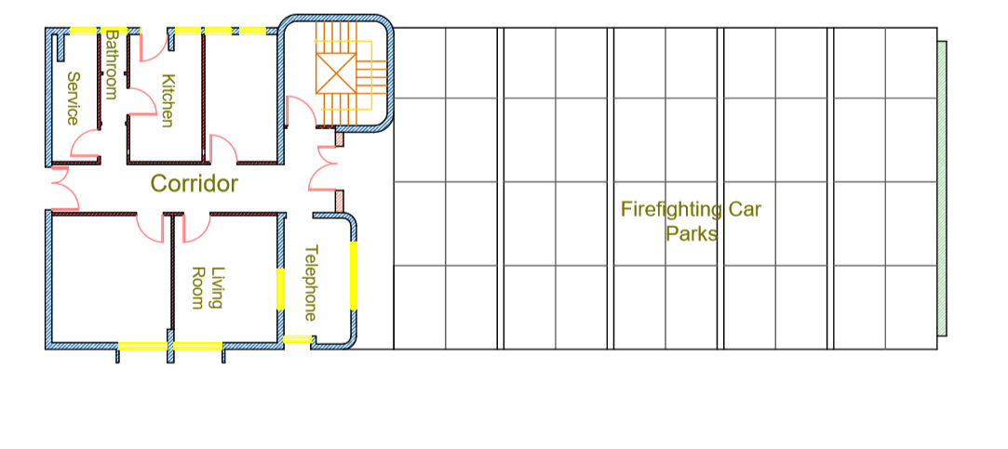
Ground floor-before

Slide 9
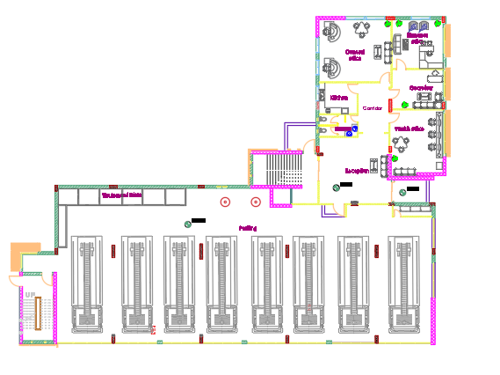
Ground floor–after

Slide 10
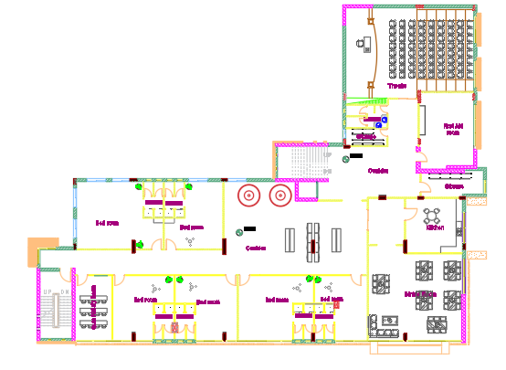
First floor–after

Slide 11
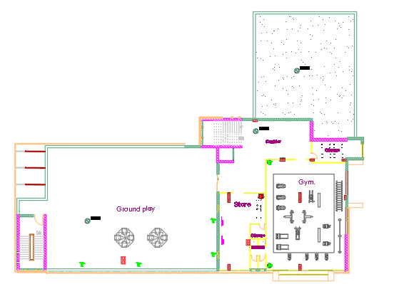
Second floor–after

Slide 12
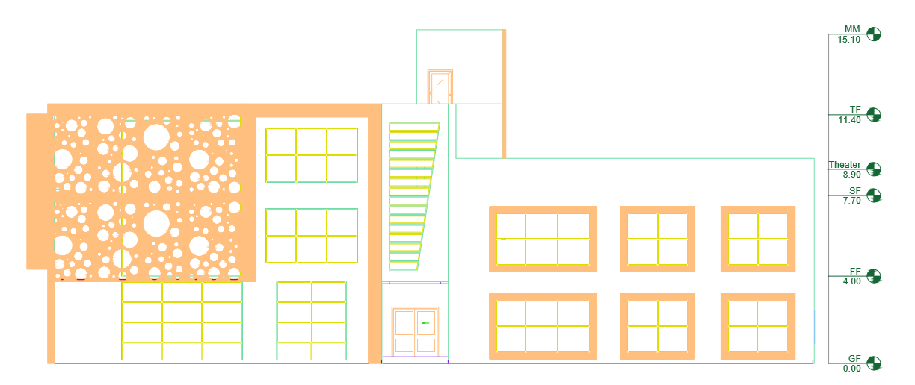
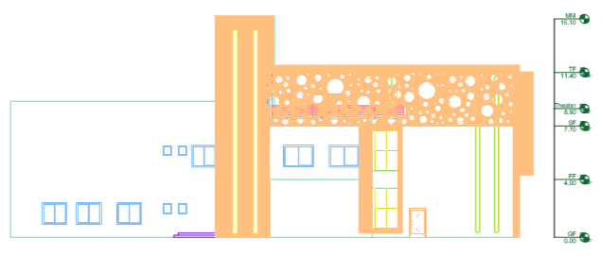
Elevations
North elevation
South elevation
South elevation

Slide 13
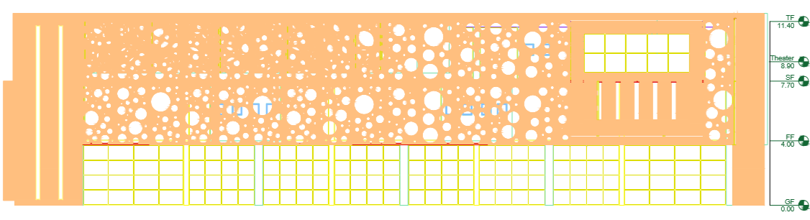
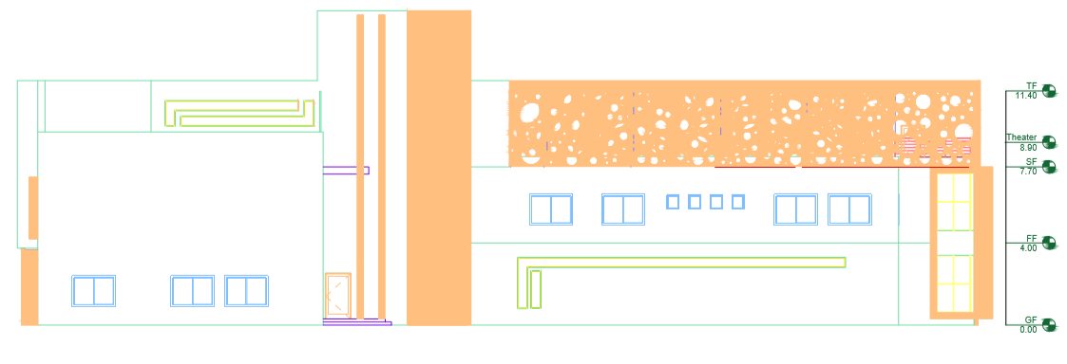
Elevations
East elevation
West elevation

Slide 14
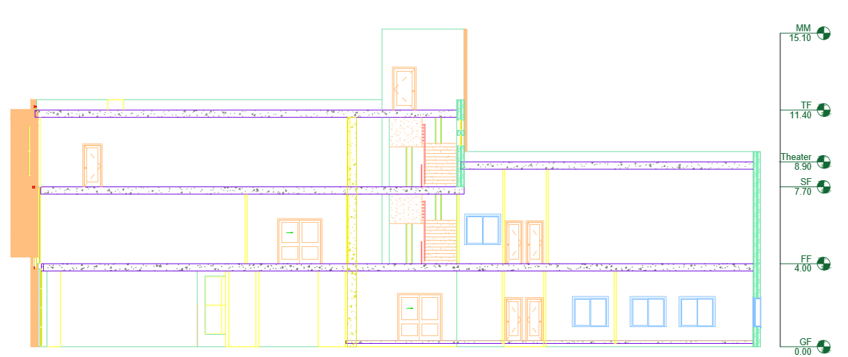
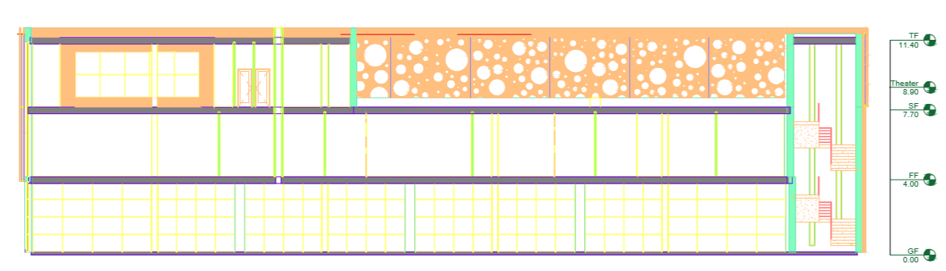
Sections
Section B-B
Section A-A

Slide 15
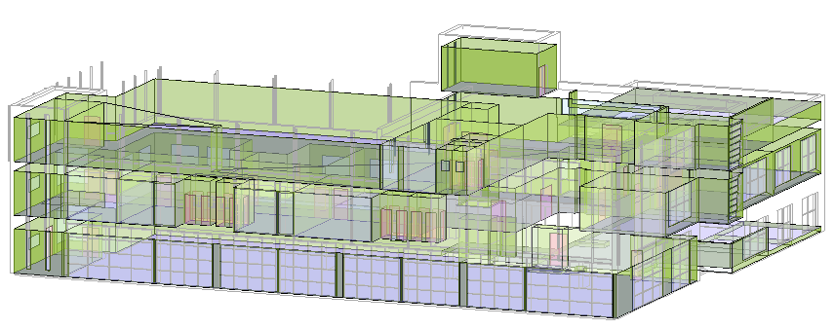
Thermal Design
03

Slide 16
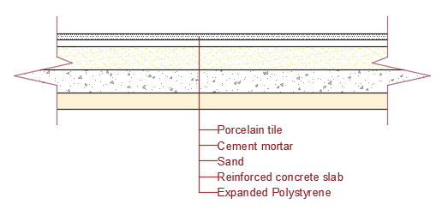
Material construction properties
Material | Thickness | K value (W/m.k)
Porcelain tile | 2 cm | 1.3
Cement mortar | 2 cm | 0.72
Sand | 7 cm | 2
Reinforced concrete | 10 cm | 1.9
EPS Expanded Polystyrene | 6 cm | 0.035
Ground Floor
U-value for ground floor = 0.487 W/m².k.

Slide 17
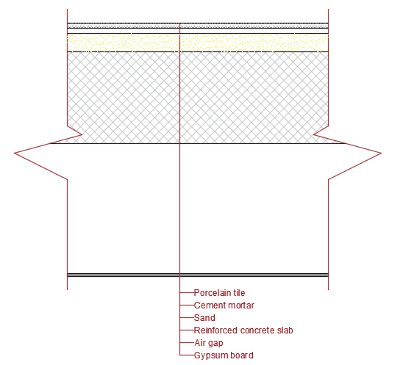
Material construction properties
Internal Floor
Material | Thickness | K value (W/m.k)
Porcelain tile | 2 cm | 1.3
Cement mortar | 2 cm | 0.72
Sand | 7 cm | 2
Reinforced concrete | 35 cm | 1.9
Air gap | 60 cm | −
Gypsum board | 1.2 cm | 0.16
U-value for internal floor = 1.132 W/m².k.

Slide 18
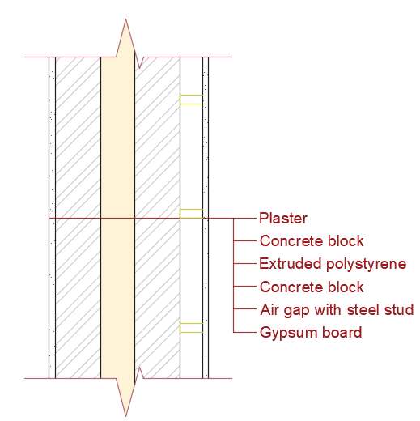
Material construction properties
External Wall
Material | Thickness | K value (W/m.k)
Plaster | 1.3 cm | 0.8
Concrete block | 10 cm | 0.62
XPS Extruded Polystyrene - CO2 Blowing | 7.4 cm | 0.034
Concrete block | 10 cm | 0.62
Air gap with steel stud | 5 cm | −
Gypsum board | 1.2 cm | 0.16
U-value for external wall = 0.343 W/m².k.

Slide 19
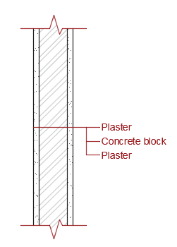
Material construction properties
Internal Wall
Material | Thickness | K value (W/m.k)
Plaster | 2 cm | 0.8
Concrete block | 10 cm | 0.62
Plaster | 2 cm | 0.8
U-value for internal wall = 2.122 W/m².k.

Slide 20
Acoustical Design
Zone | Reverberation time (RT60)
Office | 0.4-1.0 Sec
Theater | 0.6-1.3 Sec
Dining Room | <1.4 Sec
Bedroom | 0.4-1.1 Sec
Quit Study Room | 0.4-0.6 Sec
Gymnasium | 1.0-1.5 Sec
The standard value for RT60:
The absorption coefficient for the finished material:
Element | Finish material | ɑ at 125 Hz | ɑ at 250 Hz | ɑ at 500 Hz | ɑ at 1000 Hz | ɑ at 2000 Hz | ɑ at 4000 Hz
Wall | Plaster | 0.03 | 0.03 | 0.04 | 0.05 | 0.04 | 0.03
Ceiling | Suspended ceiling | 0.26 | 0.57 | 0.63 | 0.96 | 0.44 | 0.56
Floor | Porcelain tile | 0.02 | 0.03 | 0.03 | 0.03 | 0.03 | 0.02
Floor | Wood | 0.1 | 0.36 | 0.99 | 0.99 | 0.5 | 0.35
Door | Solid Wood | 0.15 | 0.11 | 0.1 | 0.07 | 0.06 | 0.07
Chair | Leather | 0.44 | 0.54 | 0.6 | 0.62 | 0.58 | 0.5
Chair | fabric | 0.19 | 0.37 | 0.56 | 0.67 | 0.61 | 0.59
Chair | wood | 0.15 | 0.19 | 0.22 | 0.39 | 0.38 | 0.3
Window | Double glass | 0.35 | 0.25 | 0.18 | 0.12 | 0.07 | 0.09
 | Baffle | 0.23 | 0.6 | 0.99 | 0.99 | 0.99 | 0.99

Slide 21
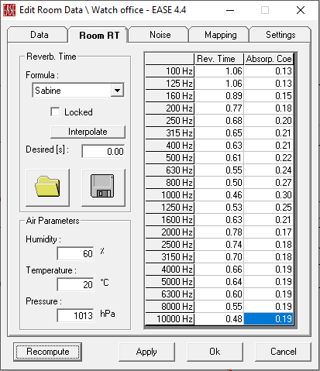
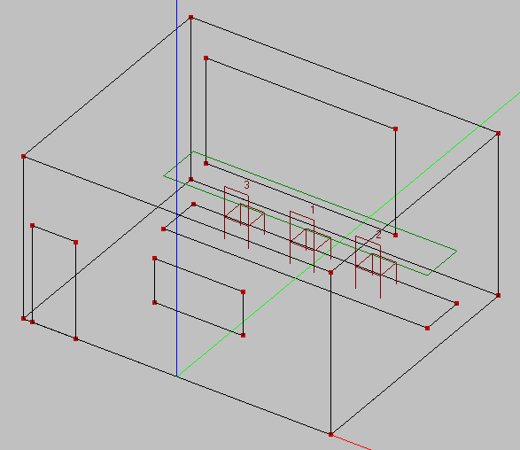
Acoustical Design
The reverberation time for the office according to Sabine:

Slide 22
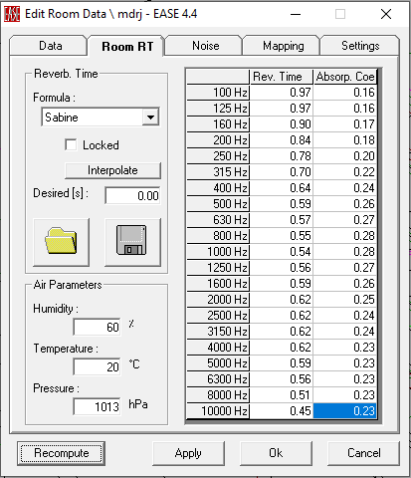
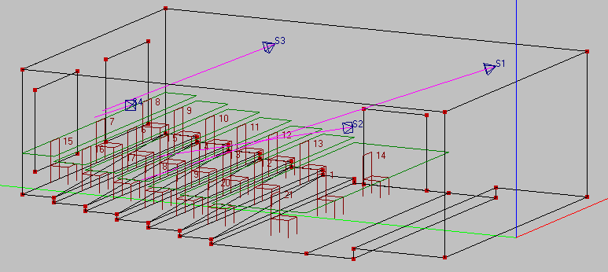
Acoustical Design
The reverberation time for the theater according to Sabine:

Slide 23
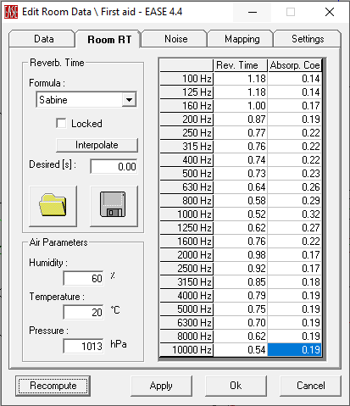
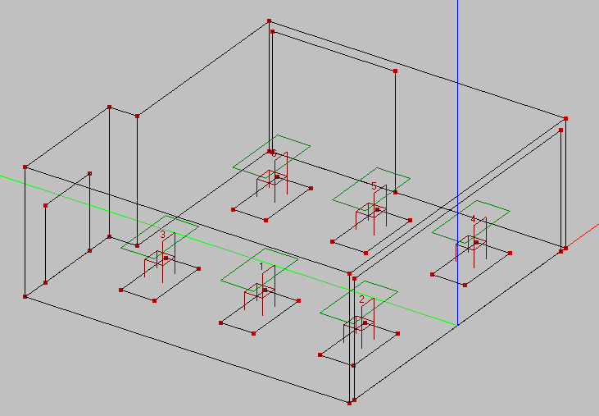
Acoustical Design
The reverberation time for the dining room according to Sabine:

Slide 24
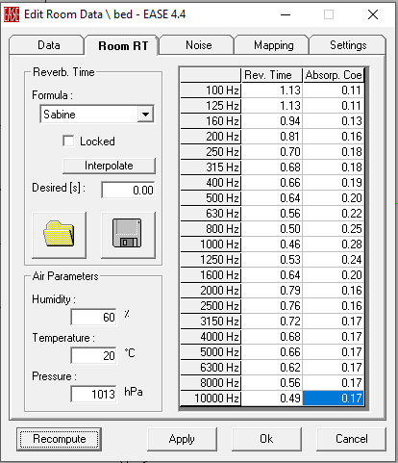
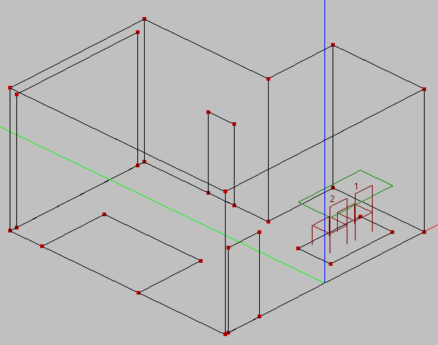
Acoustical Design
The reverberation time for the bedroom according to Sabine:

Slide 25
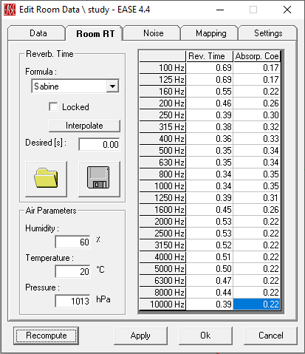
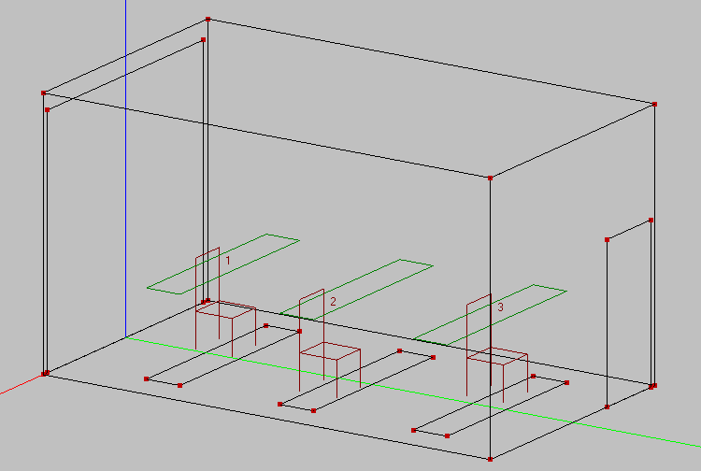
Acoustical Design
The reverberation time for the study room according to Sabine:

Slide 26
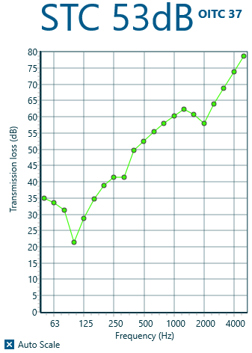
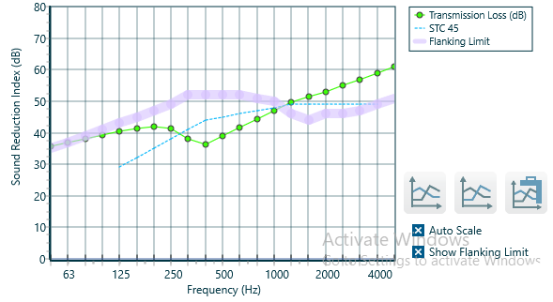
Acoustical Design
Sound Transmission Loss (STC)
The sound transmission loss for the internal walls between different spaces:
Room Being Considered | Adjacent Area | STC Level (dB)
Bedroom | Corridor | 45
 | Study Room | 45
 | Bedroom | 52
Conference Room | Corridor | 42
 | First Aid Room | 45
Store | Corridor | 40
 | Gymnasium | 53
First Aid Room | Corridor | 40
Dining Room | Corridor | 50
 | Bedroom | 50
 | Kitchen | 50
Gymnasium | Corridor | 53
Study Room | Corridor | 53

Slide 27
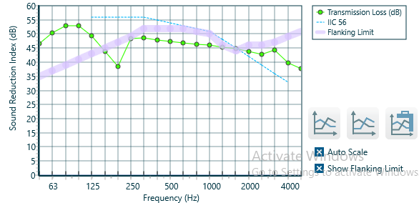
Acoustical Design
Impact Insulation Class (IIC)
The Impact insulation class for the internal floor = 56 dB and the calculated IIC for the floor should be more than 50 dB, so it’s ok.

Slide 28
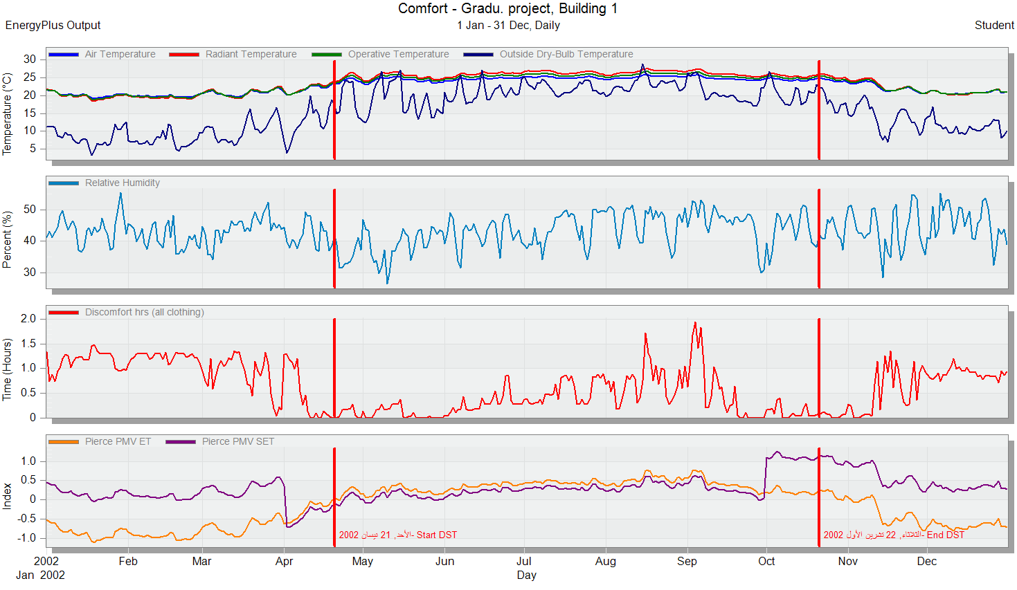
Heating & Cooling load
The comfort graph for the station from Design Builder:

Slide 29
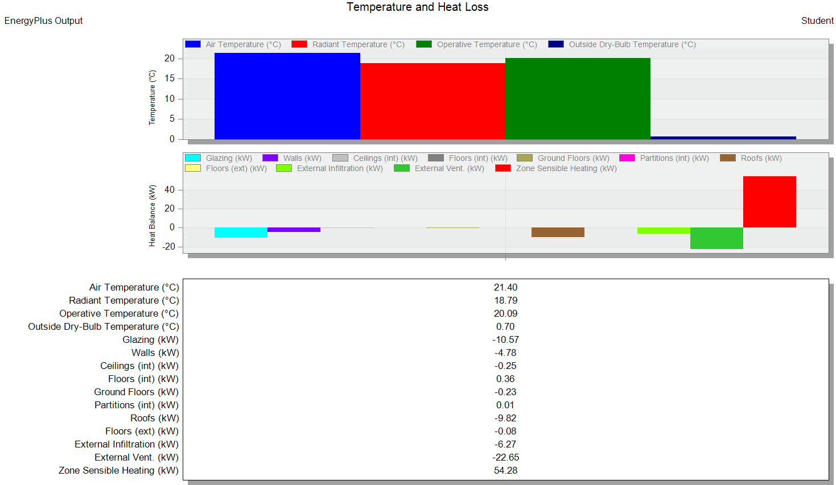
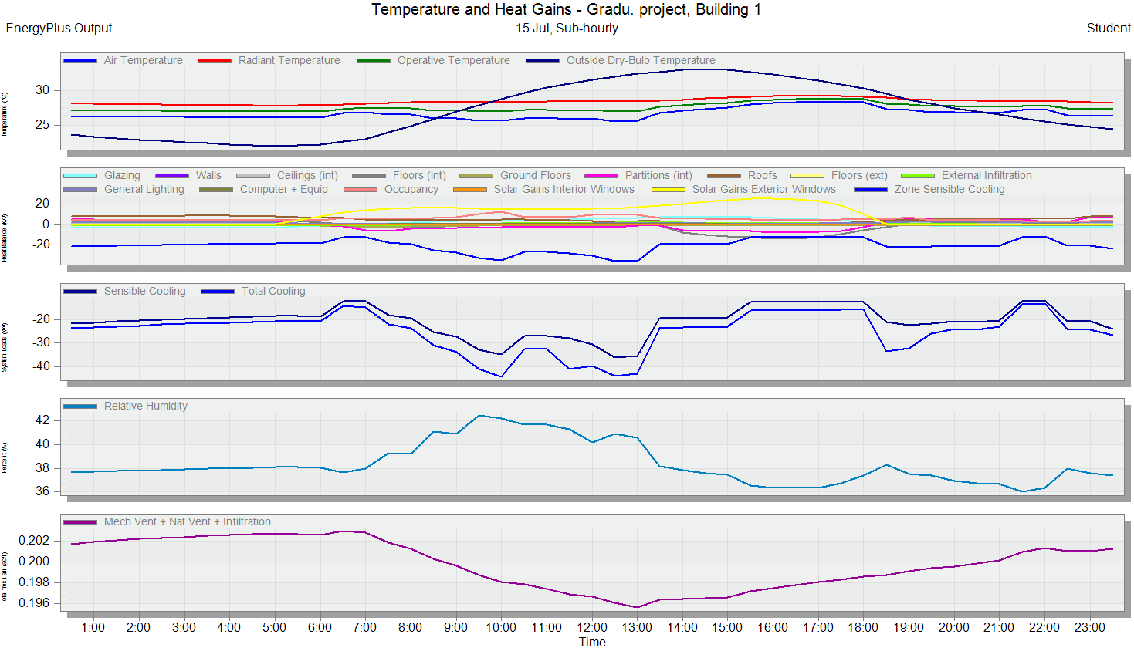
Heating & Cooling load
Temperature and heat loss from Design Builder:
Temperature and heat gain from Design Builder:

Slide 30
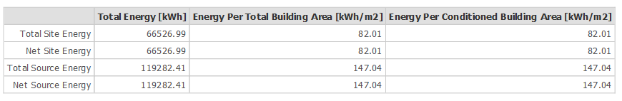
Heating & Cooling load
The site and source energy for the station from Design Builder:
The total site energy in the station is less than the baseline of the energy intensity equal to 278.1 kWh/m², which is required.

Slide 31
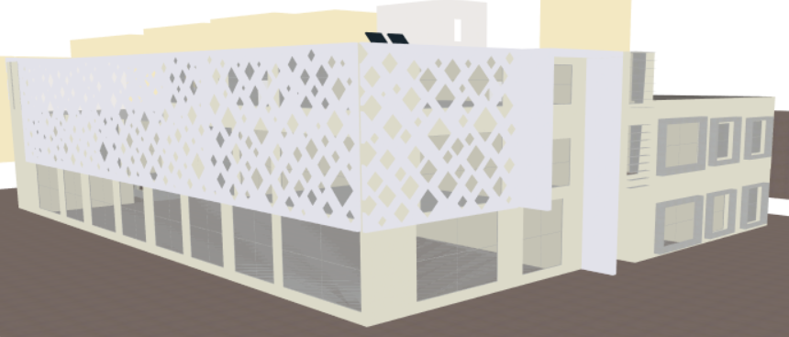
Enviromental Design
04

Slide 32
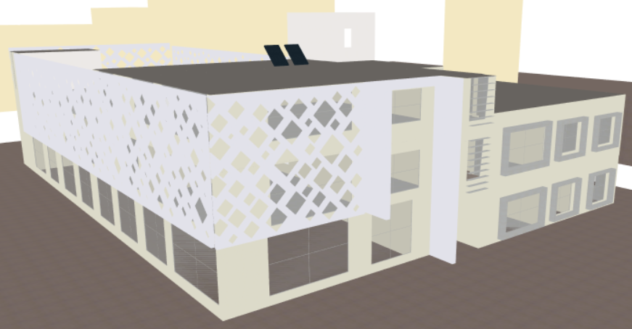
Daylighting
Main modification for daylighting:
1. Used CNC.
2. Adding Cantilevers.
3. Adding Louvers.
4. Using low transmission glass.

Slide 33
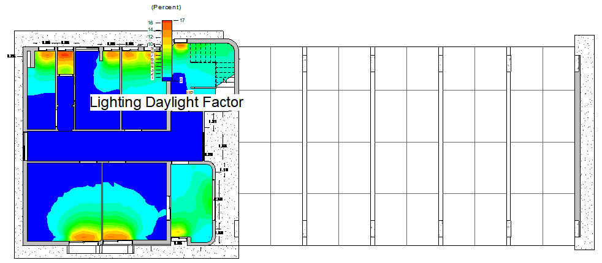
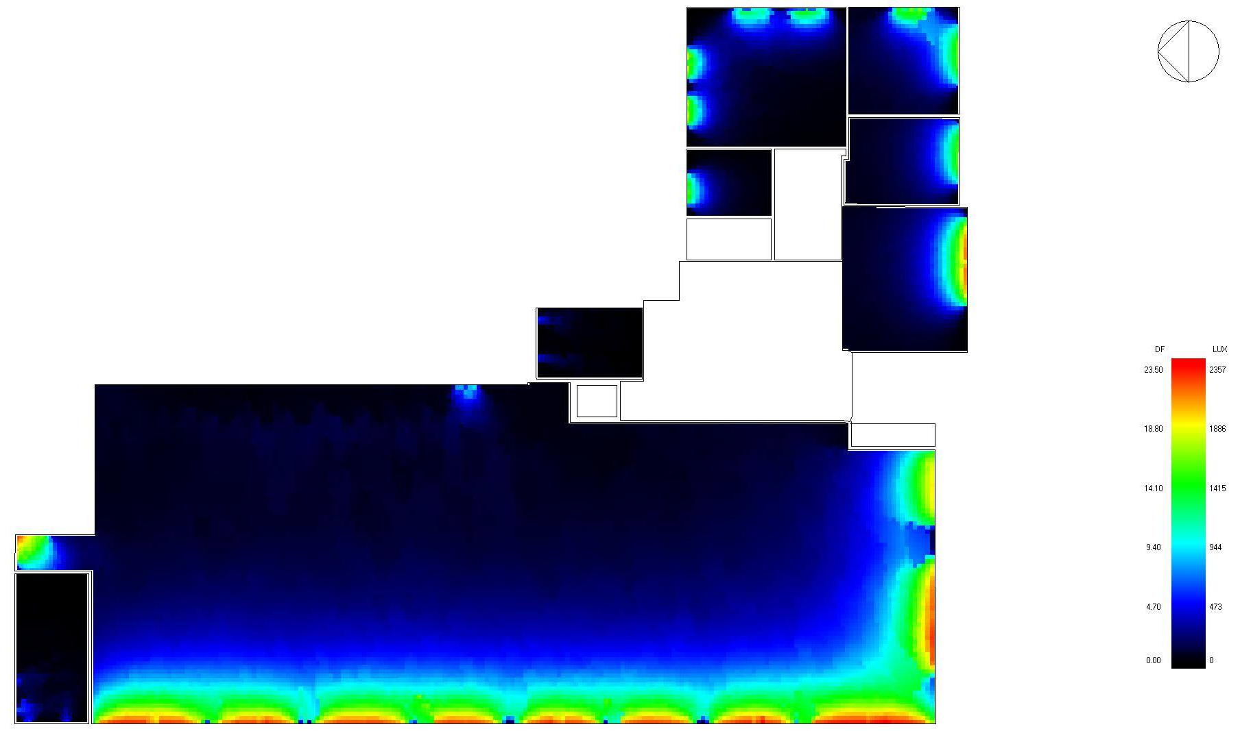
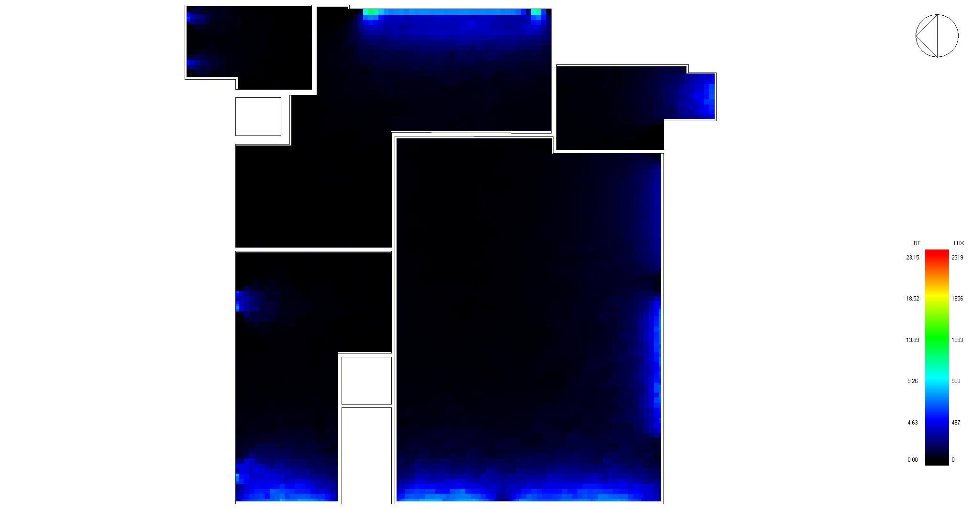
Daylight analysis for the model for the ground floor before and after modification:
After
Before
Average daylight factor = (2-6)%

Slide 34
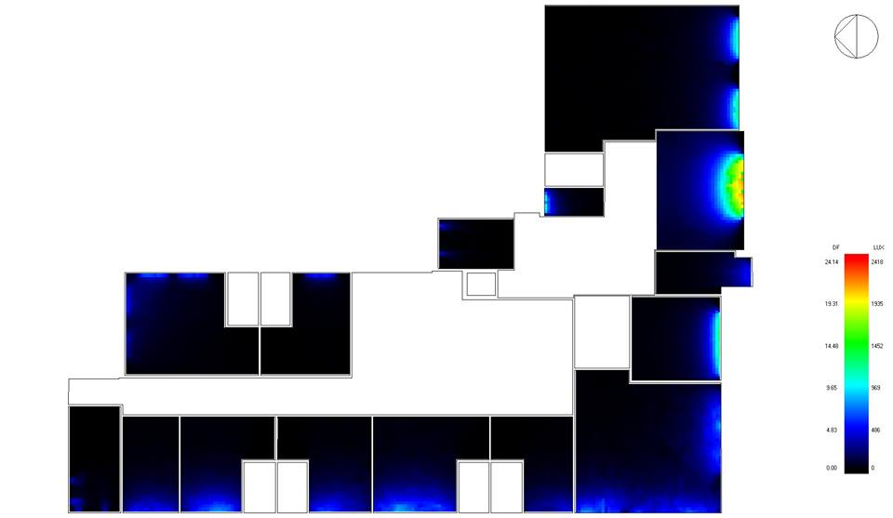
Daylight analysis for the model for the first and second floors after modification:
Average daylight factor = (2-6)%

Slide 35
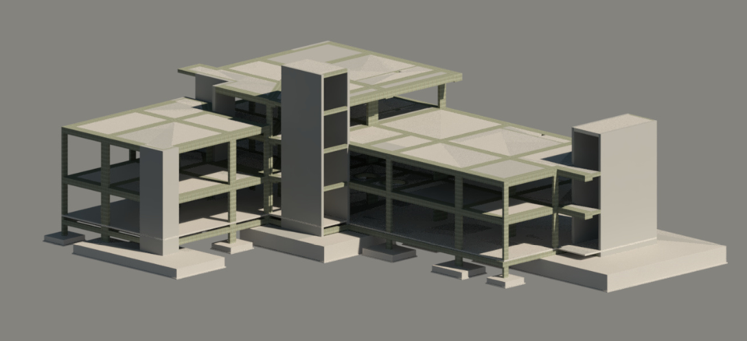
Structural Design
05

Slide 36
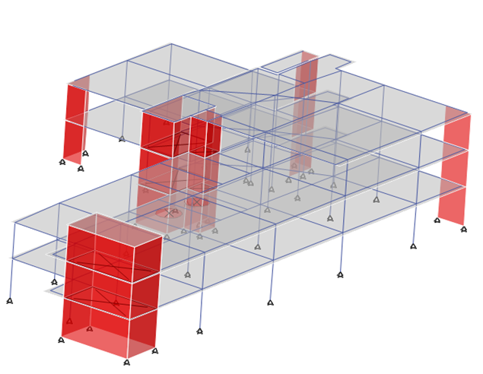
Our project is designed to carry live, dead and super imposed loads. The building has a seismic joint, so we have two parts as shown in the following figures:
Block one
Block one

Slide 37
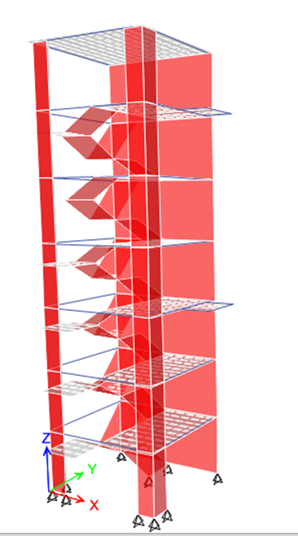
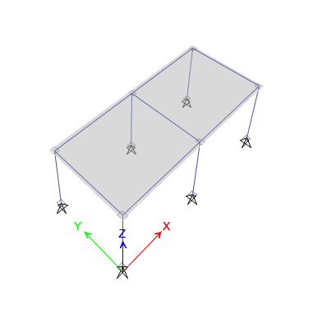
External buildings
The Tower
External rooms

Slide 38
The Loads
Live load from:
The_jordanian_national_building_code.
ICC IBC 2003
Occupancy or use | Uniform live load (psf) | Uniform live load (KN /m²)
Gymnasium | 100 | 5
Other areas | 63 | 3
Super imposed dead = 4.5 KN / m²

Slide 39
Definition of response spectrum seismic load
The building was analyzed and designed to resist seismic forces based on UBC 97 code.
The city, which will be held in building, is the city of Nablus.
Soil type is S_{E}.
Seismic zone of Nablus is 2B (Z=0.20) as shown in seismic hazard map.
Importance factor: I = 1.25, as the building is classified as an essential building
Acceleration-dependent seismic Coefficient (Ca) =0.20
Velocity-dependent seismic Coefficient (Cv) =0.20
Force reduction factor, R= 5.5

Slide 40
The checks
There are some checks through which we check if the outputs and results of the ETABS program are correct. These checks have been done as the following:
Compatibility check
Equilibrium check
Internal force check
Deflection check
Period check
Base shear check
Drift check

Slide 41
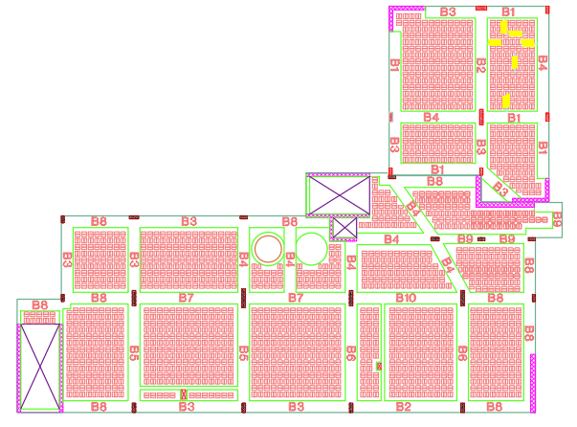
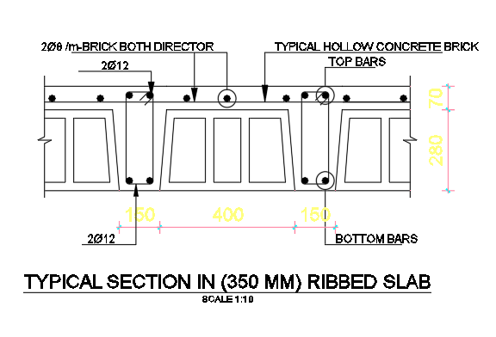
Reinforcement design
Slab design

Slide 42


Reinforcement design
Column design
Details of column 11

Slide 43

Beam design

Slide 44


Beam design
Longitudinal
Section in B8
Cross-Section of B8

Slide 45


Shear wall design
Shear wall 6
Details of Shear wall 6

Slide 46

Footing design
Mat 0.9
F15

Slide 47

Footing design
Details of F15

Slide 48


Water tank design
3D view of water tank
from SAP2000
Reinforcement details of water tank

Slide 49


Water tank design
Section A-A of water tank
Section B-B of water tank

Slide 50

Retaining walls design
Our project contains two different retaining walls in terms of loads, whereby the first wall is only exposed to soil load on one side, and the second wall is exposed to both soil load and live load on the road, so we will design them through the PROKON program.

Slide 51

Retaining walls design
Cantilever wall (1)
Wall design and dimensions by PROKON.

Slide 52


Retaining walls design
Section A in Cantilever wall (1)

Slide 53

Retaining walls design
Section A in Cantilever wall (1)

Slide 54

Steel structure design
Steel section of Umbrellas
Section | Group
HE240A | Top Cord
HE240A | Bottom Cord
HE240A | Bracing
HE240A | Column
3D view of Umbrellas from SAP2000

Slide 55

Steel structure design
Steel section of theater
Section | Group
L (40*40*3) | Top Cord
L (40*40*3) | Bottom Cord
CHS 88.9 * 3.2 | Bracing
CHS 323.9 * 6 | Column
3D view of theater from SAP2000

Slide 56

Electro-Mechanical Design
06

Slide 57











Artificial lighting
The selected Luminaires inside the building:
Venus
TPS760
SM150C
1/18W NS
Article name | Manufacturer | Luminous | Load
 |  | Lm | Watt
SM400C POE | PHILIPS | 4197 | 39
SM134V | PHILIPS | 2699 | 30.5
COMPASS | FLOS | 708 | 50
DN130B | PHILIPS | 2278 | 22
VENUS | LEDS C4 | 413 | 11
TPS760 | PHILIPS | 4431 | 108
SM150C | PHILIPS | 4799 | 45
1/18W NS HPF | NARDEEN | 810 | 18
TPS760 | PHILIPS | 4431 | 108
PT570P | PHILIPS | 2699 | 25
Lucequadro LED | 3F FILIPPI | 1904 | 28.2
PT570P
Lucequadro
SM400C
SM134V
Compass
DN130B

Slide 58









The selected Luminaires outside the building:
Article name | Manufacturer | Luminous | Load
 |  | Lm | Watt
MVP506 | PHILIPS | 21057 | 227
kamino130 led | ARES | 144 | 5.8
SPARKS 12 | SIMES | 159 | 44
SGS101 | PHILIPS | 3060 | 61
KTY234 | WEEF | 409 | 21
Flex Strip | PROLED | 120 | 1.4
COMPASS BOX | FLOS | 425 | 50
MaxiTube-Wall | UNILAMP | 895 | 84
MV P506
kamino
Spark S12
SGS101
KTY234
Flex Strip
Compass box
Maxi Tube

Slide 59







Illuminance results from DIALux.evo for the general offices

Slide 60






Illuminance results from DIALux.evo for the ground floor
Space | Lux | Required Lux | Uniformity | Required Uniformity | UGR | Required UGR
General Offices | 541 | 500 | 0.62 | 0.6 | 15.9 | 19
Watch Office | 636 | 500 | 0.54 | 0.6 | 15.1 | 19
Parking | 204 | 150 | 0.10 | 0.4 | - | 28
Reception Corridor | 223 | 200 | 0.42 | 0.4 | 19.8 | 22
Sanitary | 289 | 200 | 0.53 | 0.4 | - | 25
WC | 249 | 200 | 0.80 | 0.4 | - | 25
Stairs | 155 | 150 | 0.01 | 0.4 | - | 25

Slide 61





Illuminance result from DIALux.evo for the first floor
Space | Lux | Required Lux | Uniformity | Required Uniformity | UGR | Required UGR
Bed Room | 380 | 300 | 0.53 | 0.6 | - | 19
Dinning Room | 61.6 | 50 | 0.16 | 0.01 | 15.2 | 22
Kitchen | 568 | 500 | 0.58 | 0.6 | 16.3 | 22
Theater Workplane | 503 | 500 | 0.004 | 0.6 | 17.2 | 19
Theater Inclined surface | 734 | 500 | 0.73 | 0.6 | - | 19
Theater Top | 582 | 500 | 0.73 | 0.6 | - | 19
Theater between | 788 | 500 | 0.86 | 0.6 | - | 19
Theater Bottom | 784 | 500 | 0.85 | 0.6 | - | 19
First Aid | 662 | 500 | 0.63 | 0.6 | 15.2 | 16

Slide 62


Illuminance results from DIALux.evo for the second floor
Space | Lux | Required Lux | Uniformity | Required Uniformity | UGR | Required UGR
Gym | 401 | 300 | 0.065 | 0.6 | 11.4 | 22
Store | 149 | 100 | 0.4 | 0.4 | - | 25

Slide 63


Emergency Lights
Article name | Manufacturer | Luminous Flux | Connected Load
 |  | Lm | Watt
Emergency downlight EM120B | PHILIPS | 180 | 4
TCW060 2x36W 2H FLUORESCENT LAMP | PHILIPS | 3906 | 72
EM120B
TCW060

Slide 64


Emergency Light

Slide 65

Main Distrubiton Boards Locations

Slide 66


Sockets Plans
Distribution sockets in GF

Slide 67

The table shows the electrical load of power, lighting and speakers system in the building
Phases | Floors | D.B | Normal Load | Light Load | Total Power | I Load | I C.B | I cable | C.B | Cable (IEC) | # of power branch | # of light branch
 |  |  |  |  |  |  |  |  |  |  | 16 A,2.5 mm^2 | 10 A,1.5 mm^2
 |  |  | Watt | Watt | Watt | Amp | Amp | Amp | Amp
1 Phase | GF | D.B 1 | 8000 | 1566.5 | 3655.2 | 18.46 | 21.23 | 24.41 | 30 | (36 A) , 6 mm^2 | 11 | 7
 |  | D.B 2 | 3000 | 4920.5 | 4877.4 | 24.63 | 28.32 | 32.57 | 36 | (50 A) , 10 mm^2 | 5 | 10
 | FF | D.B 1 | 6750 | 1787 | 3956.6 | 19.98 | 22.98 | 26.43 | 30 | (36 A) , 6mm^2 | 9 | 8
 |  | D.B 2 | 14500 | 2132 | 6089.6 | 30.76 | 35.37 | 40.68 | 50 | (66 A) , 16 mm^2 | 23 | 28
 | SF | D.B | 7750 | 1389.4 | 3445.52 | 17.4 | 20.01 | 23.01 | 25 | (28 A) , 4 mm^2 | 11 | 13
3 Phases | Final | M.D.B (IN) |  |  | 22024.32 | 37.181 | 42.76 | 49.17 | 50 | (59 A) , 16 mm^2 | 5 | -

Slide 68
The table show the electrical load of lighting in the outdoor of the building [M.D.B (OUT)]
The table shows the electrical load of emergency lighting and doors [M.D.B(IN)]
Units |  | Quantity | Power | Total Power | Total Power
 |  |  | Watt | Watt | Watt
Emergency downlight EM120B |  | 34 | 4 | 136 | 1504
TCW060 2x36W 2H FLUORESCENT LAMP |  | 19 | 72 | 1368
Doors | W = 4.65m | 2 | 745.7 | 1491.4 | 4847.2
 | W = 5.65m | 6 | 559.3 | 3355.8
Phases |  |  | Light Load | Total Power | I Load | I C.B | I cable | C.B | Cable (IEC)
1 Phase | Outdoor | M.D.B(OUT) | Watt | Watt | Amp | Amp | Amp | Amp
 |  |  | 9080.2 | 7264.16 | 36.69 | 42.19 | 48.52 | 50 | (66 A) , 16 mm^2

Slide 69
The table shows the electrical load of Elevator & HVAC system in the building [M.D.B (Elevator & HVAC)]
Units |  | Units | Power | Total Power | I Load | I C.B | I cable | C.B |  | Cable (IEC)
 |  |  | Watt | Watt | Amp | Amp | Amp | Amp
Elevators |  |  | 9000 | 128572.9 | -
HVAC Outdoor | Single |  | 35168.5
 | Double |  | 84404.4
Phases | 3 Phase |  |  | 128572.9 | 217.05 | 249.61 | 287.05 |  | 400 | -
 | 1 Phase |  |  | 42857.63 | 68.73 | 79.04 | 90.9 |  |  | (93 A ) , 25 mm2
Total Power | W | KW
 | 164213 | 164.21
Total Power for Generator | W | KW | Amp | VA | KVA | KVA
 | 44640 | 44.64 | 75.45 | 49658.44 | 49.66 | 50

Slide 70

Mechanical System
Manholes on the site

Slide 71
Table of Manholes (Gray)
Depth | Invert level | Top Level | L (m) | MH's
0.6 | 102.4 | 103 | 0 | 1
0.64 | 102.36 | 103 | 4.47 | 2
0.76 | 102.24 | 103 | 12.27 | 3
0.8 | 102.2 | 103 | 4.28 | 4
0.94 | 102.06 | 103 | 13.63 | 5
1.07 | 101.93 | 103 | 12.65 | 6
1.21 | 101.79 | 103 | 13.75 | 7
1.35 | 101.65 | 103 | 13.6 | 8
1.43 | 101.57 | 103 | 8.39 | 15
0.6 | 102.4 | 103 | 0 | 9
0.64 | 102.36 | 103 | 3.95 | 10
0.67 | 102.33 | 103 | 2.68 | 11
0.77 | 102.23 | 103 | 10.32 | 12
0.79 | 102.21 | 103 | 1.65 | 13
0.89 | 102.11 | 103 | 10 | 14
0.98 | 102.02 | 103 | 8.93 | 15
Table of Manholes (Black)
Depth | Invert level | Top Level | L (m) | MH's
0.6 | 102.4 | 103 | 0 | 1
0.61 | 102.39 | 103 | 1.17 | 2
0.67 | 102.33 | 103 | 6.08 | 3
0.7 | 102.3 | 103 | 3.26 | 4
0.78 | 102.22 | 103 | 7.86 | 5
0.82 | 102.18 | 103 | 4.23 | 6
0.89 | 102.11 | 103 | 7.49 | 7
0.96 | 102.04 | 103 | 6.95 | 8
1.05 | 101.95 | 103 | 8.73 | 9
1.17 | 101.83 | 103 | 11.89 | 10
1.3 | 101.7 | 103 | 12.67 | 11
1.44 | 101.56 | 103 | 13.78 | 15
0.6 | 102.4 | 103 | 0 | 12
0.68 | 102.32 | 103 | 8.09 | 13
0.76 | 102.24 | 103 | 8.33 | 14
0.9 | 102.1 | 103 | 13.64 | 15
Manholes Calculations
T(w) CM) | T(b) CM) | H (CM) | Փ (CM)
7.5 | 12 | 50-100 | 60
12 | 12 | 100-150 | 80
14 | 13 | 150-250 | 100
14 | 14 | >250 | 120

Slide 72


Pipes Diameter
Fixture | D | S | Pipe
Sewer | 2" | 1% | PVC
Drainage | 4" | 1%
Stack | 4" | 0%
Drainage between MH's | 6" | 1%

Slide 73

Water Supply
The fresh water consumption for the fireman
= (80 L/day/person )
for the staff = (15 L/day/person )
Daily Demand = (40×80 ) +(6×15 )
= 3200 + 90 = 3290 L/day = 3.29 ̴ 3.5 L
We will need 3 tanks ( 1 , 1 , 1.5 ) L
Block 1 ( 1 L)
Block 2 ( 1 , 1.5 )L

Slide 74


Fixture Units & Collectors
Fixture Units
 | Floors | Wfu's | Demand (gpm)
Vertical | all | 176 | 63
Horizontal | GF | 18 | 14
 | FF | 138 | 14
 | SF | 20 | 14
Collectors
Floors | No. of Collectors(Fresh)
GF | 1
FF | 4
SF | 1

Slide 75


Pipe Diameters
 | Pipes | Loss
Vertical | 2.5'' | 3.53
Horizontal | 2'' | 0.38
Branch | 1'' | 0.03
∑ |  | 3.94

Slide 76


Elevator

Slide 77



HVAC system
The system that was used is VRF system with cassette units and the maximum cooling load equal 119.6 kW.
The components of this system is from YORK company.
1-Way Cassette units with a capacity of 1.76 kW and 4-Way Cassette units with a capacity of 7 kW.
We used 5 change over boxes: 4,8 and 12 port.
Single unit system with a capacity of 35.17 kW and double module system with a capacity of 84.4 kW.

Slide 78

HVAC system
The distribution of the cassette units in the first floor:
Zone | Design Capacity (kW) | Design Capacity (ton) | Model | Design flow rate (m³/min) | Num. of cassette units
Bedroom1 | 2.59 | 0.74 | 1-Way Cassette Indoor Unit | 10.1 | 2
Bedroom2 | 4.28 | 1.22 |  | 17 | 3
Bedroom3 | 3.18 | 0.9 |  | 14.3 | 2
Bedroom4 | 3.17 | 0.9 |  | 13.1 | 2
Bedroom5 | 3.38 | 0.96 |  | 14 | 2
Study room | 3.35 | 0.95 |  | 12.4 | 2
Bedroom6 | 2.42 | 0.69 |  | 9.7 | 2
Dining Room | 16.58 | 4.71 | 4-Way Cassette Indoor Unit | 31.8 | 3
Corridor 1 | 7.15 | 2.03 |  | 26.5 | 1
Kitchen | 2.58 | 0.73 | 1-Way Cassette Indoor Unit | 9.4 | 2
Corridor 2 | 0.81 | 0.23 |  | 3 | 1
Theater | 13.23 | 3.76 | 4-Way Cassette Indoor Unit | 40.7 | 2
First Aid Room | 2.01 | 0.57 | 1-Way Cassette Indoor Unit | 7.6 | 2
Corridor 3 | 2.1 | 0.6 |  | 7.1 | 2

Slide 79



Speaker system
The types of speakers used in the station:
The G2 Illuminated Speaker
The G2 OmniAlert Strobe Speaker
Cornered Audio C6 speaker

Slide 80

Fire & Safety Design
07

Slide 81



The symbols for the detection and notification system:
Firefighting plan for the first floor:
The symbols of the suppression system in the plans:

Slide 82








The different types of the extinguisher in the station:
Space | Extinguisher type
Office | CO2 & water fire extinguishers
Theater | CO2, DCP & water fire extinguishers
Bedroom | CO2, DCP & water fire extinguishers
Kitchen | CO2 & K-type fire extinguishers
Dining Room | CO2 & water fire extinguishers
Parking | CO2 & DCP fire extinguishers
Gym | DCP & water fire extinguishers
The emergency lights and signs & the detectors used in the station:

Slide 83

Reflected false ceiling for first floor:

Slide 84

Quantity Surveying & Cost Estimation
08

Slide 85
The total cost for each work of the station:
Items | Total Cost
Earth works | 150939.4
Structural works | 4827359.3
Site works | 1309814.7
Finishes works | 2725746.8
Fire & Safety works | 162268.2
Electrical works | 269197.1
Mechanical works | 433311.3
HVAC works | 438341.2
Total area of building = 2519.37 m²
Total cost of the project = 10316978 NIS
Cost / Area = 10316978/2519.37 = 4095 NIS/ m²

Slide 86
Percentage for each work from total cost of the station:

Slide 87

Thanks for your Attention

