Slide 1


An-Najah National University
Electrical and Telecommunications Engineering Departments
VR Earthquake Simulator
Students Name:
Ro’ya Al-aqraa
Ahmad Ghabbish
Supervisor:
Prof. Allam Mousa

Slide 2
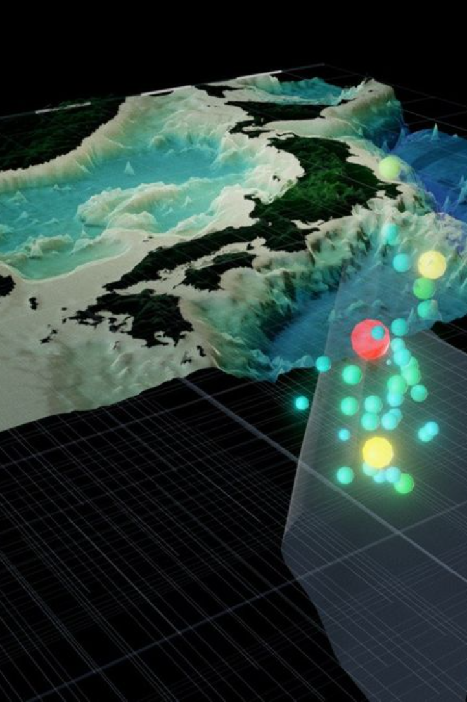
Introduction to Virtual Reality
Virtual reality is the technology that teleports you to an immersive 3D environment. It can be designed for human interaction for specific reasons in order to create experiences not otherwise possible.

Slide 3
Overview of VR Earthquake Simulation
SG-IVRE
Educational Tool
Serious games are a new learning medium that holds a special interest for simulation. While they are not a simulation modality per se, they are a way to conceive a simulation activity by emphasizing the educational value of play. Serious games can apply as much to immersive simulation (especially VR simulation) as to procedural simulation
VR earthquake simulations offer an engaging and realistic experience, allowing users to better comprehend the behavior of humans during earthquakes.
Education is another area where it is very useful. It is used to recreate complex or dangerous educational scenarios in safe and controlled environments. For example, medical students can practice virtual surgeries, and pilots can train in highly realistic flight simulators. Thus, immersive virtual reality improves knowledge retention and the acquisition of practical skills in an interactive and risk-free environment

Slide 4
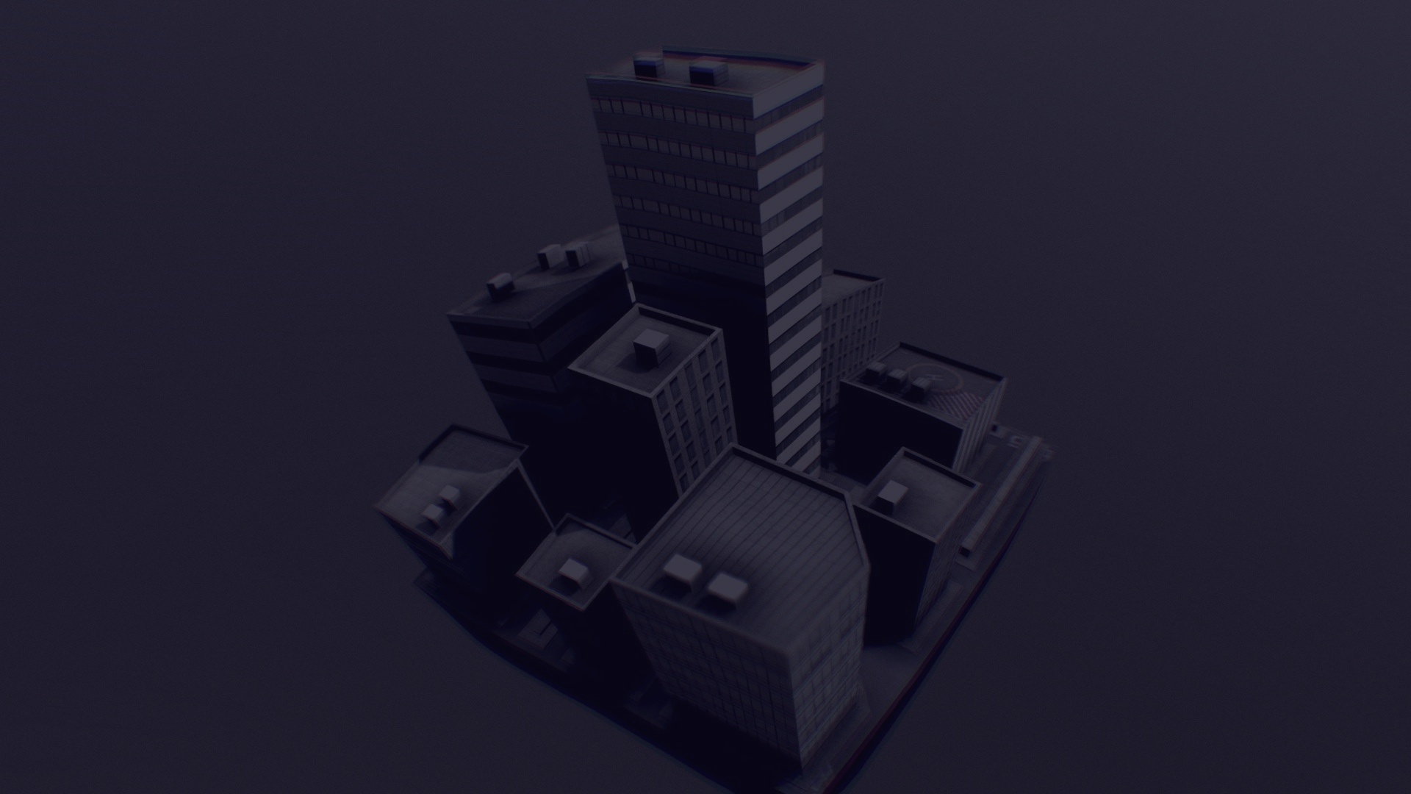
Designing 3D model Using 3D Max
1
Enhanced Realism
2
simple software
3D Max software enables the creation of visually stunning and accurate simulation environments.
Simple-to-use tools that also give the project the right format to make uploading it to the Unity application easier

Slide 5
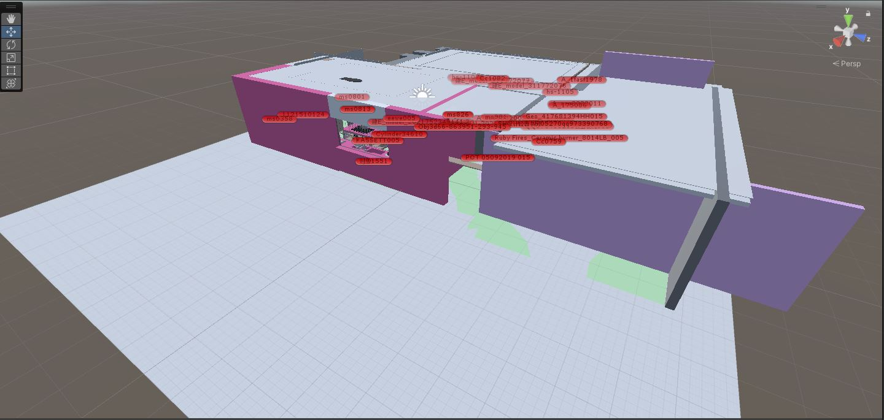
.
Creating the Virtual Environment
Realistic Scenery
Interactive Elements
The virtual environment is carefully designed to simulate a real-world area hit by earthquakes
Various interactive elements, such as objects and natural features, are integrated to provide a comprehensive experience. like XR interaction manager it include locomotion

Slide 6
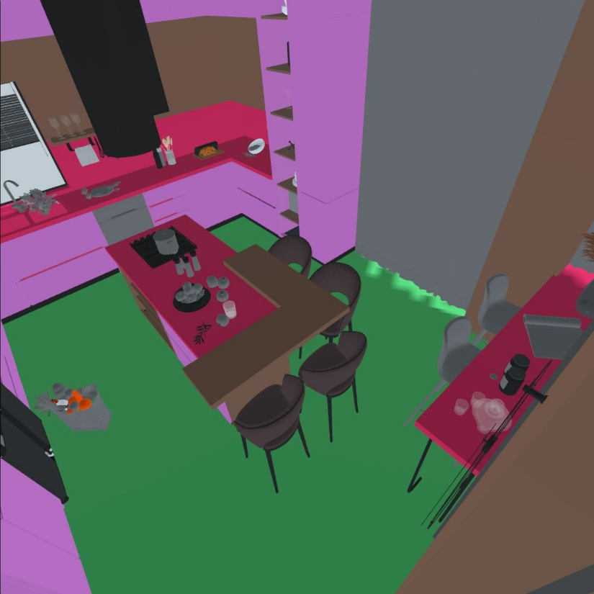
Development Process Diagram
Per- existing based 3D model
1
Autodesk Revit
2
Universal Material converter
Autodesk
3D Max
33
3
Unity
Unity Asset store
4
Visual studio C#
Configuration and optimizing
Unity Editor 2022.2.f1
5
.
Locomotion and teleporting

Slide 7
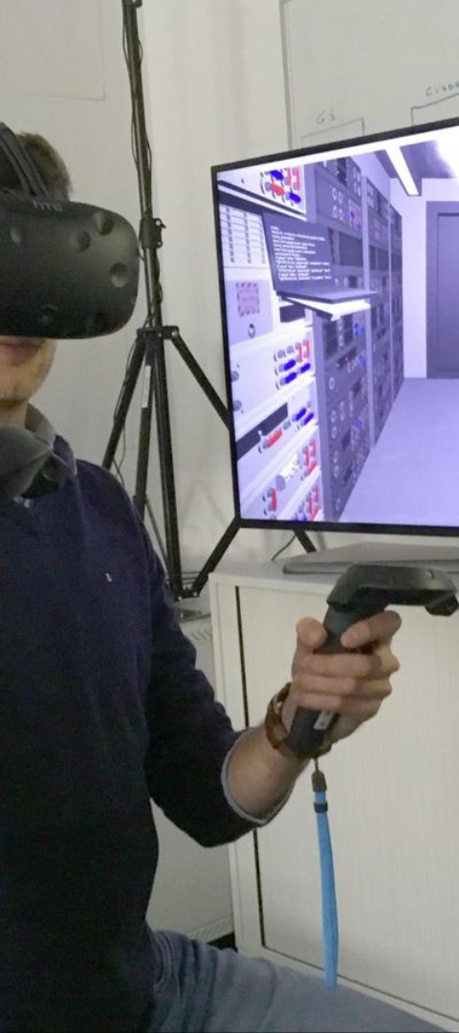
Interactivity and User Experience
User Engagement
Realistic Feedback
Interactive elements and intuitive controls are designed to keep users engaged throughout the simulation.
Real-time feedback systems ensure a real interaction with the earthquake simulation, enhancing the overall user experience.

Slide 8




RESULTS
Design a traditional home using 3d max application with many details, and the following pictures show the home from different locations, and unity environment which is a software specialist in gaming production and application, in addition, it supports different operating systems (IOS, Android, etc…), and many developing modes (VR, AR, 2D, 3d).
Make different types of moving inside the home in my project using the joystick and trigger button in the hand controller and the same thing for teleporting
Applying the shake at different objects in the game scene to simulate a IVR-SG
Making audio file for earthquake sound and smash object to give the project more realistic.

Slide 9
Conclusion and Future Developments
1
This project is an excellent example of how technological integration is changing and how developers must be able to adapt and work together across a variety of platforms. It also shows how borders between computer systems, virtual reality, and mobile devices are becoming hazier.
2
The multifaceted nature of this project necessitates addressing challenges related to hardware compatibility, real-time data exchange, and user interface design, underscoring the complexity of crafting a truly immersive and realistic earthquake experience.
3
Beyond the code and hardware, the virtual reality earthquake simulator delves into the psychology of user experience, leveraging VR technology to create a compelling and emotionally resonant learning environment.
4
Synchronization challenges in this context extend beyond mere hardware interactions; they delve into the intricacies of VR technology, necessitating precise calibration for a seamless and authentic user experience.

Slide 10
Thank you

