Slide 1
Design of Foundation Systems for Multi-storey Building
By
Eman A. Abu Helal
Ruqaia N. Abd Al-Jawad
Under supervision of: Dr. Isam Jardaneh

Slide 2
Scope of the Project
The main aim of this project is to design several foundation systems for Law and Media Faculty building. The optimal foundation system will be selected after analysing structural, constructional and economic factors.
Law and Media Faculty building is located at the north western part of An-Najah National University which is located at the western part of Nablus city. The building consists of eight floors that have a total plan area of 6115 m².

Slide 3
Design of Foundations
Three foundation systems :
Design of single footing
Design of mat foundation system
Design of hollow foundation system

Slide 4
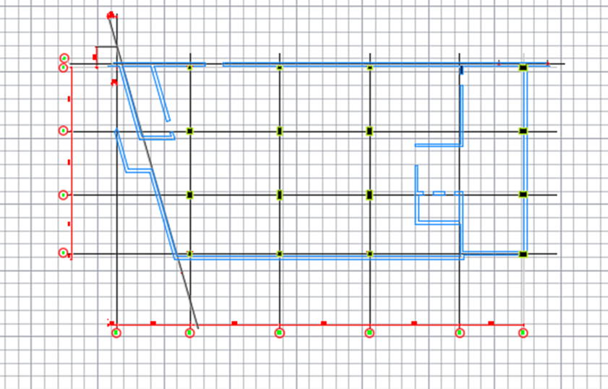
Design of Foundation
Plane shows centre line of columns for law and media faculty building.

Slide 5
Design Consideration for Isolated Footing:
1. Area of footing.
2. Depth of footing.
3. Check punching shear.
4. Reinforcement for the footing.

Slide 6
design of single footing by using hand calculations :
*Area of footing:
Af = Pa/(qall.)= (D+L)/350
= (2856.79+1505.2)/350 = 12.46 m.
By using square footing
B=L=√12.46 = 3.53≈ 3.5 *3.5 m.
*Depth of footing:
Pu = 1.2D +1.6L
= (1.2*2856.79) + (1.6*1505.2)
= 5836.46 KN.

Slide 7
qu = Pa/(Af.)=5836.46/(3.5*3.5)
= 476.45 KN/m2.
Vu = qu ((L-C)/2-d)
= 476.45((3.5-0.6)/2-d)
Vu = 690.80 – 476.45 d.
ØVc = Ø*0.33*√(fc`) *bw *d
= 0.75*0.33*√28 *1000*1000*d/1000
= 661.44 d.
We put Vu = ØVc:
690.8 – 476.45 d = 661.44 d
d = 0.60 m.
Take h = 0.75m.

Slide 8
*Check punching shear:
Vup = Pu – (A*qu)
=5836.46 – (0.6+0.6)2(476.45)
=5150.37.
ØVcp = Ø 1/6 √(f'c) b0 d
= 0.75*0.33*√28 *(600+600)*3.5*600 / 1000
= 3300.30 < 5150.37 Not good.
So we try d=0.8m & h=0.9 m.
Vup = 4902.62.
ØVcp = 5133.82.
ØVcp > Vup OK

Slide 9

Reinforcement for the footing:
Mu = $\frac{qu∗L^2}{2}$ = 500.86 KN.m
ρ = 0.002106 > ρ shrinkage(0.0018)
As = 1684.8 mm²/m.
Use 7Ø18 mm/m.
1Ø18/150 mm.
As a bottom steel and half of the shrinkage as top steel.
½ A shrinkage =810 mm²/m.
Use 4Ø18 mm/m.
1Ø18/250 mm.

Slide 12
Check overlapping of foundations No overlapping

Slide 13
Dimensions and Reinforcement of Isolated Footing

Slide 14
Design of Tie Beams
Q_{all} = 0.10 * 5000
= 500 KN.
*Tension steel:
As = 500/200,000
= 0.0025 m² = 25 cm².
Ø16= 2 cm² 13Ø16.
Ρmin =0.0033.
Ρmin = As/Area
Take b = 70 cm that give h= 108 cm.
H = 110 cm.

Slide 16
Design of Mat Foundation
Check punching shear for finding the depth of mat, applying the equation of punching shear on critical column with load equal 5000 KN/m2.
Vd= Ø Vcp Acr
Pu= 5000 KN/m2
Vd= 0.75* *()
d>
Use d =
H =
Mat Thickness = 900 mm. We use SAFE program to design it.

Slide 18
Safe Analysis
- Check Deflection : Maximum dis placement =5 mm < 10mm >> OK

Slide 19
- Check Soil Pressure under Mat foundation
Maximum soil pressure = 180 KN/m2 < 350 KN/m2 >> OK

Slide 20
- Check Punching Shear
“All values < 1 “ >> OK

Slide 21
V13

Slide 22
V23

Slide 23
m11

Slide 24
m22

Slide 25
Top Rebar in Direction 1

Slide 26
Bottom Rebar in Direction 1

Slide 27
Top Rebar in Direction 2

Slide 28
Bottom Rebar in Direction 2

Slide 29
Reinforcement of Mat Foundation
We will use Ø18/15 cm in the top and Ø20/15 cm in the bottom in the long direction.

Slide 30
We will use Ø18/15 cm in the top and Ø20/15 cm in the bottom in the long direction.

Slide 31
Design of Hollow Mat Foundation
thickness = largest thickness of single footing = 0.9 m deponding on punching shear
the strips between footing are 1.2 m width and area of footing will be the same as single footing system.
T he blanked area will be filled with base coarse
finally the floor will be casted as one unit.

Slide 33
Reinforcement
In long direction:
• For footing: we will use 8Ø16/m
• For strips: we will use 8Ø20 in top and bottom steel.

Slide 34
In short direction:
• For footing: we will use 8Ø16/m
• For strips: we will use 5Ø12 in top and bottom steel.(as stirrup)

Slide 35
Check Deformed Shape
The largest value = 2.5 mm which is very small >> OK

Slide 36
Check Soil Pressure

Slide 37
Conclusions and Recommendations
Due to existing of cavities within the bedrock formation below the level of foundation, it is highly recommended to have rigidly connected foundation. This is to over bridge the cavity if it encountered directly below any specific foundation. In this case the best type of foundation is continuous foundation or mat foundation.
Therefore, mat foundation or hollow mat foundation which replacement to continuous foundation is the most appropriate types of foundation for this site. However, the cost of hollow mat foundation is less expensive than solid mat foundation.
Hollow foundation almost have half area of total plan area, also the cost will decrease to half; so hollow mat foundation is recommended to be used for this project.

