Slide 1


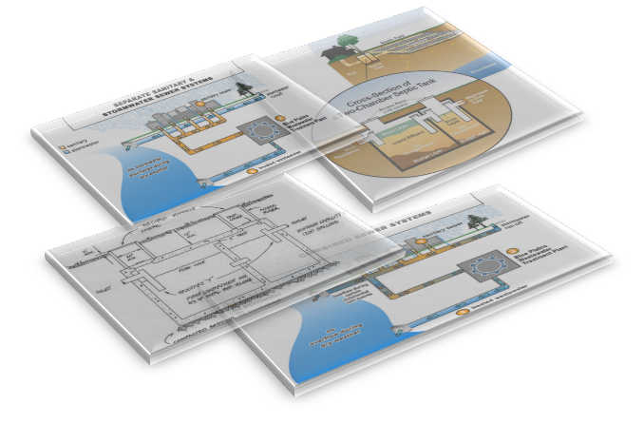
Design of a Wastewater Collection
Network for Part of Anabta Town
Prepared by:
Sumaia Radi Iswed
Supervisor
Dr. Mohammad N. Almasri
May. 2016

Slide 2


Outline:
Introduction
Objectives
Methodology
Results
Conclusions
Recommendations
SewerCAD

Slide 3


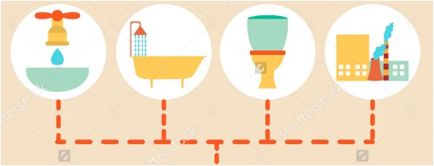
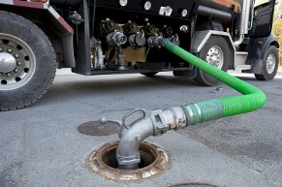
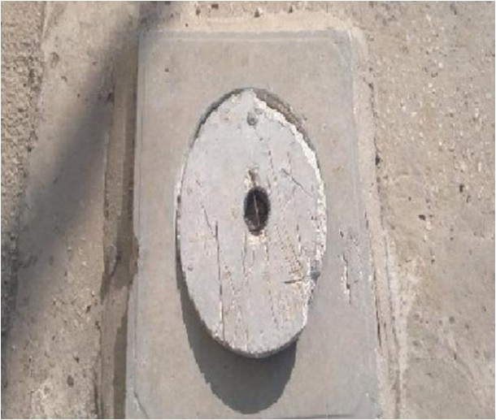
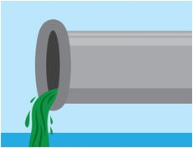

Slide 4


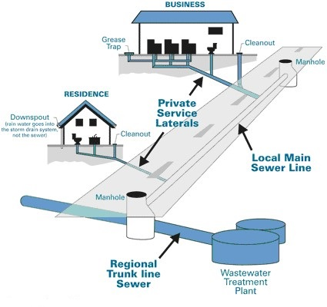

Slide 5

Objectives:
The main objectives of this project are:
To design a wastewater collection network for part of Anabta using SewarCAD
To estimate the potential cost of this network

Slide 6


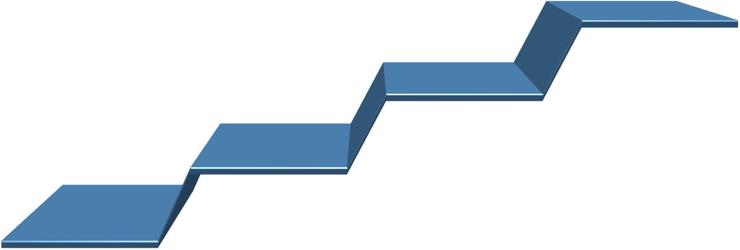





Methodology:
7
Get the results
6
Calculate the cost of a network
5
Design & analysis a wastewater collection network
4
Determine wastewater loads
3
Collect the data related to the study area
2
Selection of study area
1
Determine problem

Slide 7
Study Area
The reasons for choosing Anabta
A
Climate
D
Study Area
B
Location
C
Population

Slide 8
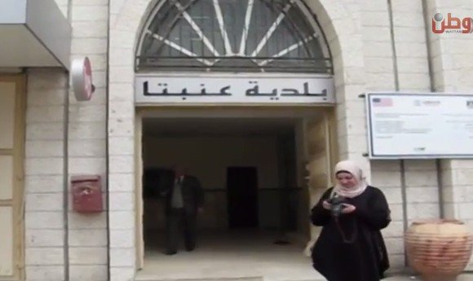
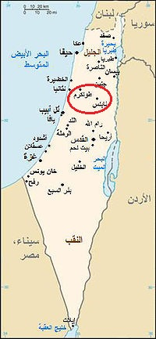
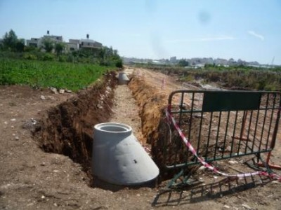
Available Data
Close to Nablus where I live
Interesting case
Unserved

Slide 9
Study Area
The reasons for choosing Anabta
A
Climate
D
Study Area
B
Location
C
Population

Slide 10
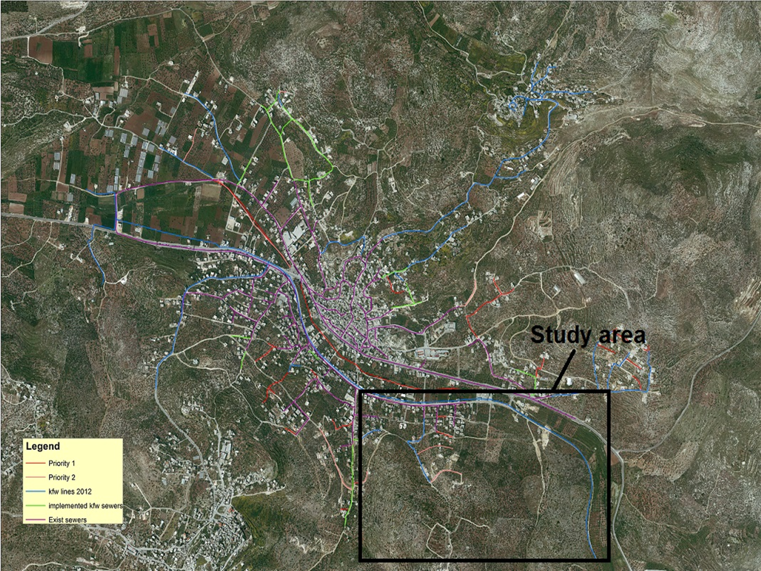
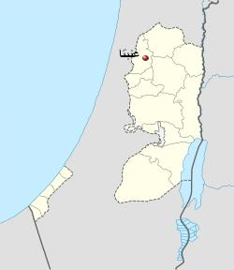

Slide 11
Study Area
The reasons for choosing Anabta
A
Climate
D
Study Area
B
Location
C
Population

Slide 12

Population:
The current population in the study area is approximately 1000 person.
It will be nearly 5000 persons for long term full saturated.
# of persons/parcel =
(# of $\frac{\text{buildings}}{\text{parcel}}$) х (# of $\frac{\text{floors}}{\text{building}}$) х
(# of $\frac{\text{department}}{\text{floor}}$) х (# of $\frac{\text{persons}}{\text{department}}$)
Assumptions:
# of floors/building = 2
# of department/floor = 1
# of person/department = 5

Slide 13
Study Area
The reasons for choosing Anabta
A
Climate
D
Study Area
B
Location
C
Population

Slide 14
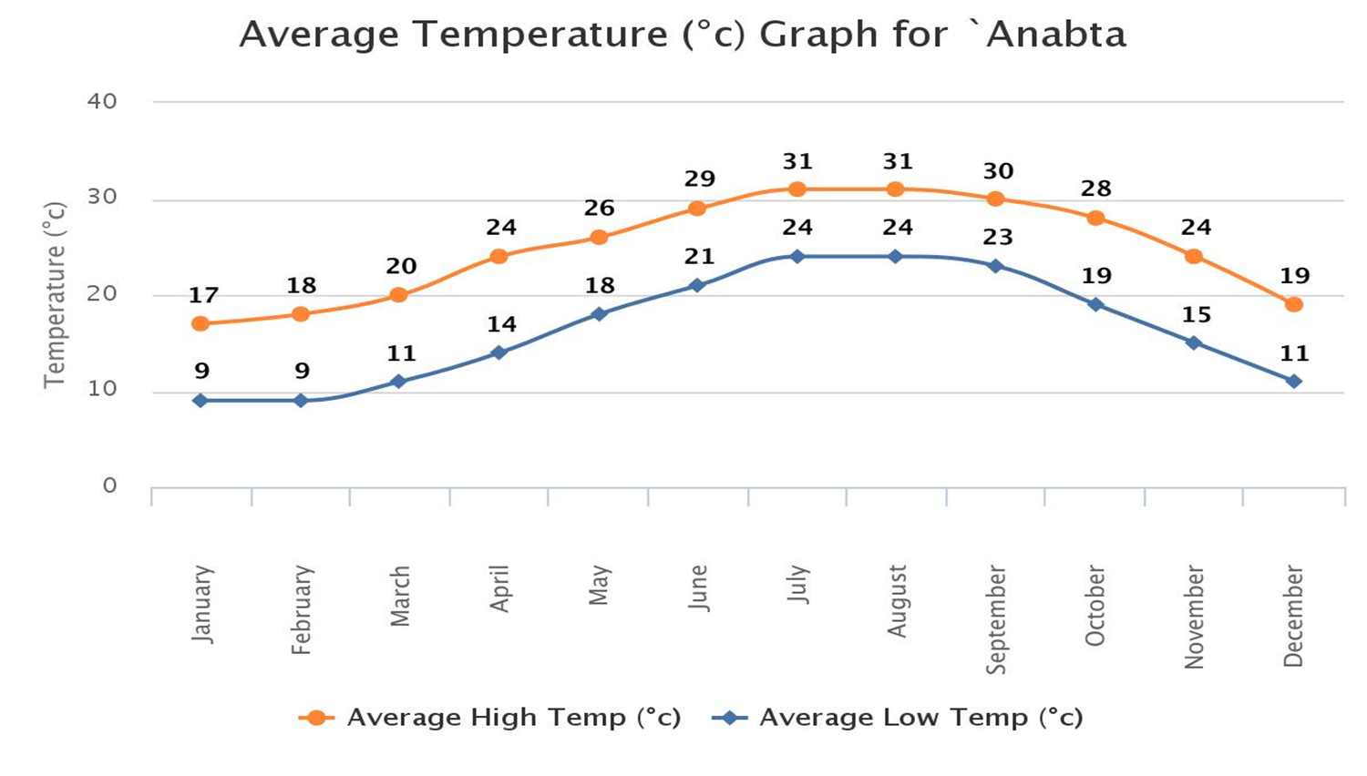
Climate:
http://www.worldweatheronline.com/Anabta-weather-averages/PS.aspx

Slide 15
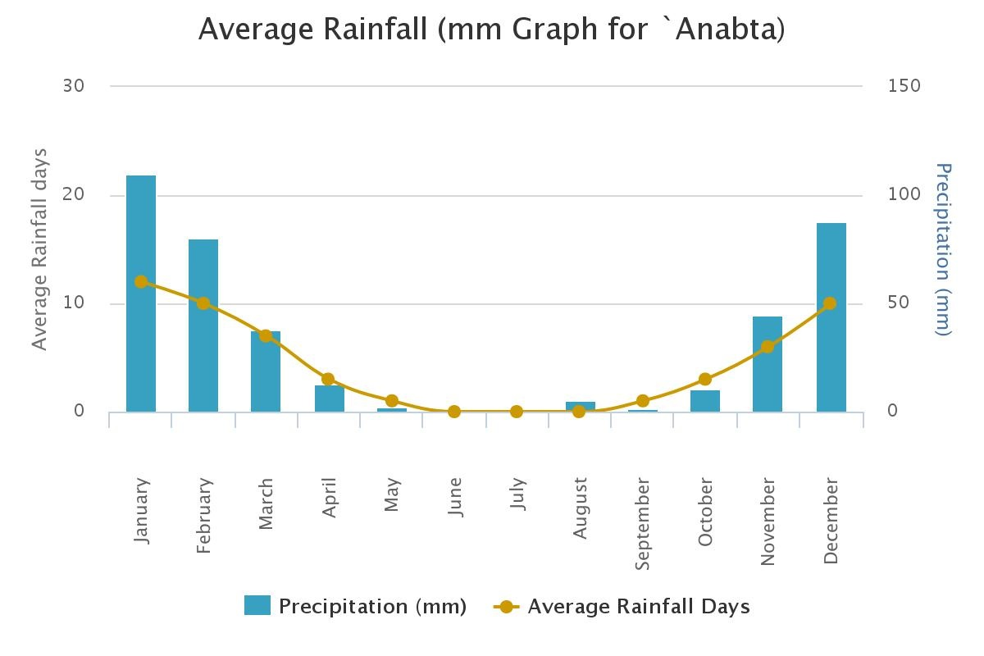
Climate:
http://www.worldweatheronline.com/Anabta-weather-averages/PS.aspx

Slide 16


Methodology:
7
Calculate the cost of a network
6
Get the results
5
Design & analysis a wastewater collection network
4
Determine wastewater loads
3
Collect the data related to the study area
2
Selection of study area
1
Determine problem

Slide 17
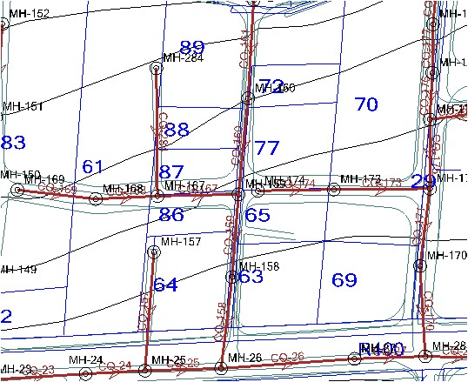
Collect the data related to the study area:
Number of houses, population, and daily consumption of water.
Contour map
AutoCAD maps

Slide 18
Methodology:
7
Get the results
6
Calculate the cost of a network
5
Design & analysis a wastewater collection network
4
Determine wastewater loads
3
Collect the data related to the study area
2
Selection of study area
1
Determine problem

Slide 19
Determine Wastewater loads:
Wastewater load/parcel (L/day) =
# of buildings/parcel (built + non built) х
# of floors/building х
# of families/floor х family size х
consumption х
percent of water that will transform to wastewater х
Max. hourly factor
Design load/parcel (L/day) =
wastewater load + (0.05 х wastewater load)
Sewer Network

Slide 20
Methodology:
7
Get the results
6
Calculate the cost of a network
5
Design & analysis a wastewater collection network
4
Determine wastewater loads
3
Collect the data related to the study area
2
Selection of study area
1
Determine problem

Slide 21
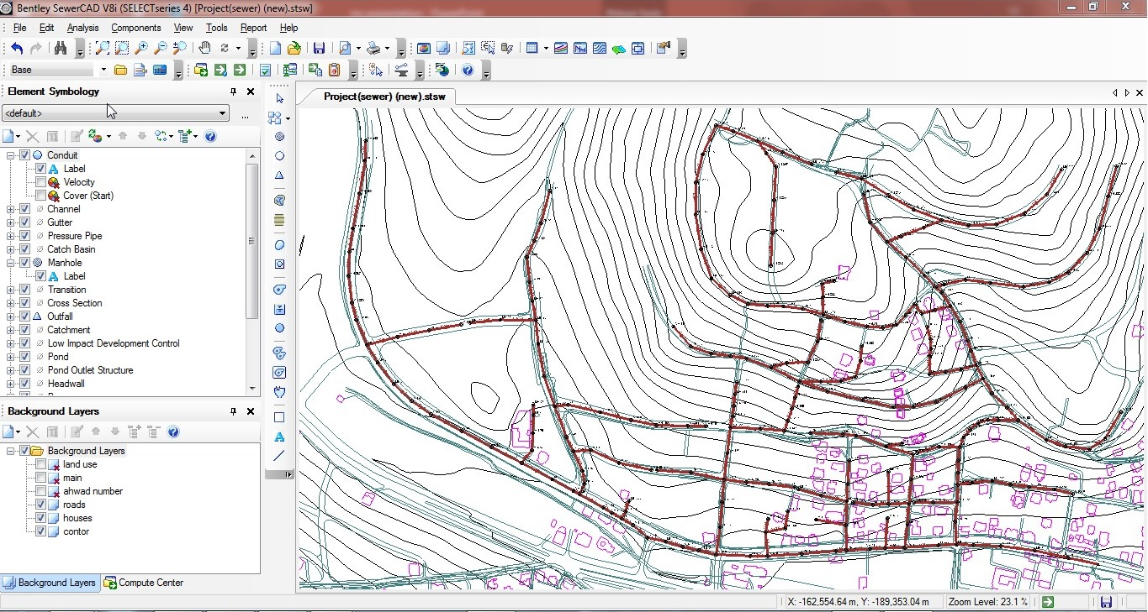
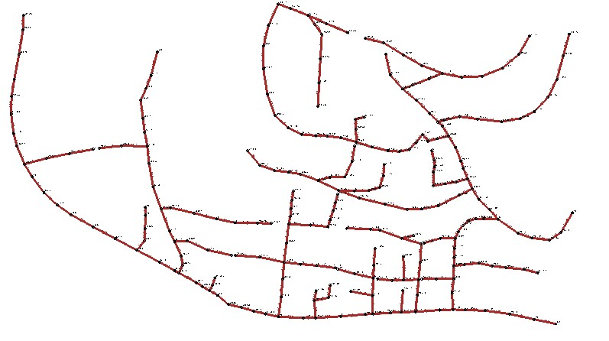
Design and analysis of wastewater Collection Network on SewarCAD
Sewer Network

Slide 22
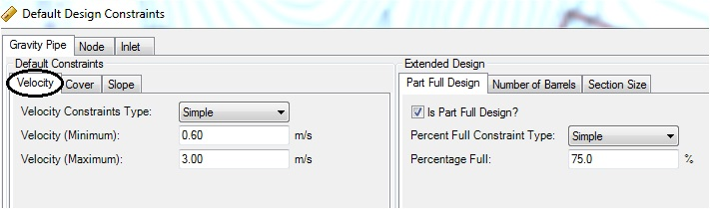
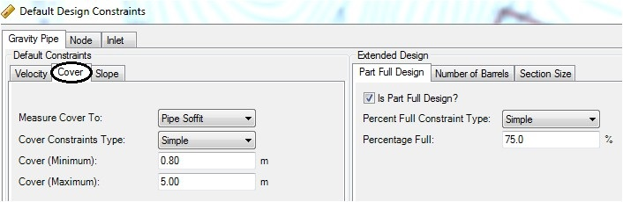
Input information to SewarCAD
Constraints information
Sewer Network

Slide 23
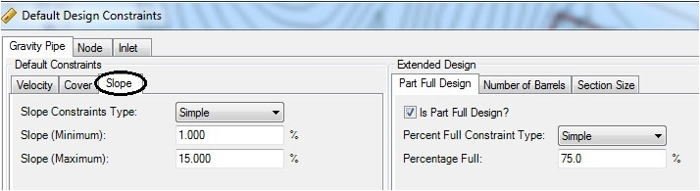
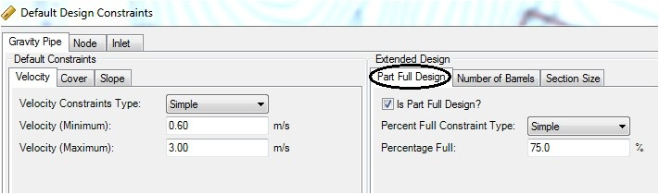
Sewer Network

Slide 24
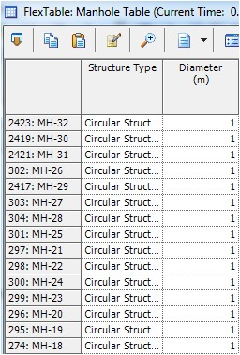
Manholes information:
Sewer Network

Slide 25
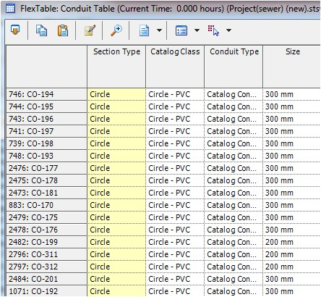
Conduits information:
Sewer Network

Slide 26
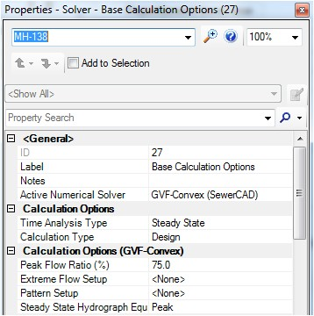
Input information to SewarCAD
Select steady state calculation type and then press run.
Sewer Network

Slide 27
Methodology:
7
Get the results
6
Calculate the cost of a network
5
Design & analysis a wastewater collection network
4
Determine wastewater loads
3
Collect the data related to the study area
2
Selection of study area
1
Determine problem

Slide 28

Network Elements to calculate the cost:

Slide 30
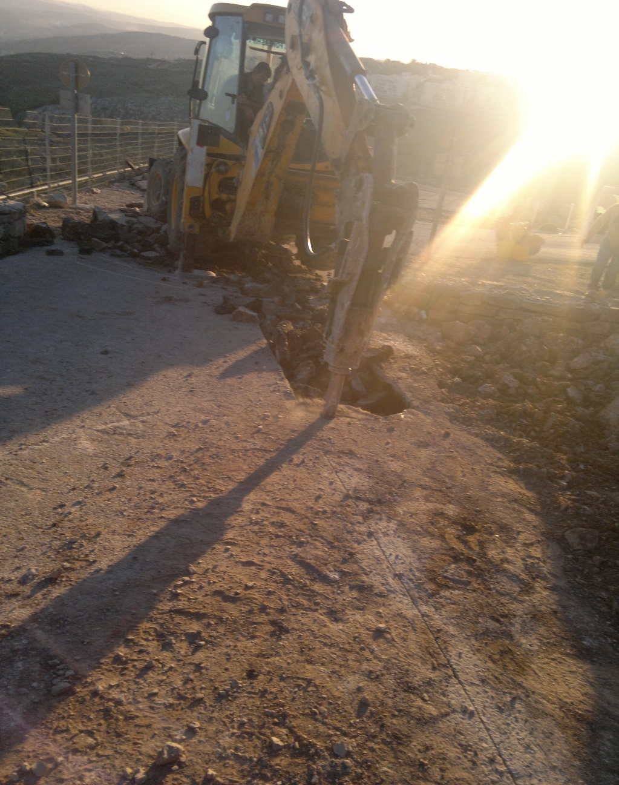
Assumptions to calculate cost of excavation:
Cost / Excavation Depth for Different Diameters
Diameter(in) | Intervals(m) | Unit Price ($)
8" | 1 up to 2 | 35
 | 2 up to 3 | 50
 | 3 up to 4 | 70
10" | 2 up to 3 | 50
 | 3 up to 4 | 72
12" | 1 up to 2 | 45
 | 2 up to 3 | 60
 | 3 up to 4 | 80

Slide 31
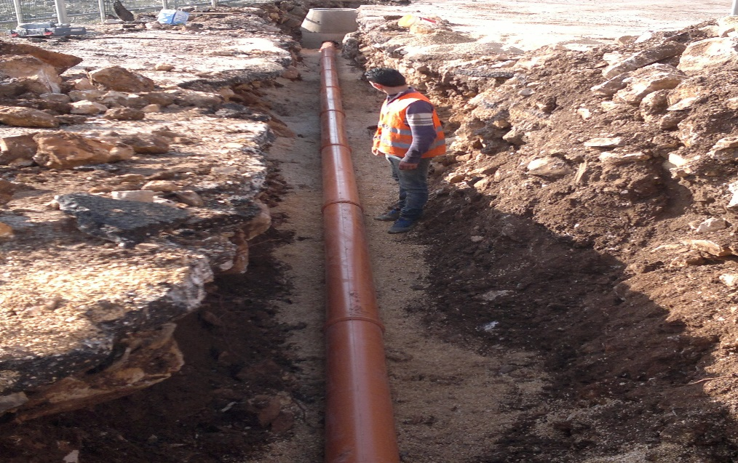
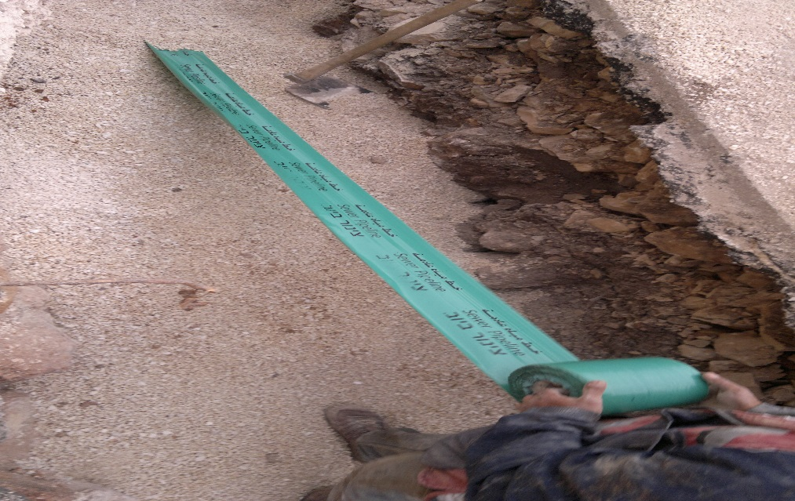
Assumptions to calculate cost of pipes:
The Pipes Cost
Diameter | Unit price ($)
8" | 13
10" | 20
12" | 30
Warning tap | 1

Slide 32
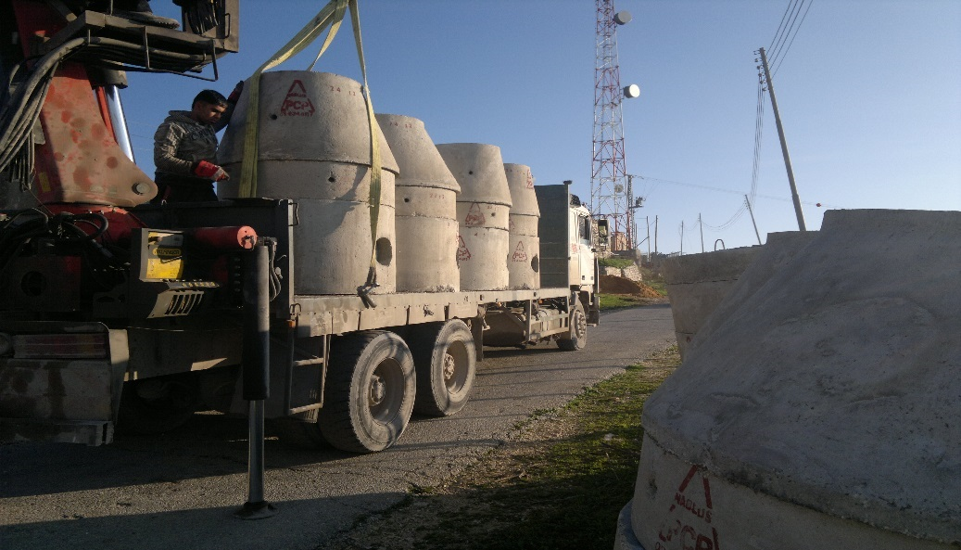
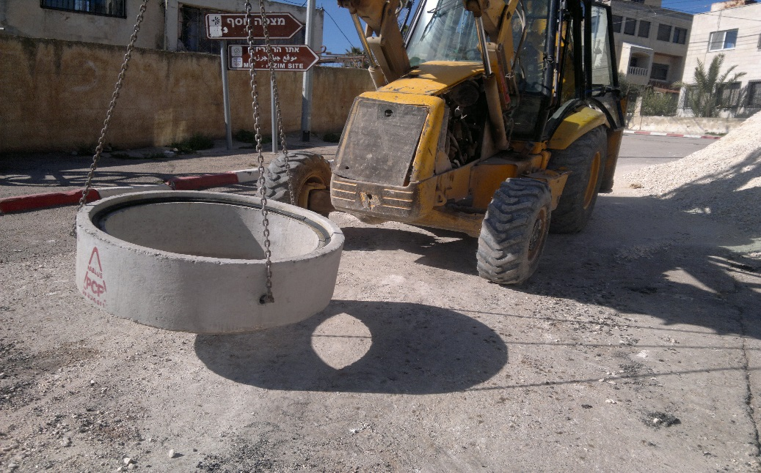
Assumptions to calculate cost of manholes:
Manholes Cost
Intervals | Unit Rate ($)
1 up to 2 | 600
2 up to 3 | 800
3 up to 4 | 950
4 up to 5 | 1000
5 up to 6 | 1500
Drop manholes | 1000

Slide 33
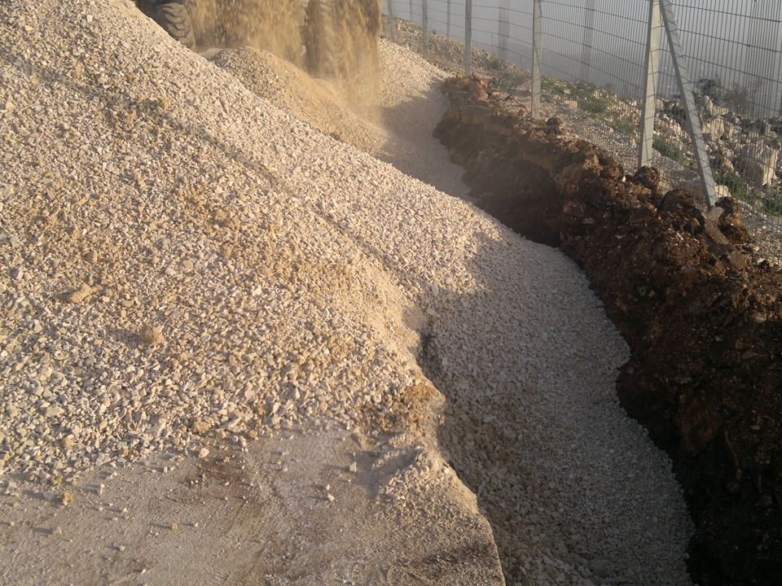
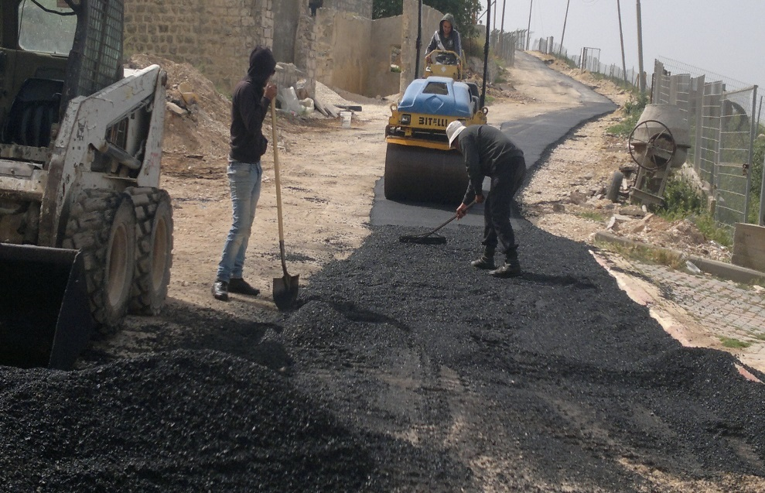
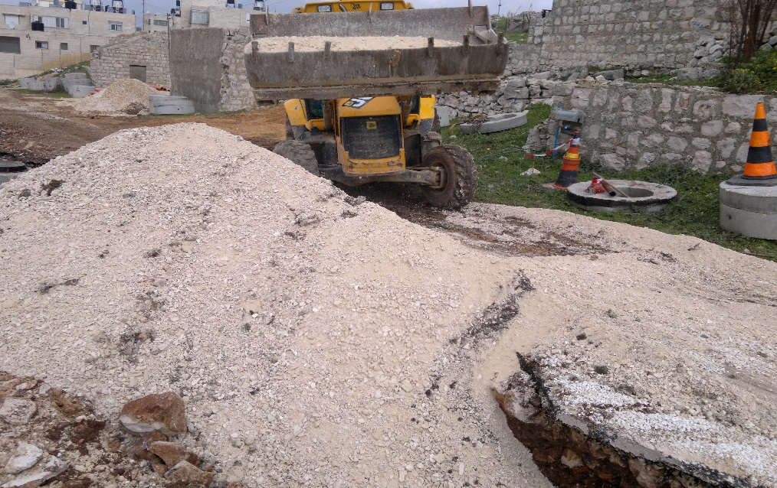
Assumptions to calculate cost of asphalt & basecourse:
Unit Price ($) per 1 m² | 18

Slide 34
Cost of Network Elements ($)

Slide 35
Methodology:
7
Get the results
6
Calculate the cost of a network
5
Design & analysis a wastewater collection network
4
Determine wastewater loads
3
Collect the data related to the study area
2
Selection of study area
1
Determine problem

Slide 36
Results:
Diameters
Cover
Velocity
Slope
Profile
Sewer Network

Slide 37
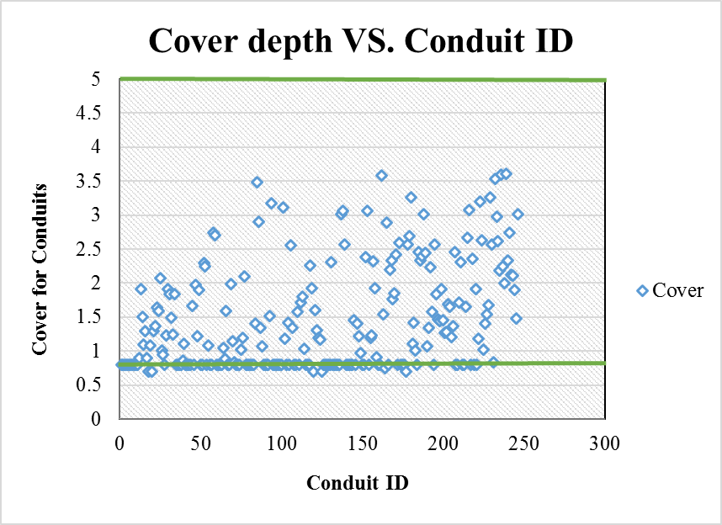

Slide 38
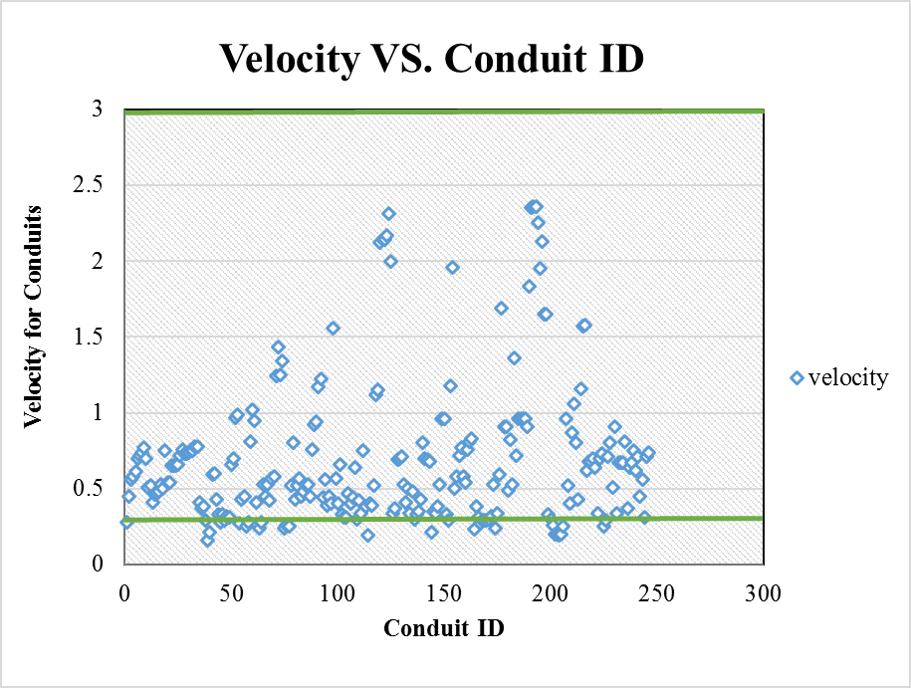

Slide 39
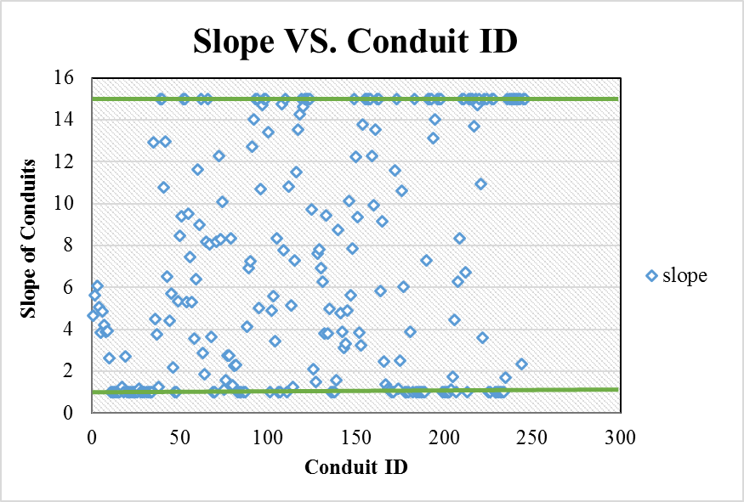

Slide 40
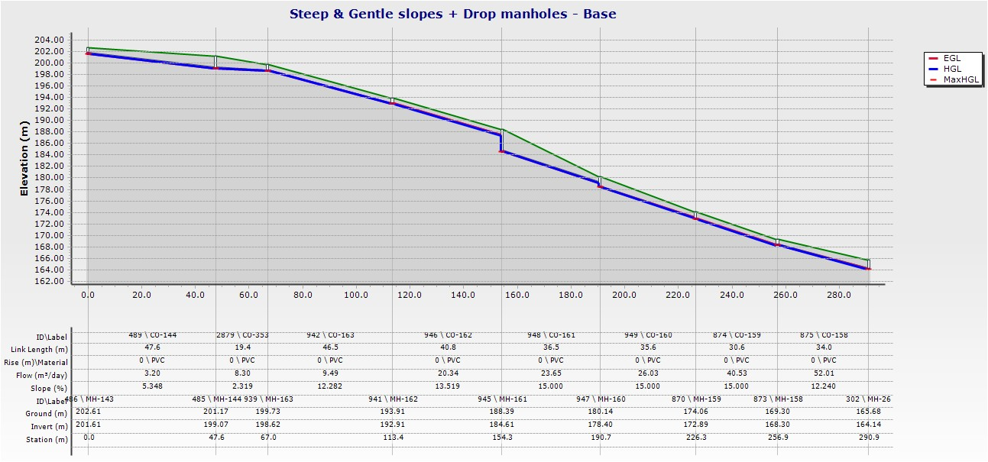

Slide 41
Conclusions:
# of Manholes | 246
# of Conduits | 246
# of Outlet | 1
Diameters | (8,10,12) inch
Cover | (0.7 - 3.61) m
Velocity | (0.16 - 2.36) m/s
Slope | (1 - 15)%
Total length of the Network | 8 Km
Total cost of the network for 1 km | $100,000

Slide 42
Recommendations:
Complete network design for the rest of Anabta
Design a wastewater treatment plant in the plain between Anabta and Noor Shams to treat the wastewater from Anabta.

Slide 43

Thank You! ☺

Slide 44



Thank You! ☺
Finished
Design & Analysis
Working hard

