Slide 1
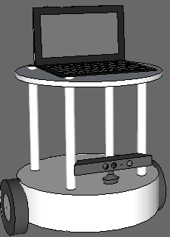
The Autonomous navigation Robot
By:
1- Aws Al-Nabulsi
2- Ibrahim Wahbeh
3- Odai Abdallah
Supervised by: Dr. Kamel Saleh

Slide 2
Overview
The main idea of the project is to create an open source hardware and software robotic platform that can be easily adapted to do several tasks.
Features of this platform:
Map construction
Localization
Path planning and obstacle avoidance
speech and object recognition

Slide 3
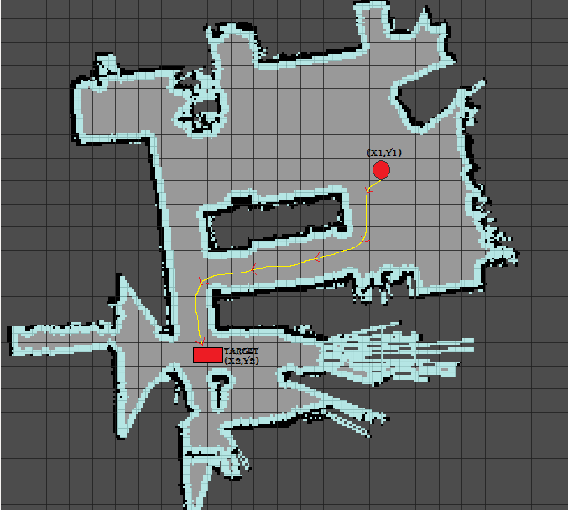
Map Construction and path planning
Estimated position (X1,Y1)
Target position (X2,Y2)
Optimum path
Move

Slide 4
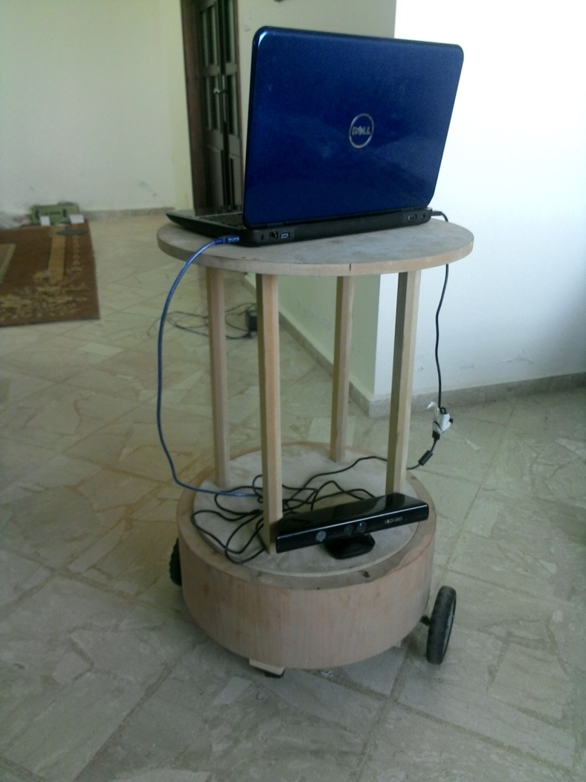
Hardware Design
Body Design showing the various parts of the robot
1) Mother Board
2) Kinect sensor
3) Base
4) Wheels

Slide 5
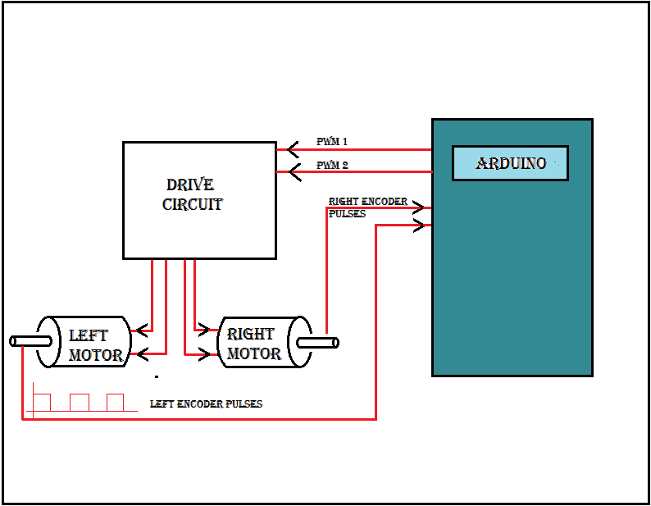
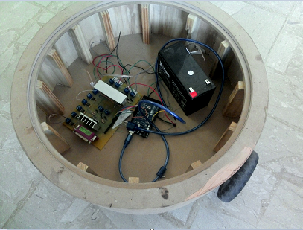
The Base Controller
The Base controller contains:
1)Microcontroller
2)Drive Circuit
3)Two Stepper motors
4)Battery

Slide 6
Choosing the motors
Torque calculations:
The following formulas were used to determine the required torque
T = F _{friction} *R
F _{friction} = µ * m * g
the estimated parameters for the robot are:
R= 6 cm , µ = 0.35 , m= 7 kg , g=9.81 m/ S²
Substituting these parameters into the equations,
We get a required torque of T = 7.3545 Kg-cm per motor.

Slide 7
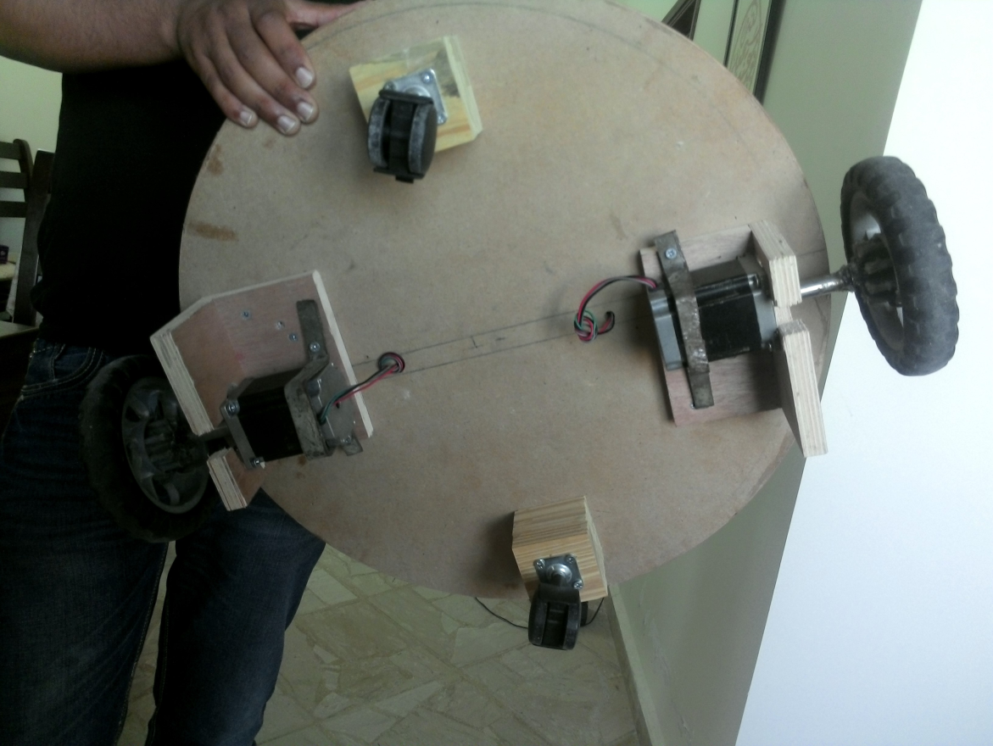
Motors used:
Two steper motors
Specifications
Size: Nema 23
Phase: 2 Phase
Step Angle: 1.8 Degrees
Voltage: 70V Max
Rated Current: 2.8A
Inductance: 4.7mH
Dual Shaft
Bipolar 4 Wire

Slide 8
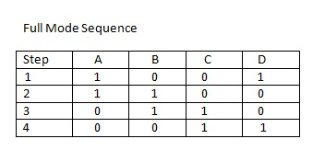
stepper motor sequence

Slide 9
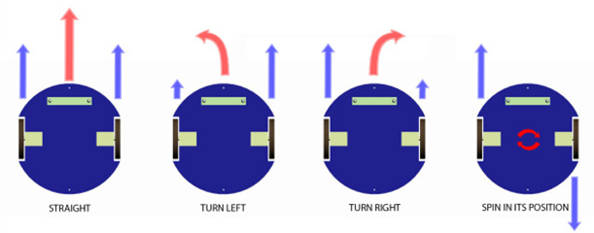
Differentially steered system

Slide 10
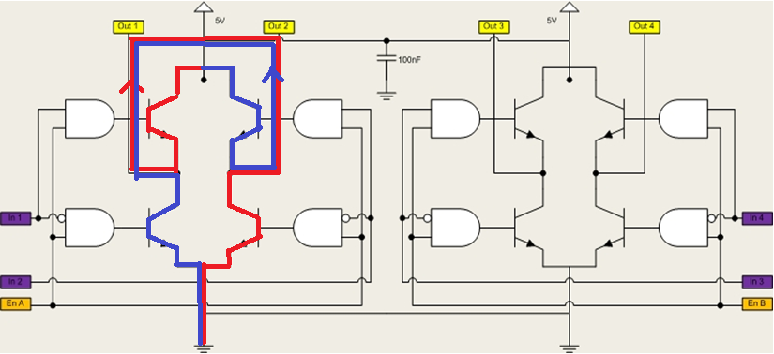
Drive circuit
A dual H-bridge with a maximum total current of 4 A will be used
to drive the motors

Slide 11
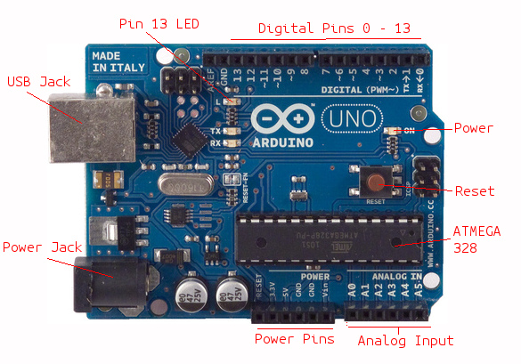
The arduino microcontroller
Main tasks:
send/receive data.
Odometry calculations.
Motor commands.

Slide 12
Kinect sensor
Features of the kinect:
RGB image
IR image
Depth map
Skeleton and object tracking

Slide 13
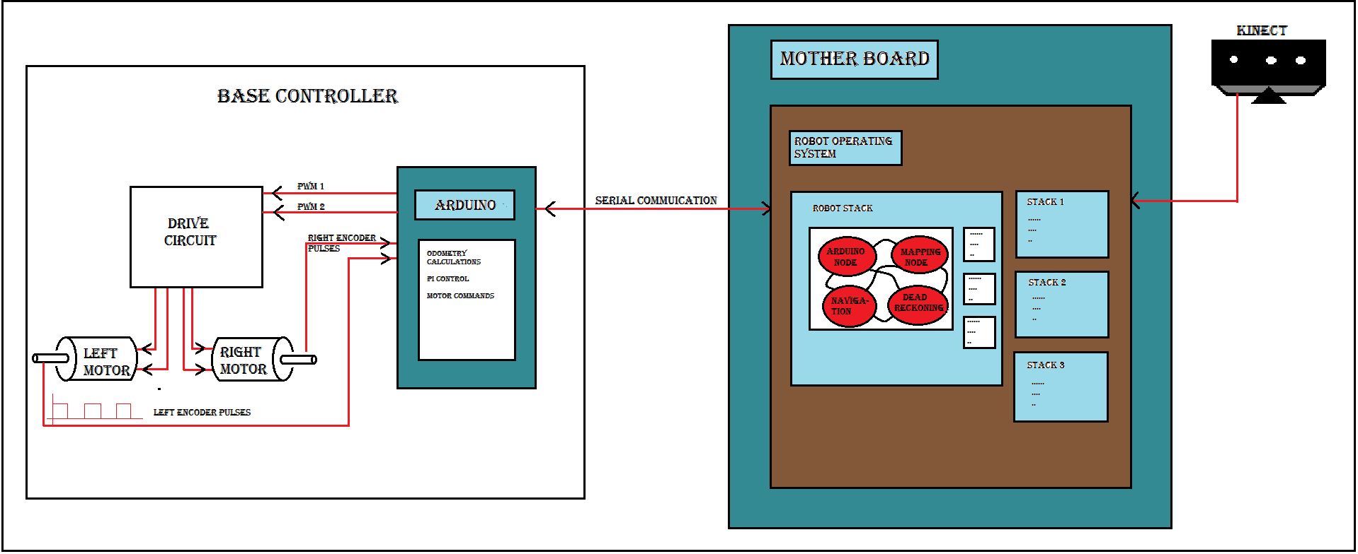
Software

Slide 14
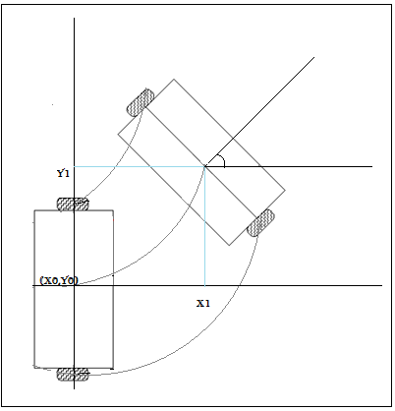
odometry calculations
The term odometry means the robot coordinates in x, y and theta. And the velocity v of the robot
∆ Distance= ∆ encoder pulses * Distance per pulse
ϴ
Right distance = previous right distance + ∆ right distance.
Left distance = previous left distance + ∆ left distance.
∆ X = ∆ distance * cos (ϴ).
∆ Y = ∆ distance * sin (ϴ).
X= previous x + ∆ x.
Y= previous y + ∆ y.
Now to calculate the heading (ϴ):
∆ ϴ = (∆ right distance - ∆ left distance) / b.
Where b is the distance between the wheels.
And ϴ = previous ϴ + ∆ ϴ.

Slide 15
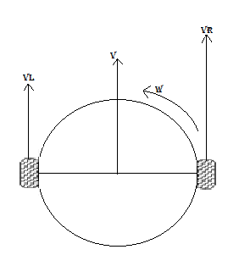
Translating the desired linear and angular velocities into motor commands:
VR = V + (b * W)/2
VL = V – (b* W)/2

Slide 16
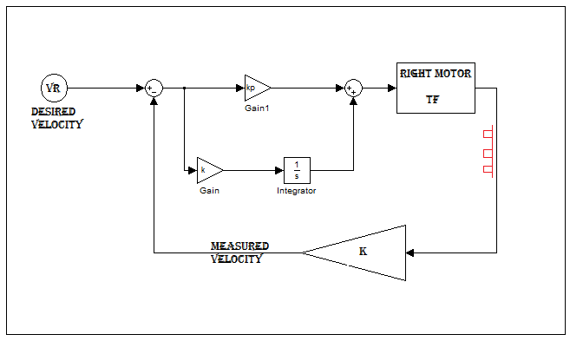
Proportional and integral (PI) speed controller:

Slide 17
Thank you for your attention
Questions?

