Slide 1
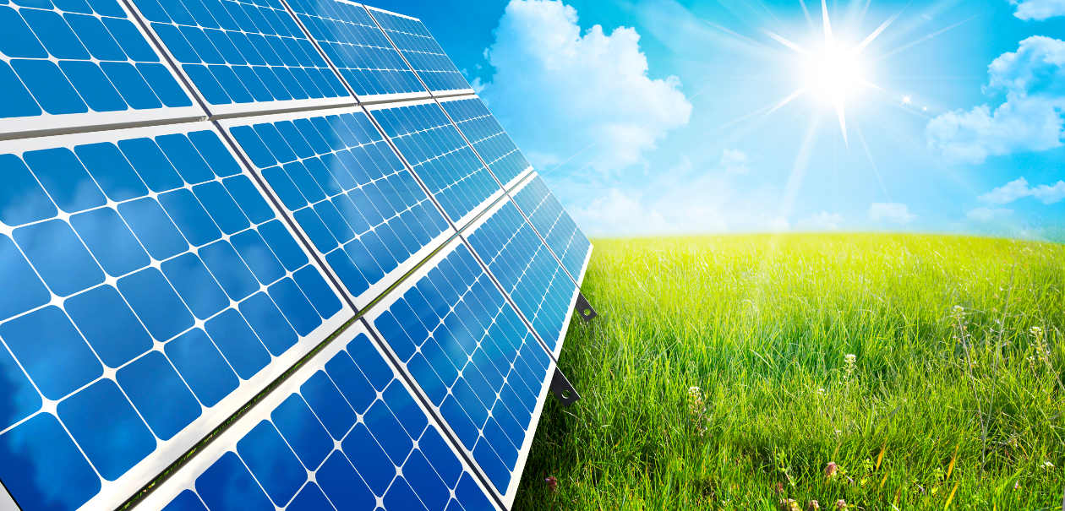
Graduation Project II solar electrical car
Prepared by
Rami Balbese
Islam Yaseen
Ameen al Masri
Under supervision of : EMAD BREAK

Slide 2
Introduction
Final year project " Smart Electric Solar Car " include the following activities
Medium size car For people with special needs, Its electrical system has been converted into a solar system, This system is composed sequentially from PV Cell which in turn convert sunlight into electricity to drive electric motor, Controller Which regulates incoming voltage from the PV Cell before it passes to the solar batteries as well as from the battery to the electric load(DC Motor).The Battery, one of the most important elements of the system and constitute the reliability of the system ,Its importance lies in the storage of power inside it ,so that the motor can use it later. Motor, is the electric load of this system, which moves the car through the consumption of electrical power produced from this system. We have added the necessary protection methods, including fuses between the controller and cell, also before the battery and we designed the structure of the car to put the cell on it. finally this car has been developed into a smart car with a GPS..

Slide 3
Aims and Objectives
This part of the project aims to implement the concept of the solar car and apply it on the ground to a small electric car for people with special needs.
The following objectives will be achieved :
1- Add the GPS Technology on the car, where the user can identify the location of the car accurately by satellite.
2-Charging the car battery by renewable energy.

Slide 4
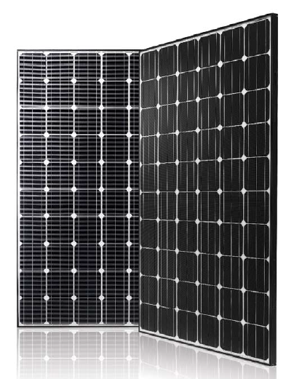
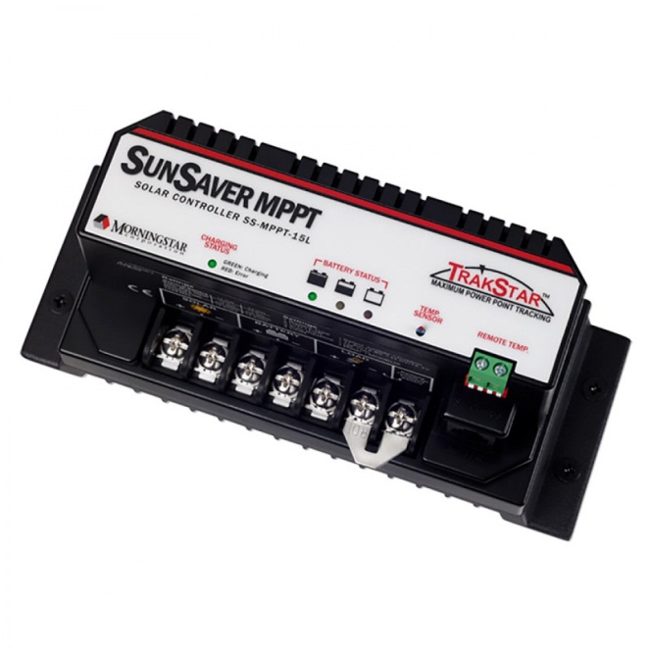
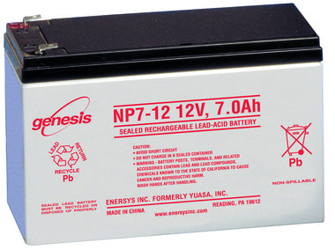
Construction Details
1- System Architecture

Slide 5
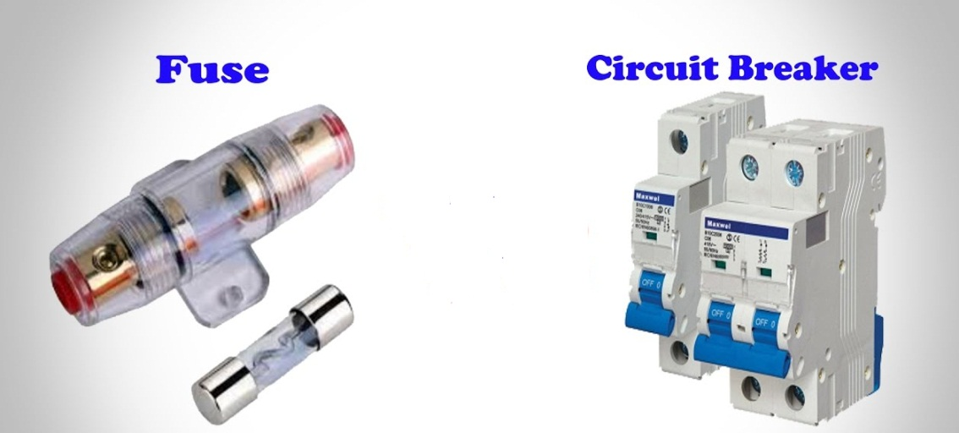
Construction Details
2- Protection Elements of The System

Slide 6
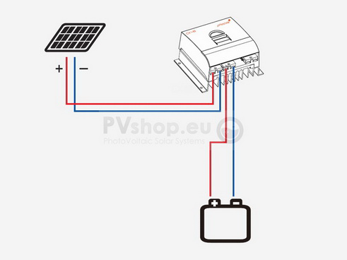
Construction Details
3- Wires Sizing

Slide 7
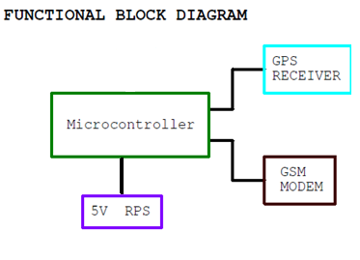
New Technology Of The Smart Car.

Slide 8
Methodology
Working Steps
In this project, we have designed the car's exterior structure and installed it on the car practically.Also, the PV module was installed on the car and connected in the appropriate way to feed the batteries of the car with the necessary power through the charge controller.

Slide 9
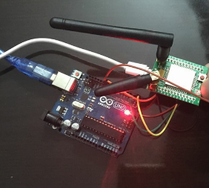
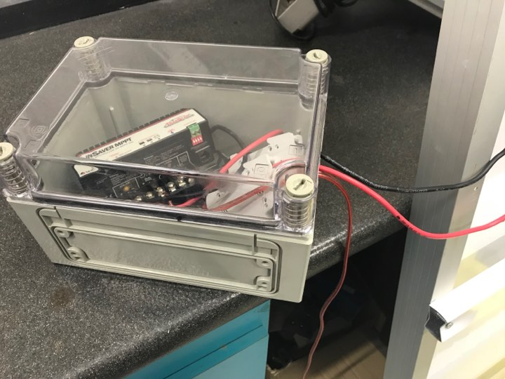
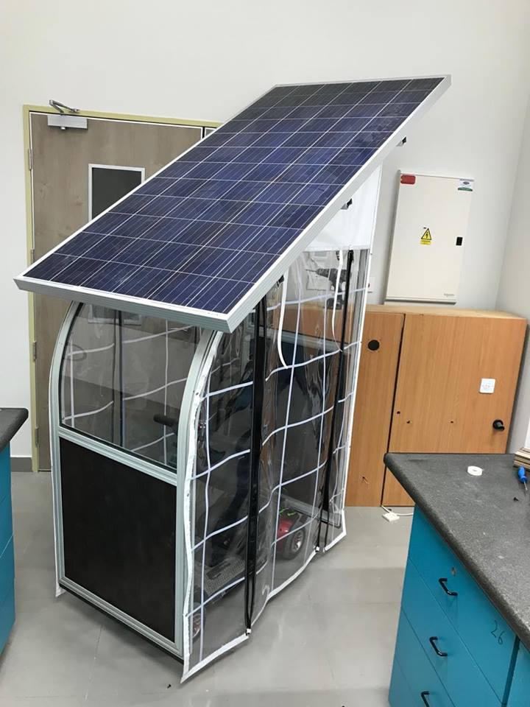
Methodology

Slide 10
Results & Conclusion
The results of our project proved that the solar electric car can be applied to the ground without causing any pollution at all compared with other gasoline and diesel cars, so solar electric cars are certainly more environmentally friendly.
Apply the GPS system to the car using Arduino that helps us to know where the car is remotely.
Gain practical experience in installing solar modules and learn how the off-grid system works.

Slide 11
Conclusion
We learnt how to use the alternative energy in order to achieve the optimum solution of the useable energy scenario by replacing the finitie electrical supply (utility) with an alternative supply (solar module).
The most important part in our project is the full knowledge of the solar energy in verious steps of the solar storege elements, the elements needed for the charging (module), the voltage stable device (charge controller) and the load as in the motor itself.
Through this project we have identified the importance of solar energy as renewable energy. Also we have recognized the components of the system and the function of each element of this system. Moreover, we discoverd how to connect the elements of this system with each other and how to make the necessary calculations, including the calculations of wires and protection.

Slide 12
References
[1] Anton A. Huurdeman, The Worldwide History of Telecommunications, John Wiley & Sons(2 Sep 2012).
[2] http://www.ee.co.za
[3] https://ewh.ieee.org/
[4] http://support.morningstarcorp.com
[5] http://www.solardesigntool.com
[6] Sauter, Martin (21 Nov 2013). "The GSM Logo: The Mystery of the 4 Dots Solved".
[7] www.power-sonic.com/
[8] https://www.arduino.cc
[9] Richard C. Dorf (ed.) The Electrical Engineering Handbook, CRC Press, Boca Raton, 1993, ISBN 0-8493-0185-8
[10] https://www.u-blox.com
[11] http://mobilesociety.typepad.com
[12] https://www.omega.com/
[13] https://www.solartubs.com

