Slide 1


An-Najah National University
Chemical Engineering Department
Graduation Project(2)
Recycling and Rreinforcing of PP from White Board Markers
Prepared by:
Feda′a Jitawi Hidaya Shaker
Ismaiel Manasrah Mays Shadeed
Supervisor: Eng. Shadi Sawalha
2011

Slide 2

Presentation Topics
Problem
Objectives
Introduction
Methodology
Result and Discussion
Conclusion and Recommendation

Slide 3

Problem
The problem comes from highly amount of consumed white board markers inside educational centres. These markers occupied large volume because they are not biodegradable due to their nature.

Slide 4
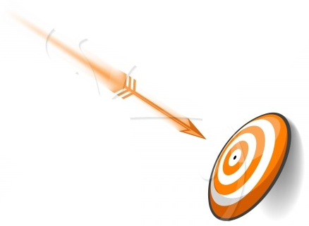
Objectives
Recycling of White Board Markers and use its constituents as composite component in order to produce a stronger polymer which could be used in other applications.

Slide 5


Introduction

Slide 6
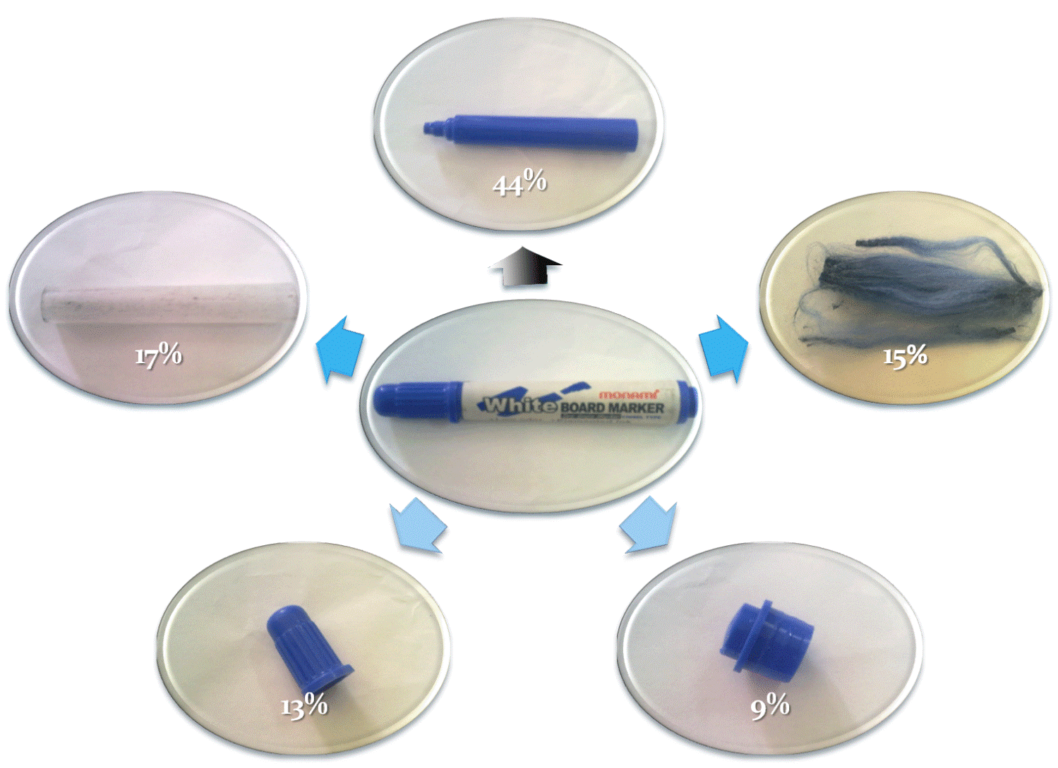
White Board Markers
PP
HDPE
PET

Slide 7

Composite
Fiber composite technology is based on taking advantage of the high strength and high stiffness of fibers, which are combined with matrix materials of similar/ dissimilar natures in various ways, creating inevitable interfaces.
Most composites have two constituent materials: a binder or matrix, and reinforcement.
The reinforcement is usually much stronger and stiffer than the matrix, and gives the composite its good properties.

Slide 8
Composite
Reinforcements basically come in three forms: particulate, discontinuous fiber, and continuous fiber.
Factors affect the composite strength:
Interfacial bonding
Influence of Fiber Length
Influence of Fiber Orientation

Slide 9
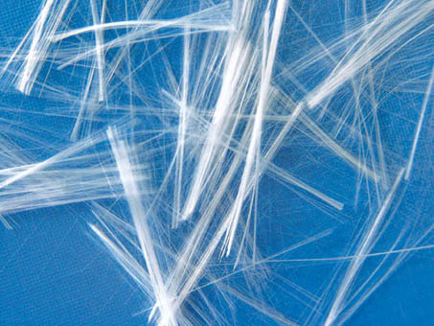
Glass Fiber
Glass Fiber-reinforced Plastic (GFRP), is a fiber reinforced polymer made of a plastic matrix reinforced by fine fibers made of glass.
Properties of glass fiber:
High strength-to-weight ratio.
High modulus of elasticity-to-weight ratio.
Good corrosion resistance.
Good insulating properties.
Low thermal resistance.
But it is weak in compression.
Glass fibers reinforced polymer matrix composites are manufactured by open mold processes, closed mold processes and Pultrusion method.

Slide 10
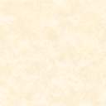
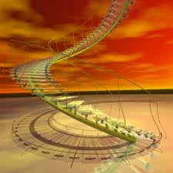
Methodology

Slide 11
Methodology
Information collection
Raw material collection
Statistical survey.
questionnaire
Material type determination
University decision for WBM collection
DSC test was performed to every part of the marker
Statistical survey.
questionnaire

Slide 12
Methodology
Raw material preparation
processing
Using thermal press
Testing and Analysis
Using tensile test
Cleaning
grinding
Produce 6 of reinforced sheet
Modulus of elasticity, tensile strength and Ke were calculated
Sorting
  Using tensile test
Sorting
Cleaning
Grinding
  Modulus of
  Using thermal press
Produce 6 series of reinforced sheet
Using tensile test
Modulus of elasticity, tensile strength and K_{E} were calculated

Slide 13
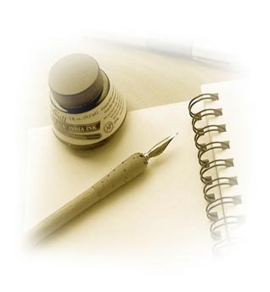
Result and Discussion

Slide 14
Statistical Survey
The number of the markers
38810
Weight (Kg)
670

Slide 15
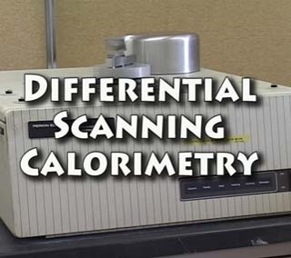
DSC Test Results

Slide 16
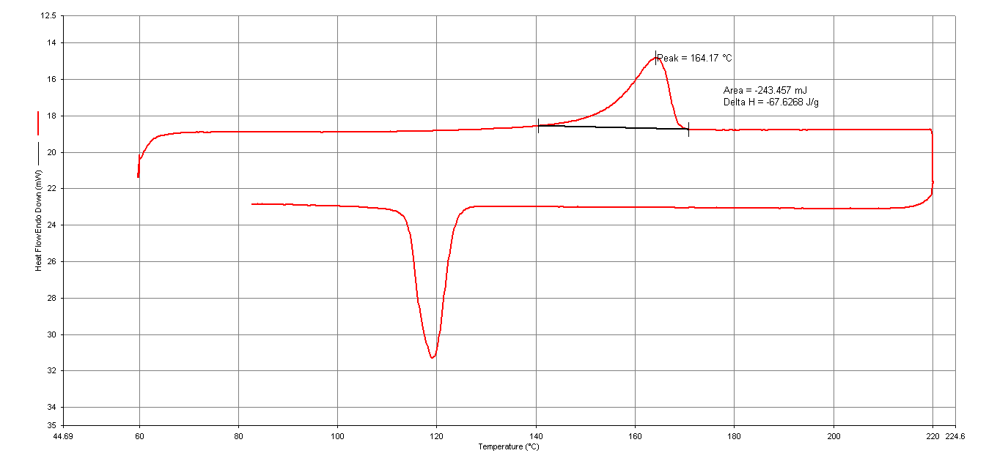
Body, cap , and plug samples
Figure (2): The DSC test result for the body of the white board marker.

Slide 17
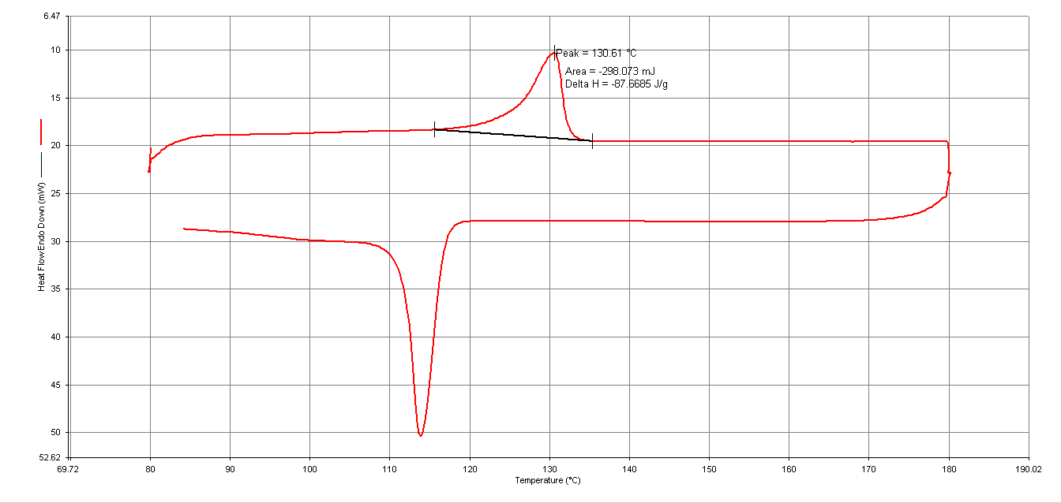
Holder sample
Figure (3): The DSC test result for the fibre holder of the white board marker.

Slide 18
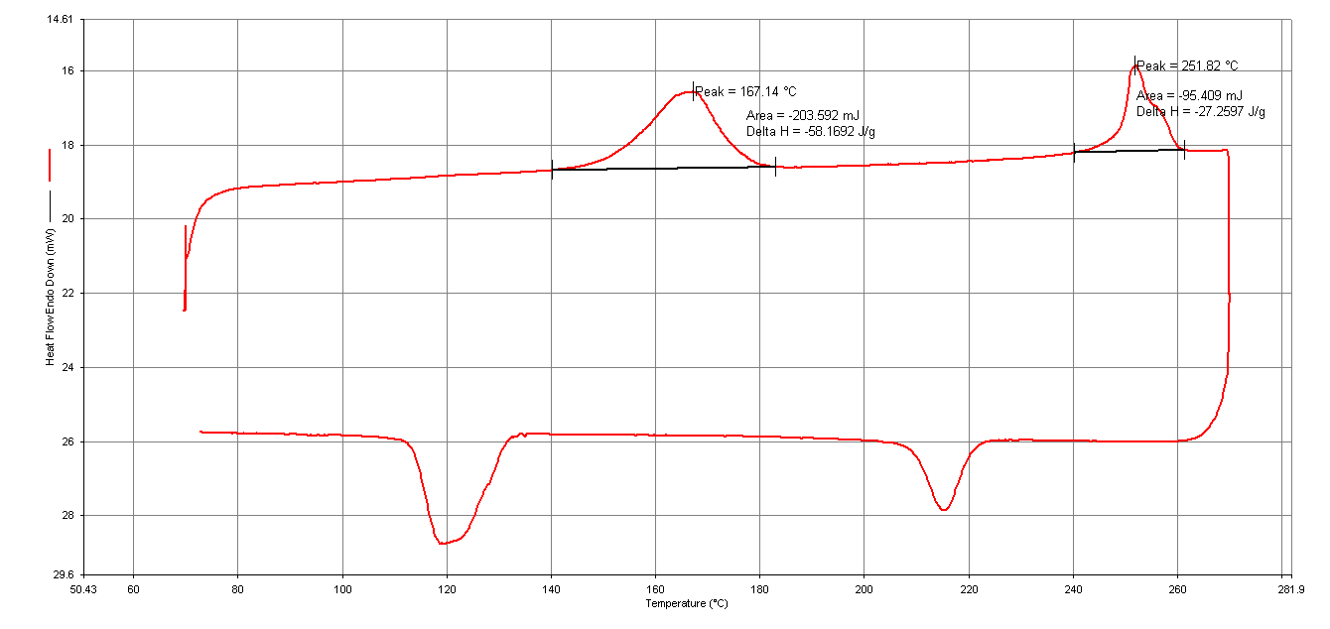
Fibers sample
Figure (4): The DSC test result for the fibers of the white board marker.

Slide 19
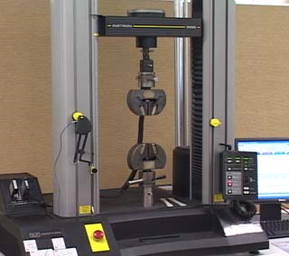
Tensile Test Results

Slide 20
Polypropylene and glass fiber composite at different composition
Figure (5): Relationship between modulus of elasticity and yield strength with glass fiber content at constant temperature 220˚C.

Slide 21
Polypropylene and glass fiber composite at different composition
Figure (6): Relationship between ke versus weight percent of glass fiber

Slide 22
Polypropylene and glass fiber composite at different temperature
Figure (7): Relationship between modulus of elasticity and yield strength with temperature at constant composition 10 wt% glass fiber.

Slide 23
Polypropylene (PP) and Recycled polyethylene teraphthalate fibers (rPETFs) composite at different composition.
Figure (8): Relationship between modulus of elasticity and yield strength with weight percentage of PET fiber at constant temperature 220˚C.

Slide 24
Polypropylene (PP) and Recycled polyethylene teraphthalate fibers (rPETFs) composite at different composition
Figure (9): Relationship between Ke versus weight percent of PET fibre

Slide 25
Polypropylene (PP) and Recycled poly ethylene terephthalate fibers (rPETF) composite at different temperature.
Figure (10): Relationship between modulus of elasticity and temperature at constant composition 8wt% PET fiber.

Slide 26
Comparison between glass fiber/PP composite and rPETf/PP composite
Figure (11): Comparison between the modulus of elasticity tensile strength of glass fibre/PP composite and rPETf/ PP.

Slide 27
Three composite component (rPETFs and PP)/GF at different composition
Figure (12): Relationship between yield strength and weight percent of PET composite with 10wt% of glass fiber and PP at 220˚C.

Slide 28
Glass fibre (mat) and Polypropylene composite at different temperature.
Figure(13): Relationship between modulus of elasticity and weight percentage of PET fiber at constant temperature 220˚C.

Slide 29

Conclusion
The PP content is 66% from the hole marker
The optimum GF composition in r-PP/GF was 15% at processing temperature of 220 (˚C).
The material of WBM consist of PP ,HDPE, and PET fibers

Slide 30

The optimum composition of rPETFs in Composite of r-PP/rPETFs is 10%, at temperature of 220 (˚C)
The optimum processing temperature for r-PP/GF (E-class mat) composite is 280 (˚C)
The optimum compositions of rPETFs and short GF where 4% and 10% respectively in rPETFs and GF/r-PP composite at processing temperature 220 (˚C).

Slide 31
Problem objective
The problem is the high amount of consumed white board markers
The objective is to recycle these markers and to produce a new product by composite .
A three component composite 4%PET and 10%GF

Slide 32

Thank You For
Coming
And
Listening
Any Question?

Slide 33
1
2
Polypropylene (PP) and Recycled poly ethylene terephthalate fibers (rPETF) composite at different temperature.
5
Glass fibre (mat) and Polypropylene composite at different temperature.
Polypropylene and glass fiber composite at different composition
4
3
6
Three composite component (rPETFs and PP)/GF at different composition
Polypropylene (PP) and Recycled polyethylene teraphthalate fibers (rPETFs) composite at different composition.
Polypropylene and glass fiber composite at different temperature

Slide 34
Polypropylene (PP):
PP is a versatile polymer used in applications from films to fibers.
PP is synthesized by the polymerization of propylene, a monomer derived from petroleum products.
With a density of 0.905 g/cm3.
The melting temperature is 165 to 170˚C.

Slide 35
Polyester (PETF):
Resin is used in several key products; a large part of the polyester is converted into fibers
Condensation polymer made from terephthalic acid and ethylene glycol.
Density :1.3-1.4 gm\cm3.
Melting temperature: 212-265 ˚C.

Slide 36
High density polyethylene (HDPE):
High-density polyethylene has the simplest structure and is essentially made of long virtually unbranched chains of polymer.
PE is synthesized by the polymerization of ethylene, a monomer derived from petroleum products.
With density in the range of 0.941–0.965 g/cm3).
The melting temperature 130˚C.

Slide 37
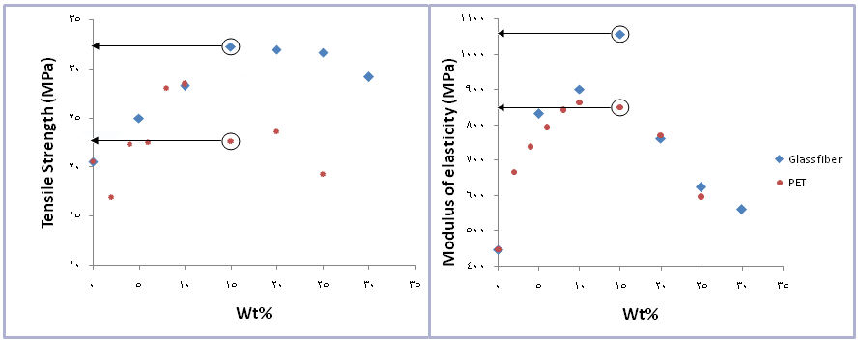
Comparison between glass fiber/PP composite and rPETFs/PP composite
Figure (13): Comparison between the modulus of elasticity tensile strength of glass fibre/PP composite and rPETFs/ PP.

Slide 38
Polypropylene and glass fiber(10wt% glass fiber) composite at different temperature
Figure (7): Relationship between modulus of elasticity and yield strength with temperature at constant composition 10 wt% glass fiber.

Slide 39
Figure (4): The DSC test result for the fibers of the white board marker.

