Slide 1

Designing a wastewater collection network for Attil Town as an option to reduce the high nitrate concentration in the groundwater of Tulkarm Governorate.
An– Najah National University
Prepared by:
- Aseel Rabee.
- Hanaa Salameh.
- Noor Odeh.
- Sara Draidi.
Under supervision of:
Dr. Mohammad N. Almasri.

Slide 2

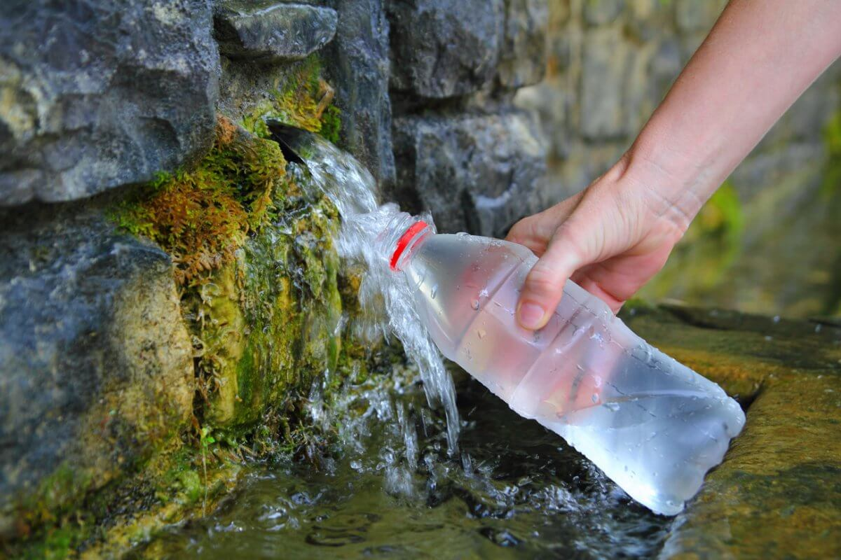
Introduction
The idea of project is based on studying the quality of groundwater in some wells of the Western Aquifer Basin in Tulkarm Governorate, but our studies have shown that there are high levels of nitrate.
We developed recommendations, including the construction of sewage collection networks to get rid of cesspits and leaks in the groundwater.

Slide 3

Objectives
Study and analyze the groundwater quality in the western basin specifically in Tulkarm Governorate in terms of the nitrate presence, pH, chloride and hardness.
Highlight the potential causes of the elevated nitrate concentration in the groundwater.
Provide the concerned authorities with recommendations and appropriate solutions to the potential problems.
Design a sewage network that serves the majority of Attil residents, which limits the use of cesspits.

Slide 4

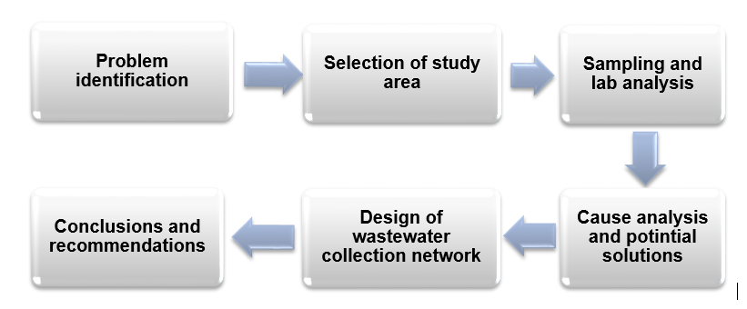
Methodology

Slide 5
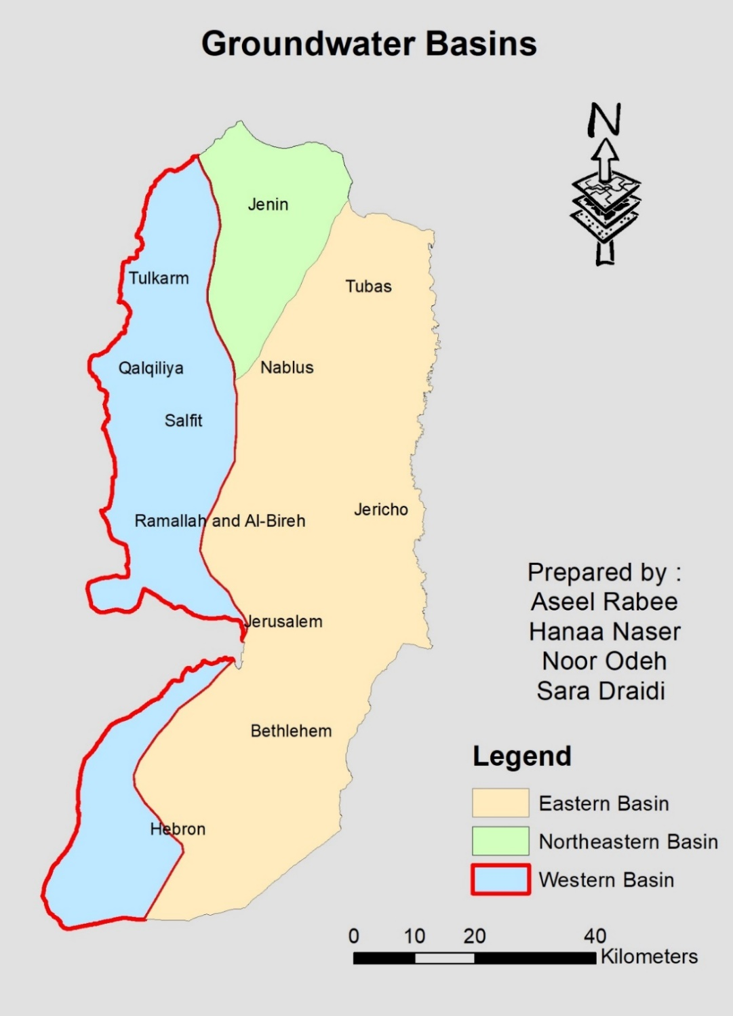
Groundwater is distributed in wells and springs in three groundwater basins in West Bank as follows: The Western, North eastern and eastern basins.

Slide 6
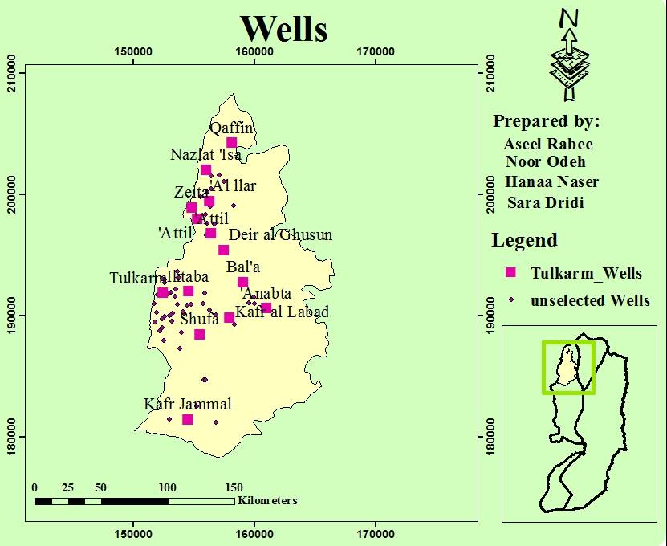
Study Area

Slide 7
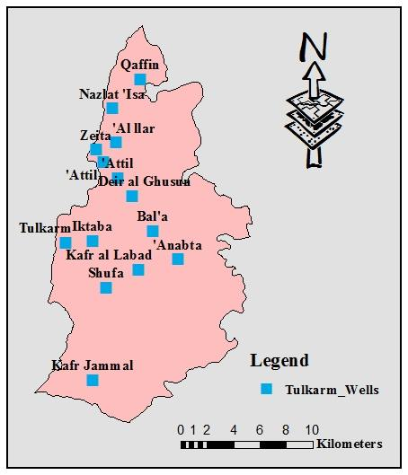
Water sampling
We selected 14 wells in different locations from Tulkarm and its villages, according to the available capabilities, in order to make a well-distributed geographical map to show the proportions.

Slide 8
The selected wells in Tulkarm

Slide 9
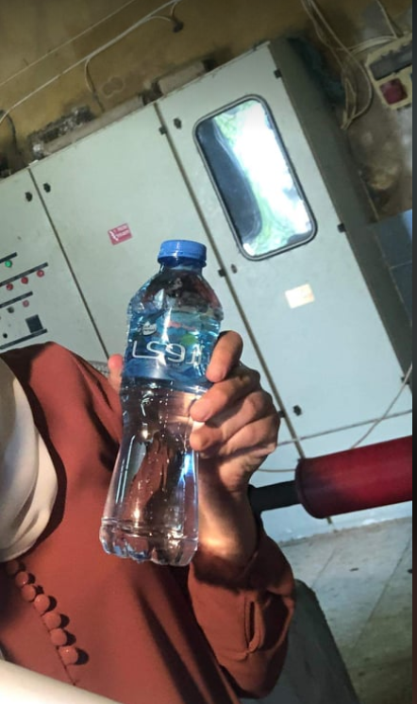
Criteria of collecting samples
1. Use sterilized bottles, washed by the water of the well that the sample will be taken from.
2. Keeping it in an icebox.
3. Making sure of running the well for an hour before taking the sample.

Slide 10
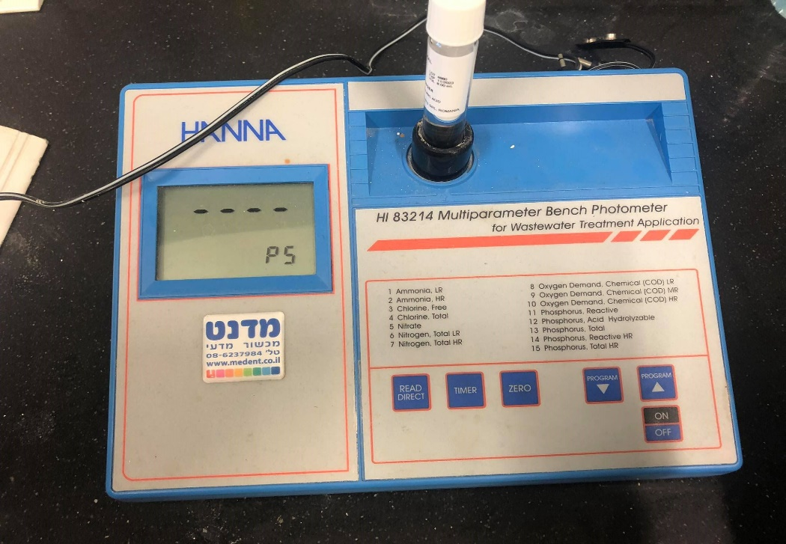
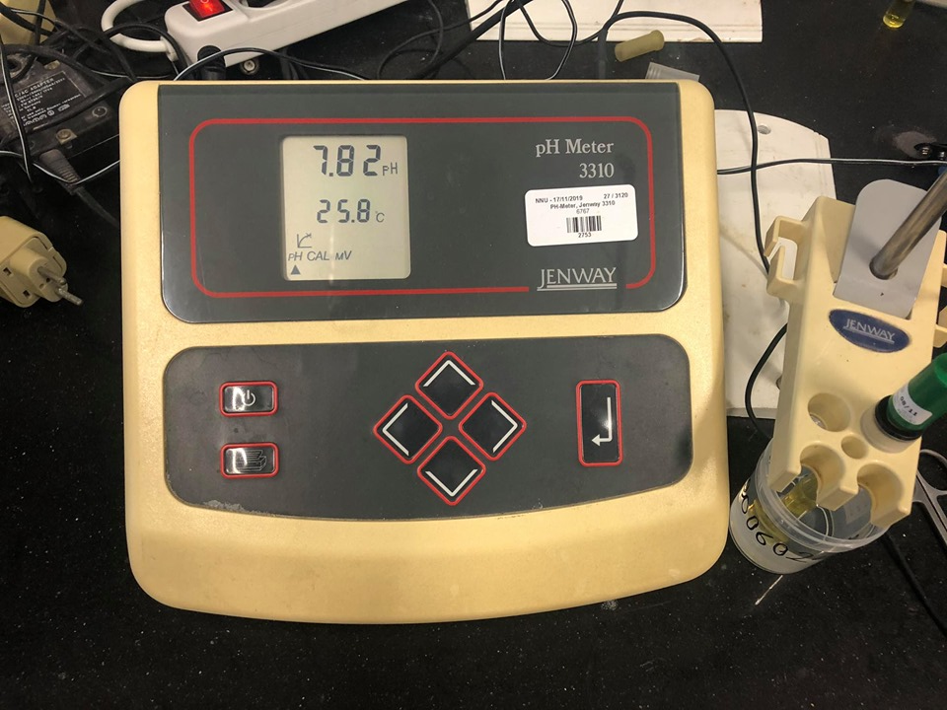
Tests that have been conducted:
1- pH test.
3- Chloride (Cl⁻).
  2- Hardness test.
4- Nitrate(No₃⁻) test.

Slide 11
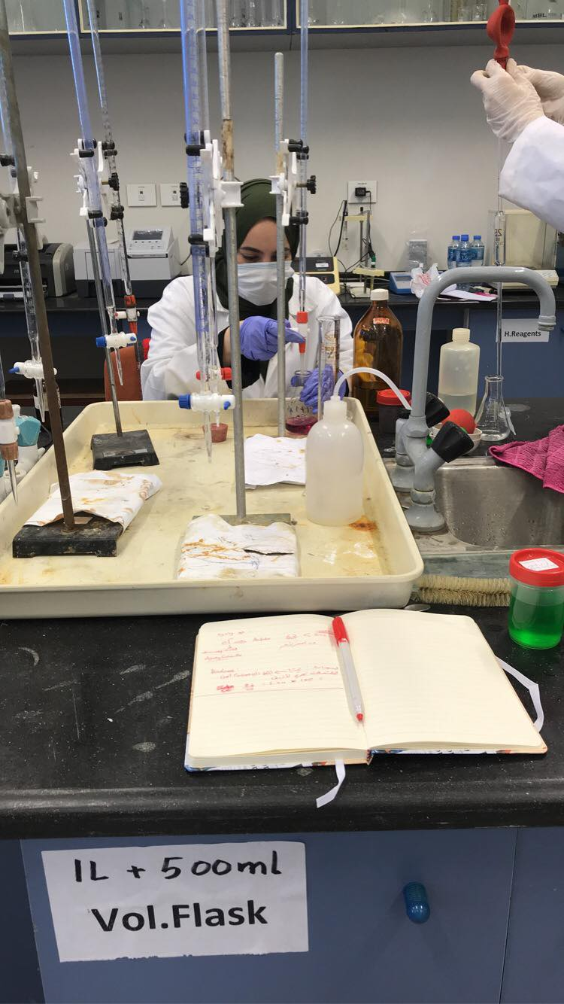
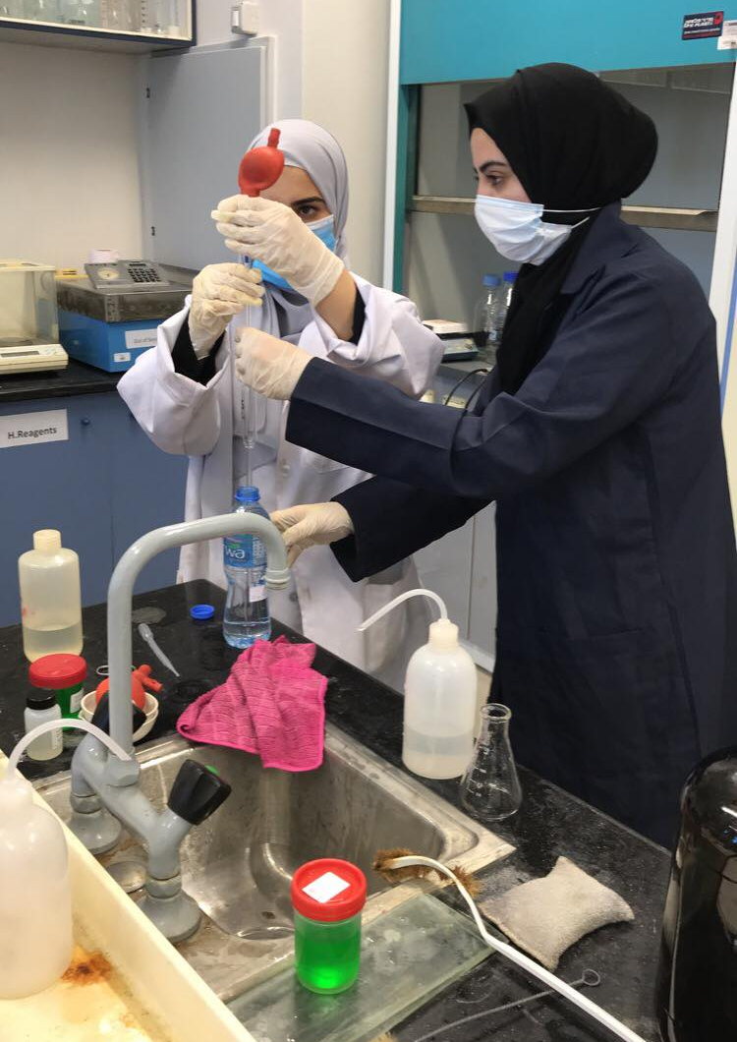

Slide 12
WHO standards

Slide 13
Analysis Results

Slide 14
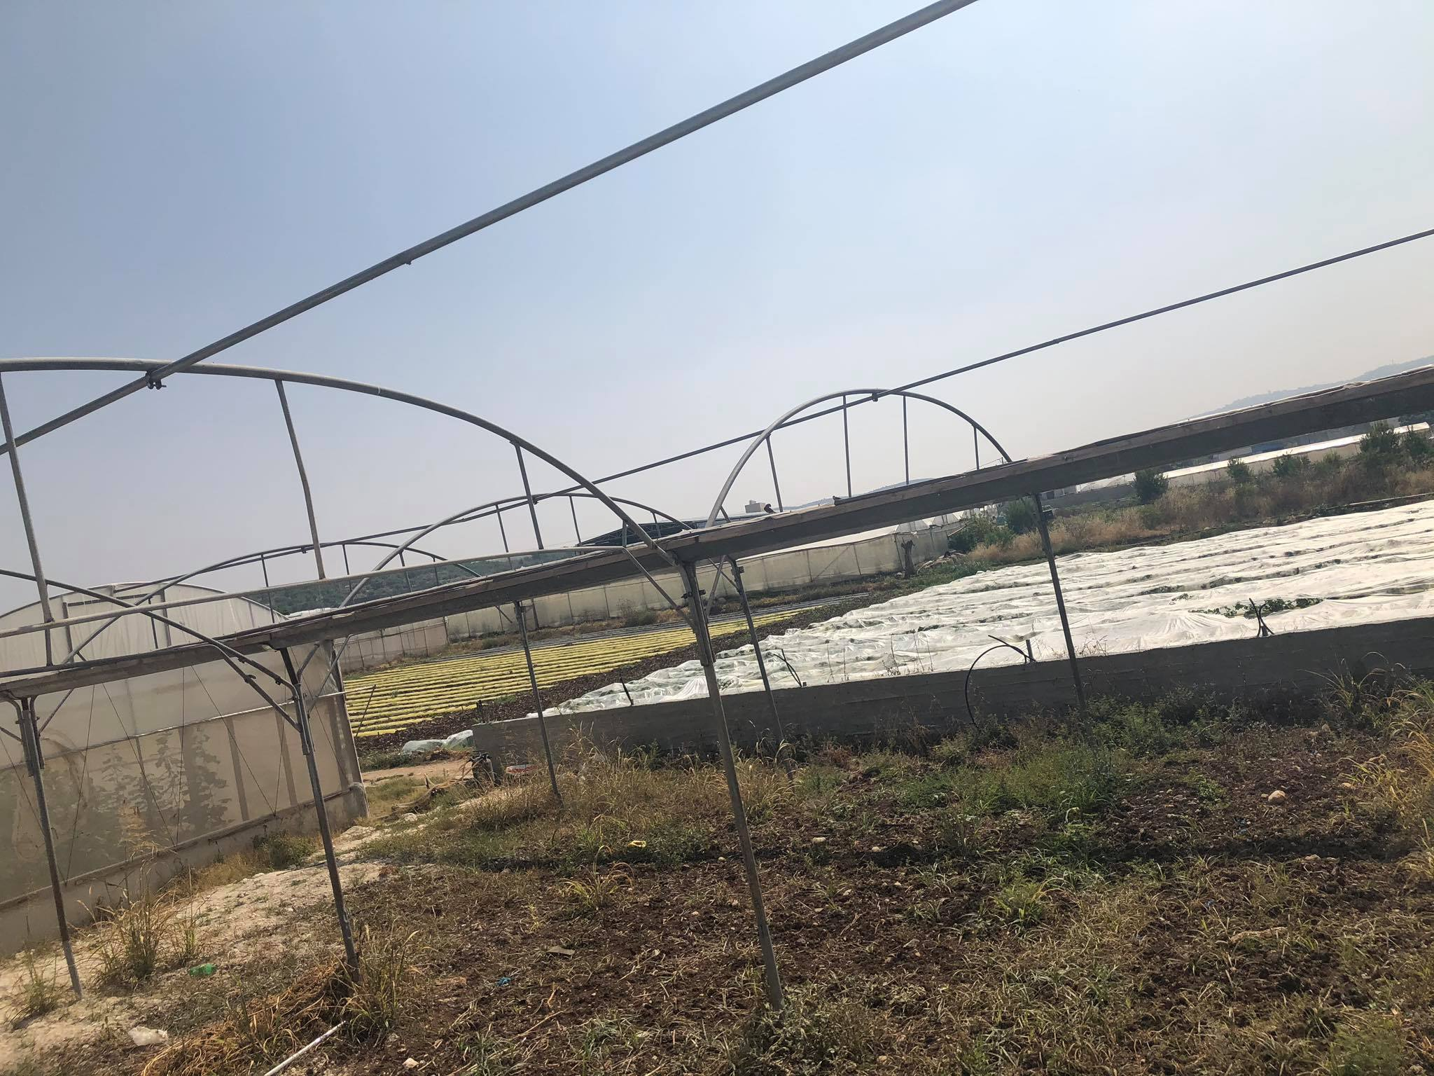
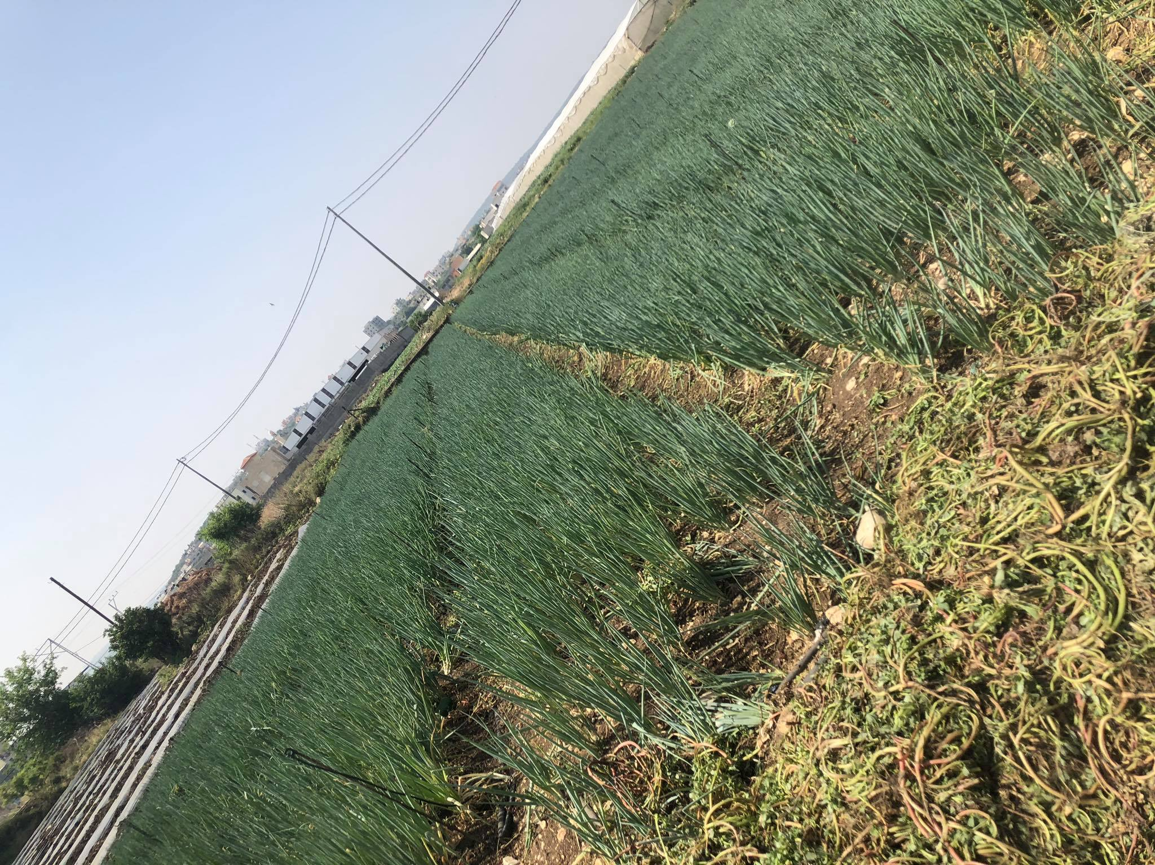
The highest concentration of nitrate was found in Illar with a value exceeding 74 mg/l. It is an agricultural well surrounded by 400 dunums of agricultural land.

Slide 15
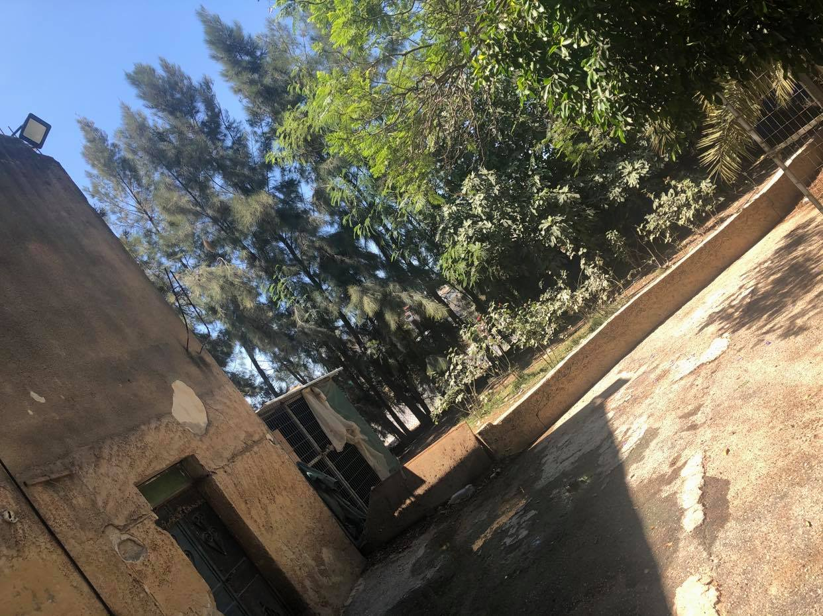
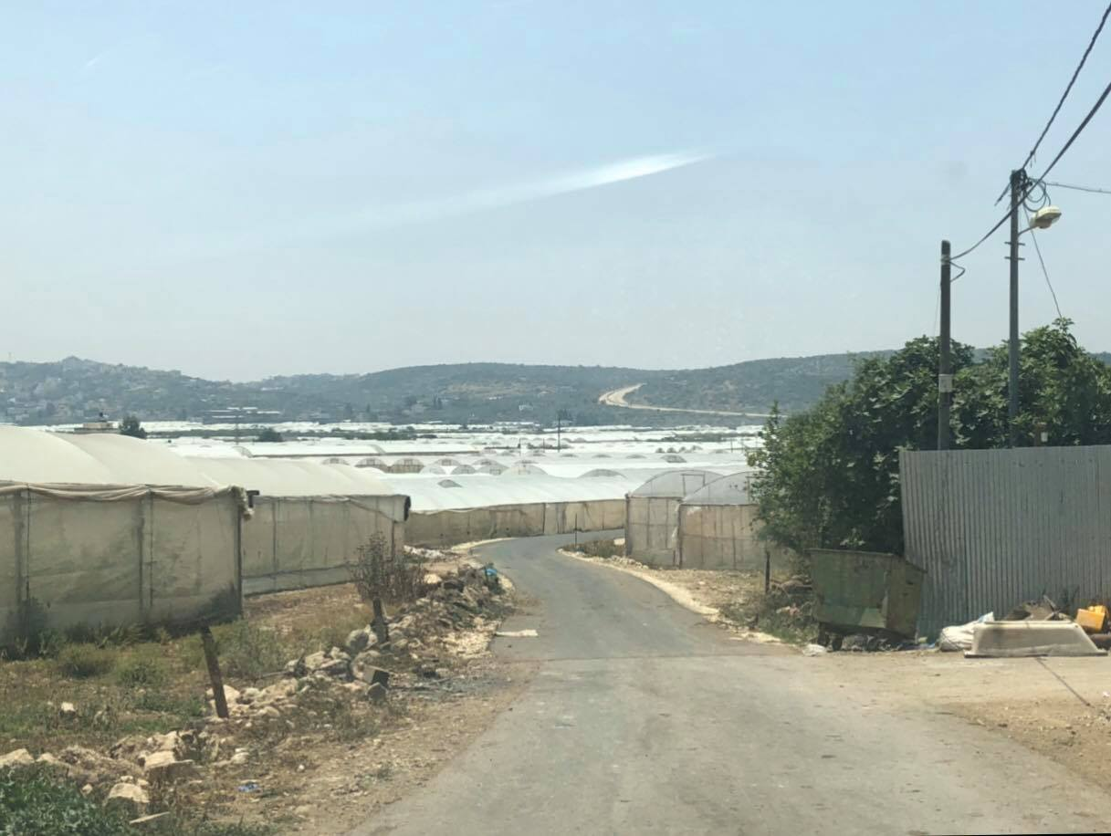
Then, the wells in which the concentration of nitrate ranged from (50-70) mg/l in each of Attil, Anabta, Kufr Jamal, Shufa, Iktaba, and Tulkarm.
Iktaba
Attil

Slide 16
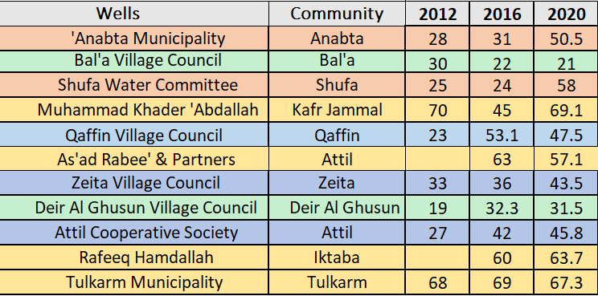
A previous results of Nitrate concentration (mg/l):

Slide 17
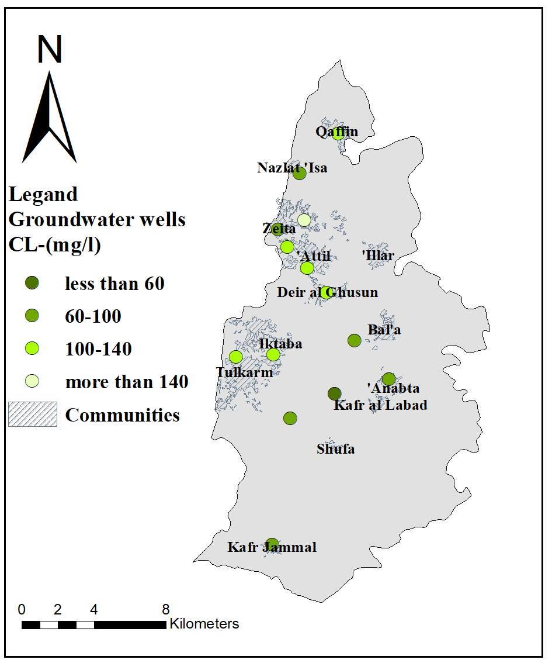
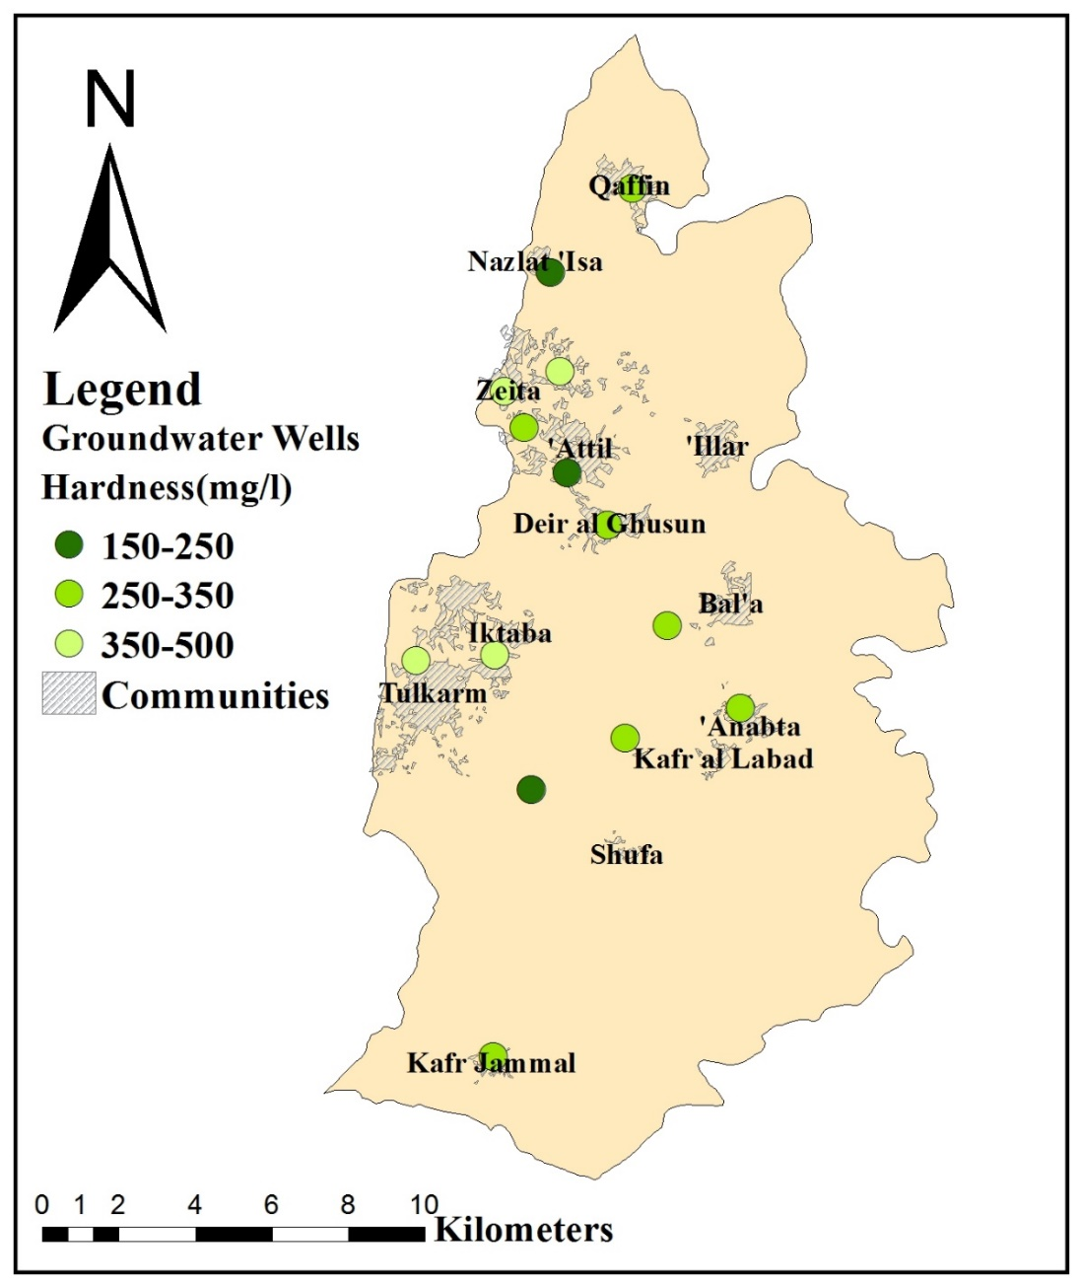
Hardness and chloride concentration distribution maps.

Slide 18
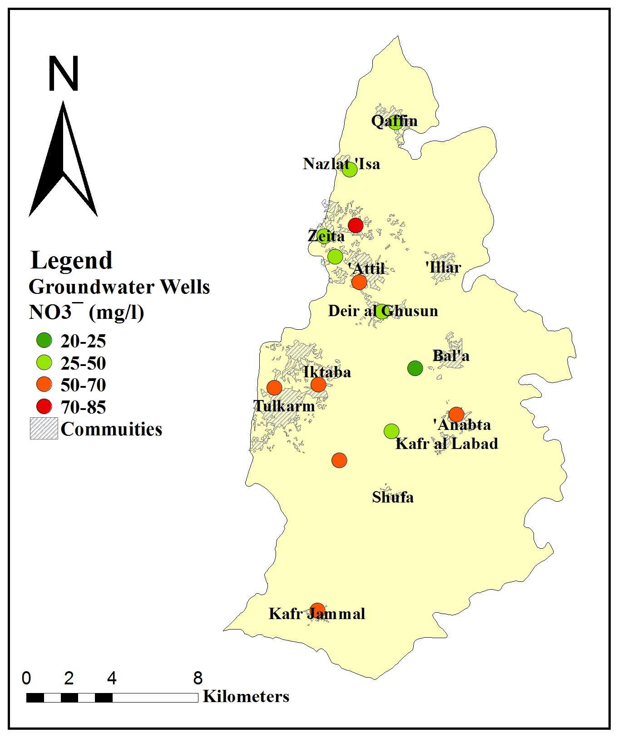
Nitrate concentration distribution map

Slide 19
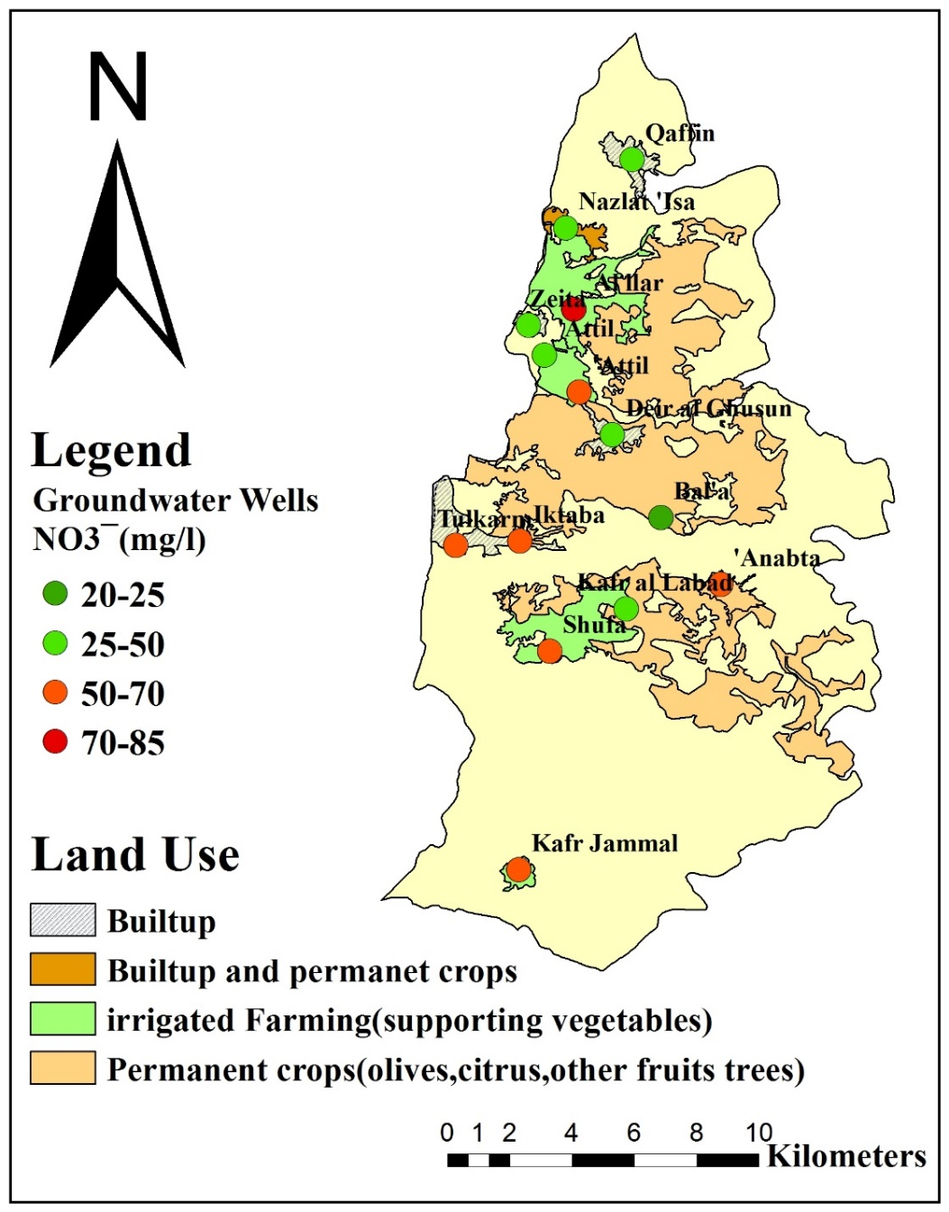
Land use map

Slide 20
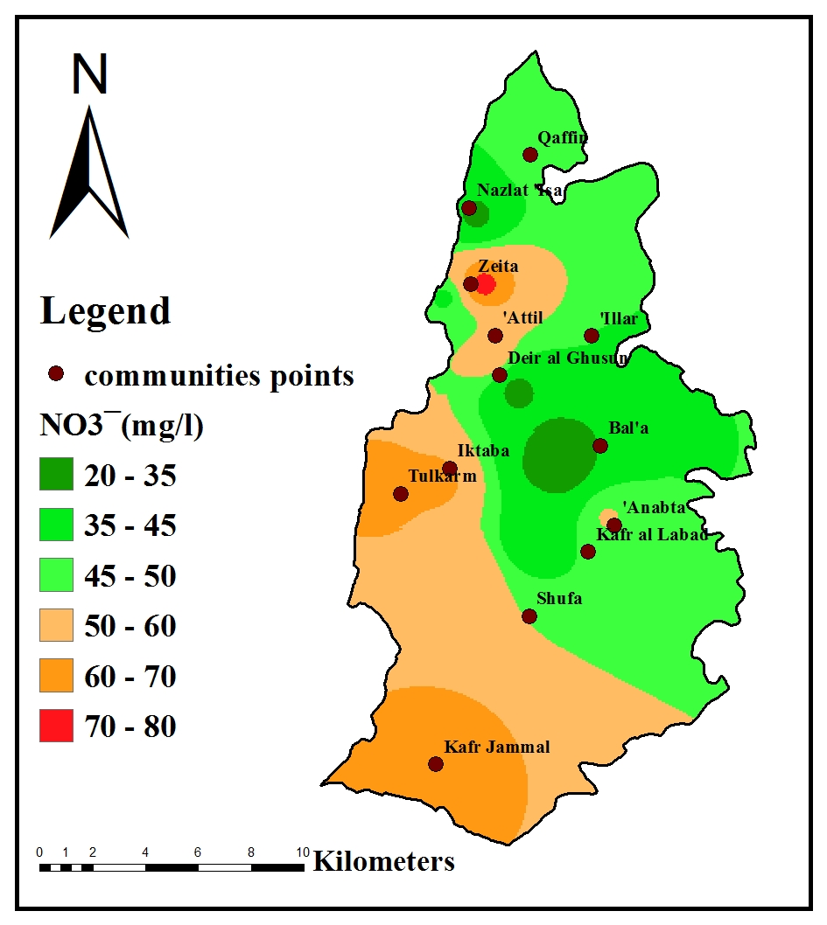
Spatial distribution for the nitrate concentration.

Slide 21
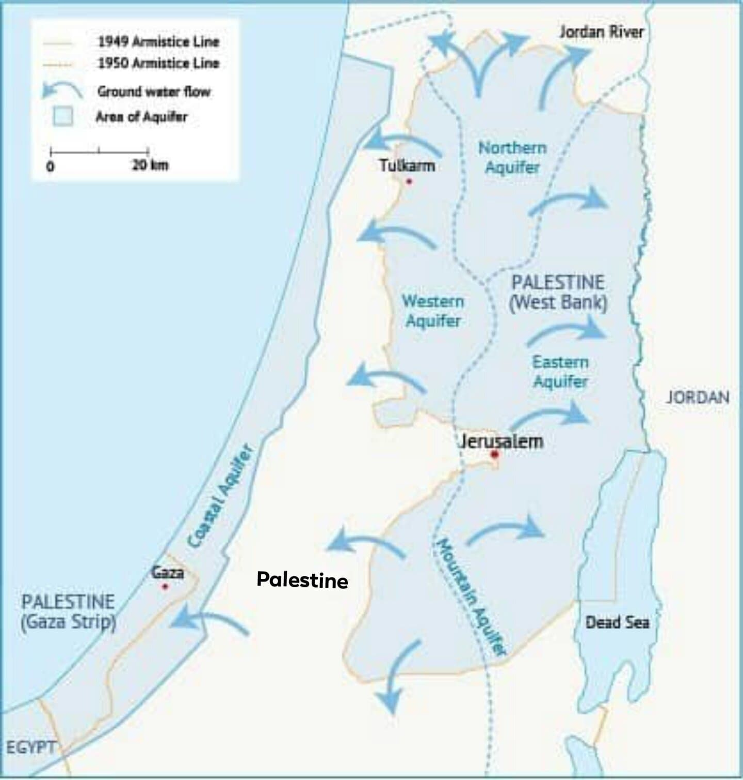
The movement of groundwater in the western basin is moving from east and south to the west due to the tendency of the constituent rock layers towards the west.

Slide 22
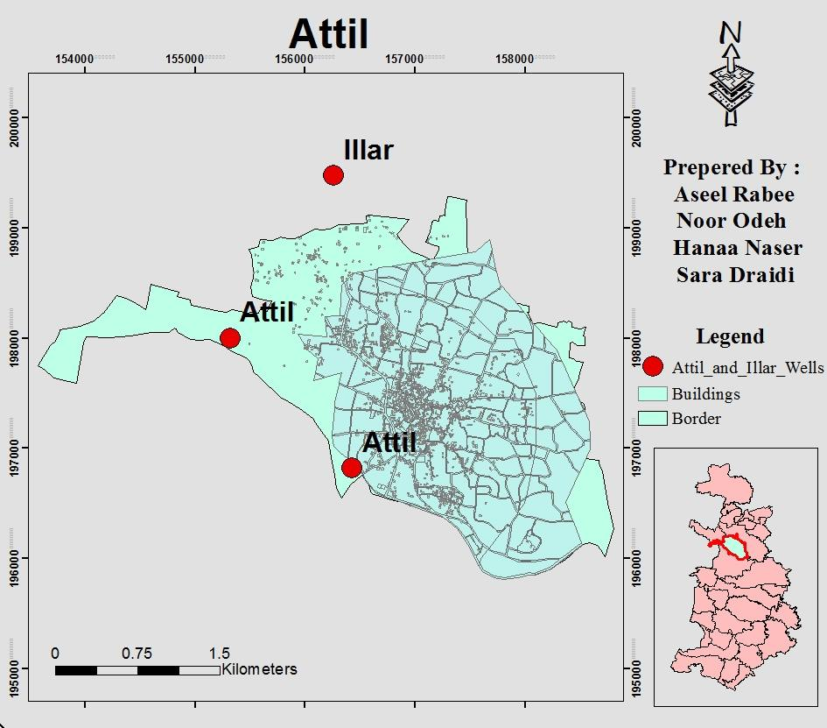
Attil town was chosen because it has a well with a high percentage of nitrate.
And it is very close to Illar, which contains the well with the highest percentage of nitrate.

Slide 23
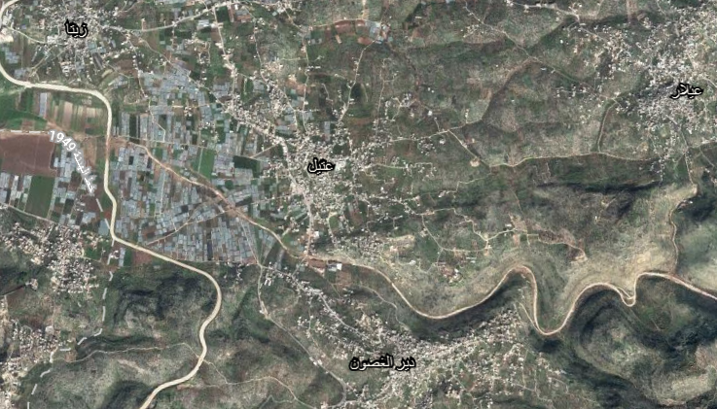
Attil is a town located to the north-east of Tulkarm Government away about 12Km, it is in the middle of the villages of Al-Shaarawiya. It rises 100 meters above sea level. Its land area is (7,337) dunums.

Slide 24
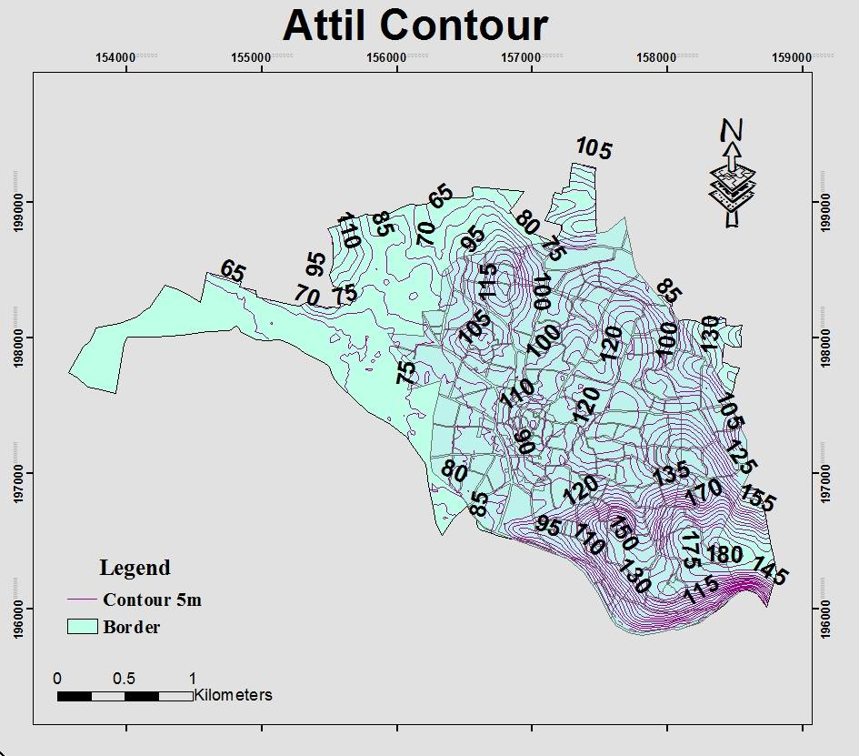
Attil has a flat nature and contain few hills and valleys.
The highest elevation is 180 m above mean sea level and goes down to a 65 m above mean sea level.

Slide 25
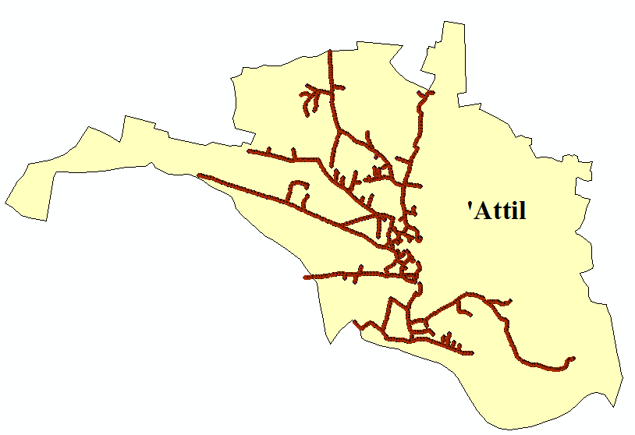
Designing a sewage network for Attil Town.

Slide 26
Calculation and Preparation of SewerCAD input Data:
The assumptions that will be considered in the design are:
1. The design period in this project is 30 years.
2. Population.
We got the data that we need for population calculations from the Palestinian Central Bureau of Statistics (PCBS).
Year | 2007 | 2010 | 2013 | 2016 | 2017 | 2020 | 2021
Pop. | 8957 | 9484 | 10039 | 10601 | 10277 | 10843 | 11038

Slide 27
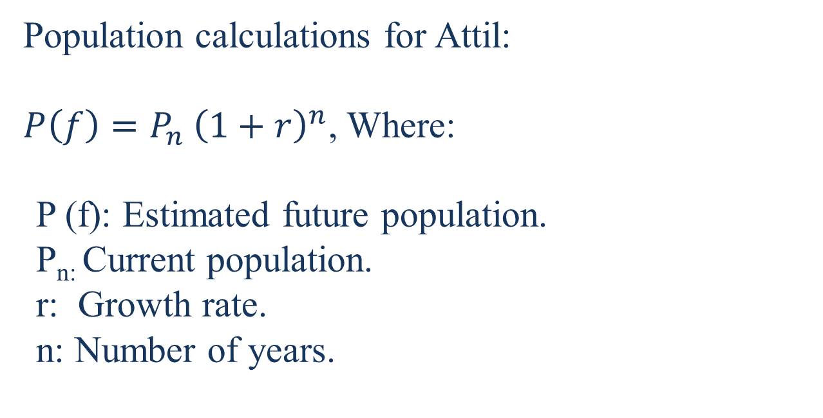
Population calculations for Attil:
$P\left(f\right)=P_{n} {\left(1+r\right)}^{n}$, Where:
P (f): Estimated future population.
P_{n:} Current population.
r: Growth rate.
n: Number of years.
The future population of Attil Town in the year 2051 is 20000 capita.

Slide 28
3. Water Demand : 120 L/c.day.
4. Infiltration: 20%.
5. Design peak factor : The value of peak hourly factor ranges from (2-4).
6. Maximum distance between manholes should be less than 30m and the diameter of manholes 1m.
7. Use PVC circular conduits, there advantages are light, durable, easy and fast installation.

Slide 29
The constraints used for the design of WWCS.
Constraints | Standard
Velocity | ( 0.6 – 3) m/s
Cover | ( 1 – 4.5 ) m
Slope | 1% - 15%

Slide 30

Calculation of the Total Wastewater Flow (Q design).
1. Calculate the Wastewater Volume.
Q (ww) = $\frac{(P×q×r×PF)+( P×q×r×i) }{1000}$
Where:
Q (ww): Wastewater quantity (m³/day).
P: Population (capita or person).
q: Water demand (L/c.d).
r (%): Return fraction.
i: Infiltration factor.
PF: Peak hourly factor.
Q (ww) = $\frac{(20000 ×120×0.8×4)+( 20000×120×0.8×0.2) }{1000}$ = 8064 m³/day.

Slide 31
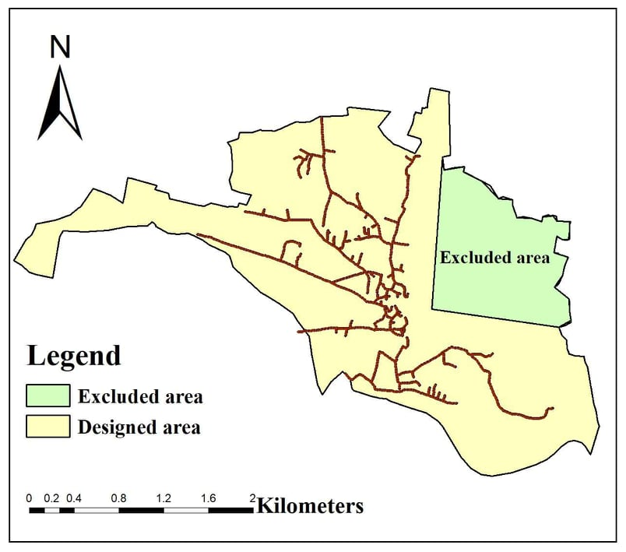
This estimate of wastewater load should be multiplied by 85% because the network serves this percentage of Attil town -as shown in the figure. This is due to the topography of the area.
So, Q (ww) = 8064* 85%
= 6854.4 m³/day.

Slide 32
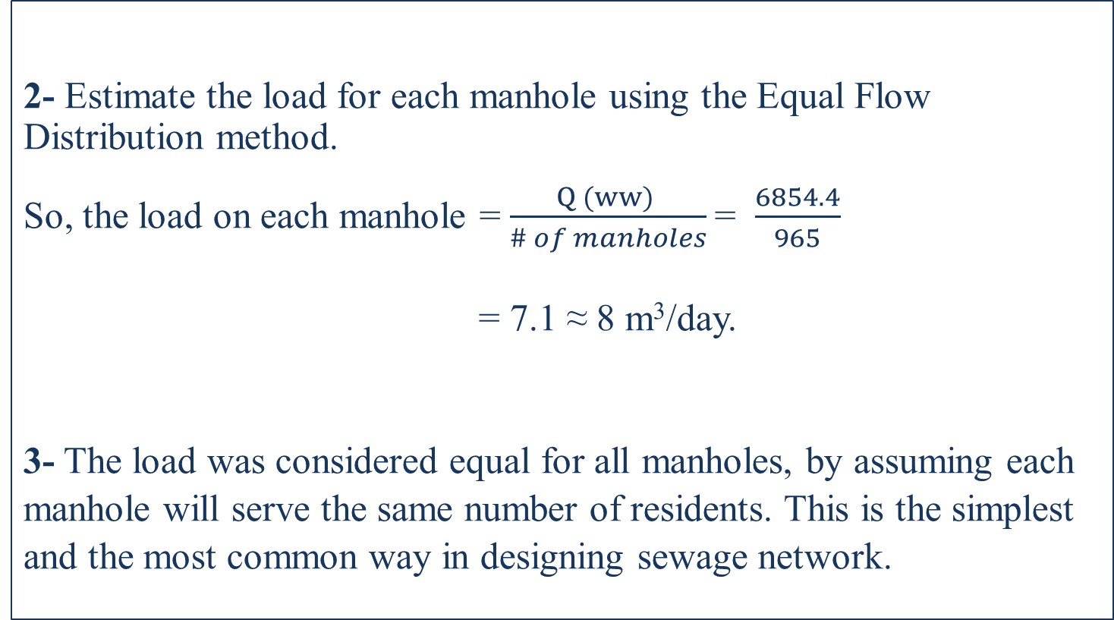
2- Estimate the load for each manhole using the Equal Flow Distribution method.
So, the load on each manhole = $\frac{Q (ww) }{\# of manholes}$= $\frac{6854.4}{965}$
= 7.1 ≈ 8 m³/day.
3- The load was considered equal for all manholes, by assuming each manhole will serve the same number of residents. This is the simplest and the most common way in designing sewage network.

Slide 33
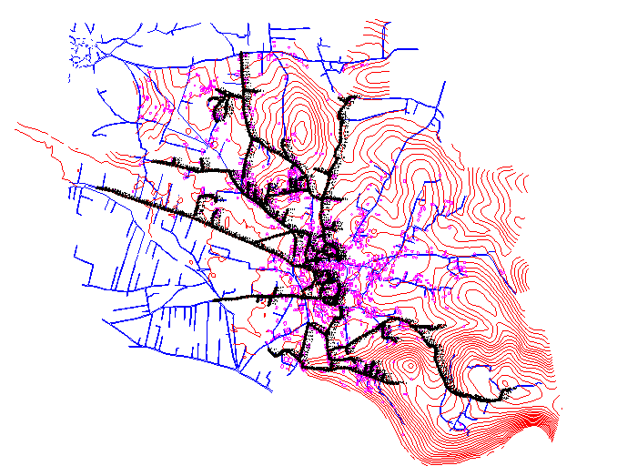
Input Data into SewerCAD.
1. Drawing the WWCS, with the three main components:
1. Circular manholes.
2. Conduits.
3. Outfalls.

Slide 34
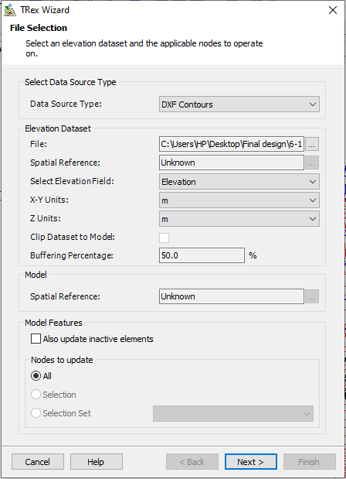
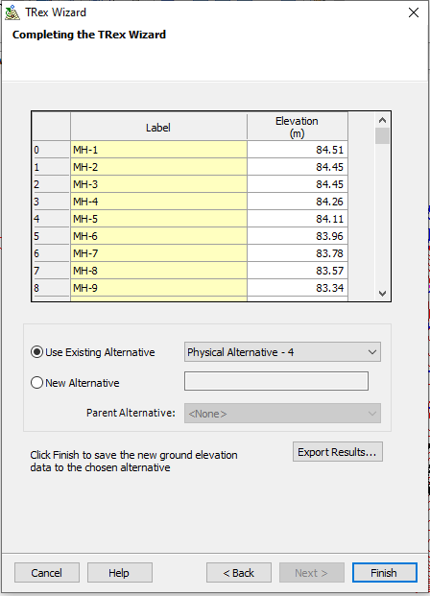
2. Using TRex feature to calculate the elevations for manholes and outfalls based on DXF contours

Slide 35
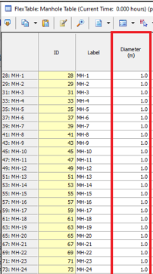
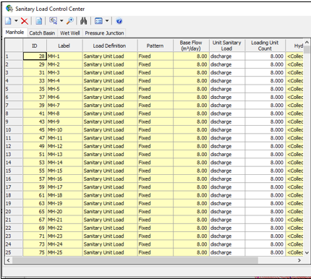
3. Define data for manholes.
- We defined manholes with 1 m diameter.

Slide 36
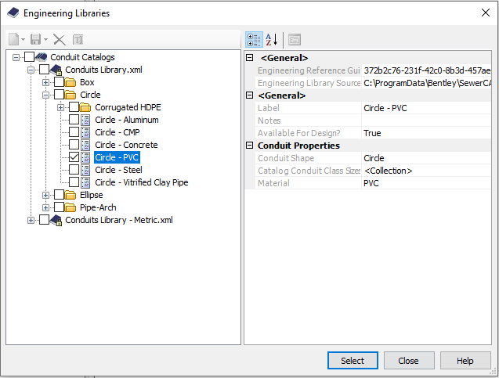
4. Define data for conduits
The circle-PVC material is imported from library to use it for conduits, which starts form 8 inches.

Slide 37
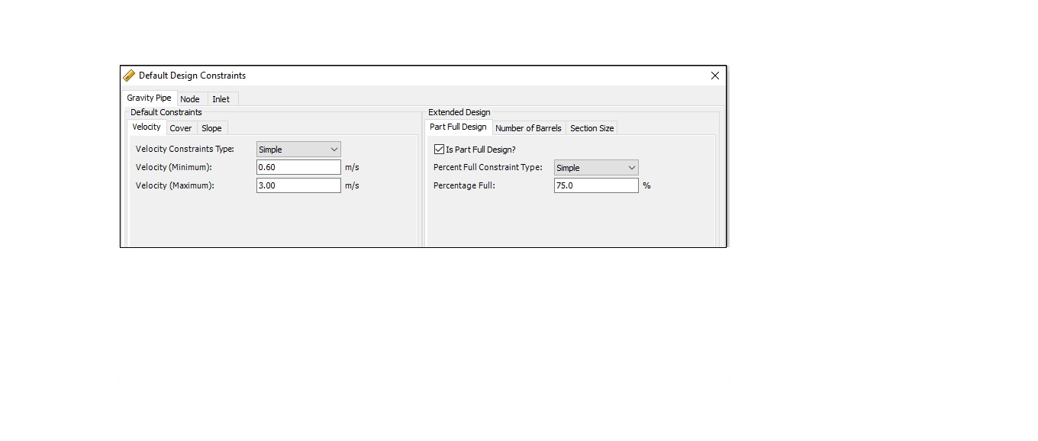
5.Input the default design constraints.
1. Velocity constraints:

Slide 38
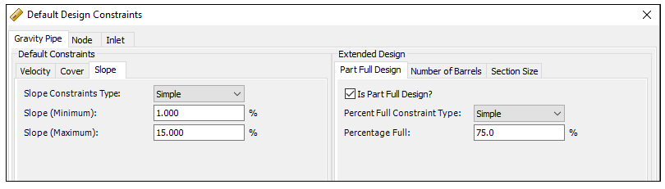
2. Slope constraints:

Slide 39
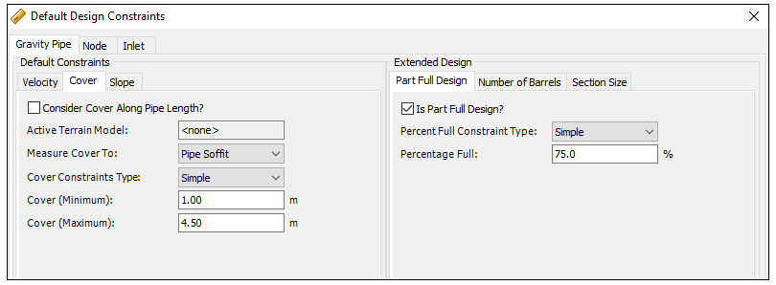
3. Cover constraints:

Slide 40
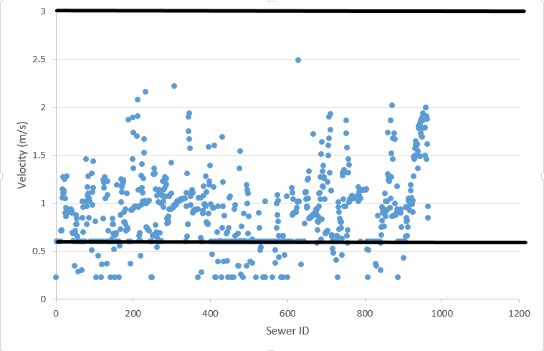
Results of design.
- Velocities.

Slide 41
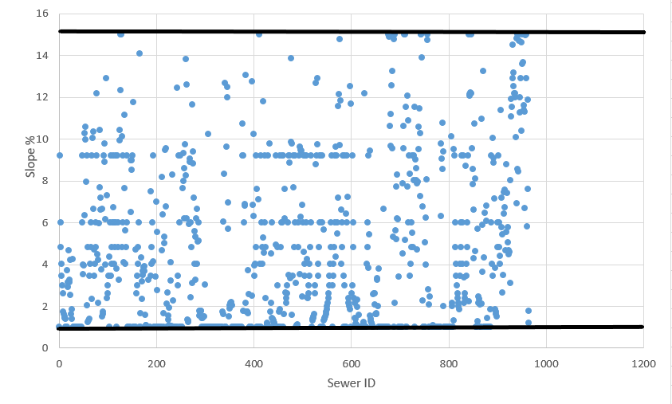
- Slope.

Slide 42
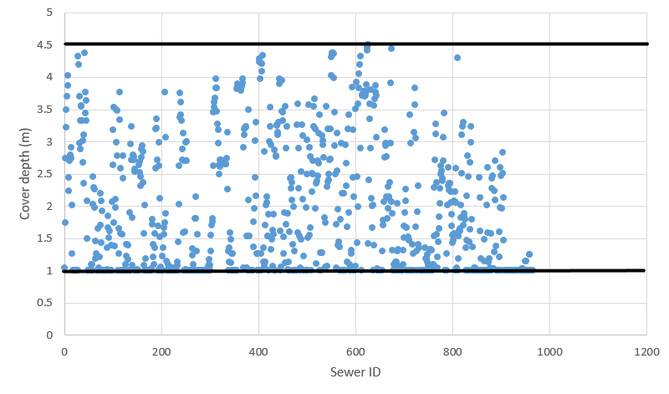
- Cover.

Slide 43
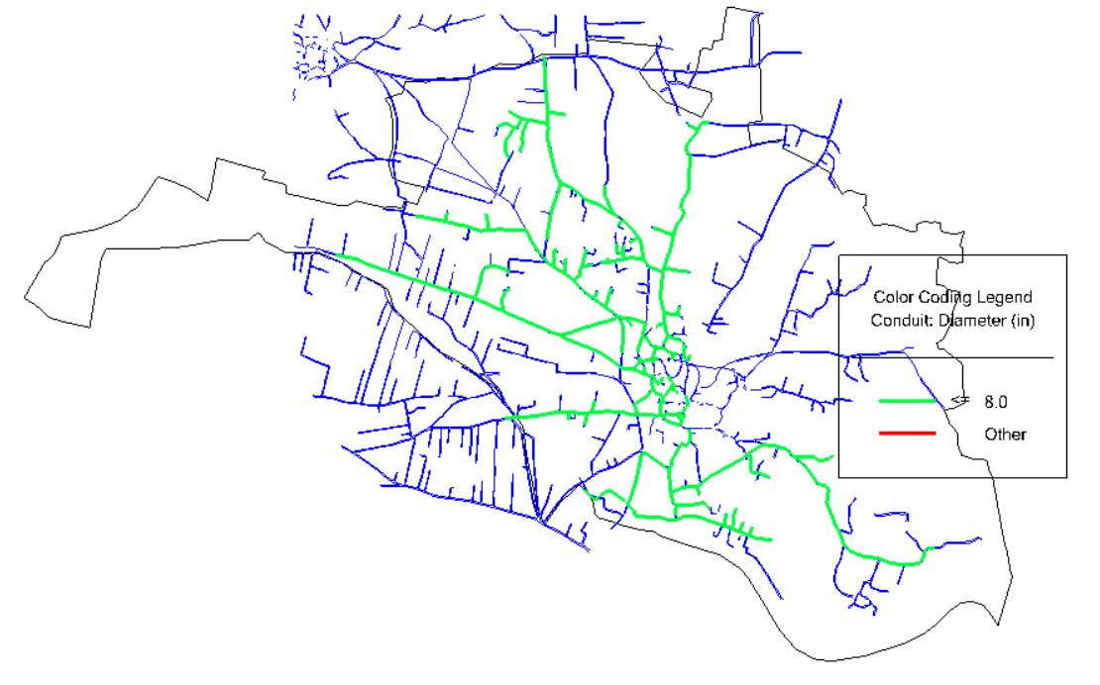
Diameters
The figure below shows that all the diameters used in the network are 8 inches and the length of the network being 18195 m.

Slide 44
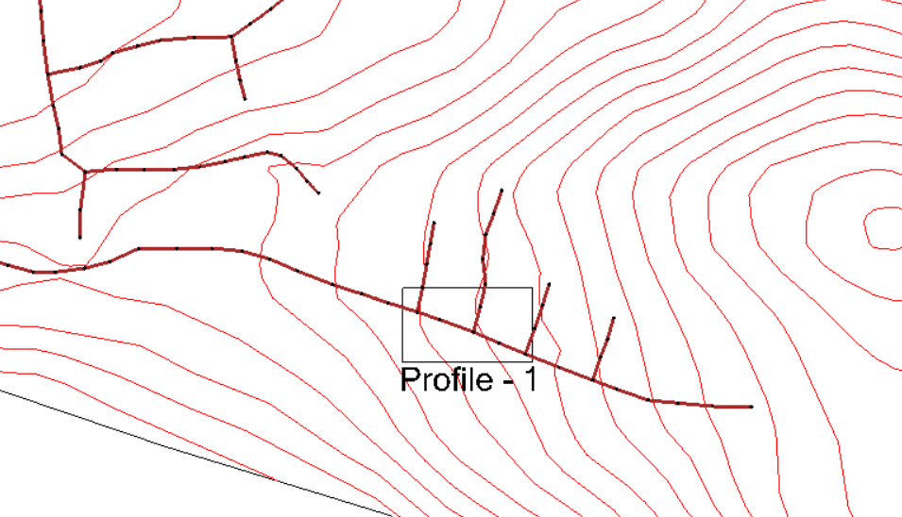
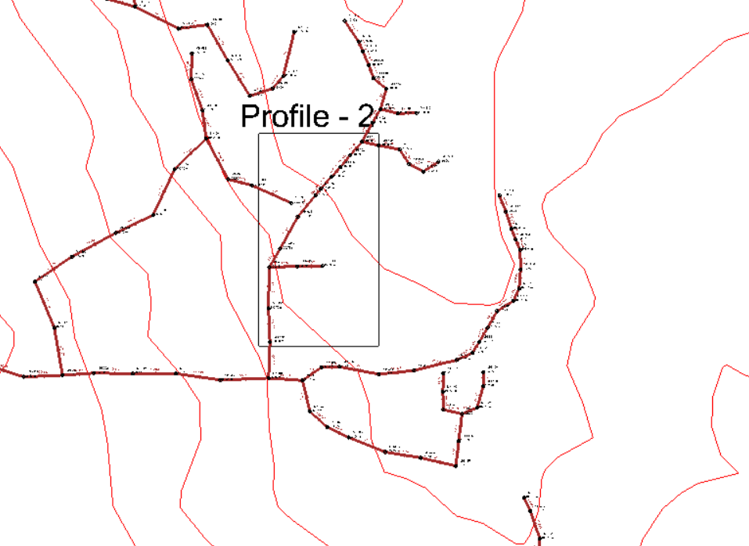
Profiles
This graph shows the profiles location that have been selected from different places on the network.

Slide 45
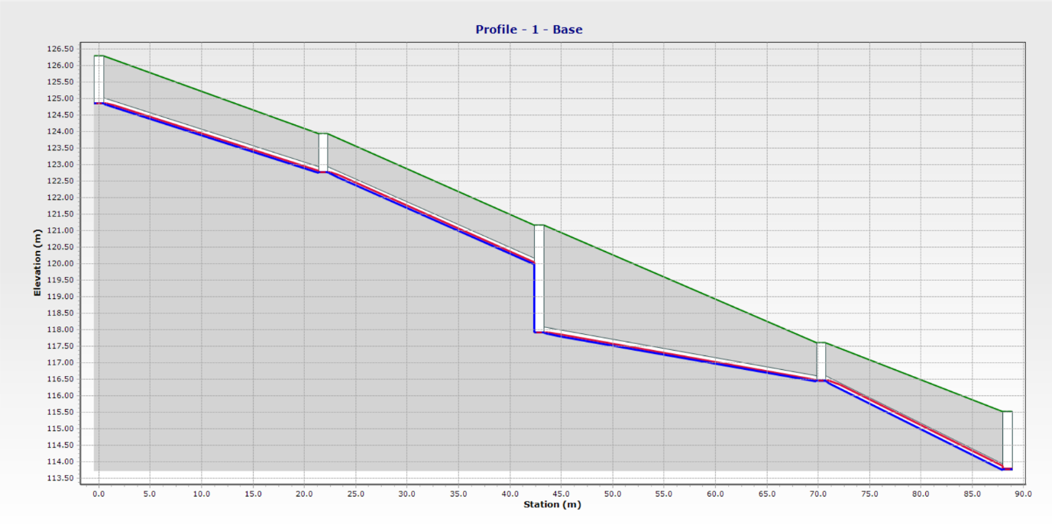
- Profile 1.

Slide 46
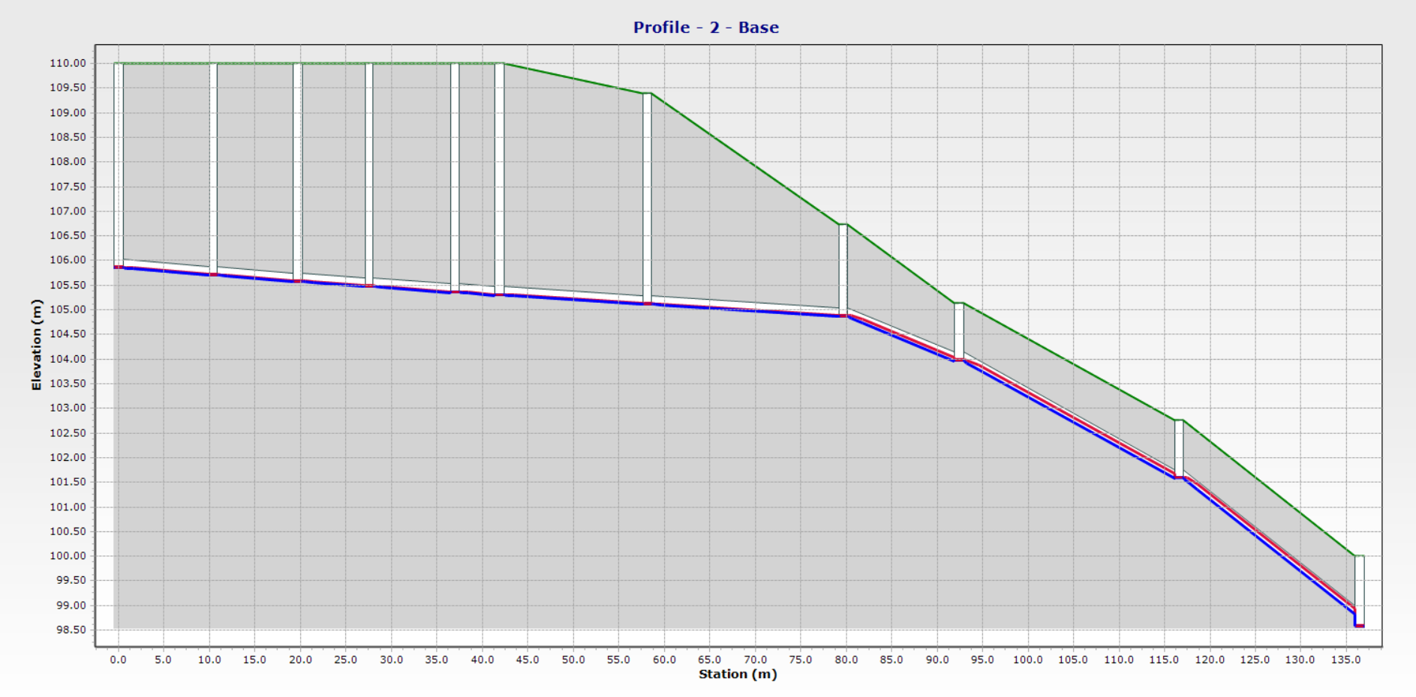
- Profile 2.

Slide 47
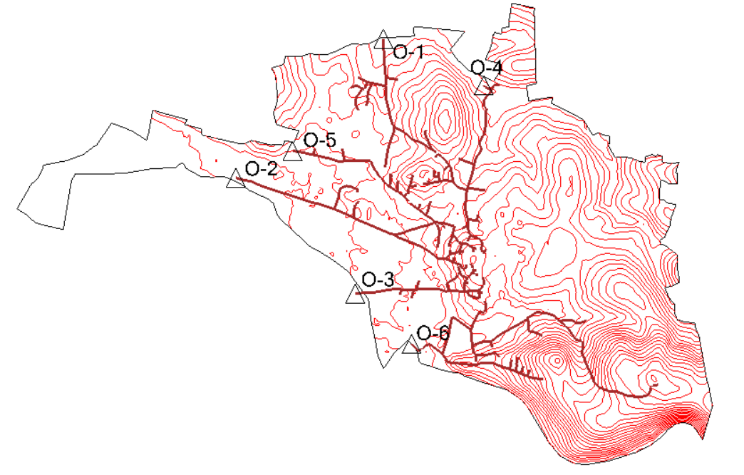
- Outfalls.

Slide 48
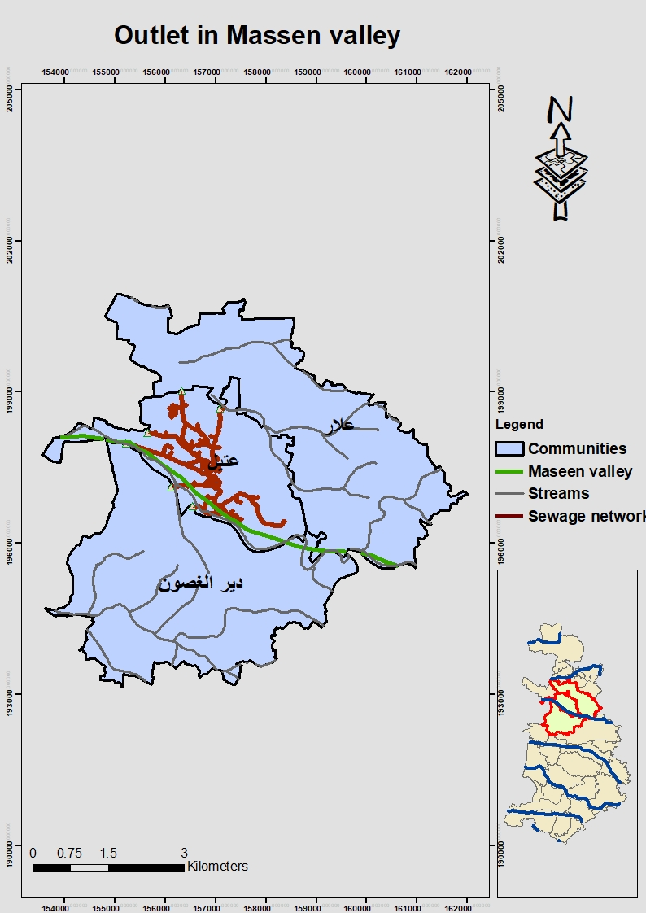
Outlet in Massen valley.

Slide 49
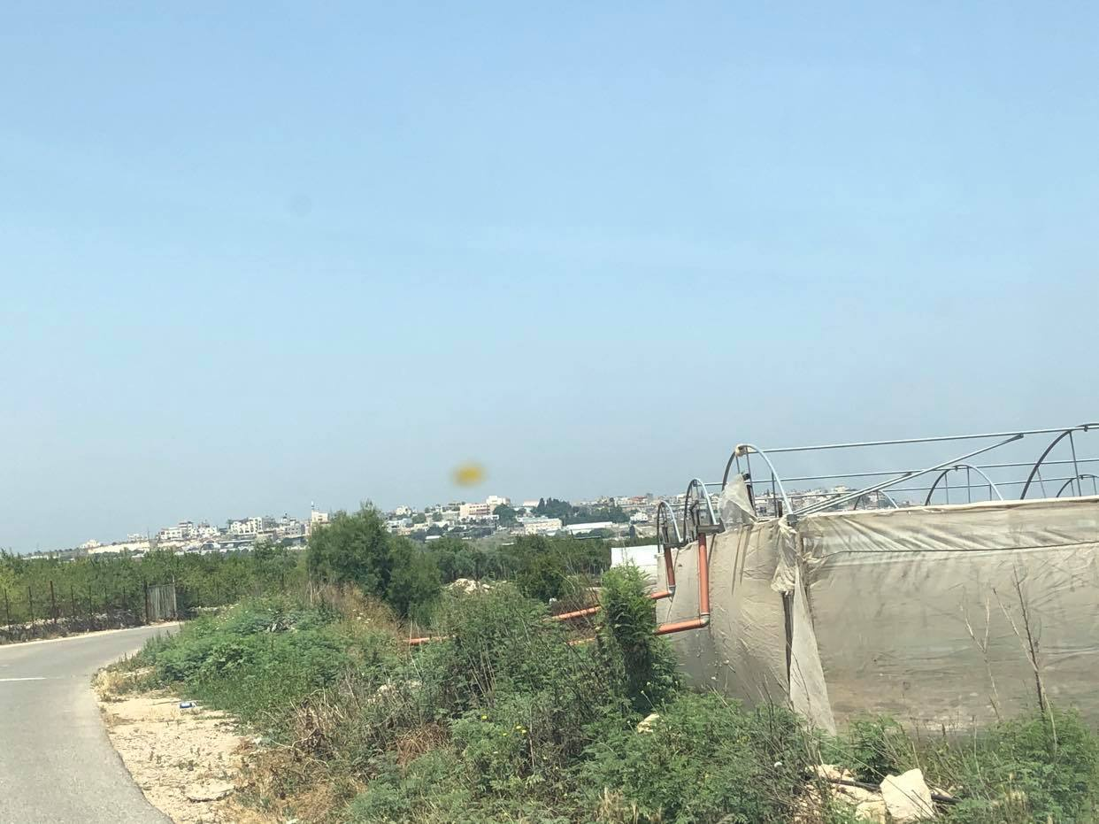
Conclusions.
1. The presence of agricultural activities near the groundwater wells has led to elevated nitrate concentrations.

Slide 50
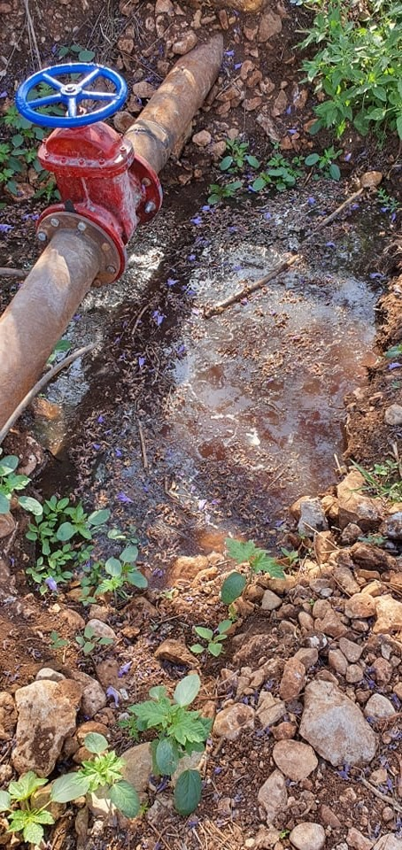

2. The closeness of cesspits to the groundwater wells and the presence of the poultry farms and the corresponding manure contributed to the on-going problem of nitrate contamination.

Slide 51
3. Due to the movement of groundwater in the western basin towards the west, the concentration of nitrate, the hardness of water, and chloride increases.

Slide 52
4. Concentrations of nitrate decrease as the depth of the groundwater wells increases.
5. Among the steps that were taken to confront the high nitrate percentage was also heading to UPWSP and informing them of the results we obtained, who in turn directed an official letter to all the municipalities that have been examined in order to encourage them to conduct tests and take serious steps to face the high nitrate rise.

Slide 53

6. When designing the sewage network, we encountered some problems, and we adopted some scientific solutions such as:
1- Changing the method of linking the manholes.
2- Adjusting the distances between manholes.
3- The use of 6 outlets.

Slide 54
Recommendations:
1. It is essential to do a periodic check to know and monitor the quality of groundwater.
2. Knowing and tracking sources of pollution for groundwater wells to reduce them and raise awareness among specify to conserve groundwater sources and prevent pollution.

Slide 55
3. Giving warnings to owners of wells with the highest nitrate levels, and educating consumers about the danger of drinking from these wells.
4. Among the proposed solutions also for the owners of the wells that have high levels of nitrate is the work of mixing these wells with wells that have low nitrate ratios as a way to treat them.
5. It is vital to have wastewater collection networks to get rid of wastewater away from groundwater wells.

Slide 56

Thank you

