Slide 1
Aerodynamic Bump
By:
Amr Malhis
Shadi Qazza
Odai Amira
Omar Abu Ghdaib
Supervisor:
Dr.Ramez Al-Khaldi

Slide 2
Content
Project Overview
Project Objectives
System Description
constrains problems
Results and Discussion
RecommendationConclusion

Slide 3
Project overview
Today, our energy system is based on motion of the cars over the bump that will concentrated on an aerodynamic energy which consist in every city in the world due to the daily increasing in cars amount.
Most regions, particularly developing countries are experiencing significant energy demand growth which puts pressure on global energy sources.

Slide 4
In general, the practice of extracting energy causes four interrelated fundamental problems: Disrupting natural energy flows, Depletion, Centralization, and Resource wars.
Unfortunately, our energy system is dysfunctional because highly based on the number of cars that passed the bump per day , so it differs from location to another, also the traffic jam plays critical role in amount of the energy generated .

Slide 5
Moreover, renewable energy are widely used today ,also it’s friendly for the environment. In the early eighties and nineties there were people and even scientist who starting to realize the negative effect of non-renewable energy on the environment.

Slide 6
Resources shortage
Resources in Palestine are restricted due to some reasons such as:
The Israel's dominance over energy resources
Shortage in resources in Palestine due to it’s location
Forbidden of use an enormous resources like nuclear energy

Slide 7
Project Objectives
1. Investigate the Aerodynamic bump systems and applications:
Review the history of aerodynamic energy applications
Review the available literature on aerodynamic energy and its use.
Look at the potential use of aerodynamic energy in Palestine.
2. To utilize the existence of the bumps on roads to generate electricity.

Slide 8
3. Design and construct aerodynamic bump systems that produce electricity without any cost depending on the air-flow principals.

Slide 9
The main goal is to examine a potential source of energy that is cheap, available, affordable, renewable and most important environmentally friendly.

Slide 10
System Description
The next slides will describe the device constructed, the working principle of the device and it’s components.

Slide 11
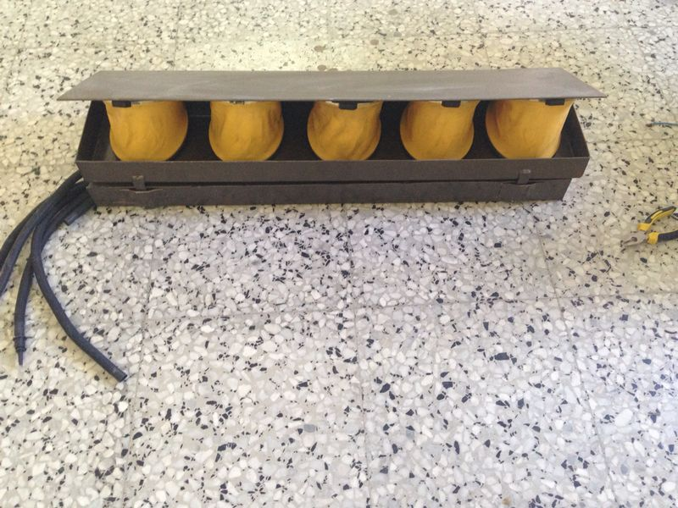

Slide 12
Working Principle:
When the vehicle cross over the bump the board metal plate presses the bump down in order to make a pressure inside the flexible pipes .
There are springs to keep the bump standing, Air rushes by the weight of the cars , then the air go to the generator through the pipes that connected to foot air pump so it’s transfer the air flow directly to the generator blades.

Slide 13
After the air arrived to the generator blades it will rotate to generate electricity , and the amount of electricity generated depending on the amount of air flow that rotate the generator.
Generator which produce a continuous electrical current DC or AC depending on the type of generator used and amount of energy generated by an electricity transformer and send the power to the electricity grid or stored in stationary batteries

Slide 14
The springs inside bumps raising the upper plate of the bump so that after crossing the vehicle and pull the air into the bump it will reflect the air again.
Then the bump ready to receive another vehicle to repeat the cycle.

Slide 15
Components of the System:
Foot air pump
Generator
Ramp Base
The Ramp
Pipes
Led Light

Slide 16
Foot air pump:
The foot air pump which consist of a torsion spring, two plastic plate and a rubber material to cover the pump, we will use five foot air pump.

Slide 17
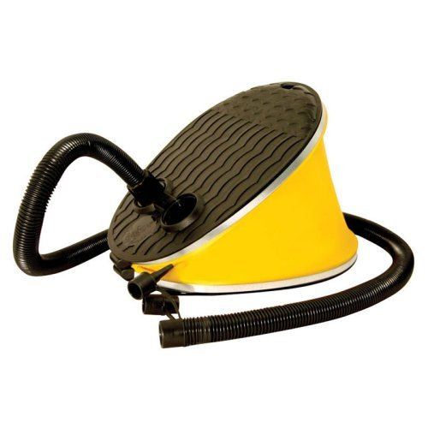
Foot air pump

Slide 18
Generator:
We will use a 12 VDC generator which considered as an educational generator.

Slide 19
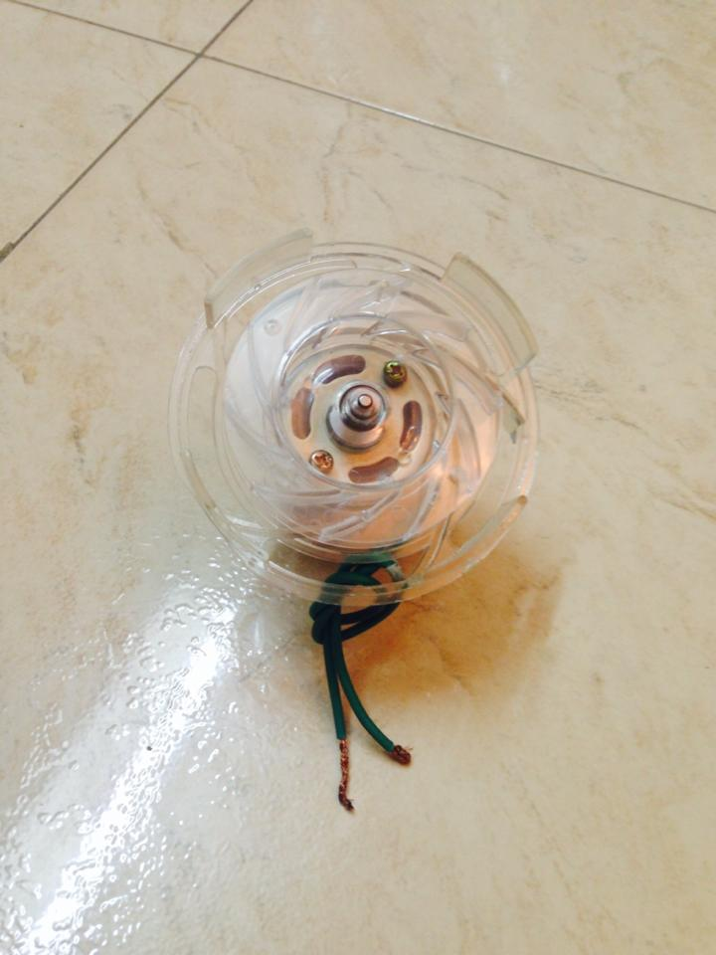

Slide 20
Ramp Base:
The ramp base is making from steel and we use it to put the pipes inside - that comes from the foot air pumps - also to protect the pipes.

Slide 21
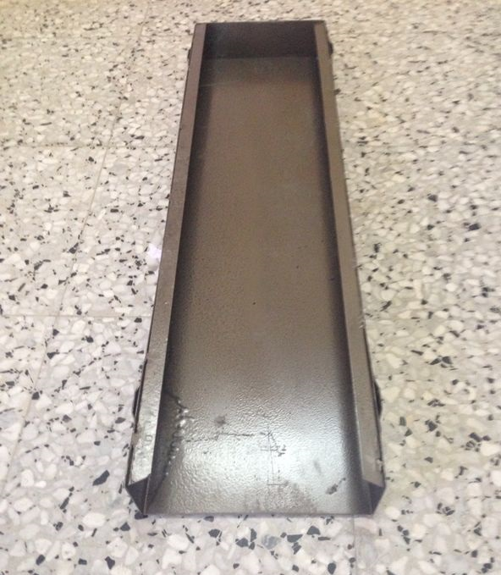
Ramp Base:

Slide 22
The Ramp:
The ramp which considered as the main component of this project which it included two steel plates the upper one is to deal with the compression of the load of car and the other one is to stick with the ramp bas which it's fixed to the ground, the ramp consist of five foot air pump and there is a wholes on the lower plate to allow to pipes to go through the ramp base to give the air to generator.

Slide 23
The model of the project:

Slide 24
CONSTRAINS AND PROBLEM:
We faced a lot of problem which they are:
The existence of wells turbine and the material we used to pressurized:
The existence of spring that we designed to use it inside the ramp
The air bumps that available in the market are not withstand a high number of pushes over it

Slide 25
4. The process of generating electricity and the two factors that the process depends on :
The pressure that produces an air flow:
The continuous of the air flow to turn the blades of the generator
5. The generator choosing , we had to make a choice between two generator which they are considering the best generator

Slide 26
6. This kind of project need a hug financial support

Slide 27
RESULTS AND DISCUSSION:
Experiments were conducted to simulate the motion of the airflow through the air bumps to the generator .

Slide 28
Pressure of air foot pump:
the pump achieves the air pressure 2.68 psi. this data is given is per one air foot pump.
in this project we use five air foot pumps so it gave us 10.5 psi but this pressure is not enough to give us a continuous air flow.

Slide 29
The data of the system, which contains the pressure of the air foot pump, the quantity of voltage generated.
the generator (12VDC Generator) which it’s considered as an educational generator gave us these data:

Slide 30


Slide 31
RECOMMENDATIONS and conclusions:
Based on the theoretical and experimental problems that we faced we recommend the following:
Because of the air flow was irregular and discontinues so it must be stored in pressure cylinder which contains a control unit to evacuate the air at a specific point to insure the large amount of air flow which give us the large amount of aerodynamic energy to produce the electricity.

Slide 32
2. To insure a large amount of air flow and energy it's recommended to use multisystem inside the ramp to give a huge amount of air such as to use a piston and springs which it's improving the coefficient of performance.
3. Manufacturing a new turbine with special specification blades and generator can rotate at low air flow with low friction pipes to have the desired energy and electricity.

Slide 33
High rubber material specifications to install inside the ramp to sustain the high pressure.
Put more than three ramps in series way in each side of street to gain more energy which converted to electricity.
Using more principles of operating such as operate on hydraulic system because the specific energy. for oil is higher than air so we recommend working this project as a hydraulic system.

Slide 34
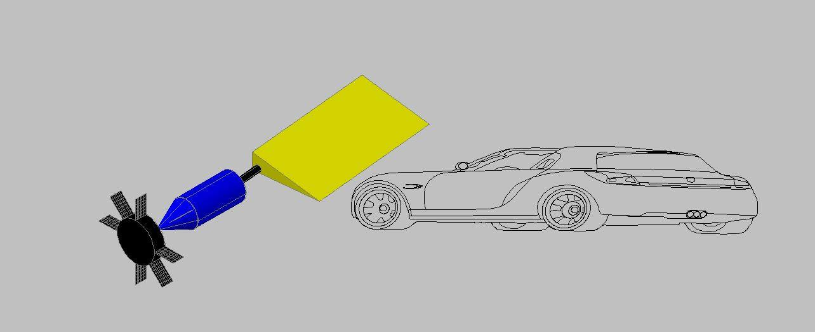
The recommended shape:

Slide 35


