Slide 1
Sudoku Solver
Supervisor : Dr . Sufyan Samara
By : Mohammad Masood & Yacoob Assi

Slide 2
Table of contents :
introduction
Components
Constraints
overview
Results
Conclusion

Slide 3
Introduction :
Idea of project :
The project idea revolves around utilizing hardware to solve Sudoku puzzles. The concept involves a fusion of image analysis and artificial intelligence through the utilization of the Backtracking algorithm. This is then integrated with hardware components, allowing the solution to be physically outputted without solely relying on software.

Slide 4
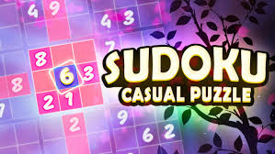
Idea of sudoku :
Sudoku is a popular numerical puzzle that challenges players to fill a 9x9 grid with digits from 1 to 9. The grid is divided into nine 3x3 subgrids, known as regions or boxes. The puzzle starts with some cells already filled in with numbers, and the goal is to complete the grid while adhering to certain rules:
No Repetition
Initial Constraints

Slide 5
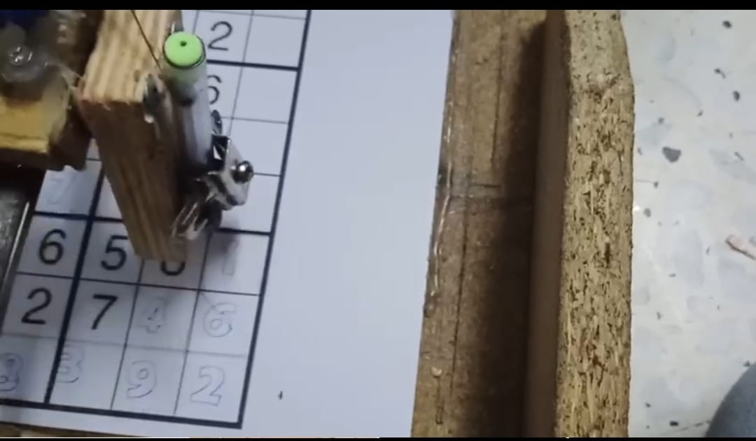
Yet, this project isn't solely a technical feat; it's a testament to human ingenuity and curiosity. It's a voyage into the realm of possibilities through technology, blurring the lines between imagination and reality. By showcasing the harmonious collaboration between image processing, robotics, and programming, this endeavor highlights the potential to simplify intricate tasks and enhance our grasp of automation capabilities.

Slide 6
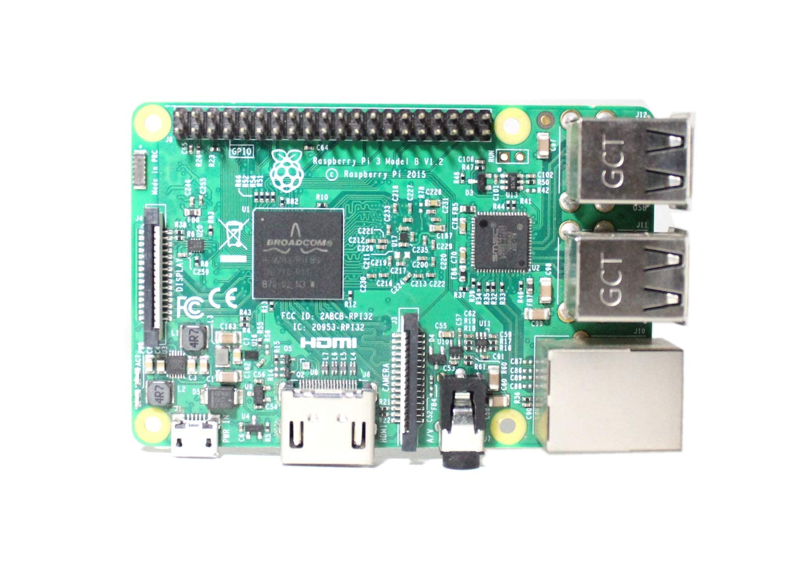
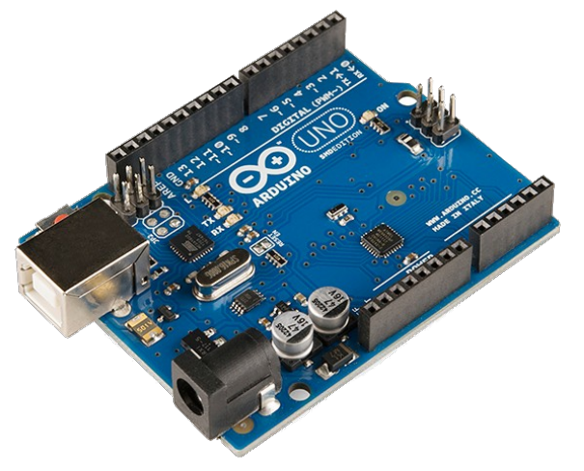
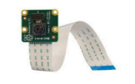
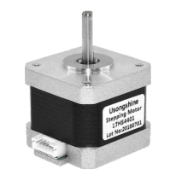
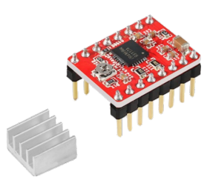
Components:

Slide 7
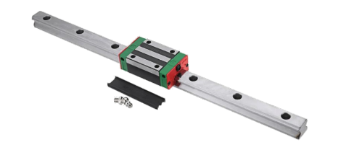
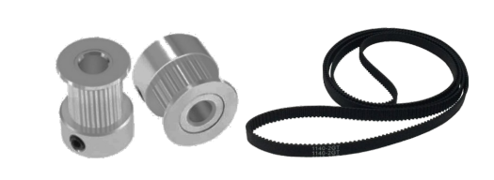
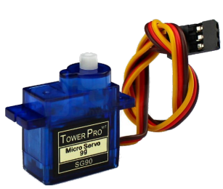

Slide 8

Constraints :
1.Convert solving matrix to G_Code .
2. Robotic Arm Precision.
3. Appropriate equipment and components.
4.Image Resolution.

Slide 9
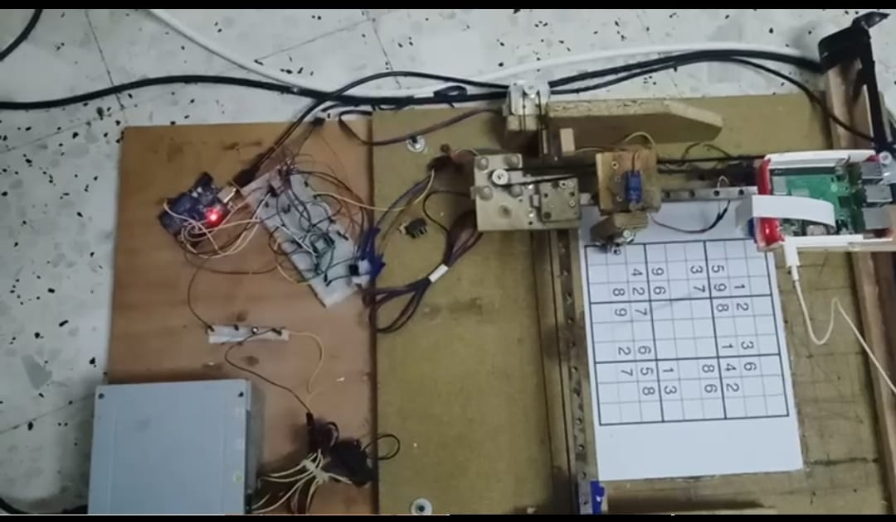
Project overview :
Build a structure :

Slide 10
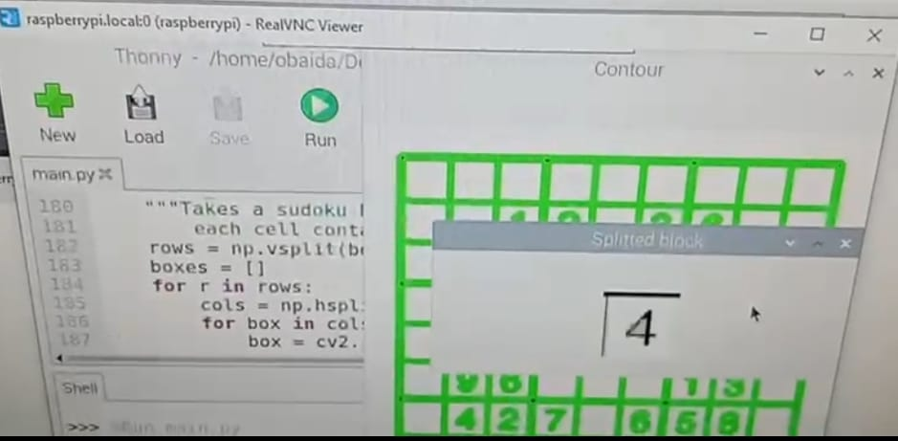
2. Capture and image processing :
1. Took a picture of the board.
2. Image Acquisition and Preprocessing.
3. Grid Detection and Extraction.
4.Number Recognition.

Slide 11
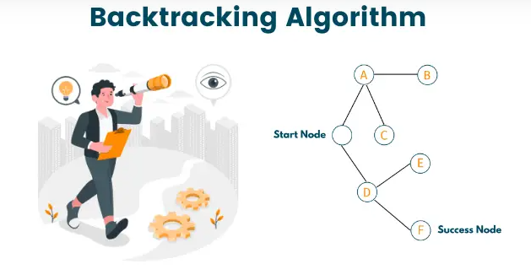

Slide 12
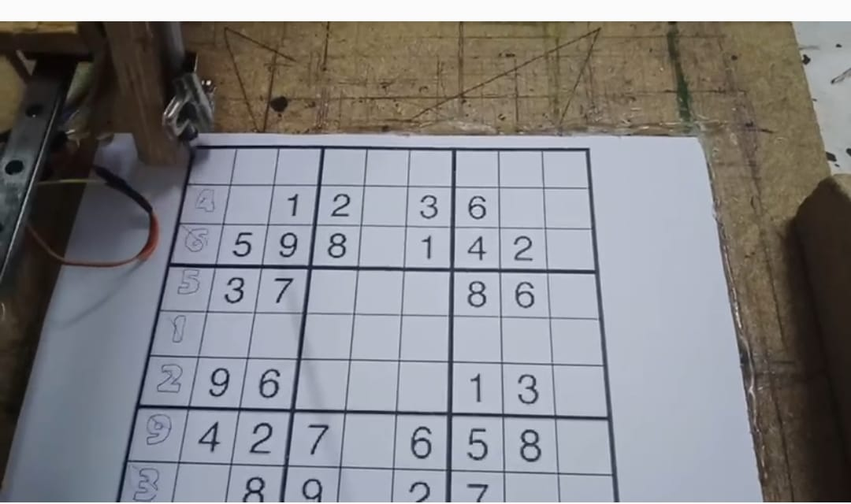
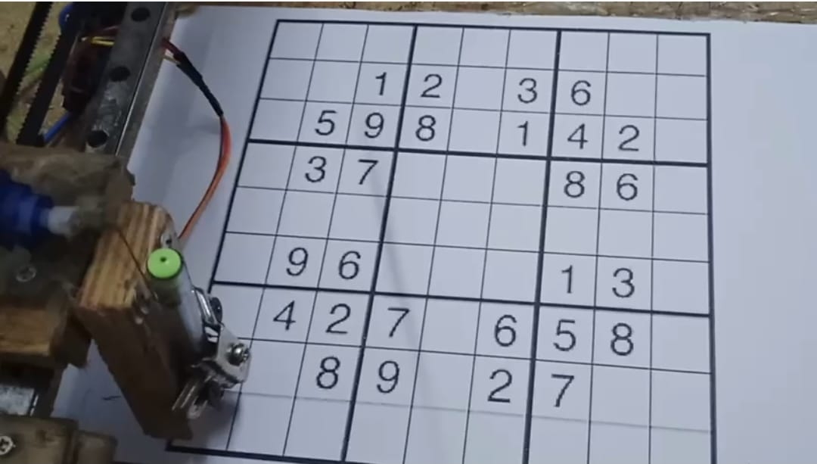
4. Robotic Arm Interaction:

Slide 13
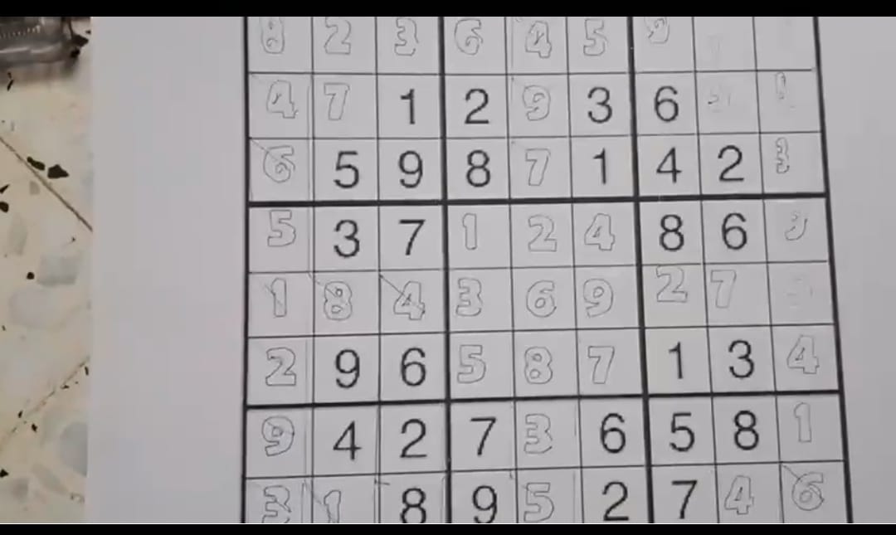
Result :

Slide 14
Conclusion :
At the end, we achieved a hardware project that combines image processing and artificial intelligence techniques.
It successfully translated practically and solved the puzzle on paper.
This aligns with the ongoing advancements of our current era, utilizing artificial intelligence to perform human tasks more efficiently. It paves the way for further progress in this direction.

Slide 15
Thank You

