Slide 1




TahiniRoute
Majd Marabe & Anwar Aqraa
Supervisor:
Dr. Abdallah Rashed

Slide 2



01
Main idea
02
Features
Structure
03
Content
Hardware Modules
04
05
Web
Application
Future
Work
06

Slide 3
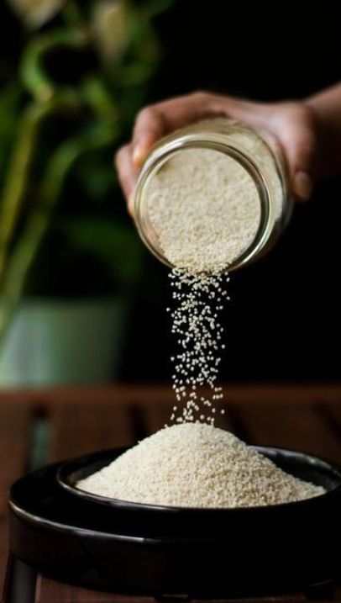
Main idea
Our project, TahiniRoute, is about creating a smart, fully automated machine that makes tahini starting from white sesame seeds. The user can choose how much tahini they want and how much salt or pepper to add. The machine then takes care of the entire process—from checking ingredients to grinding, mixing, and filling the final product. This helps make tahini in a faster, cleaner, and more accurate way, which is great for small businesses or home use.

Slide 4











Features
Sesame dispensing
Sealing
Grinding
Filling
Adding
ingredients
Mixing

Slide 5
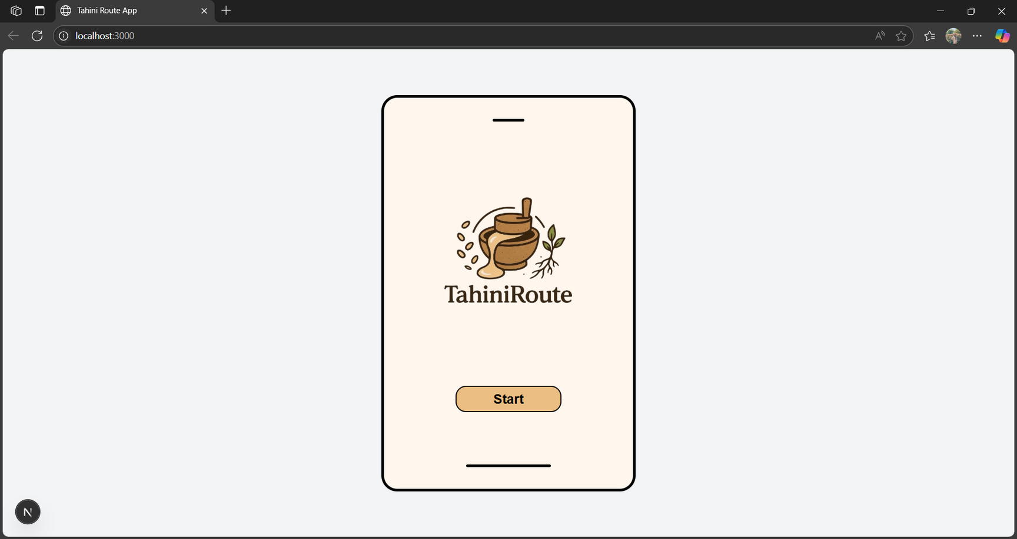
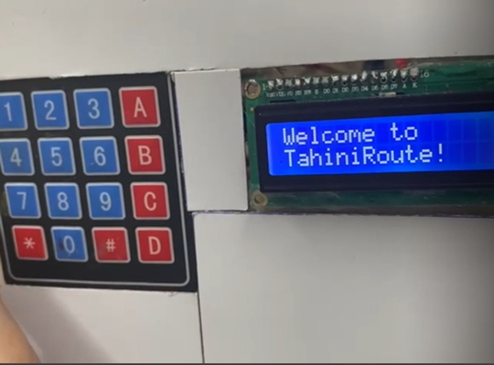
How to use the machine
Web Application
keypad

Slide 6
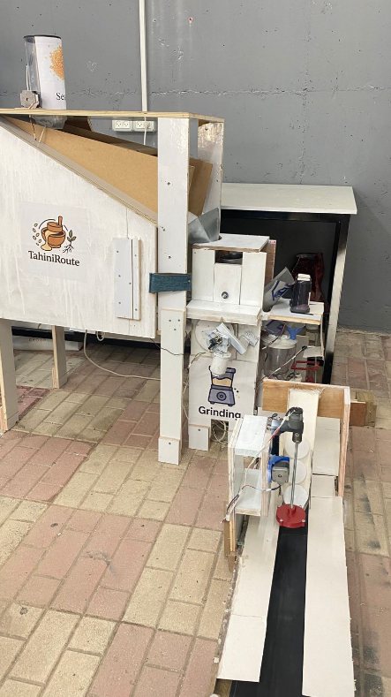
Structure

Slide 7
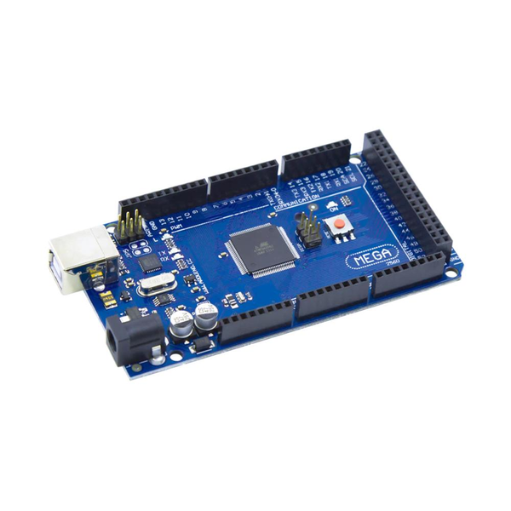
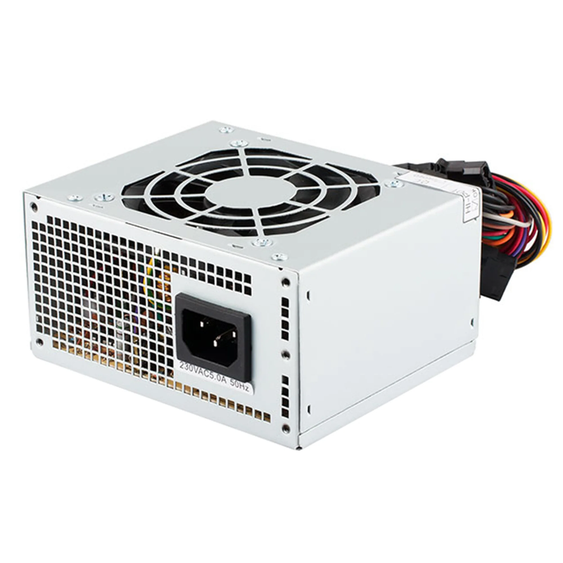
Hardware
Modules
Arduino MEGA
PC Power supply

Slide 8
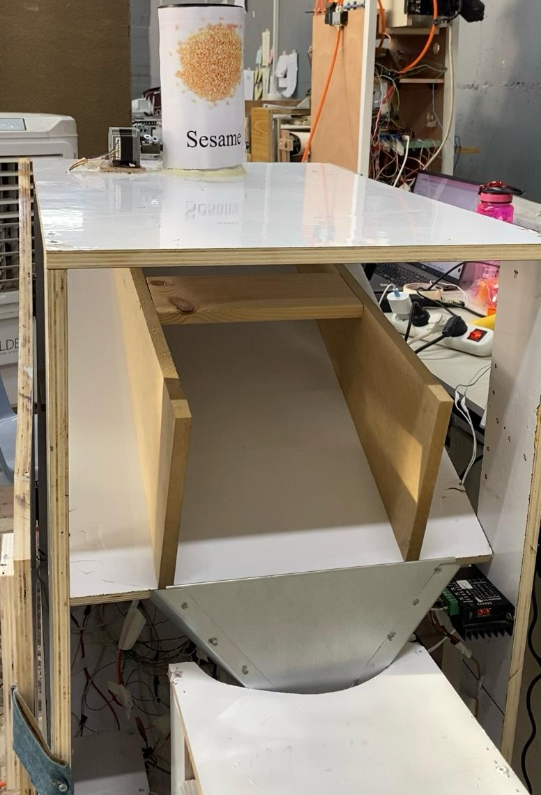
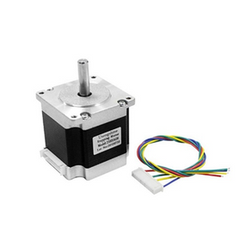
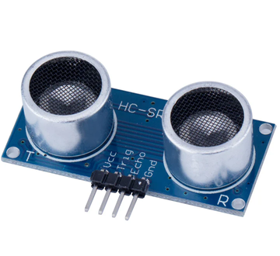
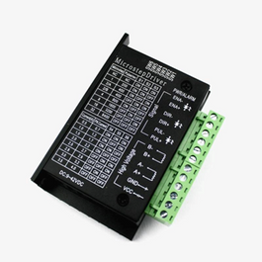
Sesame dispensing stage
This stage consists of two components:
  NEMA 23 Stepper Motor
    Controlled by a microstep driver.
    Rotates a knob to release white sesame seeds from the container.
  Ultrasonic Sensor
    Measures the amount of sesame available.
    Ensures there is enough to meet the user's selected quantity before starting the process.
NEMA23
MOTOR
ULTRASONIC
SENSOR
TB6600 MICROSTEP
DRIVER

Slide 9
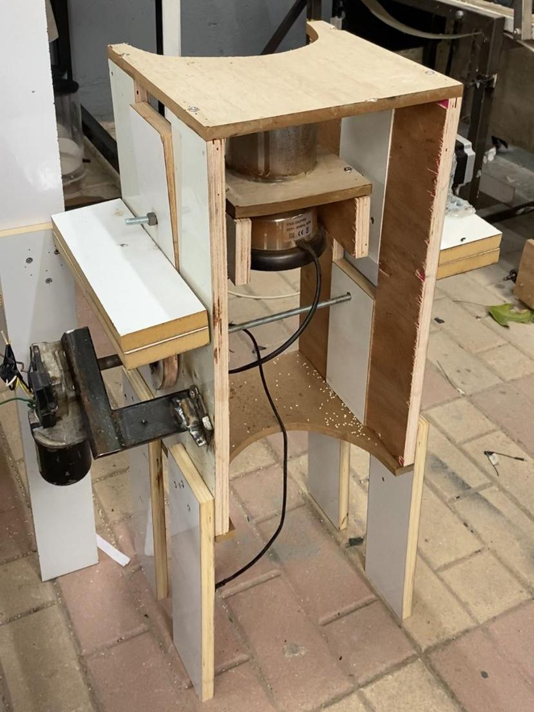
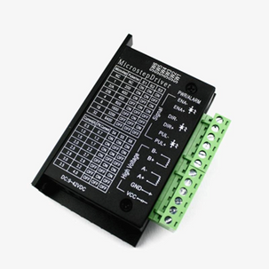
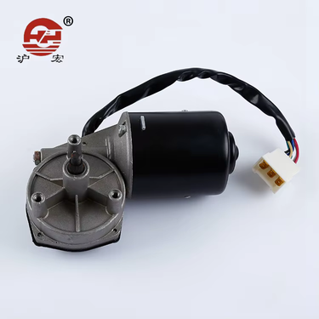
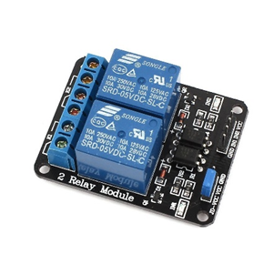
Grinding stage
This stage mainly consists of three components:
  The Grinder
    Connected to a one-channel relay.
  NEMA 23 Motor
    Connected to a Microstep Driver.
    Used to move the grinder to fill it with sesame and pour the mixture.
  DC Motor
    Connected to a two-channel relay.
    Used to move the grinder up and down.
NEMA23
MOTOR
TB6600 MICROSTEP
DRIVER
CAR WIPER
MOTOR
RELAY
2-CHANNEL

Slide 10
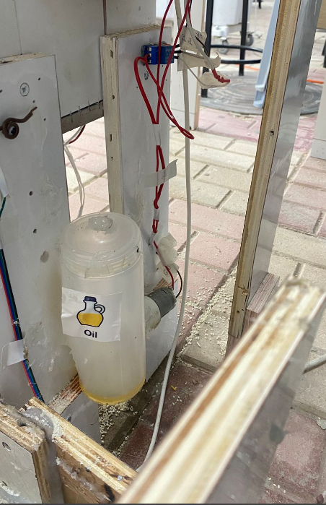
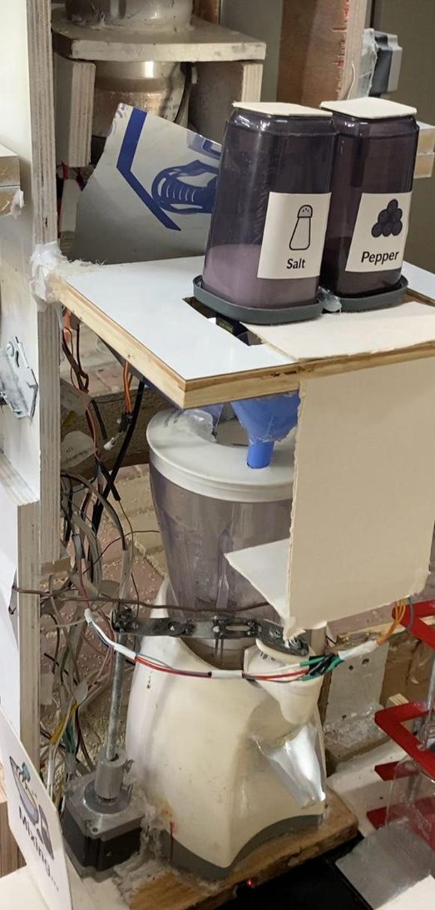
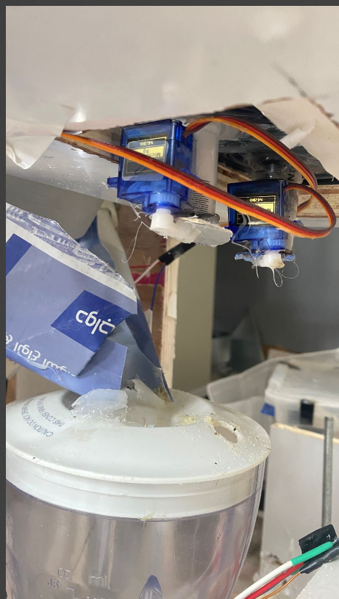
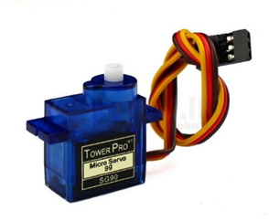
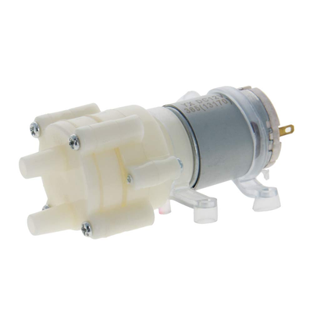
Ingredient Addition and Mixing Stage
This stage mainly consists of:
  12V DC Pump
  Controlled by a one-channel relay.
  Used to add the oil.
  Servo Motors for Salt and Black Pepper
  Dispense salt and black pepper based on the selected quantities.
  Blender
  Controlled using a one-channel relay.
  Used to mix all the ingredients.
SERVO
MOTOR
12V DC
PUMP
RELAY
2-CHANNEL

Slide 11
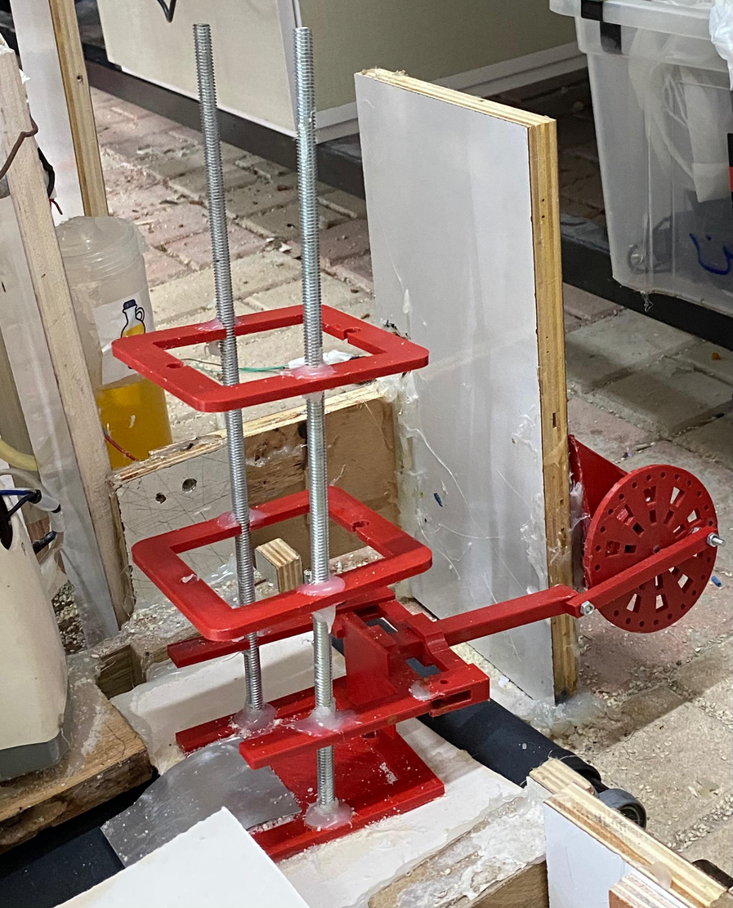
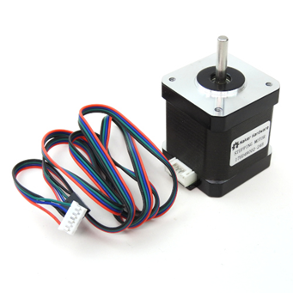
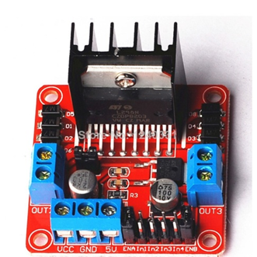
Drop the box stage
This stage includes two main components:
  3D-Printed Holder
    Designed to carry the tahini boxes.
  NEMA 17 Stepper Motor
    Connected to an H-bridge driver.
    Rotates the holder to deliver each box to the production line.
NEMA 17
H-BRIDGE DRIVER

Slide 12
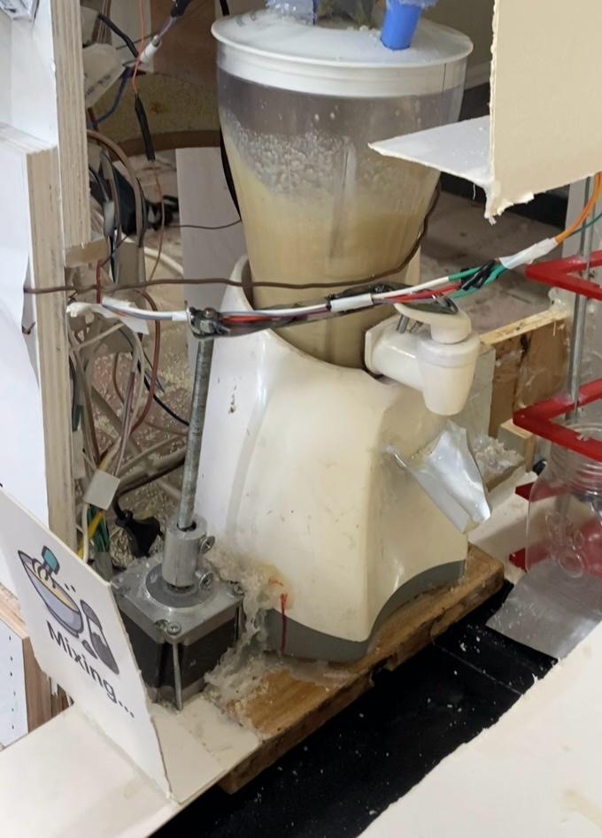


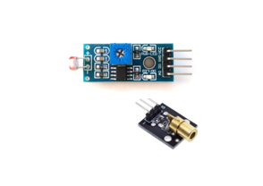
Filling stage
This stage is made up of four components:
  NEMA 23 Stepper Motor
    Opens the mixer tap.
  LDR and Laser
    Detect when a box is directly below the tap and stop its movement.
  Ultrasonic Sensor
    Mounted above the box to measure the filling level.
NEMA23
MOTOR
H-BRIDGE DRIVER
LDR AND LASER
ULTRASONIC
SENSOR

Slide 13
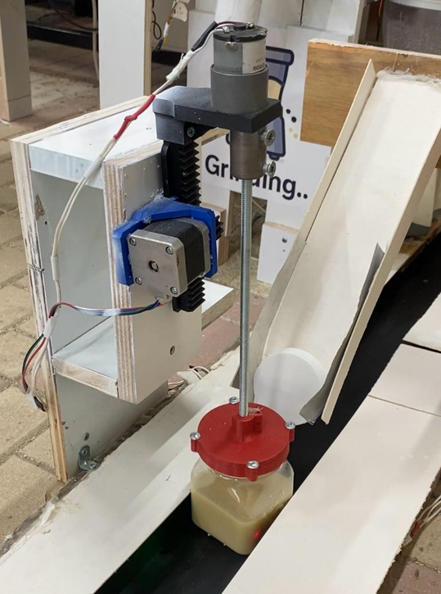
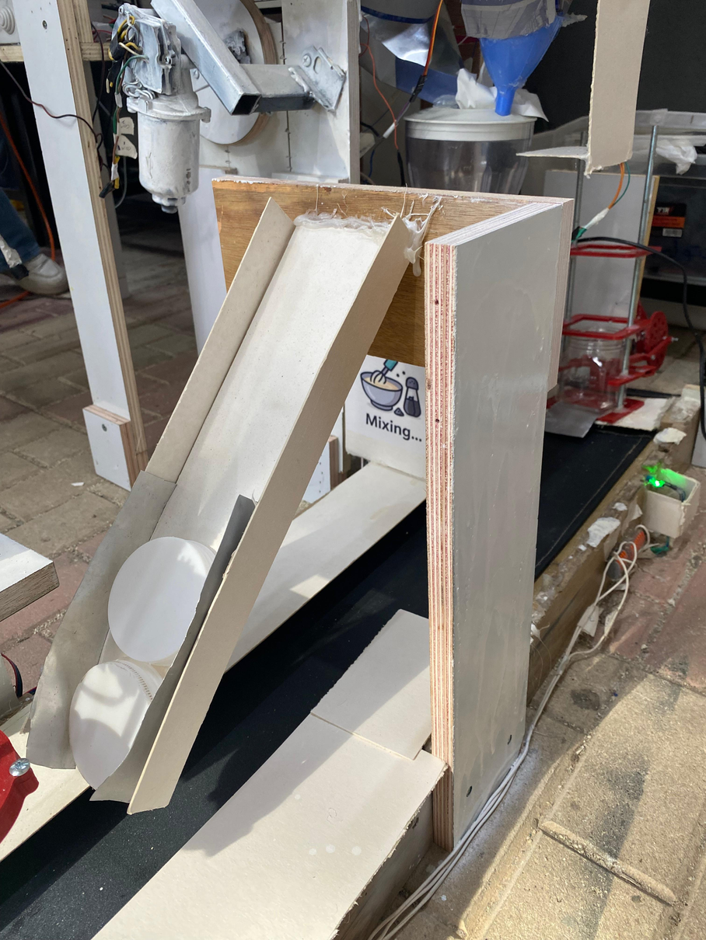
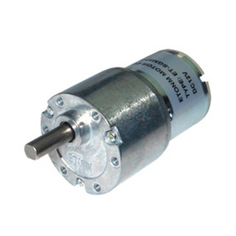
Sealing stage
As the production line moves, the box picks up the lid.
  NEMA 17 Stepper Motor
  Lowers a 3D-printed part onto the box to press the lid in place.
  DC Motor
  Rotates the lid to close it.
  LDR and Laser to stop the box.
H-BRIDGE
DRIVER
NEMA17
MOTOR
DC MOTOR
LDR AND LASER

Slide 14
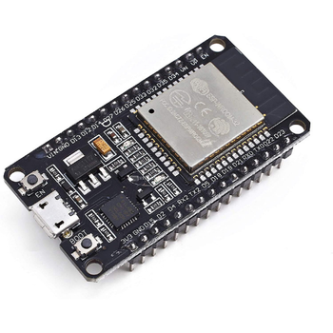
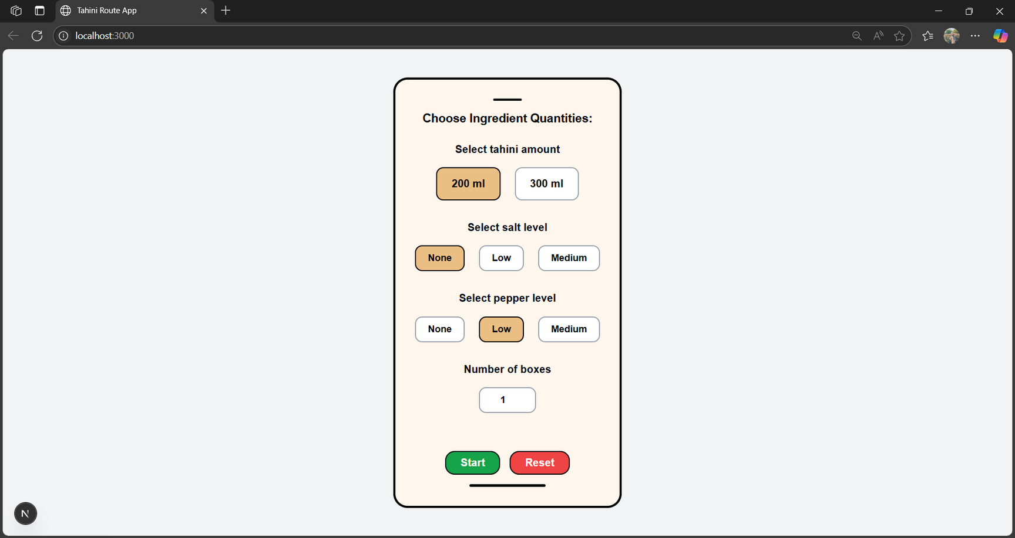
Web Application

Slide 15
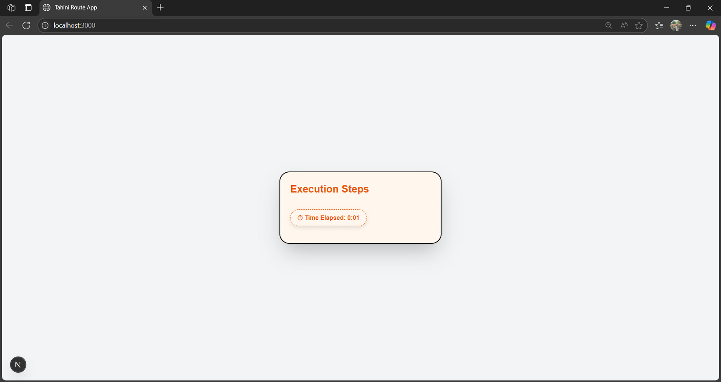
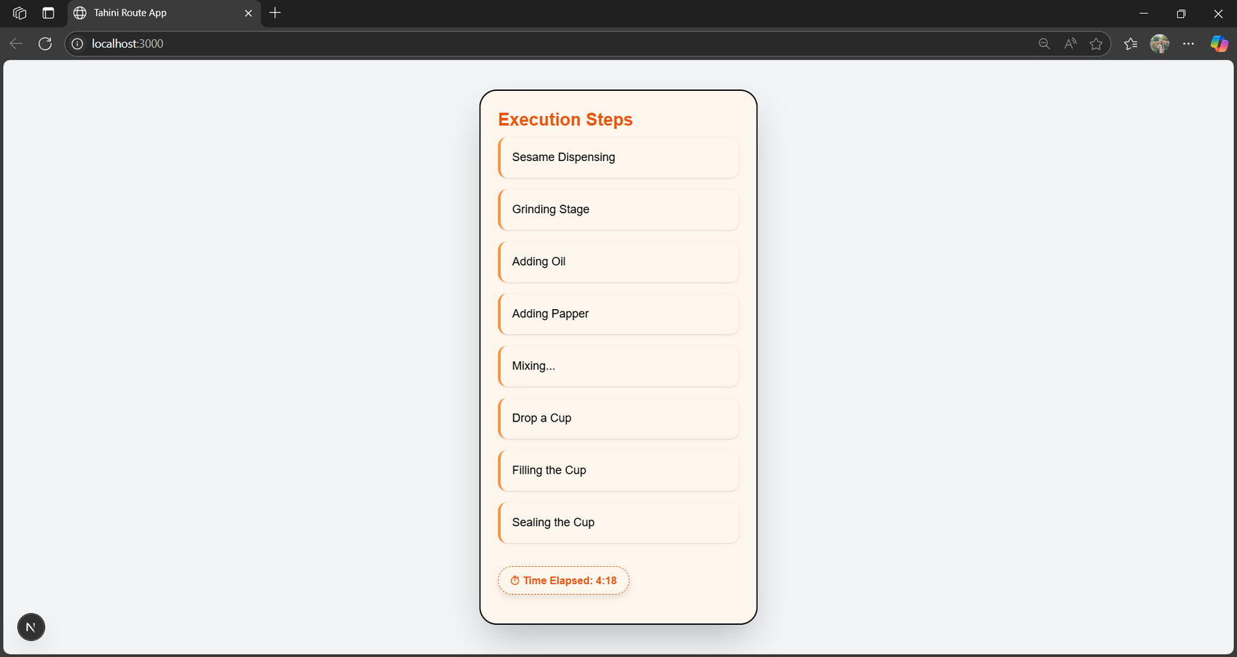
Web Application
It displays each stage of the process in real time, along with the time elapsed

Slide 16
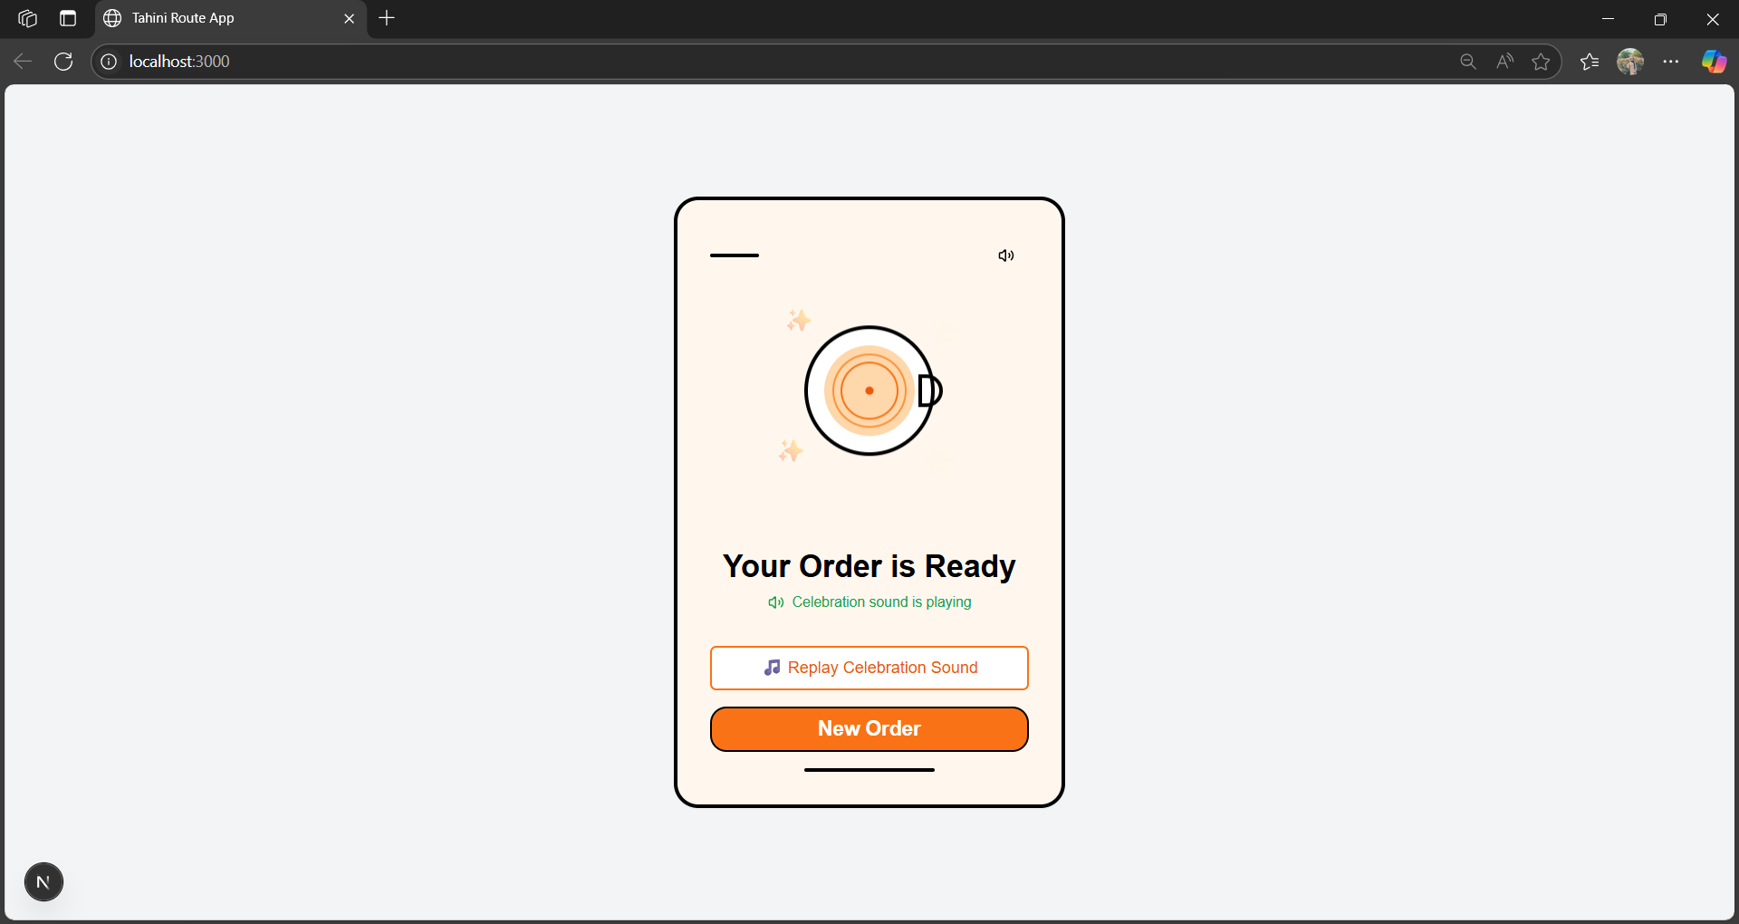
Web Application

Slide 17
Future
Work
to improve on this project we can work on ...
01
Reducing System Size.
02
Automated Cleaning.
03
Larger Filling Containers.
04
Support More Products.

Slide 18
Thank you!

