Slide 1

Faculty of Architectural Engineering
An-Najah National University
Faculty of Engineering and Information Technology
Building Engineering Department
Graduation Project (II)
Supervisor Name:
Eng. Ala’a Shaheen
Prepared by:
Asim Daghlas
Salem Sawafta
Sameh Majjad

Slide 2
Contents:
Introduction
Site Analysis
Architectural Design
Structural Design
Environmental Design
Mechanical Design
Electrical Design
Safety Design
Cost Estimation

Slide 3
Introduction
In this project, an integrated design will be created for a college that keeps up with the development of the age and meets the basic educational and architectural needs as well as extracurricular activities and functions.

Slide 4
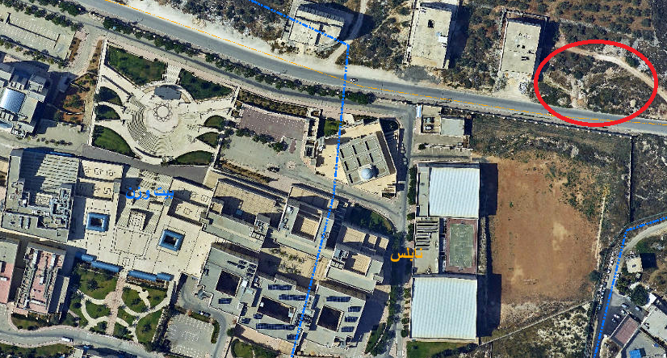
Site Analysis
Location:
The project locate in Nablus city at AL-Junaid region near Beit Wazan town

Slide 5
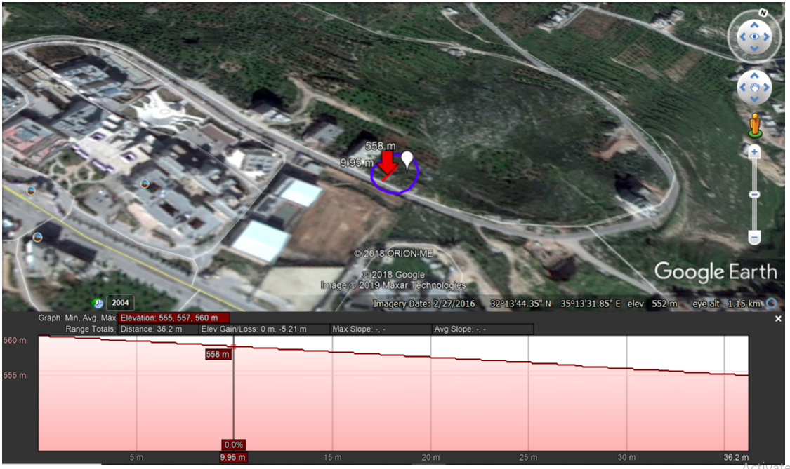
Site Analysis
Elevations and slope

Slide 6
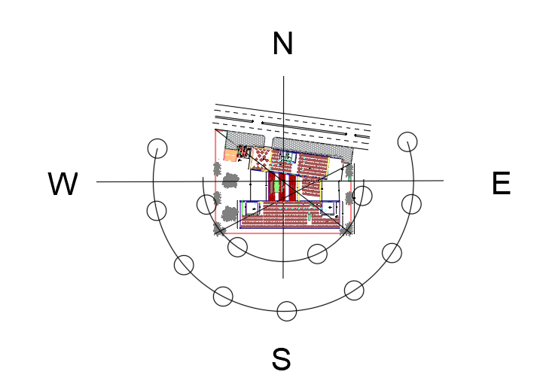
Site Analysis
Sun path
In summer
In winter

Slide 7
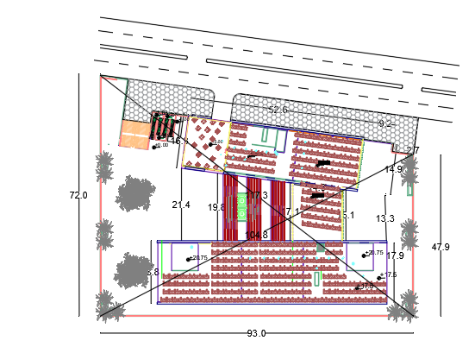
Site Analysis
Areas and slope
Area of land which college is built on equals to 5278 m² with slope 13 % approximately
The college building is built on 2386 m², which is 45.2% of total area of land.

Slide 8
Architectural Aspects
General Information
Zones and Areas
Floors
Elevations
Sections

Slide 9
Architectural Aspects
General Information
The college includes four floors.
Total area of college building = 6923 m².
college has one entrances for human and one entrance for parking.
college contains five staircases.

Slide 10
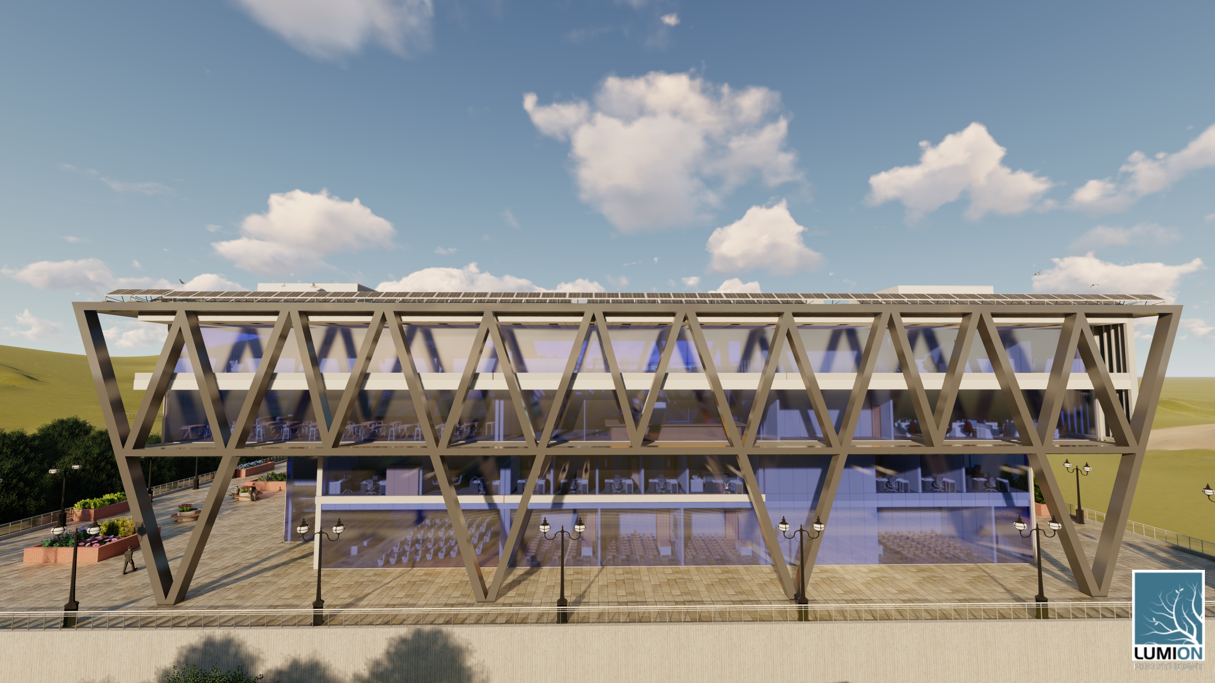
Architectural Aspects

Slide 11
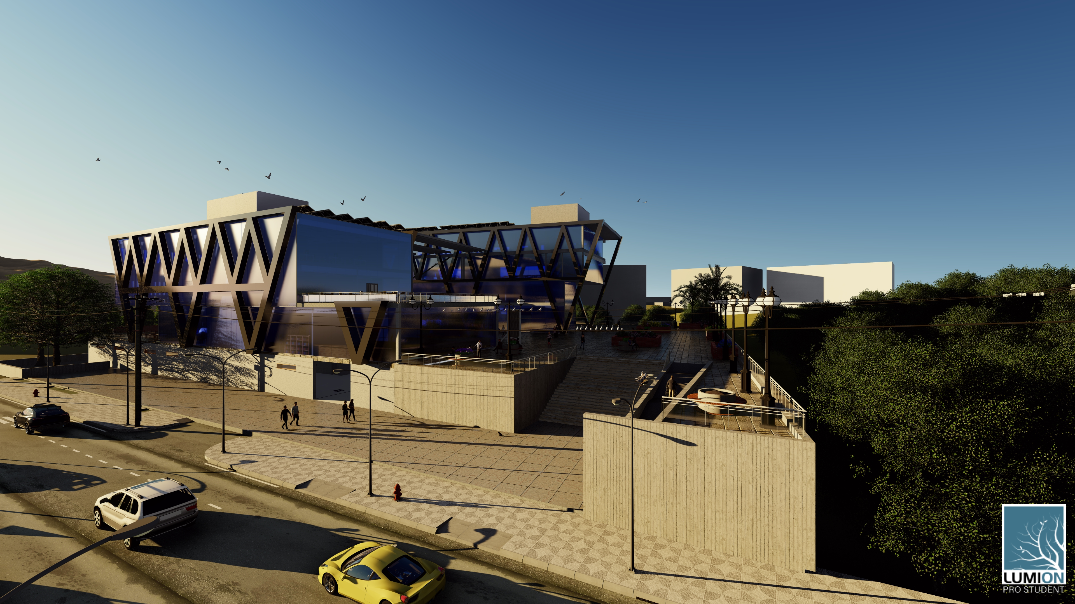
Architectural Aspects

Slide 12
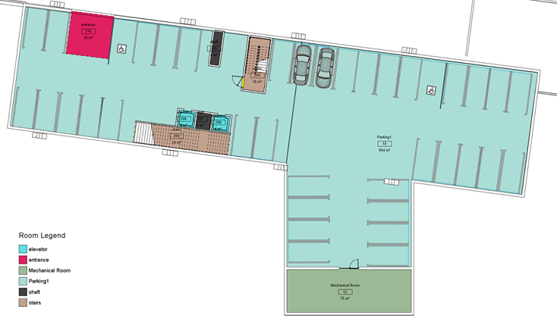
Architectural Aspects
After Design
Total area of floor=1124m^2, height of 4m.
This floor contain parking and mechanical room, electrical room.

Slide 13
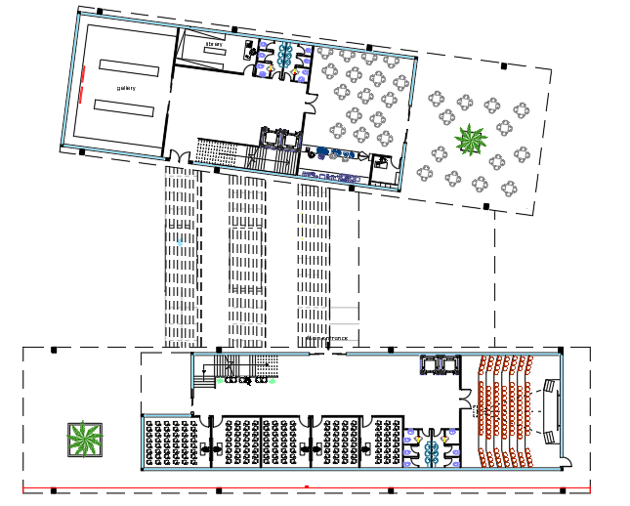
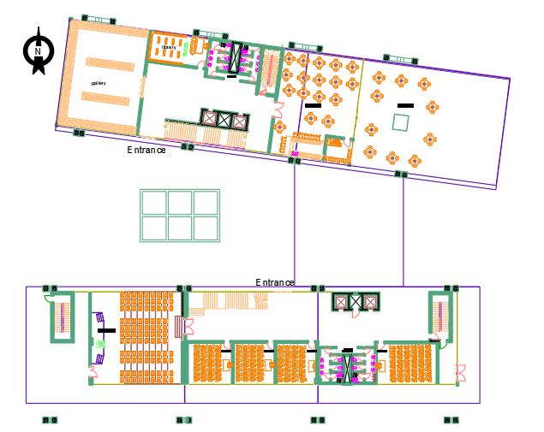
Ground floor
Architectural Aspects
After Design
Total area of floor= 1339m^2, height of 5m.
This floor contain auditorium and cafeteria.
gallery and library, classrooms.
Before

Slide 14
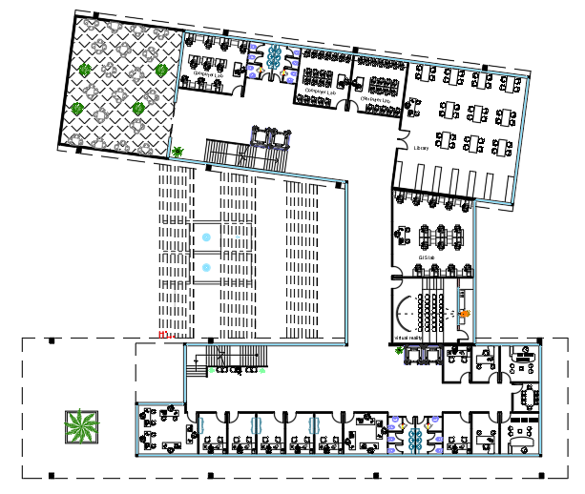
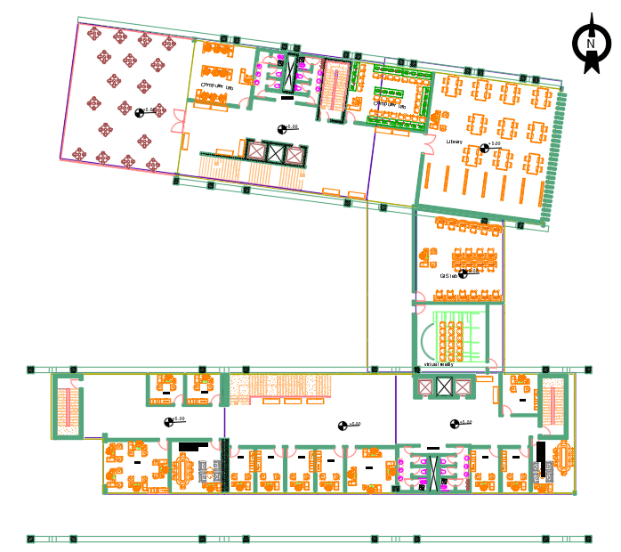
First floor
Architectural Aspects
After Design
Total area of floor= 1540m^2 height of 4m.
This floor contain offices and virtual reality and GIS Lab.
Computer labs and main library.
Before After design

Slide 15
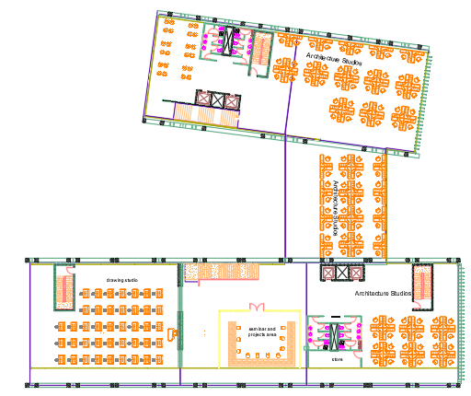
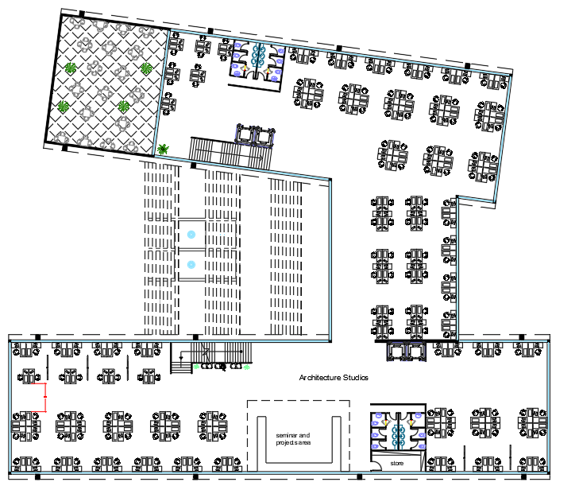
Second Floor
Architectural Aspects
After Design
Total area of floor= 1787m^2, height of 4.5m.
This floor contain architectural studios and seminar project room.
Hand drawing studios.
Before After Design

Slide 16
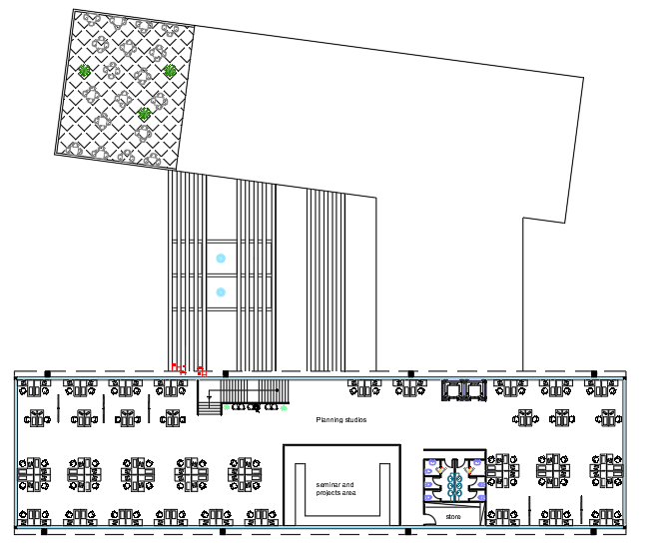
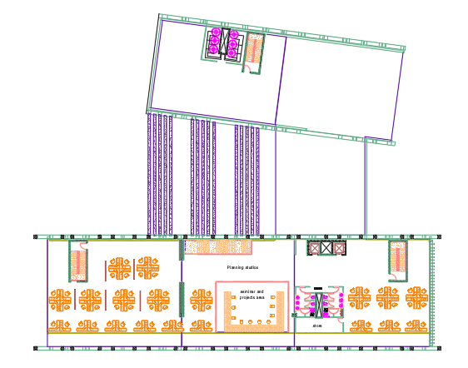
Third Floor
Architectural Aspects
After Design
Total area of floor= 1093m^2, height of 4m.
This floor contain architectural.
Before After Design

Slide 17
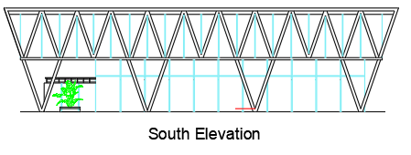
Architectural Aspects
South Elevation
Before

Slide 18
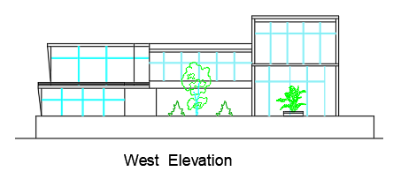
Architectural Aspects
West Elevation
Before

Slide 19
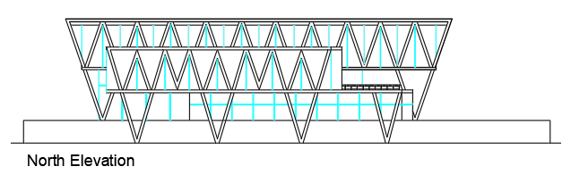
Architectural Aspects
North Elevation
Before

Slide 20
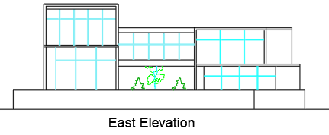
Architectural Aspects
East Elevation
Before

Slide 21
Architectural Aspects
Sec A-A
Before
After

Slide 22
Architectural Aspects
Sec B-B
Before
After

Slide 23
Architectural Aspects
Sec C-C
Before
After

Slide 24
Architectural Aspects
Sec D-D
Before
After

Slide 25
Structural Design
General Information
Design code
American Concrete Institute ACI 2014 for design.
Uniform Building Code (UBC 97) is adopted the code in Earthquake Analysis.
Materials
Concrete.
f´c = 40 Mpa for columns, walls and footings
f´c = 28 Mpa for slabs
Reinforcement steel (Fy = 420 Mpa)

Slide 26
Structural Design
General Information
Loads
Live Load= 5 KN/m²
Superimposed dead load = 4 KN/m²
Properties of Materials
Specific weight of Reinforced concrete = 25 KN/m³
Weight of glass wall = 4 KN/m
Specific weight of block = 12 KN/ m³

