Slide 1
Qabatia Storm Water Sewer System
- Jamal Nazzal
- Diaa Tamimi
- Ahmad Amarni

Slide 2
Project Objectives
understand the problem of Qabatia rainfall-runoff process. And
Improve the current stormwater routing structures. By
Using StormCAD software to design and expand the current network.

Slide 3
General description of Qabatia
Located 9 kilometers south-west of Jenin.
300 meters above sea level.
Its area is 6000 donums.
A valley surrounded by mountains.
Around 30000 capita occupy the area of Qabatia.

Slide 4
Catchment Area
A catchment can be defined as the total area of land that drains to a particular point along a stream.
Water flows perpendicular to contour lines in the direction of the slope.
Flow paths, and divides were drawn.
Main flow paths were determined.
Civil 3D was used.

Slide 5
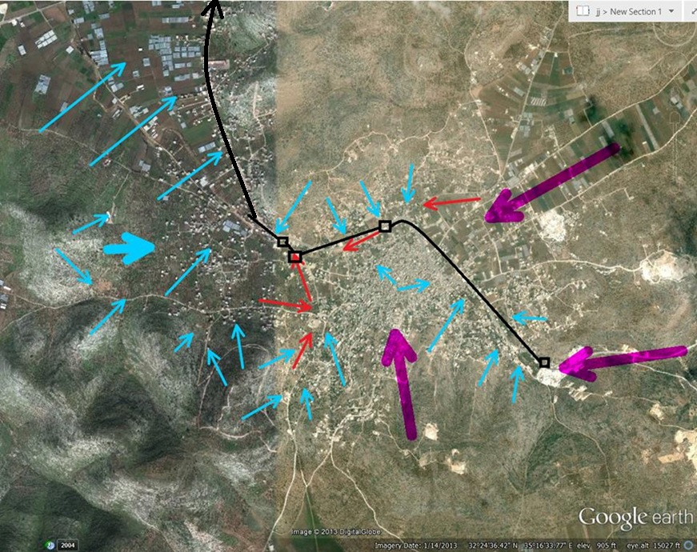

Slide 6
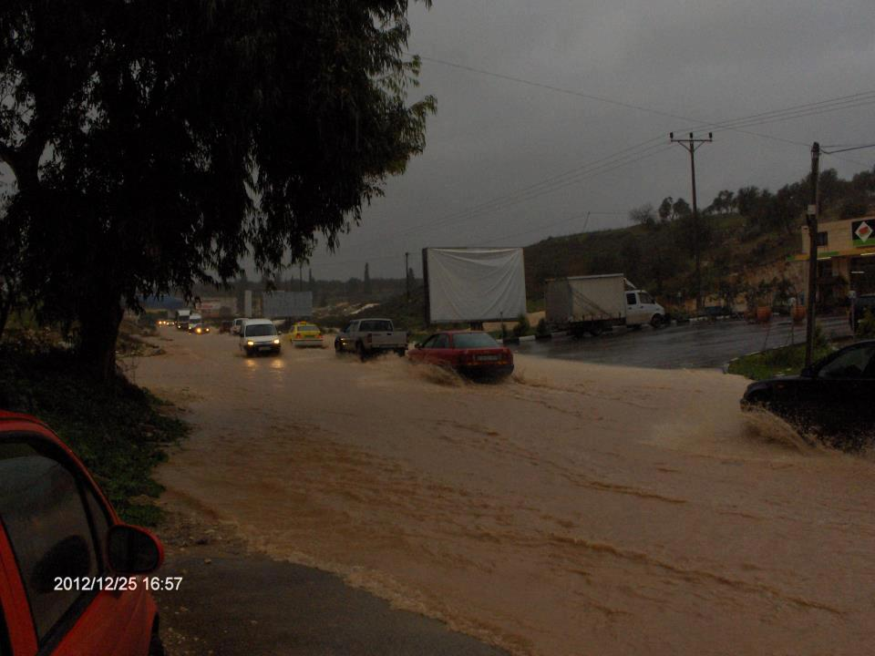

Slide 7
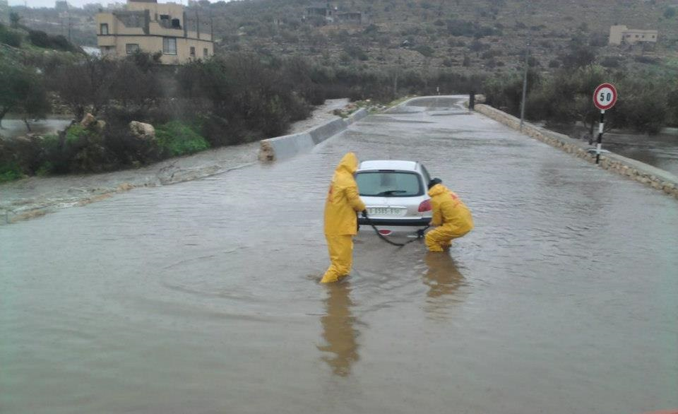

Slide 8
Stream topology and order
Stream topology and order helps the designer understand and predict the locations and dimensions of various hydraulic structures.

Slide 9
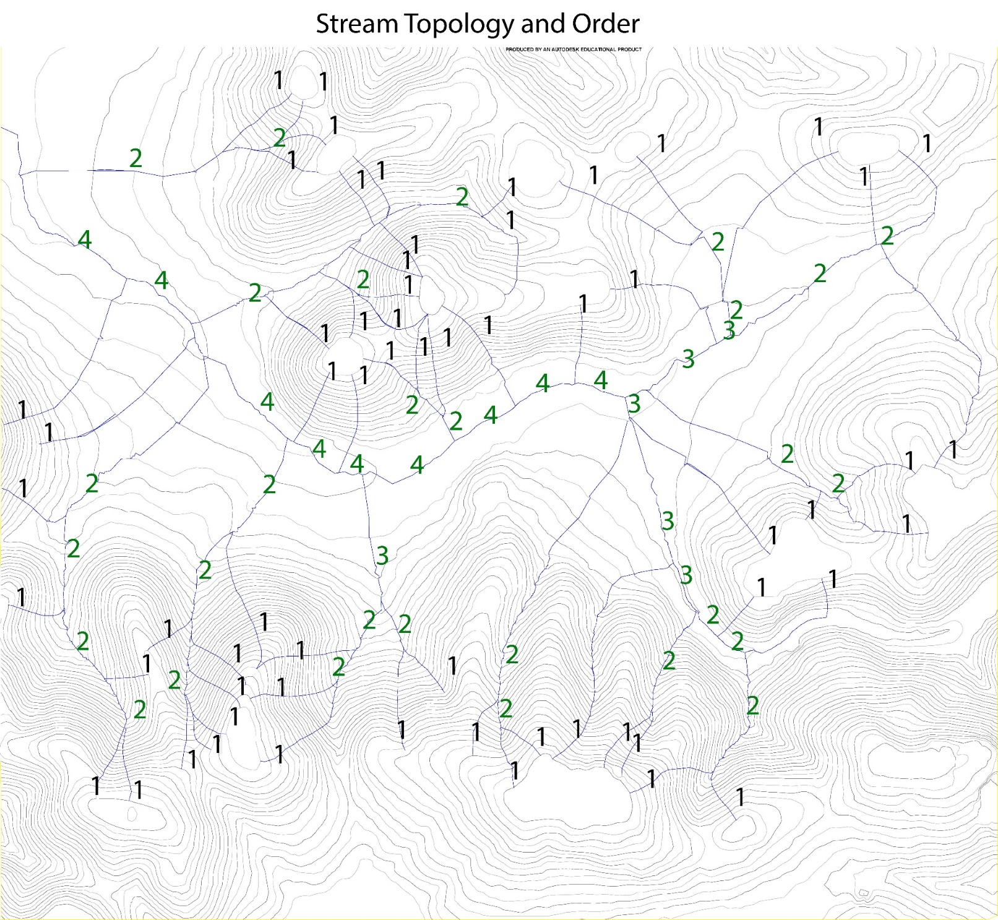

Slide 10
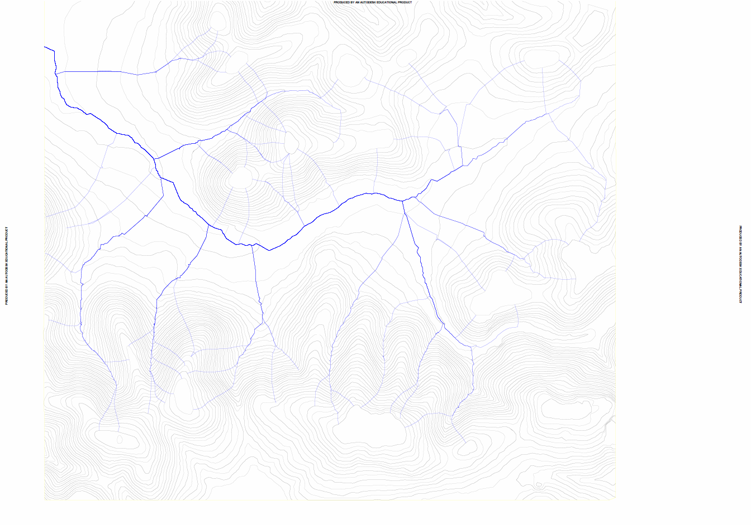

Slide 11
The IDF Curves
Using the measurements from short duration rainfall, a series of rainfall curves (IDF curves) are prepared for practical use in engineering work.
Different stations are Located, and are given weight with respect to that area.

Slide 12
the IDF data for Nablus city, used for Qabatia

Slide 14
Theory And Methods of Computation
Manning’s Equation
Darcy-Weisbach Equation
Hazen-Williams Equations
The Rational Method
Morgali and Linsley Method
Kirpich Method
Kerby-Hatheway Method
The Federal Aviation Administration equation
Shreve

Slide 15
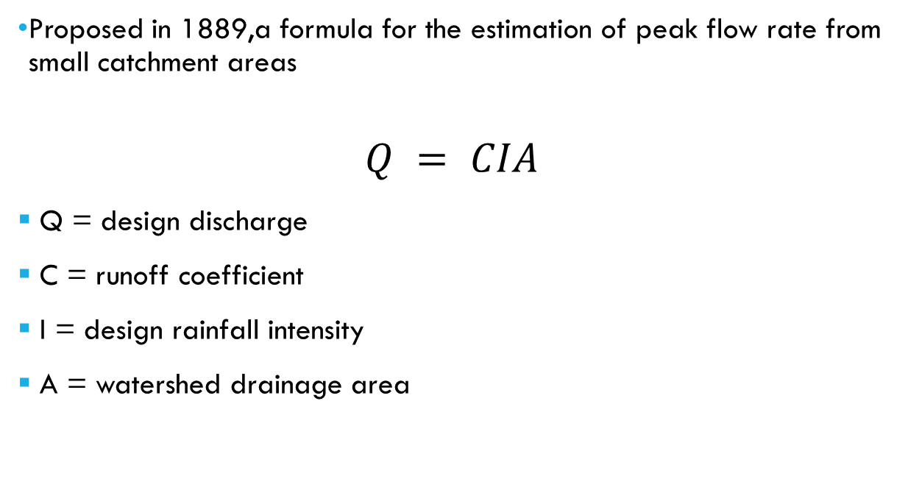
THE RATIONAL METHOD
Proposed in 1889,a formula for the estimation of peak flow rate from small catchment areas
$$Q = CIA$$
Q = design discharge
C = runoff coefficient
I = design rainfall intensity
A = watershed drainage area

Slide 16
Basic assumptions of the rational method
The max. runoff rate at any location is a function of the average rainfall rate during the time of concentration for that location.
The max. rainfall rate occurs during the time of concentration.

Slide 17
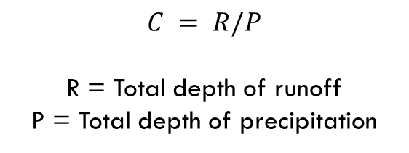
Runoff Coefficient C
$$C = R/P$$
R = Total depth of runoff
P = Total depth of precipitation
Type of surface | C
Concrete, asphalt, solid rock | 0,8-0,9
Gravel | 0,4-0,6
Farmland, parks | 0,2-0,4
Woodland | 0,1-0,2

Slide 18
Time of Concentration t_{c}
The flow time from the most remote point in the drainage area to the point in question.
Usually is equal to an overland flow time plus a channel flow time.
channel flow time estimation = channel length / avg. full-flow velocity

Slide 19
Methods for computing the overland t_{c}
Morgali and Linsley Method
Kirpich Method
Kerby-Hatheway Method
The Federal Aviation Administration equation

Slide 20
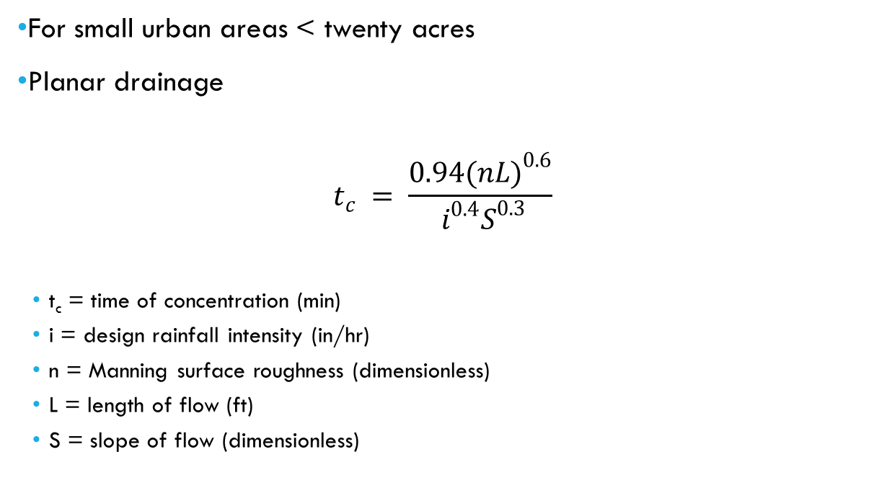
Morgali and Linsley Method 1965
For small urban areas < twenty acres
Planar drainage
$$t_{c} = \frac{{0.94(nL)}^{0.6}}{ i^{0.4}S^{0.3}}$$
t_{c} = time of concentration (min)
i = design rainfall intensity (in/hr)
n = Manning surface roughness (dimensionless)
L = length of flow (ft)
S = slope of flow (dimensionless)

Slide 21

Notes on Morgali’s
The Morgali and Linsley equation is implicit in that it cannot be solved for t_{c} without i. So, iteration is required.
Solution can be achieved by combining Morgali’s with the intensity equation
Then solving using a numerical method (such as a calculator solver). The solution of the two equations yields both t_{c} and i.

Slide 22
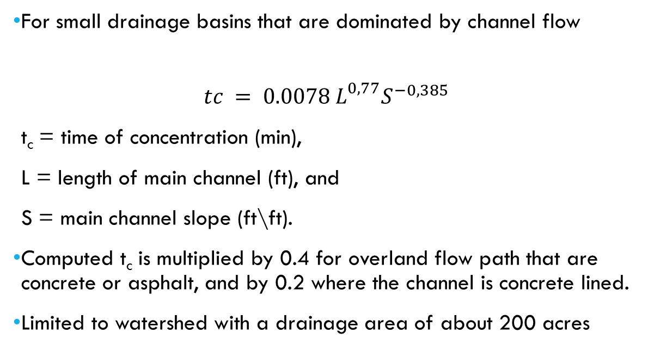
Kirpich Method 1940
For small drainage basins that are dominated by channel flow
$$tc = 0.0078{ L^{0,77}S^{−0,385}}^{}$$
t_{c} = time of concentration (min),
L = length of main channel (ft), and
S = main channel slope (ft\ft).
Computed t_{c} is multiplied by 0.4 for overland flow path that are concrete or asphalt, and by 0.2 where the channel is concrete lined.
Limited to watershed with a drainage area of about 200 acres

Slide 23
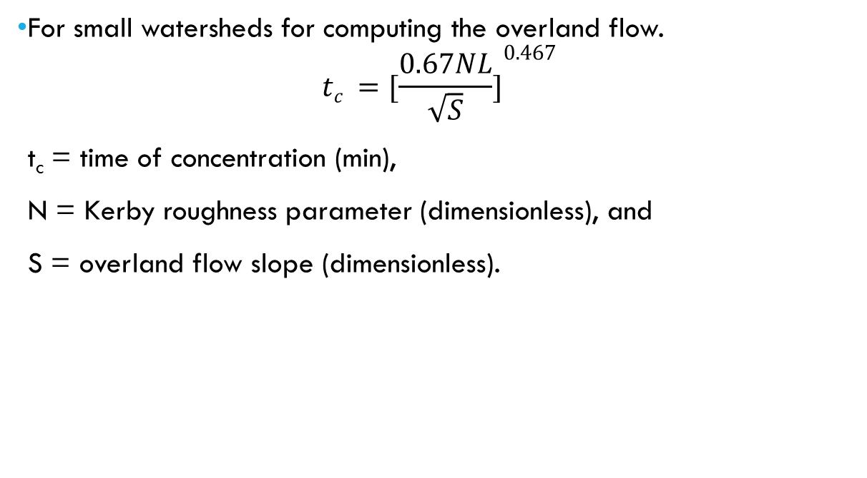
Kerby-Hatheway Method 1959
For small watersheds for computing the overland flow.
$$tc ={[\frac{0.67NL}{\sqrt{S}}]}^{0.467}$$
t_{c} = time of concentration (min),
N = Kerby roughness parameter (dimensionless), and
S = overland flow slope (dimensionless).

Slide 24
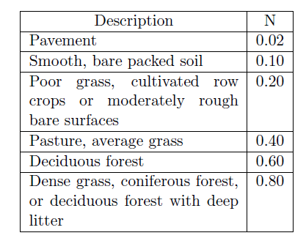
A combination
Overland flow rarely occurs for distances exceeding 1200 feet.
So, if the watershed length exceeds 1200 feet, then a combination of Kerby’s equation (Overland Flow) and the Kirpich equation (channel t_{c}) may be appropriate.
Values for Kerby’s roughness parameter N are presented on the following table

Slide 25
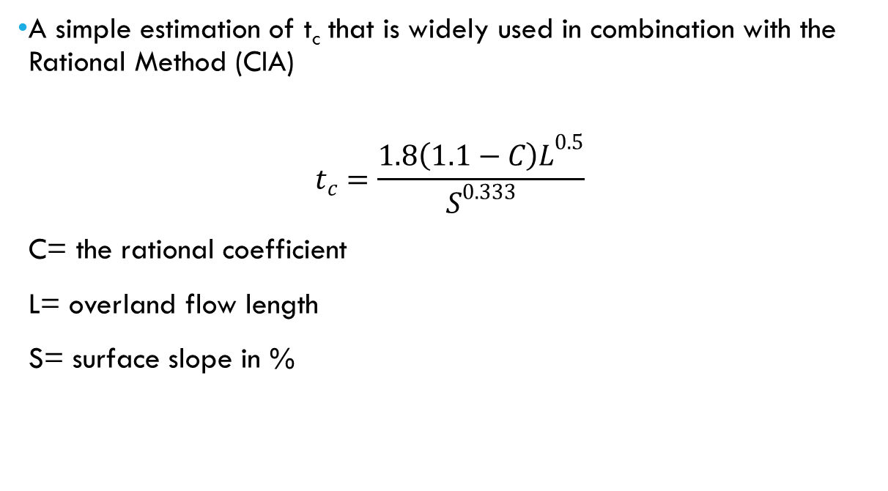
The Federal Aviation Administration equations 1965
A simple estimation of t_{c} that is widely used in combination with the Rational Method (CIA)
$$t_{c}=\frac{1.8{\left(1.1−C\right)L}^{0.5}}{S^{0.333}}$$
C= the rational coefficient
L= overland flow length
S= surface slope in %

Slide 26
Time of Concentration t_{c}
It is recommended that t_{c} be less than 300 minutes and greater than 10 minutes
The concept is that estimates of i become unacceptably large for durations less than 5 or 10 minutes
For long durations (such as longer than 300 minutes), the assumption of a relatively steady rainfall rate is less valid.

Slide 27
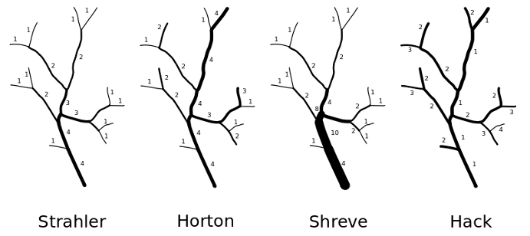
Stream Order

Slide 28
Open Channel flow and energy losses equations
Manning’s equation
Darcy-Weisbach equation
Hazen-Williams equation

Slide 29

Manning’s equation
Gravity full flow occurs at that condition where the conduit is flowing full, but not yet under any pressure
Analysis of open-channel flow in a closed conduit is no different than any other type of open-channel flow.
In gravity flow conditions, manning's discharge formula is applicable for the discharge of pipes and culverts.
Q is Discharge
n is Manning’s coefficient
A is the cross-sectional area
R is the hydraulic radius
S is the slope of the pipe

Slide 30
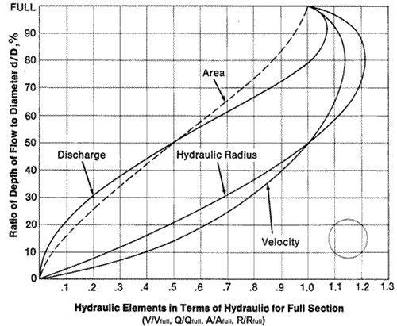
Due to the additional wetted perimeter and increased friction that occurs in a gravity full pipe, a partially full pipe carries greater flow.
For a circular conduit the peak flow occurs at 93 percent of the height of the pipe, and the average velocity flowing one-half full is the same as gravity full flow.

Slide 31
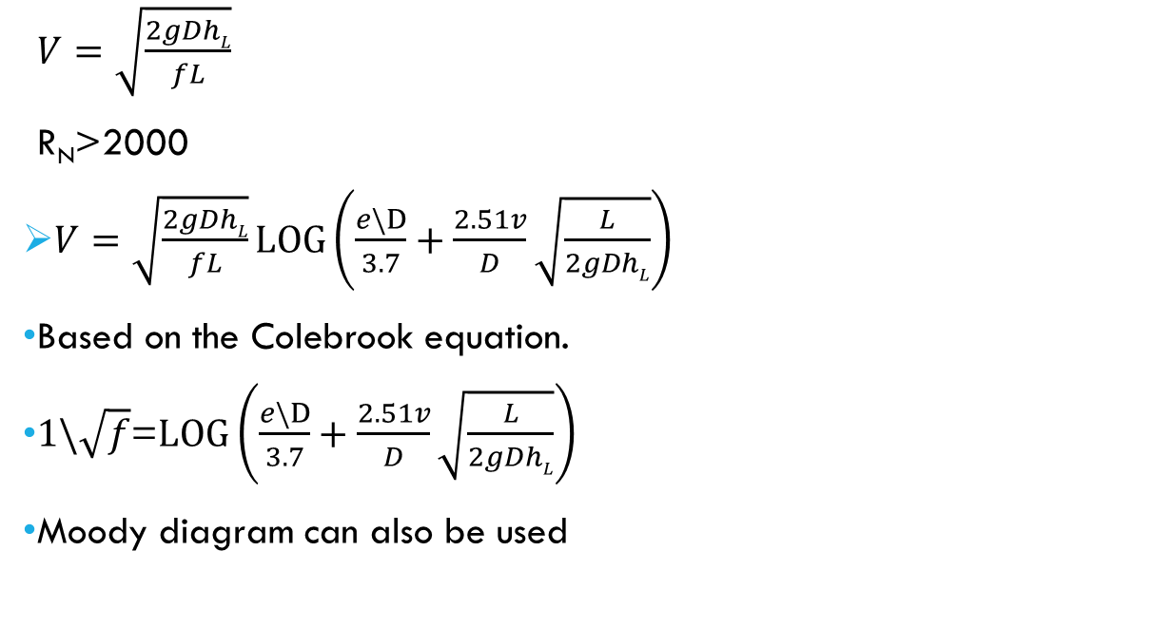
Darcy-weisbach equation
$V=\sqrt{\frac{2gDhL}{fL}}$
R_{N}>2000
$V=\sqrt{\frac{2gDhL}{fL}}LOG\left(\frac{e\backslash D}{3.7}+\frac{2.51v}{D}\sqrt{\frac{L}{2gDhL}}\right)$
Based on the Colebrook equation.
$1\backslash \sqrt{f}$=$LOG\left(\frac{e\backslash D}{3.7}+\frac{2.51v}{D}\sqrt{\frac{L}{2gDhL}}\right)$
Moody diagram can also be used

Slide 32
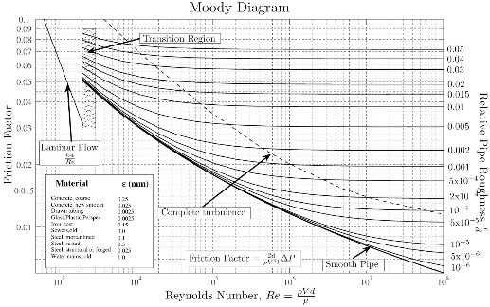
Moody diagram

Slide 33
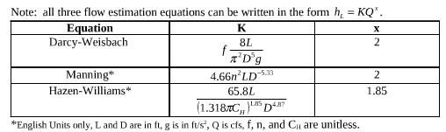
Hazen-Williams equation
V=C_{H}R^{0.63}S^{0.54}
C_{H}= the hazen-willliams coefficient

Slide 35
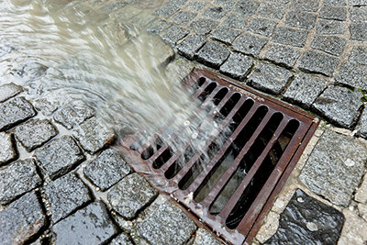
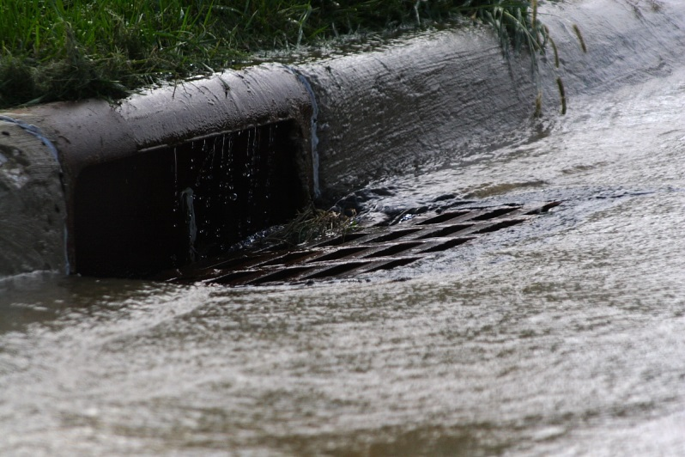
Pre-Design

Slide 36
Assumptions
1- Gravity flow (manning’s eqn):
Part full.
Flow from higher to lower elevation.

Slide 37
Assumptions
2- Rational Method for surface discharge:
Q=CiA
Rainfall is uniform along the entire catchment area.
Rainfall intensity is constant.
The discharge rate assumes that every point in the catchment contributes to the outfall.

Slide 38

Assumptions
3- Time of concentration:
Method used: FAA equation
Convert tc from hrs to mins

Slide 39
Assumptions
4- Surface flow:
All streets are surrounded by high-curb sidewalks
Water doesn’t cross from streets to land or vice-versa
All surface discharge enters the catch basin at the lowest point

Slide 40
Definition of network elements
1- Pipes:
Concrete (n=0.013)
Circular
Minimum diameter = 16” (400mm)

Slide 41
Definition of network elements
2- Catch basins:
Location: in sag
Desired sump depth = 2m
Clogging factor = 20%
Shape: sqaure
Structural width = 0.9m
Grate width = 0.8m

Slide 42
Definition of network elements
3- Manholes:
Diameter = 36”
Serves as a point of intersection of two or more pipes
Where there’s change in alignment or slope

Slide 43
Definition of network elements
4- Catchment areas:
Drawn using the positions of catch basins
C values were determined for each catchment
Tc values were determined using FAA method
For urban areas increase Tc<5 to 5

Slide 44
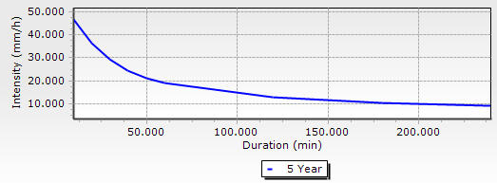
Definition of network elements
5- IDF Data
The data used was for a return period= 5 years

Slide 45
Definition of network elements
6- street-crossing culverts
Shape: box
Material : concrete (n=0.013)
Depth = 30 cm
Width range: [30cm-180cm]

Slide 46
Network layout considerations
Loops are prohibited; only 1 downstream pipe
On street paths, directed to open channel
Catch basins are appointed where there’s water accumulation

Slide 47
Network layout considerations
Street-crossing culverts are assigned to allow flow streams to cross the street section and reach the nearest catch basin
Or wherever its uneconomical to appoint a catch basin and connect it to the network

Slide 48
Design constraints
Velocity:
Pipes: [0.6 – 6] m/s
Culverts: [0.6 – 8] m/s
Slope = [1 – 10] %
While 0.5% is allowable
Cover: [0.8 – 5] m
Water depth:
Pipes: 75%
Street culverts: 50%

Slide 49
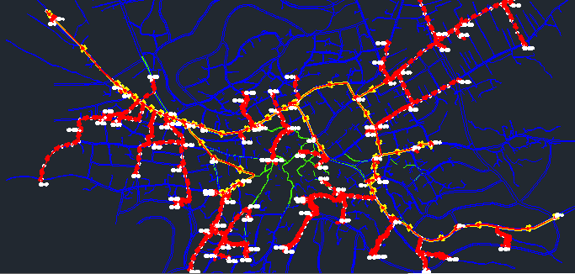
Post-Design

Slide 50
Resulted errors
1- Cover exceeded:
Change pipe paths
2- Velocity exceeded:
Use drop manholes

Slide 51
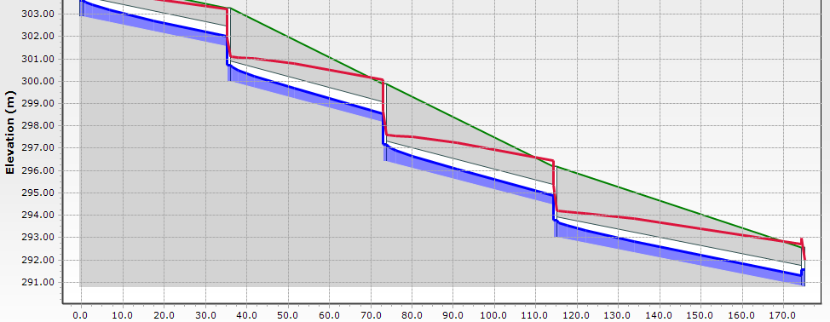
Resulted errors
Drop manholes profile

Slide 52
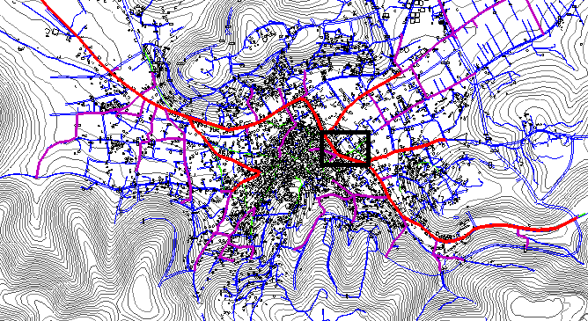
Resulted errors
3- Main open channel (impractical depth)

Slide 53
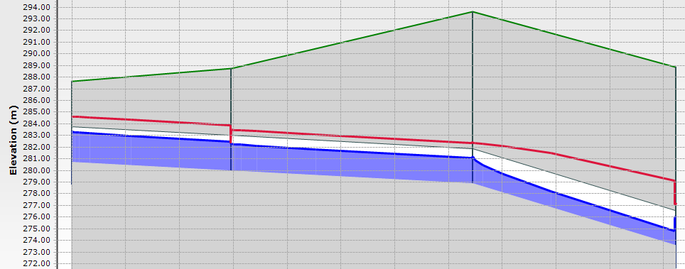
Resulted errors
Profile for that section

Slide 54
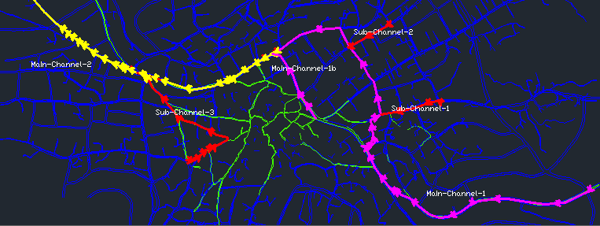
Resulted errors
Alternative path; box conduit in land

Slide 55
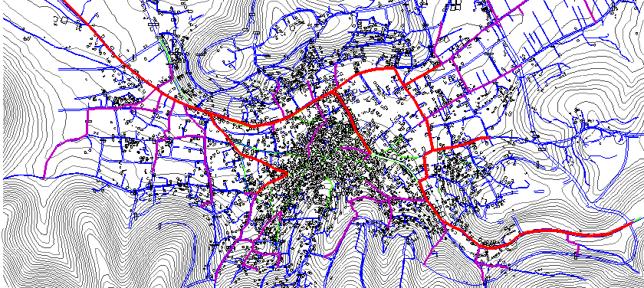
Results
Layout

Slide 56
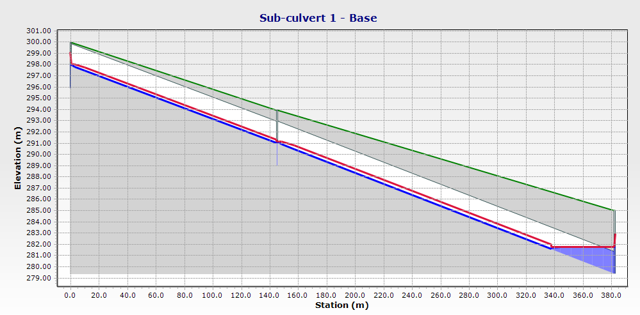
Results
Excavation = (GL – Invert elevation according to profiles) – Existing channel depth

Slide 57
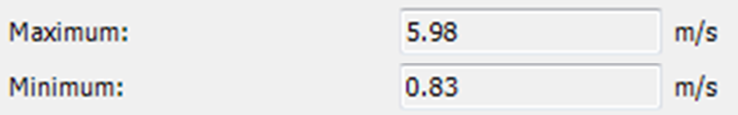
Results
1- Conduits:
Diameter range: [400mm-2250mm]
Velocity:

Slide 58
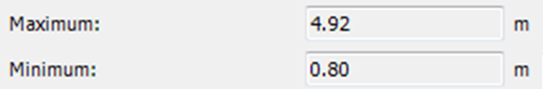
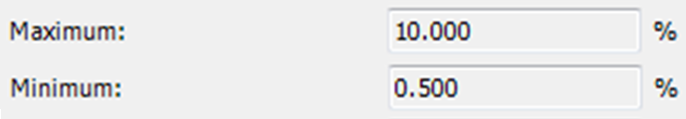
Results
Cover:
Slope

Slide 59

Results
2- Street-crossing culverts
Thickness = 30 cm
Span range: [30 – 180] cm
Velocity

Slide 60

Results
Slope
High slopes are acceptable since velocities are within range, and there aren’t any links that could be damaged

Slide 61
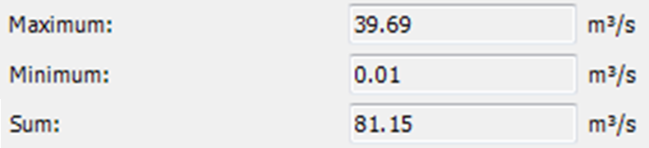
Results
3- Catchments surface discharge

Slide 62
Results
4- Outfall discharge
Q= 44.49 m3/s
Less than sum of catchments discharge because of the accumulation of Tc with pipe lengths

Slide 63
Recommendations
Covering the open channel but leaving openings for maintenance and to preserve open flow conditions.
Opening manhole covers in case of a storm event of a return period>5 to allow streams to reach the next catch basin.

Slide 64
Recommendations
Use of bars at the opening of a street culvert in addition to a depression at the opening to retain large solids.
Use of reinforced concrete around street culverts’ parameters.
Use of anchors or rings around steep-slope culverts

Slide 65
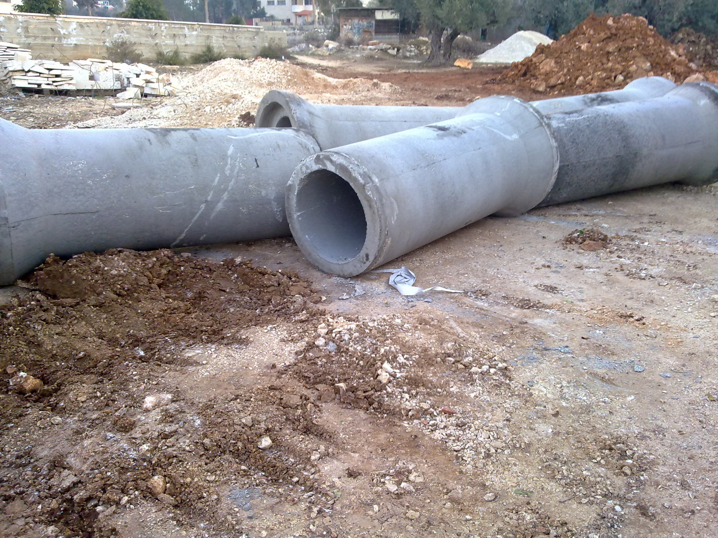

Slide 66
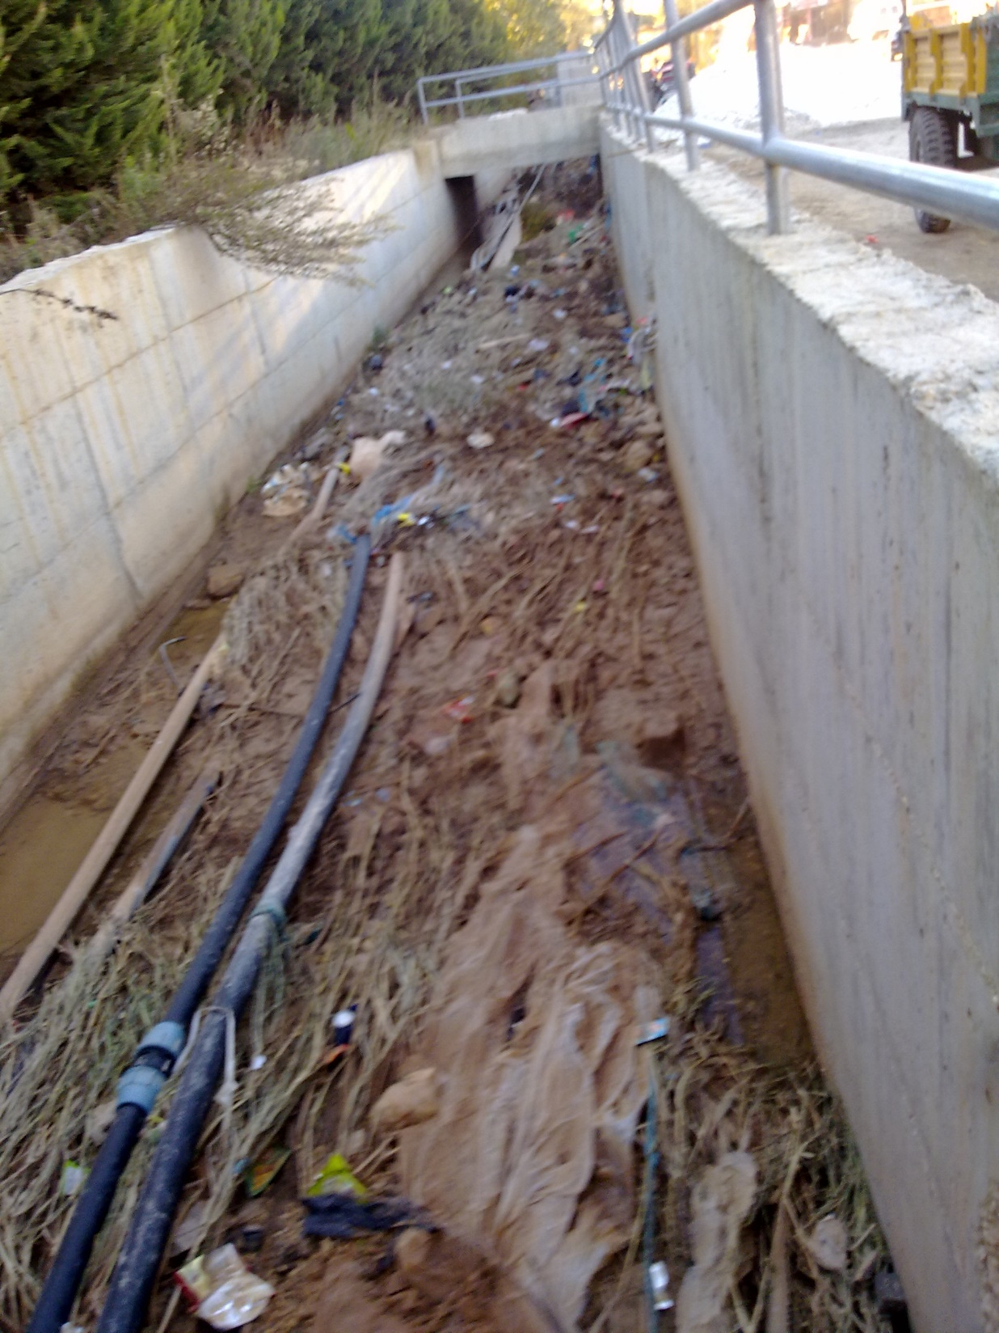

Slide 67
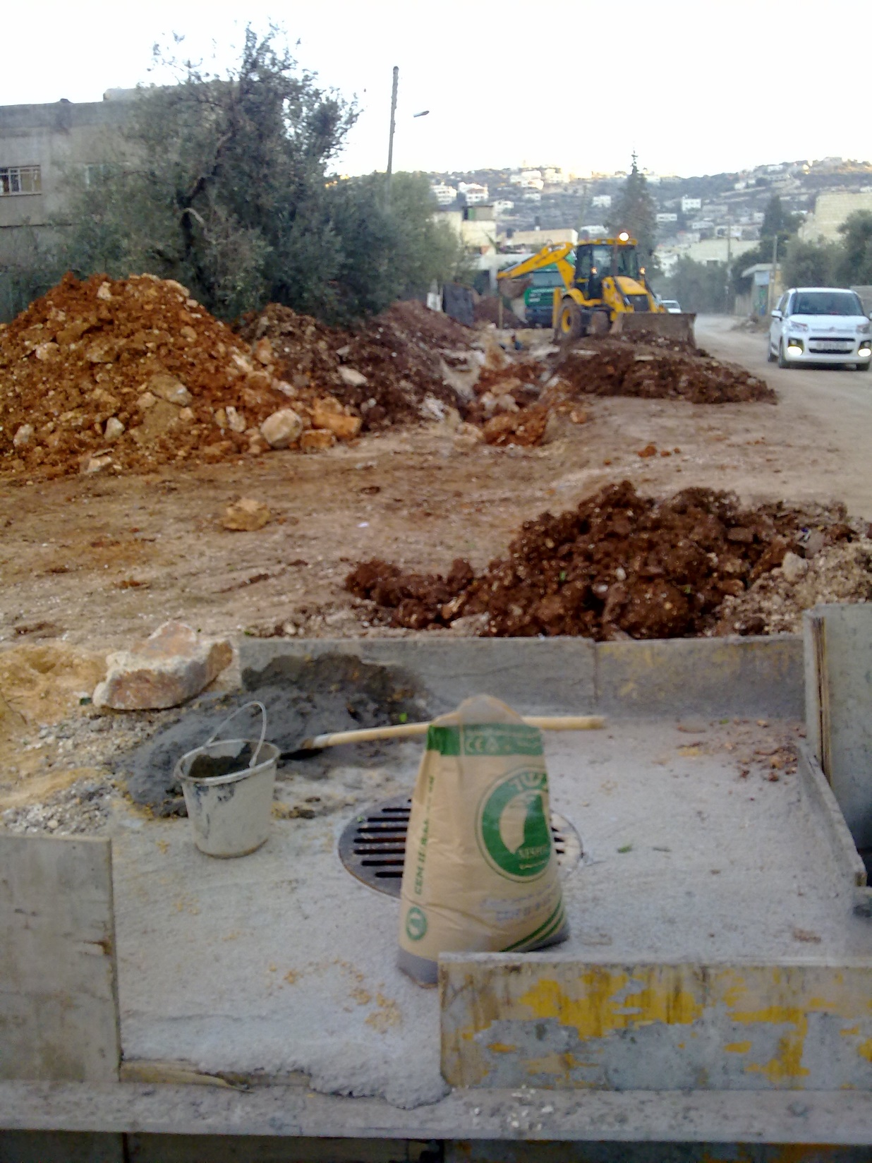

Slide 68
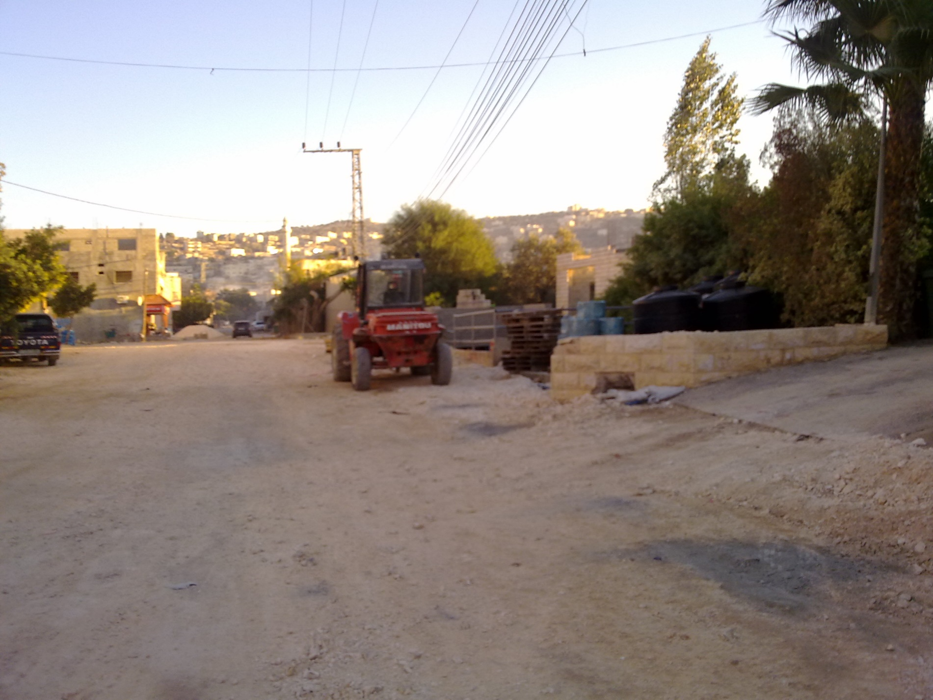

Slide 69
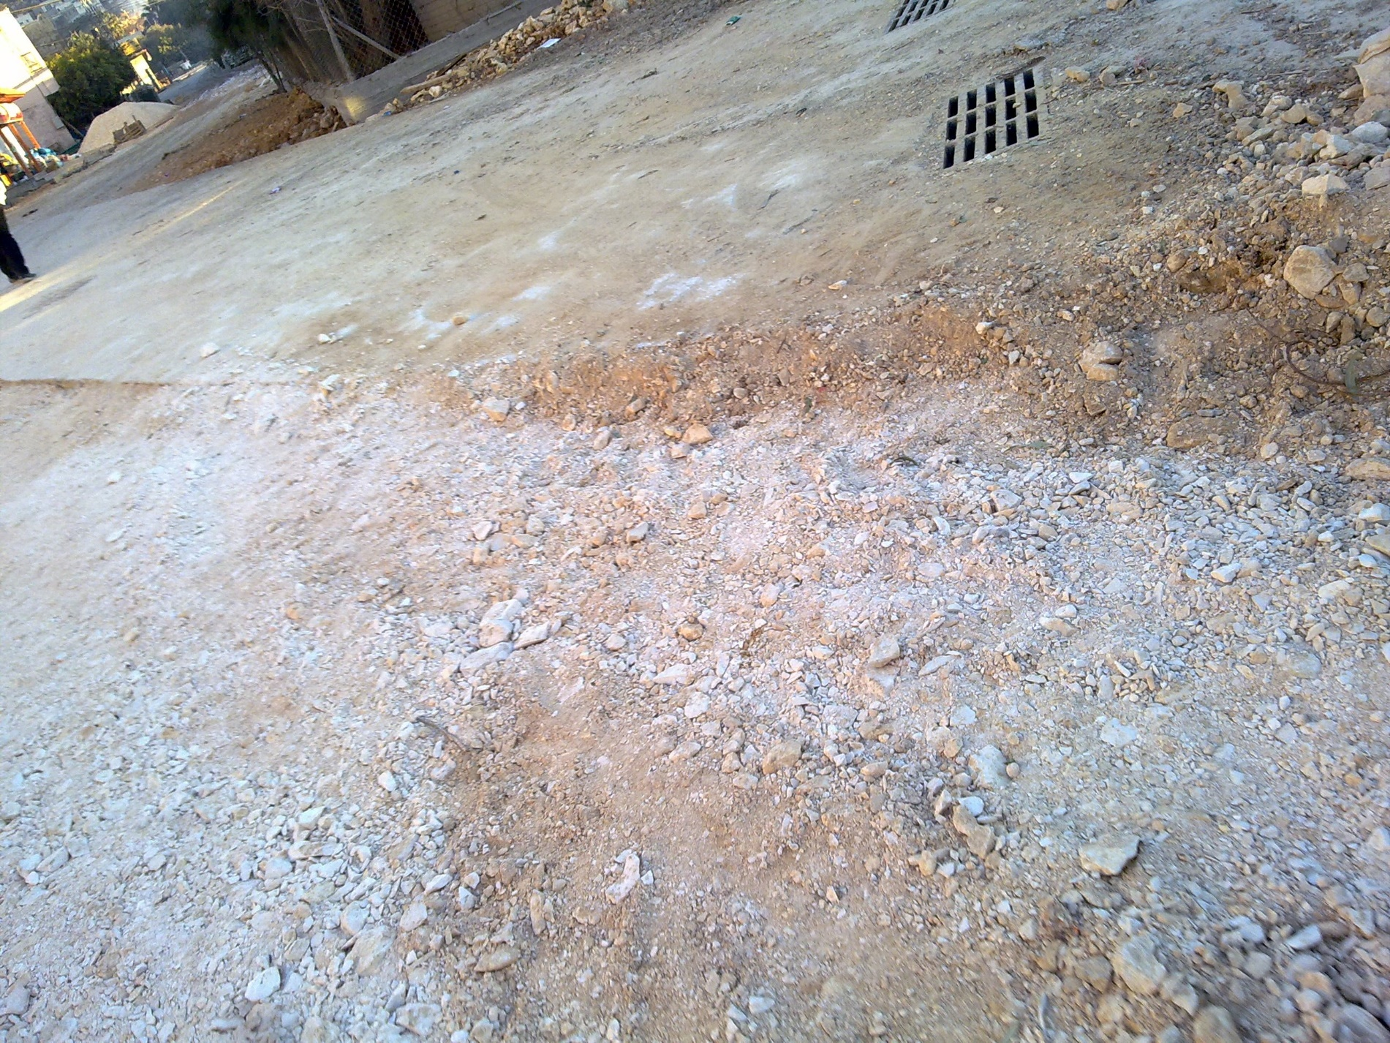

Slide 70
Thank You

