Slide 1

Supervisors:
Dr. Mona Demaidi
Presented By :
Hala Jabr
Noor Zakaria

Slide 2
Outline:
General Overview
Motivation
What is Deliveroo
Deliveroo Features
Tools and Technologies
Challenges
Constraints
Future work

Slide 3
Motivations:
Ordering Goods
  Is very easy these days
  But it’s slow and few mobile applications support this process.
Effort needed to request order
  Most services require calling
  Many people struggle finding menu to know what goods are provided.
There is no applications that allow you to track your order and open chat with delivery person.

Slide 4
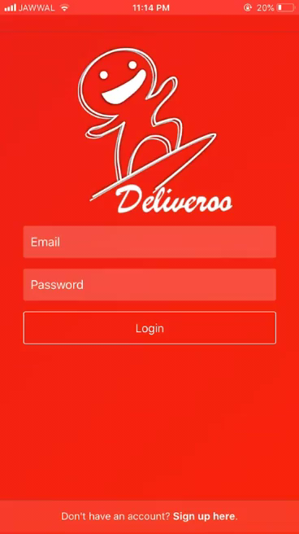
Deliveroo
Deliveroo is a mobile application with cross
platform framework and a website that help
people to get their demands as fast as possible.
Provides Menus for many restaurants.
Deliveroo makes clients track their order
on the map and make a chat with the delivery man

Slide 5
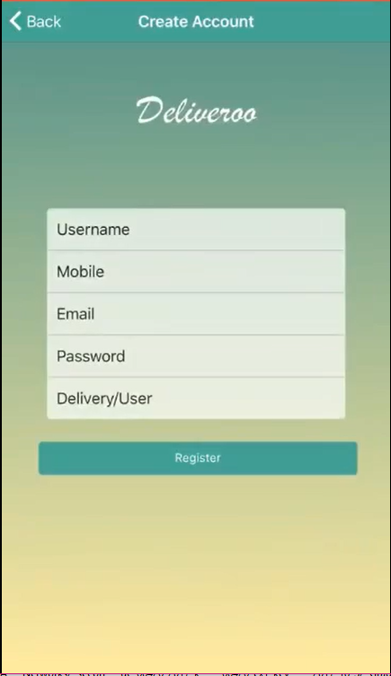
Login & signup
You can sign up as a user or a delivery man.
Login Page:
- The application ensure of the email and password then logs in due to the type of this user.

Slide 6
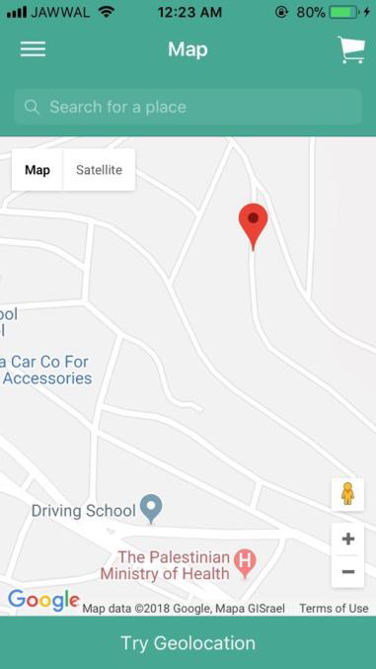
Customer Page
When Client signed in, he can see
his location with a marker.

Slide 7
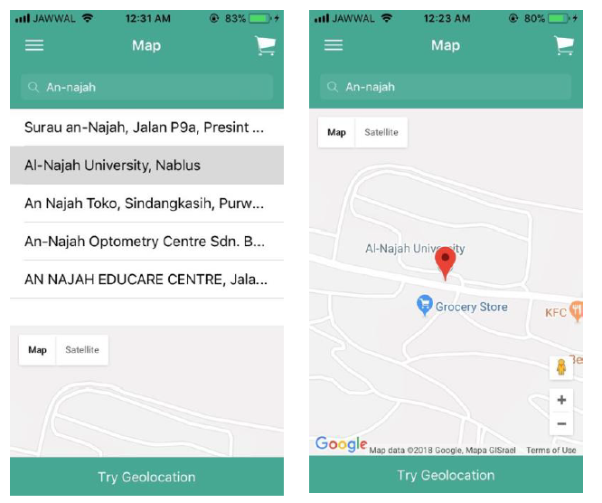
Client Page
Also he has the ability to lookup for any place on the map and put a marker to be the destination of his order.

Slide 8
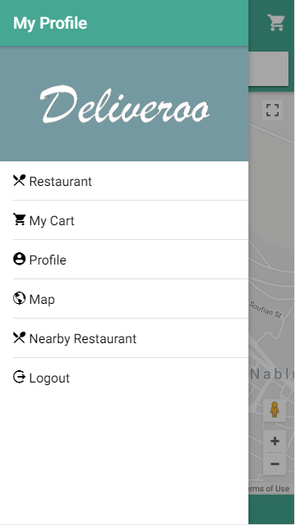
Client Page
In slide menu there are many options as shown..
He can view and edit his basic information
//video.

Slide 9
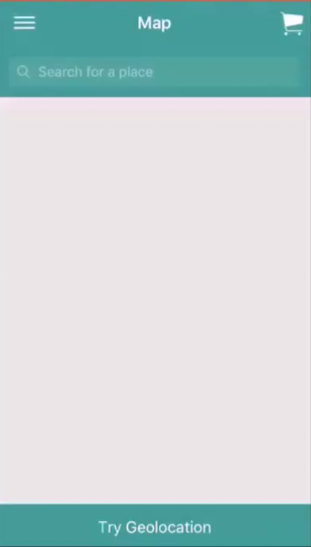
Client Page
This page helps you to get the nearby restaurants near any place you want, which done by entering the place in the search bar, then you can see the restaurants and if that restaurant either close or open.

Slide 10
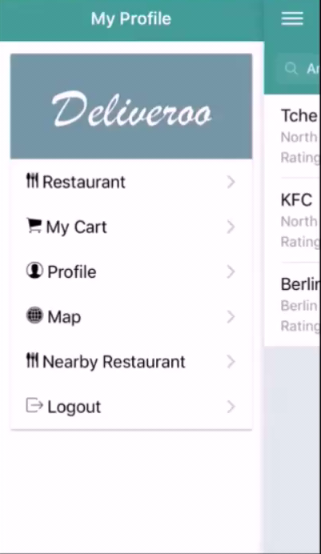
Client Page
Restaurant Page:
User can browse all restaurants in the system and their menus and order from it then the order displays in the cart page.

Slide 11
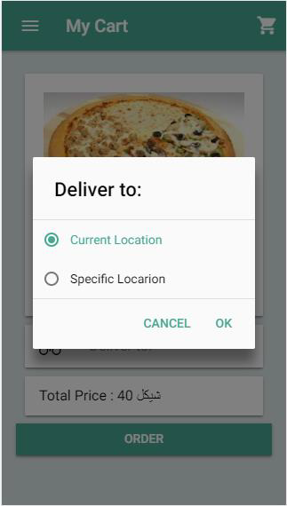
Client Page
In cart page you can choose the destination if your order.
You can order to your current location or to a specific location.

Slide 12
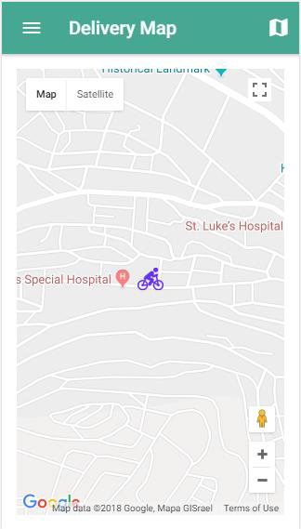
Delivery Page
When he logged into the application, he can also sees his location. He also can view and edit his basic information.

Slide 13
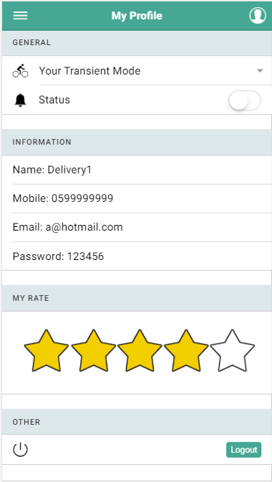
Delivery Page
The basic information in delivery profile page:
// video

Slide 14
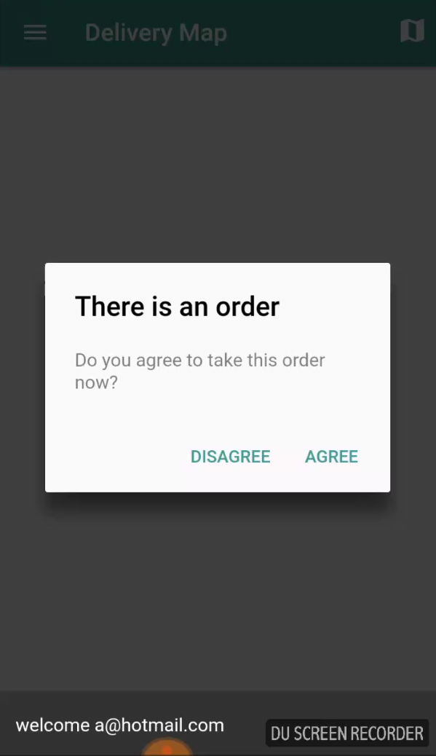
Order Page
When customer press on order button, the algorithm start choosing the best delivery person.
// video 1 min
// talking about the algo
// video

Slide 15
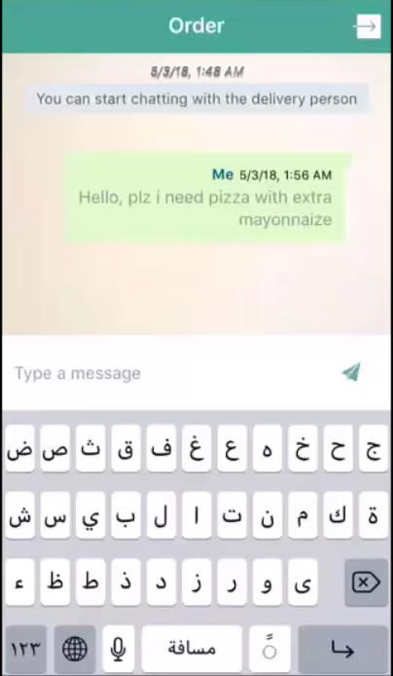
Order Page
In the order page user can make a chat with delivery person and see his order.
// add how to see the order

Slide 16
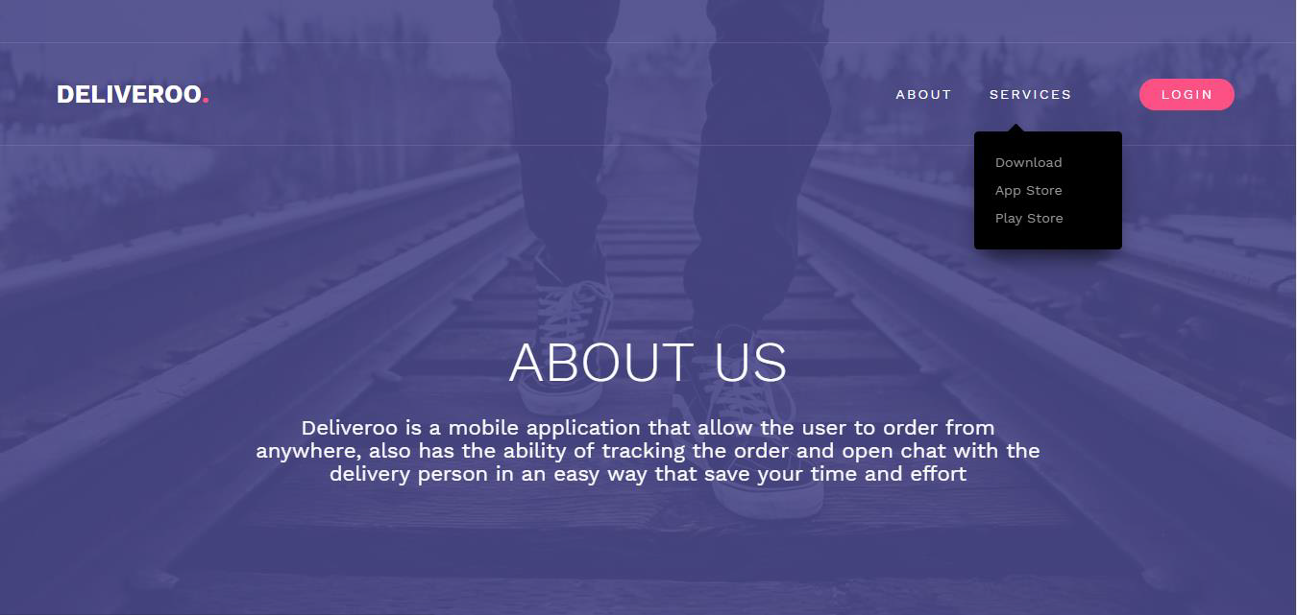
Web Page
The home page talks about the application and allow people to install it.
Web page allows Admin and Category admin to log in.

Slide 17
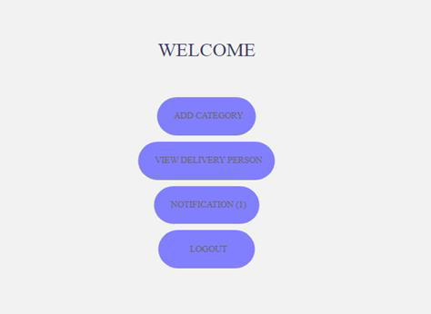
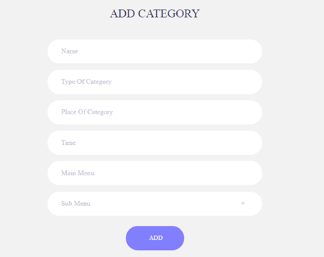
Web Page
Admin Page:

Slide 18
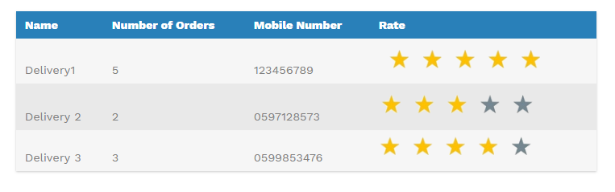
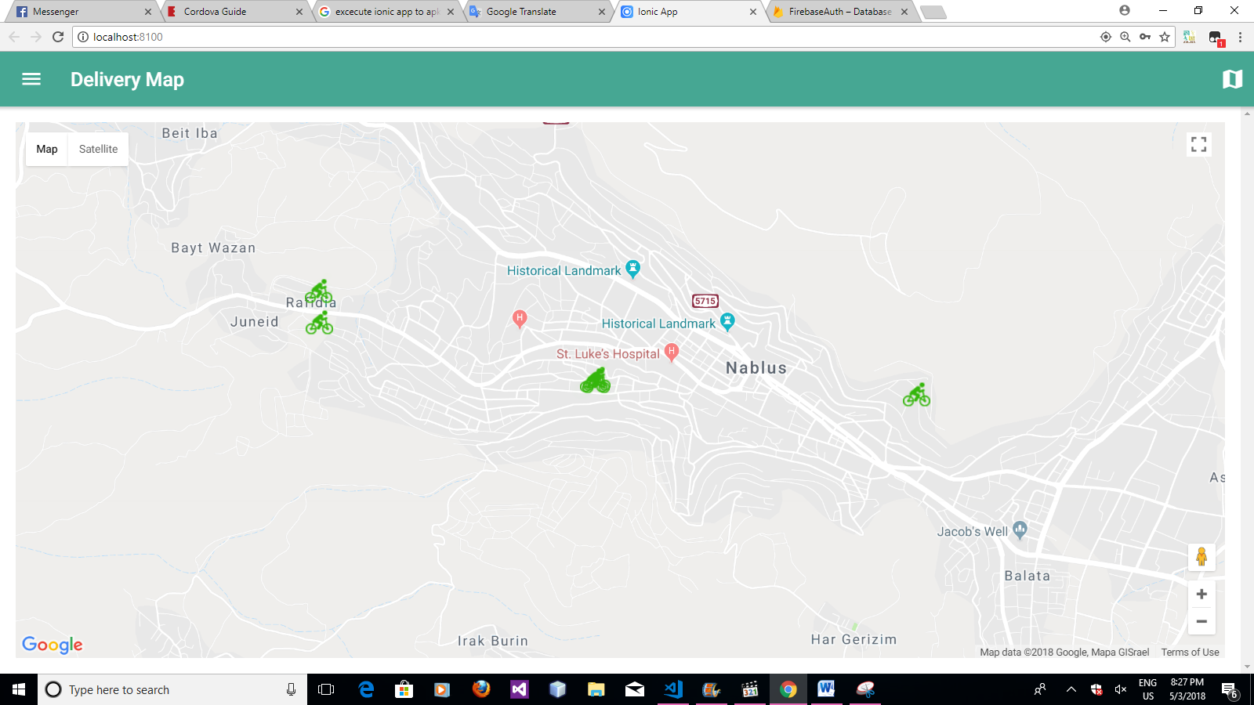
Web Page
Admin Page:

Slide 19
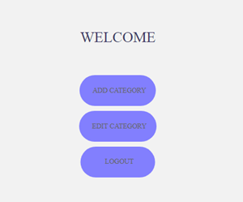
Web Page
Category admin Page:

Slide 20





Technologies and implementation// t3del +cordova
Mobile application
Dashboard website
Server

Slide 21
Challenges
Google Map
  It doesn’t recognize all places in Palestine.
  A lot of streets are not defined with its common names.
3G
  Live tracking depends mainly on the speed of the Internet

Slide 22
Future works
Ask some delivery companies to entering their employees in our system.
Expand the project by allowing any user to add goods and sell them by the application during our delivery men employees.
Make customize for some delivery men, if a restaurant has its own cars, motors, etc. Then these cars can be added as a delivery men ordering food for only that restaurant. So, this restaurant can benefit from the application features.

Slide 23
Thanks

