Slide 1

An-Najah National University
Faculty of Engineering & IT
Mechanical Engineering Department
Design and Fabrication Creep Testing Apparatus
Prepared by
Waleed Najjar
Khaled Jawabreh
Jehad Shamlouli
Supervisor
Dr. Ahmad Al-Ramahi
2014-2015

Slide 2
Outline
Introduction
Design
Manufacturing
Results.
Conclusion .

Slide 3
Introduction
Creep Definition .
Creep Theory
Objectives of project

Slide 4
Problem definition
The creep phenomena : is an important phenomena to be studied
This phenomena happens under high temperature and

Slide 5
Objectives of project
the apparatus will be designed to test plastic specimens and study their creep behaviors under different types of loading and temperatures
In our project, the added value is the ability to perform creep test under different types of loading (tension ,torsion and combined load ),however ,in the literature most testing devices dedicated on one type of loading only .

Slide 6
Creep Theory.
When designing a structural component that operation at high temperature for specified long time it's essential to obtain on the creep properties of this part, and also to determine the creep characteristics of this part the creep test or stress rupture test must be conducted to obtain on these properties and characteristics.
Creep test measure the amount of creep strain as a function of time to obtain the creep rate.

Slide 7
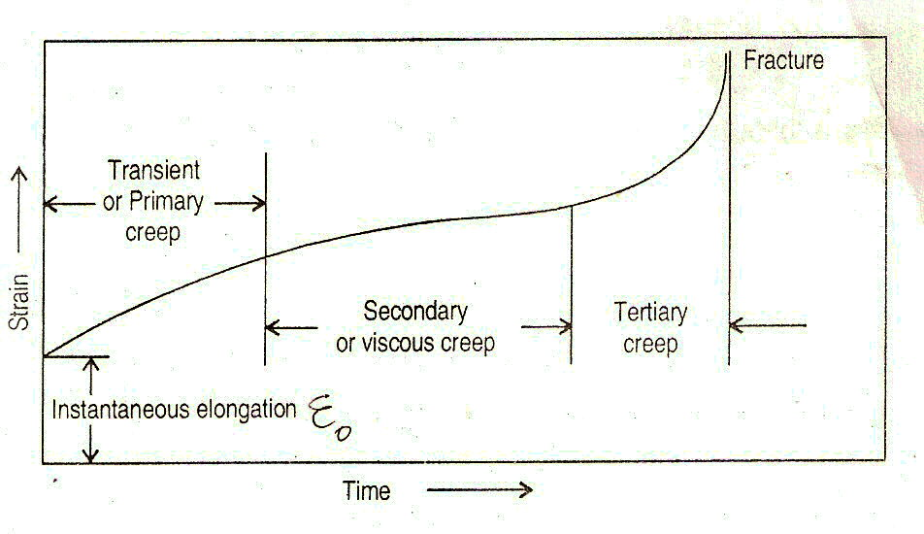
Creep curve .
- Primary Creep .
- Secondary Creep .
- Tertiary Creep .

Slide 9
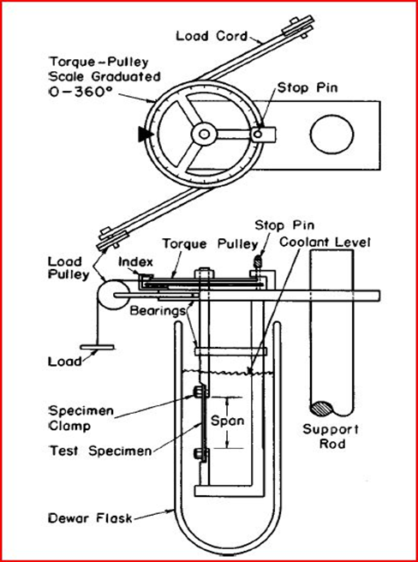
Design of Creep Testing Apparatus (CTA)
The idea of CTA comes from the ASTM D1043.
This device used to determine the modulus of rigidity

Slide 10
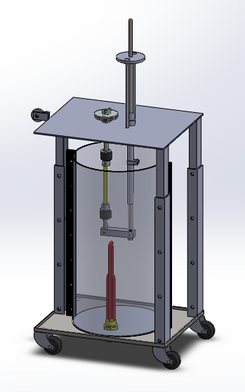
Graphical Design
Isometric View.
Sectional View.
Exploded View.
Bill Of Material (BOM ).

Slide 11
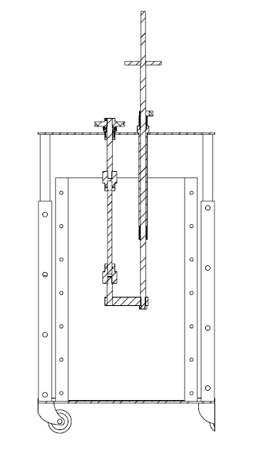
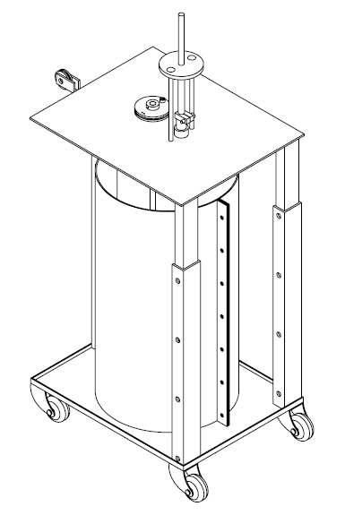
Graphical Design
Isometric View.
Sectional View.

Slide 12
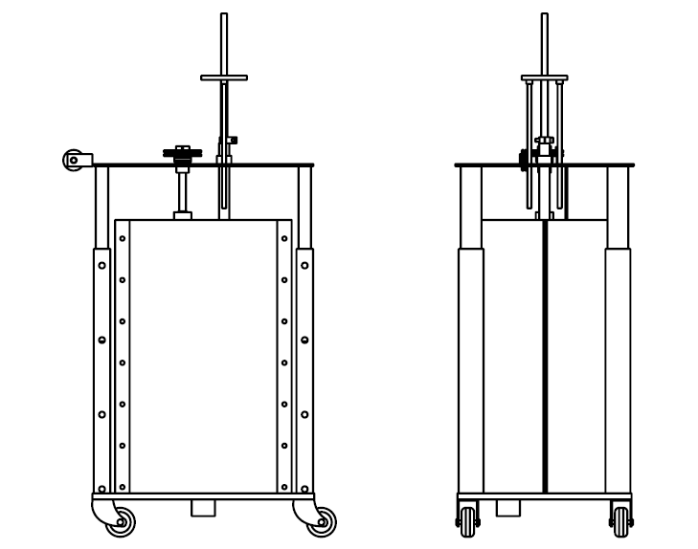
Graphical Design
Other Views
(Front and Side View)

Slide 13
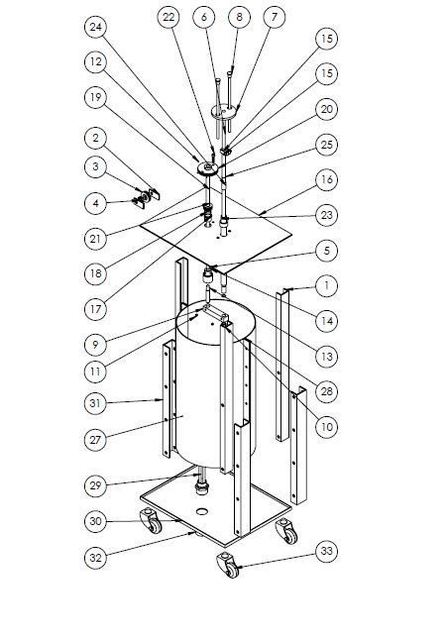
ITEM NO. | PART NUMBER | QTY.
1 | Inside Column | 3
2 | Plate for Vertical Pulley | 2
3 | Vertical Pully | 1
4 | Deep GroovBall Bearing | 1
5 | Specimen | 1
6 | Axial Shaft | 1
7 | Mass stud | 1
8 | Fixing Column | 2
9 | Connecting Shaft Plate | 1
10 | NUT | 1
11 | Socket Set Screw | 2
12 | Socket Set Screw | 2
13 | Shaft of Bottom Chuck | 1
14 | Chuck | 2
15 | Grips | 1
16 | Upper Palte | 1
17 | Torsional Bearing Holder | 1
18 | Needle Bearing | 1
19 | Shaft of Upper Chuck | 1
20 | Hoeizantol Pully | 1
21 | Thrust Bearing | 1
22 | Vertical Pin | 1
23 | Frame of Axial Shaft | 1
24 | Linear Motion Ball Bearing | 2
25 | Internal Retaining Ring | 2
26 | Base | 1
27 | Flask | 2
28 | Plate for Flask | 2
29 | Heater | 1
30 | Lower Part of Table | 1
31 | Outside Column | 3
32 | Mufeh | 1
33 | Wheel of Machine | 4

Slide 14
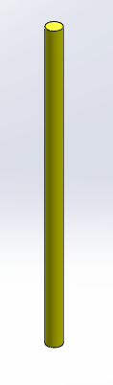
Specimen
The test specimen, is made from plastic
  High density Polyethylene (HD).
  Polypropylene.
  The Mechanical Proprieties of these material :
Specimen | Melting temperature °C | modules of elasticity Gpa | Ultimate tensile strength MPa | Elongation %
Polyethylene HD | 130-137 | 0.8 | 15 | 500
Polypropylene | 160-180 | 1.9 | 40 | 100

Slide 15
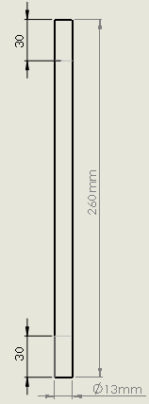
Specimen
Specified dimensions of selected specimen on the CTA.
As shown in the dimension of the free length is selected to be 200mm, the remaining length is for the clamping of the specimen by two-30 mm for chucks.

Slide 16
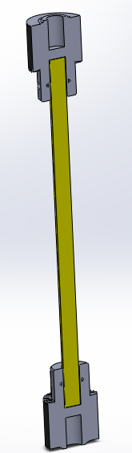
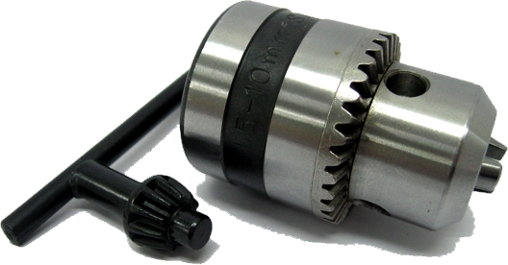
Fixing the Specimen
The Drill Chuck was used to Fix the specimen for different reasons:
  The Weight of the chucks (low)
  The Price of the chucks (low)

Slide 17
Load on the Specimen
Pure Axial Load
Pure Torsional Load
Combined Load (Axial & Torsional)

Slide 18
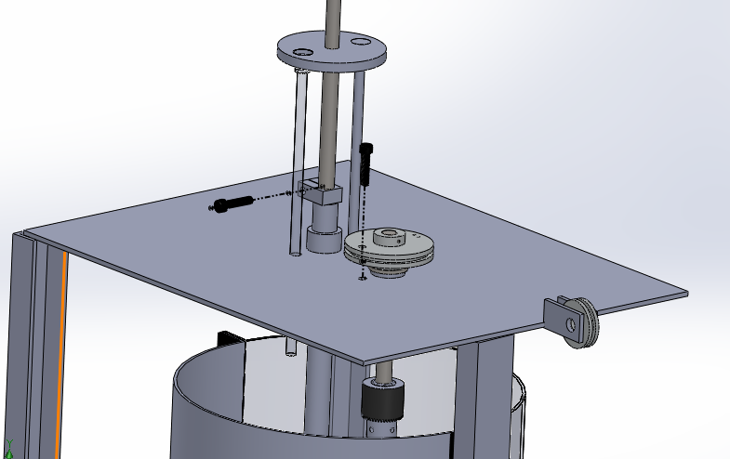
Load on the Specimen Pure Axial Load

Slide 19
Load on the Specimen Pure Torsional Load
T
Fixed

Slide 20
Load on the Specimen Combined Load
F
T

Slide 21
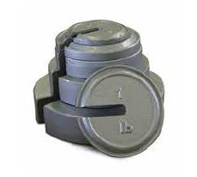
Type of Applied Load
There are many types of forcing systems that can be used. However, in the CTA case the most practical way to applying the load is to use Dead Weight. Figure shown sample of dead weights.

Slide 22
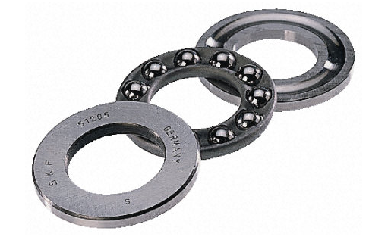
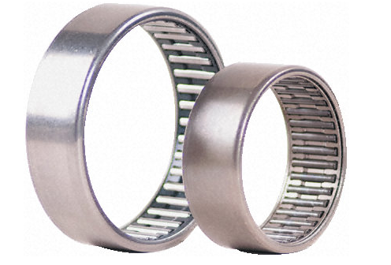
Bearing Design
In the CTA there are three types of bearing used:
  - Thrust Ball Bearing - Needle Roller Bearing.

Slide 23
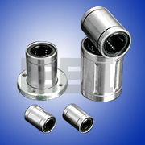
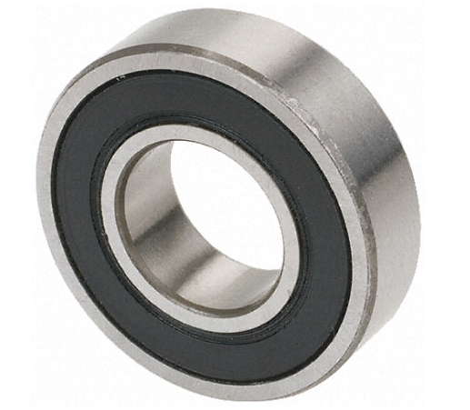
Bearing Design
In the CTA there are three types of bearing used:
  - Deep Groove Ball Bearing. - Linear Motion Ball Bearing.

Slide 24
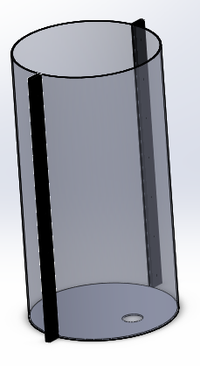
Flask
It is made from poly acrylic material. While acrylic softens at higher temperatures, it does not actually melt until it reaches 320 °F (160 °C),

Slide 25
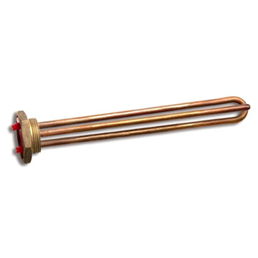
Heater
The heater is used to heat the water by conduction.
The capacity of the used heater was specified from the haters available in the market (2500 Watt).
It was needed to calculate the time required to heat the amount of required water as following.

Slide 26
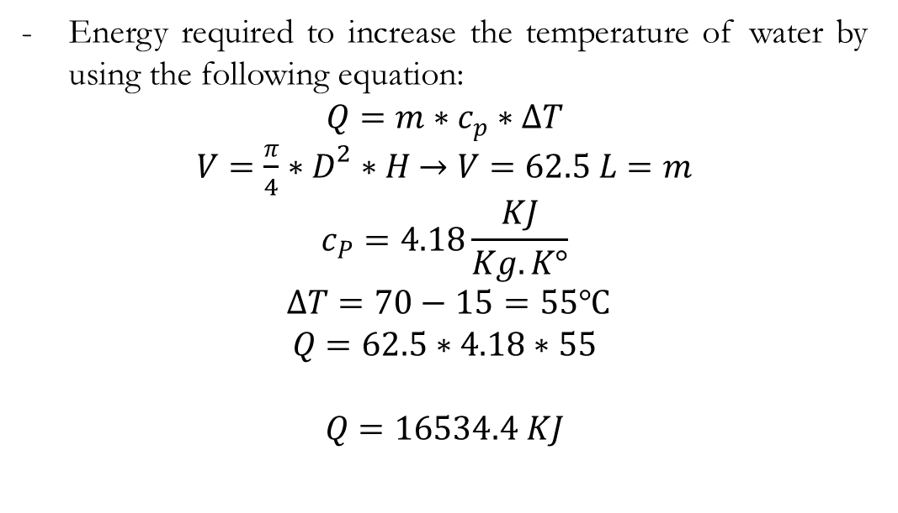
Heater
Energy required to increase the temperature of water by using the following equation:
$$Q=m∗c_{p}∗∆T$$
$V=\frac{π}{4}∗D^{2}∗H$ $→V=62.5 L=m$
$$c_{P}=4.18\frac{KJ}{Kg.K°}$$
$$∆T=70−15=55℃$$
$$Q=62.5∗4.18∗55$$
$$Q=16534.4 KJ$$

Slide 27
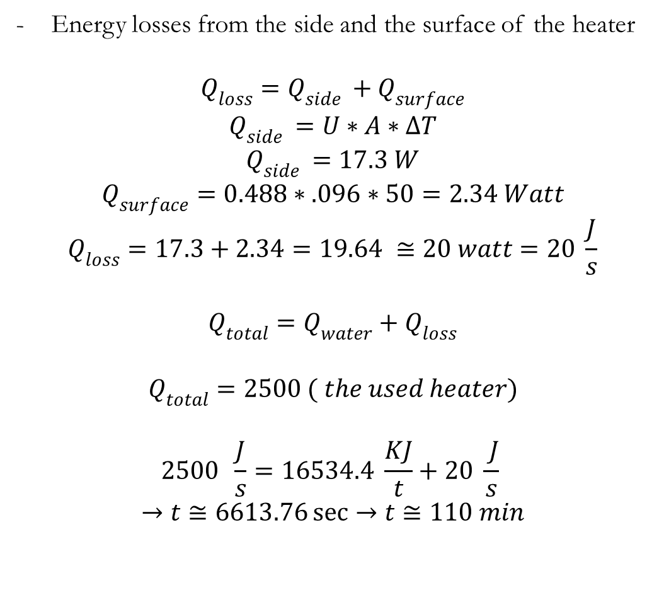
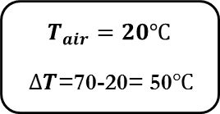

Energy losses from the side and the surface of the heater
$$Q_{loss}=Q_{side }+Q_{surface}$$
$$Q_{side }=U∗A∗∆T$$
$$Q_{side }=17.3 W$$
$$Q_{surface}=0.488∗.096∗50=2.34 Watt$$
$$Q_{loss}=17.3+2.34=19.64 ≅20 watt=20 \frac{J}{s}$$
$$Q_{total}=Q_{water}+Q_{loss}$$
$$Q_{total}=2500 ( the used heater)$$
$$2500 \frac{J}{s}=16534.4 \frac{KJ}{t}+20 \frac{ J}{s}$$
$$→t≅6613.76\sec{→t≅110 min}$$
$$T_{air}=20℃$$
$∆T$=70-20= 50$℃$
$$T_{i}=70℃$$

Slide 28

Electrical System
    Aurduino

Slide 29
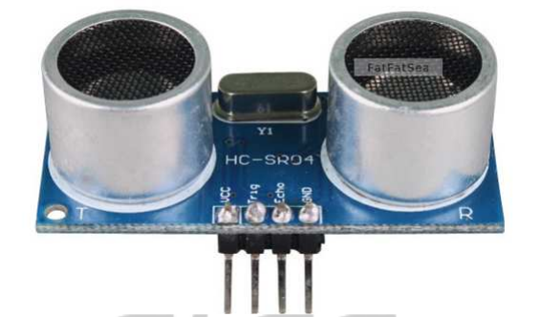
Electrical System
    Ultrasonic Ranging sensor
- This sensor was used to measure the axial deformation in the case of axial Load on the specimen.
- Ultrasonic ranging module HC - SR04 provides 2cm - 400cm non-contact measurement function.
- The ranging accuracy can reach to 3mm.
- The modules includes ultrasonic transmitters, receiver and control circuit.

Slide 30
Electrical System
    Digital Thermometer
- This sensor was used to measure the temperature of the water and give the microcontroller the signs when its work before reach to the desired temperature, and when it’s stop after achieve the desired temperature.
It has an operating temperature range of -55°C to +125°C
it is accurate to ±0.5°C, over the range of -10°C to +85°C

Slide 31
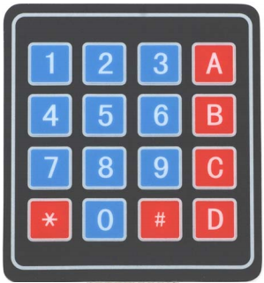
Electrical System
    Keypad
- Used to enter the value of the required temperature, this process will be achieved by microcontroller that received the input required value and give a command to the heater to work until to reach the specified temperature.

Slide 32
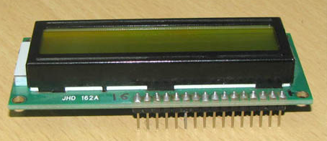
Electrical System
    LCD Screen
This screen was used to give the value of the running temperature, the value of the axial deformation that comes from the ultra-sonic sensor, and the value of the angular deflection that comes from potentiometer.

Slide 33
Manufacturing and Assembly of CTA
The manufacturing process to each part can’t be explained because there is no enough time to that ,
Assembly process is explained by using SolidWorks program.

Slide 34
Manufacturing and Assembly of CTA
We used different joining and assembling process to achieve the assembly process parts together as following:

Slide 35

a- The fixed column was joined with lower plate by welding process
Load

Slide 36

b- The wheel was joined with lower plate by welding process
Load

Slide 37

c- The Flask part was joined together
Load

Slide 38

d- The flask was joined with lower plate after that the heater was joined
Load

Slide 39

e- The needle bearing was joined with torsional shaft holder while the linear motion bearing was joined with axial shaft holder
Load

Slide 40

f- The torsional shaft holder and the axial shaft holder was joined with upper plate
Load

Slide 41

g- Horizontal pulley was joined with the shaft
Load

Slide 42

g- The shaft was joined with the chuck and the pin was used to prevent pulley motion
Load

Slide 43
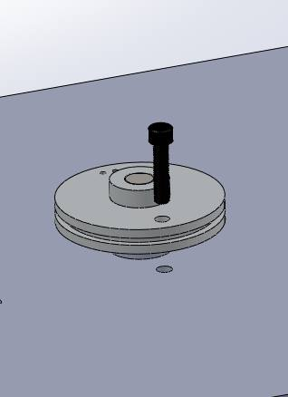
g- The shaft was joined with the chuck and the the pin was used to prevent pulley motion
Load

Slide 44
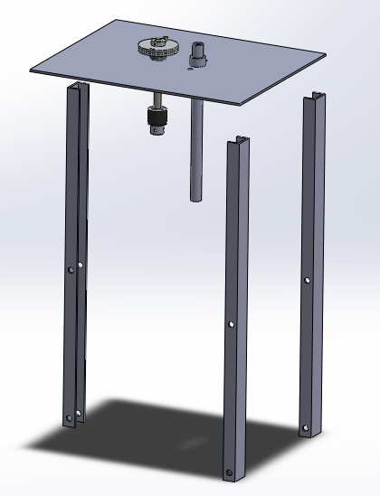
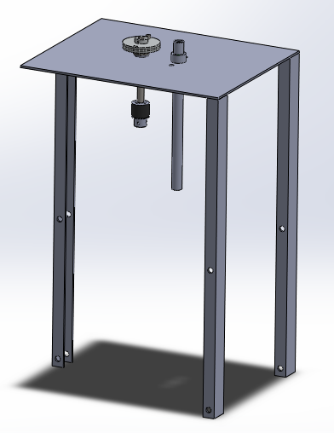
h- The upper plate was joined with the sliding column
Load

Slide 45
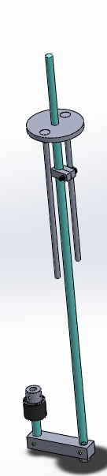
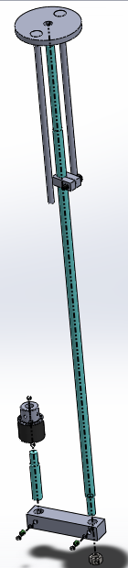
i- Axial shaft and it’s components
Load

Slide 46
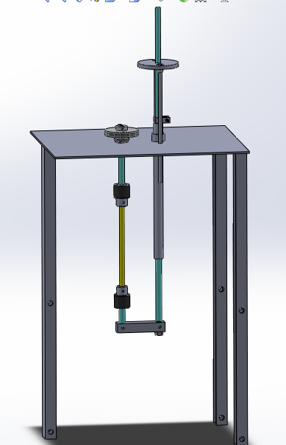
j- Axial shaft was connected with upper part
Load

Slide 47
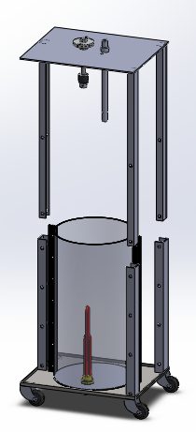
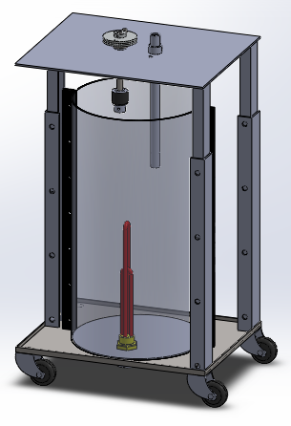
k- Upper part connected with lower part
Load

Slide 48
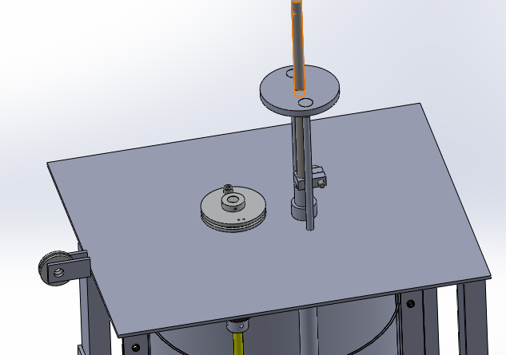
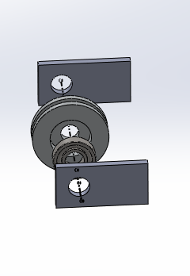
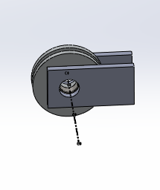
l- Vertical pulley was connected as shown
Load

Slide 50
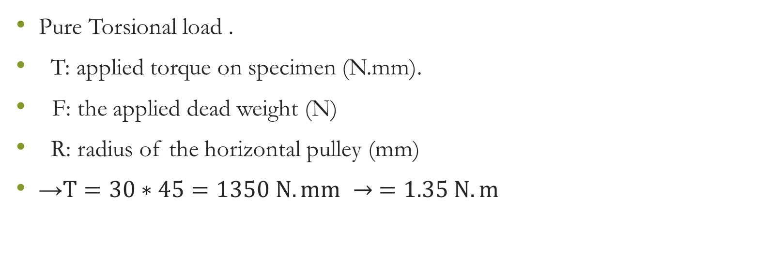
Results & Discussion
Pure Torsional load .
T: applied torque on specimen (N.mm).
F: the applied dead weight (N)
R: radius of the horizontal pulley (mm)
→$T=30∗45=1350 N.mm → =1.35 N.m$

Slide 51
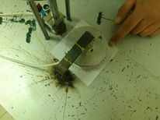
Results & Discussion

Slide 52
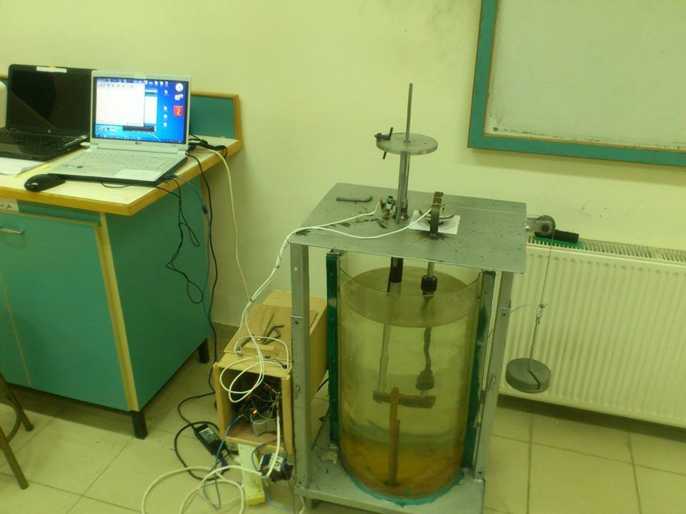
Results & Discussion

Slide 53
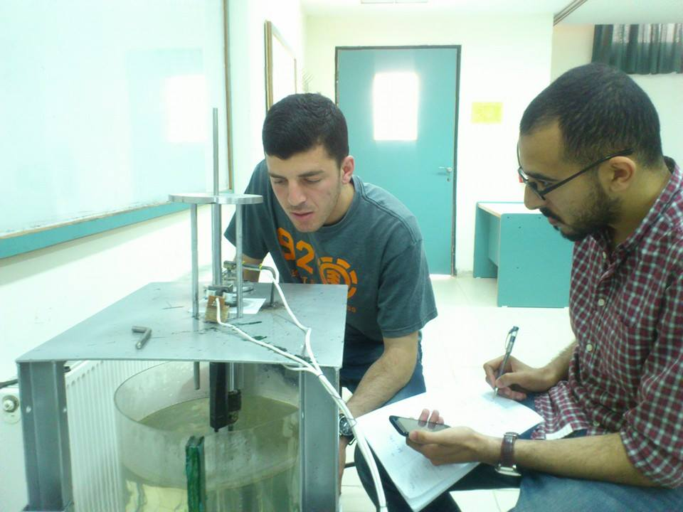
Results & Discussion

Slide 54
Results & Discussion

Slide 55
Results & Discussion

Slide 56
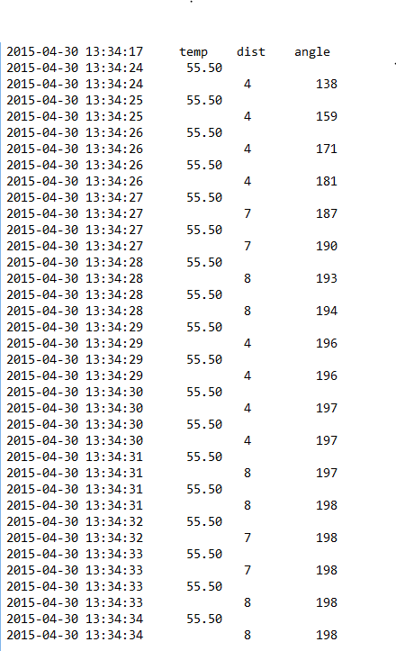
Results & Discussion
Results for pure axial load experiment :

Slide 57
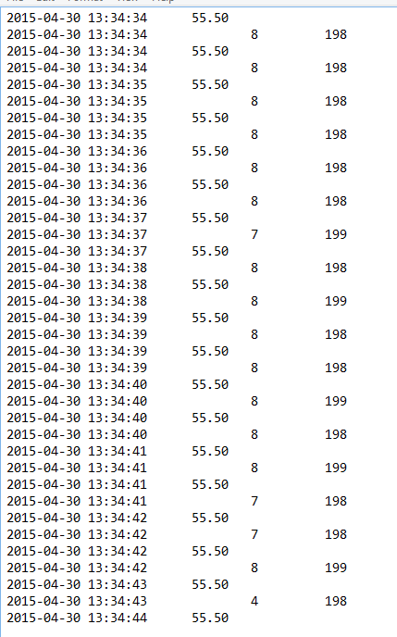
Results & Discussion

Slide 58
Results & Discussion
Combined Load Test
There is no enough time to achieve this type of test.

Slide 59
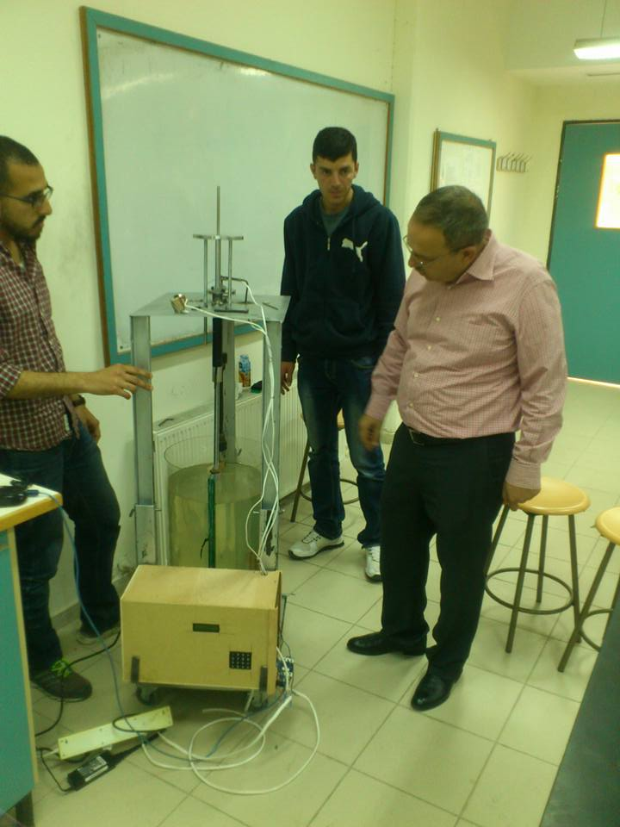
Results & Conclusion

Slide 60
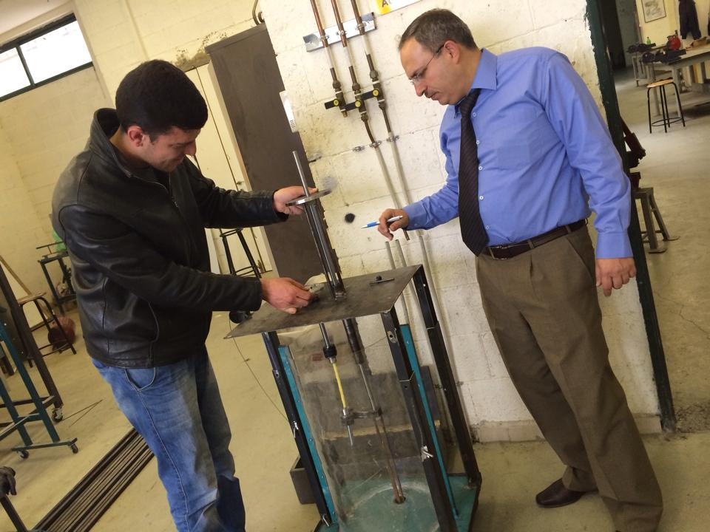

Slide 61
Conclusion
We were hope getting the best results through our project but we encountered some problems that we talked about previously ,we solved some of these but other did not solve.

Slide 62


