Slide 1
Warehouse Management for Musleh Trading Company
Graduation Project
Tamer Zabin
Riham Demaidi
Tasneem Hanini
Ahmad Abu-Issa
Eng. Suleiman Defi
2021

Slide 2
Outline
Introduction
Constrains & Standards
Implementation Methodology
Deliverables
Conclusion
Recommendation

Slide 3
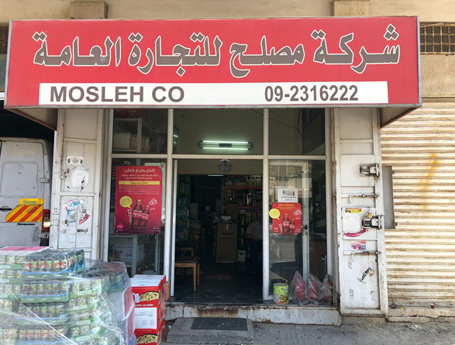
Introduction
Musleh trading company was founded in 1958 and it considered as a family business
It’s a wholesale and retail business for food supplies
Has several branches in Nablus and Huwara
Operates in the field of marketing and distribution representing international companies Brands

Slide 4
Problem Statement
Old system warehouse management
High costs
Time consuming due to several locations for their warehouses
Suggested solution
Invest in a new warehouse that integrated all warehouses in one with more space and proper management

Slide 5
This project will be aim to developing warehouse layout and inventory management system that will participate in reducing the total cost and time
Goals

Slide 6
Constrains
High cost of the new construction and material handling
Fluctuations in Orders & Demand
Pallets size has to be equal
Already Structure Layout
The Accuracy of The Data

Slide 7
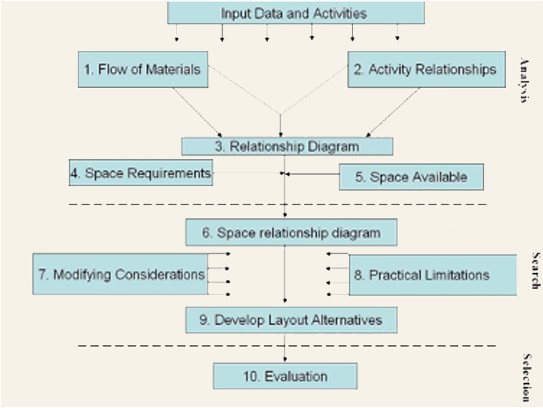
Standards
01
01
SLP: Systematic Layout Planning
02
OSHA: Occupational Safety & Health Administration

Slide 8
Implementation Methodology
Analyzing existing
situation
Data collection
Received data
Material Handling System
Layout
Design
Inventory Management System
Safety System

Slide 9
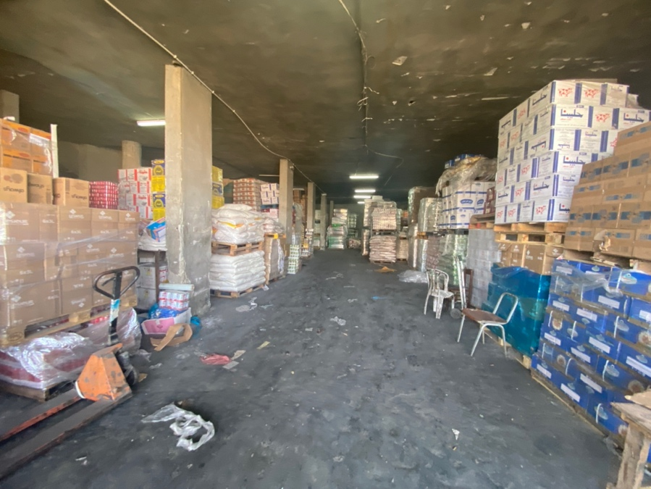
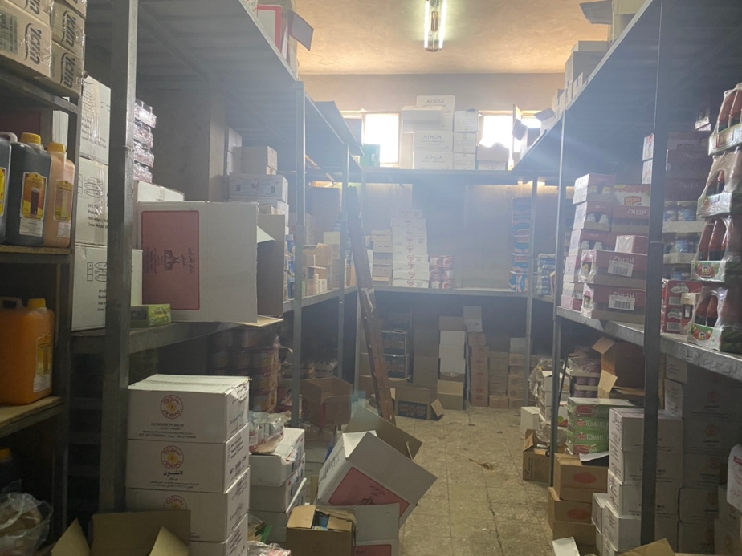
Existing Situation

Slide 10
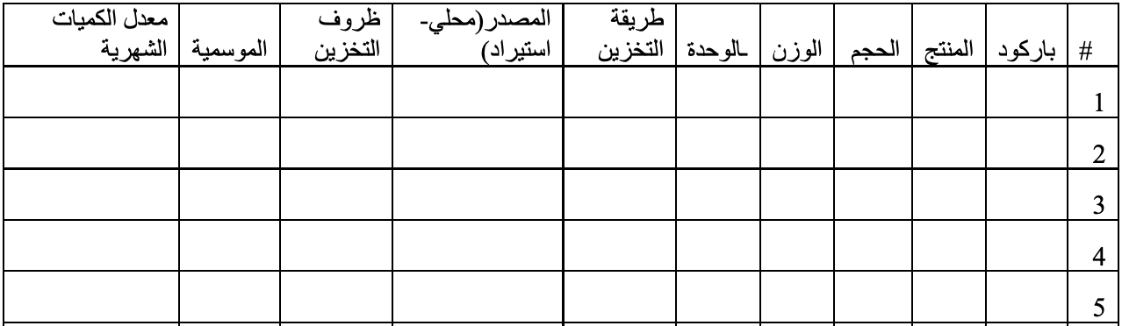
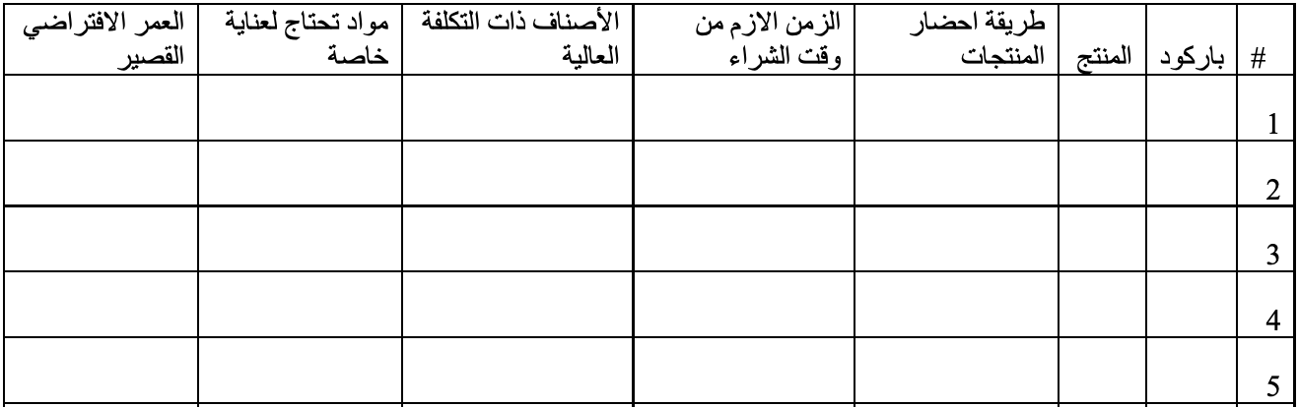
Data collection
Data sheet that collected from the company

Slide 11
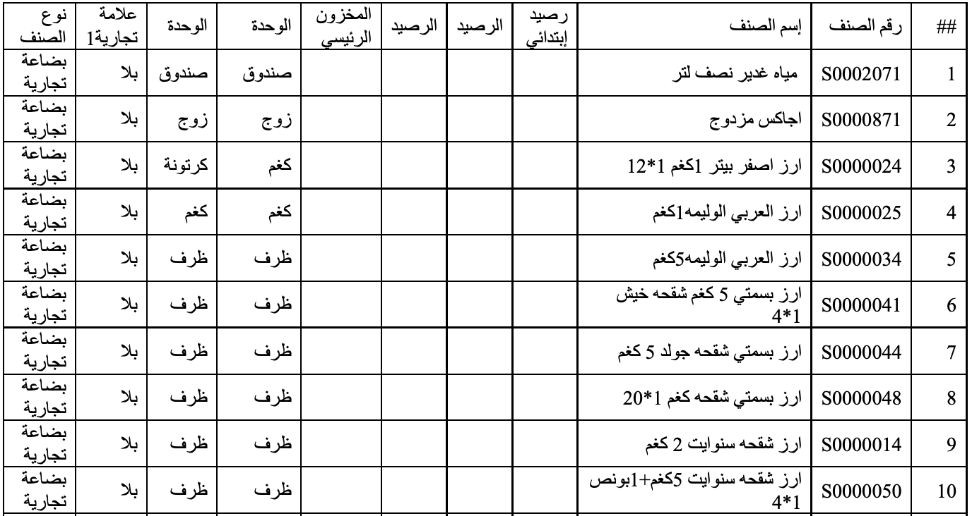
Received data
Sample of received data

Slide 12
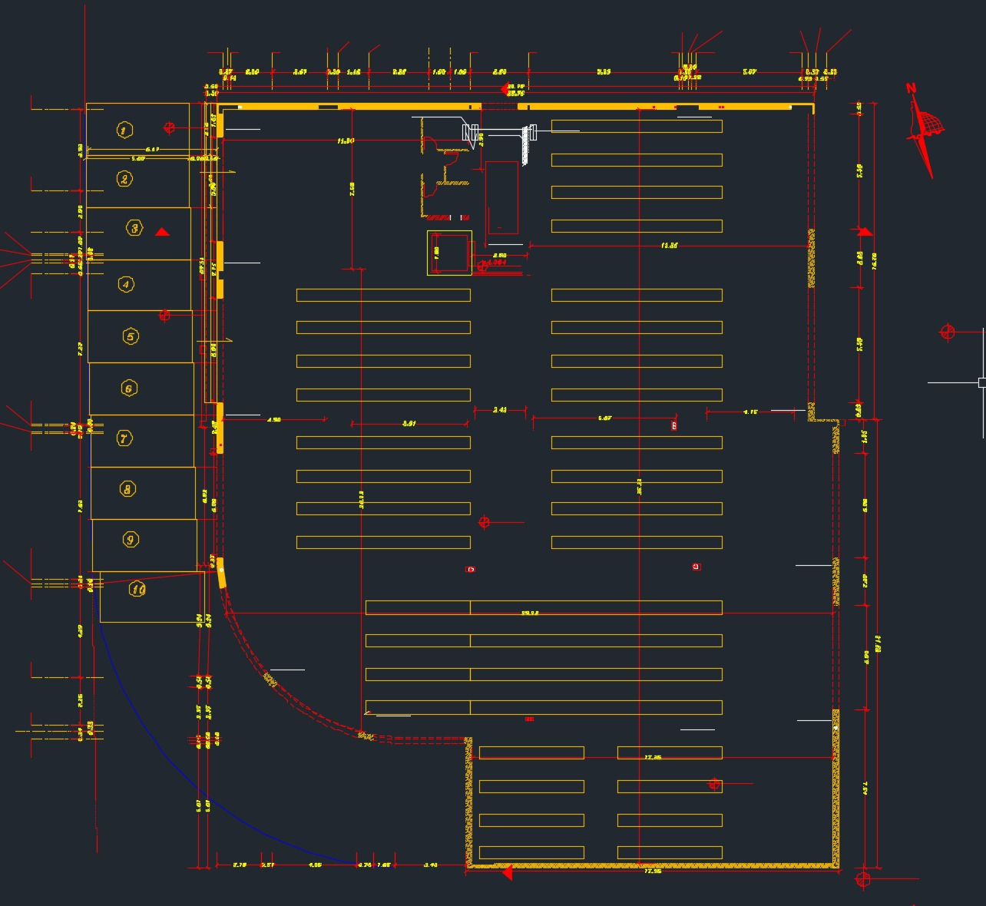
Received data
This is the given layout for the company

Slide 13
Deliverables
01
Material Handling System
03
Inventory Management
System
02
Layout Design
04
Safety System

Slide 14
Material Handling
Objective
01
02
Reduce costs
Increase capacity
Limitation
01
High investment on
material handling
02
Flexibility

Slide 15
Material Handling
Forklift
Pivot steer in 90 degree
Reduce distance between aisles
Increase available capacity

Slide 16
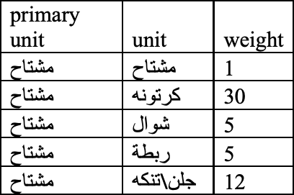
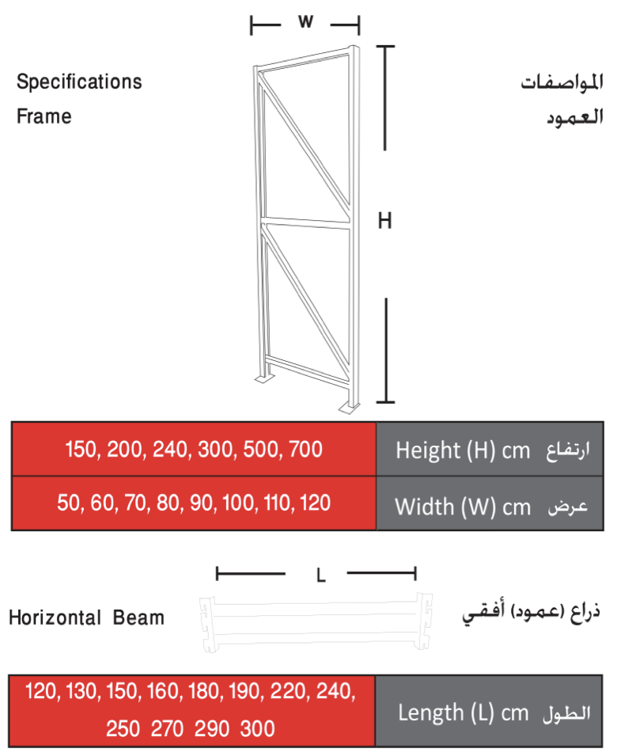
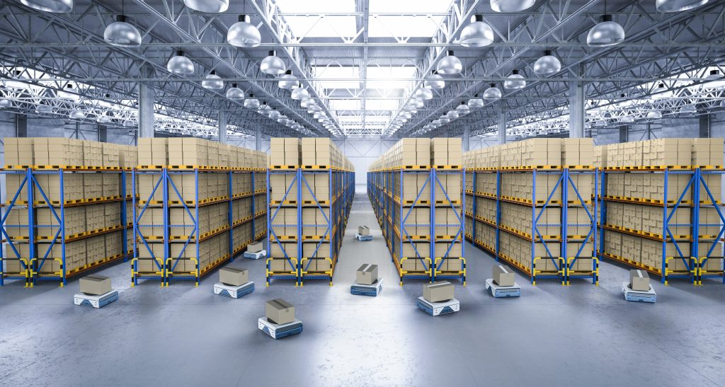
Material Handling
Rack Storage System
Units in pallets
Controllable dimension
Contain 4 pallets in vertical

Slide 17
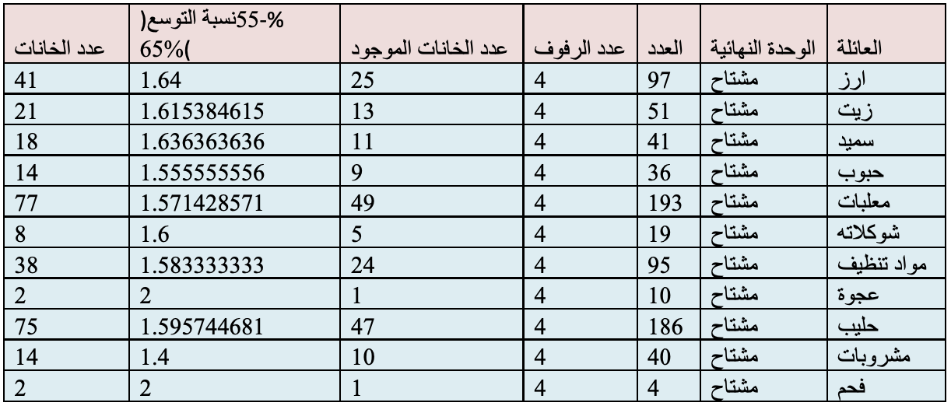
Layout Design
Analyze data
Sort products into groups
Calculate the required capacity
Calculate the predict expansion needed capacity

Slide 18
Layout Design
Factors
01
05
Extra storage area
Preparing area
02
06
Accessibility to all products
Less traveling distances
03
07
Enough receiving area
Safety exit
04
Enough shipping area
Limitations
01
Shape of the land.
Number and location of based column.
02

Slide 19
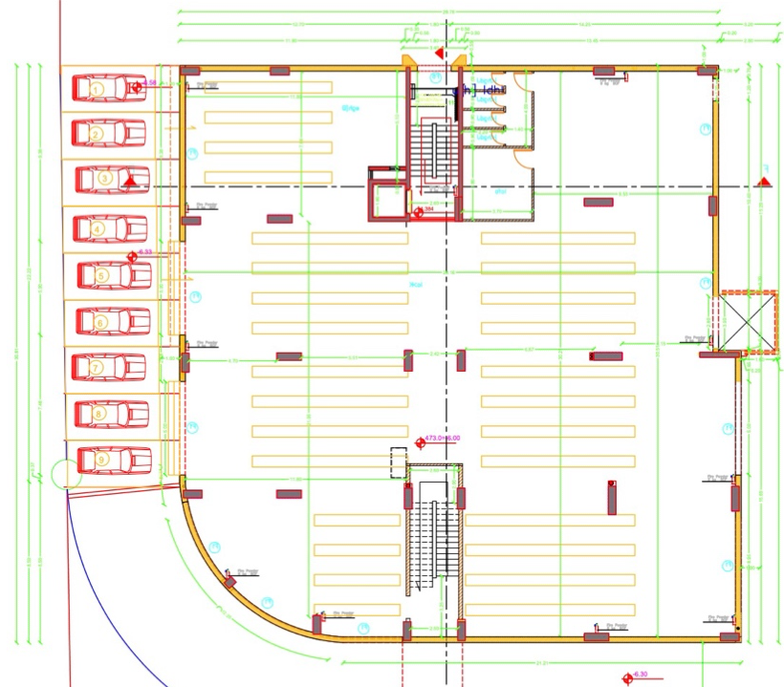
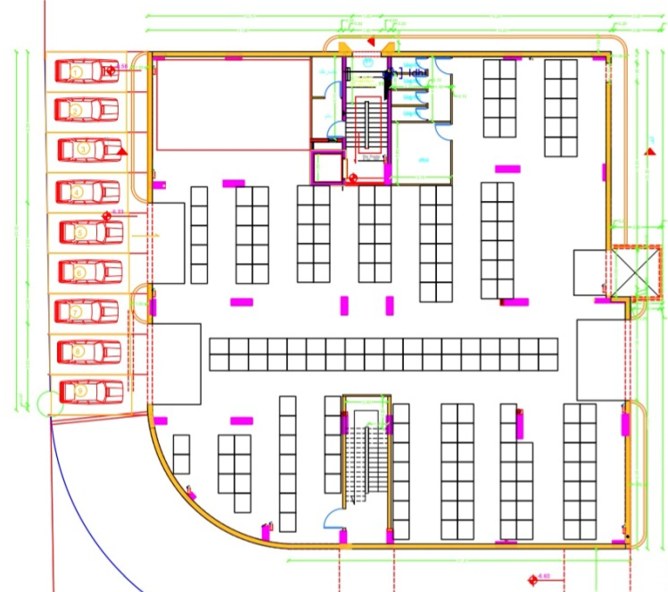
Layout Design
First Inside Layout
Second Inside Layout
Distance between shelves
Fridge room doesn’t exist
No of shelves doesn’t built in calculation
Distance between shelves consider
modern forklift
Fridge room deos exist
Doesn’t have a show room

Slide 20
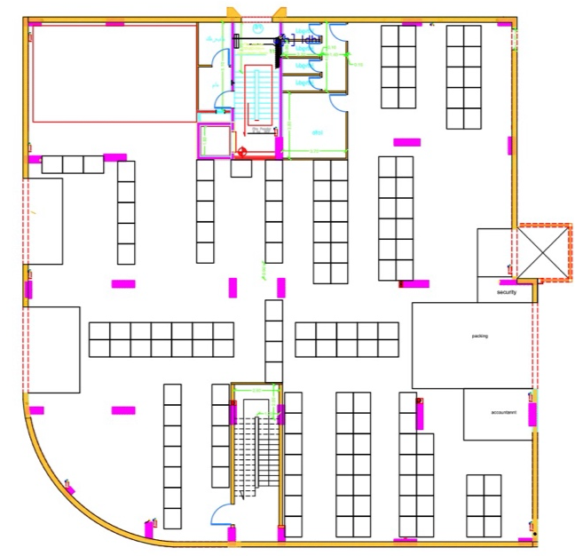
Layout Design
Third Inside Layout
Has a show room for all product
Contain a packing and preparing area
Acountant desk and a scurity room consist
Show room has a link door with storehouse
Fridege is exist

Slide 21
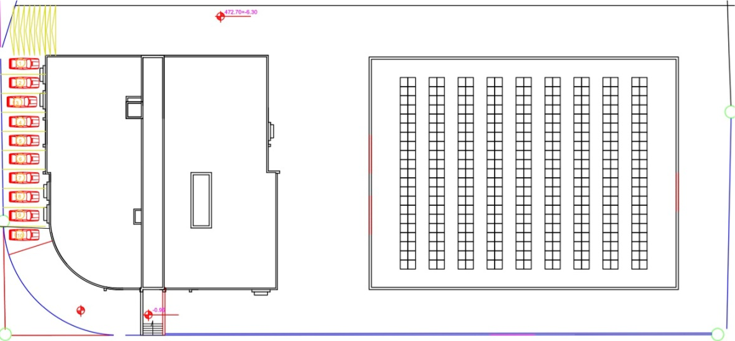
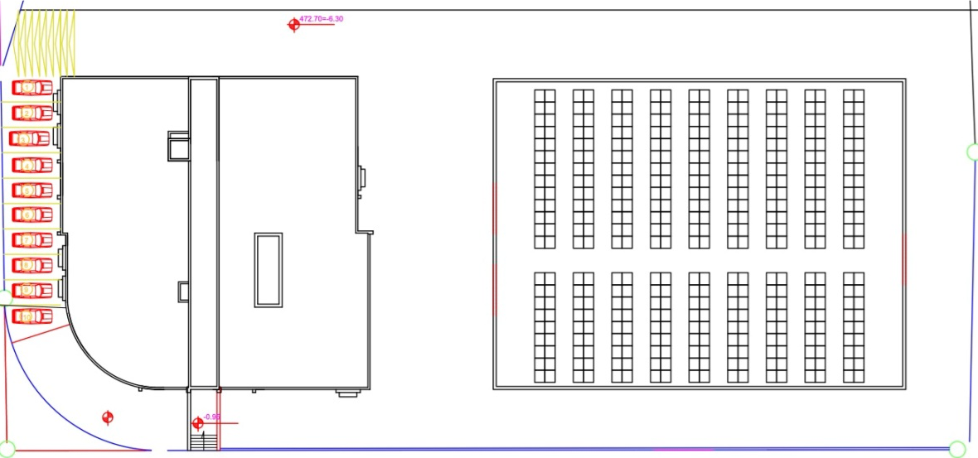
Layout Design
Alternative Outside Layout Design
Vertical outside layout
Vertical with middle aisle outside layout
Capacity: 1512 pallets
Travel distance is high
Access for the product is too difficult
Receiving preparing and shipping area
is too small
Safety exist is not exist
Capacity: 1584 pallets
Travel distance is low
Access for the product is medium
Receiving preparing and shipping area
is too small
Safety exist is not exist

Slide 22
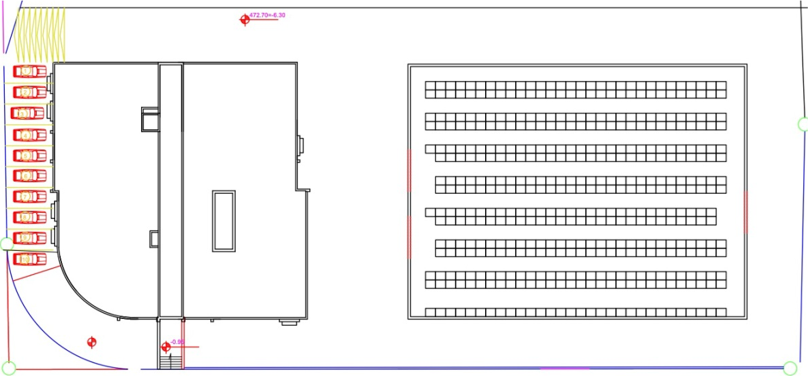
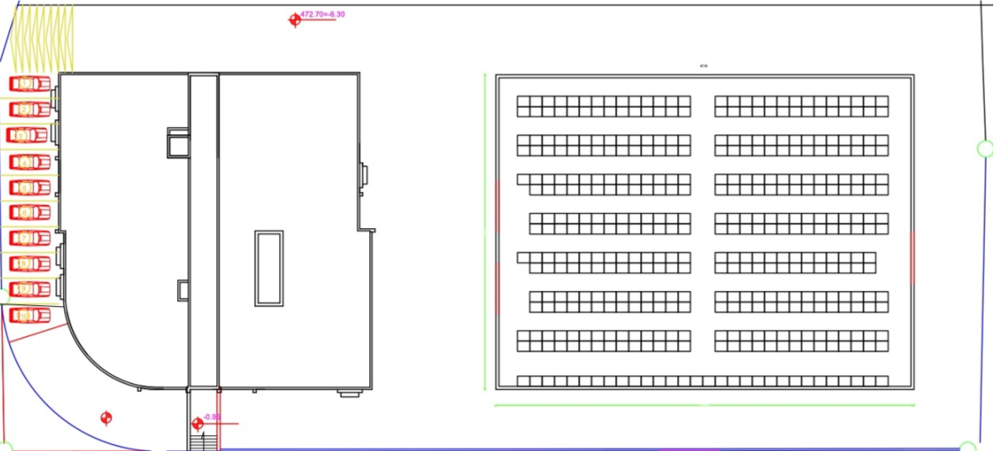
Layout Design
Horizontal outside layout
Horizontal with aisle outside layout
Capacity: 1768 pallets
Travel distance is high
Access for the product is medium
Receiving preparing and shipping area
is too small
Safety exist is not exist
Capacity: 1656 pallets
Travel distance is medium
Access for the product is easy
Receiving preparing and shipping area
is too small
Safety exist is not exist

Slide 23
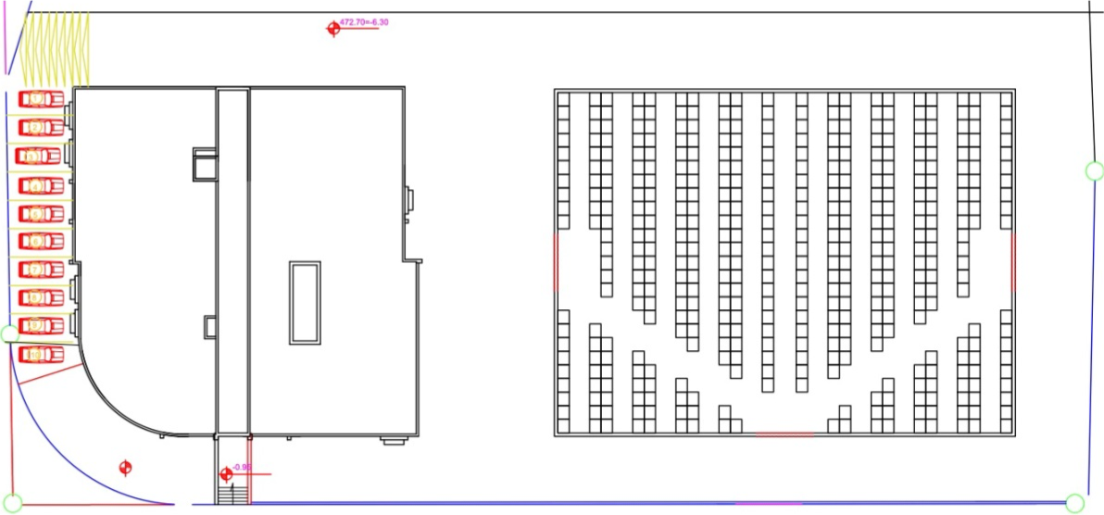
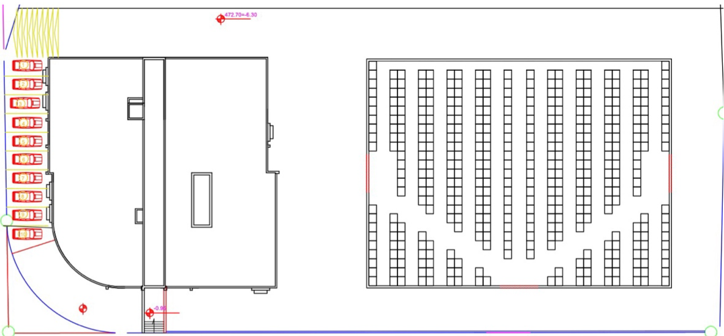
Layout Design
Flying-V outside layout
Flying-V with upper aisle outside layout
Capacity: 1704 pallets
Travel distance is low
Access for the product is medium
Receiving preparing and shipping area
is medium
Safety exist is exist
Capacity: 1632 pallets
Travel distance is low
Access for the product is easy
Receiving preparing and shipping area
is medium
Safety exist is exist

Slide 24
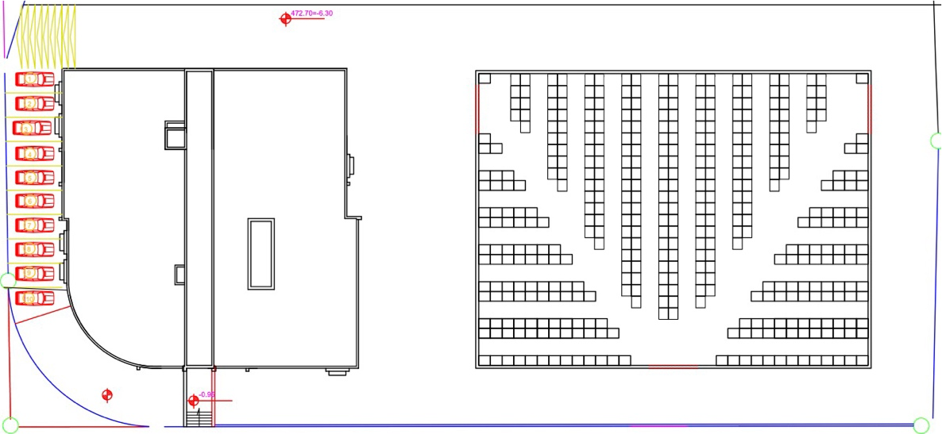
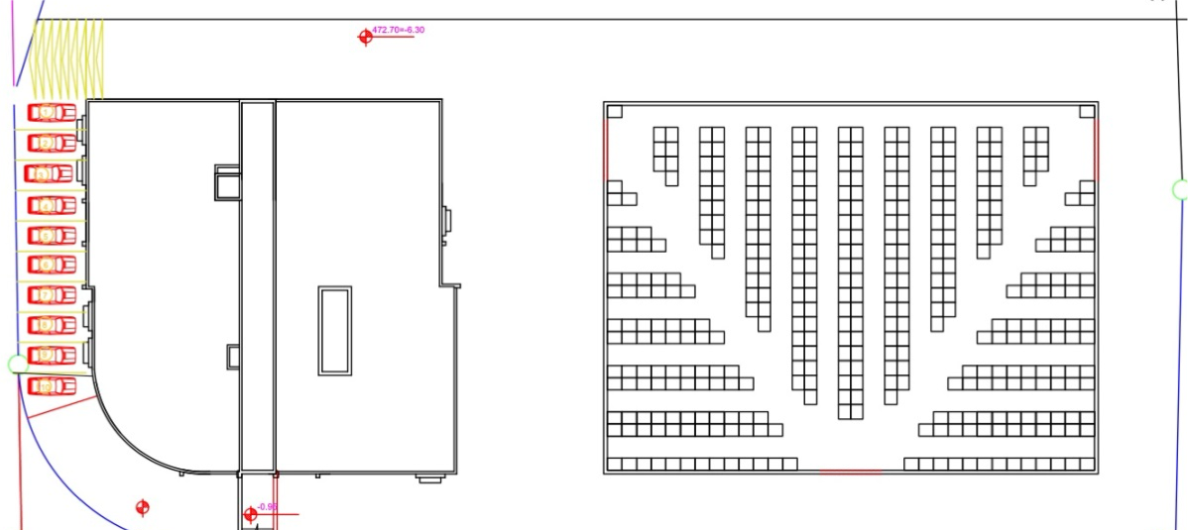
Layout Design
Fish-bone outside layout
Fish-bone with upper aisle outside layout
Capacity: 1672 pallets
Travel distance is medium
Access for the product is easy
Receiving preparing and shipping area
is medium
Safety exist is exist
Capacity: 1600 pallets
Travel distance is low
Access for the product is very easy
Receiving preparing and shipping area
is medium
Safety exist is exist

Slide 25
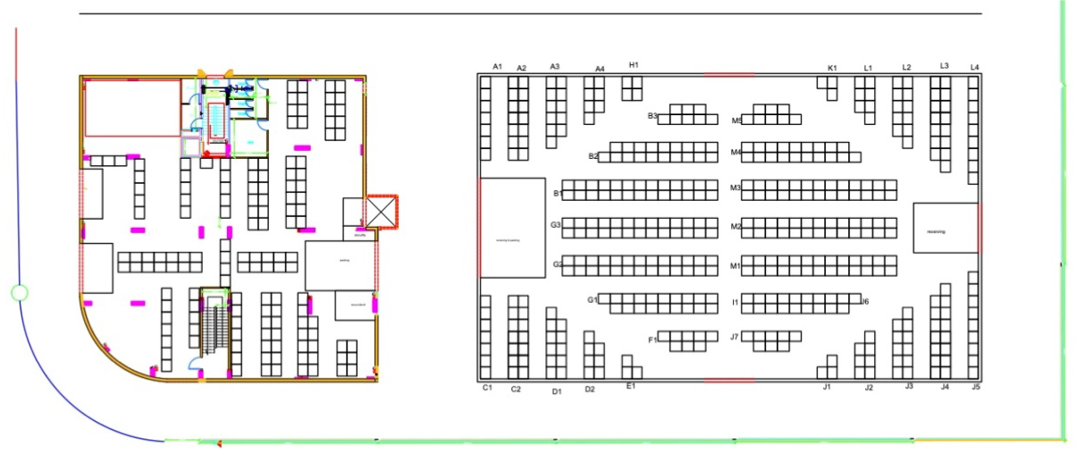
Layout Design
Double Fish-bone outside layout
Capacity: 1756 pallets
Travel distance is very low
Access for the product is very easy
Receiving preparing and shipping
area is high
Safety exist is exist

Slide 26
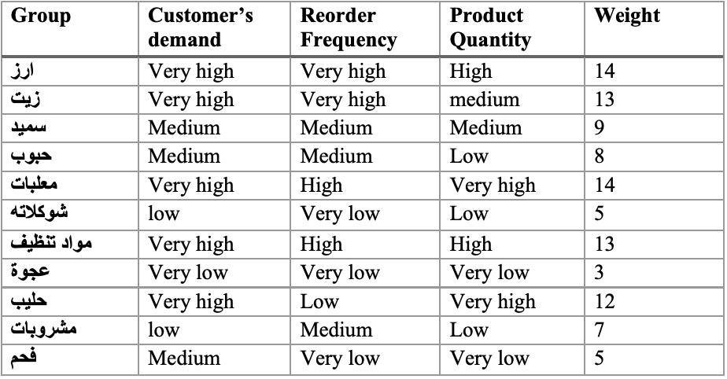
Layout Design
Distribation
Factors and groub analysis

Slide 27
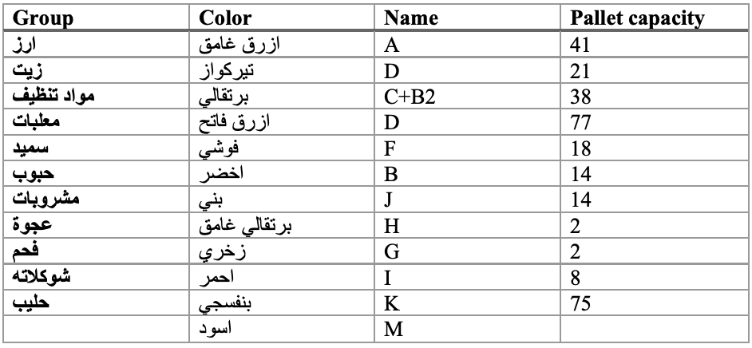
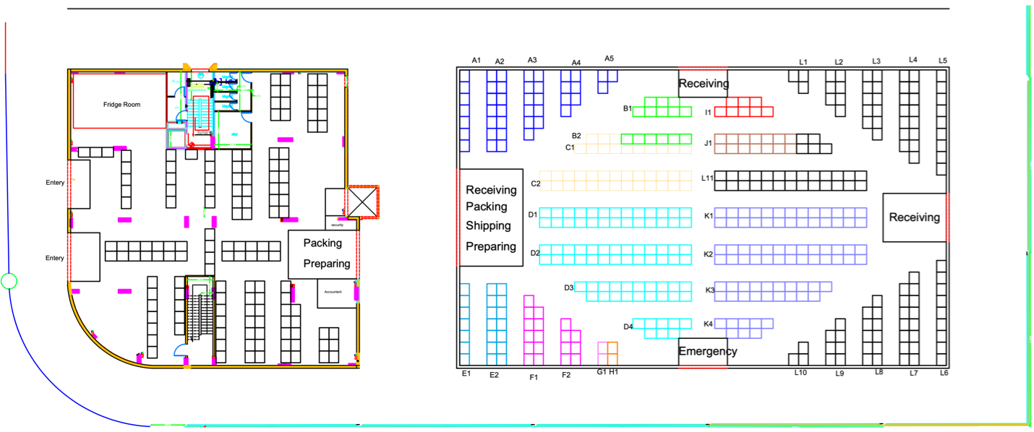
Layout Design
Groub distribuation in the layout

Slide 28
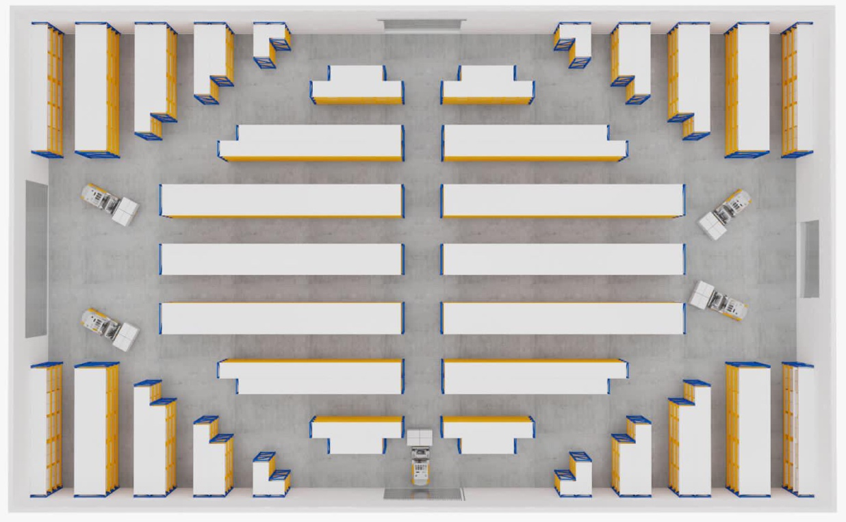
Layout Design
Final 3D design

Slide 29
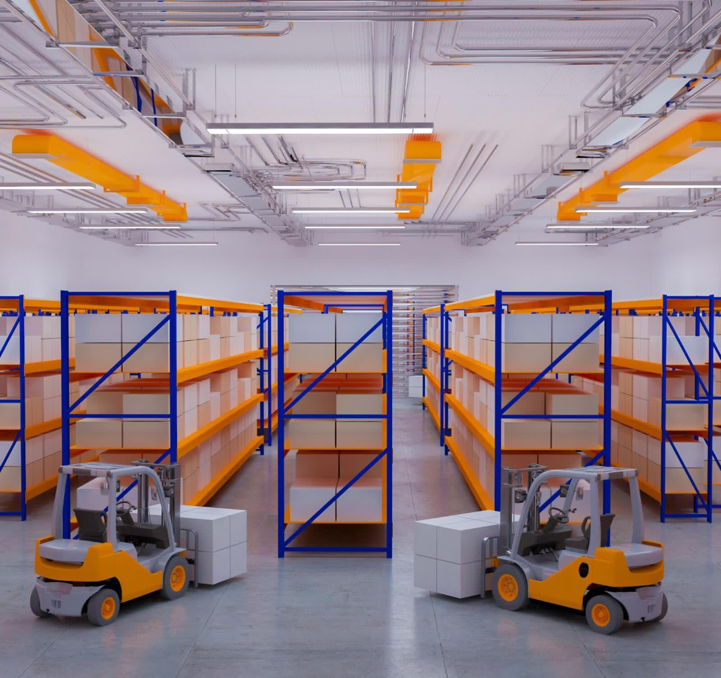
Layout Design

Slide 30
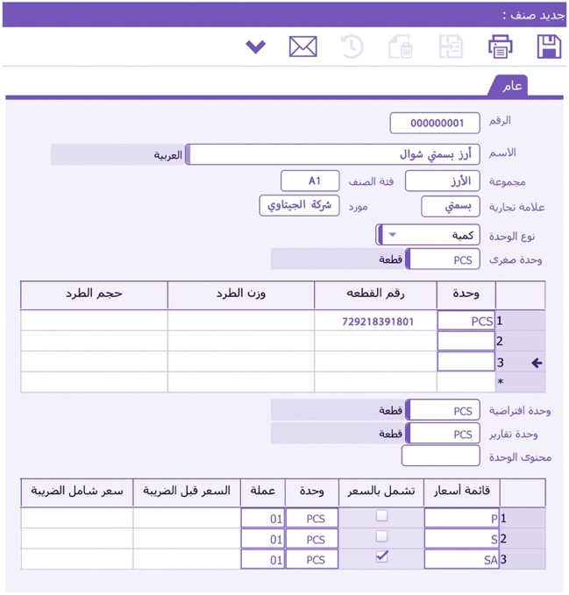
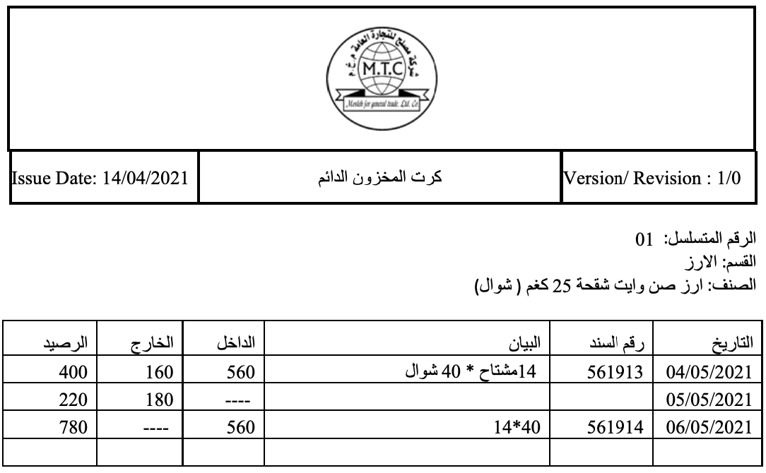
Inventory Management
Recording & Barcoding System
01
02
Item Card
Stock Card

Slide 31
Inventory Management
ABC Classification
A+ items
Cigarettes
High expensive material
A items
Private product import
High recording frequency product
B items
Medium consumption product
C items
Seasonal product
New product

Slide 32
Inventory Management
Order fulfillment procedure

Slide 33
Inventory Management

Slide 34
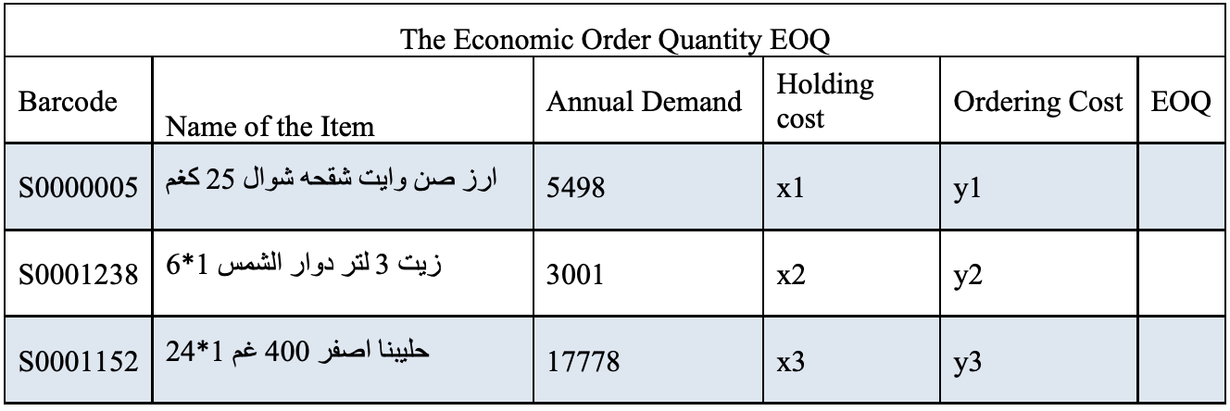
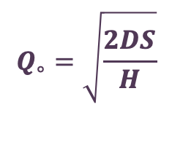
Inventory Management
The Economic Order Quantity
$$Q_{∘}=\sqrt{\frac{2DS}{H}}$$
Determine the optimal order quantity
Minimizing annual costs
Prevent the shortage of goods and run out of stock

Slide 35
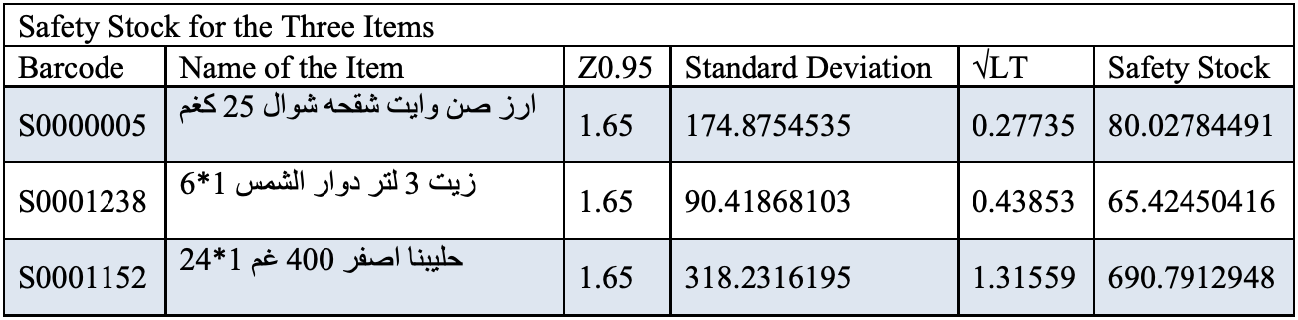

Inventory Management
Safety stock
Avoid stock out during the lead time
Serves as insurance against high unexpected demand
covers the demand until the next batch of order
$$Zσ_{dLT}=Z σ_{d}\sqrt{LT}$$

Slide 36
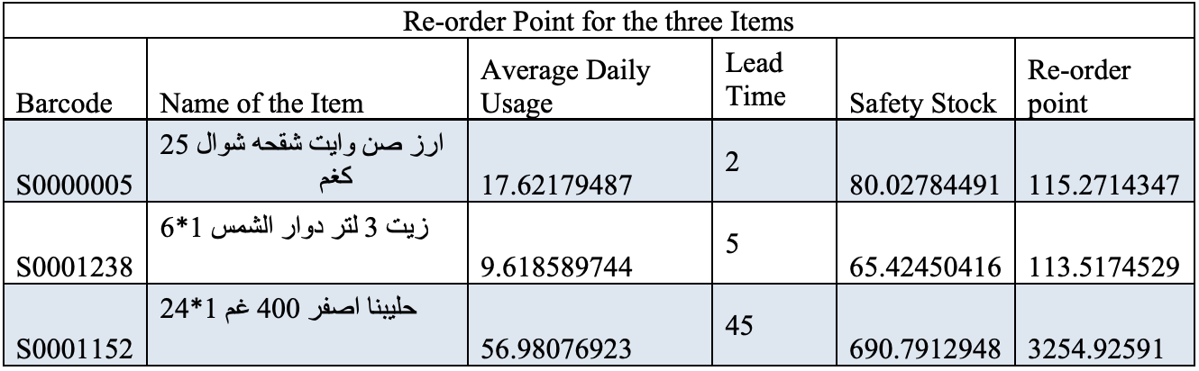

Inventory Management
Re-ordering Point
Proper time to order
avoid the stock out
Save money
$$O_{P}=DDLT+SS$$

Slide 37
Safety System
Benefits of safety system
Reduce the number of deflect product
Increase the efficiency of workers
Decrease the number of accidents

Slide 38
Safety System
Good ventelation
Proper storage system dimension
Provide warning safety sings
Using material handling equipment
Safety
Procedure
Provide safety tools
Train worker how to use equipment
Loading and unloading instruction
Continues maintainance for equipment

Slide 39
Conclusion
01
06
Different type of modern layout was designed – Double fishbone layout
Available capacity was higher than needed capacity
Modern inventory management system is established
Recording and barcoding system were added to the system
Order fulfilment procedure was created
Safety system was set for both product and employs
Existing situation is costly and time consuming
Existing system isn’t connected to scientific concepts and based on experience
Inventory management is inconsistent with standards
Data were collected, analyzed and sorted into seven groups
Modern material handling system were selected
07
02
08
03
09
04
10
05
11

Slide 40
Recommendation
01
06
Use Double Fish-Bone layout.
New modern forklift.
Computerized system.
Follow the order fulfillment procedure.
Commit to safety rules and follow safety procedure.
ISO certification.
Utilize the extra capacity.
Exploit the inside warehouse to be an order preparing room.
Show room has to involve all the product.
The old storehouse can be used to store the large quantity products.
02
07
03
08
04
09
05
10

Slide 41
Thanks
Any Question?

