Slide 1
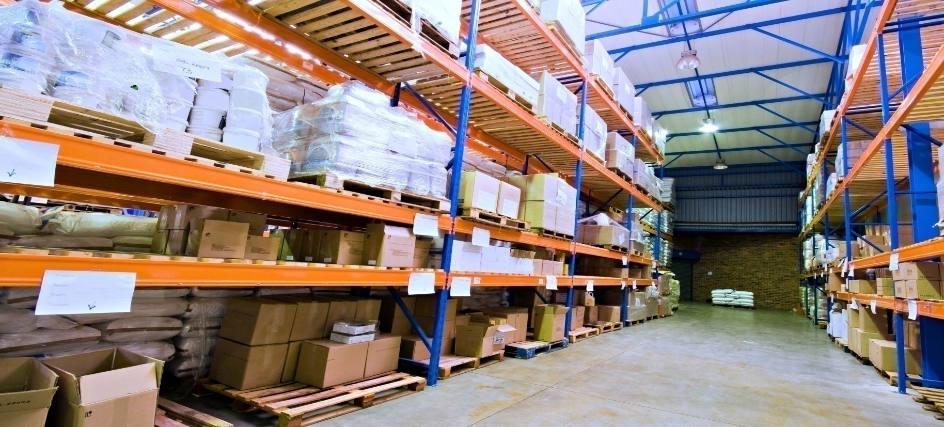

Inventory Management at JPHARM
2014

Slide 2
IE. Nawal Odeh
IE. Ola Odeh
IE. Qasem Al Qasem
IE. Ruba Daraghmah
Team Members

Slide 3
Outline
Introduction
Methodology
Results and analysis
Conclusion

Slide 4
Introduction

Slide 5

Jerusalem Pharmaceutical Company (JPHARM)
Established in 1969, after a while has expanded across the Arab region
Now has two more branches in Jordan and Algeria, with a total capital now of 6,000,000JD
Listed in Palestine Stock Exchange as a public shareholding company

Slide 6
Problems
Insufficient purchasing quantities
Lack of priorities of inventory items
Excessive quantities in stores
Delays in receiving orders due to political issues

Slide 7
Objectives
Stock optimization
Lower levels of Inventory
Greater levels of Stock Turnover
Identifying gaps in inventory system
Improved delivery and sales performance
Cost and space reduction

Slide 8
Methodology

Slide 9
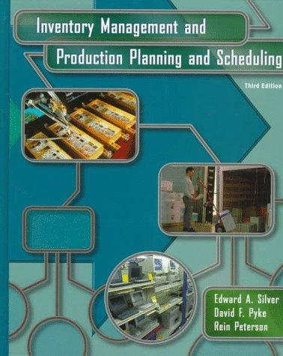
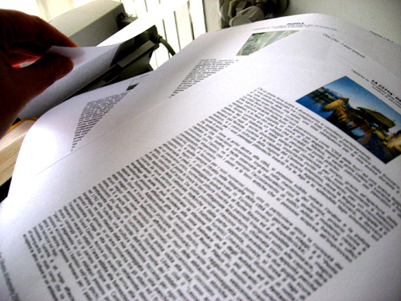

Slide 10
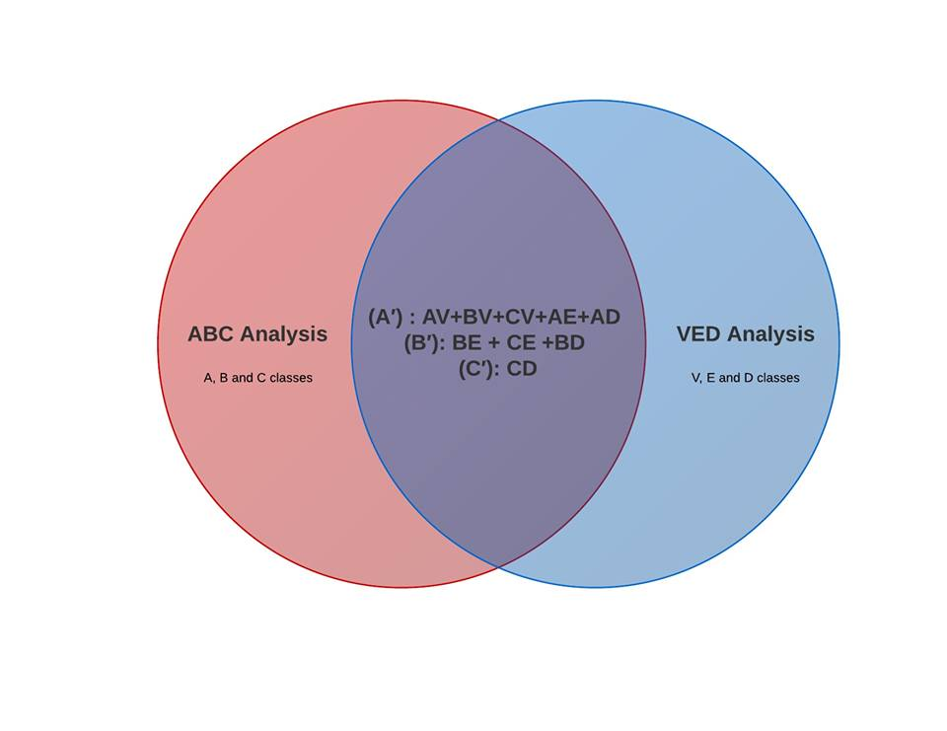
ABC,VED & Combination

Slide 11
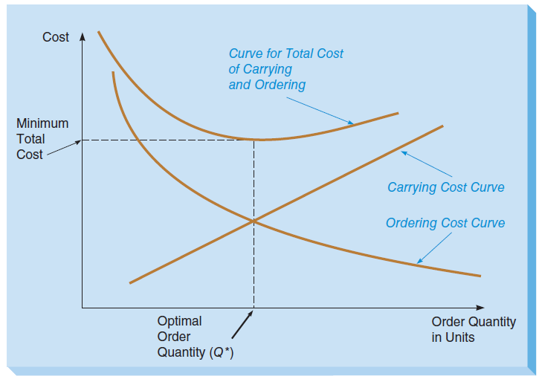

Economic Order Quantity with Leveled Demand
Economic Order Quantity
Is the quantity that minimizes
the total cost of ordering
and carrying inventory
Ordering cost
Carrying cost

Slide 12
Policies
Continuous Review
A item
(s , S)
Continuous Review
B item
(s , Q)
Periodic Review
A item
(R ,s , S)
Periodic Review
B item
(R , S)

Slide 13
Safety Stock (Based on Service Level)
Often called the cycle service level.
(P1) probability of no stock out per replenishment cycle
Notes:
Specifying a way of costing a shortage and then minimizing total cost.

Slide 14
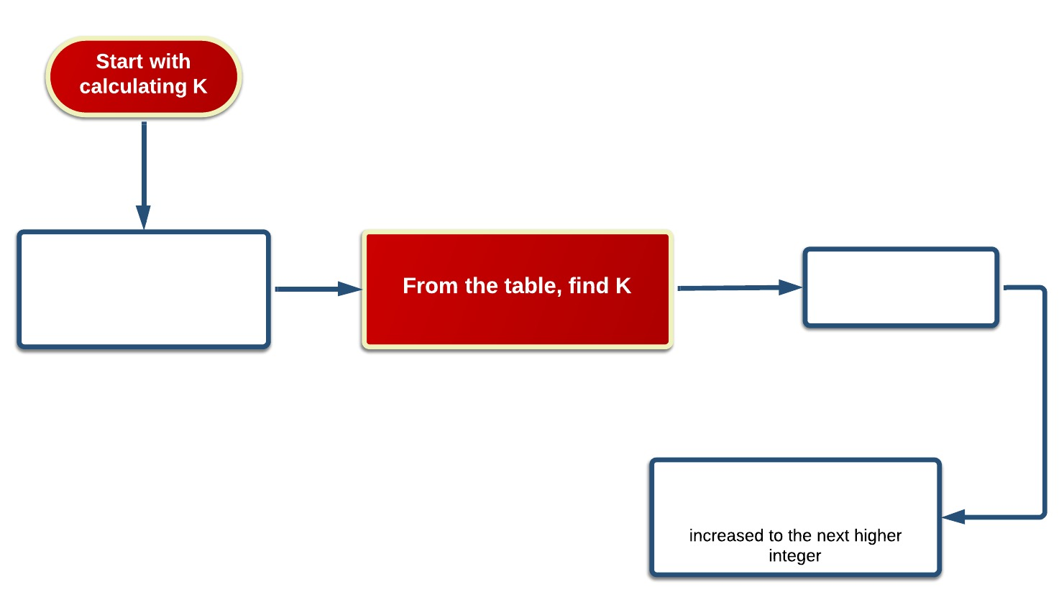
Start with identifying P1
k: safety factor
P1: service level
𝜎L: standard deviation of demand errors
15

Slide 15
Results and analysis

Slide 16
ABC & VED classification
NIS Usage : Unit cost * Annual demand
List ABC and VED items
Find Cumulative %
% NIS usage = NIS usage for each item / Total NIS usage
Sorting %NIS usage for ABC OR lead Time for VED in descending order

Slide 17
ABC Analysis
NIS usage analysis | Category |  |  | Total
 | A | B | C
Total annual consumption % | 70 | 20 | 10 | 100
Value of annual consumption | 820179.3 | 247044.2 | 116474.7 | 1183698
No. of items | 11 | 11 | 36 | 58
% of items | 26.54 | 16.24 | 57.22 | 100

Slide 18
ABC Items
A items
Item # | R.M name
44 | BOX FLU, 20 TABLETS
16 | Ibuprofen Powder
54 | Bottle PET 125mL Brown, 28mm
42 | BOX TRUFEN 75 ML SUSPENTION
43 | BOX TRUFEN 400 MG, 20 TABLETS
55 | Measusring Cup, 15 mL Graduate
53 | Cap Alum 28mm Printed , Glass Bottles
57 | PVC 250mm/250Mic Clear
58 | ALUMINUM FOIL 250mm/25 mic Silver
3 | Avicel PH 102 (Microcrystaline Cellulose)
29 | Sugar Crystal
B items
Item # | R.M name
23 | Phenylephrine Hydrochloride
1 | Acdisol (Crosscarmellose)
27 | Sorbitol Liquid 70%
50 | LEAFLET A/E TRUFEN
45 | Cartoon Brown 34X28X14FOR SYRUP
17 | Ibuprofen Micronized Powder
15 | Glycerin
6 | CaffieneAnhydrouse
22 | Paracetamol Powder
52 | LABEL TRUFEN, 75 mL SUSPENTSION
20 | Flavour Orange Powder 74388

Slide 19
C items
Item # | R.M name
34 | Witepsol H 15
10 | Dextromethorphan Hydrobromide
40 | BOX STAND FLU, 36 BOX
19 | Methocel E-5
56 | Shells SUPPOSITORIES, DICLOFEN 75mg
2 | AEROSIL 200 POWDER
21 | Paracetamol DC 96%
4 | Avicel RC 591 (Microcrystaline Cellulose)
46 | Cartoon Brown 26/27/29 TABLETS
41 | BOX OTAMOL 500MG, 20 TABLETS
39 | BOX DICLOFEN 75MG, 10 SUPPOSITORIES
51 | LEAFLET A/E FLU
36 | P.V.P. K-25
47 | Cartoon Brown 425/33/27(9*60)
35 | Xanthan Gum Powder
8 | Chlorphenramine Maleate
C items
Item # | R.M name
28 | Starch Maize
30 | Talc
18 | MAGNES. STEARATE POWDER
31 | Titanium Dioxide
49 | LEAFLET A/E OTAMOL TABLETS
11 | DICLOFENAC SOD. FINE POWD
48 | LEAFLET A/E DICLOFEN
7 | Carboxymethylcellulose Sodium
25 | Simethicone Emulsion 30%
32 | TITRIPLEX III E.D.T.A
26 | Sodium Benzoate
24 | POLYETHYLENE GLYCOL 400
33 | Tween 80
9 | Citric Acid Anhdrouse
14 | Food Colour Sunset Yellow
37 | YELLOW TARTRAZINE
13 | Food Colour Ponceu Red
12 | ETHYL ALCOHOL 95%ENTE
5 | B.H.T.
38 | WATER PURIFIED

Slide 20
VED Analysis
NIS usage analysis | Category |  |  | Total
 | V | E | D
% of items | 10 | 40 | 50 | 100
Value of annual consumption | 324798.7 | 444599.6 | 414299.8 | 1183698
No. of items | 10 | 26 | 22 | 58
Total annual consumption % | 27.44 | 37.56 | 35 | 100

Slide 21
VED Items
V items
Item # | R.M name
34 | Witepsol H 15
56 | Shells SUPPOSITORIES, DICLOFEN 75mg
1 | Acdisol (Crosscarmellose)
3 | Avicel PH 102 (Microcrystaline Cellulose)
4 | Avicel RC 591 (Microcrystaline Cellulose)
11 | DICLOFENAC SOD. FINE POWD.
16 | Ibuprofen Powder
17 | Ibuprofen Micronized Powder
18 | MAGNES. STEARATE POWDER
19 | Methocel E-5
D items
Item # | R.M name
26 | Sodium Benzoate
31 | Titanium Dioxide
32 | TITRIPLEX III E.D.T.A
33 | Tween 80
37 | YELLOW TARTRAZINE
45 | Cartoon Brown 34X28X14FOR SYRUP
46 | Cartoon Brown 26/27/29 TABLETS
47 | Cartoon Brown 425/33/27(9*60)
48 | LEAFLET A/E DICLOFEN
49 | LEAFLET A/E OTAMOL TABLETS
50 | LEAFLET A/E TRUFEN.
51 | LEAFLET A/E FLU.
52 | LABEL TRUFEN, 75 mL SUSPENTSION
2 | AEROSIL 200 POWDER.
27 | Sorbitol Liquid 70%
28 | Starch Maize
29 | Sugar Crystal
30 | Talc
38 | WATER PURIFIED
53 | Cap Alum 28mm Printed , Glass Bottles
54 | Bottle PET 125mL Brown, 28mm
55 | Measusring Cup, 15 mL Graduate

Slide 22
E items
Item # | R.M name
21 | Paracetamol DC 96%
22 | Paracetamol Powder
35 | Xanthan Gum Powder
36 | P.V.P. K-25
58 | ALUMINUM FOIL 250mm/25 mic Silver
8 | Chlorphenramine Maleate
10 | Dextromethorphan Hydrobromide
15 | Glycerin
20 | Flavour Orange Powder 74388
23 | Phenylephrine Hydrochloride
39 | BOX DICLOFEN 75MG, 10 SUPPOSITORIES.
40 | BOX STAND FLU, 36 BOX
41 | BOX OTAMOL 500MG, 20 TABLETS.
42 | BOX TRUFEN 75 ML SUSPENTION.
E items
Item # | R.M name
43 | BOX TRUFEN 400 MG, 20 TABLETS.
44 | BOX FLU, 20 TABLETS.
57 | PVC 250mm/250Mic Clear
5 | B.H.T.
6 | CaffieneAnhydrouse
7 | Carboxymethylcellulose Sodium
9 | Citric Acid Anhdrouse
12 | ETHYL ALCOHOL 95%ENTE
13 | Food ColourPonceu Red
14 | Food Colour Sunset Yellow
24 | POLYETHYLENE GLYCOL 400
25 | Simethicone Emulsion 30%

Slide 23
ABC & VED Combination Analysis
NIS usage analysis | Category |  |  | Total
 | Class I | Class II | Class III
% of items | 30 | 30 | 40 | 100
Value of annual consumption | 339865.9 | 467726.9 | 376105.4 | 1183698
No. of items | 13 | 20 | 25 | 58
Total annual consumption % | 63.1 | 15.47 | 21.51 | 100

Slide 24
Combination Items
Class 1 items
Item # | R.M name
1 | Acdisol (Crosscarmellose)
3 | Avicel PH 102 (Microcrystaline Cellulose)
16 | Ibuprofen Powder
23 | Phenylephrine Hydrochloride
29 | Sugar Crystal
42 | BOX TRUFEN 75 ML SUSPENTION.
43 | BOX TRUFEN 400 MG, 20 TABLETS.
44 | BOX FLU, 20 TABLETS.
53 | Cap Alum 28mm Printed , Glass Bottles
54 | Bottle PET 125mL Brown, 28mm
55 | Measusring Cup, 15 mL Graduate
class2 items
Item # | R.M name
2 | AEROSIL 200 POWDER.
4 | Avicel RC 591 (Microcrystaline Cellulose)
6 | CaffieneAnhydrouse
10 | Dextromethorphan Hydrobromide
15 | Glycerin
17 | Ibuprofen Micronized Powder
19 | Methocel E-5
20 | Flavour Orange Powder 74388
21 | Paracetamol DC 96%
22 | Paracetamol Powder
27 | Sorbitol Liquid 70%
34 | Witepsol H 15
39 | BOX DICLOFEN 75MG, 10 SUPPOSITORIES.
40 | BOX STAND FLU, 36 BOX
41 | BOX OTAMOL 500MG, 20 TABLETS.
45 | Cartoon Brown 34X28X14FOR SYRUP
46 | Cartoon Brown 26/27/29 TABLETS
50 | LEAFLET A/E TRUFEN.
52 | LABEL TRUFEN, 75 mL SUSPENTSION
56 | Shells SUPPOSITORIES, DICLOFEN 75mg

Slide 25
class3 items
Item # | R.M name
5 | B.H.T.
7 | Carboxymethylcellulose Sodium
8 | Chlorphenramine Maleate
9 | Citric Acid Anhdrouse
11 | DICLOFENAC SOD. FINE POWD.
12 | ETHYL ALCOHOL 95%ENTE
13 | Food ColourPonceu Red
14 | Food Colour Sunset Yellow
18 | MAGNES. STEARATE POWDER
24 | POLYETHYLENE GLYCOL 400
25 | Simethicone Emulsion 30%
26 | Sodium Benzoate
28 | Starch Maize
30 | Talc
31 | Titanium Dioxide
class3 items
Item # | R.M name
32 | TITRIPLEX III E.D.T.A
33 | Tween 80
35 | Xanthan Gum Powder
36 | P.V.P. K-25
37 | YELLOW TARTRAZINE
38 | WATER PURIFIED
47 | Cartoon Brown 425/33/27(9*60)
48 | LEAFLET A/E DICLOFEN
49 | LEAFLET A/E OTAMOL TABLETS
51 | LEAFLET A/E FLU.
32 | TITRIPLEX III E.D.T.A
33 | Tween 80
35 | Xanthan Gum Powder
36 | P.V.P. K-25
37 | YELLOW TARTRAZINE
38 | WATER PURIFIED
47 | Cartoon Brown 425/33/27(9*60)
48 | LEAFLET A/E DICLOFEN

Slide 26
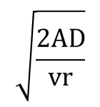

Inventory Controls Decisions
EOQ
Safety Stock
ROP
Time Between Order
Demand*lead time + SS
EOQ/ Demand
z$∗ σ∗\sqrt{l}$

Slide 27
Class I
Item # | EOQ
1 | 191.89
3 | 818.04
16 | 909.74
23 | 14.79
. | .
. | .
Item # | ROP
1 | 162.01
3 | 351.56
16 | 730.02
23 | 82.99
. | .
. | .
Item # | Safety Stock
1 | 114.64
3 | 114.64
16 | 114.64
23 | 81.06
. | .
. | .
Item # | TBO(month)
1 | 9.35
3 | 7.97
16 | 3.41
23 | 8.88
. | .
. | .

Slide 28
Class II
Item # | EOQ
2 | 64.85
4 | 98.11
6 | 25.47
10 | 10.67
. | .
. | .
Item # | ROP
2 | 8.05
4 | 127.26
6 | 60.20
10 | 82.02
. | .
. | .
Item # | Safety Stock
2 | 8.05
4 | 114.64
6 | 57.32
10 | 81.06
. | .
. | .
Item # | TBO(month)
2 | 8.06
4 | 17.94
6 | 5.09
10 | 12.80
. | .
. | .

Slide 29
Class III
Item # | EOQ
5 | 0.0680
7 | 49.95
8 | 13.46
9 | 103.41
. | .
. | .
Item # | ROP
5 | 57.32
7 | 58.22
8 | 81.45
9 | 58.45
. | .
. | .
Item # | Safety Stock
5 | 57.32
7 | 57.32
8 | 81.06
9 | 57.32
. | .
. | .
Item # | TBO(month)
5 | 12.00
7 | 31.97
8 | 40.58
9 | 52.94
. | .
. | .

Slide 30
Conclusion

Slide 31
Holding Cost Reduction
480000
NIS
122000
NIS
360000
NIS

Slide 32
Lower levels of Inventory
Zero Safety Stock!
Sugar Crystal
Talc and WATER PURIFIED
Starch Maize
Bottle PET 125mL Brown
Measuring Cup, 15 ml Graduate
AEROSIL 200 POWDER
Cap Alum 28mm

Slide 33

Your Vision, Our Passion!
StockSol

Slide 34
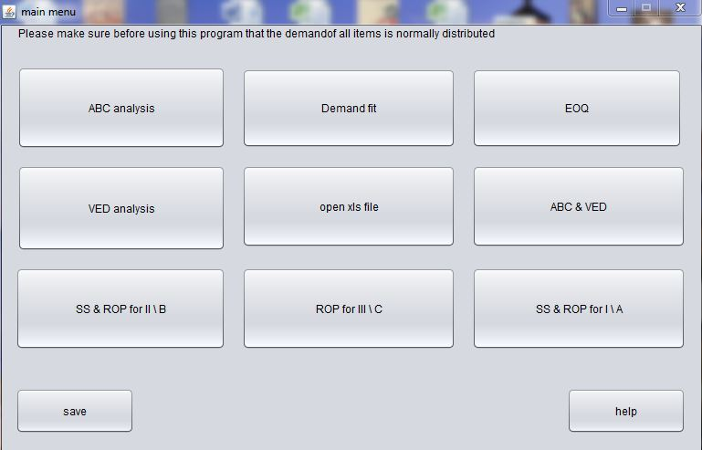
Main Menu

Slide 35
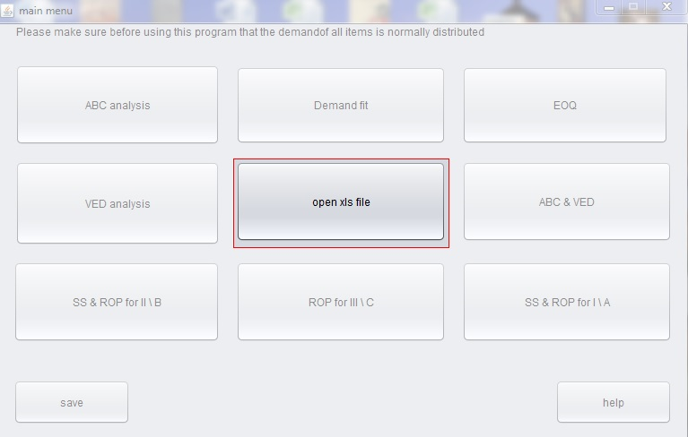
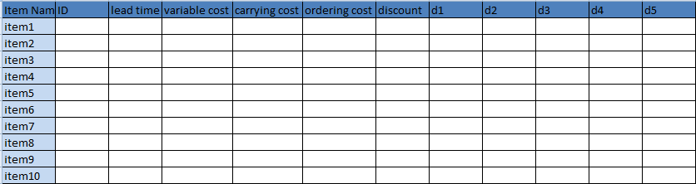
Input Button
Excel Sheet

Slide 36
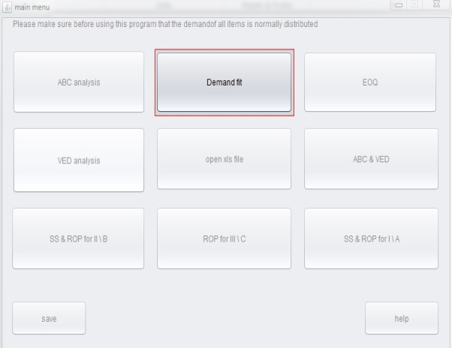
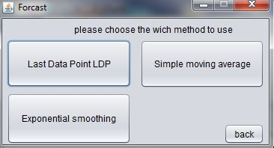
Demand Forecasting Button
Forecast
Simple Moving Average
Graph
Last Data Point
Exponential Smoothing

Slide 37
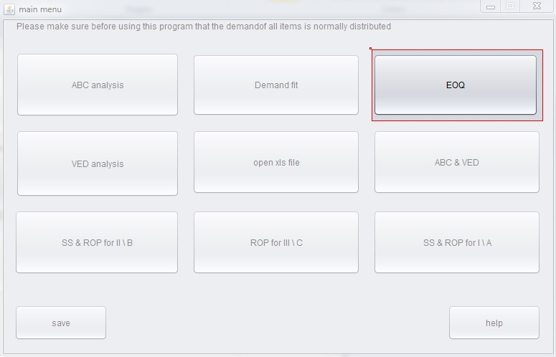
Economic Order Quantity Button

Slide 38
ABC Analysis Button

Slide 39
VED Analysis Button

Slide 40
ABC & VED Combination Button

Slide 41
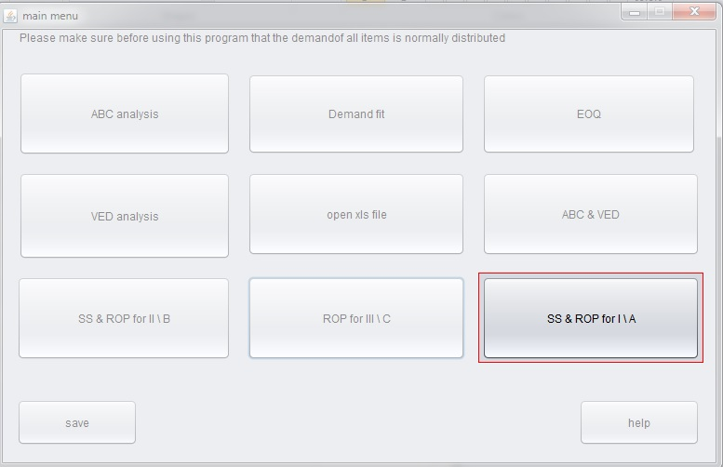


SS & ROP for I/A Button
Management

Slide 42
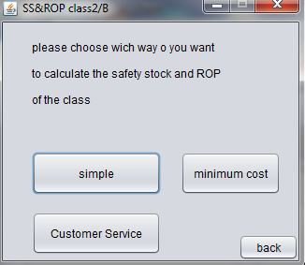
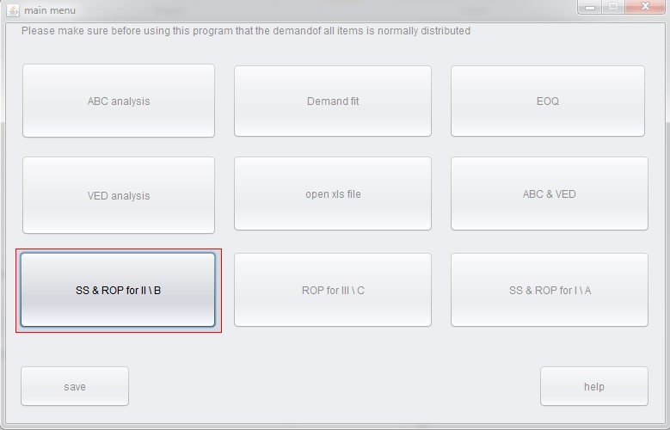
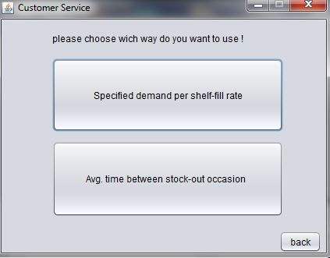
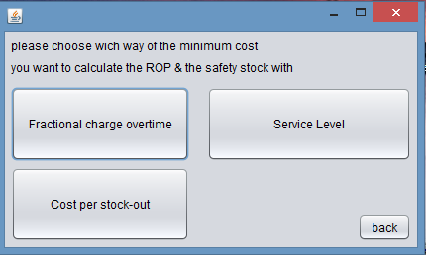
SS & ROP for II/B Button

Slide 43
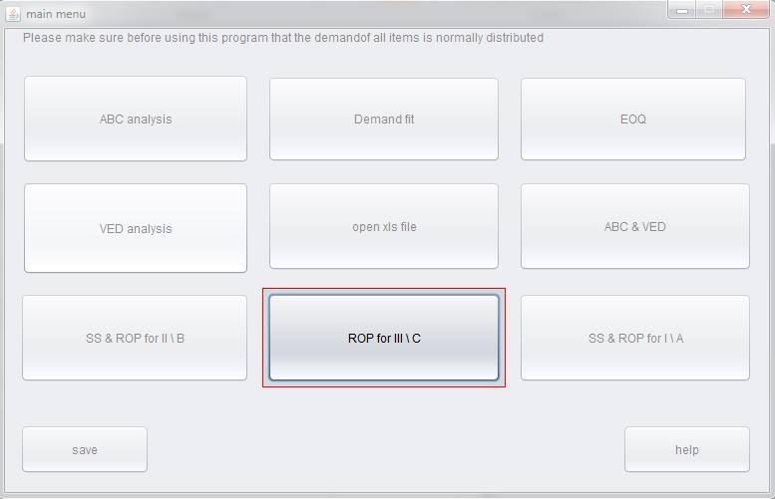
SS & ROP for III/C Button

Slide 44
Thanks for your attention

