Slide 1

An-Najah National University
Faculty of Engineering
Civil Engineering Department
Graduation Project II
Structural Analysis and Design of Al-Mallah building in Nablus city

Slide 2
Prepared by:
Musa’b Imad Fahed
“Mohammad Eyad” Samer Al-Amoudi
Ali Raef Salous
“Mohammad Khaled” Jamal Hennawi
Omar Bassam Shami
Under Supervision of : Dr. Hind Tbaileh
Academic Year: 2021-2022

Slide 3
Outline
General background review
Seismic load analysis and design
Model Verification
Design of the structural element
Limitations

Slide 4
General Background Review

Slide 5
Project Description :
This project is analysis and design Al-Mallah building in Al-Quds street in Nablus
city, This building has five floors, two of them Underground (basement) and Three
above ground . This building includes: Parking garage, Storage and residential
floors.

Slide 6
Floors | Area (m²) | Heights (m) | Cumulative height
Basement 2 | 1043.54 | 2.95 | 2.95
Basement 1 | 1295.61 | 2.95 | 5.9
Ground floor | 1423.15 | 5.55 | 11.45
Floor 1 | 1267.73 | 3.38 | 14.83
Floor 2 | 1267.73 | 3.38 | 18.21
stairs | 80.65 | 3.25 | 21.46

Slide 7
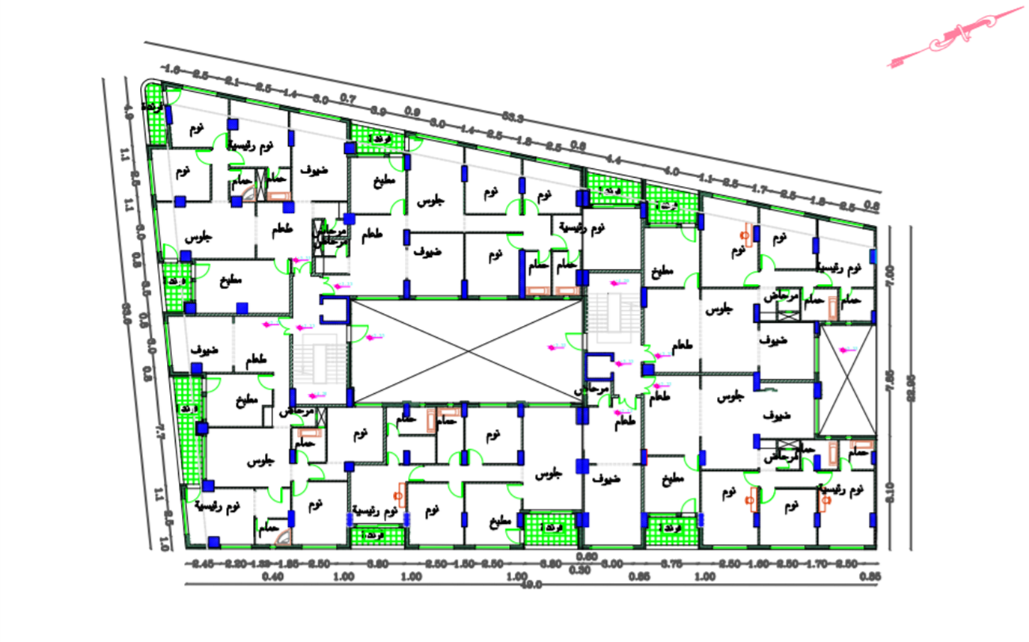
Residential floors Layout

Slide 8
  Codes and standards
  American Society for Civil Engineering (ASCE 7-16).
  American Society for Materials (ASTM).
  American Concrete Institute (ACI 318- 14)
  International Building Code (IBC- 2012).

Slide 9
Computer Software :
ETABS V.19.1 to Build a 3D model for the structure, and to take reinforcing steel results for structural elements.
AutoCAD 2018 to draw plans, and reinforcing details.
Safe 2020 to design the footings

Slide 10
Structural element materials :
    For concrete
    For Steel :
    Materials
Property | Value
Cylindrical Compressive strength ( fc ) | 40 MPa
Modulus of elasticity ( Ec) | 29.725 GPa
Unit weight (Ɣ) | 25 KN/m3
Property | Value
Yielding strength (fy) | 420 MPa
Modulus of elasticity ( Es) | 200 GPa
ASTM

Slide 11
2. Nonstructural element materials :
Material | Unit Weight Ɣ(kN/m3)
Tiles | 25
Blocks | 12
Masonry Stones | 25
Filling Materials | 18
Plaster | 23
Concrete Mortar | 23
ASTM

Slide 12
Loads
The common types of loads on the structures are as follow:
Gravitational loads such as: Live, Dead and Superimposed Dead loads.
Lateral Loads: Soil pressure, Earthquake.

Slide 13
Live load values:
Garages (Passenger cars) | 4 KN/m²
Private rooms and corridors | 2.5 KN/m²
Public rooms and corridors | 5 KN/m²
Storage ware houses | 6 KN/m²
Roof | 5 KN/m²
ASCE 7-2016

Slide 14
Basic service load combinations (IBC-2012):
D
D + L + H
D + (Lr or S or R) + H
D + 0.75L+ 0.75(Lr or Sor R) + H
D + (0.6W or 0.7E) + H
D + 0.75(0.6W) +0.75L+0.75L (Lr or Sor R) + H
D + 0.75(0.7E) +0.75L+0.75S+ H
0.6D + 0.6W+ H
0.6D + 0.7E+ H

Slide 15
Basic ultimate load combinations (IBC-2012):
1.4D
1.2D + 1.6L + 0.5(L_{r} or S or R) + 1.6H
1.2D + 1.6(Lr or S or R) + (f₁L or 0.5W) + 1.6H
1.2D + 1.0W+L+0.5(Lr or Sor R) + 1.6H
1.2D + 1.0E+ L+ 0.2S + 1.6H
0.9D+ 1.0w + 1.6H + 0.9D +1.0E + 1.6

Slide 16
Structural System Design and Analysis.

Slide 17
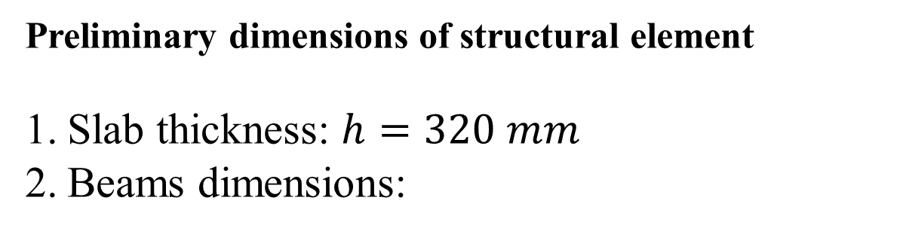
Preliminary dimensions of structural element
Slab thickness: $h=320 mm$
Beams dimensions:
Width (mm) | Depth (mm) | Beam name
1700 | 320 | B1
300 | 320 | B2
900 | 320 | B3
300 | 500 | B4
1300 | 320 | B5
400 | 600 | B6
300 | 300 | B7

Slide 18
3. Columns dimensions:
Name | Dimensions(mm)
C1 | Diameter | 750
 | Length | Width
C2 | 750 | 750
C3 | 650 | 650
C4 | 800 | 800
C5 | 1100 | 400
C6 | 1200 | 400
C7 | 1300 | 400
C8 | 1400 | 400
C9 | 1000 | 400
C10 | 900 | 300
The columns centers layout attach to the hard copy

Slide 19
4.Walls Dimensions:
Thickness (mm) | Wall name | NO.
300 | Retaining wall | W1
200 | Elevator shear wall | W2
400 | Middle shear wall | W3

Slide 20
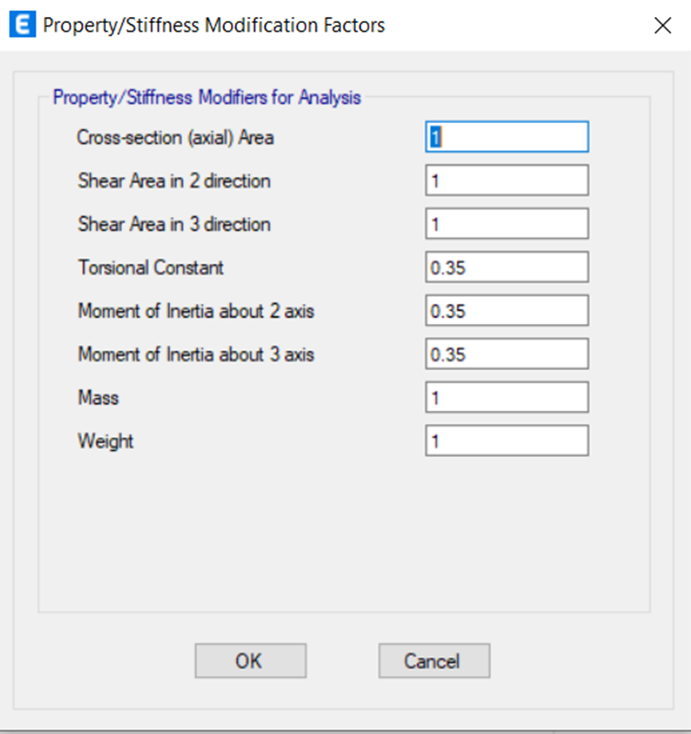
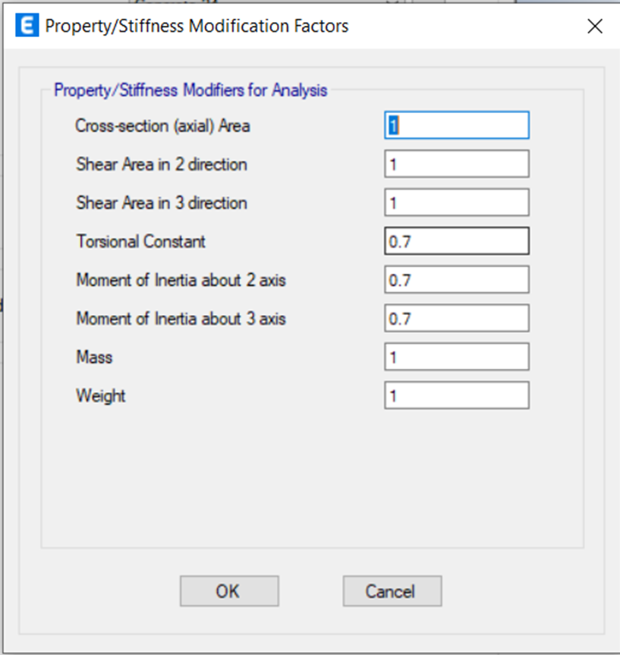
Modifiers For Structural Elements
Beam modifiers
Column and wall modifiers

Slide 21
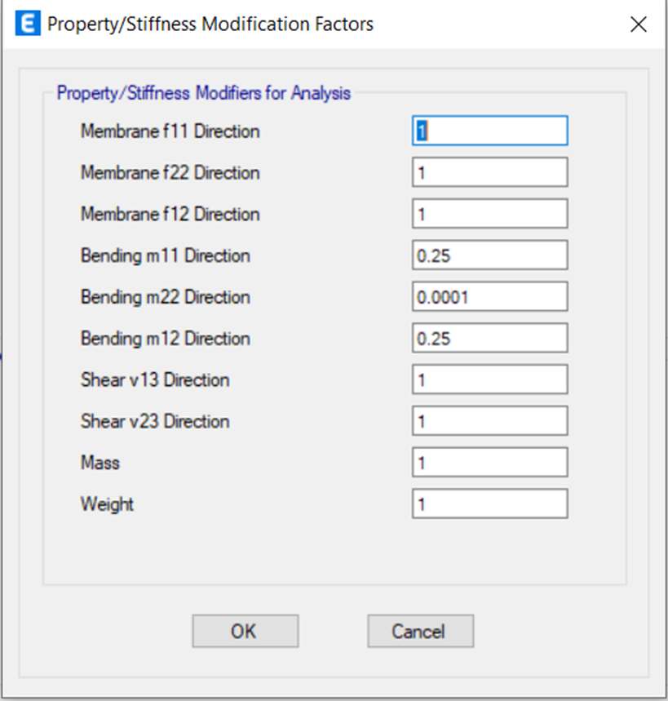
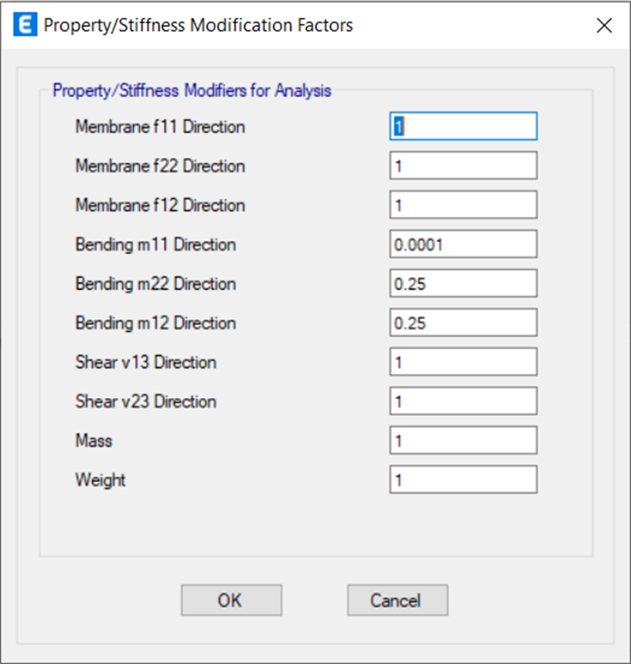
One way X slab modifiers
One way Y slab modifiers

Slide 22
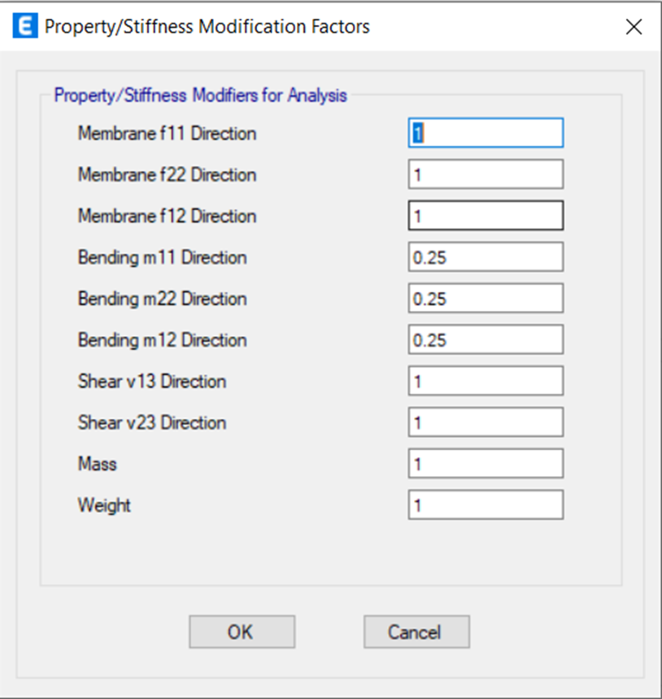
Two way slab modifiers

Slide 23
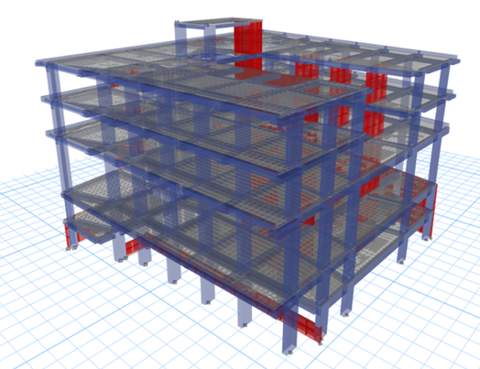
3D Model For The Left Side

Slide 24
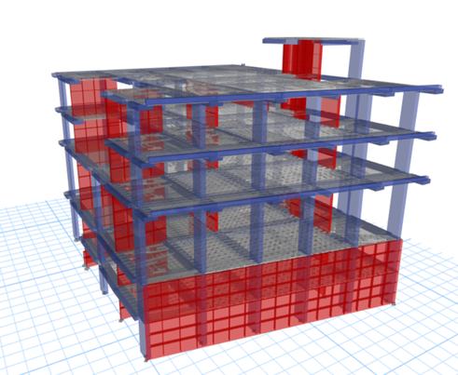
3D Model For The Right Side

Slide 25
Beam Layout

Slide 26
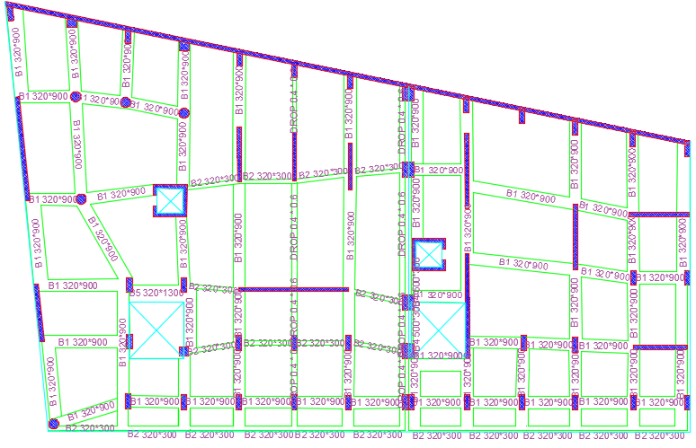

Slide 27
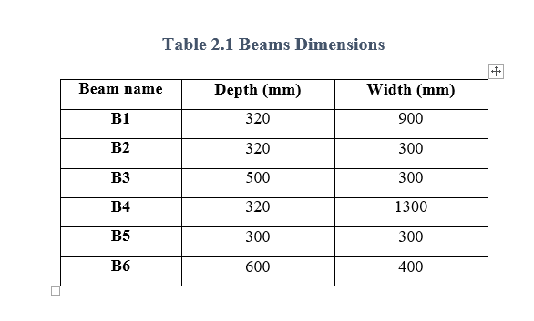
The Actual Dimensions Of Beams

Slide 28
Columns and walls new distribution

Slide 29
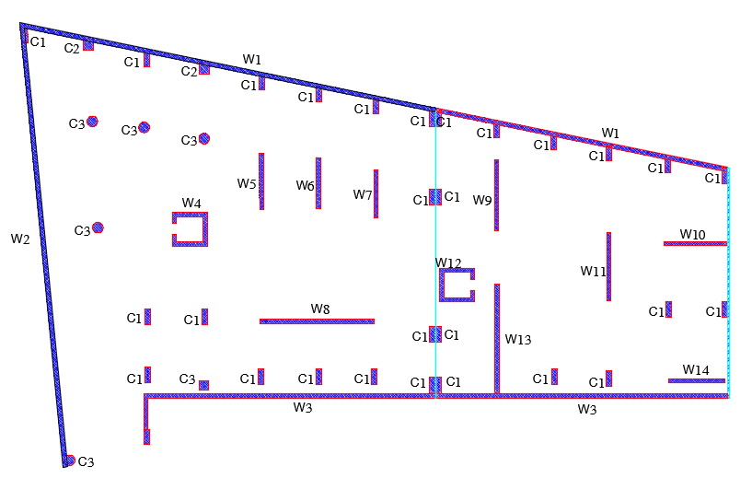
Right Block
Left Block

Slide 30
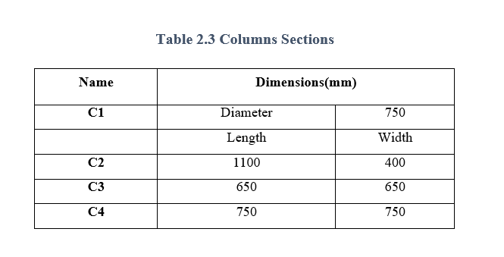
The Actual Dimensions Of Columns

Slide 31
The Actual Dimensions Of Walls
Thickness (mm) | Wall name
300 | Retaining wall
300 | Elevator shear wall
300 | Middle shear wall

Slide 32
Seismic Load Analysis And Design

Slide 33
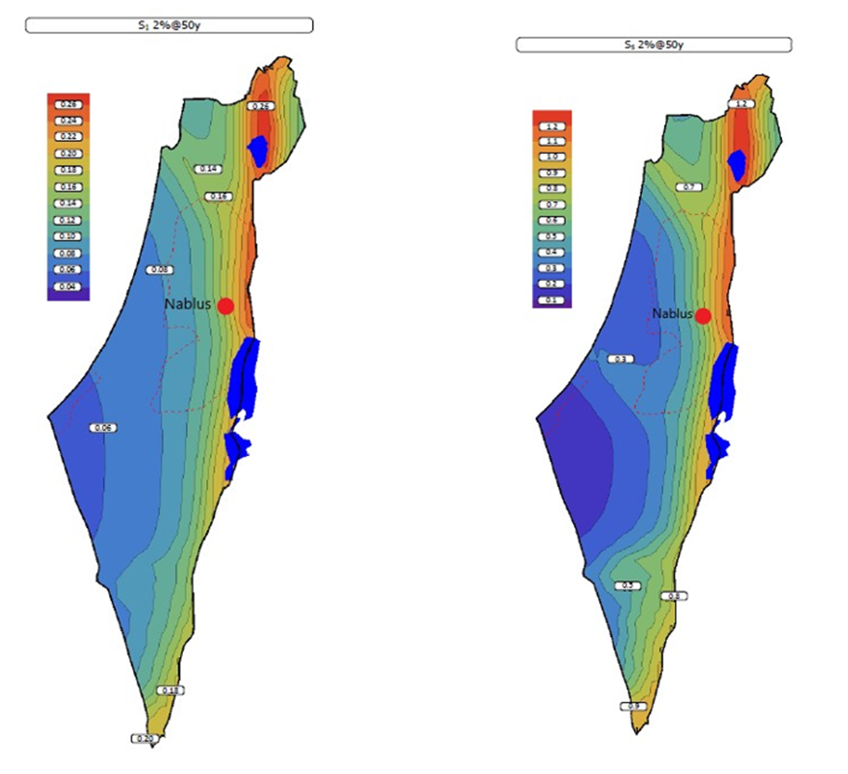
Ss and S1 values:

Slide 34
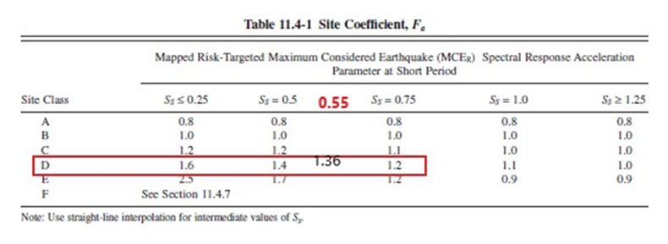
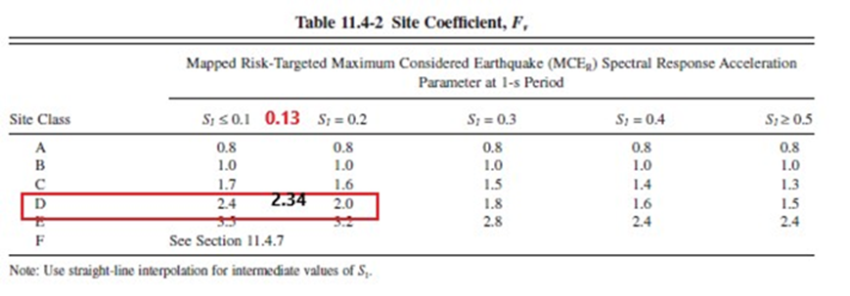
Fa and Fv values:

Slide 35
SDs and SD1 Calculations:
SMs = Fa*Ss = 0.748
SM1= Fv*S1 = 0.3042
SDs = 2/3 SMs = 0.50
SD1 = 2/3 SM1 = 0.2028

Slide 36
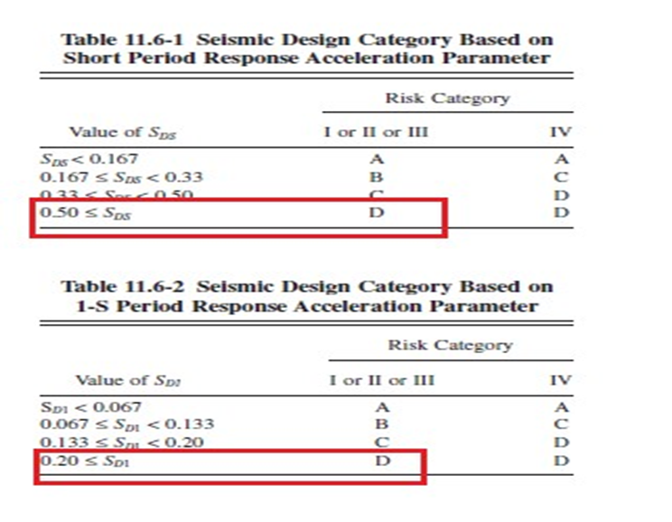
Seismic Design Category

Slide 37
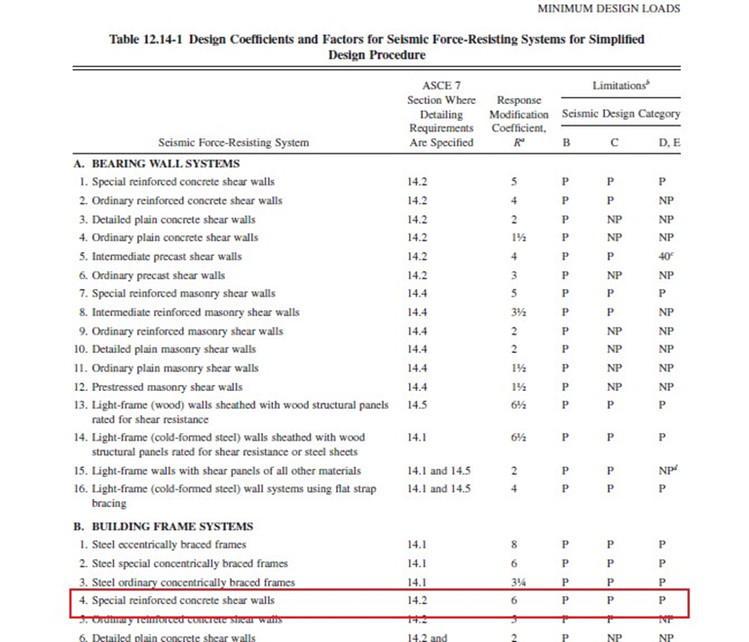
The Design System

Slide 38
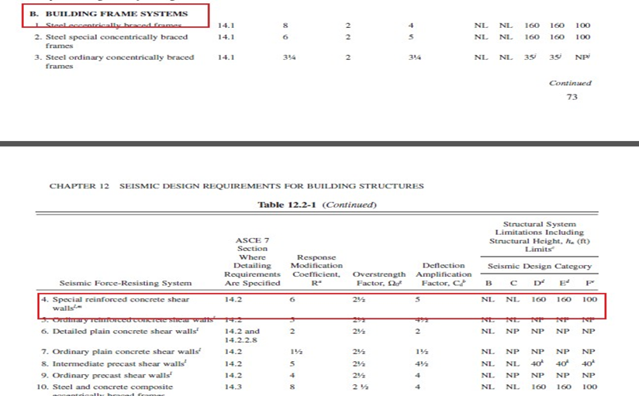
R, Ω and Cd Values

Slide 39
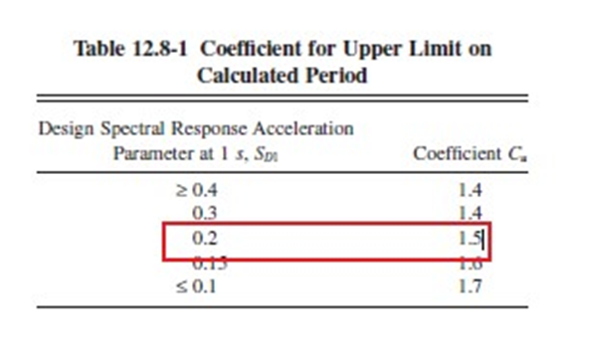
For Calculating The Period
Cu Coefficient

Slide 40
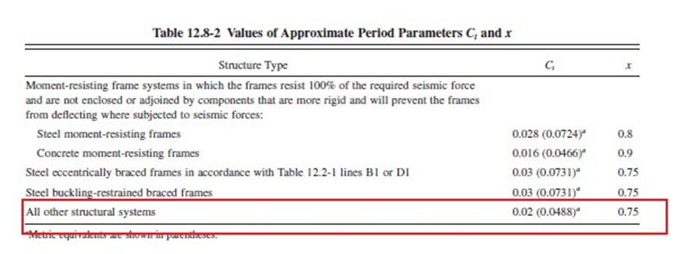
Ct and X Coefficient

Slide 41
Period Calculation
Ta = Ct ×hn ^ x × Cu = 0.0488 × 〖21.46〗 ^ 0.75 × 1.5 = 0.73 sec
Cs = SDs / (R ⁄ Ie)=0.50 / (6 ⁄ 1.25) = 0.104
Cs,max = SD1 / (TR ⁄ Ie) = 0.2028 / (((0.73*6)) ⁄ 1.25) = 0.057
Cs,min = 0.0445 × SDs × Ie = 0.0445 × 0.50 × 1.25 = 0.0275
Since Cs larger than Cs,max then take Cs = Cs,max = 0.057

Slide 42
Definitions of Seismic Parameters

Slide 43
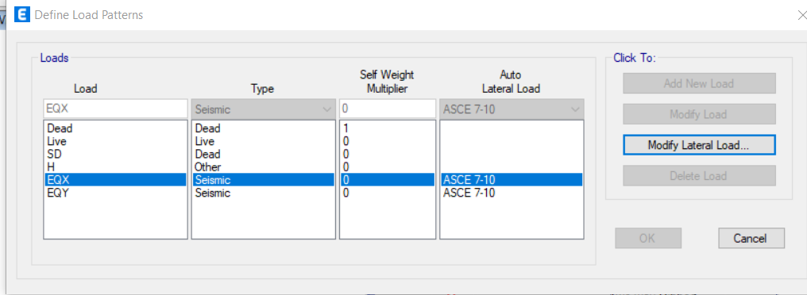
Defining The Seismic Load Pattern

Slide 44
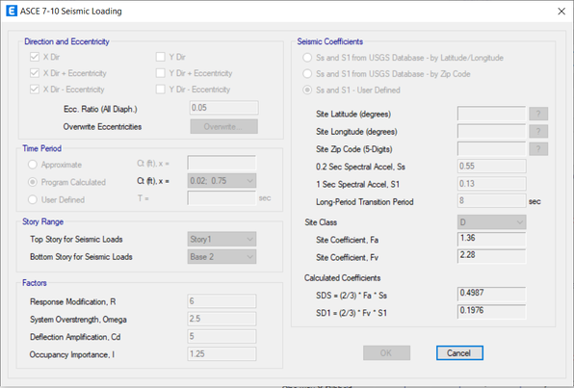
Acceleration Parameters

Slide 45
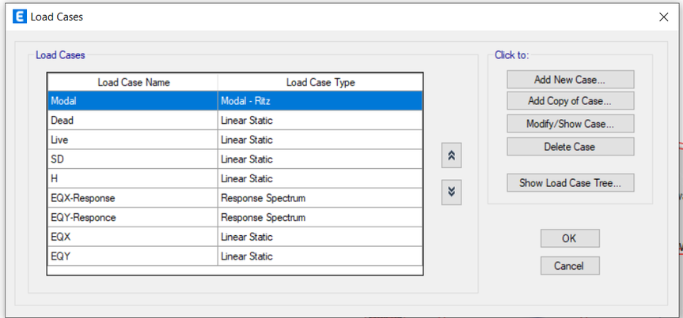
Define The Load Cases

Slide 46
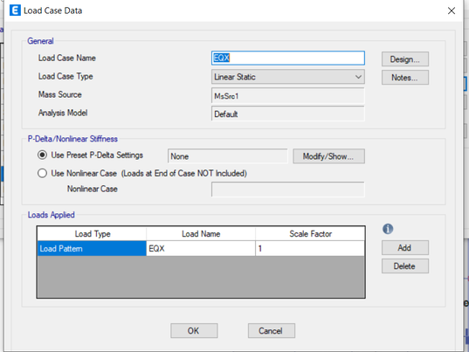
Define The Load Case Data

Slide 47
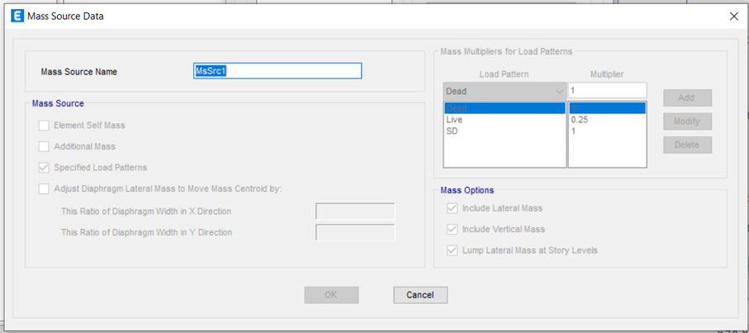
Define The Mass Source Data:

Slide 48
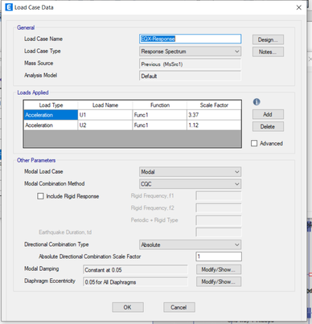
Response Spectrum Data

Slide 49
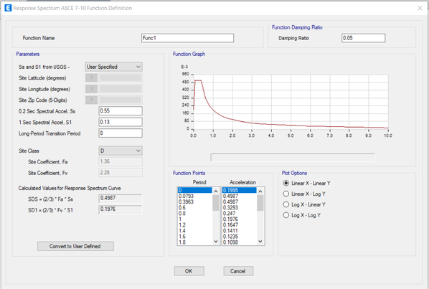
Define The Response Spectrum Function

Slide 50
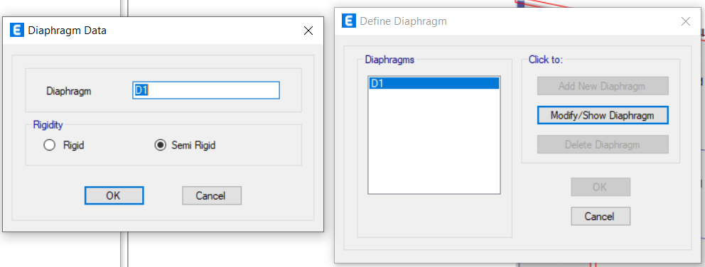
Define The Diaphragm

Slide 51
Model Verifications

Slide 52
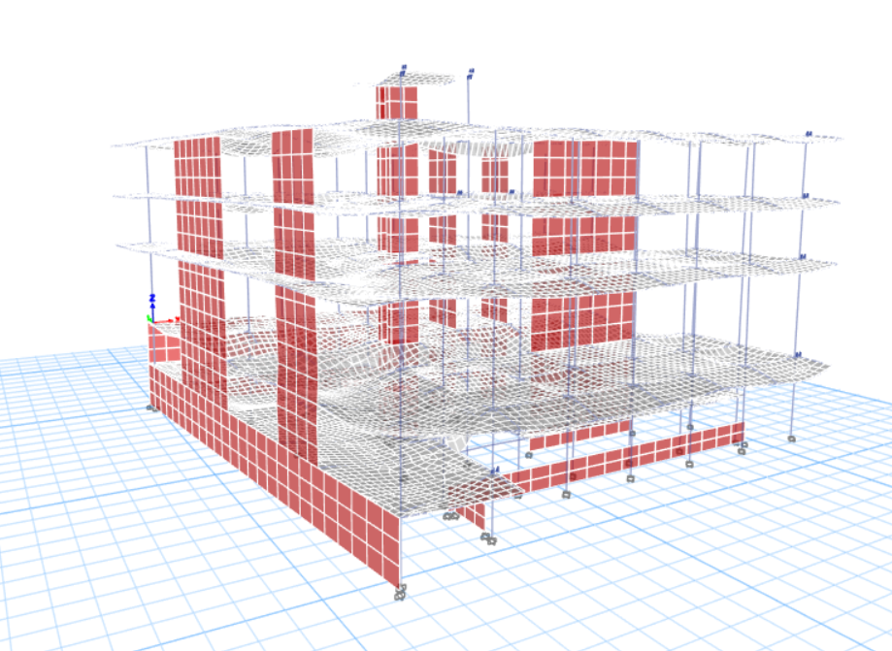
Compatibility Check

Slide 53
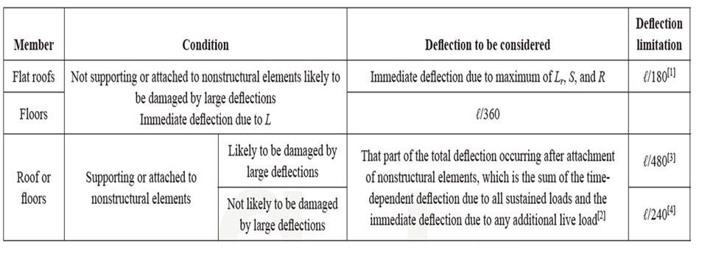
Deflection Check

Slide 54
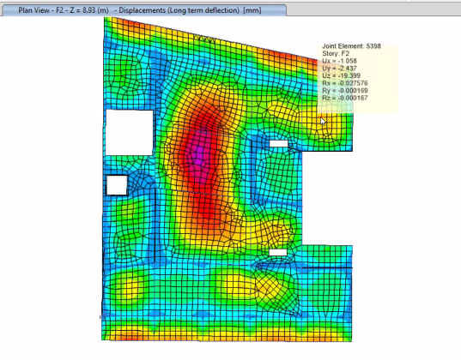

L=4200 mm
$∆all=\frac{L}{240}=\frac{4200}{240}=17.5 mm$
$∆slab=19.4 mm$
$∆beams=\left(3.87,16,7,9\right)mm$
$∆=∆slab−\left(Avg.∆beams\right)=$
=19.4−((3.87+16+7+9)/4)=10.44 𝑚𝑚
$∆≤∆all →OK$

Slide 55
Equilibrium Check
 | Hand | Etabs | Error %
Live Load | 11430.61 | 11502.9846 | 0.63 %
Dead Load | 25586.668 | 24795.2943 | 3.1 %
Super Dead | 12770.18 | 13106.4424 | 2.63 %

Slide 56
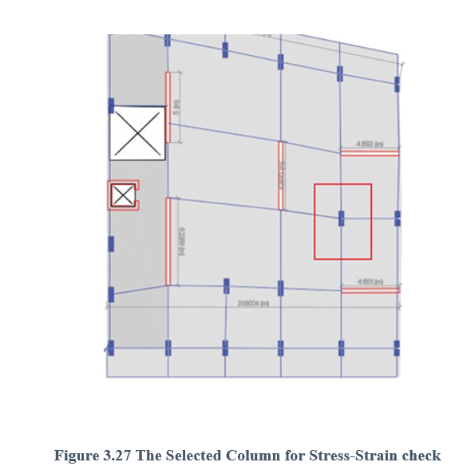
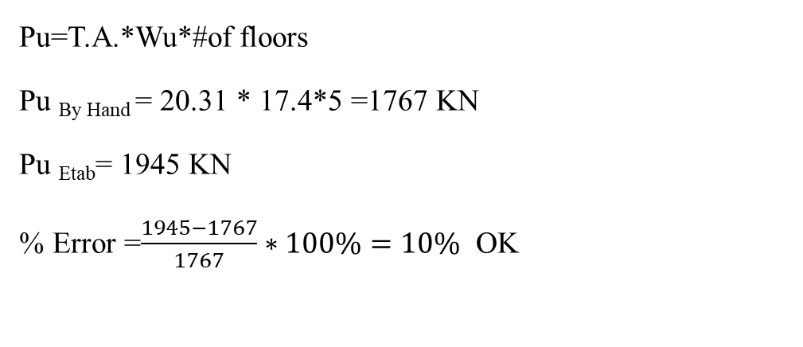
Internal Force Check
For The Column:
Pu=T.A.*Wu*#of floors
Pu _{By Hand} = 20.31 * 17.4*5 =1767 KN
Pu _{Etab}= 1945 KN
% Error =$\frac{1945−1767}{1767}∗100\%=10\%$ OK

Slide 57
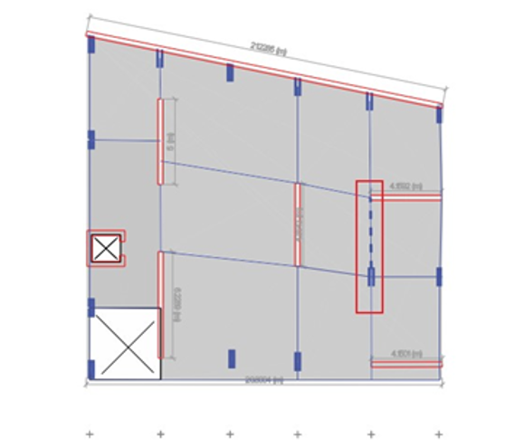
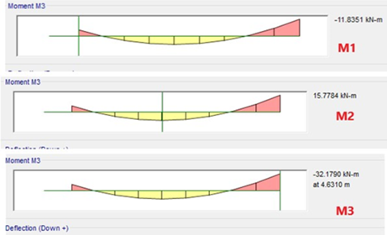
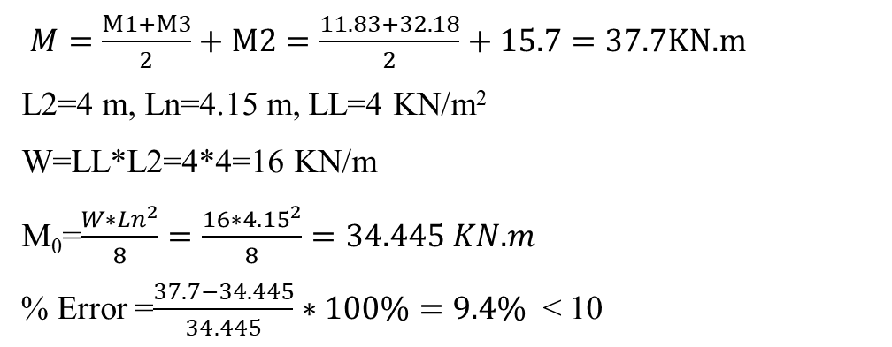
For The Beam:
$M=\frac{M1+M3}{2}+M2=\frac{11.83+32.18}{2}+15.7=37.7KN.m$
L2=4 m, Ln=4.15 m, LL=4 KN/m²
W=LL*L2=4*4=16 KN/m
M₀=$\frac{W∗{Ln}^{2}}{8}=\frac{16∗{4.15}^{2}}{8}=34.445 KN.m$
% Error =$\frac{37.7−34.445}{34.445}∗100\%=9.4\%$ < 10

Slide 58
Seismic Checks

Slide 59
Period Check
The period of a building is the time that the building takes in order to naturally vibrate back and forth and then coming back into its original shape before vibrating again .

Slide 60
T_{a} calculated by hand = 0.73 sec
For the right block:
T_{a} from Etabs = 0.64
So T_{a} = 0.64 is taken
For the left block:
T_{a} from Etabs = 0.591
So T_{a} = 0.591 is taken

Slide 61
P-Delta Check
For the P-delta effect on the building, this check is usually done to see if there is
going to be some extra moment due to the axial force that is acting on the building,
this moment appears if θ is larger than 0.1, then the vertical load will be inducted on
the horizontal displacement causing extra moments on the columns

Slide 62
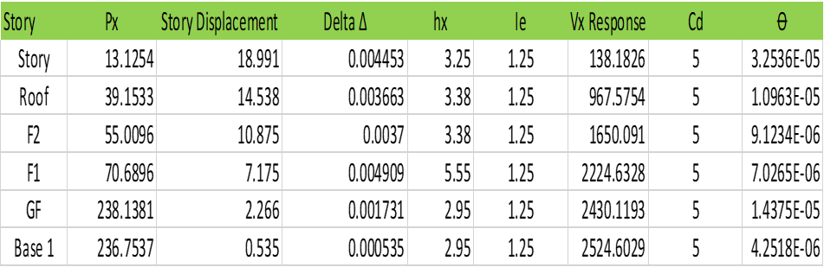

Slide 63
For the story drift check, this sort of deflection takes into account the lateral displacement in the diaphragm generated by lateral forces such as earthquakes.
Story drift begins soon after an earthquake strikes the structure
Story Drift Check

Slide 64
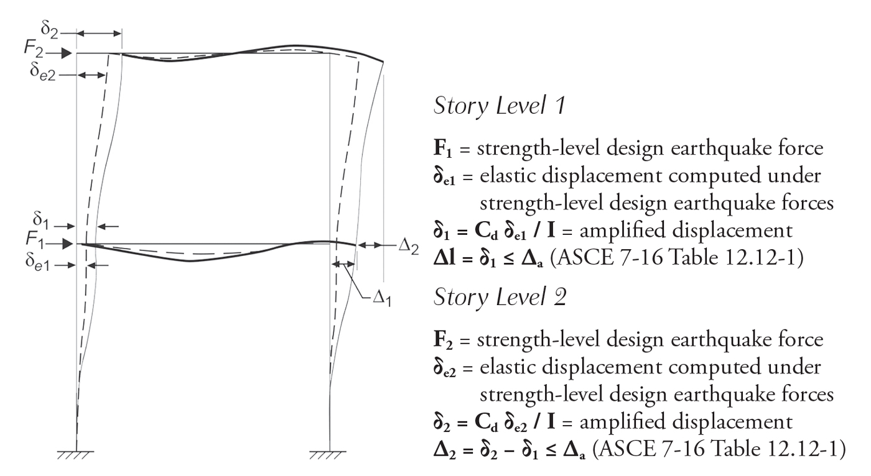

Slide 65
Table: Elastic and inelastic Drift Result Etabs in X Direction for Right Block

Slide 66
Base Shear Check
This check is done to compare the base shear forces that affect the building from
the earthquake when the building gets hit by it with the allowable force that the
same building can handle, it gives an indication whether the building is going to
survive the earthquake forces applied on it or it will just collapsed for being over
stressed.

Slide 67
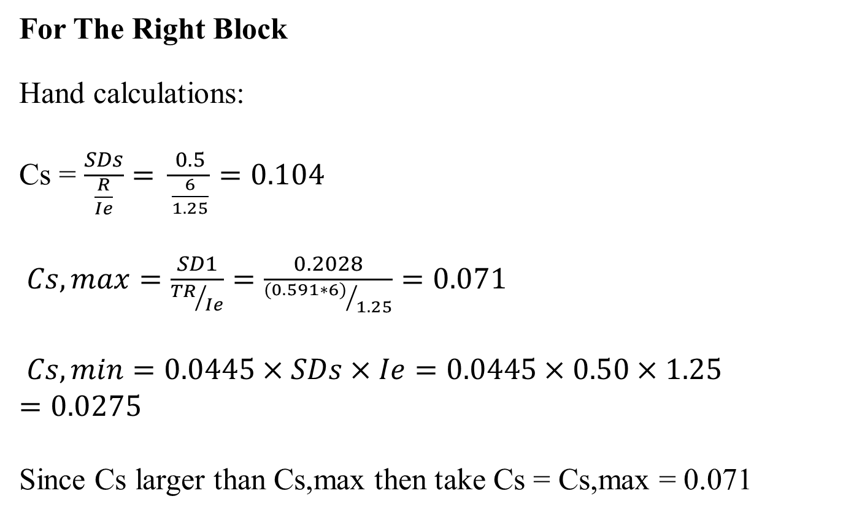
For The Right Block
Hand calculations:
Cs = $\frac{SDs}{\frac{R}{Ie}}= \frac{0.5}{\frac{6}{1.25}}=0.104$
$Cs,max=\frac{SD1}{{TR}/{Ie}}=\frac{0.2028}{{(0.591∗6)}/{1.25}}=0.071$
$Cs,min=0.0445×SDs×Ie=0.0445×0.50×1.25=0.0275$
Since Cs larger than Cs,max then take Cs = Cs,max = 0.071

Slide 68
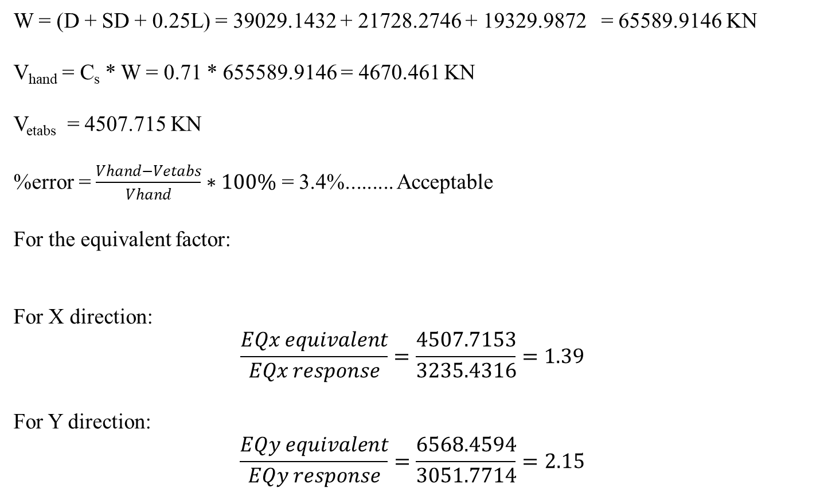
W = (D + SD + 0.25L) = 39029.1432 + 21728.2746 + 19329.9872 = 65589.9146 KN
V_{hand} = C_{s} * W = 0.71 * 655589.9146 = 4670.461 KN
V_{etabs} = 4507.715 KN
%error = $\frac{Vhand−Vetabs}{Vhand}∗100\%$ = 3.4%......... Acceptable
For the equivalent factor:
For X direction:
$$\frac{EQx equivalent}{EQx response}=\frac{4507.7153}{3235.4316}=1.39$$
For Y direction:
$$\frac{EQy equivalent}{EQy response}=\frac{6568.4594}{3051.7714}=2.15$$

Slide 69
Design Of Structural Elements

Slide 70
After making sure that the checks are all good, the project now moves to the
final step which is the design phase.
ACI 318-14 has been used to design the structural elements.

Slide 71
Beam Design

Slide 72
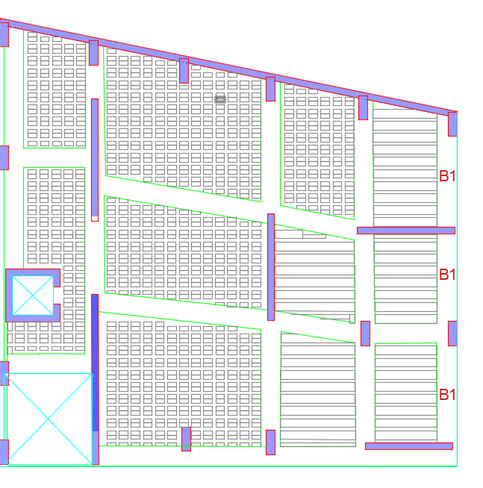

Slide 73

Sample Calculations
$ρ\min{=0.0033}$
$As\min{= ρbh=0.0033×900×320=950 mm^{2}}$
Ast = 1190 $mm^{2}$
Asb= 1000 $mm^{2}$
By using, $∅ 14for bottom \& ∅ 16 for top reinforcement$ obtain 6$∅16 \&7∅14$
$\frac{Av}{s}=2000 mm^{2}/m$
By using 10 mm 2 legs, $\frac{2×\left(\frac{π}{4}\right)×{10}^{2}}{s}=2000\frac{mm^{2}}{m}→S=0.08 m$
$So, use 4 legs→ \frac{4×\left(\frac{π}{4}\right)×{10}^{2}}{s}=2000 →S=0.16 m$
$Use 2∅10 mm / 150 mm$

Slide 74
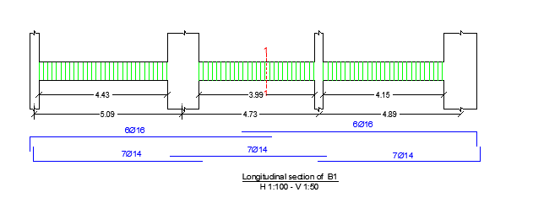

Slide 75
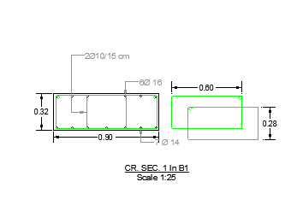

Slide 77
Column Design

Slide 78
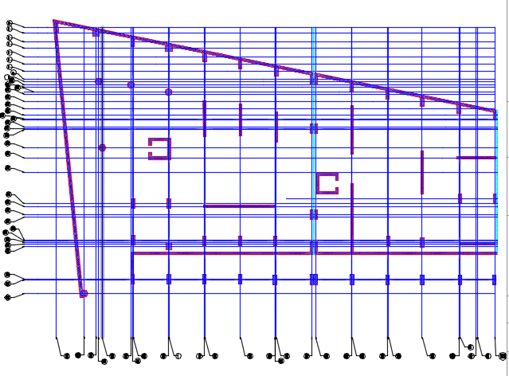
Center Lines Of Columns

Slide 79
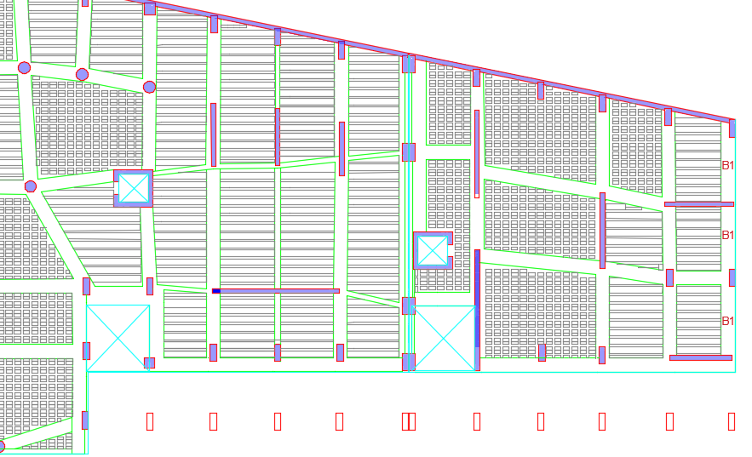

Slide 80
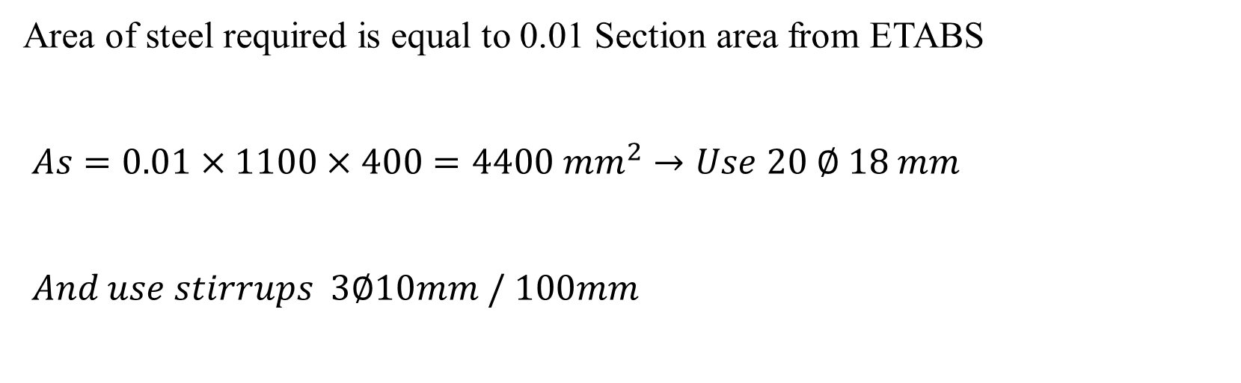
Sample Calculations
Area of steel required is equal to 0.01 Section area from ETABS
$As=0.01×1100×400=4400 mm^{2}→Use 20 ∅ 18 mm$
$And use stirrups 3∅10mm / 100mm$

Slide 81
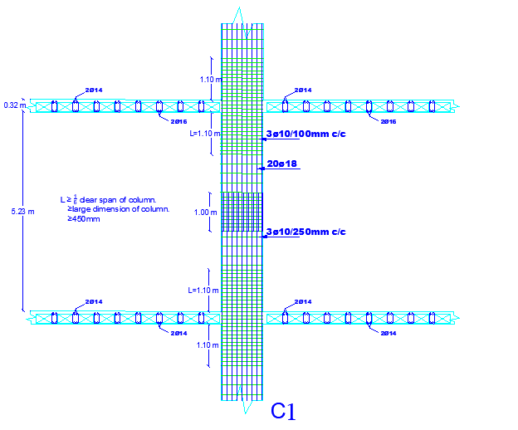

Slide 82


Slide 83
Slab Design

Slide 84


Slide 85

A
A
Base 1 Floor Rib Reinforcement

Slide 86

Section A-A in slab

Slide 87
Footing Design

Slide 88
The bearing capacity is assumed to be 250 KN/m².
Therefore the best footing that can be chosen according to the assumption of the bearing capacity is Mat foundations.

Slide 89


Slide 90

Left Block
Right Block

Slide 91
Limitations
A 3D view of the building wasn’t available.
There wasn’t any soil investigation nor soil testing for the site.
Architectural plans were changed a little by adding three columns to reduce the long spans.

Slide 92


