Slide 1
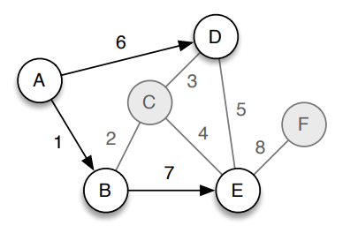
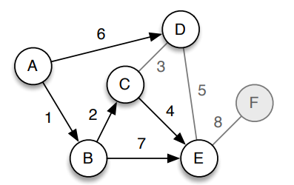
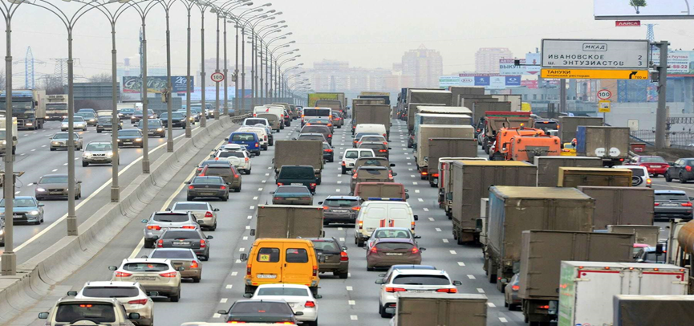
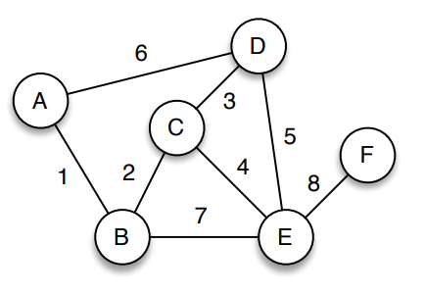
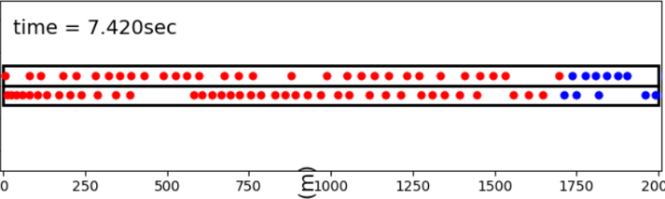
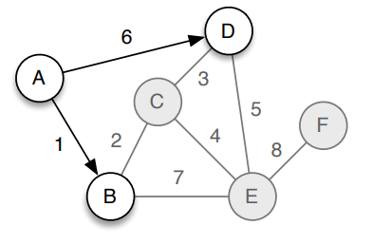
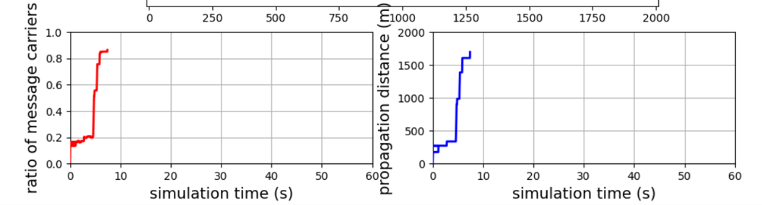
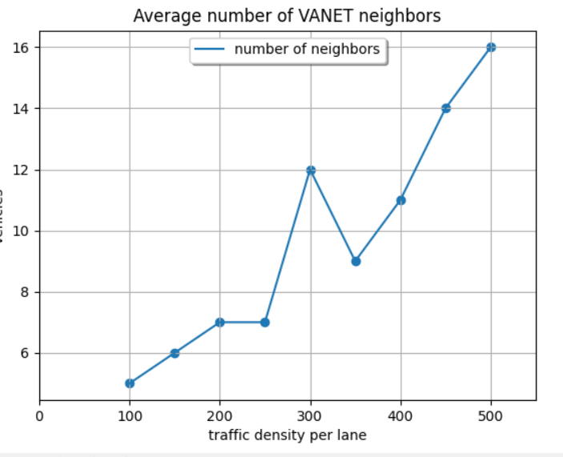
Traffic Management System- Based IOV
2021 5 -28 May 2021
Malik Shanaah, Tamer Abu Zeneh, Sarah Darwazeh Dr. Saed Tarapeah Discussion
shows the results of the simulation to tracking saliency under the healthy operating conditions as given in table 1 and in cases of single-phase open-circuit fault as given in tables 2, and
Objectives
The main function of VANET is providing information and instructional commands between vehicles for security aspects, Since the network scheme and the vehicles allocation changes in very fast way, it will introduce a connection failed problem. So we are going to build a network consists of number of vehicles, and this network will be simulated with high performance to achieve our goal which is representing in avoiding some crowded cases in an important area.
Problem Statement
Projects’ Software
  1.Requirements of fast and reliable communication to provide data dissemination is inevitable to support VANET’s needs.
  Bandwidth distribution and quick data transmission are required to provide quick handover scheme in switching from node-to-node.
Input and output of the model
Routing Protocols
Simulation Part
: Epidemic-based routing mechanism
Ant Colony Optimization Protocol.
Particle Swarm Optimization Protocol.
Reactive Routing Protocols.
Dynamic Source Routing Protocol.
c
The bottom lane which describes the input of the system shows the base case in which the vehicles are near of each other so if any possible surprising accident occurred then there will be crashes between the adjacent vehicles. And to avoid this scenario we input the base case to our model which is the Epidemic-based routing mechanism to adjust the distances between vehicles in addition to their speeds and accelerations, therefore prevent any possible crashing scenario.
: Epidemic-based routing mechanism
Results and Discussion

