Slide 1
Heating With Solar Heater
Submitted To:
Dr. Bashir Nouri
Prepared By:
Abdullah Muhammad Bsharat
Ra`ef Muhammad Bsharat
Faris Ahmad Hantoli

Slide 2
Abstract

Slide 3
Introduction

Slide 4
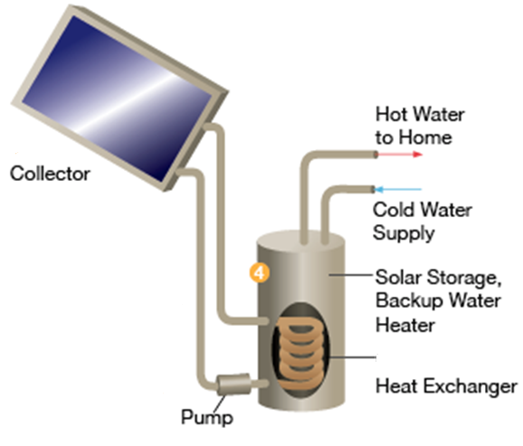
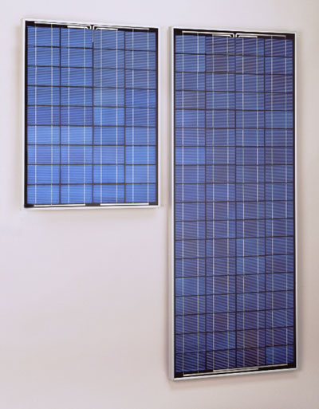
Introduction
Uses Of Solar Energy
    Generating Electricity
    Solar water heater

Slide 5
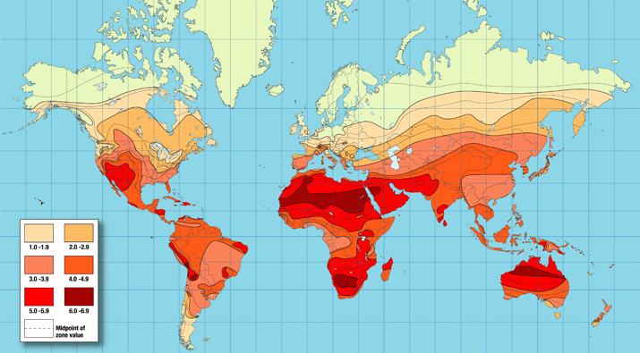
Introduction
Why solar energy can be used in Palestine ?
Palestine
1. Palestine from the country that have great value of solar radiation (5.4 KWH/m²/day).
2. Average cloudy days in the year about 20-25 days.(according to NASA studies).
3. Energy resources are either dwindling or non-existent.
4. Increase petroleum fuel unit price recently
World Solar Insolation Map

Slide 6
Flat Plate and
Evacuated Tube solar collectors

Slide 7
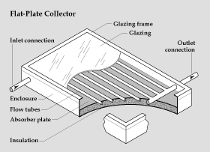
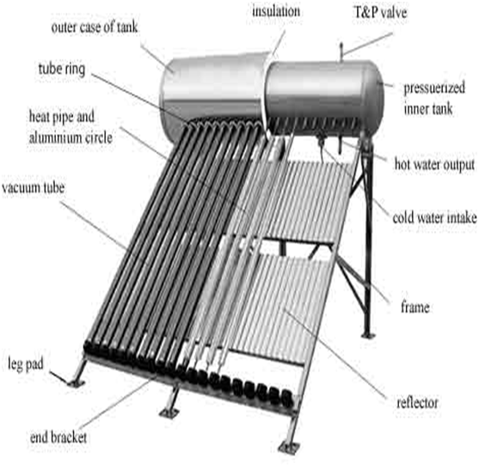
Flat Plate and Evacuated Tube Solar Collectors
Evacuated Tube Solar Collectors
Flat Plate Solar Collectors

Slide 8
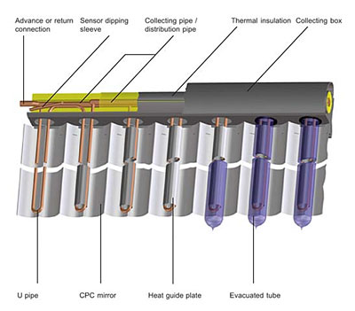
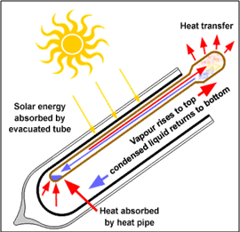
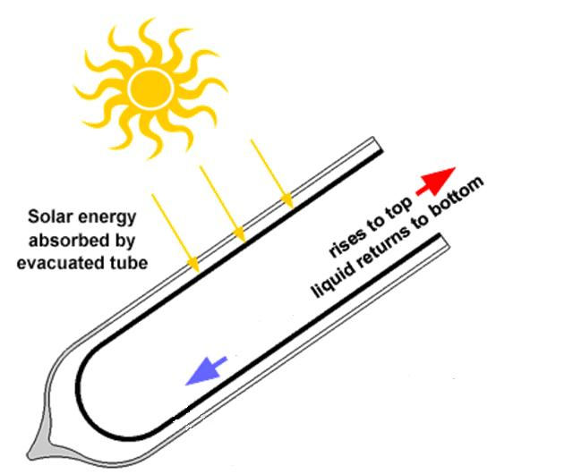
Flat Plate and Evacuated Tube Solar Collectors
Evacuated Tube Types
1. Glass to Glass Type
2. Glass to Metal Type
b. Evacuated tube with direct flow.
a. Evacuated tube with heating pipe.

Slide 9
Flat Plate and Evacuated Tube Solar Collectors
Efficiency of Flat plate and Evacuated Tube collectors
Heat collected by solar collectors equal to energy absorbed by the absorber minus the heat loss from the surface directly and indirectly to the surrounding.
Q_{C} = Q _{absorbed} – Q _{loss}
Q_{C} = A[ I_{C} *(τα)_{e} – U_{C} (T_{in} – T_{a})]
Where (τα)_{e}: effective product of transmissivity of the transparent cover and absorptivity of absorber.

Slide 10
Flat Plate and Evacuated Tube Solar Collectors
By introducing heat removal factor in the equation is will be as following:
Q_{C} = A[ I_{C} *F_{R}(τα)_{e} – F_{R} U_{C} (T_{in} – T_{a})]
The efficiency of solar collector is defined as the ratio of heat output of the collector to solar energy flux incident on the collector.

Slide 11
Flat Plate and Evacuated Tube Solar Collectors
The Following figure show the efficiency curve for three different type collectors:
Parabolic trough concentrator
Evacuated tube
Flat plate collector

Slide 12
Flat Plate and Evacuated Tube Solar Collectors
According to Nablus City condition the efficiency of Flat plate and evacuated tube collectors presented in following curves.
Evacuated tube
Flat Plate

Slide 13
Boiler

Slide 14
Boiler
Boiler Fuel Consumption
Degree Day Method
The number of degree days DD, for given year months during heating season calculated by following equation:
DD = (18.3 – T_{avg}) * Days of the month
The fuel mass M_{f} consumed in a given period of time (heating season) during winter can be estimated using degree day method by following equation:

Slide 15
Heating

Slide 16
Heating
Heating Load Calculation
1. Conduction heat loss
Q = U × A × (T_{in} – T_{out})
2. Ventilation heat loss
a. Sensible heat load
Q_{s,v} = 1.25 V_{v} (T_{i} – T_{o})
b. Latent heat load
Q_{L,v} = 3 V_{v} (w_{i} – w_{o})
3. Domestic hot water load
Q_{w} = M_{w} C_{p} (T_{h} – T_{c})

Slide 17
Heating
First Floor

Slide 18
Heating
Second Floor

Slide 19
Heating
Over Heat Transfer Coefficients
wall Type | U (W/ m². C)
Internal wall | 2.493
External wall | 2.601
Ceiling | 2.683
Floor | 1.701
Class window | 6.7
wooden door | 3.1
Stair wall | 3.05

Slide 20
Heating
Heating load for second floor
Q_{wall} =2678.64 w
Q _{s,v} = 1004.08 w
Q_{wall} =1843.05 w
Q _{s,v} = 1082.32w
Q_{wall} =5834.51w
Q _{s,v} = 3398.22w
Q_{wall} =2532.94 w
Q _{s,v} = 1095.36w
Q_{wall} =1606.5w
Q _{s,v} = 834.56w

Slide 21
Heating
Boiler load
Room Type | Wall load | Ventilation load | Total load KW
Master Bed room | 2678.46 | 1004.08 | 3.683
Girls bed room | 1843.05 | 1082.32 | 2.925
Boy bed room | 2532.94 | 1095.36 | 3.628
kitchen | 1606.55 | 834.56 | 2.441
living room & dining room | 5834.51 | 3398.224 | 9.233
Total load |  |  | 21.910
Domestic |  |  | 9.753
Boiler load |  |  | 34.830

Slide 22
Plumbing

Slide 23
Plumbing
House Fresh Water Pipe Sizing
First Floor
The collectors number 1 and 2 have the same connected fixture, and the summation of fixture unit shown in following table:
FIXTURE | Cold pipe | Hot pipe | Total
Water Closet | 1.65 | 0 | 2.2
Lavatory | 0.5 | 0.5 | 0
Kitchen sink | 1 | 1 | 0
Water Closet | 1.65 | 0 | 2.2
Lavatory | 0.5 | 0.5 | 0
Kitchen sink | 1 | 1 | 0
FU Summation | 6.3 | 3
Demand (GPM) | 11.03 | 6.5 | Table A-14
Size | 3/4`` | 1/2`` | Table A-15

Slide 24
Plumbing
House Fresh Water Pipe Sizing
First Floor
First floor main pipe:
Collector | Cold pipe | Hot pipe
Collector 1 | 6.3 | 3
Collector 2 | 6.3 | 3
FU summation | 12.6 | 6
Demand (GPM) | 16.3 | 10.7
Size | 1`` | 3/4``

Slide 25
Plumbing
House Fresh Water Pipe Sizing
Second Floor
Collector 1 :
FIXTURE | Cold pipe | Hot pipe | Total
Bathtub | 1 | 1 | 0
Water Closet | 1.65 | 0 | 2.2
Lavatory 1 | 0.5 | 0.5 | 0
Lavatory 2 | 0.5 | 0.5 | 0
Water Closet | 1.65 | 0 | 2.2
Bidet | 1.5 | 1.5 | 0
Lavatory | 0.5 | 0.5 | 0
FU summation | 7.3 | 4
Demand (GPM) | 12.1 | 8 | Table A-14
Size | 3/4`` | 3/4`` | Table A-15

Slide 26
Plumbing
House Fresh Water Pipe Sizing
Second Floor
Collector 2 :
FIXTURE | Cold pipe | Hot pipe | Total
Water Closet | 1.65 | 0 | 2.2
Lavatory | 0.5 | 0.5 | 0
Kitchen sink | 1 | 1 | 0
FU summation | 3.15 | 1.5
Demand (GPM) | 6.725 | 4 | Table A-14
Size | 1/2`` | 1/2`` | Table A-15

Slide 27
Plumbing
House Fresh Water Pipe Sizing
Second Floor
Second floor main pipe:
Collector # | Cold pipe | Hot pipe
Collector 1 | 7.3 | 4
Collector 2 | 3.15 | 1.5
Second floor FU | 10.45 | 5.5
Demand (GPM) | 14.95 | 10.065
Size | 1 | 3/4``

Slide 28
Plumbing
House Fresh Water Pipe Sizing
First and Second Floors Main pipe
Floors # | Cold pipe | Hot pipe
First floor | 12.6 | 6
second floor | 10.45 | 5.5
FU summation | 23.05 | 11.5
Demand (GPM) | 20.759 | 15.58
Size | 1.25`` | 1

Slide 29
Plumbing
Drainage System Pipe Design

Slide 30
System Design and
Selection

Slide 31
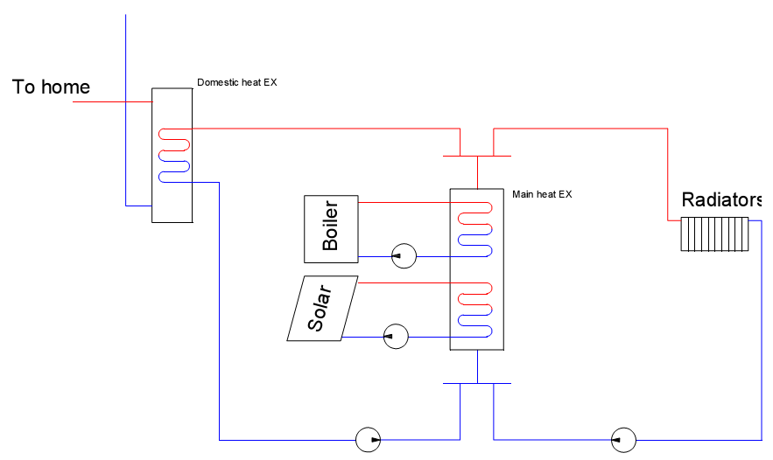
System Design and Selection
System Description

Slide 32
System Design and Selection
Boiler selection
System | Heating load KW | Boiler type | Boiler capacity KW
Boiler only | 34.83 | 1R4 | 39.2
Boiler & solar system | 23.22 | Rondo3 | 23.5

Slide 33
System Design and Selection
Solar collector selection
(AP-30) model
Number of tube | 30
Tube length (m) | 1.98
Collector width (m) | 2.198
Absorber area (m) | 2.4
Maximum operating pressure | 8 bar
Optimal flow rate | 0.1 L/min/tube

Slide 34
System Design and Selection
Solar collector selection
Month | Solar radiation (KWh/m²/day) | Heat collected amount (KWh/day) | Output heat (Kw)
November | 3.28 | 4.41 | 13.22
December | 2.65 | 3.56 | 10.68
January | 2.85 | 3.83 | 11.49
February | 3.38 | 4.54 | 13.63
March | 5.05 | 6.79 | 20.36
April | 6.7 | 9.00 | 27.01
Note that the collector efficiency is 56% from chapter 2

Slide 35
System Design and Selection
Radiator selection
Die cast aluminum alloy radiator finger which called ROUNDING will be used.
The finger type RA600 give 203 watt per finger.
Room Type | Room load (watt) | # Rad Finger | Finger per room | Radiator number | Length
Master bed room | 3682.54 | 18.14 | 19 | 1 | 152
Girls bed room | 2925.37 | 14.41 | 15 | 1 | 120
Boys bed room | 3628.30 | 17.87 | 19 | 1 | 152
Kitchen | 2441.11 | 12.03 | 13 | 1 | 104
living room & dining room | 9232.73 | 45.48 | 46 | 2 | 368

Slide 36
System Design and Selection
Radiator piping system
1. Using Figure (A–1) with flow 0.525 L/s and pressure drop 375 Pa/m the main steel supply and return pipe diameter was (1.25 in).
2. The plastic tube diameter between the collector and each radiator was (15 mm).

Slide 37
System Design and Selection
Heat Exchangers Coils Design By NTU Method
0.0778 L/s
5 m
0.278 L/s
5 m
0.111 L/s
6 m
0.617 L/s
Note that:
0.093 L/s
0.524 L/s

Slide 38
System Design and Selection
Pump Selection
0.278 L/s
TOP-S 25/13 1~ PN 10
0.111 L/s
Star-RS 25/2
0.093 L/s
0.524 L/s
Stratos PICO 25/1-6 130
TOP-S 30/7 1~ PN 10

Slide 39
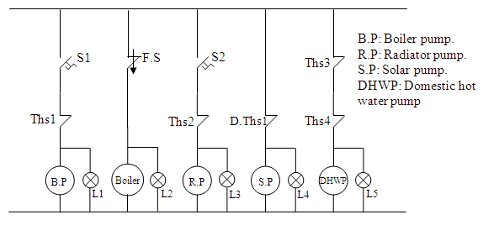
System Design and Selection
System Control

Slide 40
Result and Recommendation

Slide 41
Result and Recommendation
Initial Cost Comparison

Slide 42
Result and Recommendation
Running Cost Comparison

Slide 43
Result and Recommendation
Payback period
System type | Initial cost ($) | Running cost ($/year)
heating without using solar | 4298.27 | 1214.73
heating with using solar | 6802.60 | 728.22
Difference | 2504.33 | 486.51
Payback period | 5.14 Years

Slide 44
Recommendation

Slide 45
The End

