Slide 1

HR management system
Aida Bustami, Aseel Bustami
Dr.Raed Qadi

Slide 2
Outline
Motivation
Objectives
Features
Tools && technologies
Future work

Slide 3
Motivation
Working as HR requires you to get involved in many different tasks and responsibilities.

Slide 4
Objectives
We want to design a system for Human Resources which will simplify their job and make it much easier.

Slide 5
Efficient time/Location tracking
Time off requests
Time off History
Out the office
Scheduling events
Holidays
Scheduling meeting rooms
Employees Management
Communication channel: Notifications /Live chat
Team management
Recruitment
Manage Expenses
Company’s policy

Slide 6
Features

Slide 7
Efficient Time/Location tracking

Slide 8
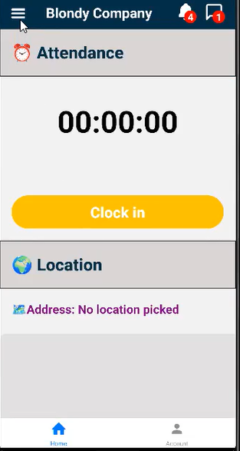
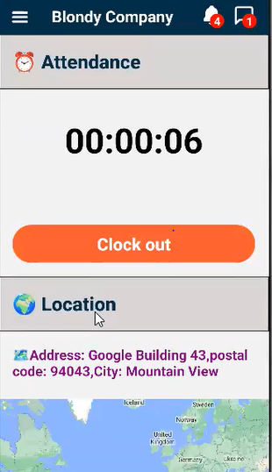
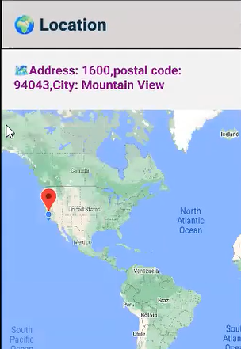

Slide 9
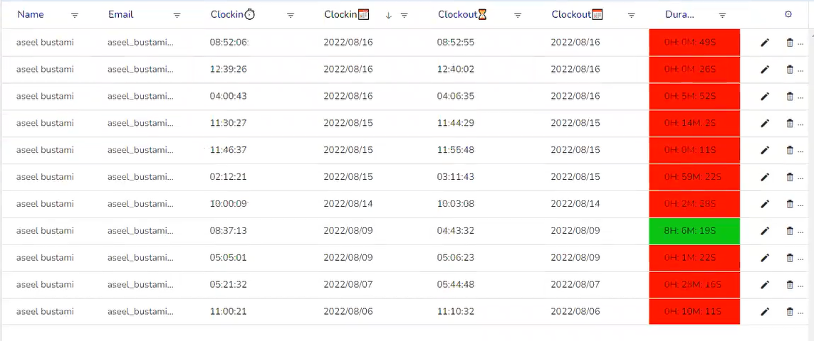

Slide 10
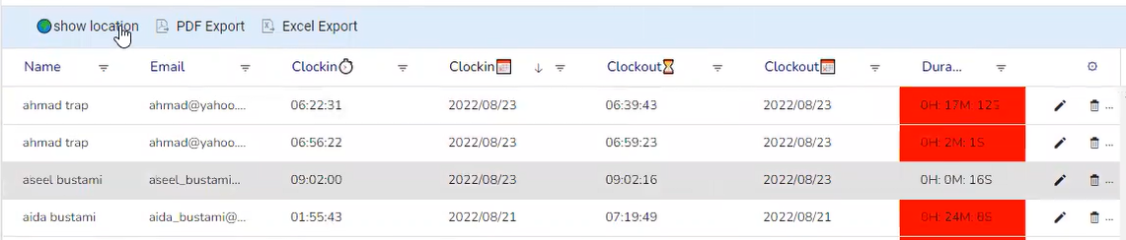
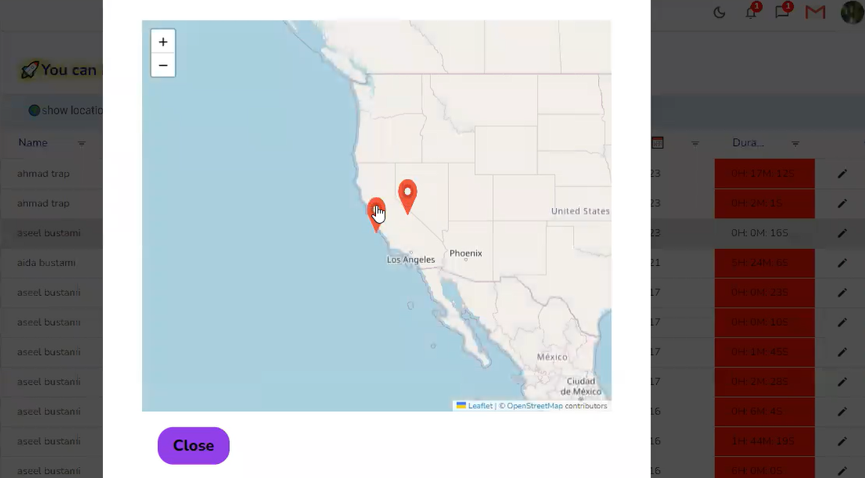

Slide 11
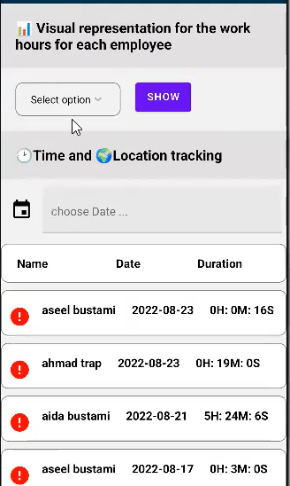
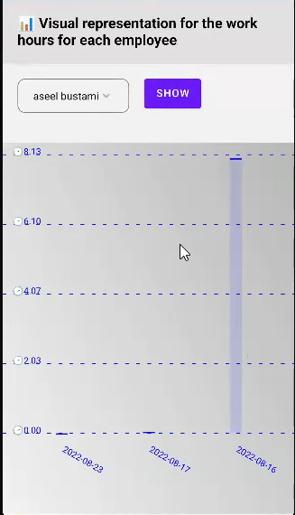

Slide 12
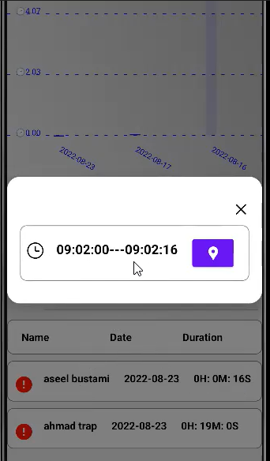
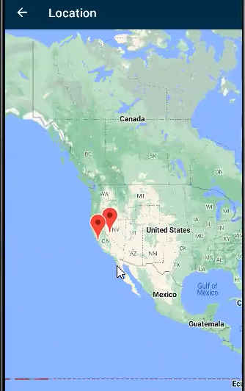

Slide 13
Time off requests

Slide 14
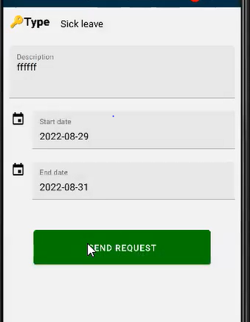
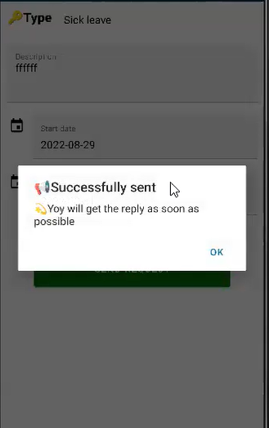

Slide 15
Time off History

Slide 16
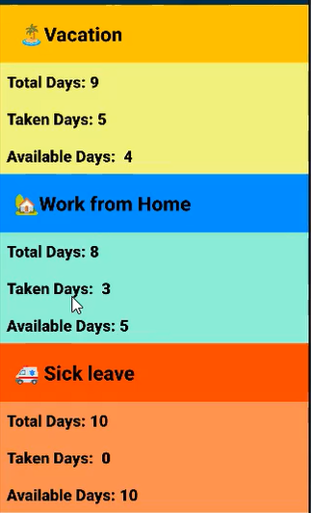
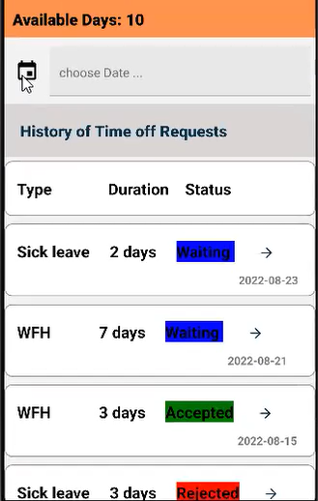

Slide 17
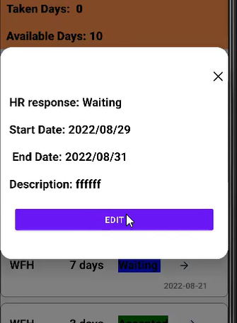
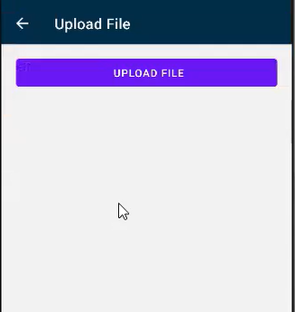

Slide 18
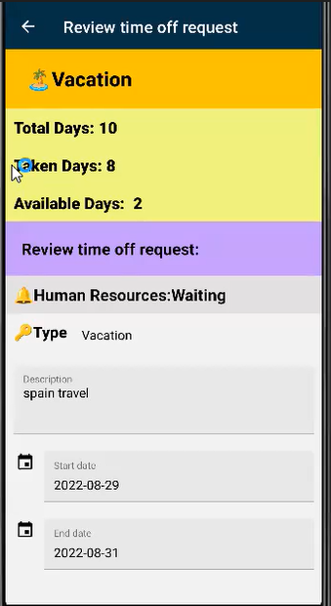

Slide 19
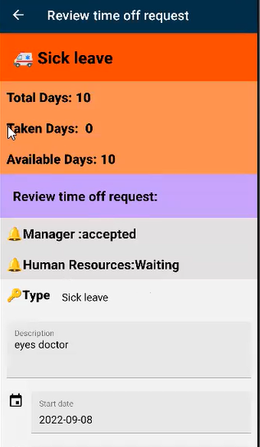
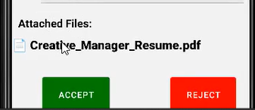

Slide 20
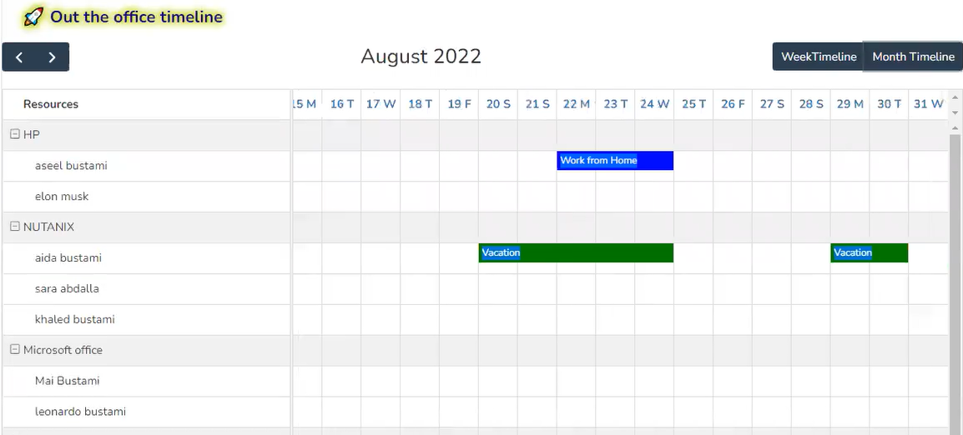
Know who is out the office:

Slide 21
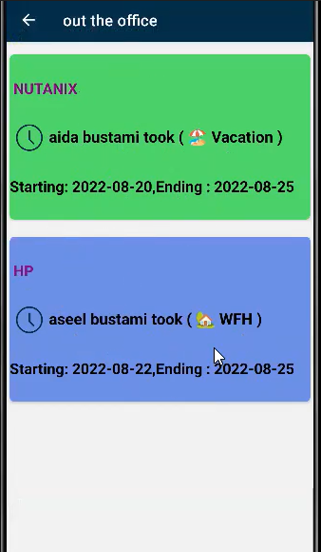

Slide 22
Scheduling events on the calendar

Slide 23
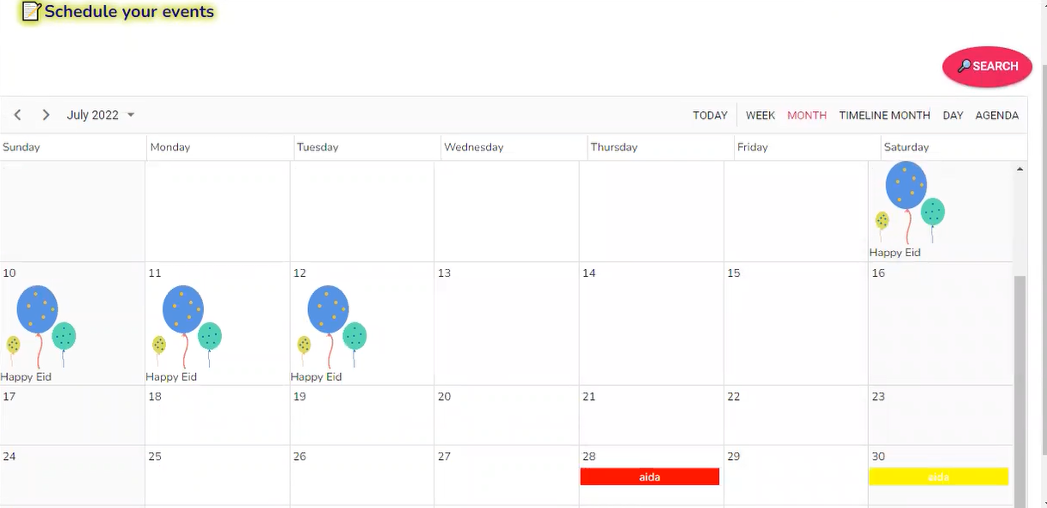

Slide 24
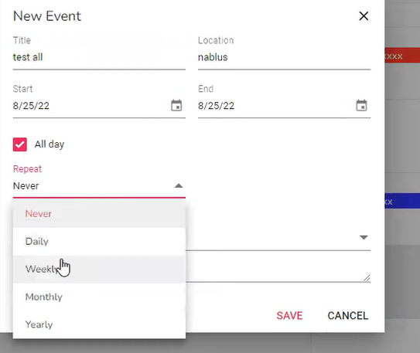
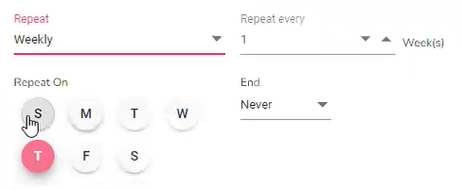

Slide 25
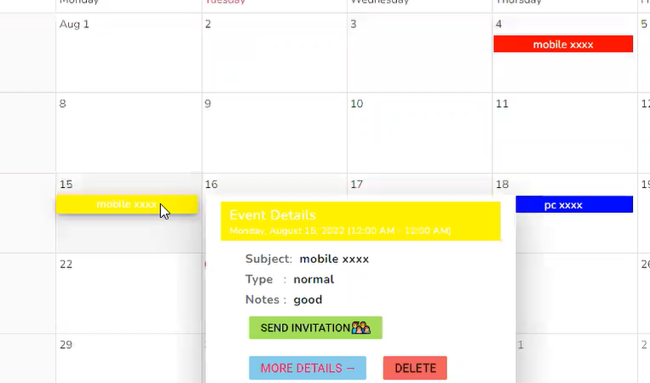

Slide 26
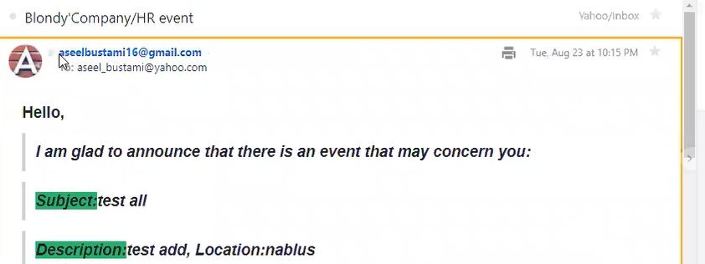
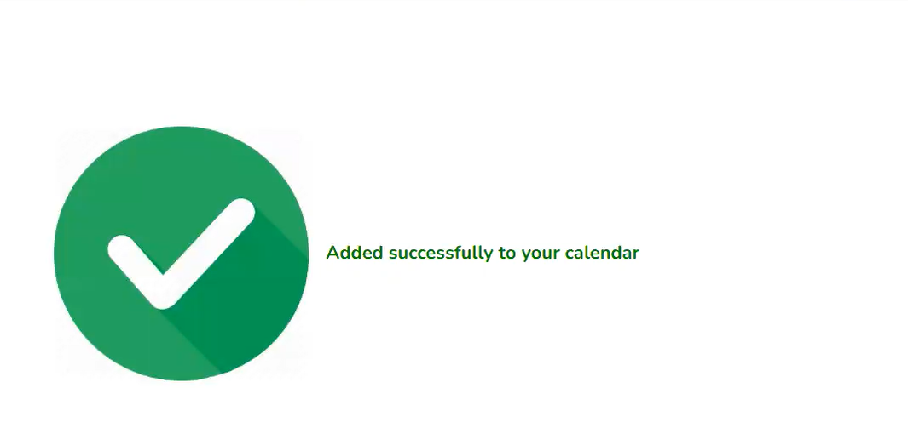
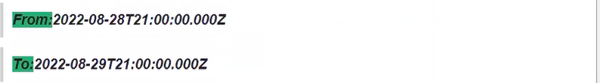
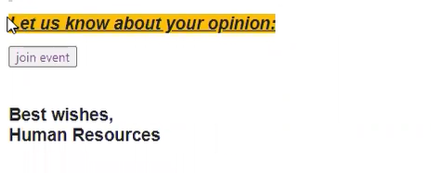

Slide 27
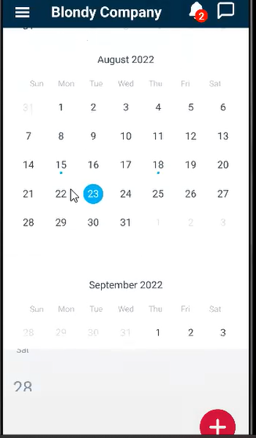
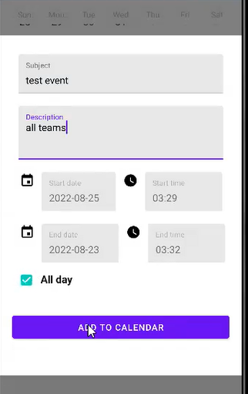
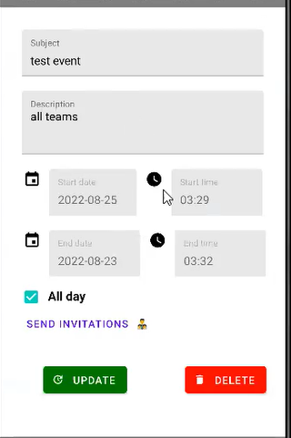

Slide 28
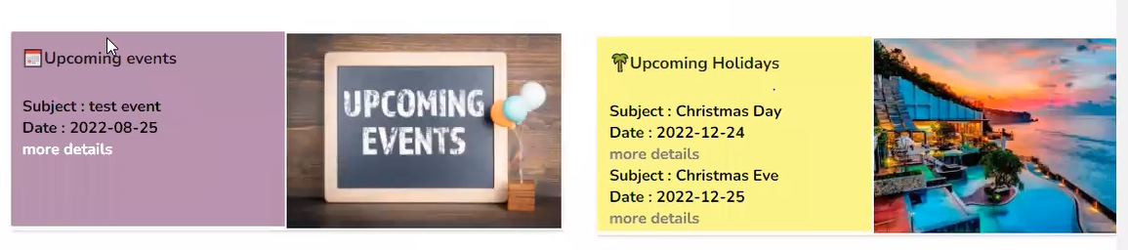
Show the upcoming events and holiday

Slide 29
Schedule Room

Slide 30
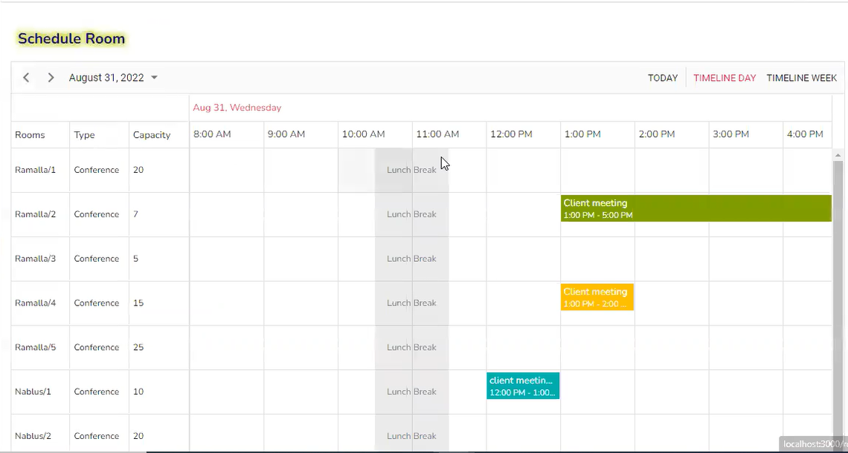

Slide 31
Employees Management

Slide 32
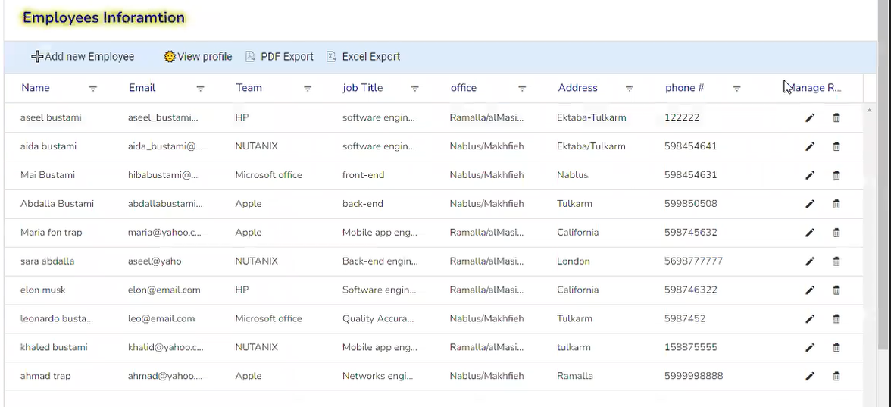

Slide 33
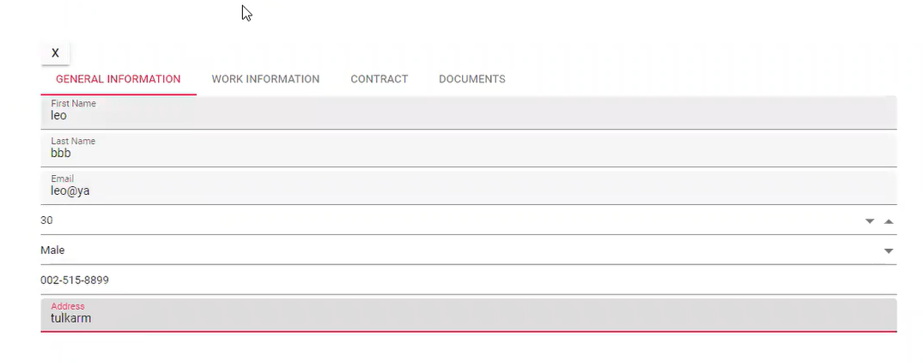
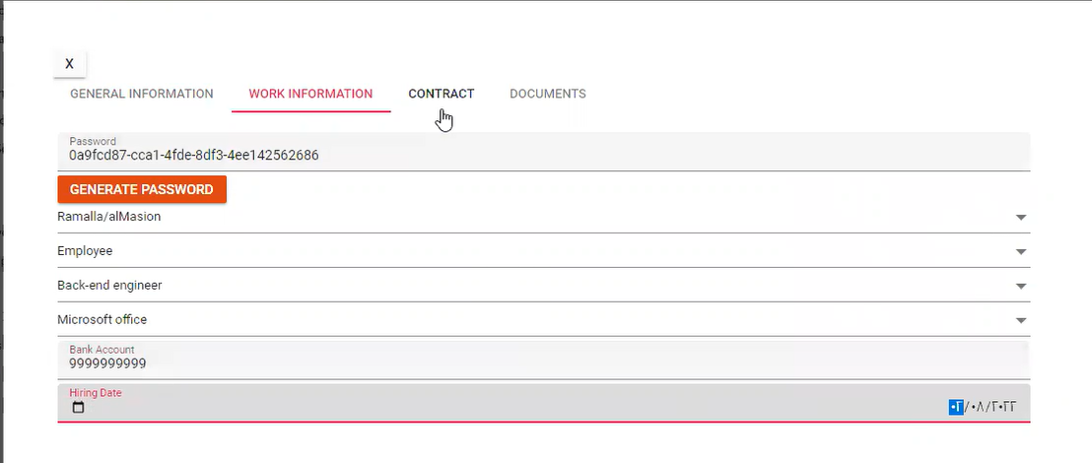

Slide 34
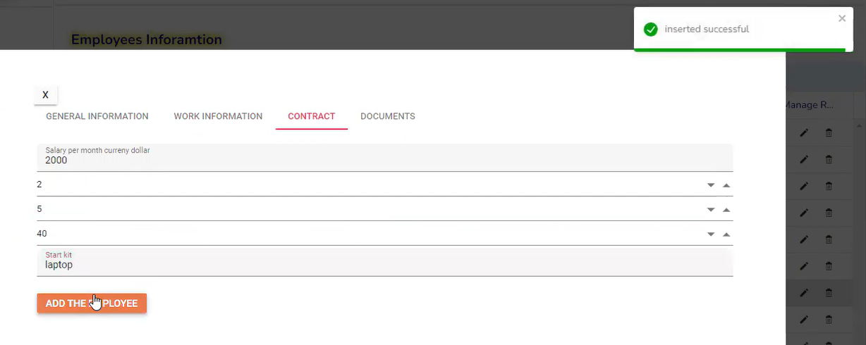

Slide 35
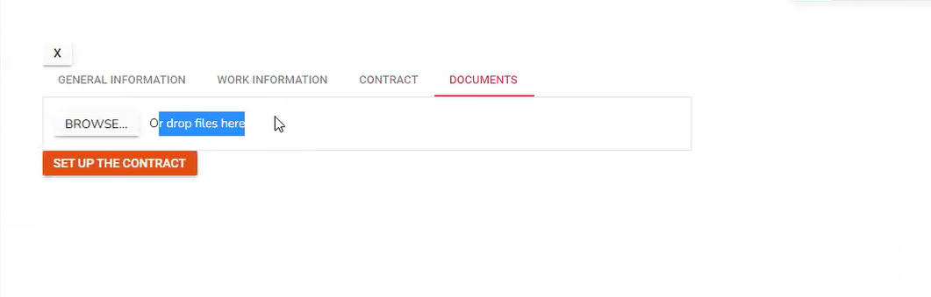
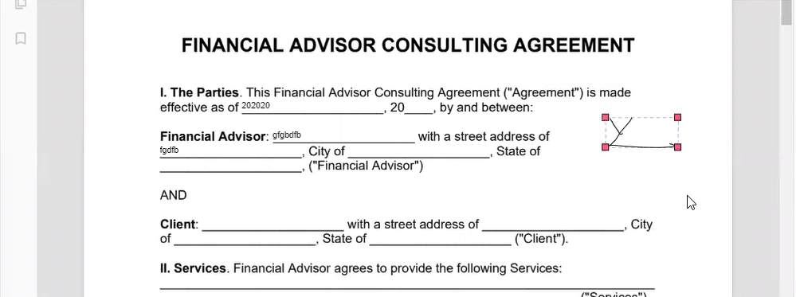

Slide 36
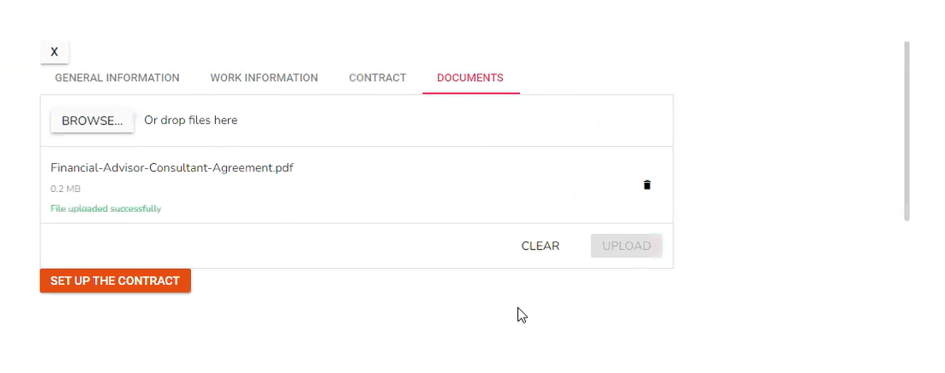

Slide 37
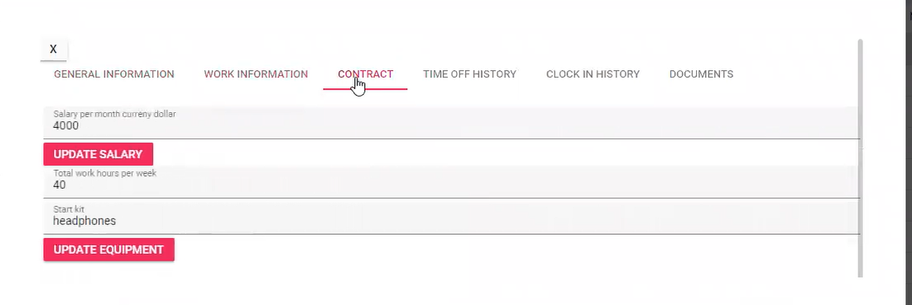
View Profile

Slide 38
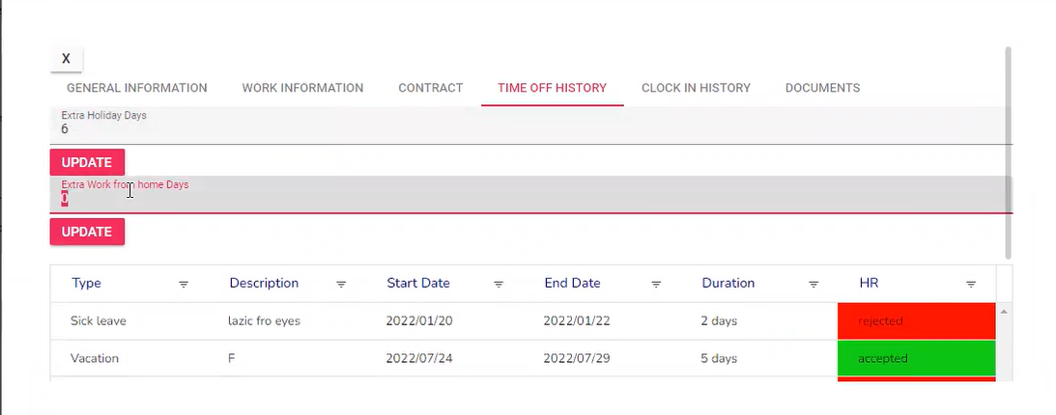

Slide 39
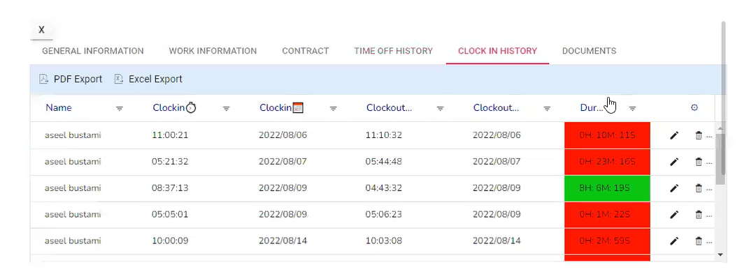
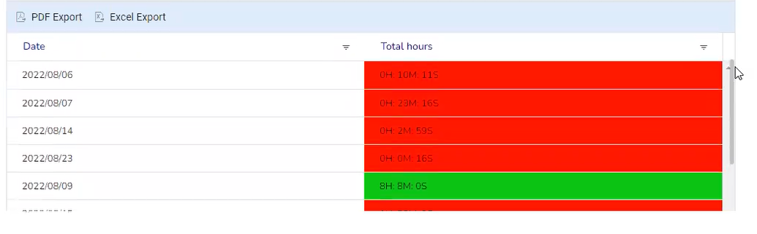

Slide 40
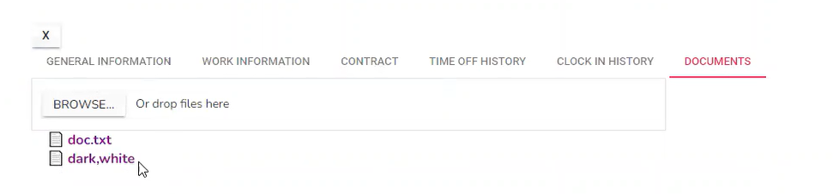

Slide 41
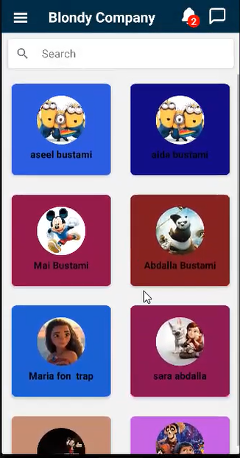
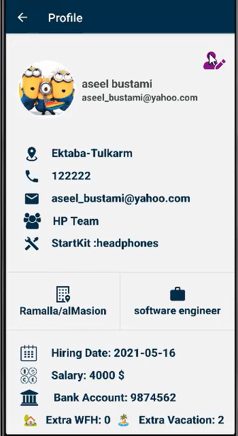
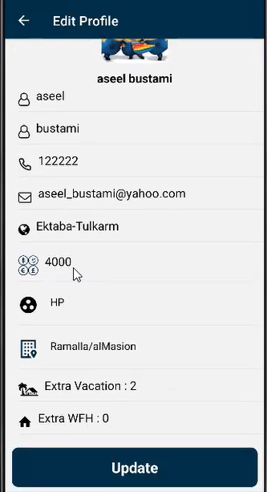

Slide 42
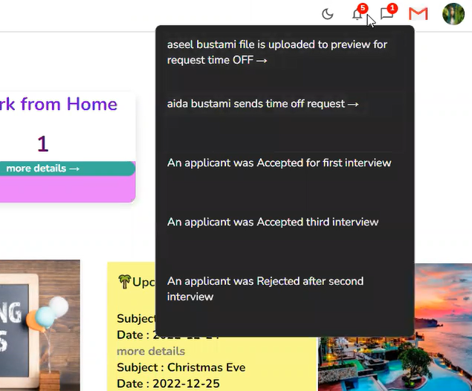

Notifications:

Slide 43


Slide 44

Live chat

Slide 45



Slide 46


Have a profile for each team in the company

Slide 47




Slide 48


Slide 49


Slide 50


Slide 51
Recruitment

Slide 52


Slide 53


Slide 54


Slide 55


Slide 56



Slide 57



Slide 58



Slide 59


Slide 60


Slide 61


Slide 62


Slide 63
Manage Expenses

Slide 64



Slide 65



Slide 66



Slide 67


Slide 68



Slide 69


Slide 70
Company’s policy

Slide 71


Slide 72


Slide 73


Slide 74


Slide 75



Slide 76


Slide 77



Tools && technologies

Slide 78
Future work
1-Smart system that suggests the best available time slot to create interview depends on The room availability and the interviewer schedule.
2- In case the recruitment interview is delayed or cancelled find the best matching time=> having available manger and room.
3- Expanding our system to manage Training

Slide 79
Thank you

