Slide 1

WE HEAR YOU
Presented By:
Aya Sabbah
Duha Shawareb
Supervisor :
Dr.Raed Al-Qadi

Slide 2
Outline:
1
Introduction
2
Tools and Languages
3
Features
Sign Language Interpreter
Text to sign translator
ASL Dictionary
4
Constraints and Problems
5
Future Work
6
Conclusion

Slide 3
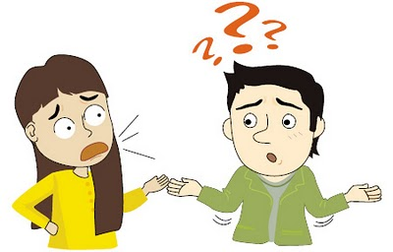
Introduction:

Slide 4






Tools and Languages :
Android Studio
Android NDK
PyCharm and Python interpreter
Opencv Library
LIBSVM
Firebase Database
Sublime text editor
Esign editor

Slide 5
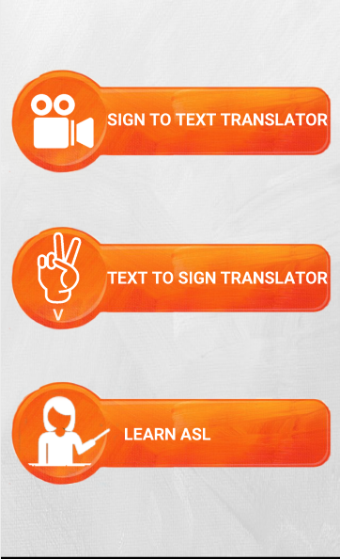
Features:
1
American Sign Language
Interpreter
2
English Text To Sign
Gestures translator
3
ASL Dictionary

Slide 6
American Sign Language Interpreter
Capture Frame
Image Processing
Transform To HSV
Hand Recognition
Hand Detection

Slide 7
Hand Detection Process
Load Hand Pose
Template Contours
Taking Frames By Real Time Camera
Skin Detection
Skin Colored Area
Contour Comparing with Hand Pose Loaded Templates

Slide 8
Hand Recognition Process
We have followed two approaches in this process:
Sign Gesture Recognition Using SVM.
Sign Gesture Recognition Using Haar Cascade Classifier
Adopted
Sign Gesture Recognition Using Haar Cascade Classifier.

Slide 9
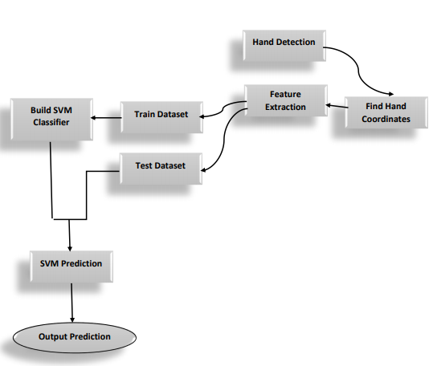
Sign Gesture Recognition Using SVM
Adopted

Slide 10
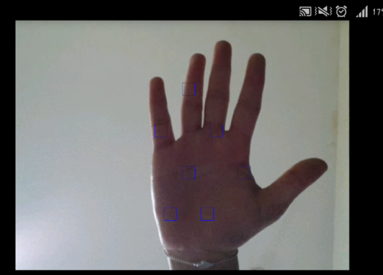
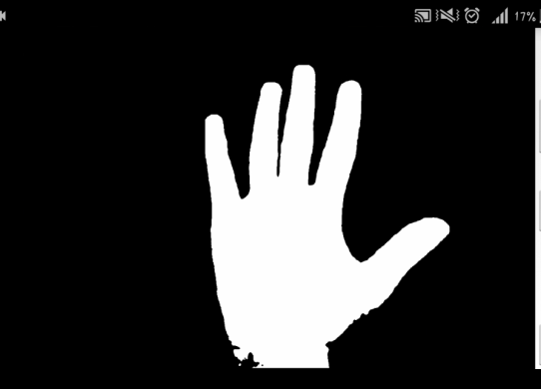
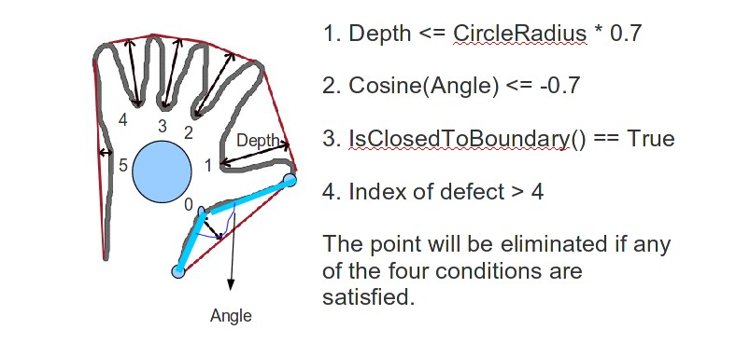
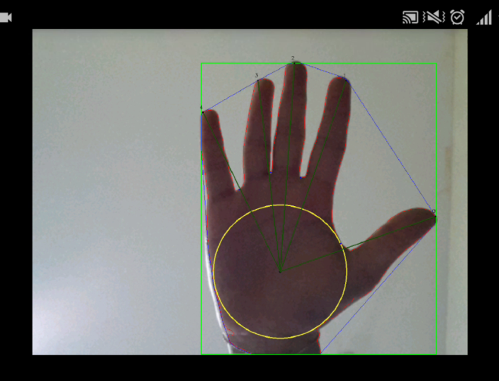
Sign Gesture Recognition Using SVM

Slide 11
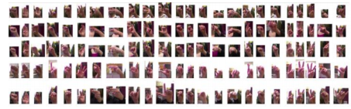
Sign Gesture Recognition Using Haar Cascade Classifier
Acquisition of large data training sets
Train Haar Cascade using Opencv
Adopted

Slide 12
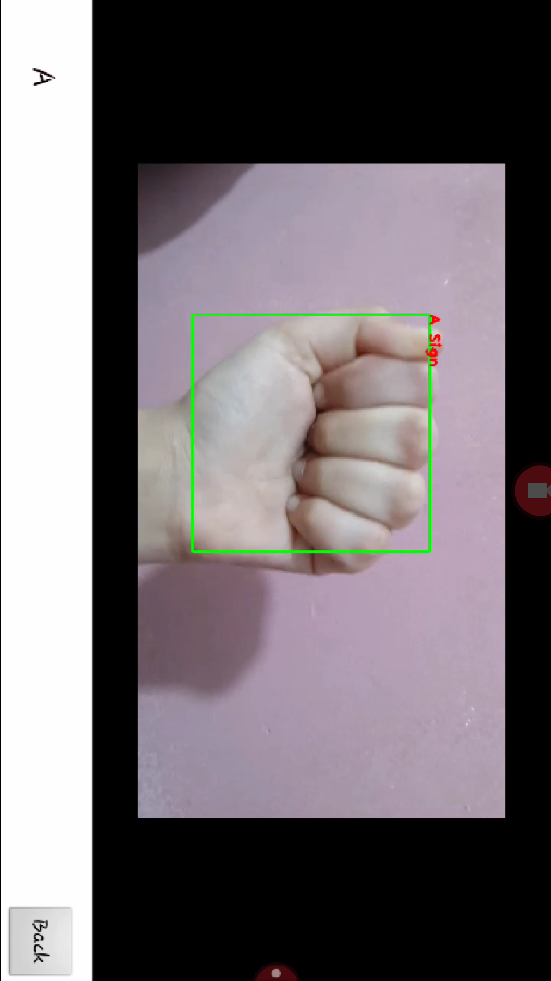
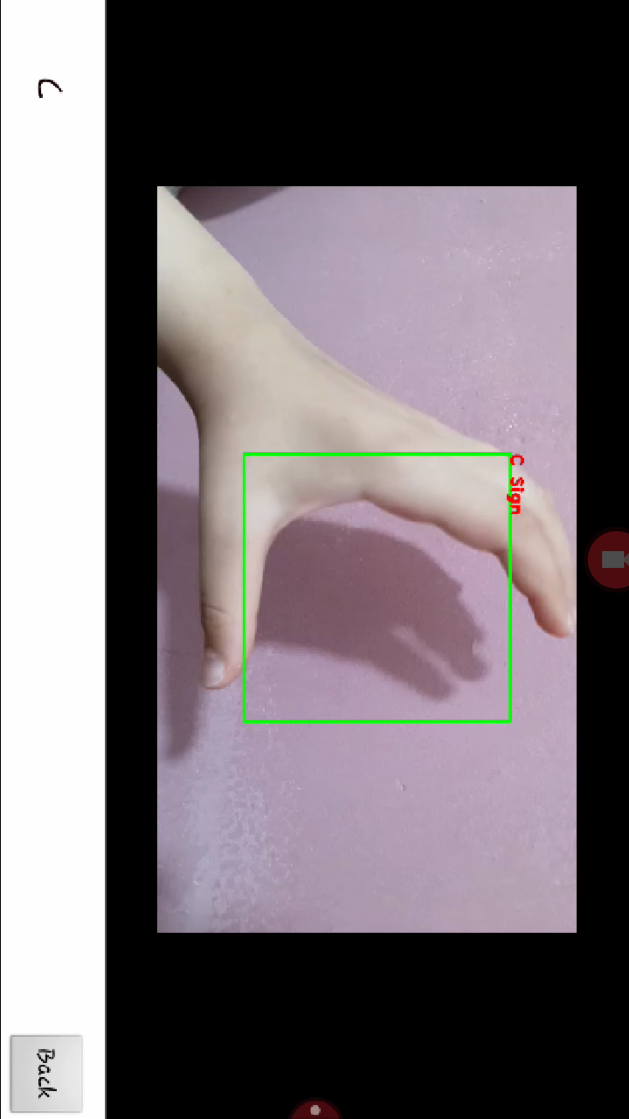
Sign Gesture Recognition Using Haar Cascade Classifier
Adopted

Slide 13
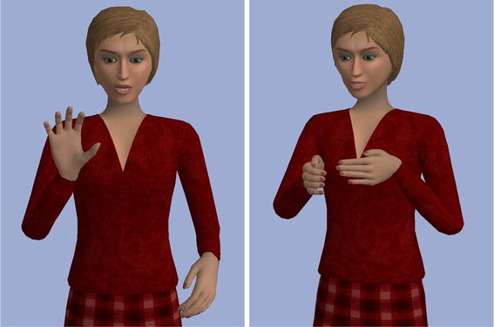
English Text To Sign Gestures Translator
Convert Text to HamNoSys
Convert Symbol
to SIGMAL file
Output in the
Avatar
Type Text

Slide 14
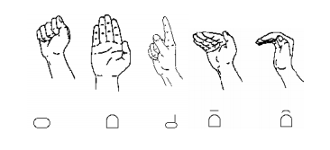
HamNoSys (Hamburg Notation System)
A standard notation to write signs
It consists of description of the posture include
hand shape , hand orientation and hand location.

Slide 15
SiGML language (Signing Gesture Markup Language)
It’s a standard language to describe the symbol of the HamNoSys.
The SiGML language describe the HamNoSys into XML tag.
We use the SiGML file as an input for the Avatar player

Slide 16
JA SiGML URL App
The JA SiGML URL App consist of Avatar which is used to play the sign.
The Avatar or the virtual bodies take the SiGML file as an input to convert
it to animation.
They are three common Avatar, which called “Anna”, “Marc” and “francoise”.

Slide 17
WebView
This webview is an extension of the android view that let you display the
web pages as a part of your activity layout
we built it in web and then use the webview in android to display
it as a web application.

Slide 18
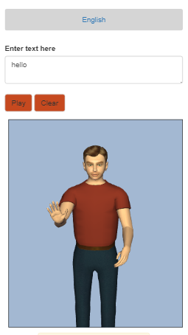
Text to Sign
-Number
-word
-sentence

Slide 19
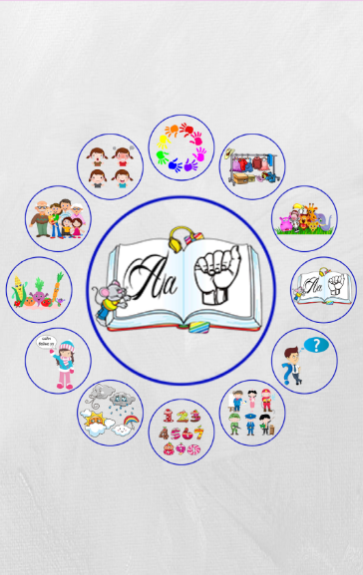
ASL Dictionary
This Feature Contains a dictionary for basic gestures in American Sign language (ASL)

Slide 20
Constraints And Problems:
1
Knowledge
2
Time
3
Resources
4
Animated Character

Slide 21
Future Work:
recognize and track dynamic gestures.
Add a chatting system .
Add more Languages .

Slide 22
Conclusion:
As number of people facing challenges in hearing and speaking or both
due to be born as that or caused by accidents increasing, there still a need
for a technology that allowing them to integrate and interact
with surrounding society.
Despite lack of time and resources we could say that we were able to develop
Android mobile application that could be one day by adding more words
and gestures one of the best apps that helps deaf and dumb society.

Slide 23
Thank you
Notes:
في وضع "عرض الشرائح"، حدد الأسهم لزيارة الارتباطات.

