Slide 1
Developing Manual Procedures for Deanship of Student’s Affairs
Supervisor Name:
Eng. Suleiman AL-Daifi
Group Members:
Anwaar Janem
Raneen Nairat
Farizan Salman
Haneen Rabayaa
Maha Janajra

Slide 2
Outline
Introduction
Problem statement
Project description
Project objectives
Implementation methodology
Literature review
Results
Conclusion and Recommendation

Slide 3
Introduction
The Student Affairs Deanship offers direct supervision of student activities and contributes to students' growth as academics and individual.
It need to be organized as part of the university in order to increase their effectiveness.

Slide 4

Problem Statement
In the Deanship of Student’s Affairs there is no available
procedure manual.

Slide 5
Project Description
In this project, we try to develop the accomplish of work in the Deanship of Student Affairs, depending on the engineering methods and documentation tools

Slide 6
Project objectives
Organized and standardized methods for working.
Reduce administrative efforts in the follow-up actions.
Facilitate the training of new employees.
Identification of the administrative error.

Slide 7
Implementation Methodology
Research and data collection
Interviewing employees and Gathering Needed Data
Developing A Processes Flowcharts
Developing Written Standard Operating Procedures
Developing a job description
Establishing a final report
Reviewing and updating organization structure and job description

Slide 8

Literature Review
Many research, articles and courses
have focused on how to organize and
develop a procedures manual

Slide 9
Cont.
Methods engineering
The selection, development and documentation of the
methods by which work is to be done.
Organizational Structure
How job tasks are formally divided, grouped and
coordinated.

Slide 10
Cont.
Standard Operating Procedures (SOP)
A set of written instructions that document a
routine or repetitive activity followed by an
organization.
Flow chart
Shows the breakdown of task into a separate steps.

Slide 11
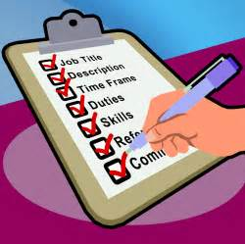
Cont.
Job Description (JD)
Brief statement on job.
List of important functions
of a job.

Slide 12

Prepare Institutional Development
Design a proposed
organizational structure.
Collect all procedures that
implemented in each department in
the deanship.

Slide 13
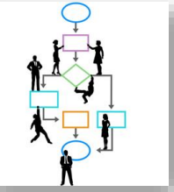
Designing flow charts
for this procedures.
Designing a standardized forms.
Job description.

Slide 14
Results
Developing 30 procedures for each job that accomplish in
the Deanship.
Design 30 flowcharts (flowchart for each procedures).

Slide 15
Cont.
Designing a job description card for each job title of the Deanship.
Development of some existing forms and design some of a new forms they are necessary for some procedures.

Slide 16
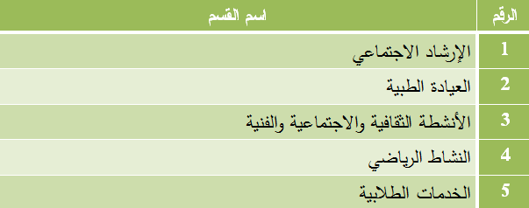
Divisions of Deanship of Student’s Affairs

Slide 17
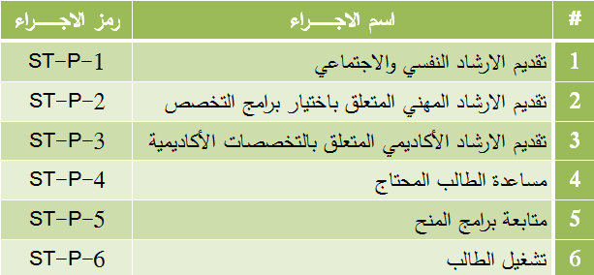
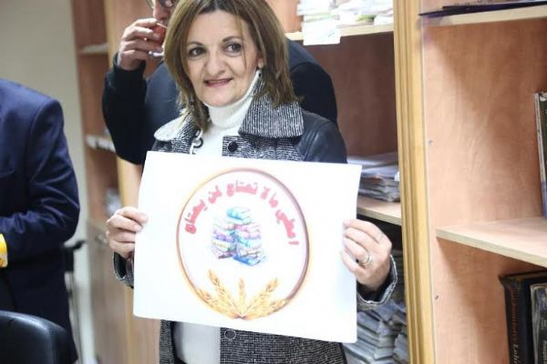
Social Counseling

Slide 18
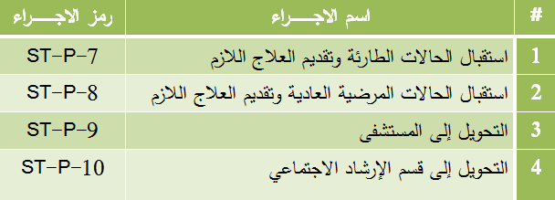
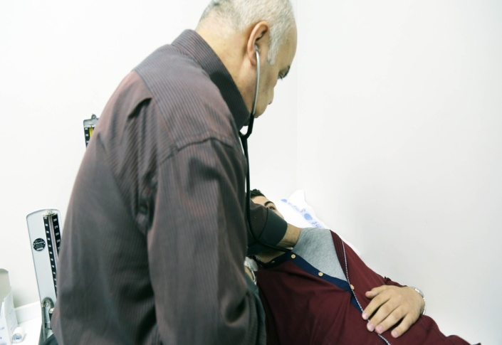
Medical clinic

Slide 19
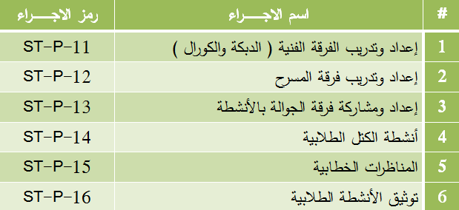
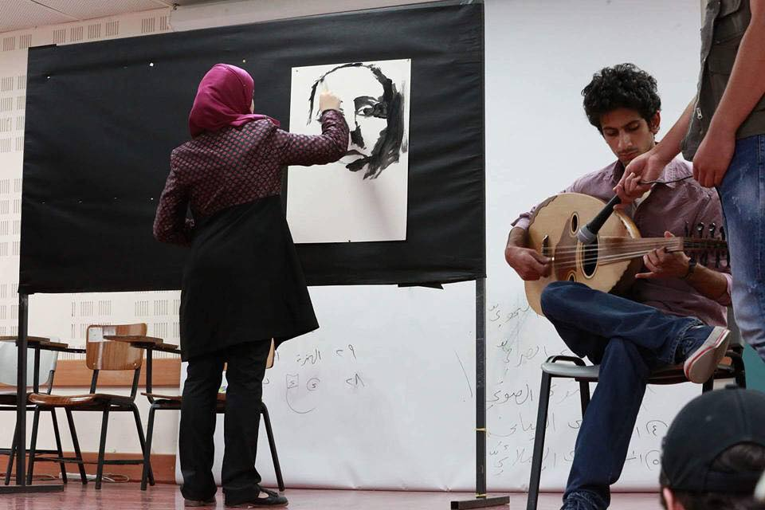
Cultural, social and artistic activities

Slide 20
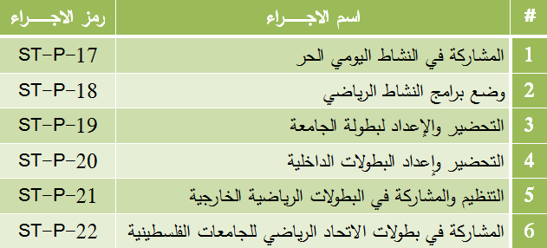
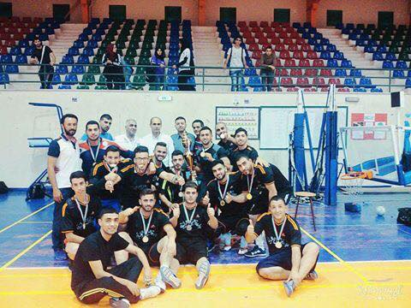
Sport activities

Slide 21
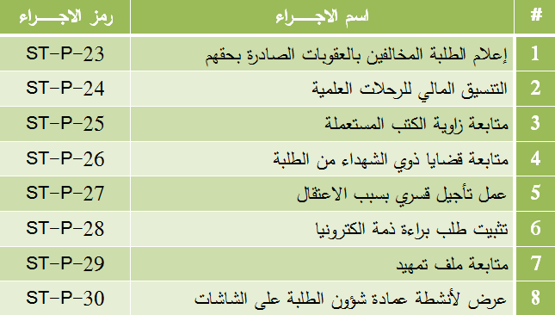
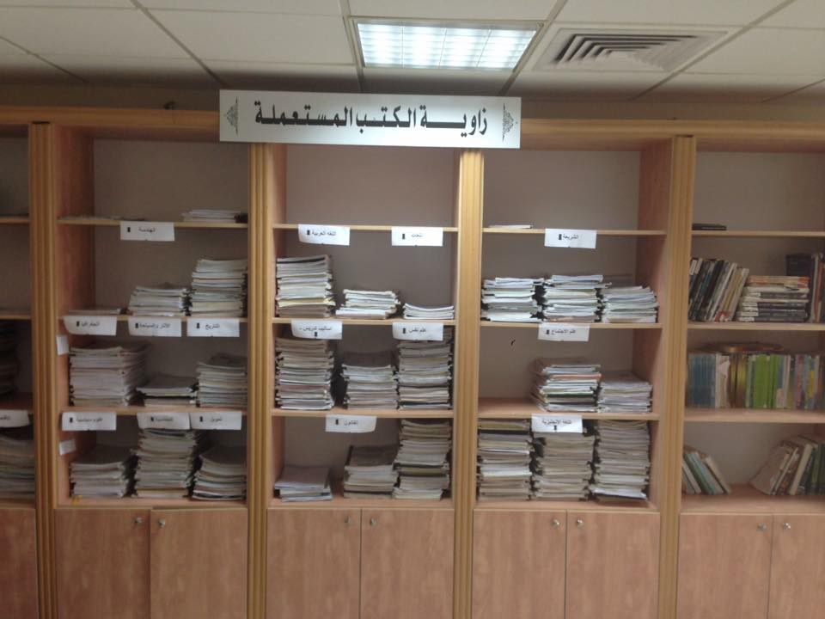
Students services

Slide 22
Conclusions
Documentation of all operations and activities in each section through flow chart to understand the activities and improve communication between departments.
SOP helps build a culture of perfection and in-depth thinking.
Job description helps to manage employees and to increase the individual accountability.

Slide 23
Recommendation
Creating electronic communication instead of using paper correspondence between the departments to reduce the time and effort.
Improve all computers system in to facilitate all action in each department.

Slide 24


