Slide 1



DRIVE PRO

Slide 2

OUR
TEAM
Ahmad Awad
Mohammad Salha
SUPERVISOR
DR. Oula Mardawi

Slide 3
CONTENT
01
Introduction
04
Main Features
02
Problem & Solution
05
system Implementation
03
Student Journey
06
Challenges & Future Work

Slide 4
Introduction
Every journey is a series of
automated steps forward

Slide 5
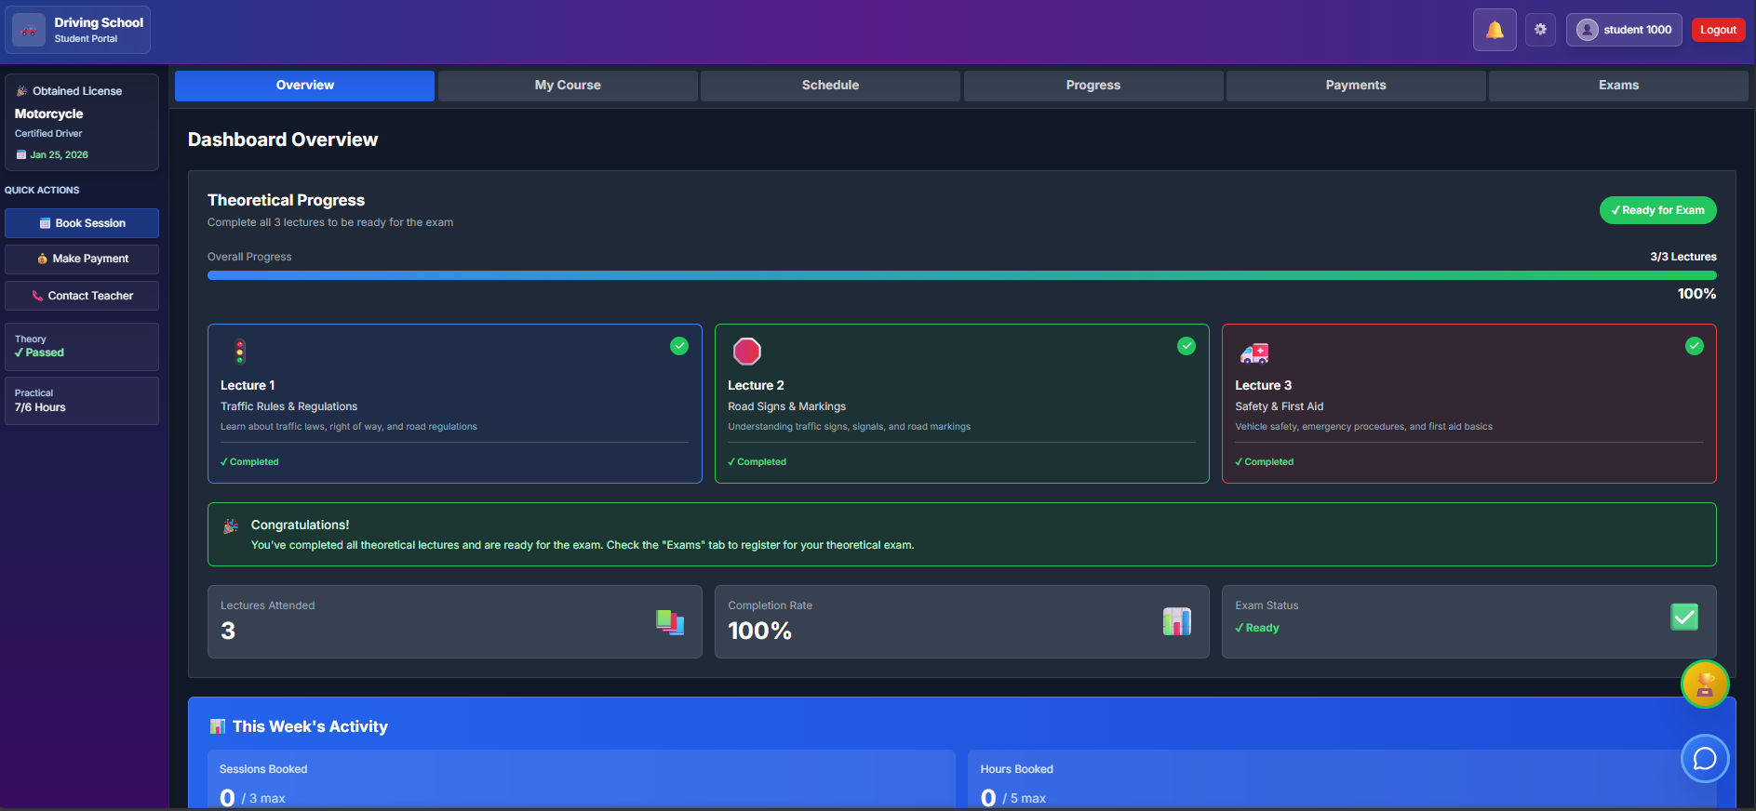
Project overview :
What Did We Build?
• Multi-Platform System: Web application and Mobile app • 4 User Roles: Admin, Student, Teacher, Trainer. • Complete Automation: From enrollment to license certification • Real Integrations: Stripe payments, Firebase notifications

Slide 6
Problem & Solution
From Manual Chaos to Digital Clarity

Slide 7


Challenges :
Scheduling Chaos: Phone calls and WhatsApp messages for every booking, leading to double-bookings, missed sessions, and 10+ hours/week wasted on coordination
Lost Training Records: Paper attendance sheets disappear or get damaged, causing disputes at exam time when students can't prove their completed hours
Payment Disputes: "I paid you last week!" vs "No, you didn't" - Zero paper trail creates conflicts and untracked revenue loss

Slide 8
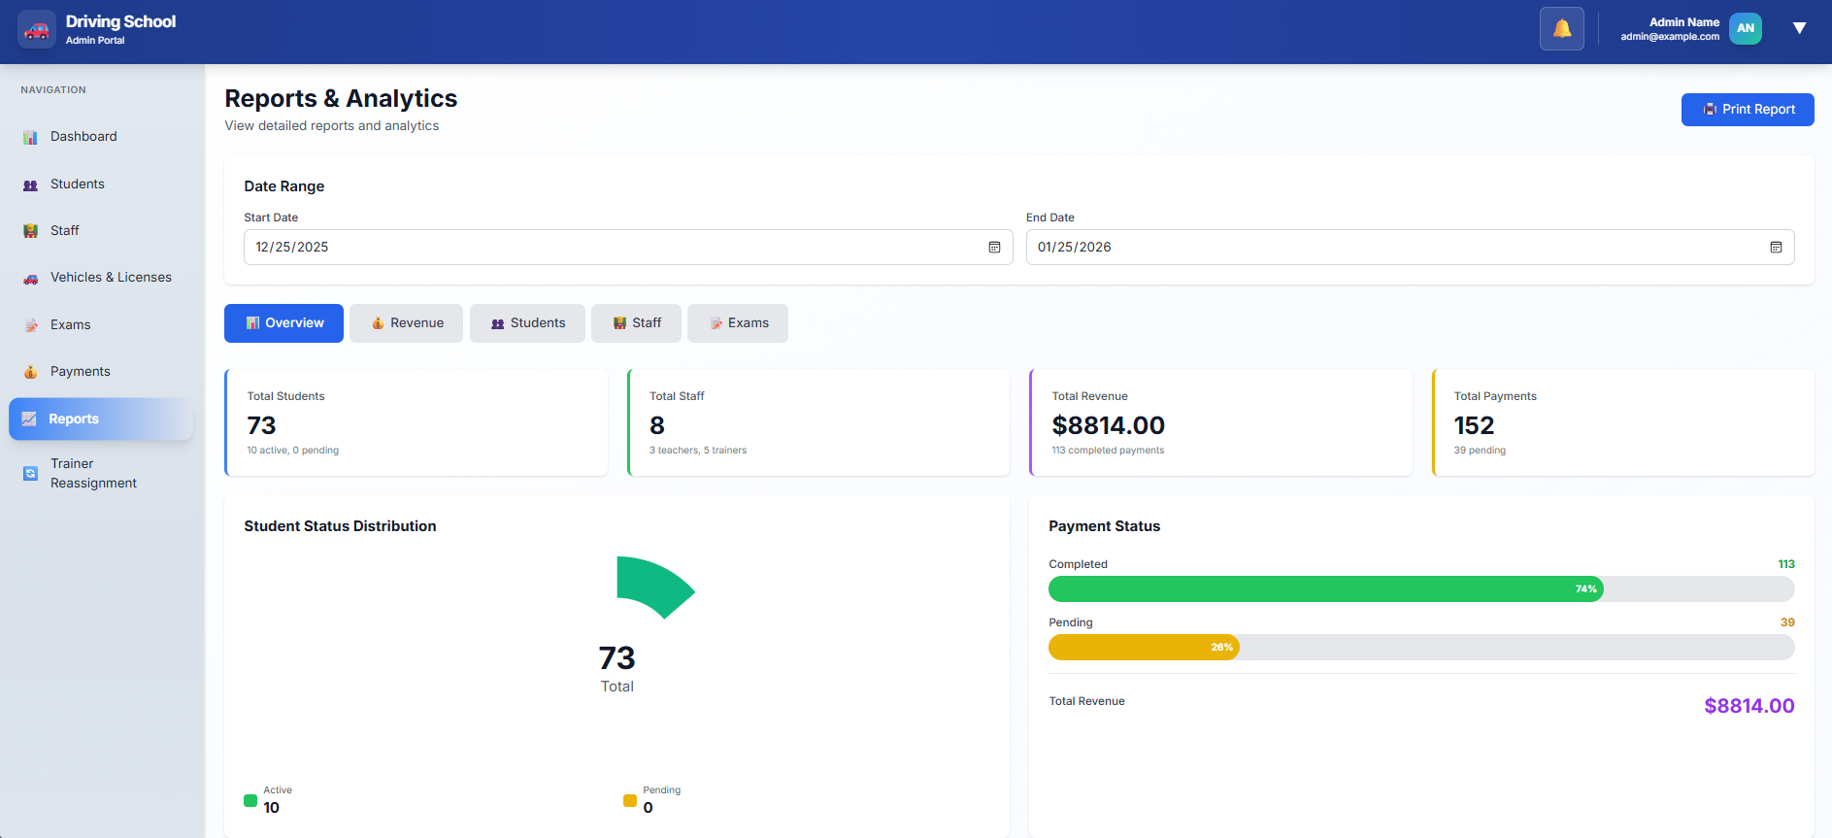
Our Solution :
Automated booking system prevents conflicts with real-time availability
Digital attendance tracking with instant notifications to all parties
Dual payment system: Instant online payments + verified cash tracking

Slide 9




U SER ROLES
STUDENT
TRAINER
TEACHER
Admin

Slide 10
STUDENT JOURNEY
Every journey is a series of
automated steps forward

Slide 11
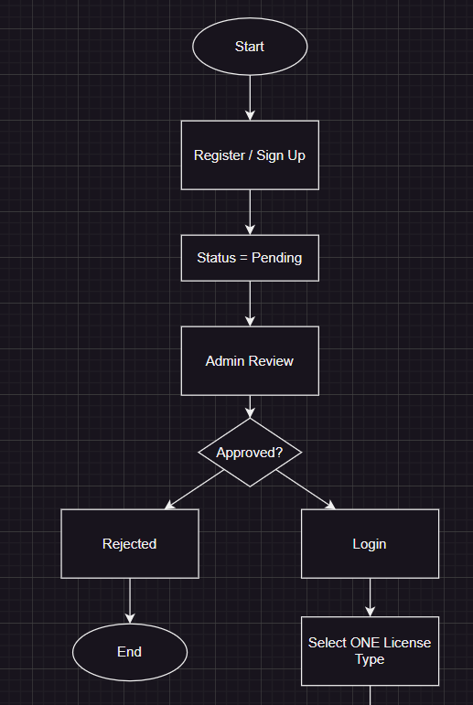
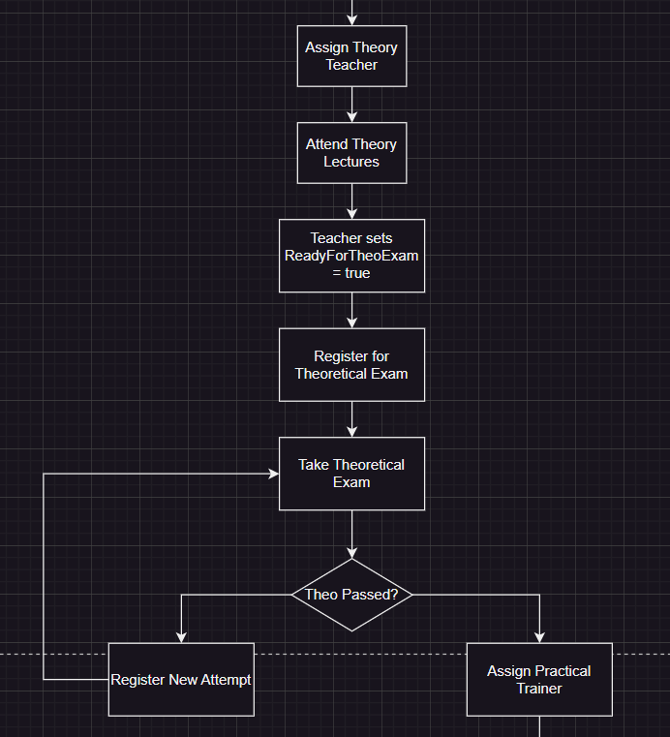

Complete Student Journey

Slide 12
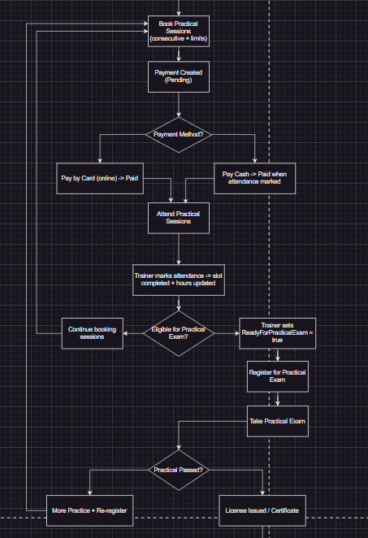
Continue :

Slide 13
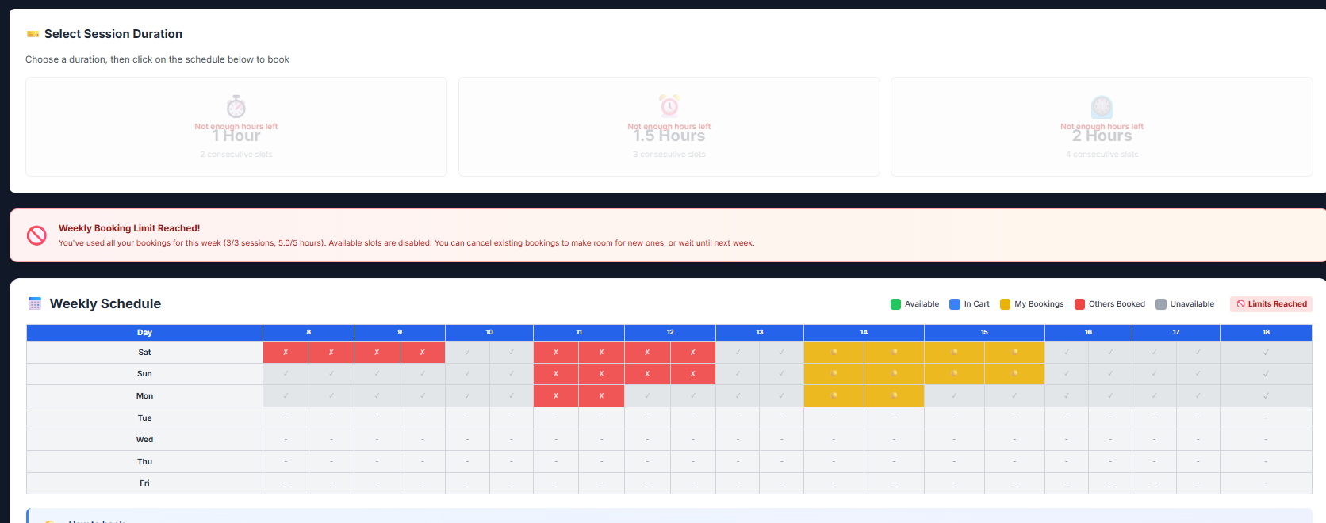
Smart Booking Rules :
Maximum 3 sessions per week to prevent student overload
Maximum 5 training hours per week for safety and learning effectiveness
One session per day rule ensures proper rest between practice

Slide 14
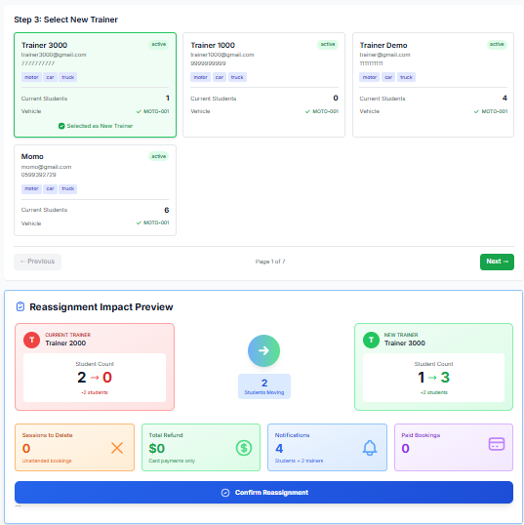
Trainer Reassignment :
Automatic cleanup: Cancels future bookings and refunds card payments
Preserves completed sessions for accurate historical records
Instant notifications sent to student, old trainer, and new trainer

Slide 15
Main Features
Innovation through intelligent
automation and integration

Slide 16
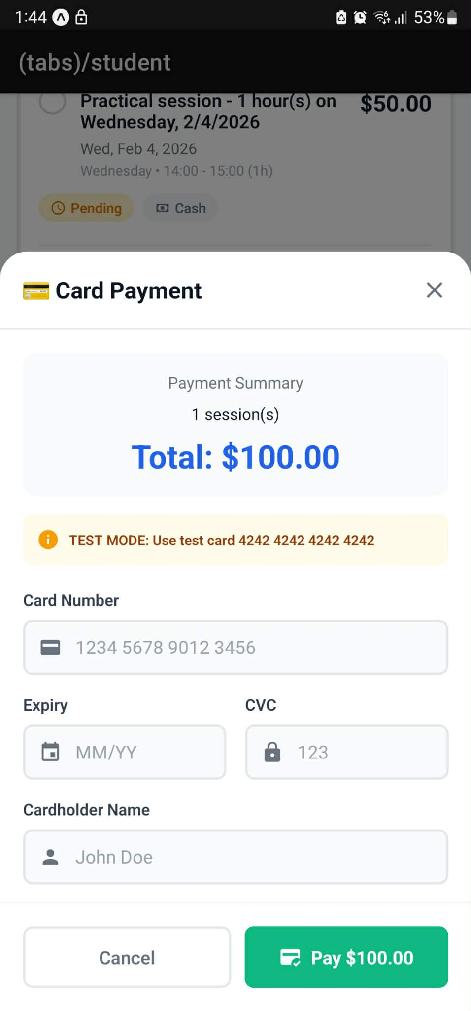
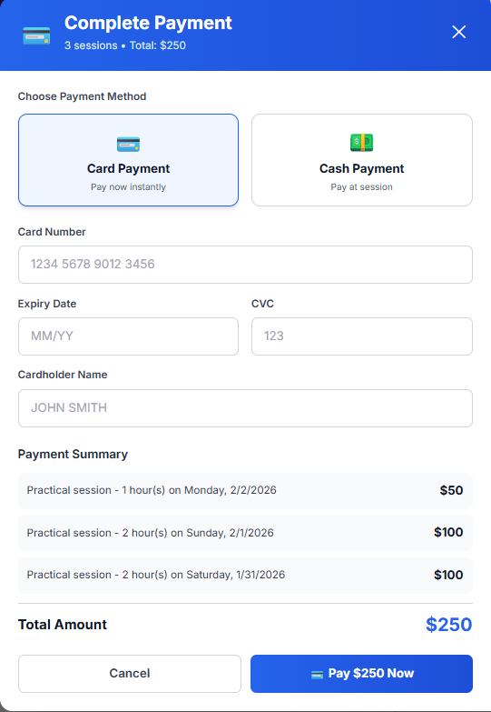
Dual Payment System
Automated booking system prevents conflicts with real-time availability
Digital attendance tracking with instant notifications to all parties
Dual payment system: Instant online payments + verified cash tracking

Slide 17
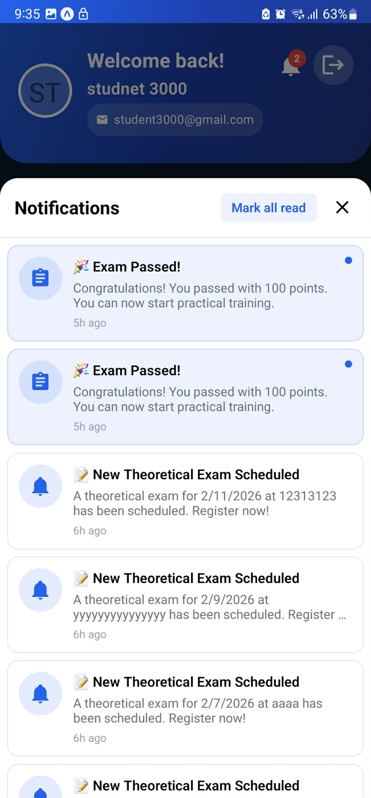
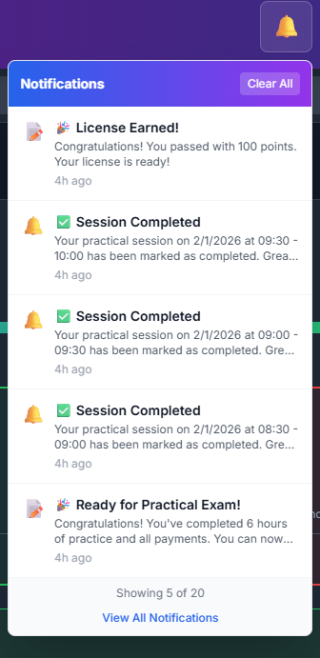
Push Notifications :
Real-time alerts for bookings, cancellations, and exam results
Multi-device support: Web and mobile notifications synchronized
Reduces missed sessions with timely reminders

Slide 18
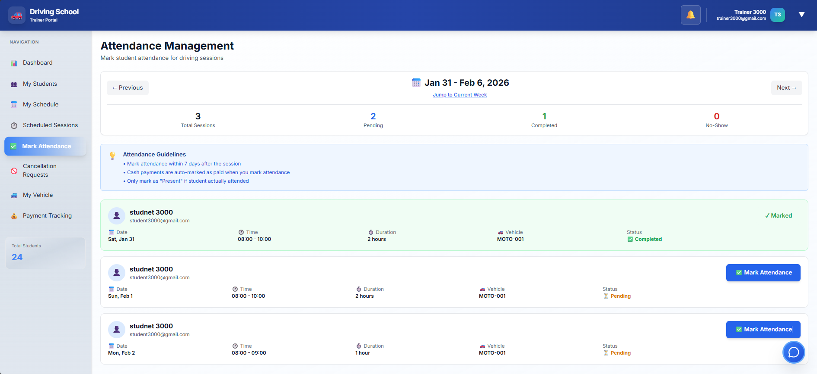
Attendance Tracking :
Digital records replace paper logs for accuracy
Automatic payment status updates when attendance marked
Progress tracking synced with minimum hour requirements

Slide 19
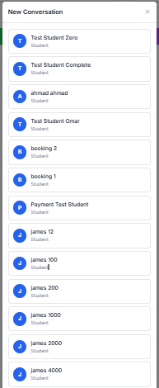
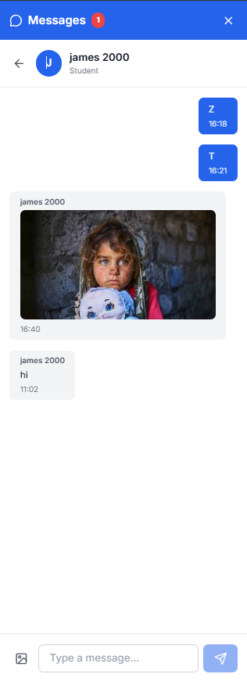
Messaging System :
Direct messaging between students and assigned teachers/trainers
Image attachments for sharing documents or questions
Broadcast messages for announcements to all students

Slide 20
System Implementation
Building tomorrow's solutions
with today's technology

Slide 21
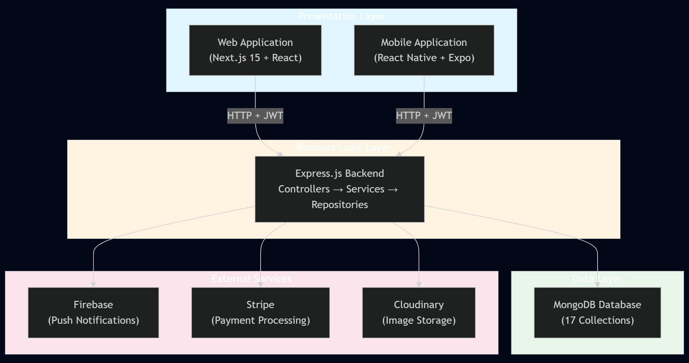
System Architecture
Layered backend: Controllers → Services → Repositories for clean separation
Multi-platform frontend: Next.js web + React Native mobile with shared API
Real-time features: Push notifications via Firebase, live booking updates

Slide 22






TECHNOLOGIES
Backend:
Node.js + Express
MongoDB database
JWT authentication
Frontend:
Next.js (Web)
React Native + Expo (Mobile)
TypeScript + Tailwind CSS
Integrations:
Stripe payments
Firebase notifications
Cloudinary storage

Slide 23
Future Work
Learning from today,
building for tomorrow

Slide 24
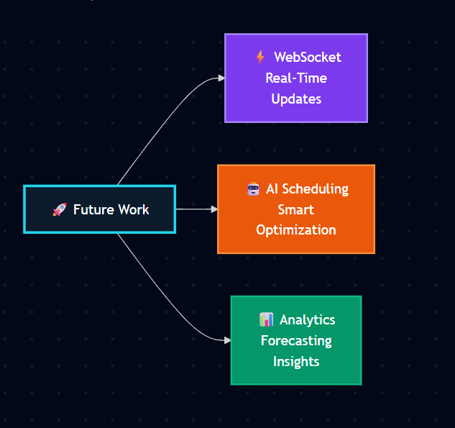
FUTURE WORK
Real-time WebSocket integration for live booking updates
AI-powered scheduling to optimize trainer availability and student preferences
Advanced analytics dashboard with revenue forecasting and retention metrics

Slide 25



THANK
FOR
LISTENING

