Slide 1
Object detection
and
tracking system
Done by :Oraib Daas
Safa Shehada
Supervisor :Dr. Ashraf Armoush
Dr.Emad Natsheh

Slide 2
Introduction
Object detection and tracking system is vast and complex area of computer vision where robustness, accuracy and run-time performance are of critical importance, due to increase its utilization in monitoring , security and many other application .

Slide 3
Motivations
People are looking for a way to ensure their safety .
Detection for moving object is a very challenging for any video surveillance system. Object Tracking is used to find the area where objects are available and shape of objects in each frame in higher level application

Slide 4
Hardware components
Raspberry Pi 3 modal b
Raspberry pi camera
Arduino Uno
H-Bridge
DC motor
Step-down converter

Slide 5
Methodology

Slide 6
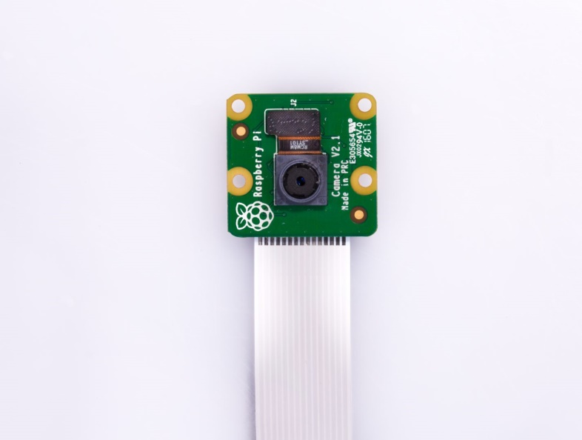
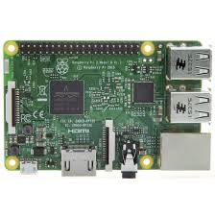
Raspberry pi camera
Raspberry Pi 3 modal b

Slide 7
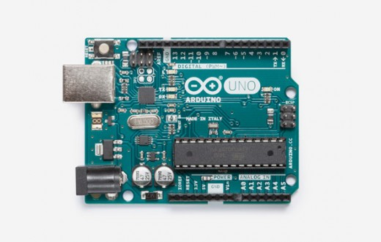
Arduino Uno
It’s used for serial communication

Slide 8
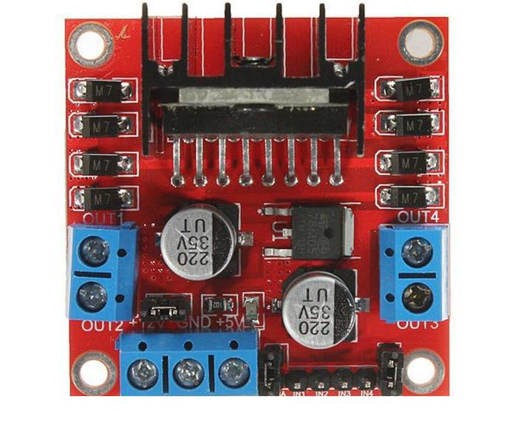
H-Bridge
It’s control DC motors to run forwards or backwards.
And it enables a voltage to be applied across a load in opposite direction

Slide 9
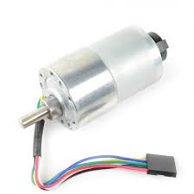
DC motor
It rotated in such a way that wherever the object moves.

Slide 10
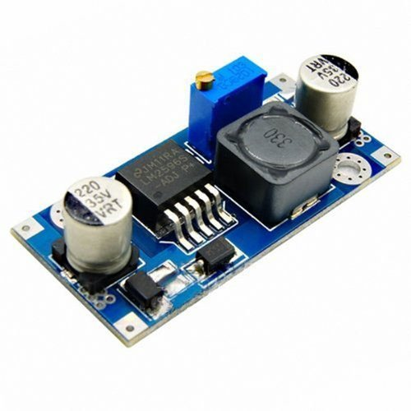
Step-down converter
which steps down voltage (while stepping up current) from its input (supply) to its output (load).
We use it because the DC motors voltage is 12v and the Raspberry pi is 5 volt.

Slide 11
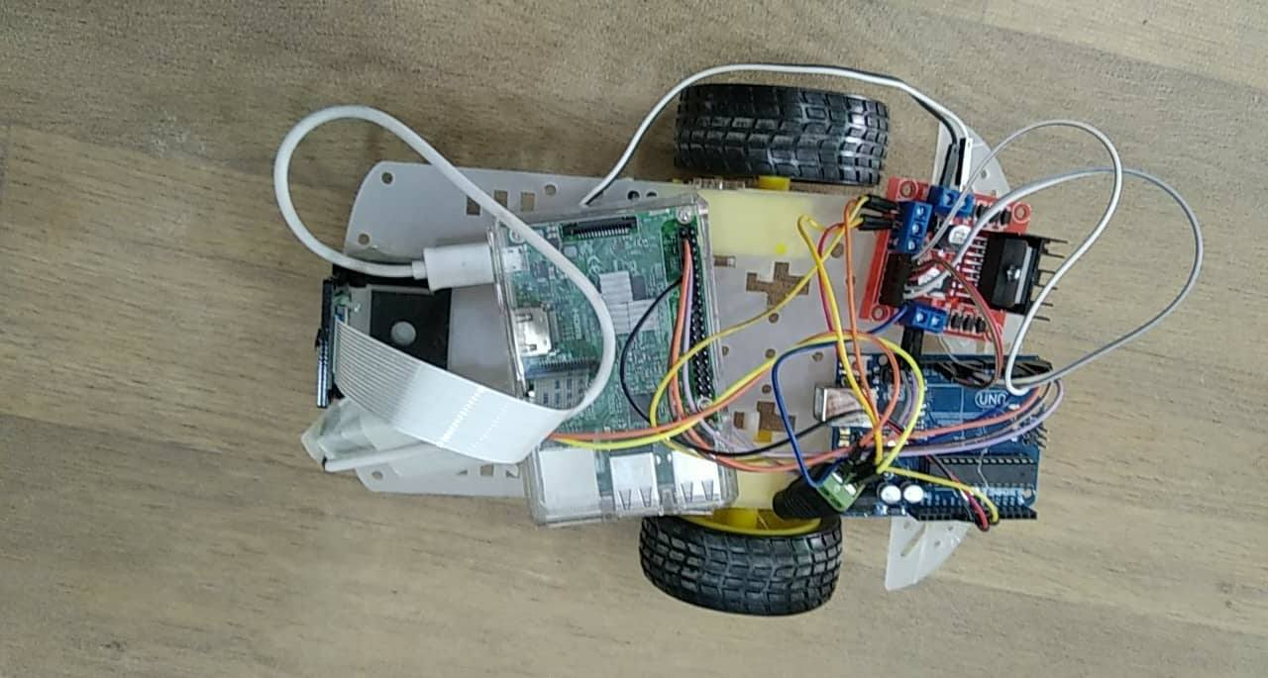
Final Design

Slide 12
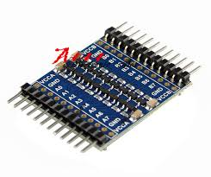
Challenges
Difference in voltage levels between Raspberry Pi and Arduino, where output voltage level from Raspberry Pi 3.3 volts is the input voltage for Arduino that works on 5 volt .so, we solved this problem using level shifter.

Slide 13
Raspberry Pi has burned two weeks before the project ended because of the high temperature that caused by the image processing. Then we ordered another one, which literally means more money to pay

Slide 14
Future work
Our future work will focus on make this project work with more functionality as detect different shapes and faces

Slide 15
Conclusion
The objective is to build a model that can detect and track the object depend on a specified color and that works on the basis of visual data captured from a typical camera which has a fair clarity.

Slide 16
Project Demo

