Slide 1
Smart Grid “Grouping “

Slide 2
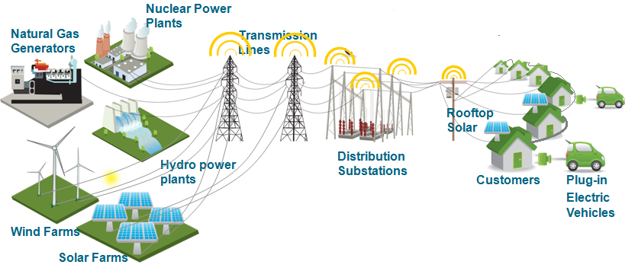

Slide 3
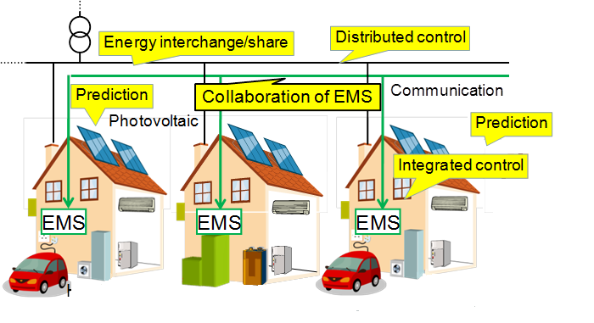

Slide 4
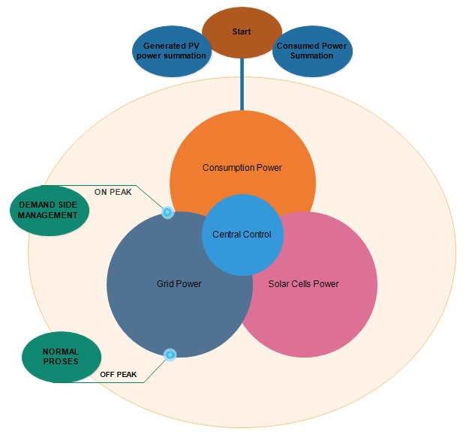

Slide 5
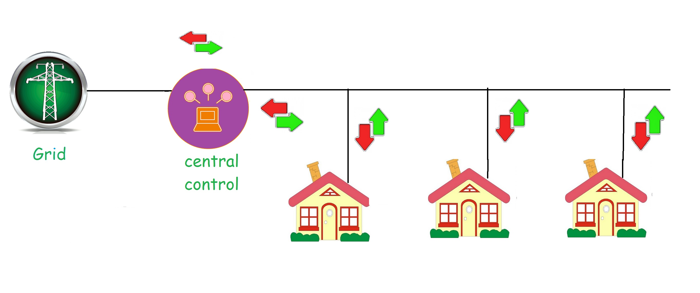

Slide 10
Benefits And Recommendations
Less payback period
Makes power system more reliable
Cleaner and greener enviroment

