Slide 1
OSBT
Presented by: Ameen Kharma
Sohaib Shayeb
Supervisor: Dr.Luai Malhis

Slide 2
Outline
Introduction.
Motivation.
Features.
How does it work.
Technologies.
Methods & Techniques.
Constraints.
Future work & recommendations.

Slide 3
What is OSBT ?
OSBT stands for: Optimus School Bus Tracker.
It’s a cross-platform mobile application that tracks the movement of school buses, and provides a noti-communication system.

Slide 4
Motivation
Transportation in Palestine suffers from traffic jams.
Students face difficulties to get to school in time.
Students go through a lot of dangers while waiting in streets for the bus.
3G Availability.

Slide 5
Features
GPS tracking tool for students’ parents.
Display the shortest distance for the bus driver.
Communication system that provides a level of direct communication between the parents and teachers.
A calendar where the principle can add special events and occasions.

Slide 6
Noti-communication system:
  Provides parents with the latest happenings at school.
  update them on the whereabouts of their children.
  Send a notification to the parents when the bus is about to arrive.
  Send a notification when the bus arrives.
  Send a notification from the bus to the parents, to tell them if it’s going to be late for some reason.
  Broadcast a notification for all about occasions and holidays.

Slide 7





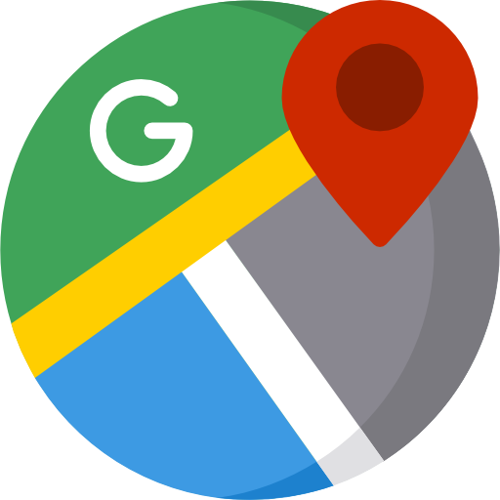

Technologies

Slide 8
React-Native
JavaScript framework for writing native mobile applications for iOS and Android.
React Native applications are written using JSX.
React Native Apps will render using mobile components.

Slide 9
It’s one of the top mobile JavaScript frameworks among the developers.
React-Native is all about the UI.
Apply React Native UI components to an existing app’s code

Slide 10
Node Js
Platform built on Chrome's JavaScript runtime for easily building fast, scalable network applications.
Node.js uses an event-driven model that makes it lightweight and efficient.
Event-driven means that the server only reacts when an event occurs.

Slide 11
Firebase
Firebase Real-time Database is a cloud-hosted database.
Data is stored as JSON and synchronized in real-time to every connected client.
It stores and syncs data with our NoSQL cloud database.
Data is synced across all clients in real-time, and remains available when our app goes offline.

Slide 12
OneSignal
OneSignal as a third party API to send Push Notifications.
Reliable services that can be used for both mobile application and websites.
It’s free, easy to use and supported with helpful documentations.

Slide 13
Methods & Techniques
Registration.
Home page & Navigation.
Noti-Communication system.
Database.

Slide 14
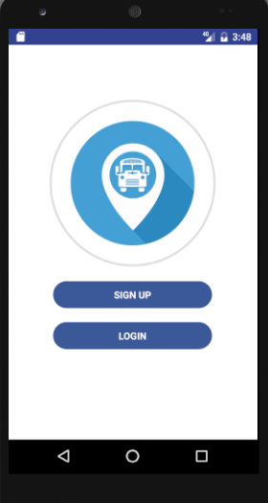
Registration

Slide 15
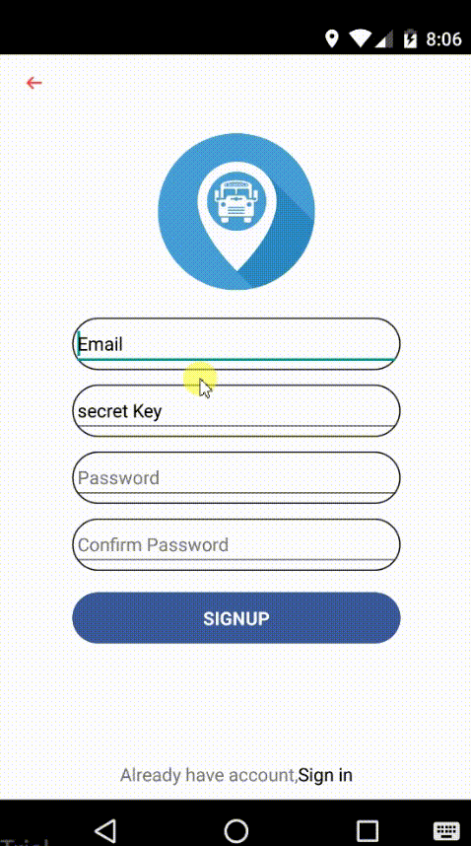
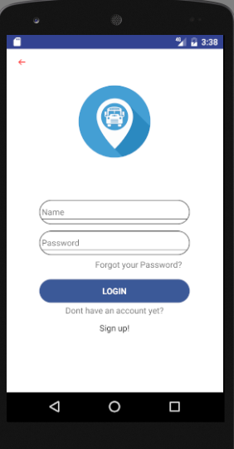

Slide 16
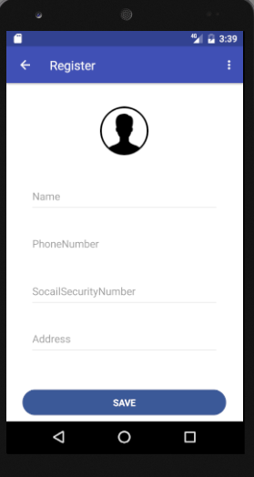
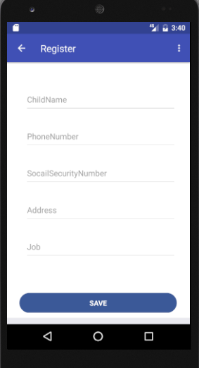

Slide 17
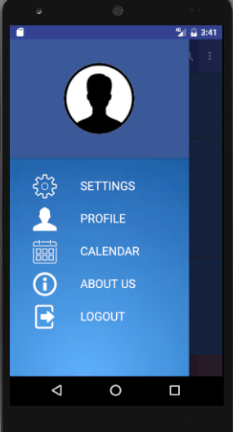
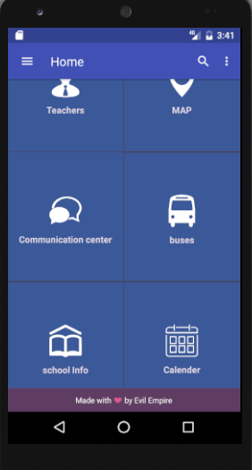
Home & Navigation

Slide 18
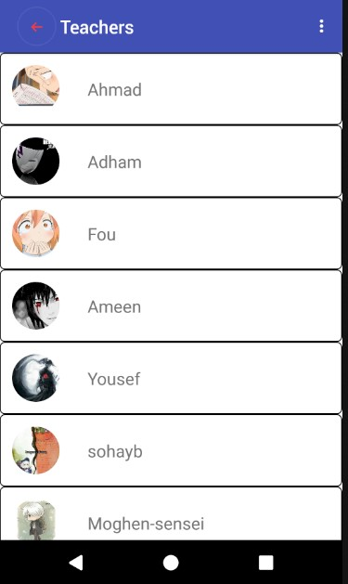
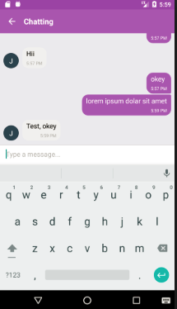

Slide 19
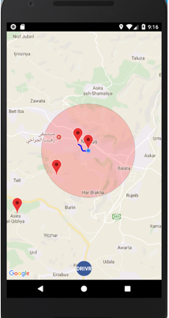
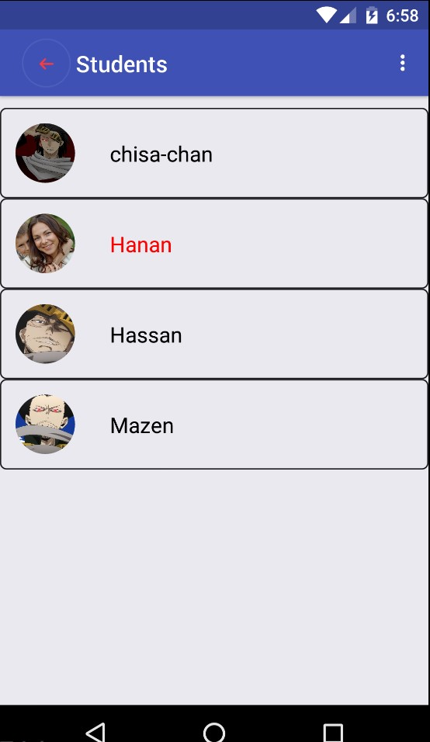

Slide 20
Noti-Communication system
Parents provide the needed information about their location.
After rendering the map, every parent that is assigned to that driver will appear at the map.
The app calculates the distance between each node and the driver node.
It will sort the nodes according to the distance,so we will get the shortest distance.

Slide 22
A routing path between the bus node and the closest node (house) will be shown.
When that node enters the bus range the first notification will be sent automatically to the target device.
If many nodes are located nearby each other, the first node that enters the range will cause the app to send the first notification to other nodes as will.
When the bus is within the parent house range, the second notification will be sent.

Slide 23
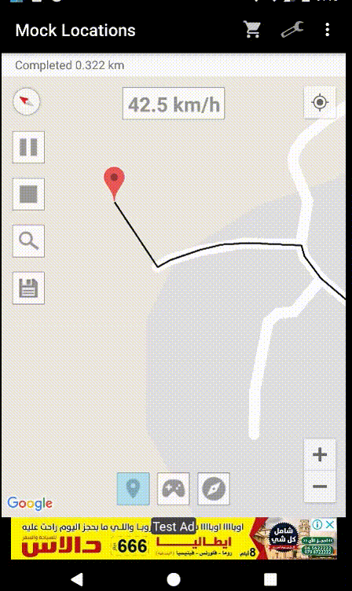
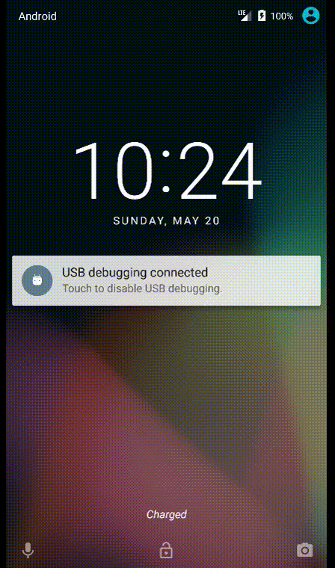

Slide 24
The parents will be notified if the bus is late.
If a student wont go to the school for some reason, the parent can send a message to the bus and the school authority.
The principle can broadcast a message to all of the parents and teachers to tell them about special events or occasions.
Direct communication between the parents and teachers, so the parents can enquire about their child academic performance.

Slide 25
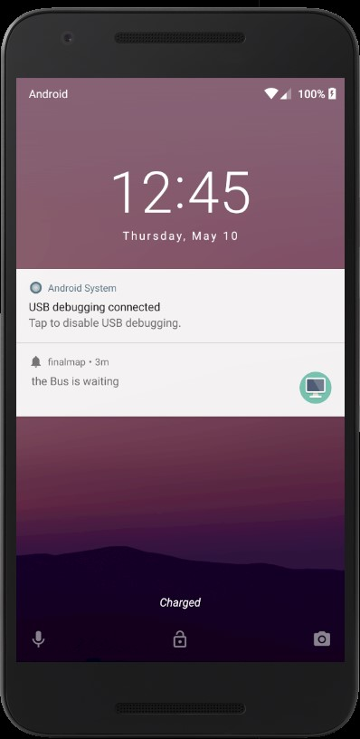

Slide 26
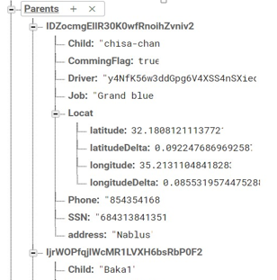
Database

Slide 27
Constraints
Shortage of Time.
React Native setup is tedious and annoying.
  Documentations: most of react native documentations were about basic concepts.
A lot of things we needed to learn:
  Android Studio: to test and build our app.
  JSX: To produce react components, render elements, etc.
  ES6: We only have basic familiarity with the JavaScript syntax.

Slide 28
Future work
Build a React for web based site for the principle.
Calculating the fastest path.
Organize the school semester like grades and lectures.
Manage the school buses and students.
The calendar.
The chat.

