Slide 1

Smart Traffic Lights Network For Nablus City
Faculty of Engineering
Electrical Engineering Department
Presented by: Rami Bsharat
Abbas Ramadan
Emad Aqel
Abd Alrahman Snobar
Supervisor: Dr. Samer Mayyalih
24/12/2018
Smart Traffic Lights Network For Nablus City
Electrical Engineering

Slide 2
Outline
Controller & HMI screen (Monitoring )
Project Idea in general
emergency
Feasibility study
Synchronization
Each intersection is on its own
1
2
3
4
5
6
24/12/2018
Smart Traffic Lights Network For Nablus City
Electrical Engineering

Slide 3
● What is the idea of the project
Project Idea in general
Controller & HMI screen
Monitoring
Each intersection is on its own
Synchronization
emergency
Feasibility study
1/3
- Traffic system is essentially interacting with the traffic situation moment by moment
24/12/2018
Smart Traffic Lights Network For Nablus City
Electrical Engineering

Slide 4
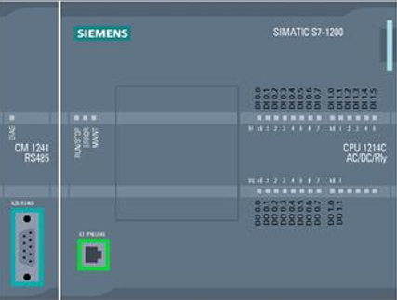
Project Idea in general
Controller & HMI screen
Monitoring
Each intersection is on its own
Synchronization
emergency
Feasibility study
Controller
PLC siemens S7-1200
Contain 24 input, 22 digital input and 2 analog input.
Contain 6 output, 4 digital output and 2 analog output.
1/1
24/12/2018
Smart Traffic Lights Network For Nablus City
Electrical Engineering

Slide 5
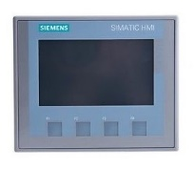
Project Idea in general
Controller & HMI screen
Monitoring
Each intersection is on its own
Synchronization
emergency
Feasibility study
HMI
What is HMI and why we use it in our project ?
-
1/1
24/12/2018
Smart Traffic Lights Network For Nablus City
Electrical Engineering

Slide 6
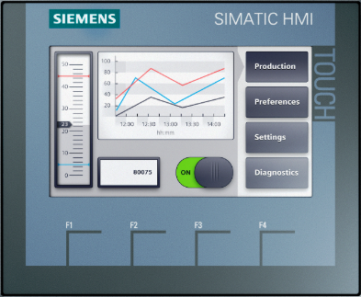
Project Idea in general
Controller & HMI screen
Monitoring
Each intersection is on its own
Synchronization
emergency
Feasibility study
HMI
Human Machine Interface (HMI)
We use a Tia Portal V14 SP1
interface between the process and
the operators
1/1
24/12/2018
Smart Traffic Lights Network For Nablus City
Electrical Engineering

Slide 7
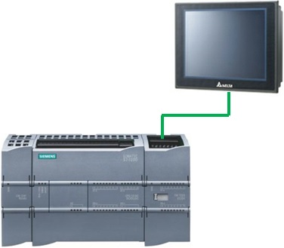
Project Idea in general
Controller & HMI screen
Monitoring
Each intersection is on its own
Synchronization
emergency
Feasibility study
Connection between PLC && HMI

Slide 8
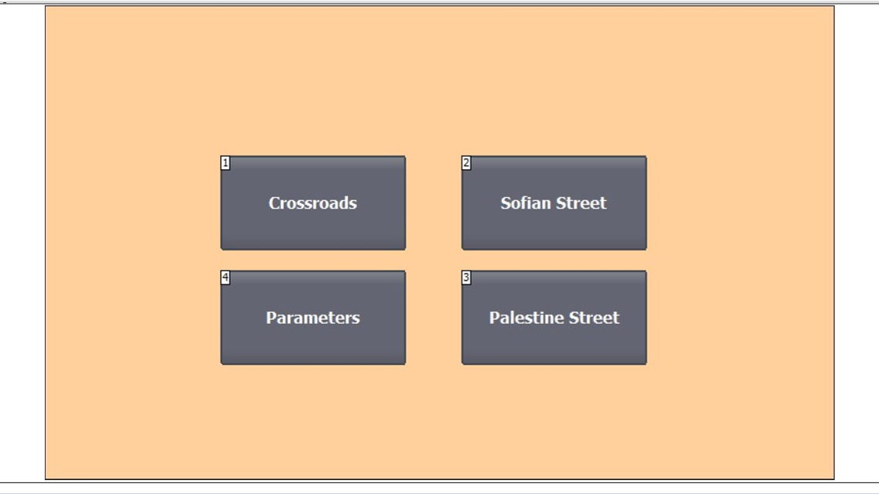
Project Idea in general
Controller & HMI screen
Monitoring
Each intersection is on its own
Synchronization
emergency
Feasibility study
Traffic congestion problem
we worked on the TWO mechanisms :
1. Each intersection is on its own.
2. Synchronization.
3. Emergency
1/1
24/12/2018
Electrical Engineering
Smart Traffic Lights Network For Nablus City

Slide 9
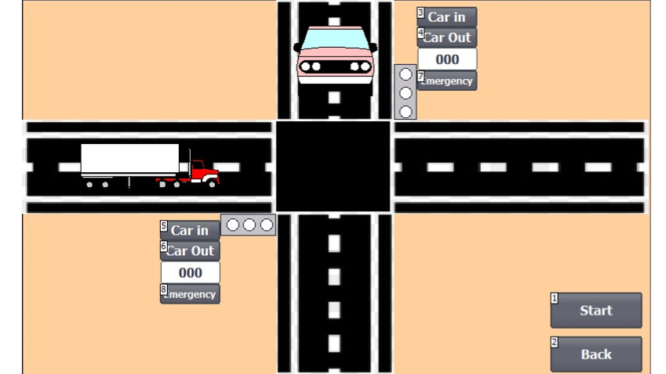
Project Idea in general
Controller & HMI screen
Monitoring
Each intersection is on its own
Synchronization
emergency
Feasibility study
1. Each intersection is on its own
For example… BOP-PS INTERSECTION ……
1/1
24/12/2018
Electrical Engineering
Smart Traffic Lights Network For Nablus City

Slide 10
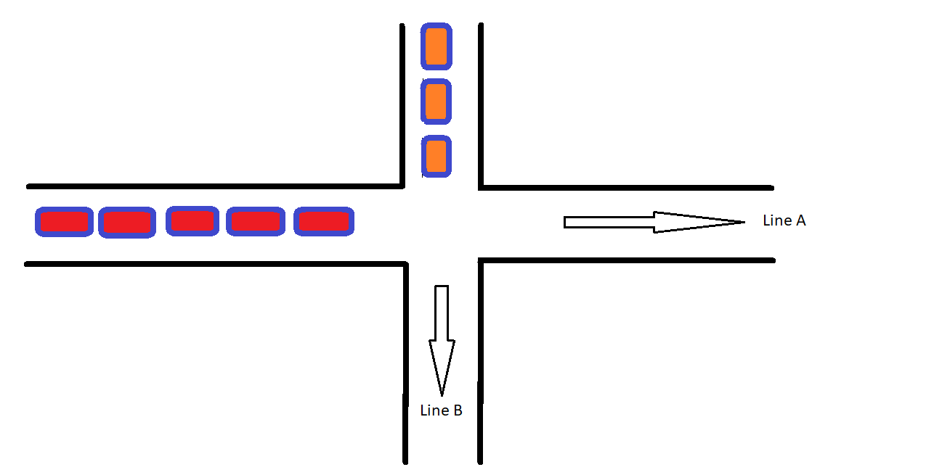
Project Idea in general
Controller & HMI screen
Monitoring
Each intersection is on its own
Synchronization
emergency
Feasibility study
1. Each intersection is on its own
solve the congestion problem at the intersection itself by giving the time to pass the cars that stand on the red signal
1/1
24/12/2018
Electrical Engineering
Smart Traffic Lights Network For Nablus City

Slide 11
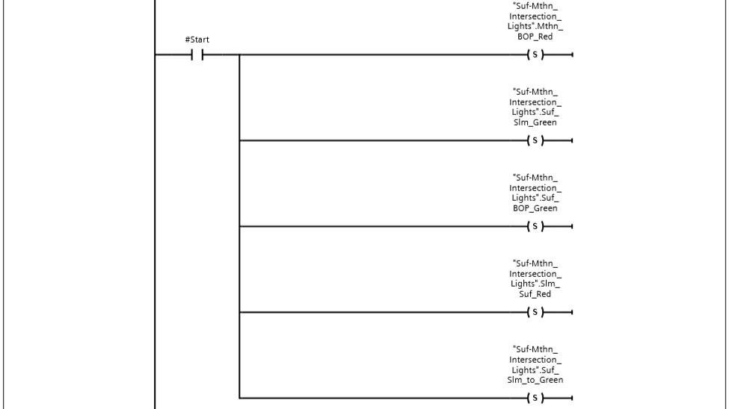
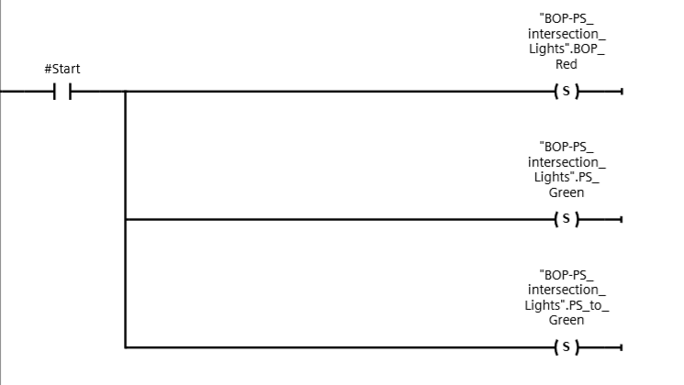
Project Idea in general
Controller & HMI screen
Monitoring
Each intersection is on its own
Synchronization
emergency
Feasibility study
Initial Case For BOP-PS Intersection && initial case for muthana-suf intersection

Slide 12
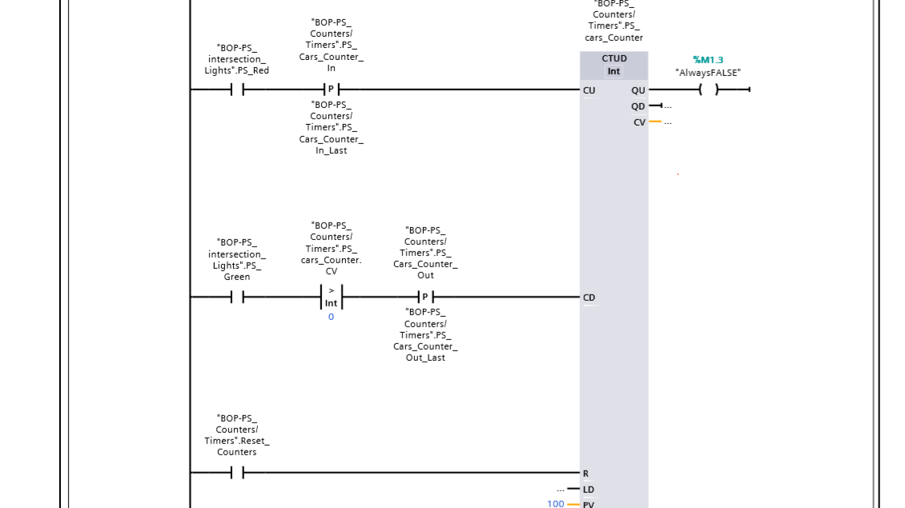
Project Idea in general
Controller & HMI screen
Monitoring
Each intersection is on its own
Synchronization
emergency
Feasibility study
Count the cars one each line in one intersection

Slide 13
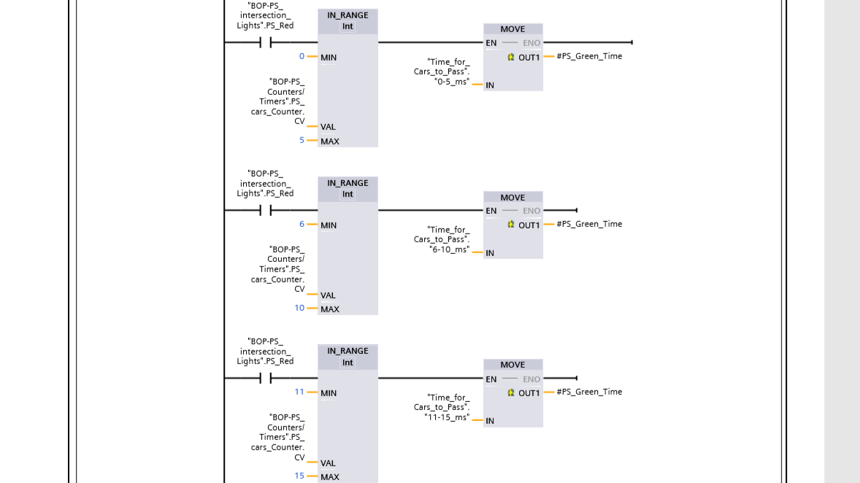
Project Idea in general
Controller & HMI screen
Monitoring
Each intersection is on its own
Synchronization
emergency
Feasibility study
Control with time for each line in one intersection

Slide 14
Project Idea in general
Controller & HMI screen
Monitoring
Each intersection is on its own
Synchronization
emergency
Feasibility study
2. Synchronization
idea is to give the priority to certain ways or Paths of roads and at certain times require it
1/1
24/12/2018 Smart Traffic Lights Network For Nablus City Electrical Engineering

Slide 15
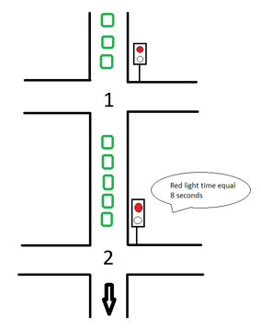
Project Idea in general
Controller & HMI screen
Monitoring
Each intersection is on its own
Synchronization
emergency
Feasibility study
for example...
1/1
24/12/2018
Smart Traffic Lights Network For Nablus City
Electrical Engineering

Slide 16
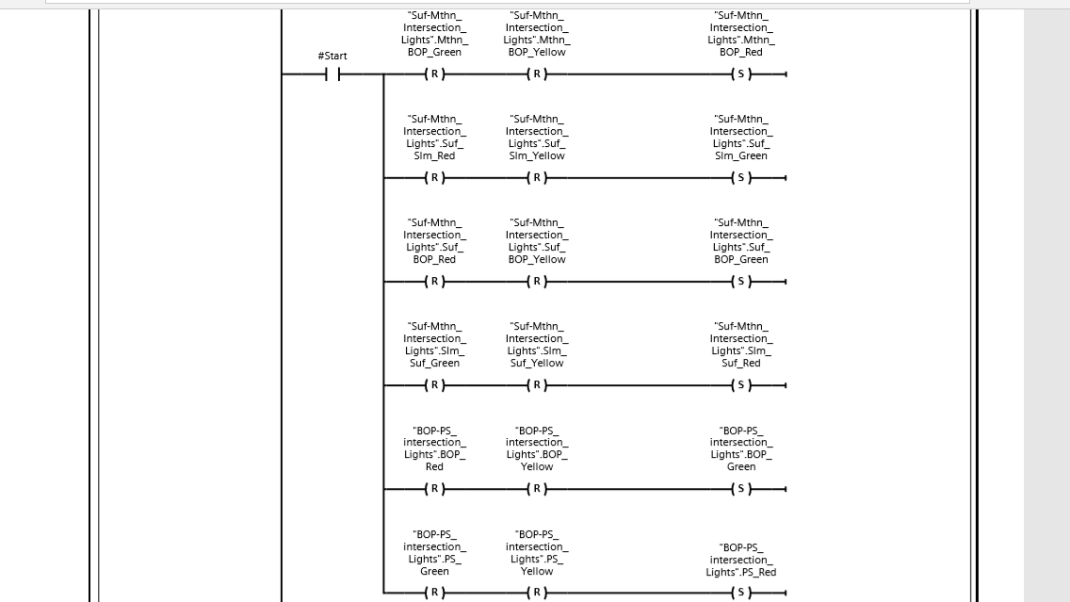
Project Idea in general
Controller & HMI screen
Monitoring
Each intersection is on its own
Synchronization
emergency
Feasibility study
Initial for each intersection in synchronization

Slide 17
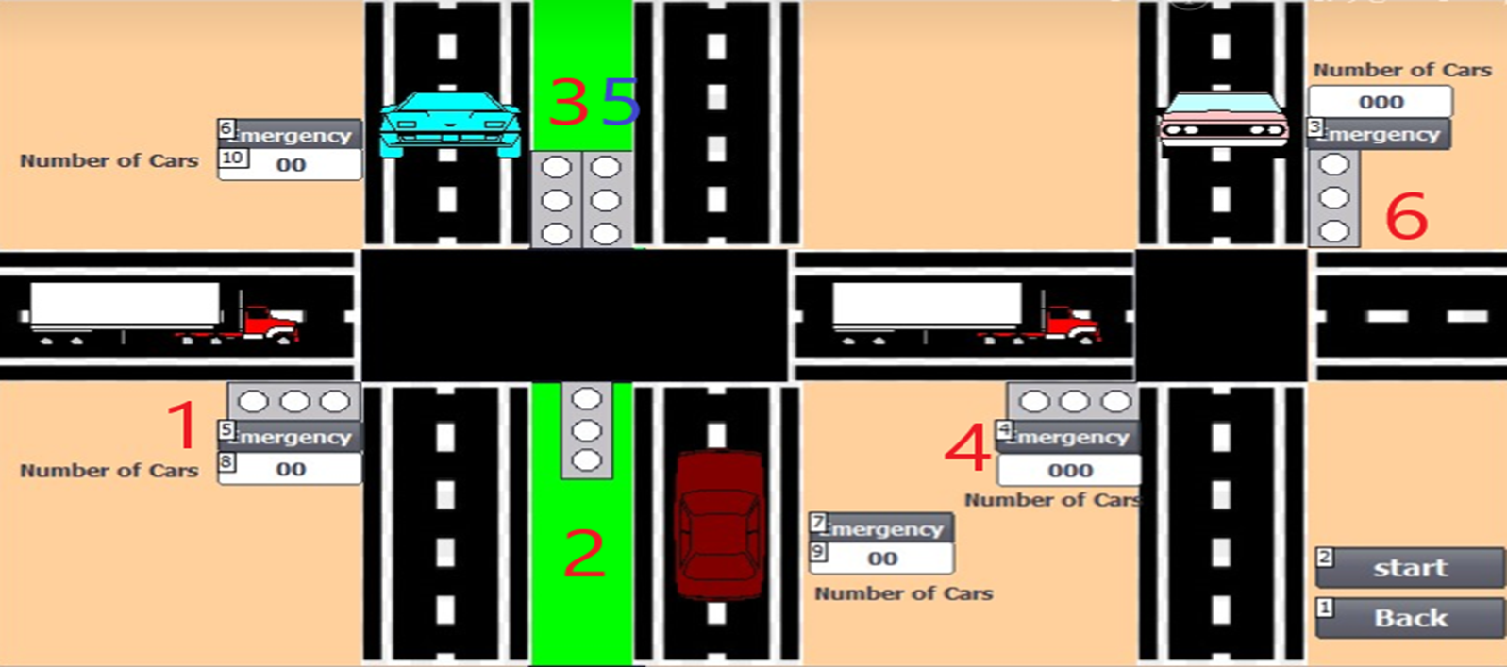
Project Idea in general
Controller & HMI screen
Monitoring
Each intersection is on its own
Synchronization
emergency
Feasibility study
2. Synchronization
The main idea is making interfacing between traffic lights that are in the same path, so that the traffic lights will turn over to green gradually
1/1
24/12/2018 Smart Traffic Lights Network For Nablus City Electrical Engineering

Slide 18
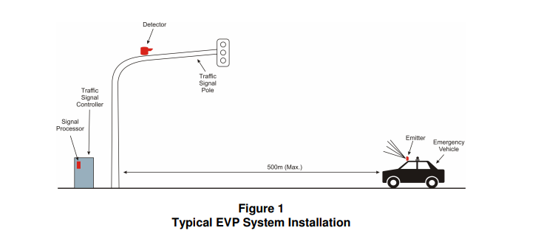
Project Idea in general
Controller & HMI screen
Monitoring
Each intersection is on its own
Synchronization
emergency
Feasibility study
EMERGENCY VEHICLE PREEMPTION (EVP)
1/1
24/12/2018 Smart Traffic Lights Network For Nablus City Electrical Engineering

Slide 19
Project Idea in general
Controller & HMI screen
Monitoring
Each intersection is on its own
Synchronization
emergency
Feasibility study
Solution
EMERGENCY VEHICLE PREEMPTION (EVP)
Emitter – emits an infrared, strobing, optical signal from the emergency vehicle.
Detector – detects the optical signal from the emitter and is typically mounted on a traffic signal pole.
1/1
24/12/2018 Smart Traffic Lights Network For Nablus City Electrical Engineering

Slide 20
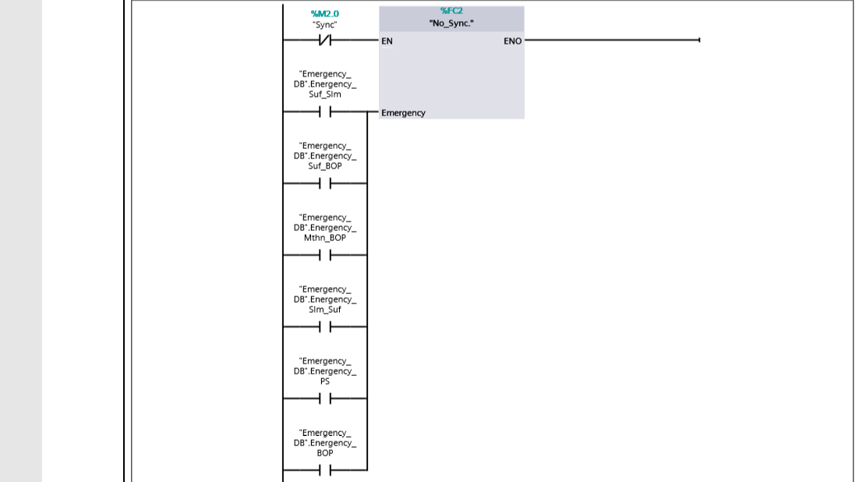
Project Idea in general
Controller & HMI screen
Monitoring
Each intersection is on its own
Synchronization
emergency
Feasibility study

Slide 21
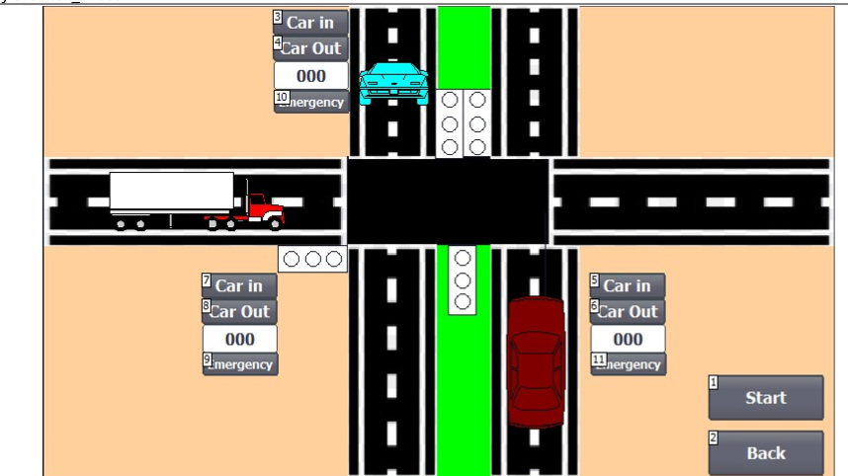
Project Idea in general
Controller & HMI screen
Monitoring
Each intersection is on its own
Synchronization
emergency
Feasibility study
EMERGENCY

Slide 22
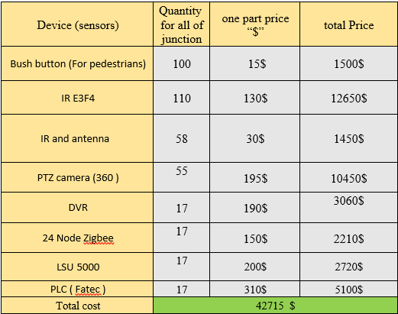
Feasibility study
Project Idea in general
Controller & HMI screen
Monitoring
Each intersection is on its own
Synchronization
emergency
Feasibility study
1/4
24/12/2018
Effective presentation
Fihme Hantoli / Mechanical Engineering

Slide 23

Thank You

