Slide 1
OPTIMUM TILT ANGLE AND ORIENTATION FOR SOLAR COLLECTORS IN PALESTINE
Supervisor:
Dr.Salameh Abdulfattah
Students:
Baha’a AL-Haj
Hareth Zyoud
Mohammad Qarout

Slide 2
Table of Contents
Objectives
Introduction
Previous work
Models
Results
Recommendations

Slide 3
Objectives:
The main purpose of our work was to maximize the efficiency of the solar collectors in relation to it’s orientation and position, and that would mean more benefit for the same structure, and so more profit.

Slide 4
Introduction
To get the most from solar panels, you need to point them in the direction that captures the most sun, the more the sun is perpendicular to the panel the better output power we get.
Solar panels should always face true south if you are in the northern hemisphere, but True south is not the same as magnetic south, taking that into consideration for Palestine barely mattered for the magnetic declination in Palestine is approximately 4° which is too small to actually make a difference.

Slide 5
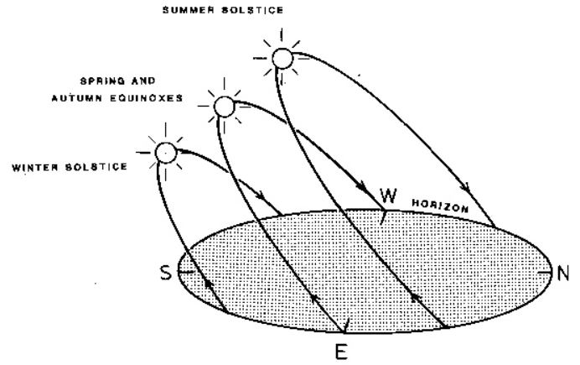
Mounting the solar panel at a fixed tilt is the simplest and the most
affordable way, but not always the smartest way.
depending on sun emissions , more energy could be captured during the whole year by adjusting the tilt of the panels according to the season.

Slide 6
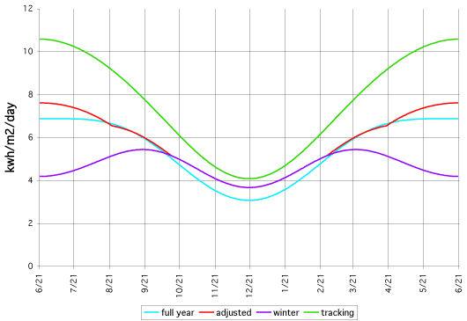
The following table shows the effect of adjusting the angle, using a system at 40° latitude as an example:
 | % of optimum
Fixed | 71.1%
Adj. 2 seasons | 75.2%
Adj. 4 seasons | 75.7%
2-axis tracker | 100%

Slide 7
Previous work
For our last project we have used multiple simulation tools using the geographical and irradiance data gathered by satellites like :
System Advisor Model “SAM”
PVSYST
European Commission's interactive tool

Slide 8

System Advisor Model “SAM”:
“SAM” Is a performance and financial model designed to facilitate decision making for renewable energy.
The program was only defined for the United States, but using the data obtained from the European Commission we was able to use it in Palestine.
After running many simulations on numerus angles, we found that the optimum tilt angle to be 29°

Slide 9
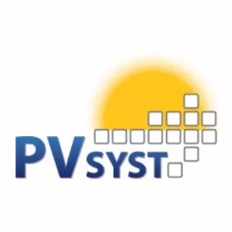
PVSYST:
PVSYST is one of the most famous programs that is used to fully design and analyze solar collectors projects, but not particularly used for calculating the tilt.
Nethertheless, it has been used and the optimum tilt angle was found to be 29°

Slide 10

European Commission's interactive tool
Using European Commission’s photovoltaic geographical information system “PVGIS” we were able to calculate the tilt angle and optimizing it to get the highest irradiance available and the angle was 29°.
The advantage that “PVGIS” has is that it uses a database that’s obtained from satellites for the last two decades

Slide 11
Models
We have used two main models and they are:
Mathematical model
Practical Model

Slide 12
1.Mathematical model
For the mathematical model, we have used El-Kassaby theoretical model for “estimating Monthly and daily optimum tilt angle” which was used by numerous researchers world wide.
Prof. El-Kassaby’s equations was used to build a Matlab program to accumulate the results that has been used to approximate the total solar irradiance and tilt angles for Palestine.

Slide 13
Here a sample of the Matlab code and Prof. El-Kassaby equations
a=1;
b=1;
for latt = [32.453953 32.309801 32.21966 32.21966 31.777158 31.526524 31.855866 31.505978 31.274738]
for nincangle=121:151
incangle = -23.45*cosd((nincangle+10.5)*(360/365));
hss = acos(-tand(latt)*tand(incangle));
tiltoptd = latt - atand((hss*tand(incangle))/sin(hss));
irro = 1.367;
irrd(b)=((24/pi)*irro*(1+.034*cosd((3*pi*nincangle)/365)))*((cosd(latt-tiltoptd)*cosd(incangle)*sin(hss))+hss*sind(latt-tiltoptd)*sind(incangle));
optb(b)= (((24/pi)*irro*(1+.034*cosd((3*pi*nincangle)/365)))*sind(incangle)*hss)
optc(b)=(((24/pi)*irro*(1+.034*cosd((3*pi*nincangle)/365)))*cosd(incangle)*sin(hss))
sumirrd = sum(irrd);
suma = sum(optb)
sumb = sum(optc)
b=b+1;
end
b=1;
idmonthlyForjan(a) = sumirrd;
z(a)=latt-atand(suma/sumb);
a=a+1;
end

Slide 14
1. Practical Model
We have built a prototype that uses a solar panel and is able to work in full tracking mode in order measure the output power.
Using that, it is able to calculate the optimum tilt angle for a certain period.

Slide 15
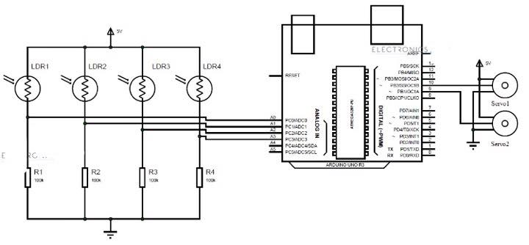
The tracking system uses a 4 LDRs by 4 way principle, which uses the output of the LDRs and compares them to each other to control the servo motors that rotate the prototype in the lights direction, the figure shows a simplest diagram of the tracking system

Slide 16
Results:
Through our work we have found out that the tilt angle is almost the same in all of Palestinian.

Slide 17
The yearly optimum tilt angle and the solar irradiance in Palestine is shown in the table:
and as shown there’s only a trivial difference between the cities

Slide 18
although Changing the tilt monthly would increase the efficiency up to 12%, it is not practical, for changing it seasonally is so much easier, cheaper and would increase the efficiency almost as much.
It is advised to mount the solar water heaters “SWH” at a winter tilt angle to gain the most of the suns ray for it is greatly more important in winter.
The seasonally optimum tilt angles for Palestine as obtained:

Slide 19
Recommendations
The optimum tilt angle is nearly the same in all of Palestine yet it is advised to use the appropriate tilt for each city for a 1° error could have a loss of approximately 0.3% in efficiency which may look small, but for big solar projects it may differ widely and it can be easily avoided.

Slide 20
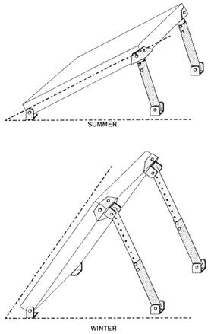
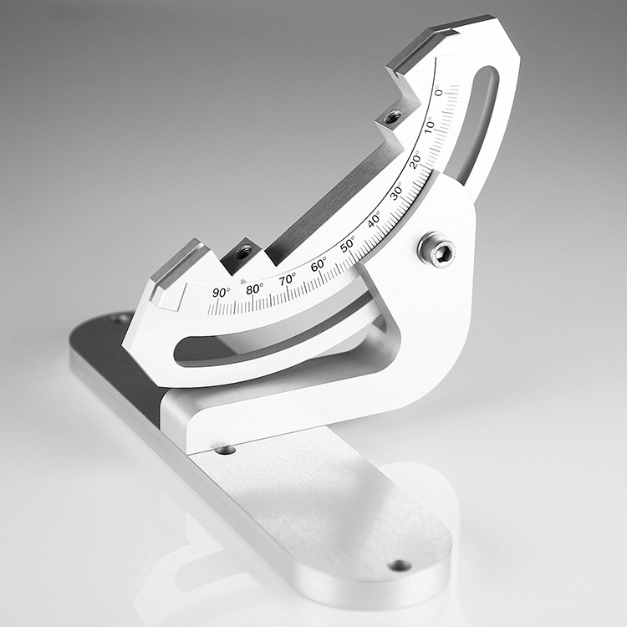
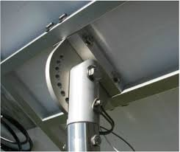
Our work has shown that changing tilt angle seasonally may increase the efficiency for up to 10% and that can be done cheaply and manually. The following pictures show some examples of manually-adjustable solar panel mounts:

Slide 21
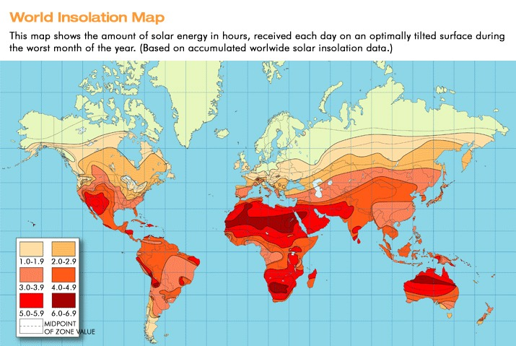
Increasing the efficiency will surely increase the profit especially in big solar projects, for example a 5MW fixed-mount solar farm will produce approximately an annual profit of 1.8M$ but using seasonally adjustable mount that number could easily go up to 2M$ which is a huge increase in profit and that can be used to develop the infrastructure or reduce the cost of electricity from 0.612 ₪/kWh down to 0.56 ₪/kWh.
Peak sun hour world wide

