Slide 1

Prepared by: Abdallah Haj Ahmad
Ahmad Lahlouh
Sari Zaazaa
Supervised by: Dr. mohammad Samaneh
An-Najah National University
Faculty of Engineering and Information Technology
Civil Engineering department
Structural Analysis and Design Of Clock Tower Jenin-city

Slide 2
Content:
1
Introduction
2
Preliminary Design
-Project description.
-codes.
-Material.
-Loads and load combinations.
-Beam preliminary design.
-Slab preliminary design.
-column preliminary design.
-Shear walls preliminary design.
3
Modeling & Analysis
4
Design
-Introduction.
-Define material, sections and loads.
-Verification of structural analysis
-Introduction.
-Design results.

Slide 3
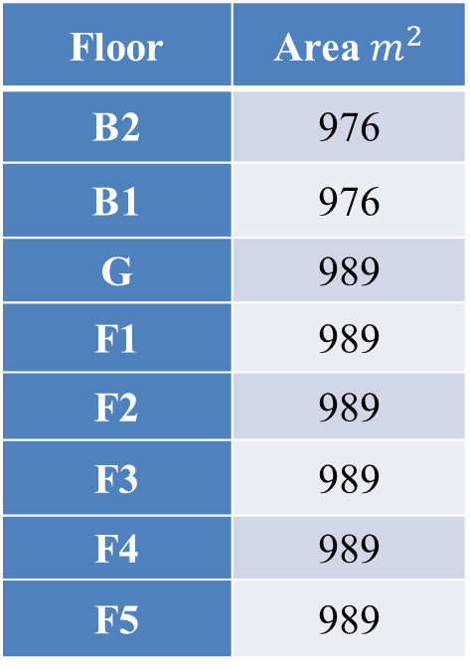

1 Introduction
Table-1: Floors Area.
Project description:-
Floor | Area$m^{2}$
B2 | 976
B1 | 976
G | 989
F1 | 989
F2 | 989
F3 | 989
F4 | 989
F5 | 989
Clock Tower located in the center of Jenin city.
The building consist of 8 floors, with total area of building= ${8875 m}^{2}$ with area as shown in the table.
Soil bearing capacity= 200KN/ $m^{2},the site class is D.$

Slide 4
1 Introduction
Project description:-
For seismic purposes the structure is separated by seismic (separation) joint into two blocks, left block and right block.
Both blocks were modeled in ETABS using layers imported from AutoCAD.

Slide 5
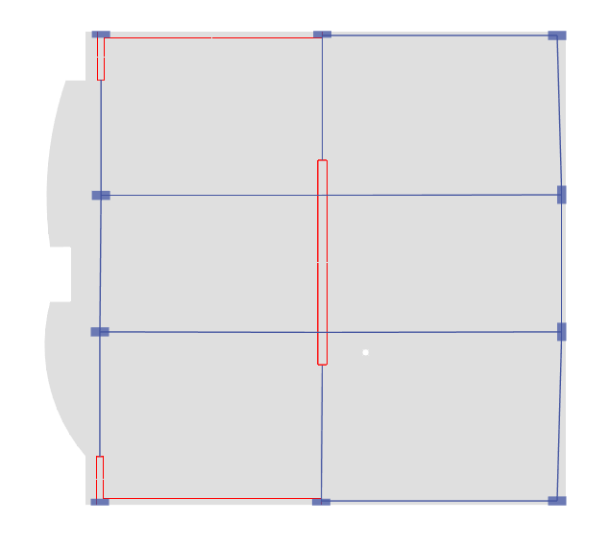
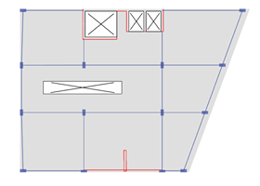
1 Introduction
Project description:-
Ground floor plan view for the left block
Ground floor plan view for the right block

Slide 6
1 Introduction
Codes and Standard:-
ACI318-14.
ASCE 7-16.

Slide 7
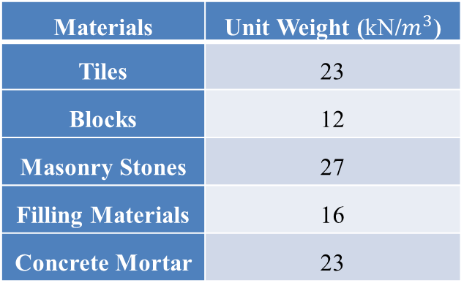
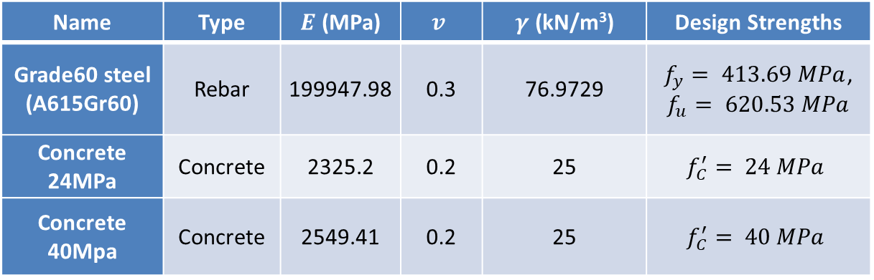
1 Introduction
Material:-
Material used in the project :-
Name | Type | $E$ (MPa) | $$v$$ | $γ$ (kN/m³) | Design Strengths
Grade60 steel (A615Gr60) | Rebar | 199947.98 | 0.3 | 76.9729 | $f_{y}= 413.69 MPa$, $$f_{u}= 620.53 MPa$$
Concrete 24MPa | Concrete | 2325.2 | 0.2 | 25 | $$f_{C}^{′}= 24 MPa$$
Concrete 40Mpa | Concrete | 2549.41 | 0.2 | 25 | $$f_{C}^{′}= 40 MPa$$
Materials | Unit Weight (kN/$m^{3}$)
Tiles | 23
Blocks | 12
Masonry Stones | 27
Filling Materials | 16
Concrete Mortar | 23

Slide 8
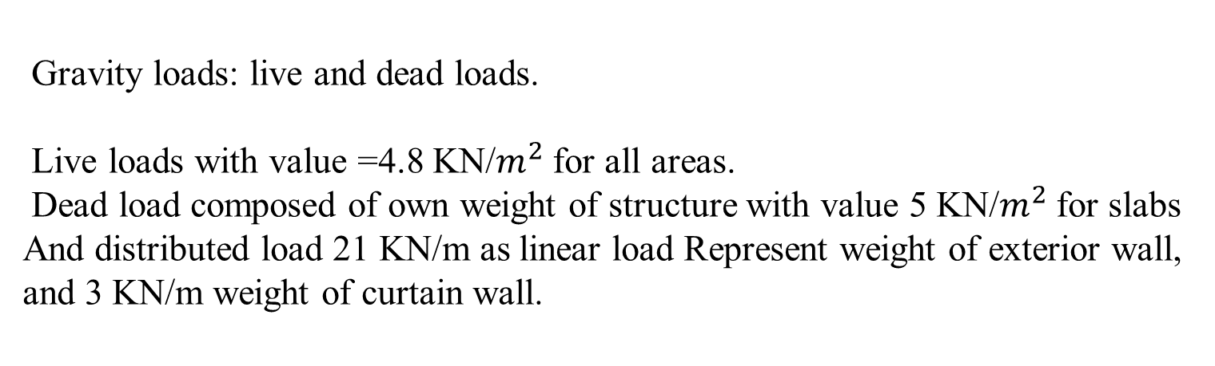
1 Introduction
Loads and load combinations:-
Gravity loads: live and dead loads.
Live loads with value =4.8 KN/$m^{2}$for all areas.
Dead load composed of own weight of structure with value 5 KN/$m^{2}$for slabs
And distributed load 21 KN/m as linear load Represent weight of exterior wall, and 3 KN/m weight of curtain wall.
Superdead from tiles, mortar , partitions and plaster equal 3.5 KN/$m^{2}$

Slide 9

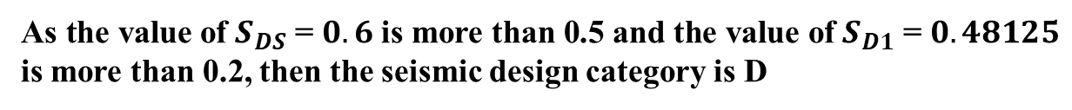

1 Introduction
Loads and load combinations:-
Lateral loads:
Seismic zone is 2B then seismic zone factor, $Z=0.2$
Design Spectral Acceleration parameters S_{Ds} and S_{D1}
$$S_{s }\left(2\%\right)=0.75$$
$S_{1 }\left(2\%\right)=0.375$
$S_{DS}=0.6$
$S_{D1}=0.48125$
And risk category III
As the value of $S_{DS}$ = $0.6$ is more than 0.5 and the value of $S_{D1}$ = $0.48125$ is more than 0.2, then the seismic design category is D

Slide 10
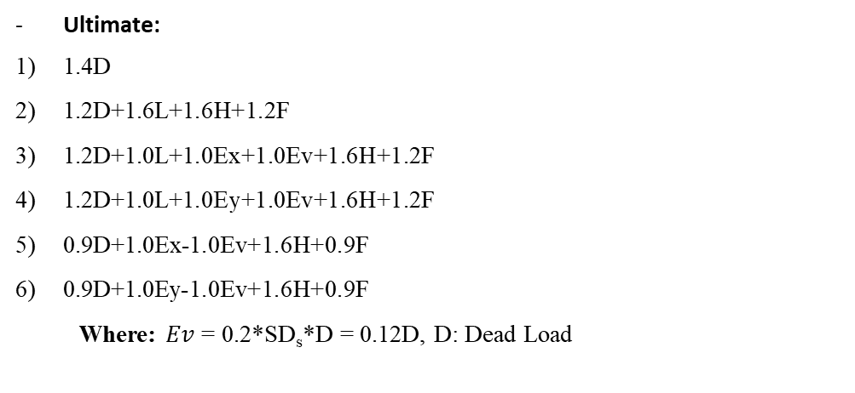
1 Introduction
Loads and load combinations:-
Load combination used with according to ASCE7-16 :
Ultimate:
1.4D
1.2D+1.6L+1.6H+1.2F
1.2D+1.0L+1.0Ex+1.0Ev+1.6H+1.2F
1.2D+1.0L+1.0Ey+1.0Ev+1.6H+1.2F
0.9D+1.0Ex-1.0Ev+1.6H+0.9F
0.9D+1.0Ey-1.0Ev+1.6H+0.9F
Where: $Ev$ = 0.2*SD_{s}*D = 0.12D, D: Dead Load
Service:
1.0D+1.0L
0.7Ex
0.7Ey
1.0D+0.7Ex+0.7Ev+1.0H+1.0F
1.0D+0.7Ey+0.7Ev+1.0H+1.0F
1.0D+0.525Ex+0.75L+0.525Ev+1.0H+1.0F
1.0D+0.525Ey+0.75L+0.525Ev+1.0H+1.0F
0.6D+1.0Ex-0.7Ev+1.0H+0.6F
0.6D+1.0Ey-0.7Ev+1.0H+0.6F

Slide 11
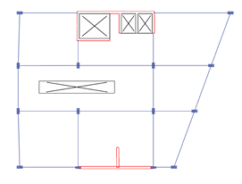
2 Preliminary Design
Beam preliminary design:-
Figure ‎2.1 Beams layout in the right block

Slide 12
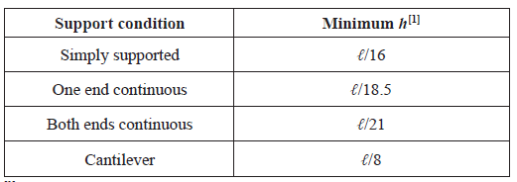
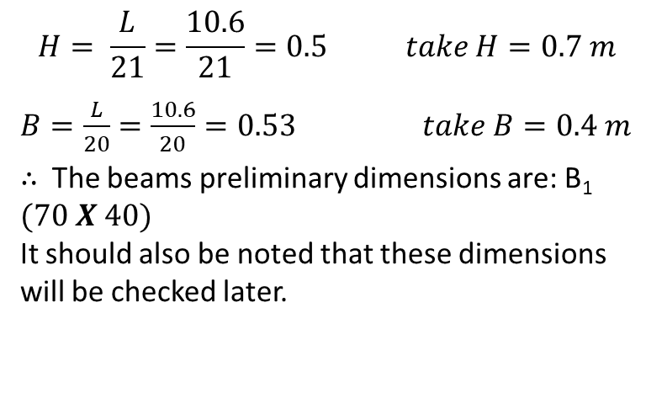
2 Preliminary Design
Beam preliminary design:-
System of beam used is drop beams between all columns.
Dimension of beam will be determine as the following:
$$H= \frac{L}{21}=\frac{10.6}{21}=0.5 take H=0.7 m$$
$B=\frac{L}{20}=\frac{10.6}{20}=0.53 take B=0.4 m$
$∴$The beams preliminary dimensions are: B₁ $(70 X 40)$
It should also be noted that these dimensions will be checked later.
Table 2.1: Minimum depth of non-prestressed beams.

Slide 13
2 Preliminary Design
slab preliminary design:-
As in this project, the U-Boot voided slab system will be used, the preliminary thickness of slabs will be determined according to ACI 318-14.
For this project, the slab system that will be used is U-Boot system as it is preferable for many reasons like:
Longer spans
Less consumption of concrete
Lower total weight
Architecture flexibility

Slide 14
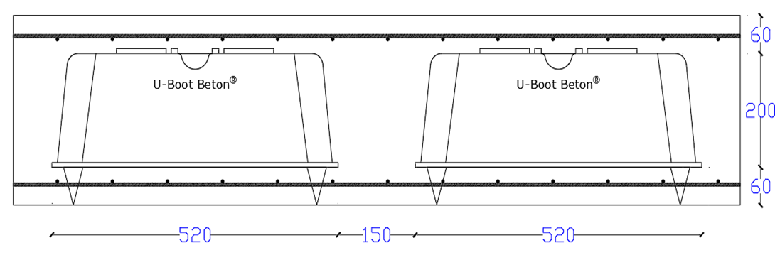
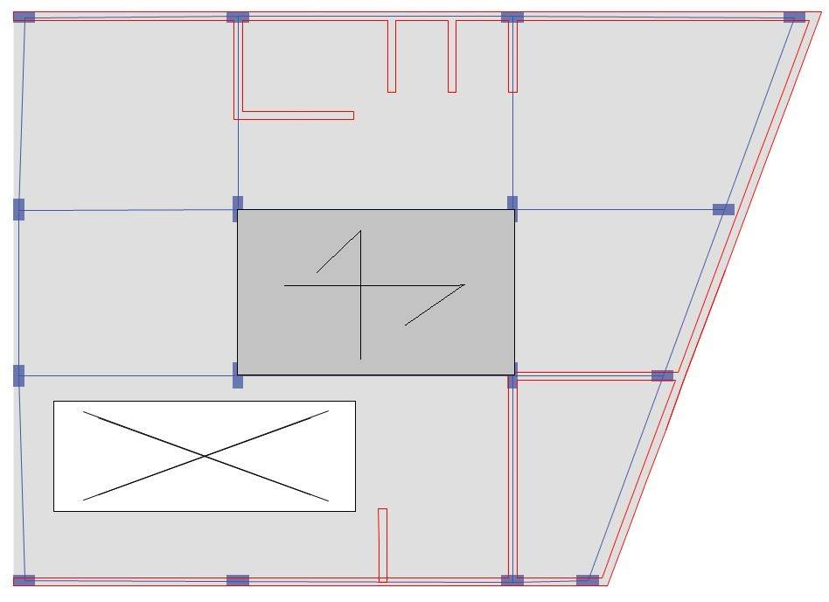
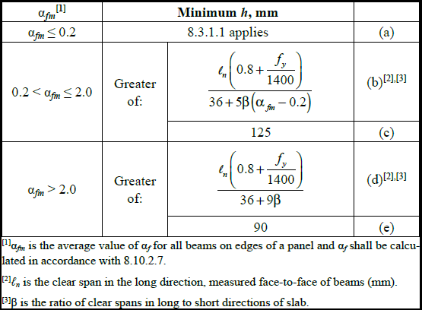
2 Preliminary Design
slab preliminary design:-
Figure ‎2.3 Cross section in slab
Table ‎2.2 Minimum thickness of non-prestressed two-way slabs with beams spanning between supports on all sides
Figure ‎2.2 Critical panel for the slab thickness

Slide 15
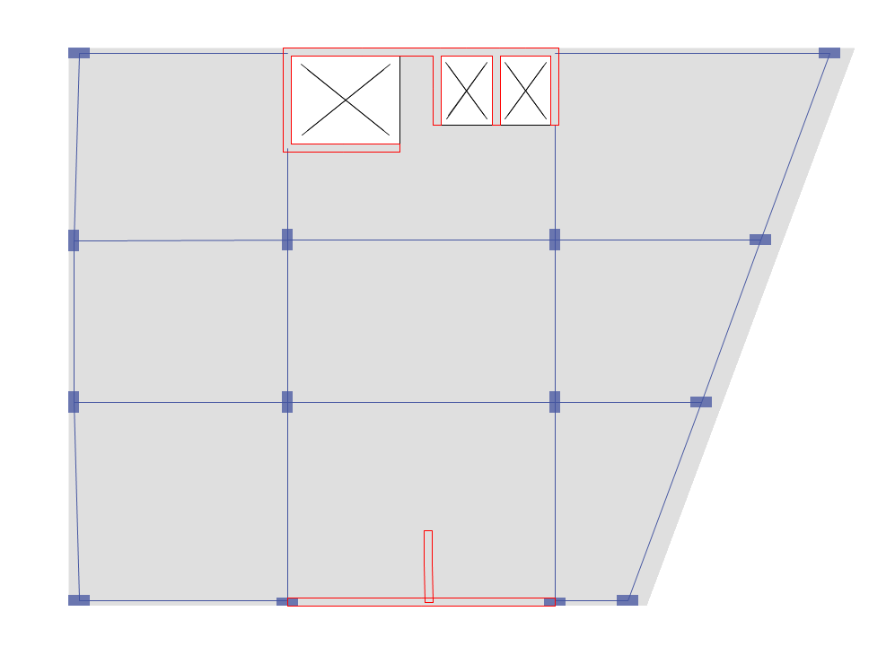
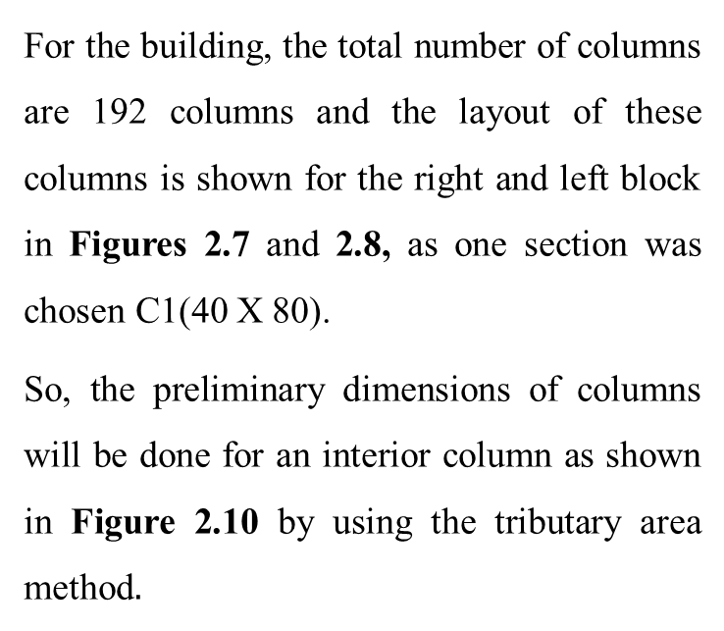
2 Preliminary Design
column preliminary design:-
For the building, the total number of columns are 192 columns and the layout of these columns is shown for the right and left block in Figures 2.7 and 2.8, as one section was chosen C1(40 X 80).
So, the preliminary dimensions of columns will be done for an interior column as shown in Figure 2.10 by using the tributary area method$.$

Slide 16
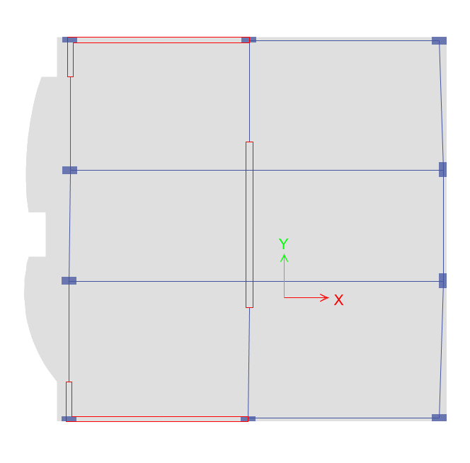
2 Preliminary Design
Shear wall preliminary design:-
Shear walls have been distributed according to Figures 2.11 and 2.12 below, for all the shear walls in the tower let all thicknesses to be 300mm, these dimensions will be check later for the capacity.
Figure ‎2.11 Shear walls layout for the left block
Figure ‎2.12 Shear walls layout for the right block

Slide 17
3 Modeling and Analysis
Introduction:-
Modeling and analysis will performed by using ETABS 18 program.
All supports will be modeled as fixed support.
Exterior partition as linear load and interior partition as distributed load.
Ultimate strength method (LRFD) method will be used.

Slide 18
3 Modeling and Analysis
Model checks:-
Three-dimensional modeling
For seismic purposes the structure is separated by seismic (separation) joint into two blocks, left block and right block as shown in Figure 3.13 and Figure 3.14, respectively. It should also be noted that for the verification process in this project each block will be verified separately except for the deflection check as the critical block will dominate

Slide 19
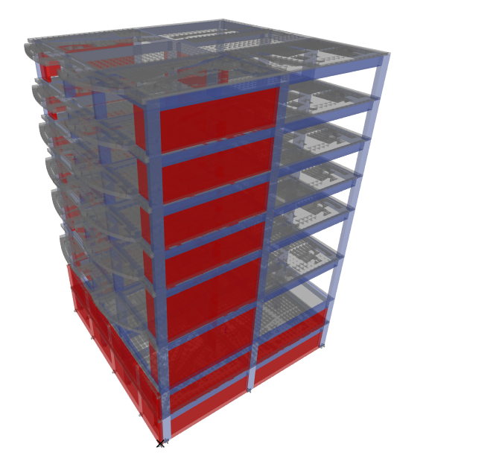
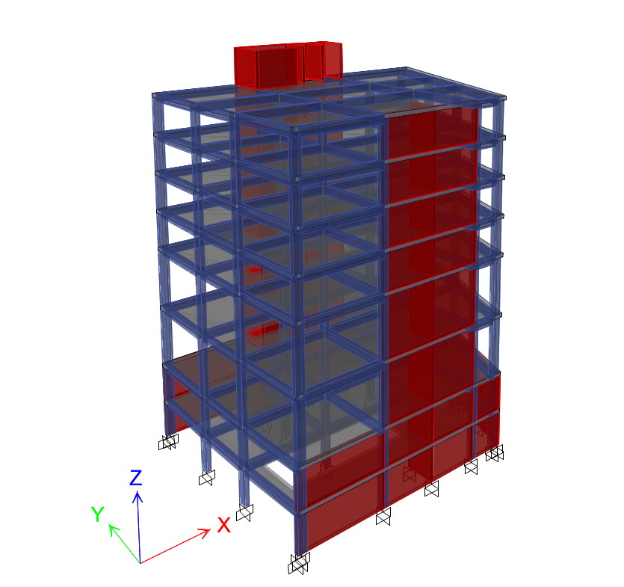
3 Modeling and Analysis
Three-dimensional modeling
Figure ‎3.13 3D-view for the left block
Figure ‎3.14 3D-view for the right block

Slide 20
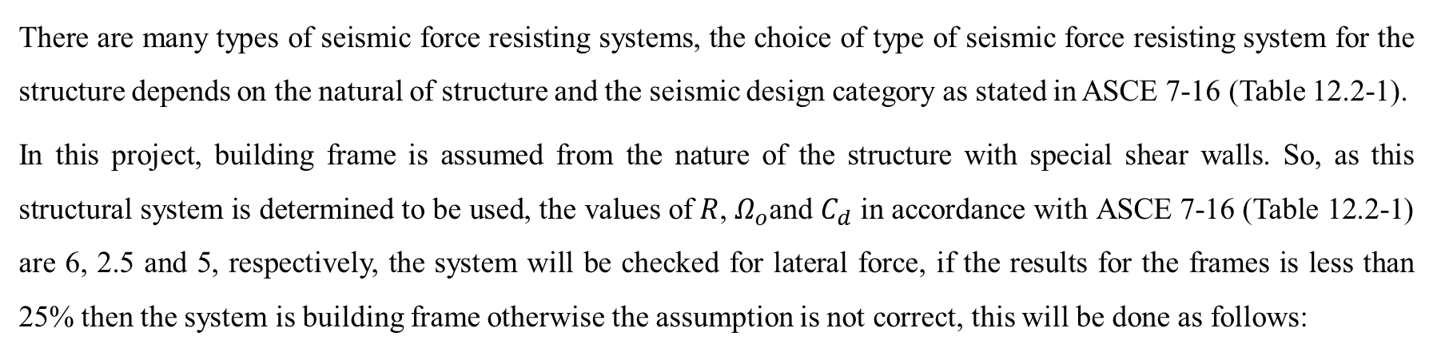
3 Modeling and Analysis
Type of lateral force resisting system:
There are many types of seismic force resisting systems, the choice of type of seismic force resisting system for the structure depends on the natural of structure and the seismic design category as stated in ASCE 7-16 (Table 12.2-1).
In this project, building frame is assumed from the nature of the structure with special shear walls. So, as this structural system is determined to be used, the values of$R$, $Ω_{o}$and $C_{d}$ in accordance with ASCE 7-16 (Table 12.2-1) are 6, 2.5 and 5, respectively, the system will be checked for lateral force, if the results for the frames is less than 25% then the system is building frame otherwise the assumption is not correct, this will be done as follows:

Slide 21
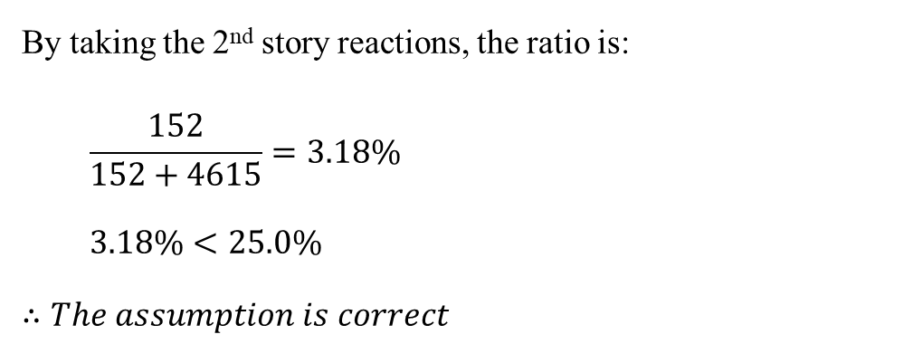
3 Modeling and Analysis
Type of lateral force resisting system:
Table ‎1.9 Lateral force reactions in the left block
By taking the 2nd story reactions, the ratio is:
$$\frac{152}{152+4615}=3.18\%$$
$3.18\%<25.0\%$
$$∴The assumption is correct$$
Story | Frames | Shear walls
B2 | 89kN | 6589kN
B1 | 90kN | 6585kN
GF | 95kN | 6219kN
1st story | 71kN | 5593kN
2nd story | 152kN | 4615kN
3rd story | 135kN | 3646kN
4th story | 119kN | 2517kN
5th story | 157kN | 1174kN

Slide 22
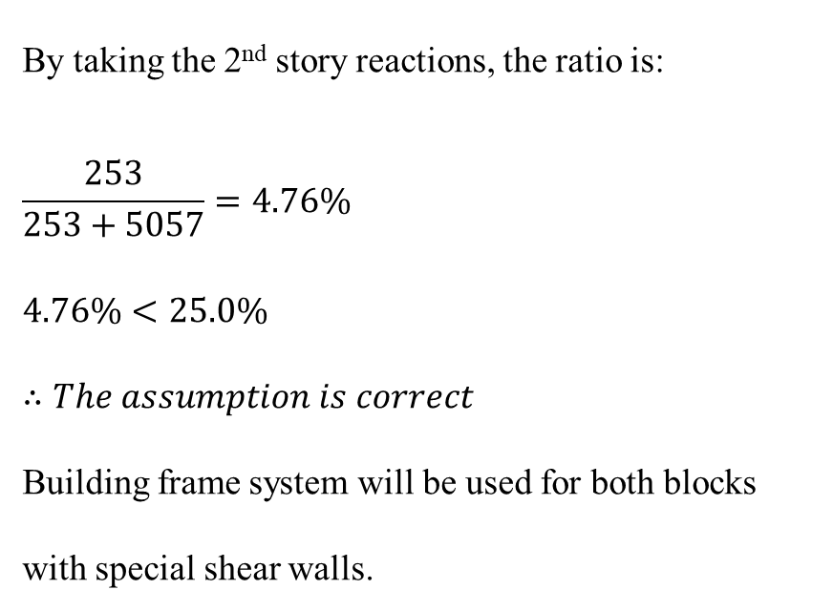
3 Modeling and Analysis
Type of lateral force resisting system:
By taking the 2nd story reactions, the ratio is:
$$\frac{253}{253+5057}=4.76\%$$
$4.76\%<25.0\%$
$$∴The assumption is correct$$
Building frame system will be used for both blocks with special shear walls.
Table ‎1.10 Lateral force reactions in the right block
Story | Frames | Shear walls
B2 | 232kN | 7411kN
B1 | 23kN | 6531kN
GF | 127kN | 6431kN
1st story | 114kN | 6015kN
2nd story | 253kN | 5057kN
3rd story | 233kN | 4089kN
4th story | 207kN | 2906kN
5th story | 290kN | 1368kN

Slide 23
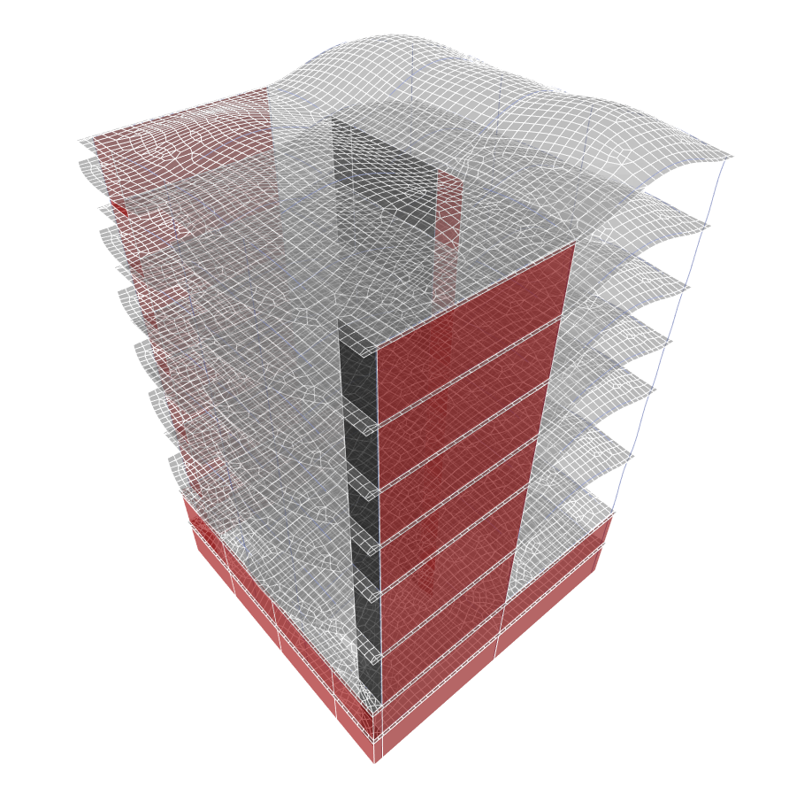
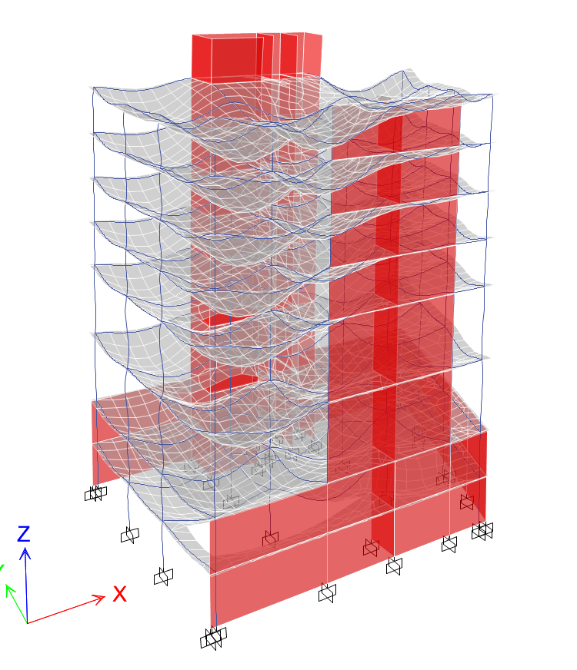
3 Modeling and Analysis
compatibility check:
Figure ‎3.15 Compatibility of the left block
Figure ‎3.16 Compatibility of the right block

Slide 24
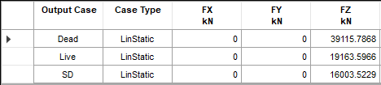
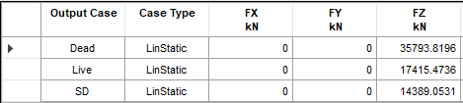

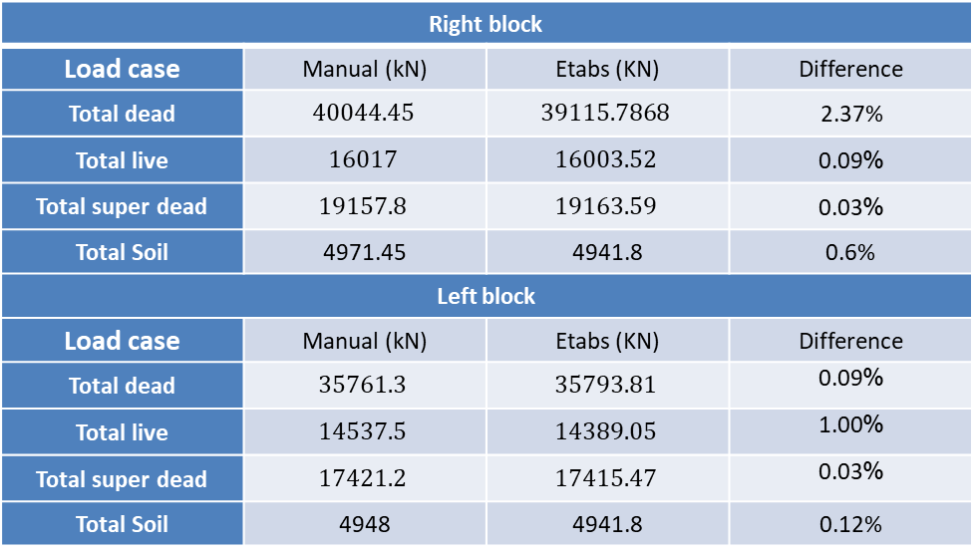
3 Modeling and Analysis
Equilibrium for gravity loads
Table ‎3.4 Base reactions for the right block
Right block
Load case | Manual (kN) | Etabs (KN) | Difference
Total dead | $$40044.45$$ | $$39115.7868$$ | 2.37%
Total live | $$16017$$ | $$16003.52$$ | %0.09
Total super dead | $$19157.8$$ | $$19163.59$$ | %0.03
Total Soil | 4971.45 | 4941.8 | 0.6%
Left block
Load case | Manual (kN) | Etabs (KN) | Difference
Total dead | $$35761.3$$ | $$35793.81$$ | %0.09
Total live | $$14537.5$$ | $$14389.05$$ | %1.00
Total super dead | $$17421.2$$ | $$17415.47$$ | %0.03
Total Soil | 4948 | 4941.8 | 0.12%
Table ‎3.5 Base reactions for the left block
Table ‎3.6 Soil reactions in both blocks

Slide 25
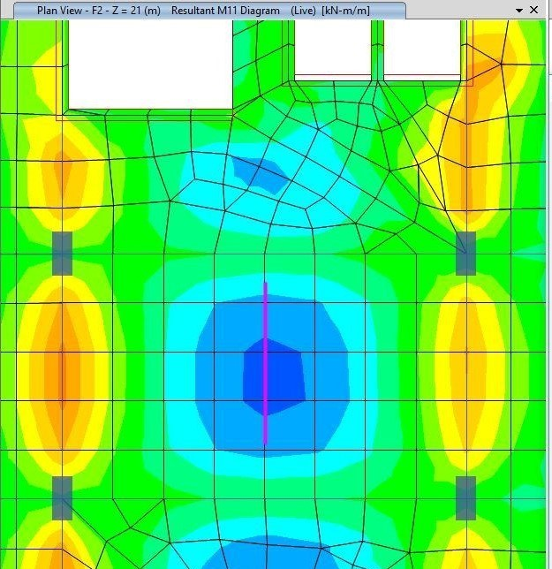

3 Modeling and Analysis
Internal force check:
Right block
Slab
$$M_{Manual}=60 kN.m$$
$$M_{Etabs}=61.75 kN.m$$
$$\%Difference =2.9\%<5\% → OK$$
Figure ‎3.19 Slab panel location in the right block

Slide 26
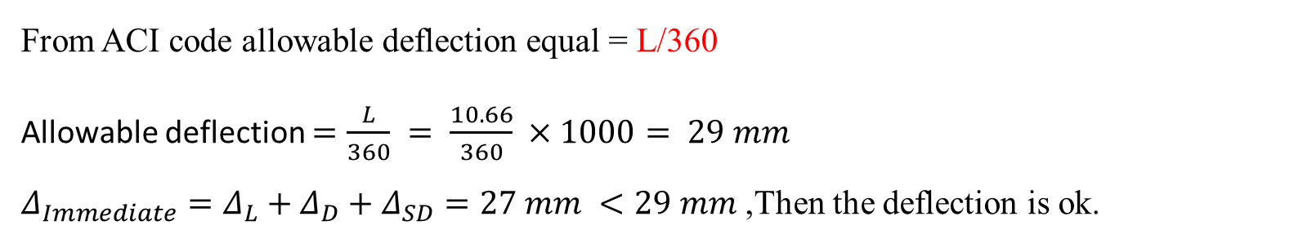
3 Modeling and Analysis
Deflection check:
Immediate deflection check
From ACI code allowable deflection equal = L/360
Allowable deflection $=\frac{L}{360} = \frac{10.66}{360} ×1000= 29 mm$
$Δ_{Immediate}=Δ_{L}+Δ_{D}+Δ_{SD}=27 mm <29 mm$ ,Then the deflection is ok.

Slide 27
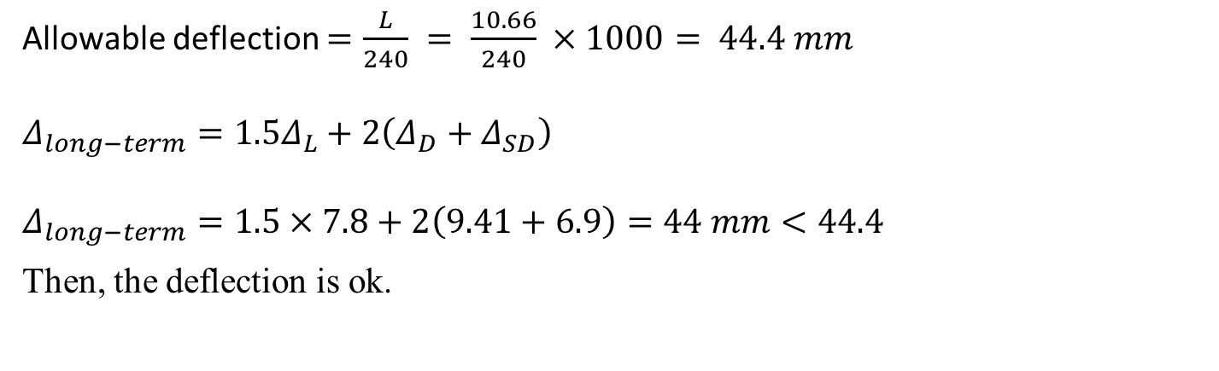
3 Modeling and Analysis
long term deflection
Deflection check:
From ACI code allowable deflection equal = L/240
Allowable deflection $=\frac{L}{240} = \frac{10.66}{240} ×1000= 44.4 mm$
$$Δ_{long−term}=1.5Δ_{L}+2\left(Δ_{D}+Δ_{SD}\right)$$
$$Δ_{long−term}=1.5×7.8+2\left(9.41+6.9\right)=44 mm<44.4$$
Then, the deflection is ok.

Slide 28
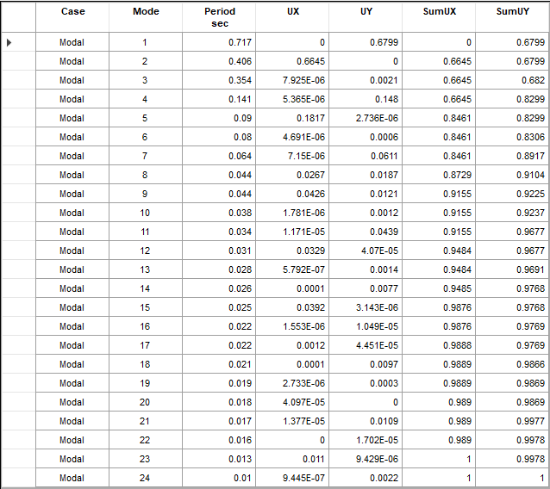
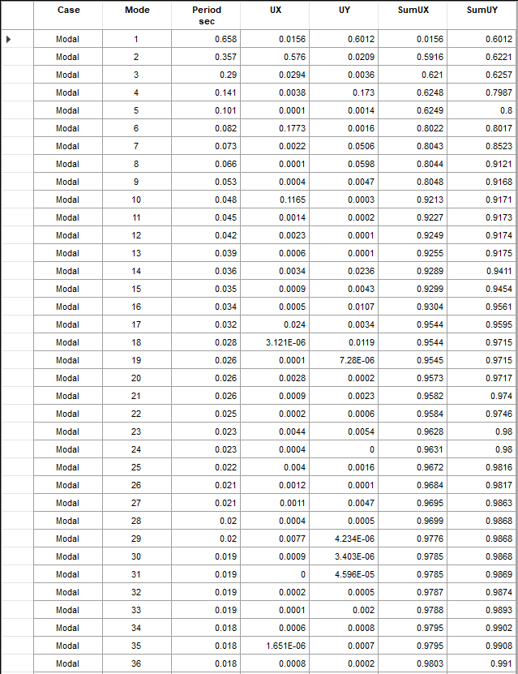
3 Modeling and Analysis
Mass participation ratio for modal analysis
Figure ‎3.25 Modal mass participation ratio for the left block
Figure ‎3.26 Modal mass participation ratio for the right block

Slide 29
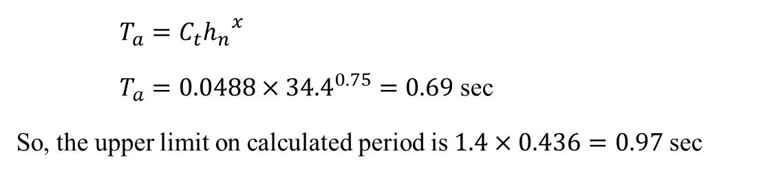
3 Modeling and Analysis
Approximate Fundamental Period, $T_{a}$
$$T_{a}=C_{t}{h_{n}}^{x}$$
  $T_{a}=0.0488×{34.4}^{0.75}=0.69$ sec
So, the upper limit on calculated period is $1.4×0.436=0.97$ sec
The value of period from ETABS for the two blocks is less than the value of $C_{u}T_{a}$ which is equal to 0.97.

Slide 30



3 Modeling and Analysis
Equilibrium check for base shear
$$C_{s,max} in both directions=\frac{S_{D1}}{T\left(\frac{R}{I_{e}}\right)}=\frac{0.48125}{0.717×\left(\frac{6}{1.25}\right)}=0.1398$$
So, the final value of $C_{s}$ in both directions is equal to 0.125 for the left block, as the base shear for the block is:
$$ELF=W×C_{s}=53357.6×0.125=6670 KN$$
$$\%Difference for{ ELF}_{x, y}\frac{6670−6672}{6670}×100\%=0.03\%$$
For the left block
$$W=53357.6 kN$$
  $$C_{s,min}=0.033$$
  $$T_{l}=8 sec$$
$$C_{s}=\frac{S_{DS}}{\left(\frac{R}{I_{e}}\right)}=0.125$$

Slide 31
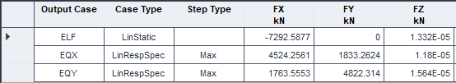
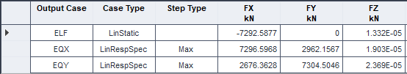
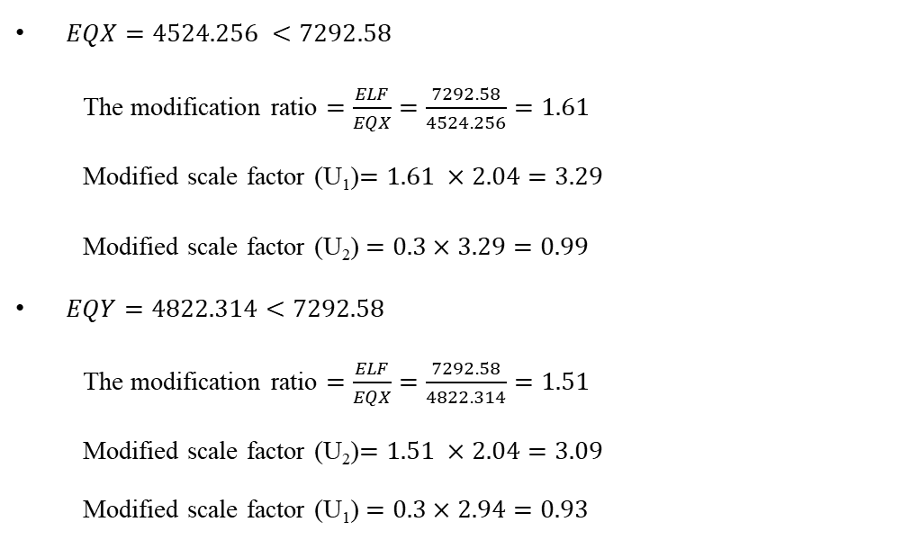
3 Modeling and Analysis
Dynamic response spectrum method
Table ‎3.10 Base shear from etabs in the right block
For the right block
$EQX=4524.256 <7292.58$
The modification ratio $=\frac{ELF}{EQX}=\frac{7292.58}{4524.256}=1.61$
Modified scale factor (U₁)$=1.61 ×2.04=3.29$
Modified scale factor (U₂)$=0.3×3.29=0.99$
$EQY=4822.314<7292.58$
The modification ratio $=\frac{ELF}{EQX}=\frac{7292.58}{4822.314}=1.51$
Modified scale factor (U₂)$=1.51 ×2.04=3.09$
Modified scale factor (U₁)$=0.3×2.94=0.93$
Table ‎3.11 Modified base shear in the right block

Slide 32
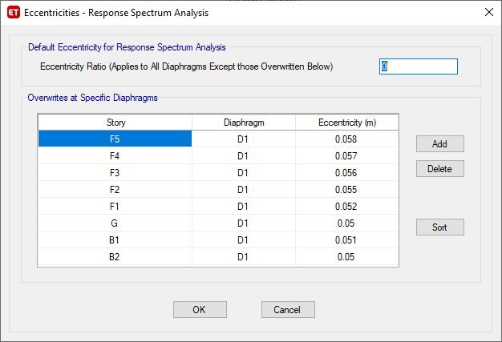
3 Modeling and Analysis
Torsional Irregularity
For the right block
Table ‎3.14 Torsional Irregularity check for the block in X-D
Story | Max Drift | Avg Drift | Ratio | Check | Ax | Eccentricity % | Extreme Torsional Irregularity Check
F5 | 0.000582 | 0.000451 | 1.29 | Irregular | 1.1556 | 0.058 | Regular
F4 | 0.000601 | 0.00047 | 1.279 | Irregular | 1.1360 | 0.057 | Regular
F3 | 0.000602 | 0.000475 | 1.267 | Irregular | 1.1148 | 0.056 | Regular
F2 | 0.000579 | 0.000462 | 1.254 | Irregular | 1.0920 | 0.055 | Regular
F1 | 0.000502 | 0.000408 | 1.228 | Irregular | 1.0472 | 0.052 | Regular
G | 0.000327 | 0.000279 | 1.169 | Regular | - | - | Regular
B1 | 7.70E-05 | 6.30E-05 | 1.214 | Irregular | 1.0235 | 0.051 | Regular
B2 | 4.70E-05 | 4.10E-05 | 1.153 | Regular | - | - | Regular
Figure ‎3.33 Modified Eccentricity Ratio in EQX for the right block

Slide 33
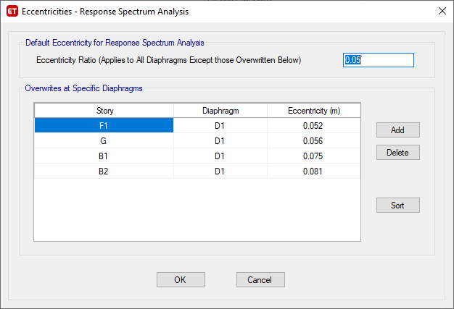
3 Modeling and Analysis
Torsional Irregularity
For the right block
Table ‎3.15 Torsional Irregularity check for the right block in Y-D
Story | Max Drift | Avg Drift | Ratio | Check | Ax | Eccentricity % | Extreme Torsional Irregularity Check
F5 | 0.00158 | 0.001345 | 1.174 | Regular | - | - | Regular
F4 | 0.00164 | 0.001384 | 1.185 | Regular | - | - | Regular
F3 | 0.001662 | 0.001392 | 1.194 | Regular | - | - | Regular
F2 | 0.001629 | 0.001353 | 1.204 | Irregular | 1.0067 | 0.050 | Regular
F1 | 0.00146 | 0.001193 | 1.224 | Irregular | 1.0404 | 0.052 | Regular
G | 0.001014 | 0.000795 | 1.275 | Irregular | 1.1289 | 0.056 | Regular
B1 | 0.000433 | 0.000295 | 1.469 | Irregular | 1.4986 | 0.075 | Irregular
B2 | 0.000196 | 0.000128 | 1.532 | Irregular | 1.6299 | 0.081 | Irregular
Figure ‎3.34 Modified Eccentricity Ratio in EQY for the right block

Slide 34
3 Modeling and Analysis
Stiffness-Soft Story Irregularity
For the right block
Table ‎3.18 Stiffness-Soft Story Irregularity for the right block in X-D
Table ‎3.19 Stiffness-Soft Story Irregularity for the right block in Y-D
Story | Load Case | Stiffness X (kN/m) | Ratio (%) | Check
F5 | EQX | 1420174.076 | - | -
F4 | EQX | 2487915.662 | 175.1838527 | No
F3 | EQX | 3345191.024 | 134.4575733 | No
F2 | EQX | 4153367.787 | 124.1593606 | No
F1 | EQX | 3383310.305 | 81.45944396 | No
G | EQX | 5364558.435 | 158.5594566 | No
B1 | EQX | 40524873.93 | 755.4186317 | No
B2 | EQX | 57340346.51 | 141.4942008 | No
Story | Load Case | Stiffness Y (kN/m) | Ratio (%) | Check
F5 | EQY | 480109.389 | - | -
F4 | EQY | 842986.525 | 175.5821786 | No
F3 | EQY | 1133669.955 | 134.4825714 | No
F2 | EQY | 1405869.356 | 124.0104626 | No
F1 | EQY | 1152615.558 | 81.98596499 | No
G | EQY | 1898548.684 | 164.7165589 | No
B1 | EQY | 8591889.958 | 452.5504155 | No
B2 | EQY | 19543271.14 | 227.4618418 | No

Slide 35
3 Modeling and Analysis
Weight (Mass) Irregularity
Table ‎3.20 Mass Irregularity check for the left block
Table ‎3.21 Mass Irregularity check for the right block
Story | Mass | Criteria | Ratio (%)
F5 | 645704.42 | - | -
F4 | 710381.69 | F4/F5 | 110.0165444
F3 | 710381.69 | F3/F4 | 100
F2 | 710381.69 | F2/F3 | 100
F1 | 770469.44 | F1/F2 | 108.4585162
G | 808514.89 | G/F1 | 104.937957
B1 | 525061.17 | B1/G | 64.94143478
B2 | 567280.63 | B2/B1 | 108.040865
Story | Mass | Criteria | Ratio (%)
F5 | 740678.04 | - | -
F4 | 794451.99 | F4/F5 | 107.2601
F3 | 794451.99 | F3/F4 | 100
F2 | 794451.99 | F2/F3 | 100
F1 | 873445.44 | F1/F2 | 109.94314
G | 924872.3 | G/F1 | 105.88782
B1 | 605297.39 | B1/G | 65.446591
B2 | 598156.27 | B2/B1 | 98.82023

Slide 36
3 Modeling and Analysis
Check Type of Diaphragm
For the right block
Table ‎3.24 Type of diaphragm for the right block in X-D
Table ‎3.25 Type of diaphragm for the right block in Y-D
Story | Direction | Max. Displacement (mm) | Avg. Displacement (mm) | Avg. Displacement*2 (mm) | Rigid/Flexible
F5 | X | 11.984 | 9.683 | 19.366 | Rigid
F4 | X | 10.141 | 8.249 | 16.498 | Rigid
F3 | X | 8.24 | 6.757 | 13.514 | Rigid
F2 | X | 6.339 | 5.25 | 10.5 | Rigid
F1 | X | 4.511 | 3.787 | 7.574 | Rigid
G | X | 2.001 | 1.734 | 3.468 | Rigid
B1 | X | 0.388 | 0.335 | 0.67 | Rigid
B2 | X | 0.149 | 0.132 | 0.264 | Rigid
Story | Direction | Max. Displacement (mm) | Avg. Displacement (mm) | Avg. Displacement*2 (mm) | Rigid/Flexible
F5 | Y | 37.312 | 30.743 | 61.486 | Rigid
F4 | Y | 31.98 | 26.178 | 52.356 | Rigid
F3 | Y | 26.447 | 21.481 | 42.962 | Rigid
F2 | Y | 20.841 | 16.756 | 33.512 | Rigid
F1 | Y | 15.344 | 12.159 | 24.318 | Rigid
G | Y | 7.526 | 5.724 | 11.448 | Rigid
B1 | Y | 2.119 | 1.428 | 2.856 | Rigid
B2 | Y | 0.659 | 0.43 | 0.86 | Rigid

Slide 37
3 Modeling and Analysis
Effect of p-delta
For the right block
Table ‎3.28 P-Delta check for the right block in X-D
Table ‎3.29 P-Delta check for the right block in Y-D
Story | Axial Load | Seismic Shear | Story Drift | Importance Factor | Amplification Factor | Stability Coefficient
B2 | 76371 | 7563 | 0.00016 | 1.25 | 5 | 0.00041401
B1 | 68660 | 7523 | 0.00009 | 1.25 | 5 | 0.00021675
G | 60863 | 7449 | 0.00119 | 1.25 | 5 | 0.00243688
F1 | 50020 | 6974 | 0.00171 | 1.25 | 5 | 0.00307514
F2 | 39177 | 6108 | 0.00124 | 1.25 | 5 | 0.00199316
F3 | 29555 | 5070 | 0.00129 | 1.25 | 5 | 0.00188143
F4 | 19933 | 3736 | 0.00129 | 1.25 | 5 | 0.00172066
F5 | 10312 | 2050 | 0.00125 | 1.25 | 5 | 0.00157195
Story | Axial Load | Seismic Shear | Story Drift | Importance Factor | Amplification Factor | Stability Coefficient
B2 | 76371 | 7580 | 0.0002 | 1.25 | 5 | 0.0006045
B1 | 68660 | 7533 | 0.0000 | 1.25 | 5 | 0.0001777
G | 60863 | 7425 | 0.0025 | 1.25 | 5 | 0.0051231
F1 | 50020 | 6833 | 0.0033 | 1.25 | 5 | 0.0061985
F2 | 39177 | 6008 | 0.0024 | 1.25 | 5 | 0.0040087
F3 | 29555 | 4994 | 0.0023 | 1.25 | 5 | 0.0034769
F4 | 19933 | 3710 | 0.0025 | 1.25 | 5 | 0.0034265
F5 | 10312 | 2069 | 0.0023 | 1.25 | 5 | 0.0029356

Slide 38
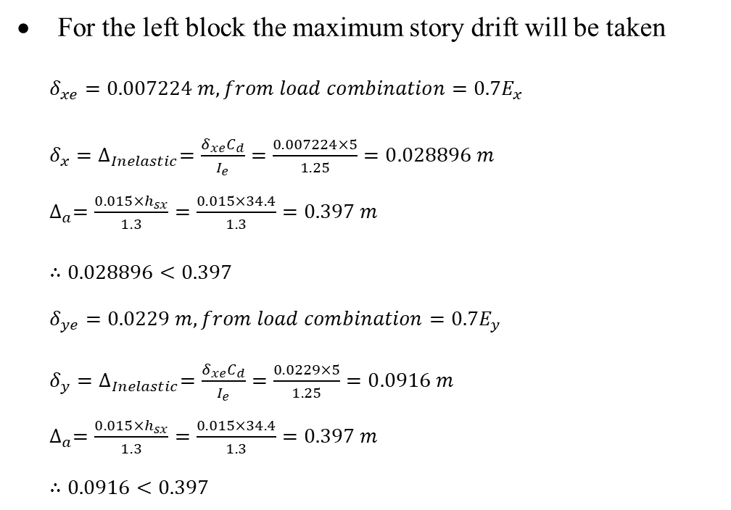
3 Modeling and Analysis
Story Drift
For the left block the maximum story drift will be taken
$δ_{xe}=0.007224 m, from load combination=0.7E_{x}$
$δ_{x}=∆_{Inelastic}=\frac{δ_{xe}C_{d}}{I_{e}}=\frac{0.007224×5}{1.25}=0.028896 m$
$∆_{a}=\frac{0.015×h_{sx}}{1.3}=\frac{0.015×34.4}{1.3}=0.397 m$
$∴0.028896<0.397$
$δ_{ye}=0.0229 m, from load combination=0.7E_{y}$
$δ_{y}=∆_{Inelastic}=\frac{δ_{xe}C_{d}}{I_{e}}=\frac{0.0229×5}{1.25}=0.0916 m$
$∆_{a}=\frac{0.015×h_{sx}}{1.3}=\frac{0.015×34.4}{1.3}=0.397 m$
$∴0.0916<0.397$

Slide 39
4 Design
Introduction:-
The design will be done for the structural elements including slabs, beams, columns, mat foundation and shear walls, for both blocks based on ACI 318-14.
Engineering software programs like ETABS 18, SAFE 16, EXCEL and AutoCAD will be used for all structural members in the building.
The calculations for the width of the seismic separation joint will also be included.

Slide 40
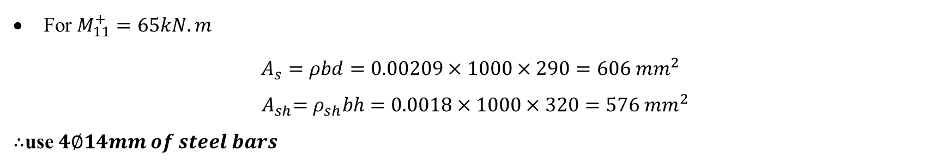
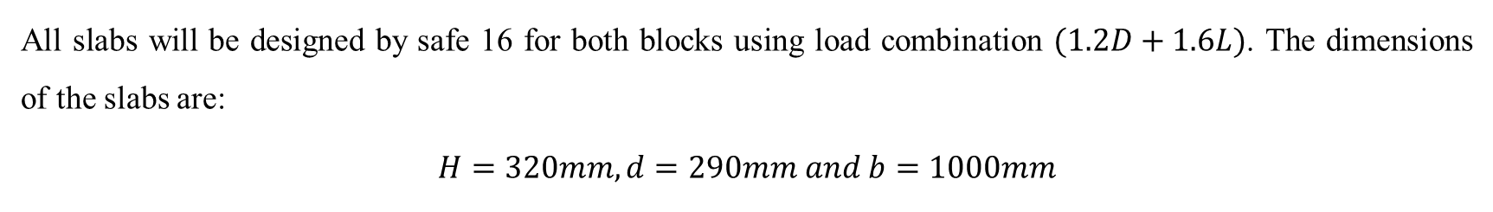

4 Design
Design Results:-
Slab
All slabs will be designed by safe 16 for both blocks using load combination $(1.2D+1.6L)$. The dimensions of the slabs are:
$$H=320mm,d=290mm and b=1000mm$$
For $M_{11}^{+}=65kN.m$
$$A_{s}=ρbd=0.00209×1000×290=606 {mm}^{2}$$
$${ A}_{sh}=ρ_{sh}bh=0.0018×1000×320=576 {mm}^{2}$$
$∴$use $4∅14mm of steel bars$
$ρ$ = 0.00209

Slide 41
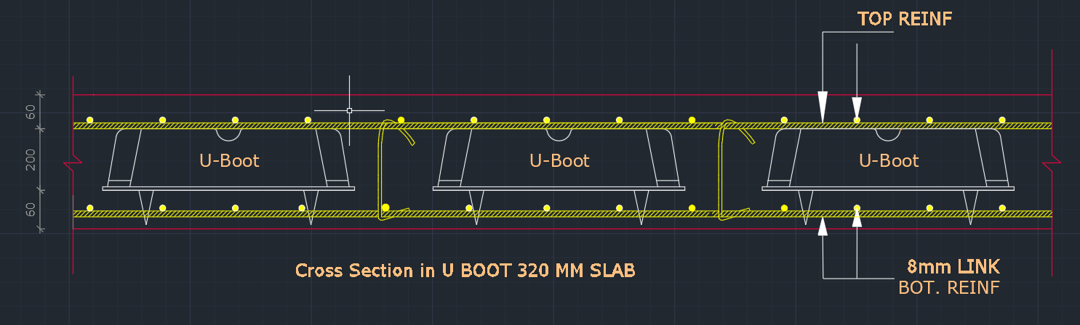
4 Design
Design Results:-
Slab

Slide 42
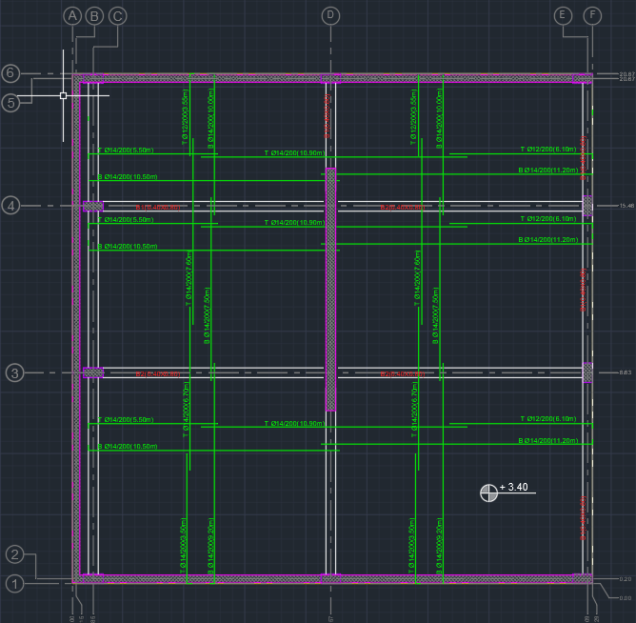
4 Design
Design Results:-
Slab

Slide 43
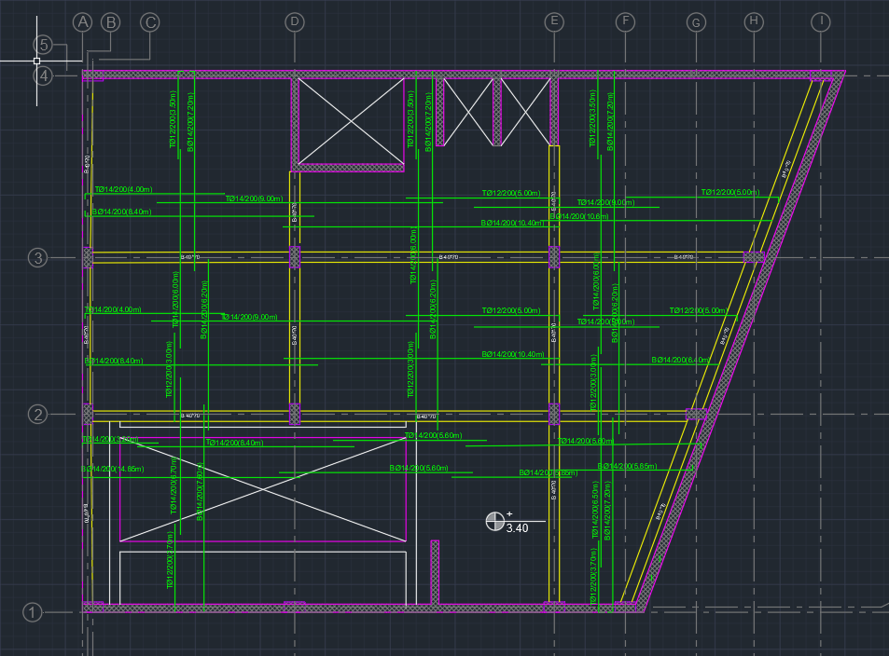
4 Design
Design Results:-
Slab

Slide 44
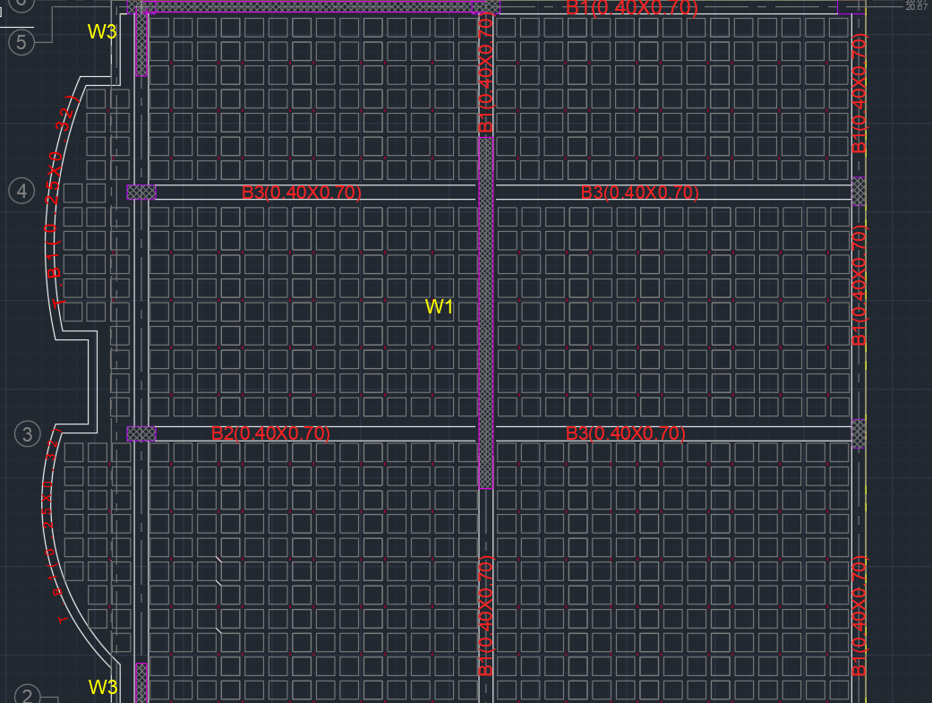
4 Design
Design Results:-
Beam
b= 400 mm, h= 700 mm, d = 660 mm

Slide 45

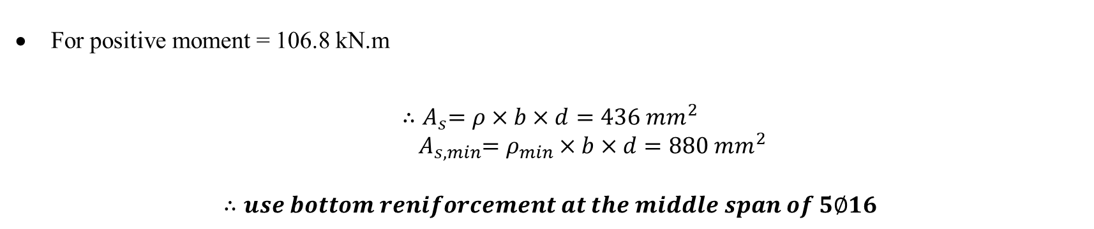
4 Design
Design Results:-
Beam
For positive moment = 106.8 kN.m
$${∴A}_{s}=ρ×b×d=436 {mm}^{2}$$
$${ A}_{s,min}=ρ_{min}×b×d=880 mm^{2}$$
$$∴use bottom reniforcement at the middle span of 5∅16$$
$$ρ= 0.00165$$

Slide 46


4 Design
Design Results:-
Beam
For negative moment = 221 kN.m
$${∴A}_{s}=ρ×b×d=953 {mm}^{2}$$
$$A_{s,min}=ρ_{min}×b×d=880 mm^{2}$$
$$∴use top reniforcement at the beam face of 5∅16$$
$$ρ=0.00361$$

Slide 47

4 Design
Design Results:-
Beam

Slide 48

4 Design
Design Results:-
Columns
The column cross-section is 400 x 800 mm and the major end moments are about axis 3, while the end moments in other direction are small (ignore them).

Slide 49

4 Design
Design Results:-
Columns

Slide 50

4 Design
Design Results:-
Columns

Slide 51

4 Design
Design Results:-
Mat foundation
Mat foundation will be designed using safe 16 for both blocks using the envelope of all load combinations, and final dimensions of mat foundation, in order to avoid punching shear, are:
$$H=1000 mm, d=940 mm and b=1000 mm$$

Slide 52

4 Design
Design Results:-
Mat foundation
The Soil pressure for both blocks is less than Bearing capacity of the soil.

Slide 53



4 Design
Design Results:-
Mat foundation
For $M_{11}^{+}=655 kN.m$
$$ρ=0.002$$
$$A_{s}=ρbd=0.002×1000×940=1880 {mm}^{2}$$
$${ A}_{sh}=ρ_{sh}bh=0.0018×1000×320=1800 {mm}^{2}$$
As $A_{s}>A_{sh}∴$ Use $A_{s}=1880 {mm}^{2}$
So, use $∅18/150mm of steel bars$

Slide 54

4 Design
Design Results:-
Mat foundation
For $M_{11}^{−}=655 kN.m$
$$A_{s}=ρbd=0.002×1000×940=1880 {mm}^{2}$$
$${ A}_{sh}=ρ_{sh}bh=0.0018×1000×320=1800 {mm}^{2}$$
As $A_{s}>A_{sh}∴$ Use $A_{s}=1880 {mm}^{2}$
So, use ∅𝟏𝟖/𝟏𝟓𝟎𝒎𝒎 𝒐𝒇 𝒔𝒕𝒆𝒆𝒍 𝒃𝒂𝒓𝒔
$$ρ=0.002$$

Slide 55


4 Design
Design Results:-
Mat foundation

Slide 56


4 Design
Design Results:-
Basement wall
$Z =3.4m$
$$q=18×3.4×0.5=30.6 kN/m^{2}$$
$M=q×\frac{H^{2}}{15}=30.6×\frac{{3.4}^{2}}{15}=51 kN.m$
For earthquake consideration the moment will be magnified by $40\%$
$$∴M=51×1.4=71.4 kN.m$$
$for the ultimate moment M=71.4×1.6=114.24 kN.m$ (per ACI Code).
𝑭𝒐𝒓 𝒂 𝟏𝒎 𝒔𝒕𝒓𝒊𝒑 𝒕𝒉𝒆 𝒂𝒔𝒔𝒖𝒎𝒆𝒅 𝒓𝒆𝒊𝒇𝒐𝒓𝒄𝒆𝒎𝒆𝒏𝒕 𝒘𝒊𝒍𝒍 𝒃𝒆 𝟏∅𝟏𝟒/𝟐𝟎𝟎𝒎𝒎.

Slide 57

4 Design
Design Results:-
Basement wall

Slide 58

4 Design
Design Results:-
Shear wall
Special shear walls will be designed to resist all lateral earthquake loads using ETABS 18. the following figure shows the wall that will be checked for the design in this section.

Slide 59

4 Design
Design Results:-
Shear wall

Slide 60

4 Design
Design Results:-
Shear wall

Slide 61


4 Design
Design Results:-
Shear wall
Length of wall $l_{w}= 9.0 m$
Thickness of wall $b_{w} = 400 mm.$
Height of wall $h_{w}= 31.2 m.$
ℎ𝑤∕𝑙𝑤 = 31.2 ∕ 9 = 3.47
𝑙𝑤∕𝑏𝑤 = 9 ∕ 0.4 = 22.5

Slide 62

4 Design
Design Results:-
Shear wall
Pu, Vu and Mu for the selected walls

Slide 63

4 Design
Design Results:-
Shear wall
Design for shear:
At least two curtains of reinforcement shall be used in a wall if the in-plane factored shear force exceeds $0.17 A_{cv} \sqrt{f ′c}$ or${h_{w}}/{l_{w}}≥2$
$$V_{n}=0.17 A_{cv} \sqrt{f′c}=0.17×400×9000×\sqrt{40}=3870.6 kN$$
$$V_{u}=5141.13 kN >3870.6$$
$${h_{w}}/{l_{w}}=3.47≥2$$
$$∴Two curtains of reinforcement are required$$

Slide 64



4 Design
Design Results:-
For two curtains of reinforcement and assuming $∅10$ bars:
$\frac{2×78.53}{S_{t}}=1$
$$S_{t}=157.1mm≤450mm$$
$$∴use ∅10/150 mm$$
Shear wall
Horizontal and vertical shear reinforcement:
$$ρ_{t}=0.0025$$
Max spacing $S_{max}=450 mm$, as per ACI Code.
$$\frac{A_{t}}{S_{t}}=0.0025b_{w}=0.0025×400=1 {mm}^{2}/mm$$
$If V_{u }≤0.083 A_{cv} \sqrt{f′c}$, then $ρ_{l} and ρ_{t }can be reduced.$
$$0.083 A_{cv} \sqrt{f′c}=0.083×400×9000×\sqrt{40}=1889.77kN$$
$$V_{u}=5141.13 kN >1889.77 kN$$
$$∴ρ_{l} and ρ_{t }can^{′}t be reduced$$

Slide 65

4 Design
Design Results:-
Shear wall
Design for flexure and axial loads:
There are two methods that can be used for the boundary element check:
Displacement method
Stress method
Boundary elements are required where the maximum fiber compression stress $>0.2f^{′}c$
Maximum stress limit $=0.2×40=8 Mpa$
The boundary element shall be discontinued where the compressive stress$=0.15f^{′}c=6 Mpa$

Slide 66


4 Design
Design Results:-
Shear wall
From B2 to F1 the stress is$>8 Mpa$, also the value of $c=2654mm>c_{max}=2000mm$, then special boundary elements are required at the wall end.
Length of boundary element is equal to the max of:
$c−0.1l_{w}=2654−0.1×9000=1754mm$
$\frac{c}{2}=\frac{2654}{2}=1327mm$
The final boundary element design length will be taken as $1800mm$

Slide 67


4 Design
Design Results:-
Shear wall
Thickness of the boundary element $b_{b}$:
$h_{u}:clear hight= 5.4m$
  $$\frac{h_{u}}{16}=337.5mm$$
  $$\frac{c}{l_{w}}=\frac{2654}{9000}=0.295≤0.375$$
$$∴thickness of the boundary is the same as the thickness of wall=400 mm$$

Slide 68

4 Design
Design Results:-
Shear wall
Boundary element transverse reinforcement:

Slide 69


4 Design
Design Results:-
Shear wall
Boundary element transverse reinforcement:
For the longer direction of boundary:
$$b_{c1}=1800−40=1760 mm$$
For the shorter direction of boundary:
$$b_{c2}=400−2×40=320 mm$$

Slide 70


4 Design
Design Results:-
Shear wall
Boundary element transverse reinforcement:
$$0.09\frac{{f′}_{c}}{f_{yt}}=0.09×\frac{40}{420}=8.57×{10}^{−3}$$
$$0.3\left(\frac{A_{g}}{A_{ch}}−1\right)\frac{{f^{′}}_{c}}{f_{yt}}=0.3×\left(\frac{400×1800}{1760×320}−1\right)×\frac{40}{420}=7.95×{10}^{−3}$$
$$∴\frac{A_{sh}}{sb_{c}}=8.57×{10}^{−3}$$
$h_{x}:$ max spacing of hoop or tie legs$≤35cm and \frac{2}{3}b$
$$\frac{2}{3}b=\frac{2}{3}×40=26.67cm$$
$$∴h_{x}=26.67cm$$
$$S_{max}≤ \left\{\begin{aligned}\frac{b}{3}=\frac{40}{3}=13.3 cm \\ 6×2.5=15 cm \\ 10cm≤10+\left(\frac{35−h_{x}}{3}\right)=10+\left(\frac{35−26.67}{3}\right)=12.77 cm≤15cm\end{aligned}\right.$$
$$∴use S=13cm$$

Slide 71

4 Design
Design Results:-
Shear wall
Boundary element transverse reinforcement:
$$∴\frac{A_{sh}}{sb_{c}}=8.57×{10}^{−3}$$
$$A_{sh}=8.57×{10}^{−3}×130×320=365.51 {mm}^{2}$$
$$∴use 7 leg ∅10/13cm$$

Slide 72

4 Design
Design Results:-
Special boundary elements transverse reinforcement shall extend above and below the critical section a distance equal to:
Max $≥ \left\{\begin{aligned}l_{w}=9.0 m \\ \frac{M_{u}}{4V_{u}}=3.3 m\end{aligned}\right.$
$$∴The distance is equal to 9.0m$$
Shear wall

Slide 73

4 Design
Design Results:-
Shear wall
Longitudinal reinforcement will be assumed using section designer in ETABS 18 as the following:
Shear wall reinforcement (B2-F1)

Slide 74

4 Design
Design Results:-
Shear wall

Slide 75


4 Design
Design Results:-
Shear wall
Special boundary elements are not required, as the stress is less than $8Mpa,$also the boundary element shall be discontinued where the compressive stress$=0.15f^{′}c=6 Mpa$
As per ACI Code, if $ρ≥2.8/f_{y}$ ordinary boundary elements are required, also if $ρ≤2.8/f_{y}$ ties are not required.

Slide 76


4 Design
Design Results:-
Shear wall
The uniform reinforcement for P1(F2-F5) will be $∅12/200mm.$

Slide 77

4 Design
Design Results:-
Shear wall

Slide 78

4 Design
Design Results:-
Shear wall

Slide 79

4 Design
Design Results:-
Width of separation joints between building parts
Separations shall allow for the maximum inelastic response displacement ($δ_{M}$). $δ_{M}$ shall be determined at critical locations with consideration for translational and torsional displacements of the structure including torsional amplifications using equation (12.12-1) from ASCE 7-16 as the following:
$$δ_{M}=\frac{δ_{max}C_{d}}{I_{e}}$$
Where:
$δ_{max}:$ maximum elastic displacement at the critical location.
            $$C_{d}=5$$
            $$I_{e}=1.25$$
Adjacent structures on the same property shall be separated by at least $δ_{MT}$, determined as equation (12.12-2) from ASCE 7-16 as the following:
$$δ_{MT}=\sqrt{{\left(δ_{MI}\right)}^{2}+{\left(δ_{MII}\right)}^{2}}$$

Slide 80

4 Design
Design Results:-
Width of separation joints between building parts
Where $δ_{MI}$ and $δ_{MII}$ are the maximum inelastic response displacements of the adjacent structures at their adjacent edges.

Slide 81


4 Design
Design Results:-
Width of separation joints between building parts
Joint | $δ_{max}$ $$(mm)$$ | $δ_{M}$ $(mm)$
280 | 7.5 | 30
81 | 5 | 20
281 | 7.5 | 30
80 | 10 | 40
So, the width of separation is:
$$δ_{MT}=\sqrt{{\left(δ_{M1}\right)}^{2}+{\left(δ_{M2}\right)}^{2}}=\sqrt{{\left(30\right)}^{2}+{\left(20\right)}^{2}}=36.06 mm$$
$$δ_{MT}=\sqrt{{\left(δ_{M3}\right)}^{2}+{\left(δ_{M4}\right)}^{2}}=\sqrt{{\left(30\right)}^{2}+{\left(40\right)}^{2}}=50.0 mm$$
The width of separation between the blocks is considered to be equal 50 mm.

Slide 82
The End
Thank you

