Slide 1
An-Najah National university
Faculty of engineering
Building engineering departmenet
Graduation project ||
Center for the Leaders of the Future
Prepared By :
Bayan Sameer Younis
Esraa Ali Assaf
Ruba Nael Duraidi
Yasmeen Nezar Tuffaha
Supervisor :
Dr. MontherDwaikat

Slide 2
Outline
Introduction.
Site analysis.
Architectural design.
Structural design.
Environmental design.
Electrical design.
Mechanical design.
Safety and fire system.
Quantity survey

Slide 3
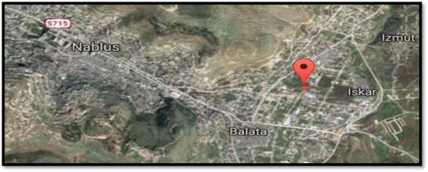
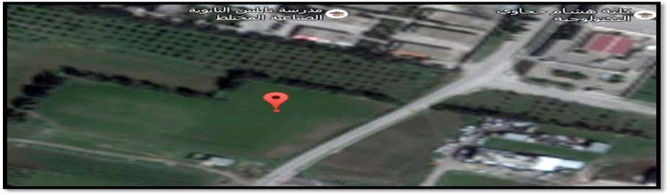
Site Analysis
Nablus – Palestine.
North-east from the city center
Total area of 15000 m2

Slide 4
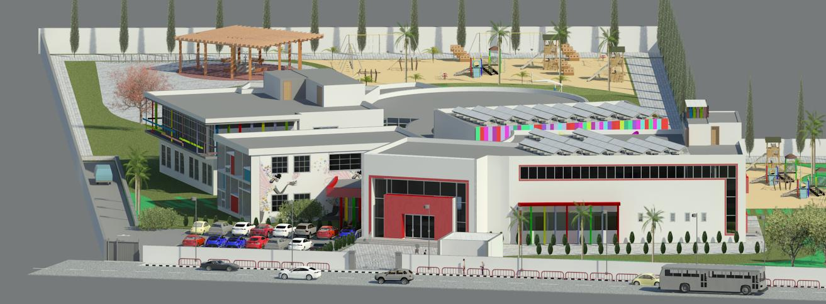
Architectural Design

Slide 5
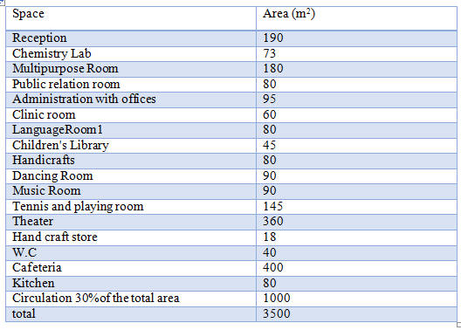
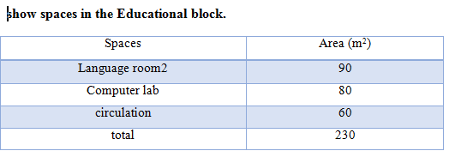
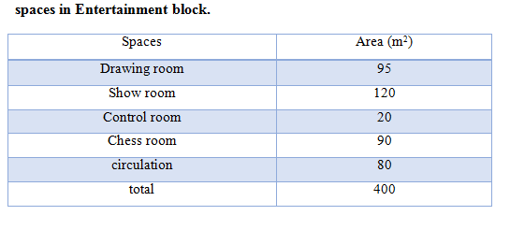
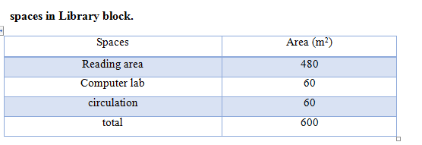
Ground floor :
The total area of a center equal 4600 m² divided into two floors, the distributions and area of spaces and area of spaces in each floor are shown in the following table.

Slide 6
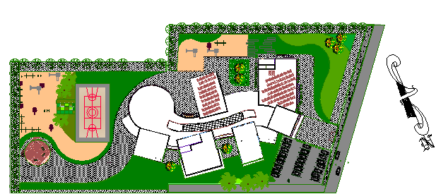
Architectural Design
Site plan

Slide 7
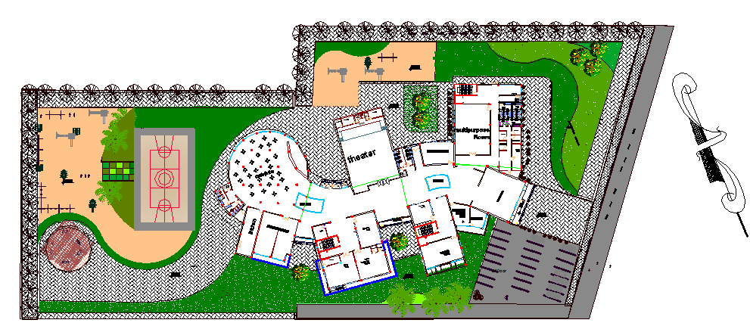
Architectural Design
Master plan

Slide 8
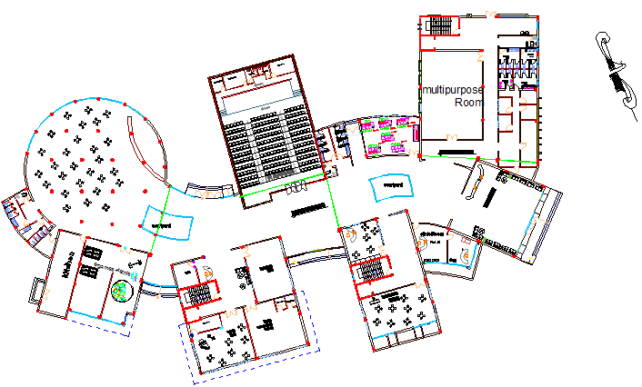
Architectural Design
Ground floor :

Slide 9
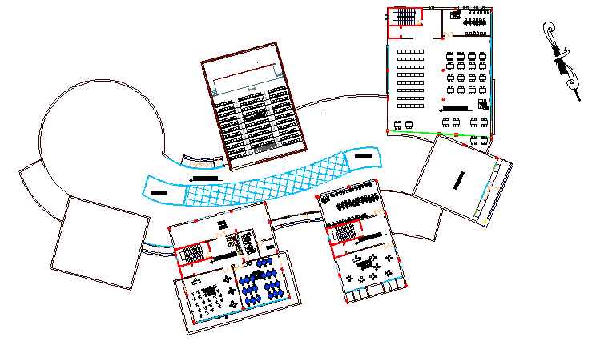
Architectural Design
First floor

Slide 10
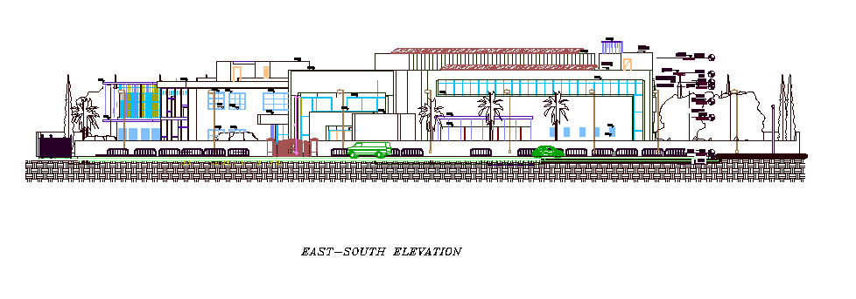
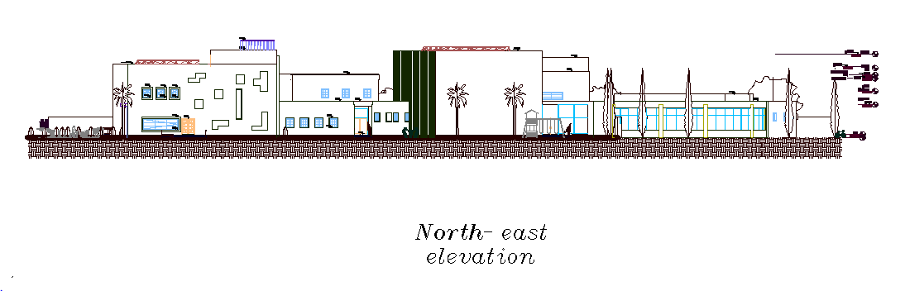
Architectural Design

Slide 11
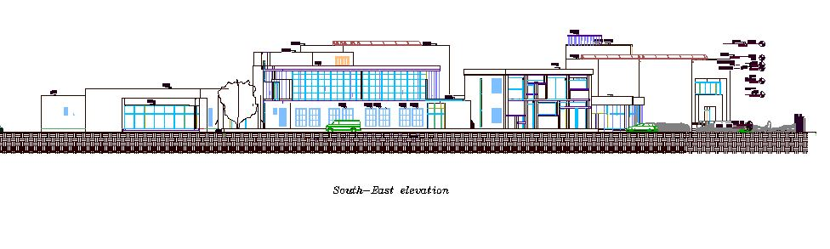
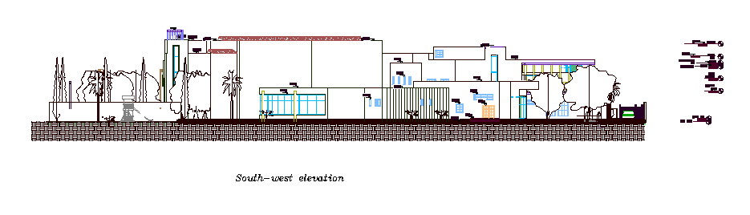

Slide 12
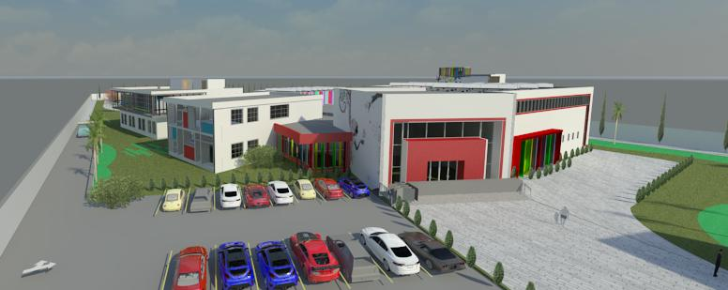
Architectural Design
3DView
East and main view

Slide 13
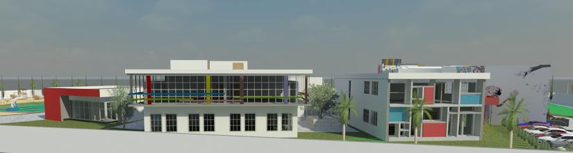
Architectural Design
South-East view

Slide 14
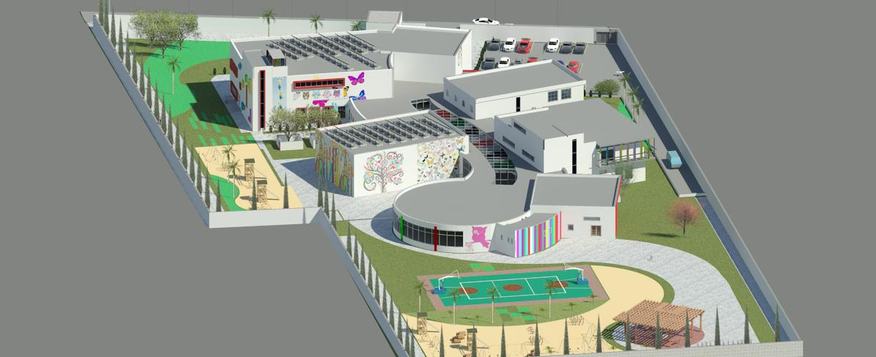
Architectural Design
West-north view

Slide 15
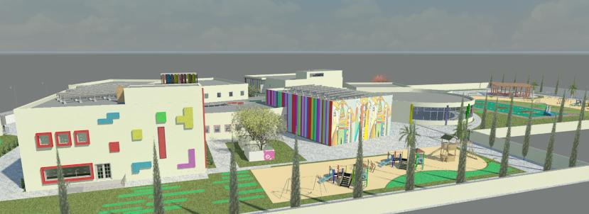
Architectural Design
.North-east view

Slide 16
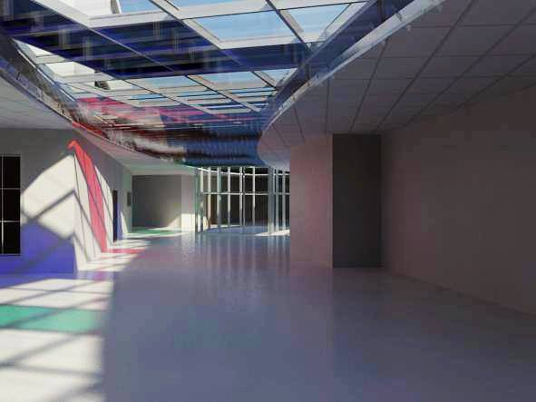
Architectural Design
Corridor with skylight view

Slide 17
Structural Design

Slide 18
Design codes.
ASCE (American Society Of Civil Engineers) 7 2010 for design loads.
ACI -318-08 (American Concrete Institution) for reinforced concrete structural design.
UBC-97 (Uniform Building Code) for earthquake load computations.

Slide 19
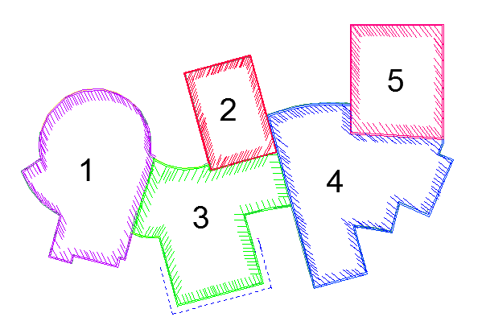
Building Structural Joints.

Slide 20
Design Data.
f’c = 24 MPa for slabs and beams.
f’c = 28 MPa for columns and footings. (B350)
fy = 420 MPa
Bearing capacity for soil =180 (KN/m²)
Loads.
Live load = 5 (KN/m²)
Super imposed dead load= 4 (KN/m²)

Slide 21
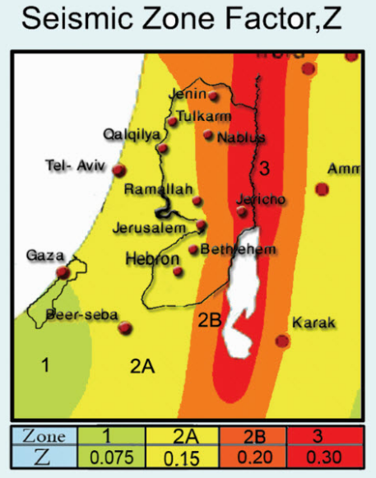
Seismic design data.
Location : Nablus.
Zone 2B ➔ Z = 0.2
Cv = 0.33 , Ca= 0.24
R=5.5 , I = 1
Location : Nablus.
Zone 2B ➔ Z = 0.2
Cv = 0.33 , Ca= 0.24
R=5.5 , I = 1

Slide 22
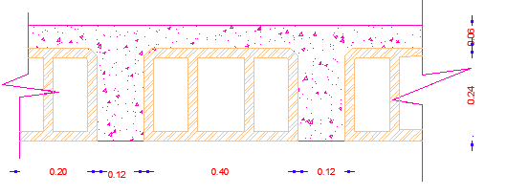
Structural System
The system of the slab is one way ribbed slab with (30 cm) thickness and dropped beams. For cafeteria block 1
Dimensions of the sections
Main beam | 40 * 50 cm
Secondary beam | 40*30 cm
Columns | 30*30 cm
 | 40*50 cm
 | 60*40 cm
 | 60*30 cm
 | R = 25 cm and R = 30 cm

Slide 23
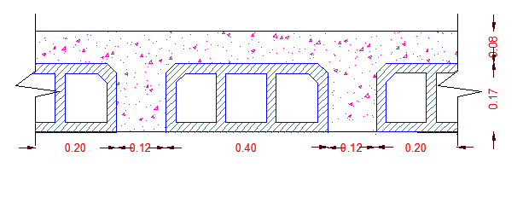
The system of the slab is one way ribbed slab with (25 cm) thickness and dropped beams. Also, used shear wall. For theater block 2.
Dimensions
Beam | 50 * 120 cm
Shear wall ( thickness ) | 20 cm

Slide 24
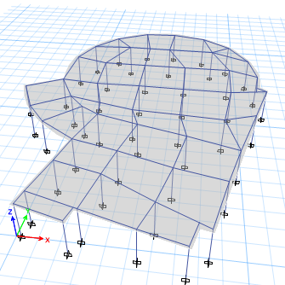
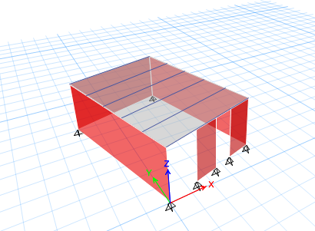
3-DETABS modeling
Block 1 Block 2

Slide 25
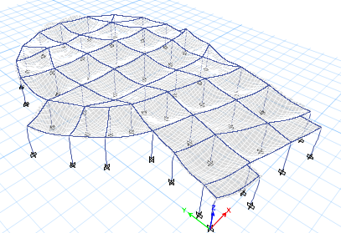
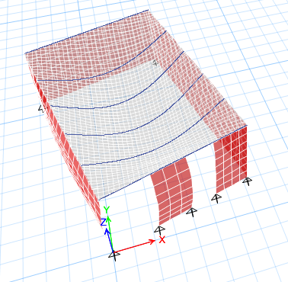
Models Validation
Compatibility check
Block 1 Block 2

Slide 26
Equilibrium check.
Block 1
Block 2
Types of Loads | ETABS (KN) | Manual (KN) | % error
Live load | 4325 | 4325 | 0.00
SID | 5363 | 5363 | 0.00
DL | 5660 | 5791 | 2.3
Types of load | ETAPS (KN) | Manual (KN) | % error
Live load | 1824 | 1824 | 0.00
SID | 2043 | 2043 | 0.00
DL | 5820 | 5582 | 4

Slide 27
Internal forces check
Block 1:
Block 2 :
Element | ETAPS | Manual | % error <10 %
Column No. 14 | 573 | 571 | 0.4
Beam 2 | 205 | 215 | 5
Slab 2 | 51 | 50 | 2
Element | ETABS | Manual | % error
Beam | 2200 | 2533 | 13
Slab | 47 | 48 | 1.6

Slide 28
Validation of the earthquake loads
Block 2:
Check period
Base shear check
check drift is ok 1.54 mm less than delta limit = 167 mm
Mass participation ratio is more than 90 %
ETABS (S) | Manual (S)
0.2 | 0.5
EQ | ETABS Force | Manual force | %error
EQx | 750 | 748.21 | 0.26
EQy | 759.9 | 748.21 | 1.47

Slide 29
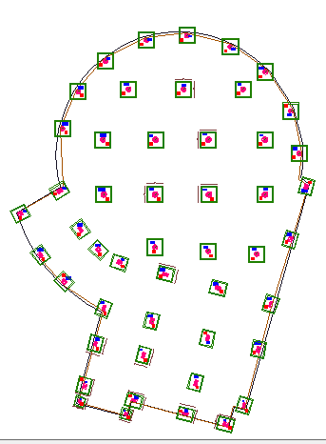
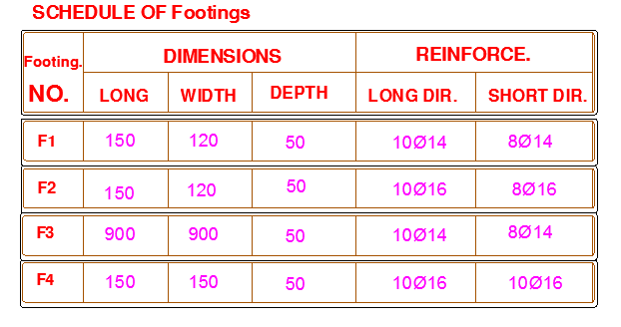
Structural elements and detailing
Footing Plan

Slide 30
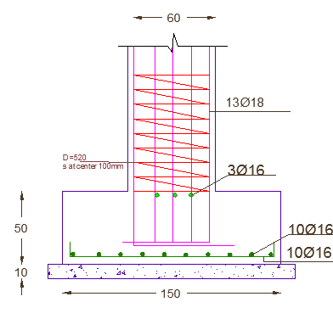
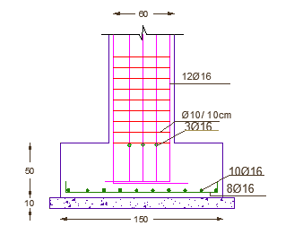
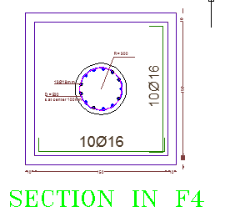
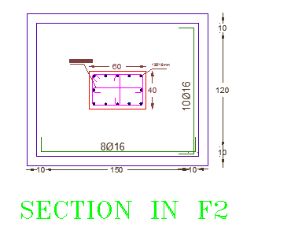
Detailing of the
Single footing

Slide 31
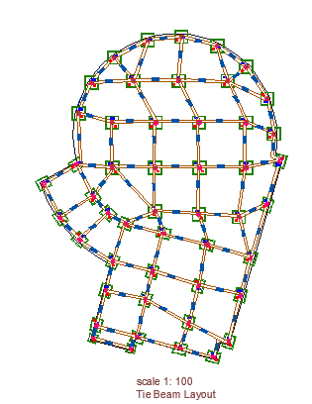
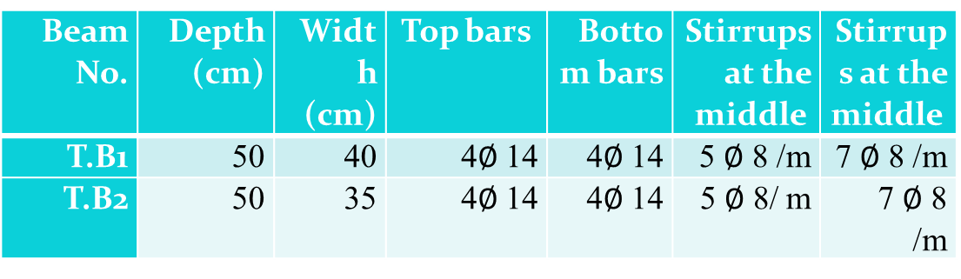
Tie beam plan
Beam No. | Depth (cm) | Width (cm) | Top bars | Bottom bars | Stirrups at the middle | Stirrups at the middle
T.B1 | 50 | 40 | 4$∅$ 14 | 4$∅$ 14 | 5 $∅$ 8 /m | 7 $∅$ 8 /m
T.B2 | 50 | 35 | 4$∅$ 14 | 4$∅$ 14 | 5 $∅$ 8/ m | 7 $∅$ 8 /m

Slide 32
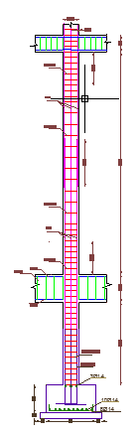
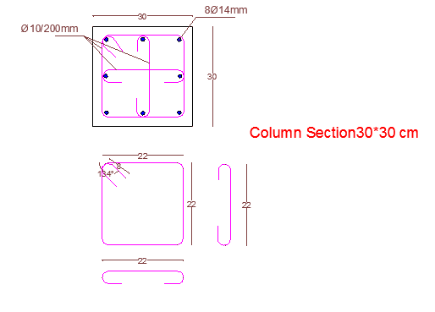
Longitudinal column section

Slide 33
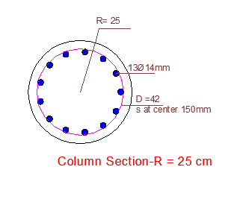
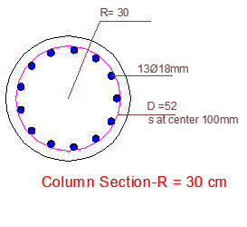
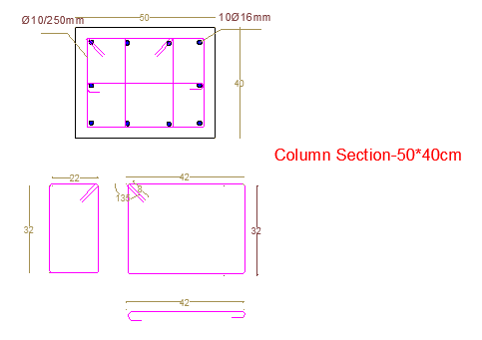
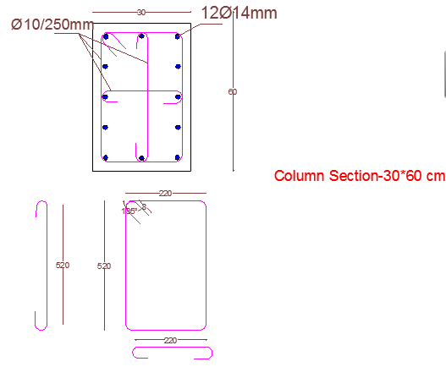
Sections for the columns

Slide 34
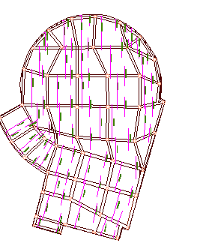
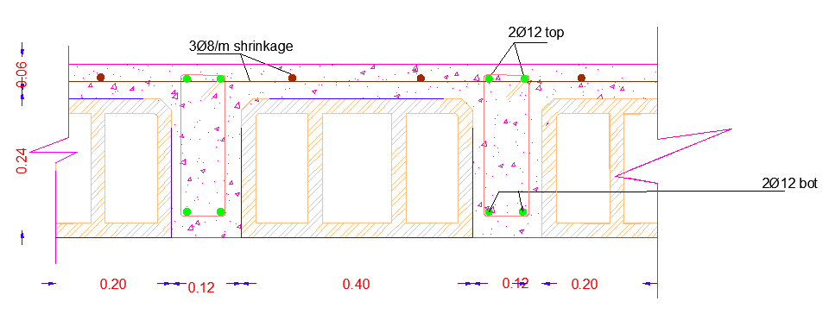
Slab reinforcement

Slide 35
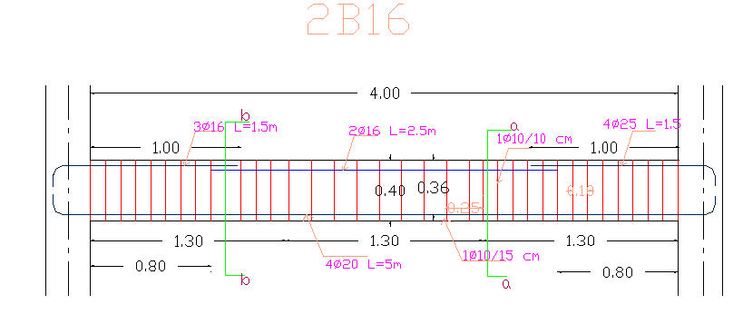
Beam reinforcement

Slide 36
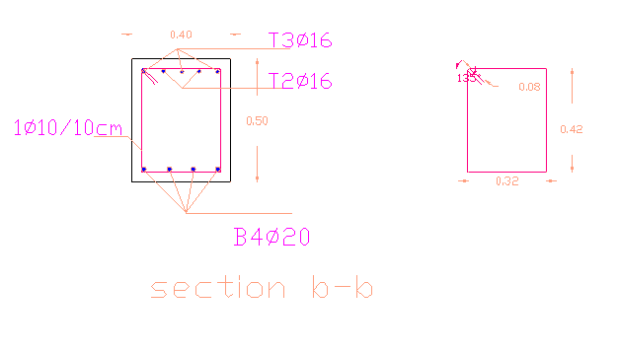
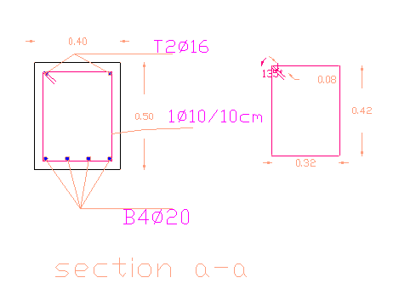

Slide 37
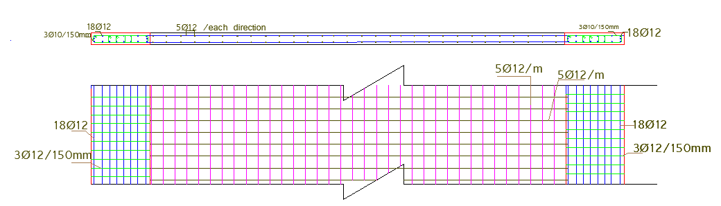
Shear wall

Slide 38
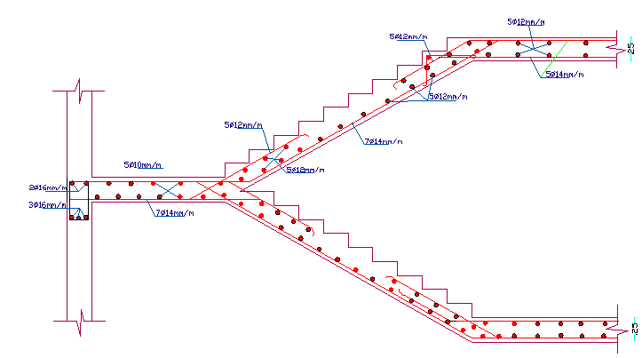
Stairs

Slide 39
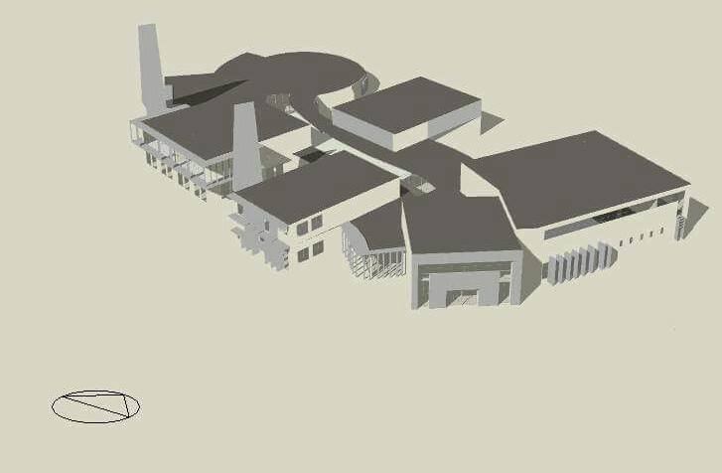
Environmental design
Modeling

Slide 40


DblClr 6mm/6mm Argon
Environmental design
Materials
Type of glass DblClr 6mm/6mm Argon
Element | U Value
External theater walls | 0.5 w/m².k
External center walls | 0.457 w/m².k
External roof | 0.379 w/m².k
Interior slab | 0.328 w/m².k
Ground slab | 0.25 w/m².k
Double clear glass with Dbl LoE (e2=.1) Clr 3mm/12mm (12mm) Arggas using
Outer:(3mm)PPGIindustriesSolarbronze.
Inner: 12mmSouthwall Technologies Inc. XIR 7241 Low Reflective

Slide 41


Shading:
Shading 21 – Jan at 12:00 pm.
Shading 21 – July at 12:00 pm.

Slide 42


Analysis t he corridor with skylight.
In summer.

Slide 43



In summer.
Analysisthe corridor with skylight.
CFD"Computational Fluid Dynamics" analysis.

Slide 44


PMV(prediction mean value) in the center
thermal comfort in summer of the center
thermal comfort in winter for the center
Simulation results for the center.
These simulation are taken from design builder.
In summer:
 | Total Energy [kWh] | Energy Per Total Building Area [kWh/m2] | Energy Per Conditioned Building Area [kWh/m2]
Total Site Energy | 276356.61 | 62.60 | 62.60
Net Site Energy | 276356.61 | 62.60 | 62.60
Total Source Energy | 426481.19 | 96.60 | 96.60
Net Source Energy | 426481.19 | 96.60 | 96.60

Slide 45
In winter:
 | Total Energy [kWh] | Energy Per Total Building Area [kWh/m2] | Energy Per Conditioned Building Area [kWh/m2]
Total Site Energy | 182146.29 | 41.26 | 41.26
Net Site Energy | 182146.29 | 41.26 | 41.26
Total Source Energy | 640303.42 | 145.03 | 145.03
Net Source Energy | 640303.42 | 145.03 | 145.03

Slide 46


The annual simulation result.

Slide 47

Day light factor
the Average DF % | floor | Room
1.32 | ff | computer lab
3.14 | ff | language room2
1.47 | ff | show room
1.96 | ff | chess room
1.99 | ff | drawing room
3.95 | ff | Reading room
7.54 | GF | computer lab
2.71 | GF | Language room1
3.6 | GF | dancing room
3.24 | GF | music room
9.7 | GF | office4
4.74 | GF | cafeteria
5.91 | GF | play tennis 1
6.08 | GF | first aid
5.44 | GF | first aid 1
3.31 | GF | Children's Library
1.21 | GF | food making
1.83 | GF | Handicrafts
0 | GF | store
2.60 | GF | Multi-purpose room
1.80 | GF | Chemistry Lab
0 |  | theater
3.67 | For total the building floor | Average daylight factor for the center
The distribution of daylight factor of the ground floor.

Slide 48

Acoustical Design
block | RT60 Calculated | RT60 Recommend
Theater | 1-1.6 | .9-1.6

Slide 49


Acoustical Design
Internal wall
wall | STC (dB)
Theater wall | 65
Internal wall | 49
Theater wall

Slide 50

Water heater System
Consumption of hot water. | 800 L/day
Slope of collector. | 45°
Storage capacity area of collector. | 75 L/M^2
Number of collectors. | 5
Initial cost | 9310 ILS
annual fuel costs | 1880.6 ILS

Slide 51

Photovoltaic System

Slide 52
Photovoltaic System
polycrystalline | Modules type
30° | Slope of collector.
179 m^2 | Area of modules.
108 | Number of Modules.
143640 | Initial cost
9842 | annual fuel costs
 | E Grid (kWh)
Jan | 29975
Feb | 3058
Mar | 4289
Apr | 4359
May | 4705
Jun | 4678
Jul | 4782
Aug | 4828
Sep | 4497
Oct | 4082
Nov | 3403
Dec | 3079
Year (kWh) | 48773
48773 kWh total consumption energy.
100% can be covered
of lighting energy.

Slide 53




Artificial Lighting

Slide 54





Artificial Lighting
 | Illuminance (lux) | Recommended illuminance | Uniformity
Theater | 440 | 300 | .6
Entrance hall | 107 | 100 | .63
Music room | 612 | 500 | .64
Dance room | 661 | 500 | .67
Physics and chemistry lab | 500 | 663

Slide 55


Electrical design.

Slide 56

Electrical design.
Theater circuit breaker digram

Slide 57

Electrical design.

Slide 58


Drainage system

Slide 59


Drainage system

Slide 60


Layout of Water Tanks

Slide 61


System of Distribution of water Tank

Slide 62


Water Supply system

Slide 63
VRF System
Story | Block | Ton Refrigerator (TR) | Capacity of indoor unit (TR)
Ground floor | Block 1 | 11.7 | 12
 | Block 2 | 7.7 | 8
 | Block 3 | 12.9 | 13
 | Block 4 | 15 | 15
 | Block 6 | 12.6 | 13
First Floor | Block 7 | 7 | 7
 | Block 8 | 9.8 | 10
Sum. |  |  | 78 (TR)

Slide 64

VRF System

Slide 65

VRF System

Slide 66


Safety System

Slide 67




Safety System

Slide 68

Safety System

Slide 69
Cost
ID | Item name | Units | Quantities | Cost / unit (NIS) | Total cost (NIS)
1 | Earthwork
1.1 | Excavation | M³ | 3268 | 40 | 130 720
1.2 | Base coarse | M³ | 1000 | 30 | 30 000
1.3 | Backfill footing | M³ | 500 | 30 | 15 000
2 | Civil works
2.1 | Steel
2.1.1 | Footings | Ton | 2.4 | 2500 | 6000
2.1.2 | Columns | Ton | 4.8 | 2500 | 12 000
2.1.3 | Beams | Ton | 11.2 | 2500 | 28 000
2.1.4 | Tie beams | Ton | 4 | 2500 | 10 000
2.1.5 | Slabs | Ton | 3 | 2500 | 7500
2.1.6 | Stirrups | Ton | 2 | 2500 | 5000
2.2 | Concrete
2.2.1 | Footings | M³ | 47.5 | 370 | 17 575
2.2.2 | Columns | M³ | 36.5 | 370 | 13 505
2.2.3 | Beams | M³ | 149.5 | 370 | 55 315
2.2.4 | Tie beams | M³ | 50 | 370 | 18 500
2.2.5 | Slab | M³ | 183 | 370 | 67 7710
2.3 | formworks
2.3.1 | Footings | M² | 128.5 | 50 | 6425
2.3.2 | Columns | M² | 331 | 50 | 16 550
2.3.3 | Beams | M² | 625 | 50 | 31.250
2.3.4 | Slab | M² | 901.5 | 50 | 45 075

Slide 70
2.4 | Blinding concrete
2.4.1 | Footing | M³ | 15 | 150 | 2250
3 | Architectural work
3.1 | Walls
3.1.1 | Hollow block work
3.1.1.1 | External walls block ( 15 * 20 *40) | M² | 1400 | 30 | 42 000
3.1.1.2 | External walls block (10*20*40) | M² | 1400 | 30 | 42 000
3.1.1.3 | Internal walls block (10*20*40) | M² | 933 | 30 | 27 990
3.1.2.1 | Polystyrene 5 cm | M² | 1400 | 40 | 56 000
3.1.3 | Glass wall | M² | 160 | 600 | 96 000
3.2 | Finishing
3.2.1 | Plastering internal and external wall | M² | 2333 | 25 | 58 325
3.2.2 | Painting internal wall | M² | 1000 | 25 | 25 000
3.2.3 | Painting external wall | M² | 1400 | 25 | 35 000
3.2.4 | False ceiling bath rooms | M² | 65 | 220 | 14 300
 | False ceiling normal | M² | 3000 | 80 | 240 000
3.2.5 | Tile works | M² | 2000 | 120 | 240 000
 | Doors
3.2.6 | Emergency Doors | Unit | 5 | 2500 | 12 500
 | doors normal | Unit | 25 | 1500 | 37 500
 | Doors bathrooms | Units | 26 | 1000 | 26 000
3.2.7 | Windows | M² | 225 | 600 | 135 000

Slide 71
4 | Mechanical works
4.1 | Water tank |  | Number |  |  | 8 |  | 1500 | 12000
4.2 | Water Closet |  | Number |  |  | 148 |  | 400 | 59200
4.3 | urinal |  | Number |  |  | 2 |  | 150 | 300
4.4 | sink |  | Number |  |  | 1 |  | 300 | 300
4.5 | lavatory |  | Number |  |  | 28 |  | 300 | 8400
4.6 | Fire Extinguishers |  | Number |  |  | 18 |  | 200 | 3600
4.7 | Collectors |  | Number |  |  | 4 |  | 150 | 600
4.8 | Manholes |  | Number |  |  | 32 |  | 20 | 640
4.9 | Pump |  | Number |  |  | 4 |  | 400 | 1600
4.10 | Sprinklers |  | Number |  |  | 230 |  | 30 | 6900
4.11 | Air unit |  | Number |  |  | 90 |  | 300 | 27000
4.12 | Water pipe |  | M |  |  | 260 |  | 20 | 5200
4.13 | VRF ducts |  | M |  |  | 180 |  | 30 | 5400
4.14 | Sewage pipe |  | M |  |  | 260 |  | 30 | 5200
5 | Electrical works
5.1 | Sockets | Unit |  | 234 | 80 |  | 18720
5.2 | Square unit led | Unit |  | 370 | 200 |  | 74 000
5.3 | Rectangular unit led | Unit | 29 | 150 | 4350
5.4 | Spots | Unit | 181 | 10 | 1810
5.5 | Lamps with different shape | Unit | 30 | 180 | 5400
5.6 | Small leds | Units | 1350 | 2 | 2700
5.7 | Photovoltaic | Units | 143 640
5.8 | Water heater collector | Units | 9310
Total cost | 6,000,000 NIS 1,300 NIS / m²

Slide 72
THANK
YOU

