Slide 1


Real Time Human Identification Systems
“Face Recognition”
Supervisor:
Dr.Saed Tarapiah
Students:
Aya Hawamda
Waed Al-Haj

Slide 2
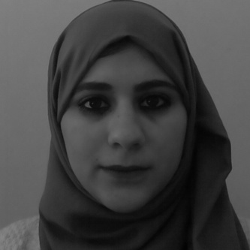
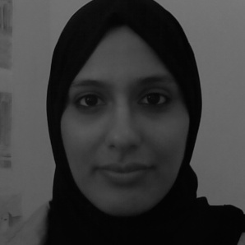
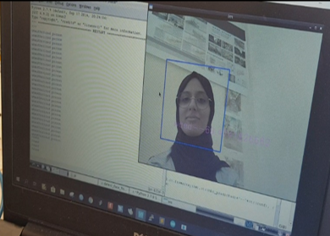
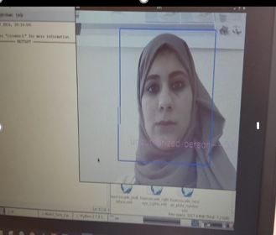

Slide 3
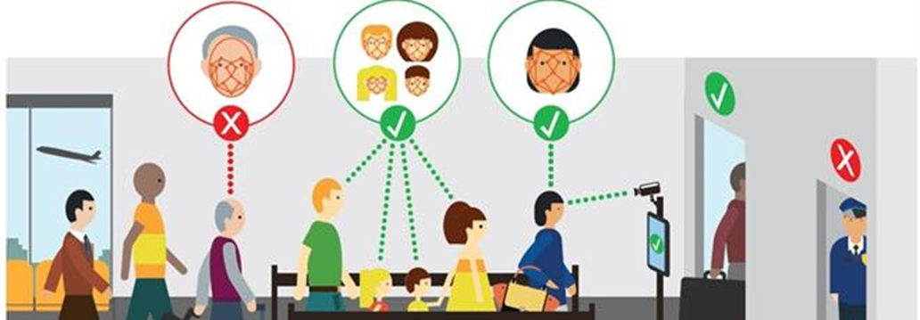

Slide 4

Presentation list
01
overview
02
Motivations
03
Applications
04
Project description
05
Project steps
06
Results and SWOT analysis
07
Future work

Slide 5
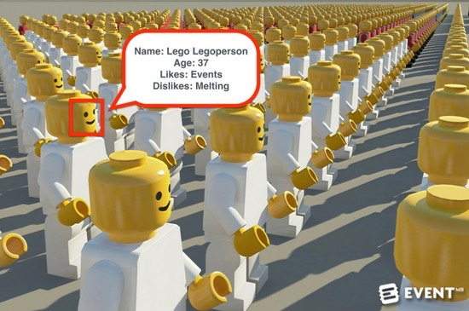

Slide 6

(overview)
Nowadays, Real time human identification systems are important for security, surveillance and biometric applications. Usually it is desirable
to detect, track and recognize persons in public areas such as airports, shopping centers, in
areas with restricted access such as private offices, houses etc. Human identification can be performed by analyzing its biometric information, such as fingerprints, face, iris, Palm prints, palm veins etc. However, for fast and convenient person recognition, still the most suitable biometric parameter is facial information. In order to achieve a higher accuracy and effectiveness we use Open CV libraries and python computer language. Training and identification is done in Raspberry Pi.

Slide 7
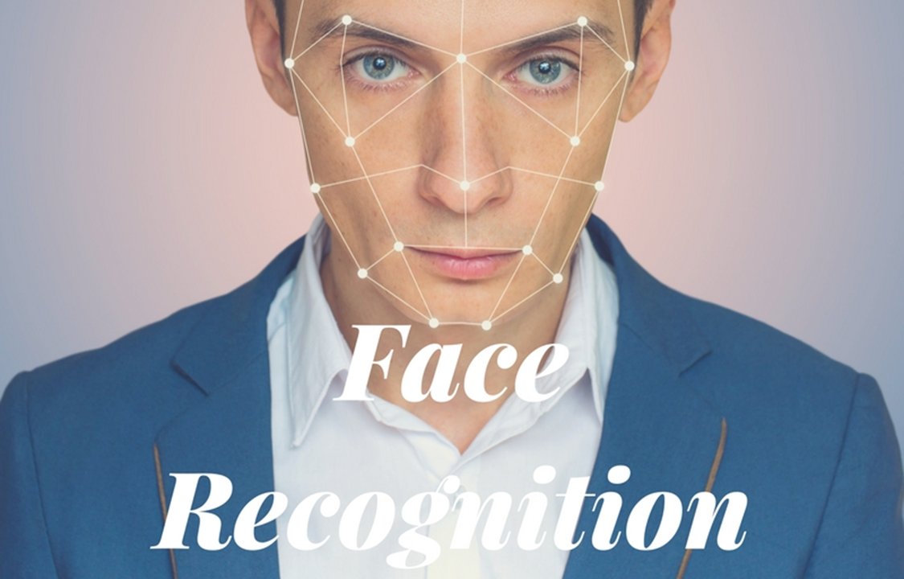
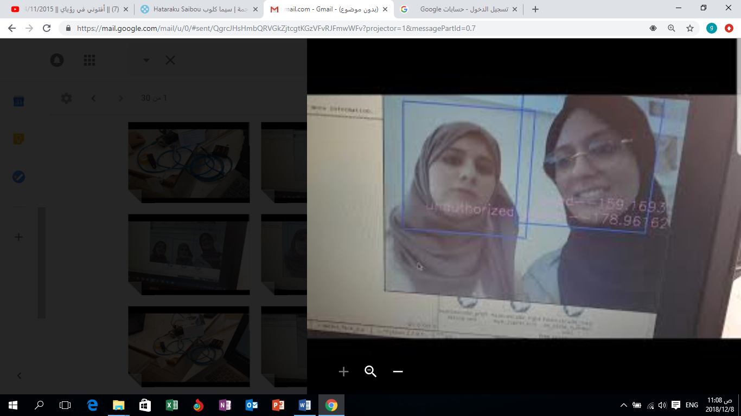

Slide 8
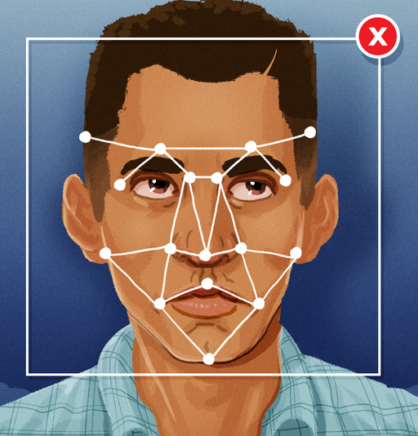
Face recognition
What is face recognition ???
Facial recognition is a biometric software application capable of uniquely identifying or verifying a person by comparing an analyzing patterns based on the person's facial contours.

Slide 9

Motivations
Why to choose face recognition ?
a. It requires no physical interaction on behalf of the user.
b. It is accurate and allows for high enrolment and verification rates.
c. It is the only biometric that allow you to perform passive identification in a one to. Many environments (e.g.: identifying a terrorist in a busy Airport terminal

Slide 10
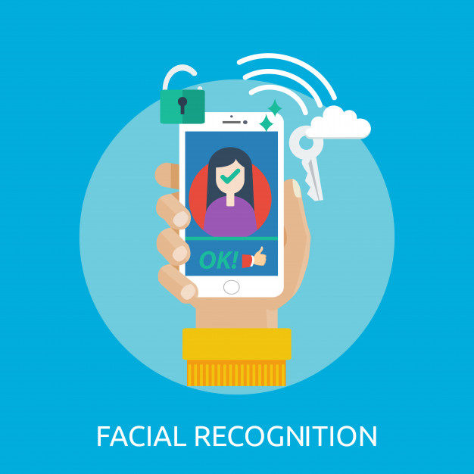
Motivation
What is face recognition ???
d. It does not require an expert to interpret the comparison result.
e. It can use your existing hardware infrastructure, existing cameras and image capture devices will work with no problems

Slide 11
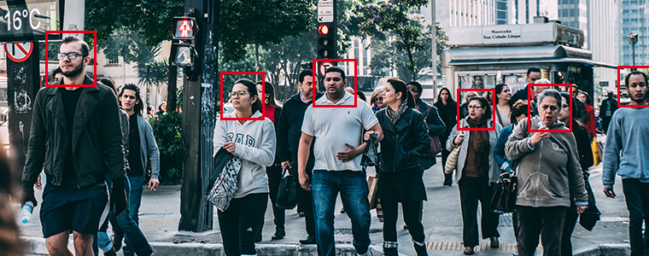

Slide 12
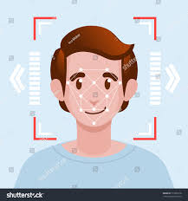

Applications
Criminal Investigations App
Financial services
Social Networking sites & photography
Airport security and restrict access

Slide 13
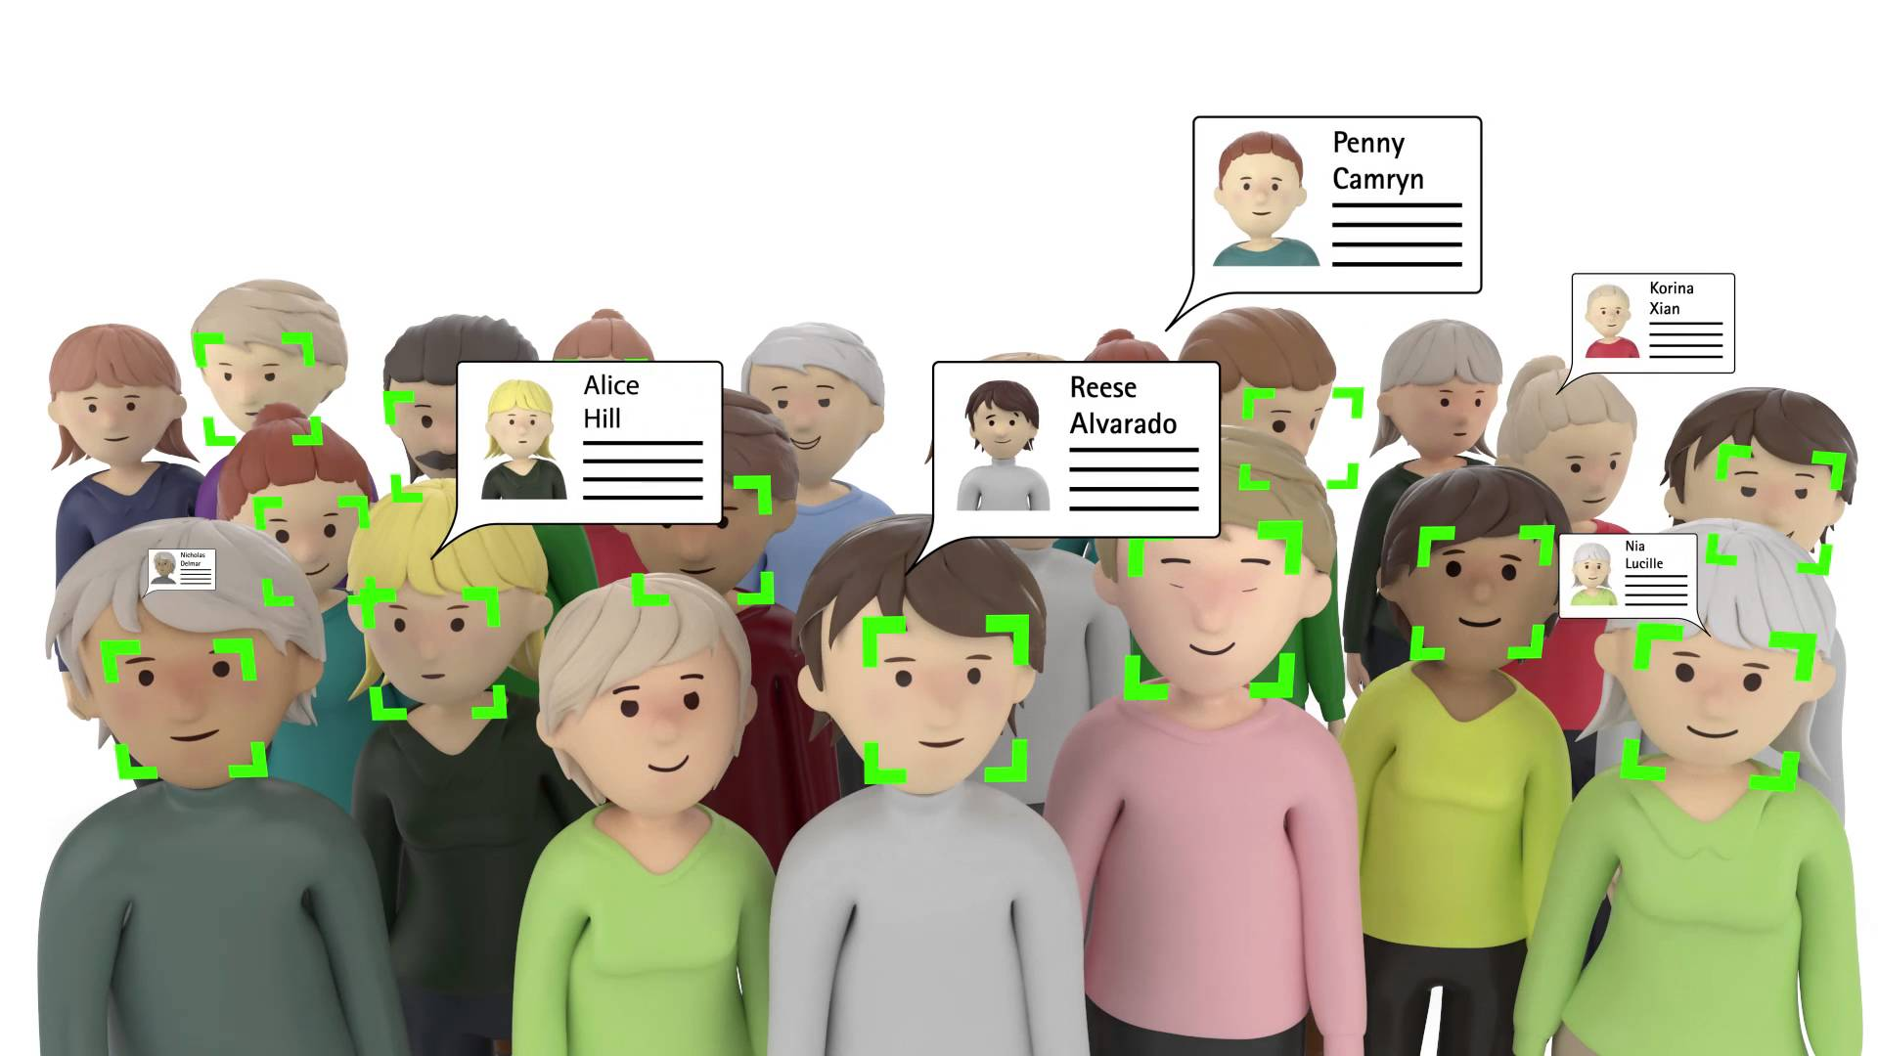

Slide 14
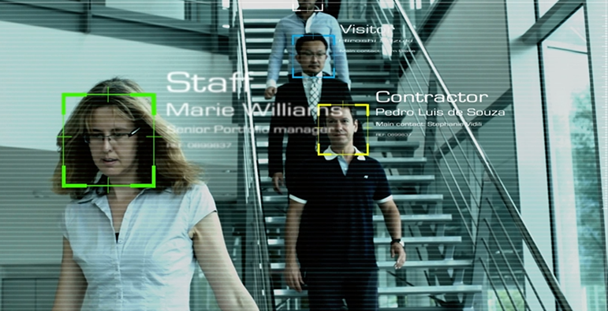

Slide 15
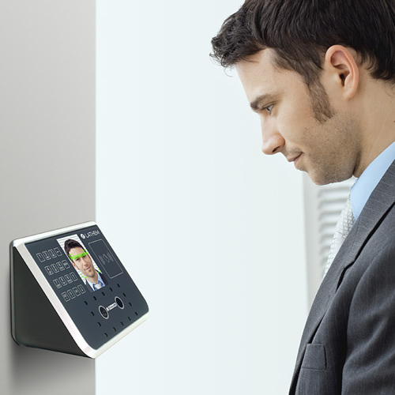
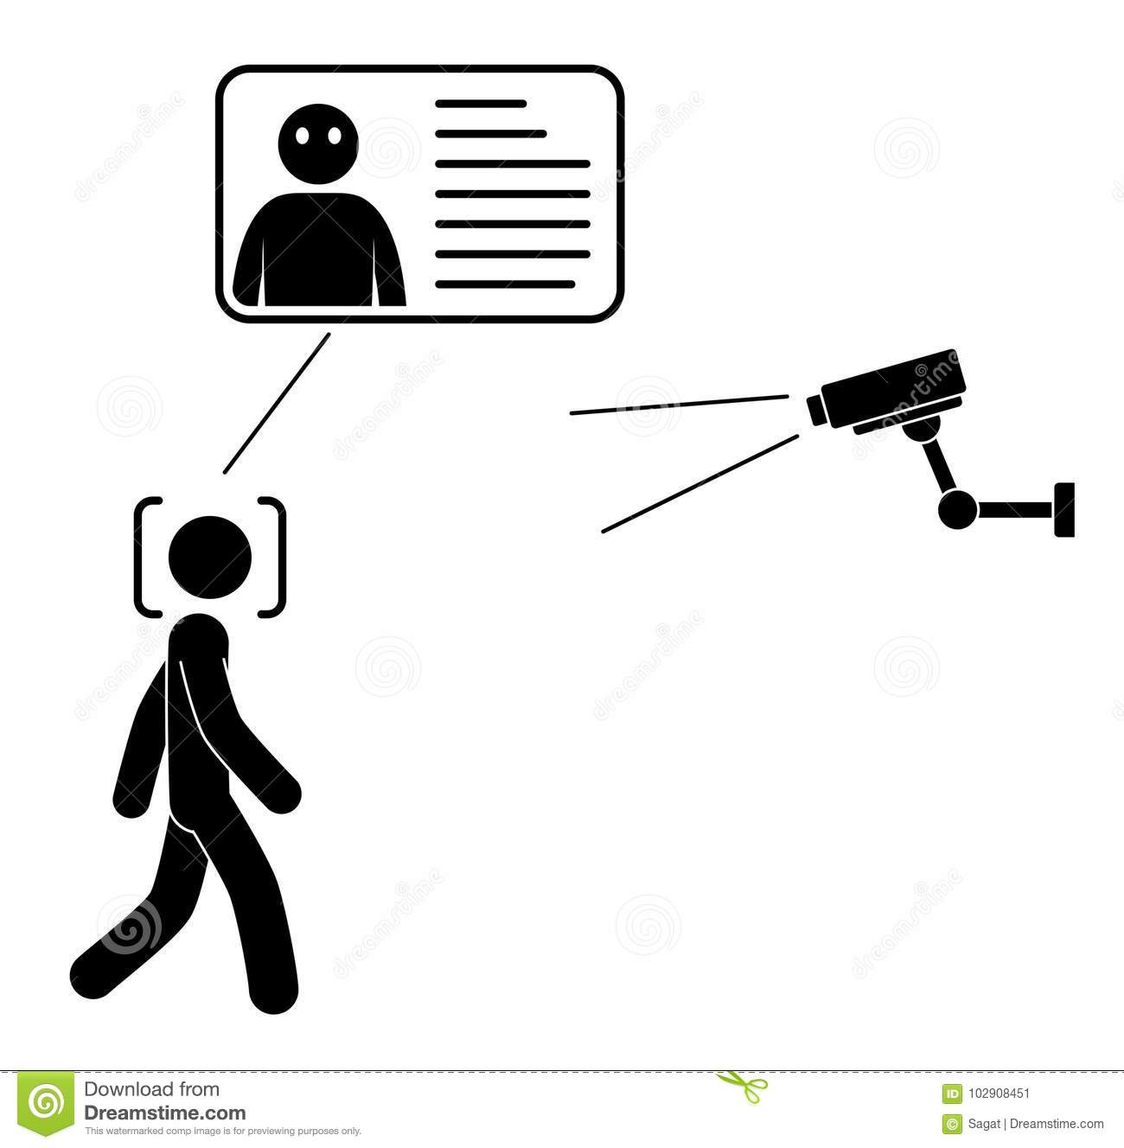

Slide 16
Project Description

Slide 17

Hardware overview
Dc motor
Raspberry pi 3 model B+
Power supply
SD Card
Hardware
Relay Wires
Raspberry pi camera B+8 mega
HDMI Monitor or laptop

Slide 18
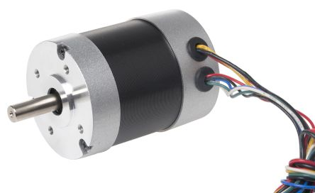
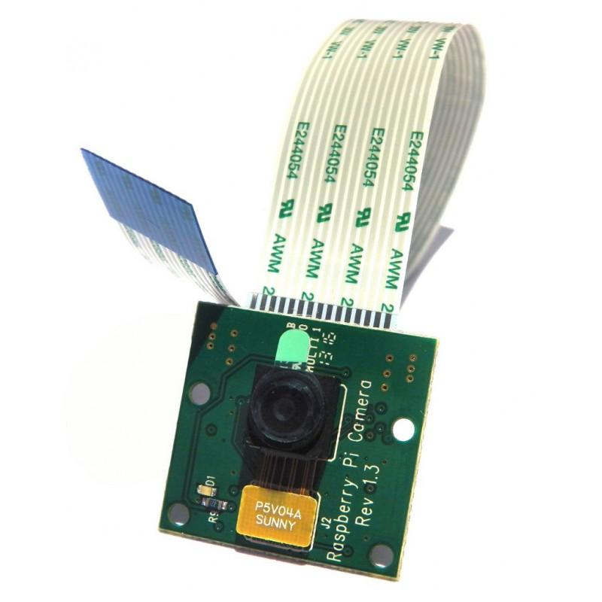
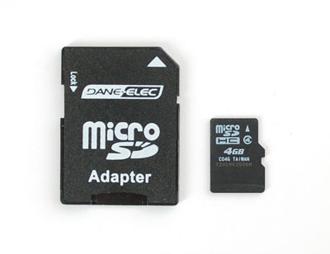

Slide 19
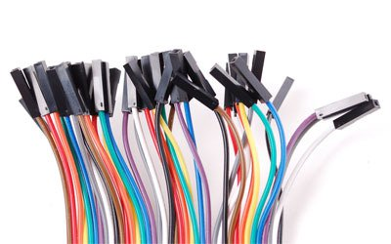
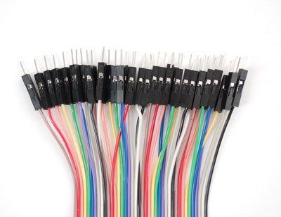
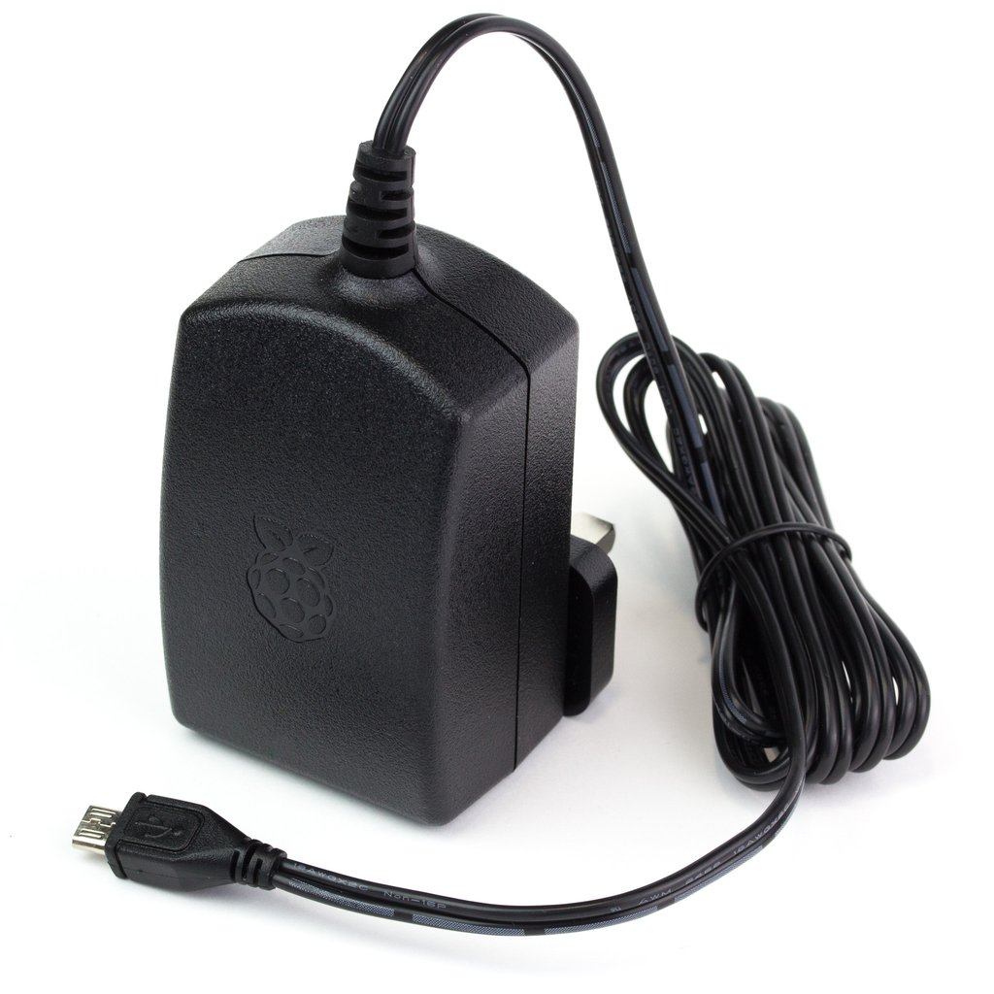
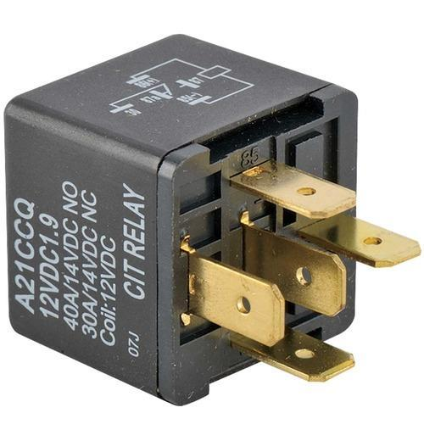

Slide 20
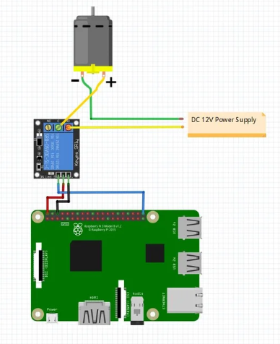
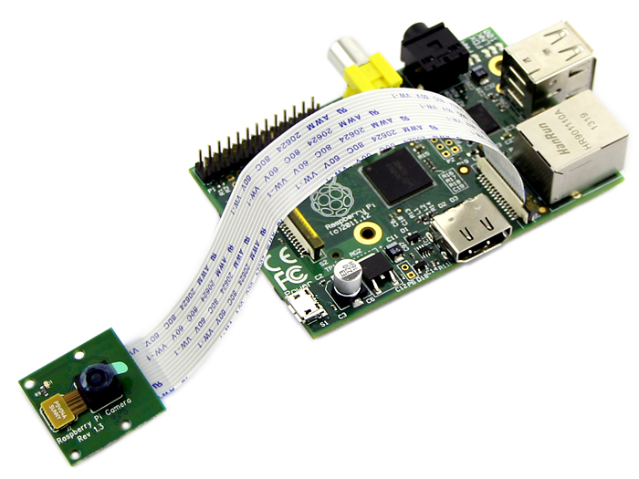

Slide 21
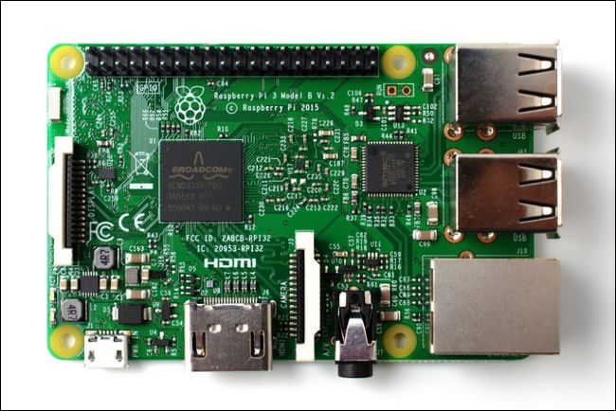

Slide 22

Connection part
Connecting raspberry pi with raspberry pi camera and using relay to connect the motor.

Slide 23
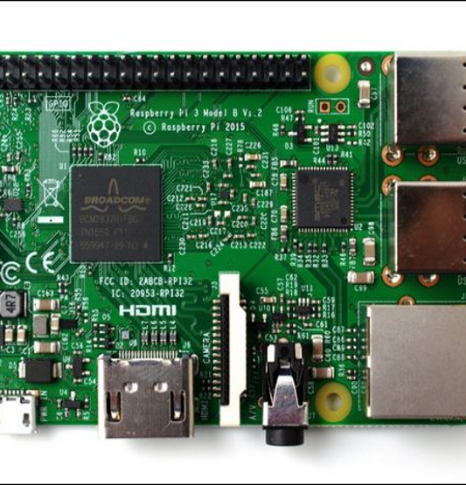
Raspberry pi
What is Raspberry pi ???
The Raspberry Pi is a series of small single-board computers developed in the United Kingdom by the Raspberry Pi Foundation to promote the teaching of basic computer science in schools and in developing countries.

Slide 24
Software overview
OpenCV
Python2
Raspbian Stretch 2018
Programs for connecting raspberry to laptop directly:
IP scanner
VNC Viewer
Programs for preparing SD card for Raspberry:
Win32Deskimager
SD Card formatter

Slide 25

Open CV
What is Open cv ???
Open CV (Open Source Computer Vision Library) is an open source PC vision and machine learning programming library. The library has in excess of 2500 enhanced calculations Open CV has in excess of 47 thousand individuals of client network and assessed number of downloads surpassing 14 million..

Slide 26
Project Process
Steps
01
Installing Raspbian 2018
04
Face detection
Installing software programs to connect raspberry pi with laptop
Gathering data
02
05
03
Training
Testing the camera
06

Slide 27

Project Process
steps
07
Recognizing
08
Driving Dc motor

Slide 28
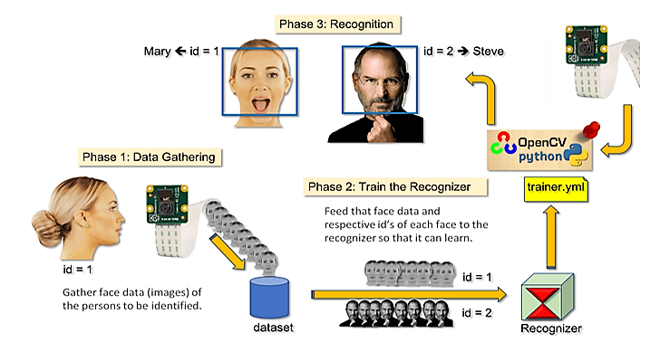




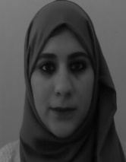


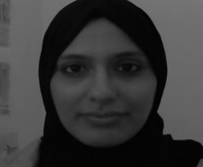



The hole process
ALLPPT Layout
Clean Text Slide
for your Presentation
Waed
Aya
Id=2
Modern Portfolio Presentation
Id=1

Slide 29
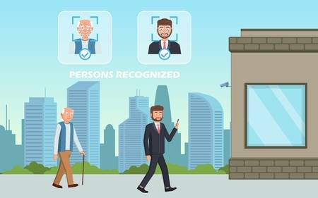
Results and Analysis:
when completing the we obtained highly accurate face recognition .Realistically, there isn’t a whole lot we can do about speeding up the algorithm, the Raspberry Pi, while powerful for such a small device, is naturally limited in terms of computation power and memory (especially because a GPU)

Slide 30
Project result
Video

Slide 31

Results and Analysis
The cost of the system less than face detection devices imported from Industrialized countries.
Relatively high performance.
Flexibility to add new services to the system like such Identify person expressions.
This system use for both monitor and control.
Free operational cost.
1-There is a small possibility of error.
2-Facial detection speed and treatment is not super.
STRENGTHS
WEAKNESS
THREATS
SWOT
OPPORTUNITIES
Ability to extending the practical applications of the system due to its simplicity using and high efficiency.
We will also increase the security of the project by adding another real time human identification and biometric items
Pose variation
2. Feature occlusion
3. Facial expression
4. Imaging conditions

Slide 32
Problems we faced
during the work

Slide 33
Problems and constrains due to software.
Using SSH to connect raspberry pi to laptop using VNC was a new and difficult mission for us.
01
02
Problems because using old software not compatible to the newest raspberry pi
03
The major software problem that we faced related to the Open CV while compiling step.

Slide 34
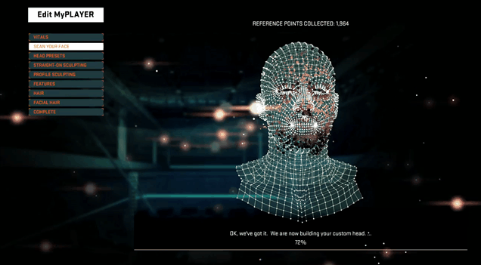

Slide 35
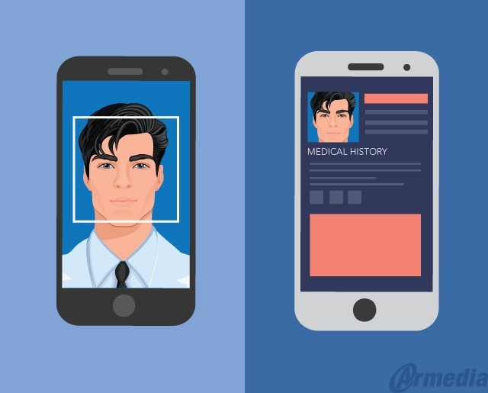
Problems and constrains due to Hardware
01
At the beginning the motor didn’t work until we did the research we discovered that a relay is required.
Suddenly the camera give a message that camera is not detected. After long time of research and training we discovered that this camera is so sensitive and that was damaged. So we were forced to buy a new one and do the mechanical protection of the camera,
02
06

Slide 36
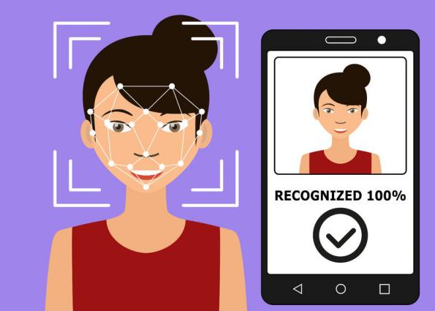
Problems and constrains due to Hardware
03
The process of detection and recognition of the face is not as fast as required. ,because the raspberry pi is naturally limited in terms of computation power and memory (especially because of the GPU)
06

Slide 37
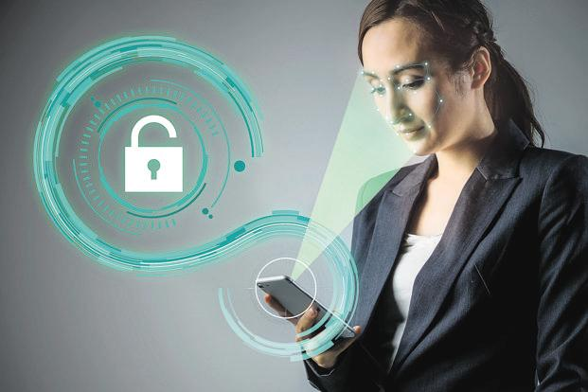
Future work :
According to Problems and constrains due to software, we found problems which need improvement. We will try to improve the project due to those problems.

Slide 38
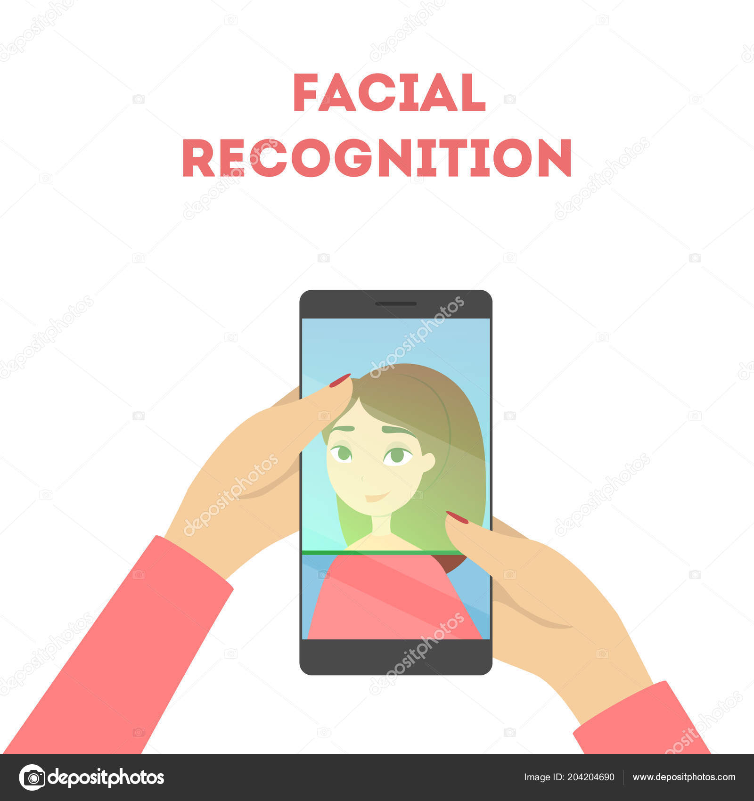
Future work
What can do next to improve the project ?
increasing the security of the project is possible by adding another real time human identification and biometric items such as finger print, Iris recognition, or voice recognition or password number.
In other hand , using tracking face robot is possible and nice. which is useful in many applications.
Smart mirror is also an exciting goal. It is possible to add face recognition to smart mirror app..

Slide 39
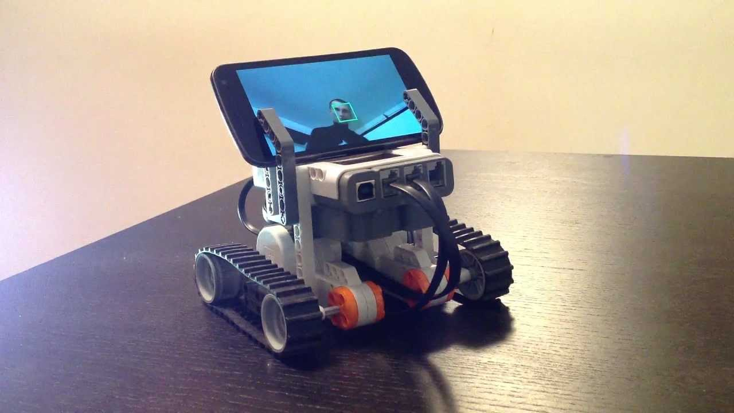
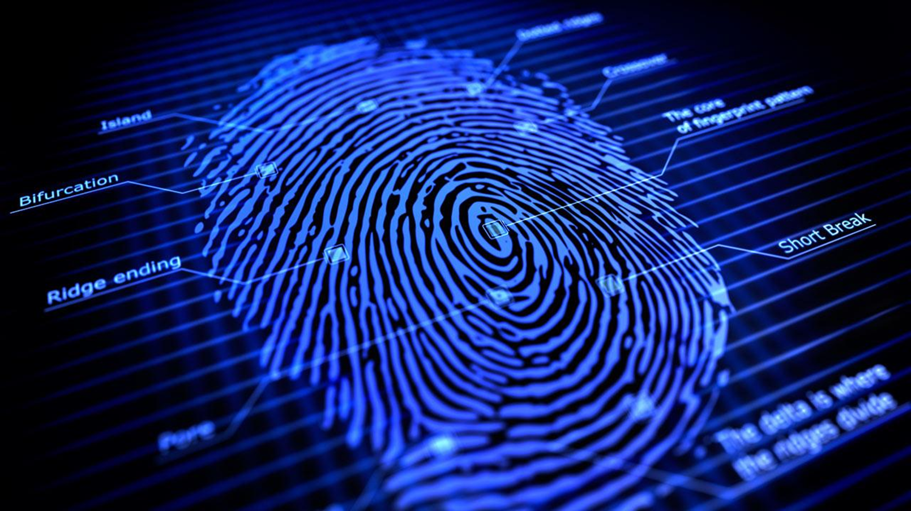

Slide 40
Thank You
Any Question

