Slide 1
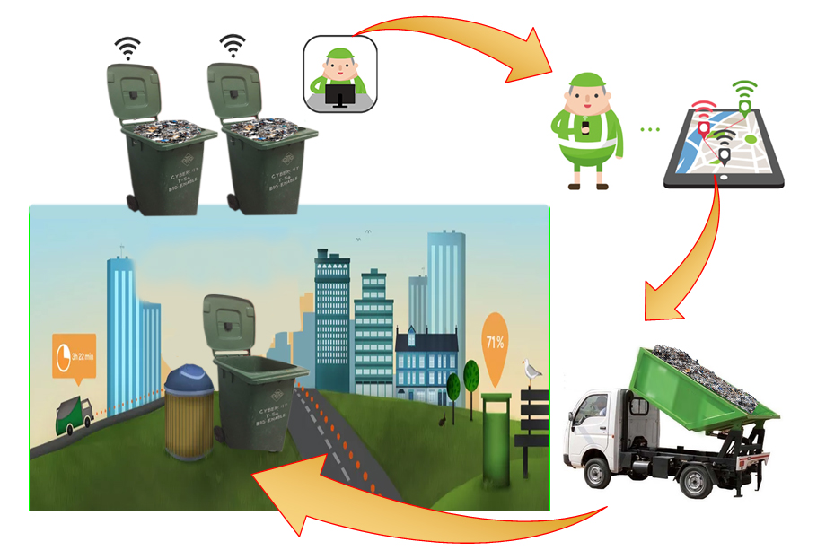
Smart Waste Management System Based on IoT
Graduation Project 2

Slide 2

Team Members Under Supervision of Dr. Saed Tarapiah
Noura Booz
Nisreen Saadeh
Mariam Qawariq

Slide 3
Contents :
Introduction
Problem Statement
Problem Solution
IoT
Results and Discussion
VRP
Methodology
Conclusion and Future Work

Slide 4
Introduction:

Slide 5
Introduction :
This project deals with the problem of Waste management in smart cities, where the garbage collection system is not optimized.
In this system , the smart bins are connected to the internet to get the real time information of the smart dustbins .

Slide 6
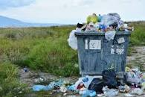
Problem Statement
Solid waste management is one of the main environmental problems.
The traditional manual way is an inefficient method because it wastes the time and fuel which leads to a waste of money.

Slide 7
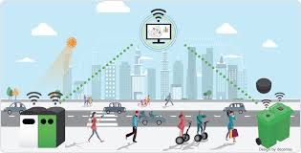
Solution
Using an IoT-based waste management system reduces fuel consumption leads to saving money and time.

Slide 8
Smart Waste Management Advantages:
Minimal Time
Easy Collection
Decision Support
Reduce Fuel Consumption
Clean Environment
Save Money
Optimize Resources

Slide 9

Internet of Things (IoT)
The Internet of Things (IoT) is a concept in which surrounding objects are connected through wired and wireless networks without user intervention. In the field of IoT, the objects communicate and exchange information to provide advanced intelligent services for users.

Slide 10
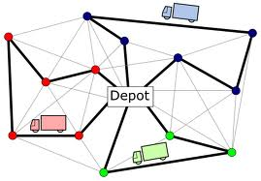
Vehicle Routing Problem(VRP)
The vehicle routing problem is known as the problem of finding the optimum way to deliver or collect from one or more warehouses to many cities or customers.

Slide 11
Methodology

Slide 12
Methodology
Design
System’s Block Diagram
System’s Flowcharts

Slide 13
Design
Full System Design & Waste Bin Design

Slide 14
Full System Design
Sensing
Monitoring
Control

Slide 15
Waste Bin Design
Smart waste bin
Led control system
Data control system

Slide 16
System’s Block Diagram

Slide 17
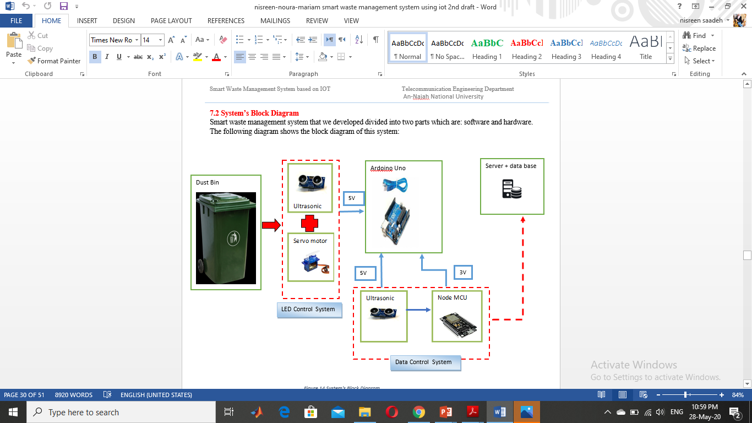

Slide 18
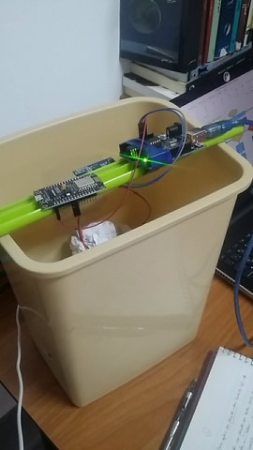
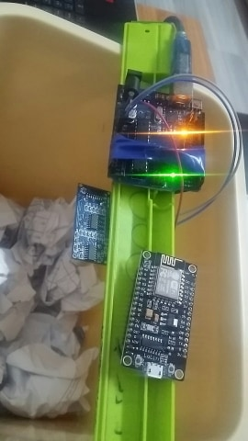
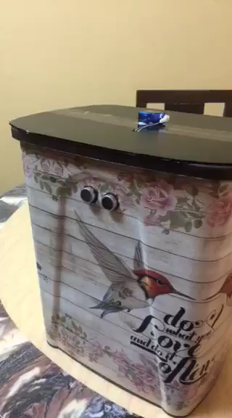
Smart Waste Bin:

Slide 19
System’s Flowcharts
Waste Bin Flowchart & Server and Database Flowchart

Slide 20

Waste Bin Flowchart
start
Set level= 0
Read the bin’s waste level
If level<40%
If 40%<level<70%
If level>70%
Set color of bin green
Set color of bin yellow
Set color of bin red
Current level=level
Current level=level
Current level=level
Send current level
Send current level
Send current level
Data sent to server each 50 seconds

Slide 21
Server and Database Flowchart
Website prepares the current location.
Start
Node id, percentage and location are sent through Node MCU to save_db server.
The website connects to fetch_api server and sends the location to it.
fetch_api server does the following:
Connects to the same database and fetches all records already saved.
The save_db server connects to the database.
Retrieves the location and calculates the distance and time between that location and the location of each node.
Save_db server puts the retrieved data to the database.
All data are sent to the website and previewed on the table.
Executed each 50 s
End

Slide 22
Results and Discussion

Slide 23
Starting from the trash bins, to the end where the results are displayed on the online page that was designed, this page will be displayed and explained in detail.
Database
Server
MYSQL
Database
PHP Server

Slide 24
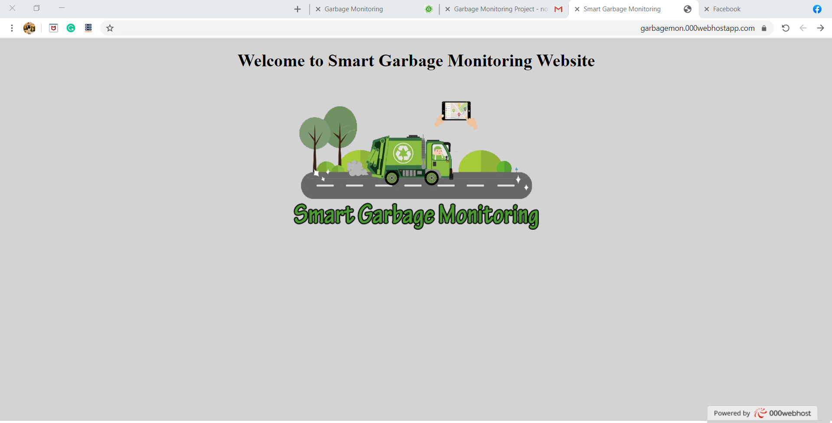
When we enter our website the welcoming page will appear at first as follow:

Slide 25
https://garbagemon.netlify.app/
The login page will appear and ask you to enter a password to let you continue to the home page:

Slide 26
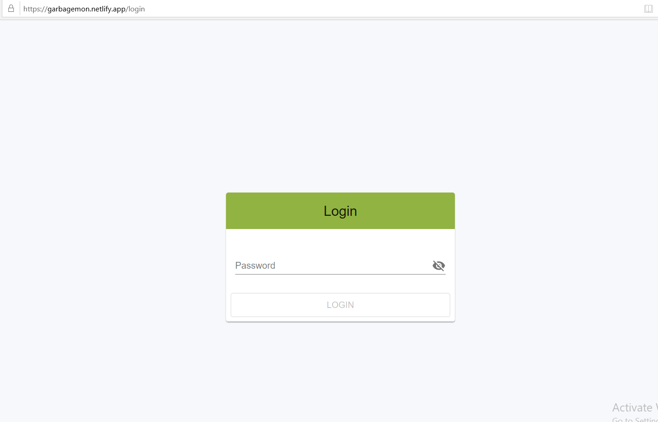

Slide 27
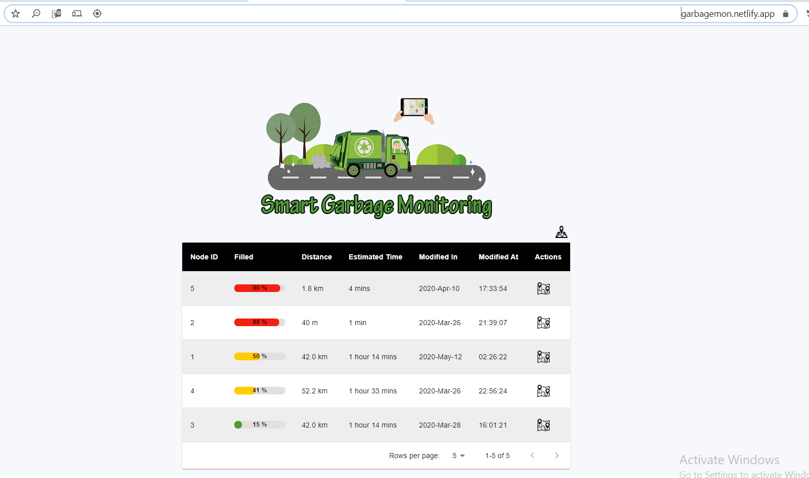
Home Page

Slide 28
It is the distance between the location of the device that we open the website on it and the node that the truck will go to it
Is the time that the driver need to reach the next node starting from his current location.
Shows the date of the last modification made at the level of trash bins and the time that the adjustment was made in hours, minutes, and in seconds.
When you click on this icon, all baskets appear on the map in color to indicate the fullness of their fullness, as in the next slide
This column gives the percentage of fill for each waste bin
Every waste bin (node) have a detected ID, and this help to differentiate between nodes.
By this column the map with the shortest path to detected node will be appear when we press to the map icon. as in the next two slides.

Slide 29
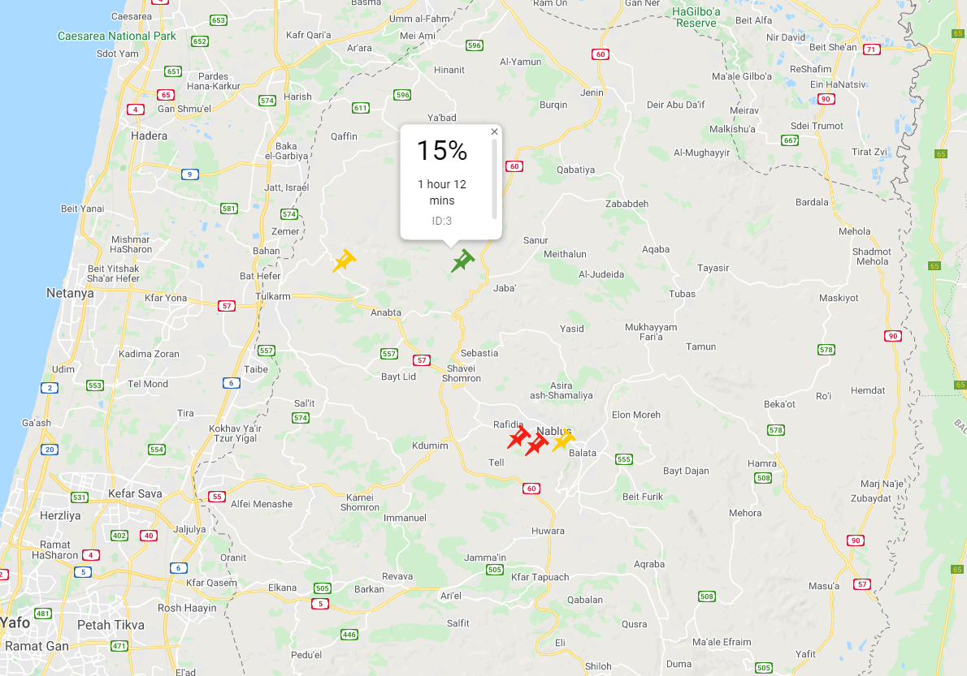
This figure appears where all the trash bins are on the map when clicking on the map mark in the top right of home page ,where the red color indicates that the trash bin is full and yellow indicates that it is half full and green it is almost empty or completely empty.

Slide 30
When you click on the map icon for some of trash bin, this result will be as the following :

Slide 31
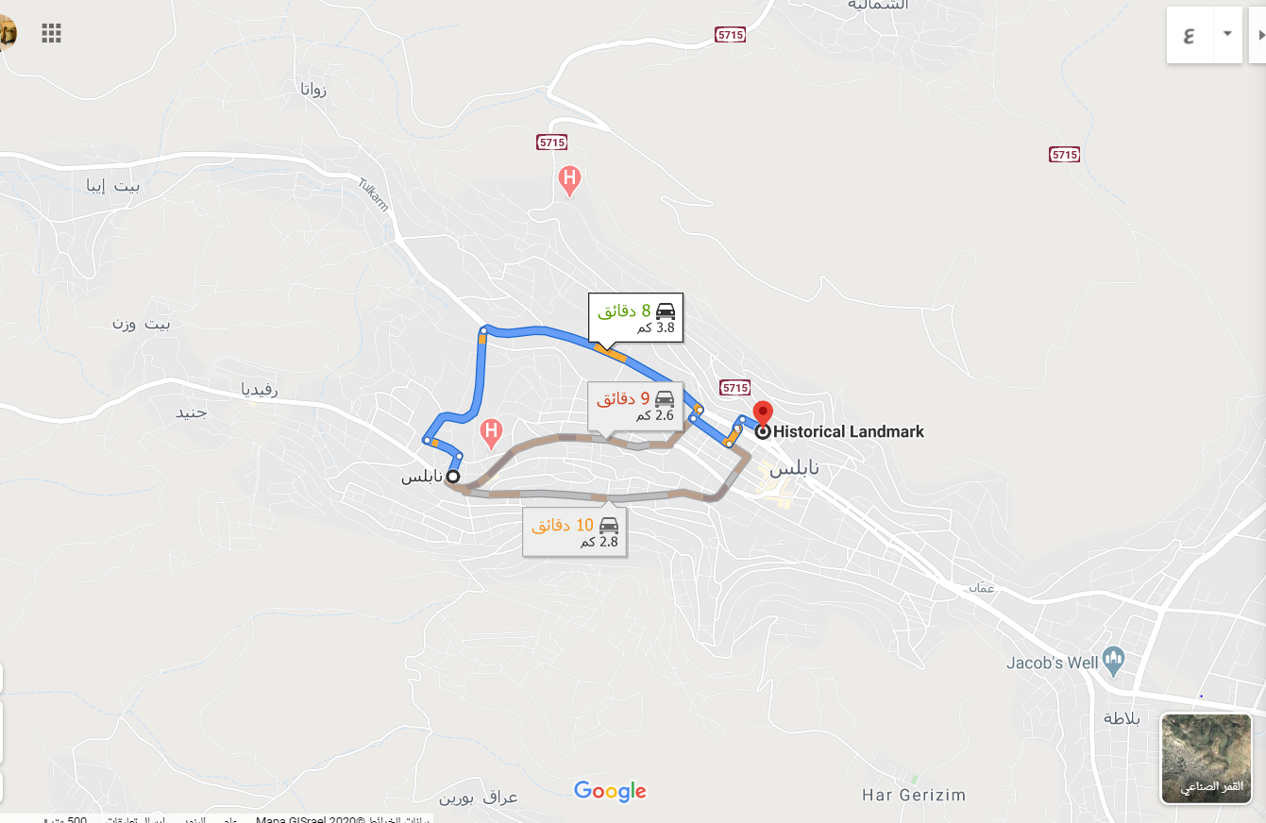
The shortest route and the distance between the trash bin No.1 and the driver on the map.

Slide 32
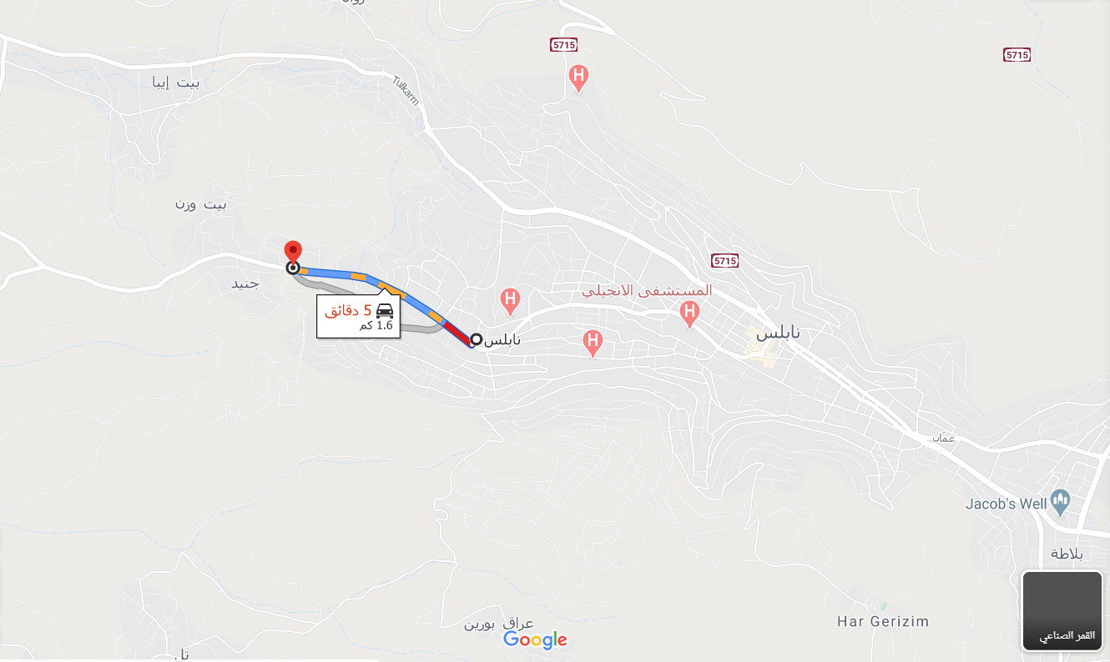
The shortest route and the distance between the trash bin No.5 and the driver on the map.

Slide 33
Conclusion and Future Work:

Slide 34
Conclusion
The IoT based waste monitoring is very useful for cities.
By implementing this project we will avoid over flowing of garbage and reducing the traffic .

Slide 35
Future Work:
The system will be improved to give greater efficiency by introducing solar cells on it.
Design an application on the mobile device to facilitate the process, and sending data to a truck.
Using some data in the analysis.
In the near future, an additional algorithm based on machine learning will be developed, so it can expect the garbage bins which filled faster than others and draw a daily path for the driver that connects all the filled bins to empty them easily, and in a shorter time.

Slide 36
The End

