Slide 1
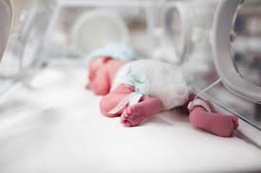
Home Nursing System for Babies
Prepared by:
Deema Emad Zayed,
Rania Naim Sabra.
Submitted to:
Dr. Ashraf Armoush,
Dr. Alaa Al masri.

Slide 2
Outline
Problem to solve.
Customer requirement.
Why PIC with Arduino?
Overview.
Features and component.
Displaying the result.
Problem.
Future work.

Slide 3
Problem to solve
Hospital incubator costs 600 NIS per day which forms an added burden on the parents.
Stress that the parent feel while their newborn is in the hospital .
Many cases newborn don’t need all the health care that the hospital provides.

Slide 4
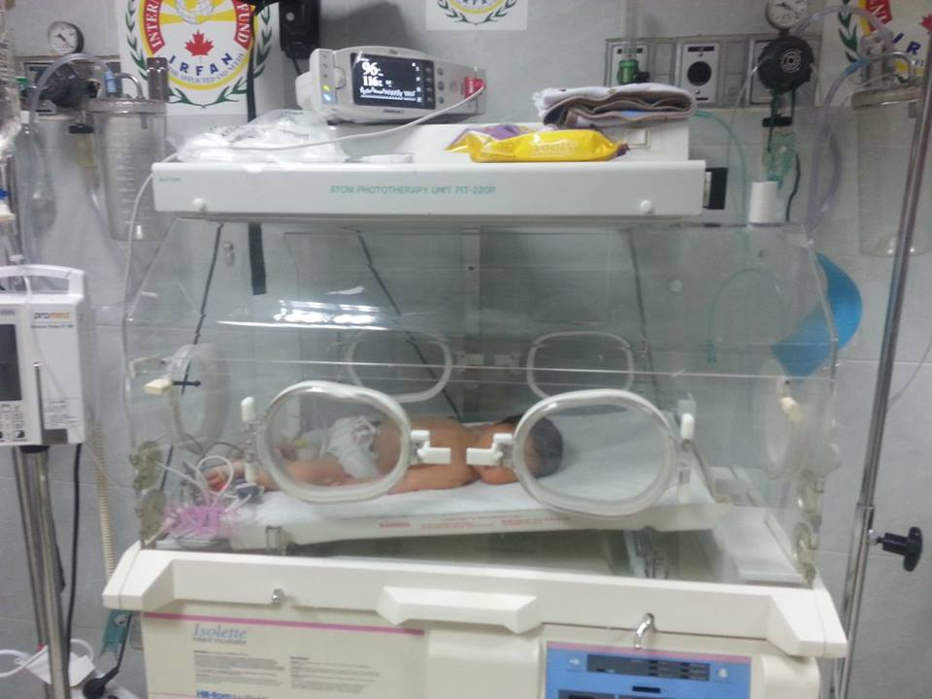
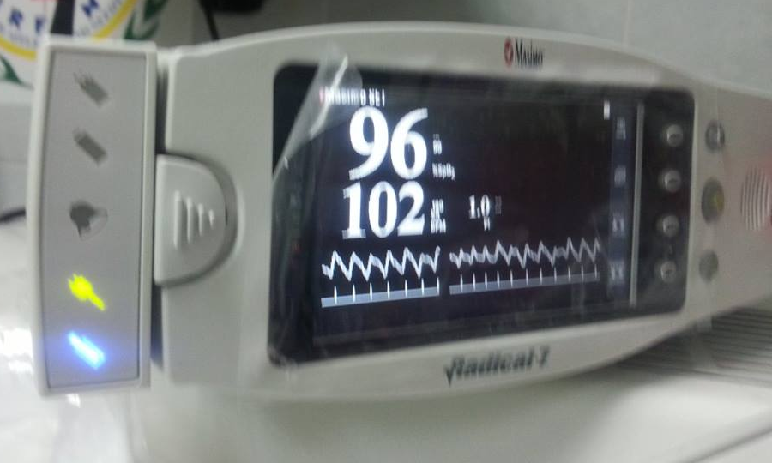
Customer requirements
Visit to the incubator department in Al-Enjeli
Hospital in Nablus, and Al-Razi Hospital in Jenin.

Slide 5
Customer requirements
Result from the questionnaire form:
95% of parent doesn’t prefer to keep their newborn in hospital incubator.
83% of people see the hospital incubator is very expensive.
75% of people will buy this product if it found in market in acceptable price.
for extra feature :
30% of people doesn’t prefer any extra field to this product.
45% of people prefer to have music when baby cries.
25% of people prefer to have vibrate to the baby’s bed.

Slide 6
Customer requirements
Previous work:
Baby health monitoring system.
Intensive Health Care at Home.
System and method for coordinated health monitoring, emergency response, and medical record delivery.
Emote child monitoring system with temperature sensing.

Slide 7
Why PIC with Arduino?
In our system we use PIC with Arduino because we have pulse sensor that have library only in Arduino, so we take the information from this sensor and send it serially to PIC.

Slide 8
Overview
Home nursing system for babies provides a continuous monitoring and readings of measurements of the environment around the baby like :
Temperature and humidity.
Readings of the baby monitoring like its temperature and heart rate.
Monitoring the baby’s crying and playing music.
Providing a fast solution if the baby is suffering from a high Jaundice rate.

Slide 9
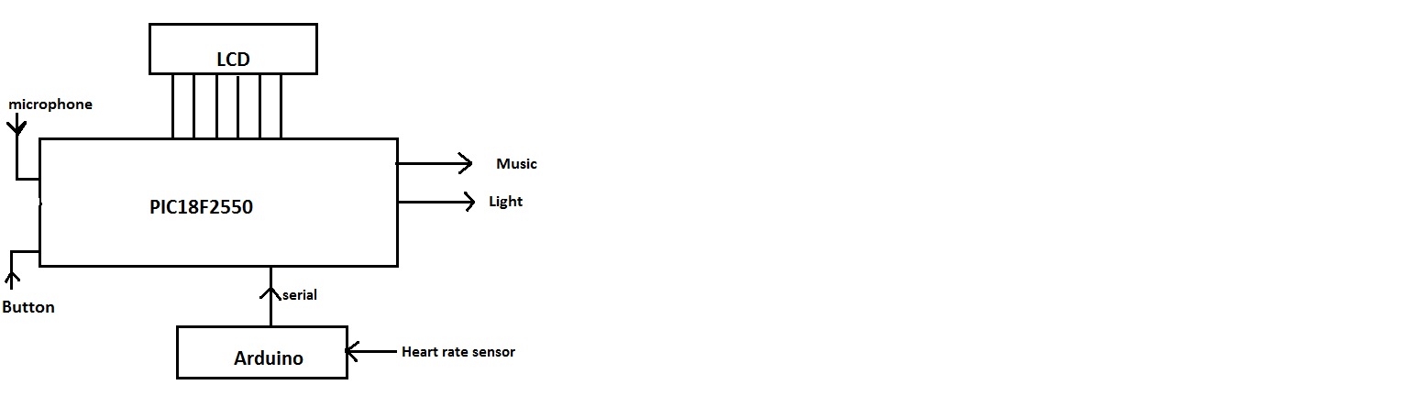
Overview

Slide 10
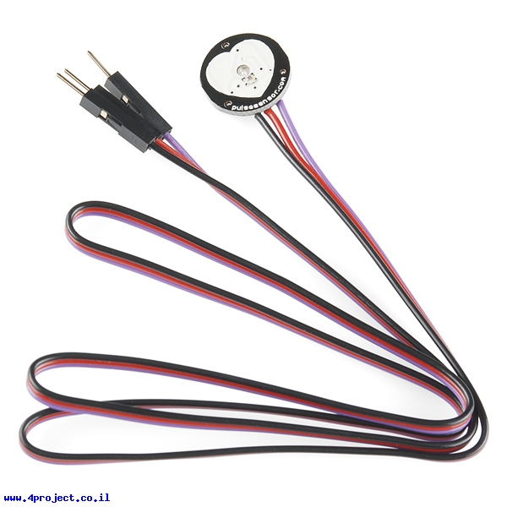
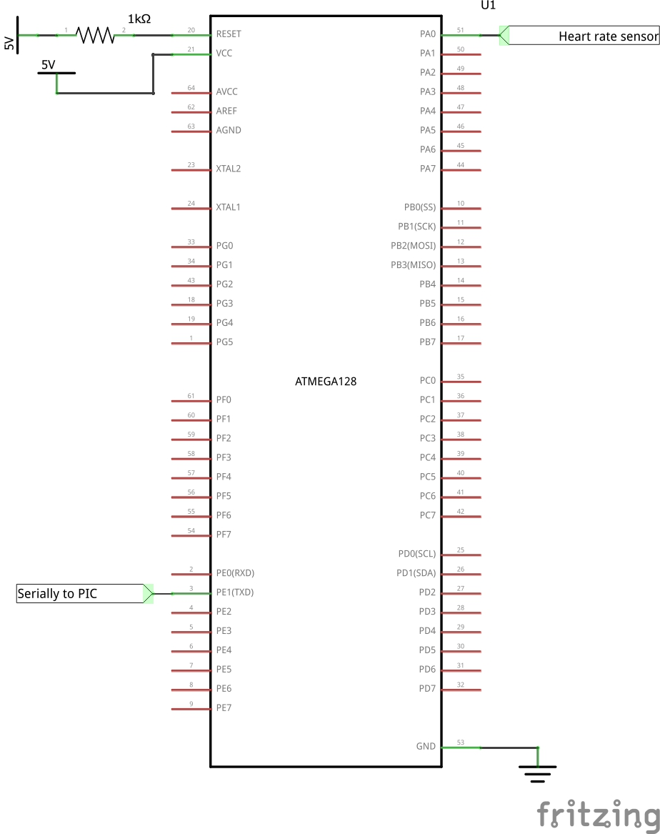
Features and component
Measuring heart rate
 | Ranges Normal | Output from our system
Heart rate range (pulse/minute) | 110-160 | 110-160

Slide 11
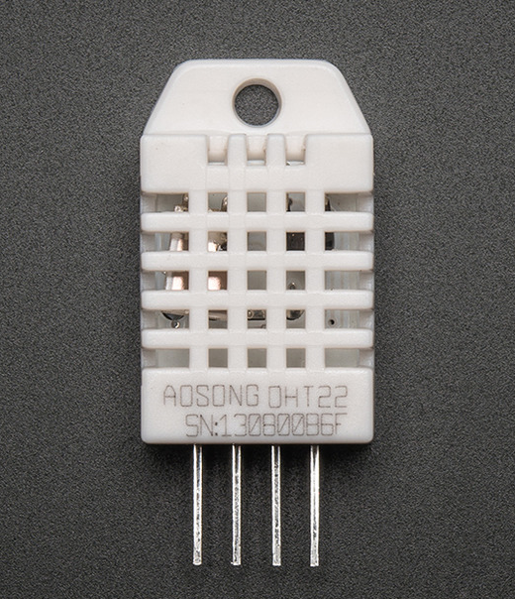
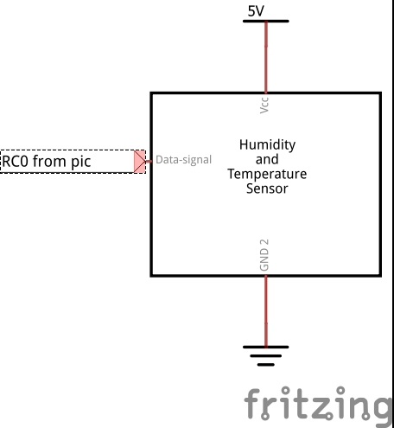
Features and component
Scale temperature inside incubator
 | Ranges Normal | Output from our system
Surrounding temperature(ºC) | Less than 35 | 22-26

Slide 12
Features and component
Scale the percentage of humidity inside incubator
 | Ranges Normal | Output from our system
Humidity percent (%) | 30-60 | 0-100

Slide 13
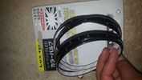
Features and component
Help Jaundice problem

Slide 14

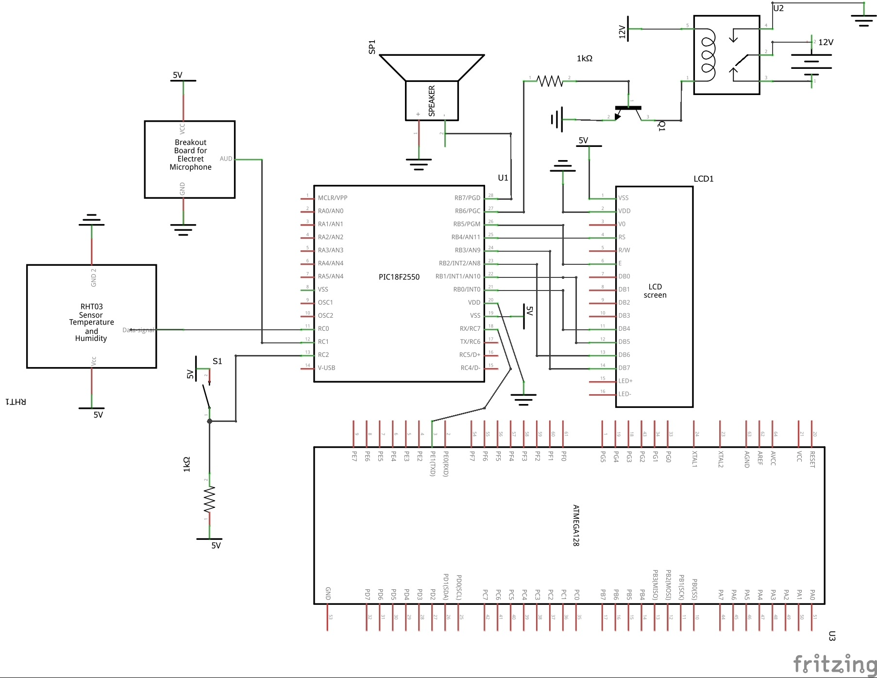
Features and component
Play music when the baby cries

Slide 15
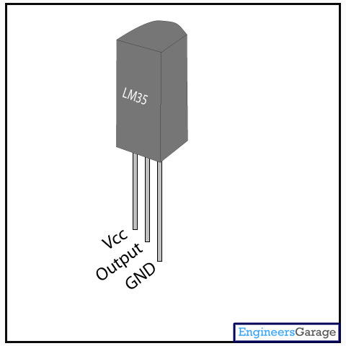
Features and component
Scale body temperature
 | Ranges Normal | Output from our system
Body temperature(ºC) | 36.5-37.5 | Less than 40

Slide 16
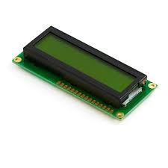
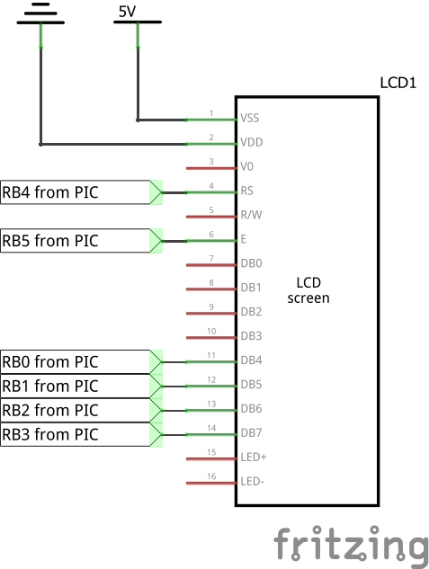
Displaying the result
On LCD

Slide 17
Displaying the result
On computer screen

Slide 18
Problem
The difficulty of getting a heart sensor in our country.
There’s no library that supports the pulse sensor on PIC, and the one that supports it is on Arduino.
The lack of LCD 16x4 had left us with only one choice; which is getting LCD 16x2 and displaying information page by page instead of displaying it all at once.
Since readings of the system are accurate and critical, we had to think of a way to save that information in addition to LCD.
We exceeded the expected cost which was 1200 NIS, because the added costs of the adapter installation, and heart sensor.

Slide 19
Future work
Working to get a sensor that measures percentage of oxygen in blood.
Connect the system with a room control system in order to control room temperature (+/-) through temperature sensor.
Installing a camera to monitor the baby’s movements and its skin color, in order to discover if the Jaundice rate in its blood is high.
Connect the system with mobile phones in order to alert the parents about the baby’s status.

