Slide 1









BY
SUPERVISOR
SHAHD HENNAWI
DR.SAMER ARANDI
HALA MAREE
DR.EMAD NATSHEH
School
Hub

Slide 2
TABLE OF CONTENT
1
2
3
INTRODUCTION
TECHNOLOGIES USED
FEATURES
4
5
6
CONSTRAINTS
FUTURE WORK
CONCLUSION
02

Slide 3
INTRODUCTION
1
SCHOOLHUB IS A SMART SCHOOL MANAGEMENT SYSTEM.
2
IT UNIFIES ACADEMIC, ADMINISTRATIVE, AND COMMUNICATION PROCESSES IN ONE PLATFORM.
3
SUPPORTS MULTIPLE USER ROLES: PARENTS, STUDENTS, TEACHERS, SCHOOL ADMINISTRATORS, AND WAREHOUSE ADMINISTRATORS.
4
IT PROVIDES REAL-TIME ACCESS TO ACADEMIC INFORMATION, ANNOUNCEMENTS, MESSAGING, AND SCHOOL STORE SERVICES.
5
AIMS TO IMPROVE COMMUNICATION, ORGANIZATION, AND EFFICIENCY IN SCHOOLS.
03

Slide 4

TECHNOLOGIES
USED

Slide 5



FRONTEND
FLUTTER
ANDROID STUDIO
05

Slide 6


BACKEND
NODE.JS
GEMINI (AI)
06

Slide 7

DATABASE
MONGODB
07

Slide 8

COMMUNICATION & NOTIFICATIONS
FIREBASE
(CHATTING & NOTIFICATIONS)
08

Slide 9



TOOLS & OTHERS
GITHUB
POSTMAN
(API TESTING)
CLOUDINARY
(IMAGE AND WORKSHEETS)
09

Slide 10
FEATURES

Slide 11


LOG IN

Slide 12

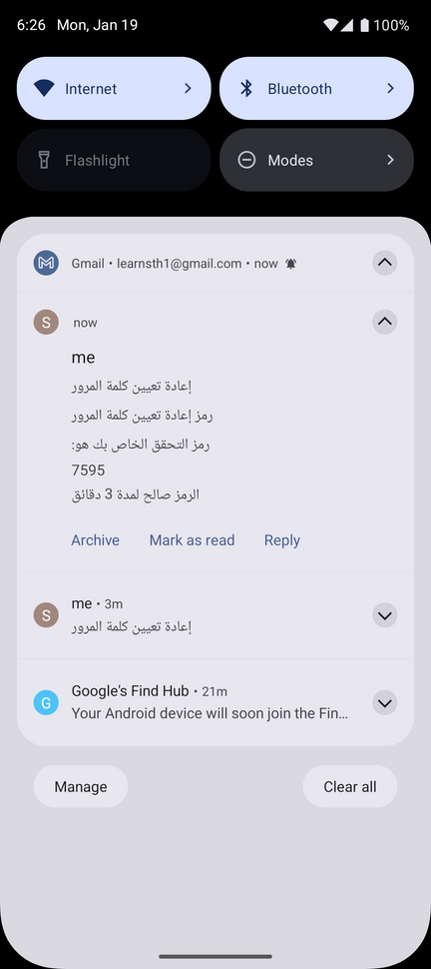
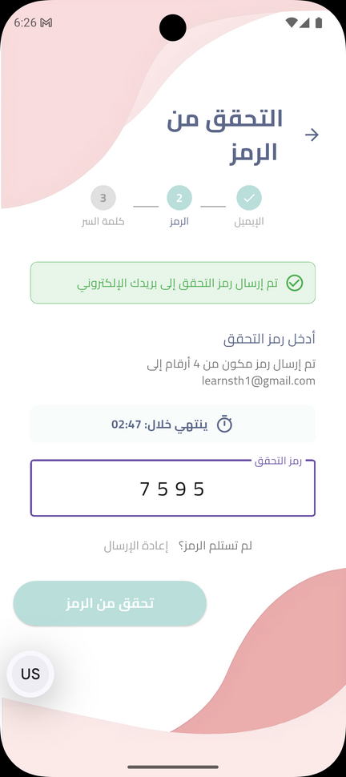
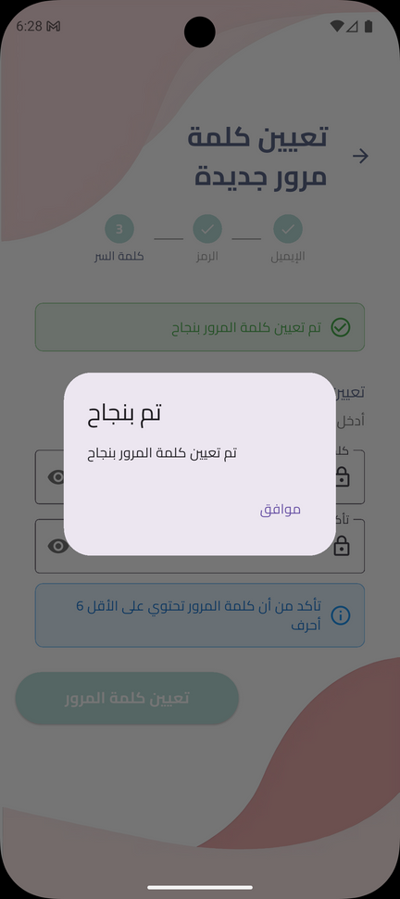
FORGET PASSWORD

Slide 13
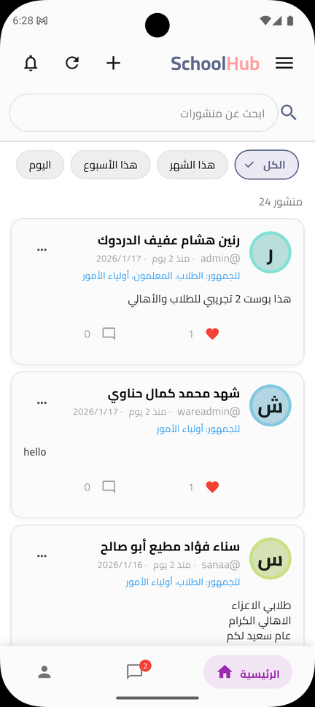
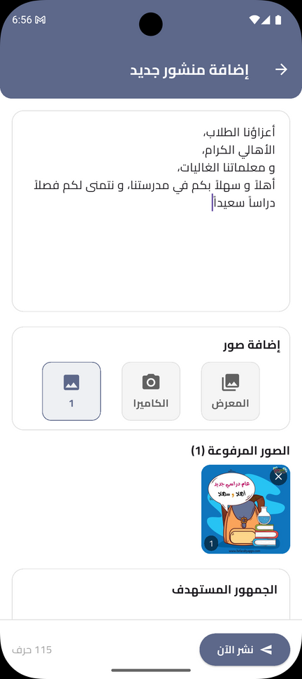
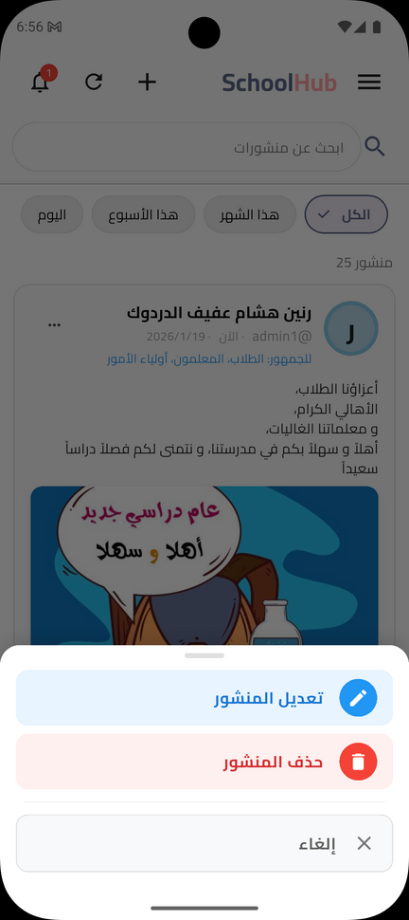

HOME PAGE SCREEN

Slide 14
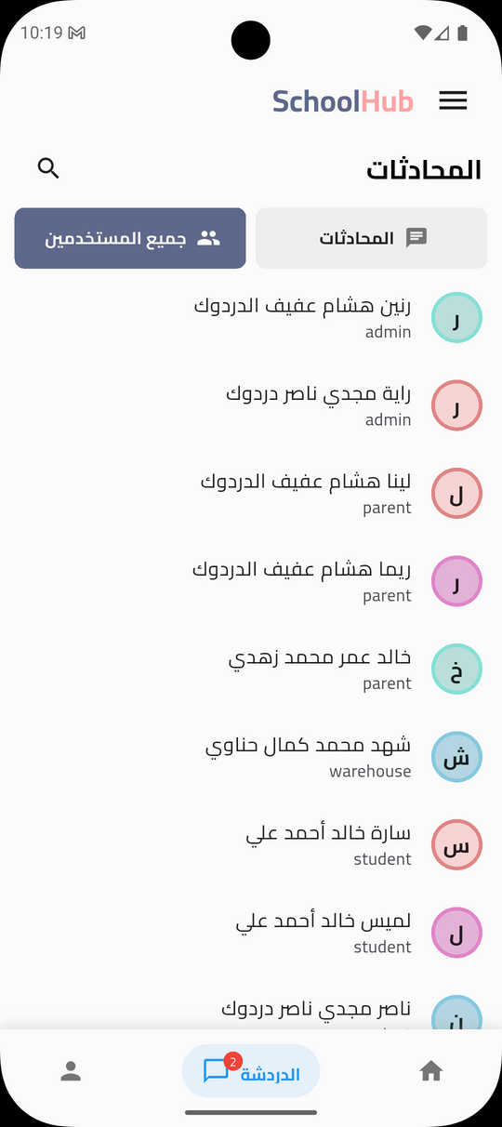
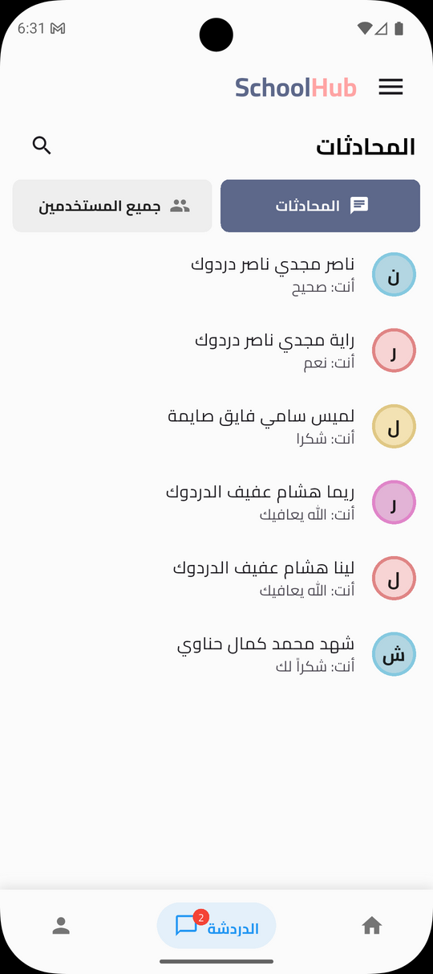
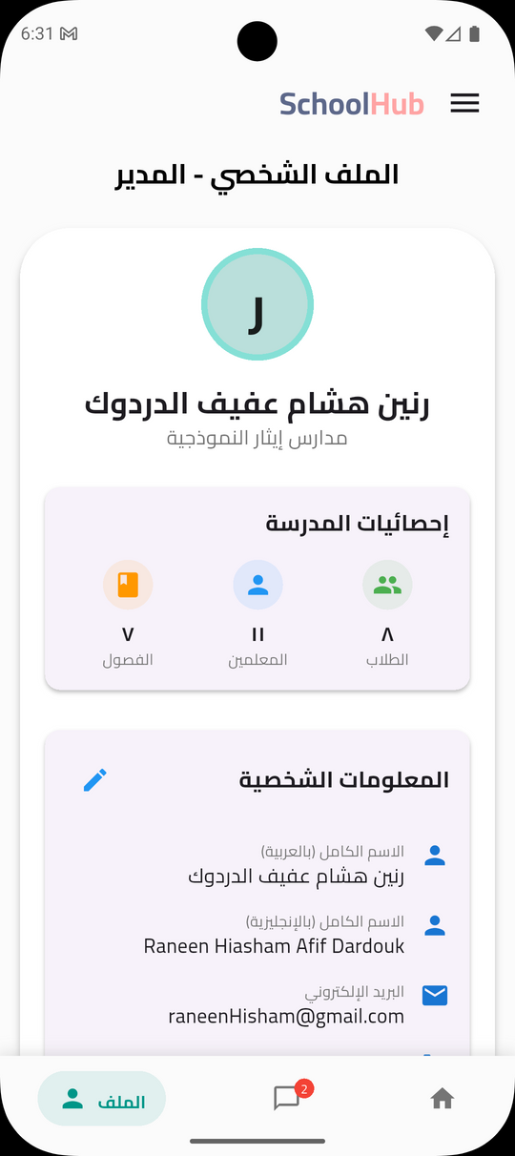
CHATTING AND PROFILE SCREENS

Slide 15
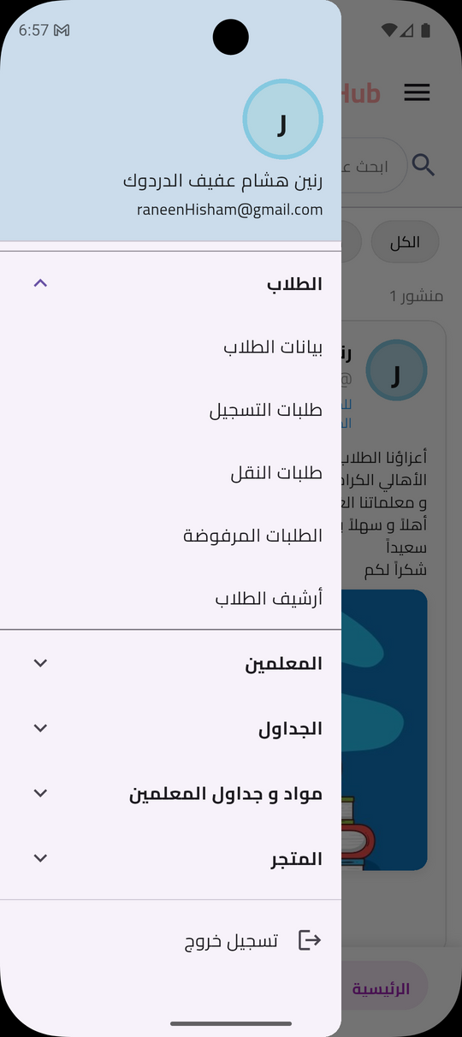


STUDENTS’ DATA
SCREEN

Slide 16

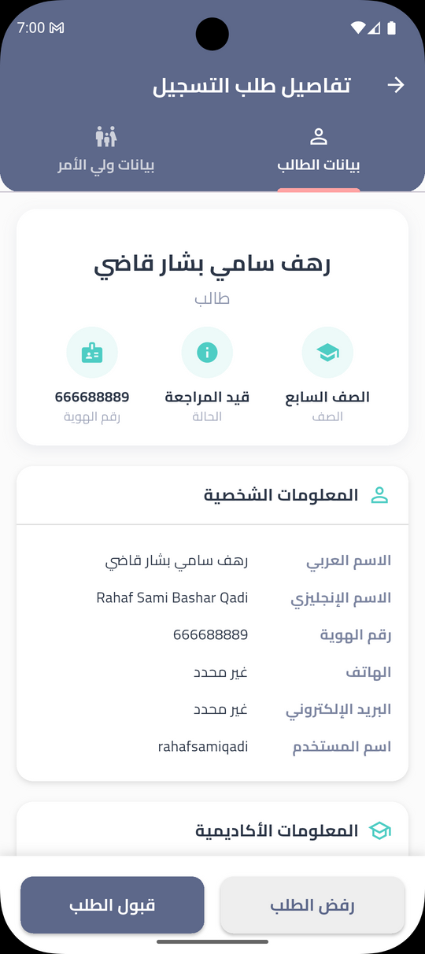
REGISTRATION REQUESTS SCREEN

Slide 17
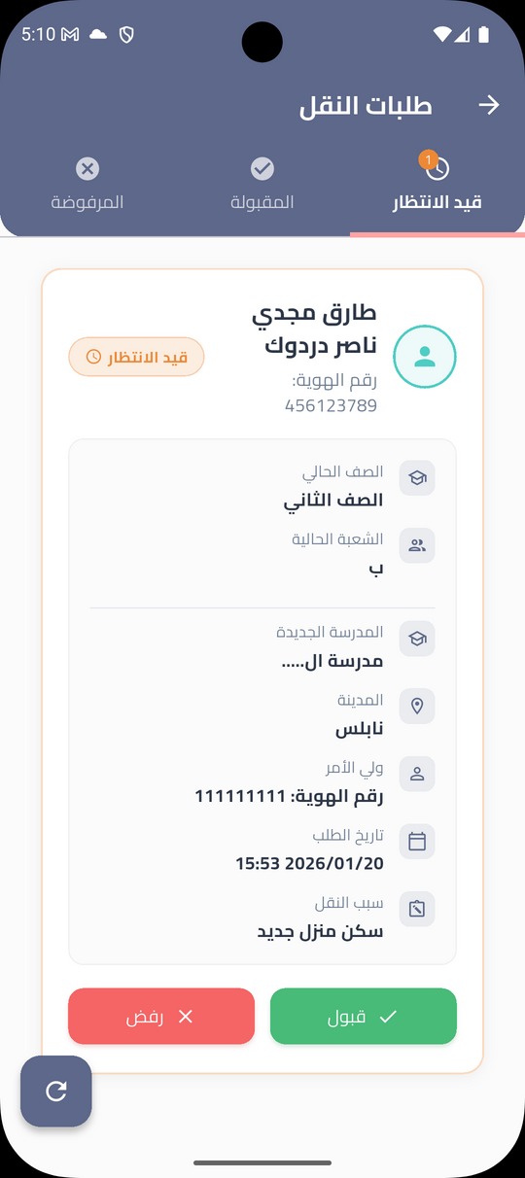

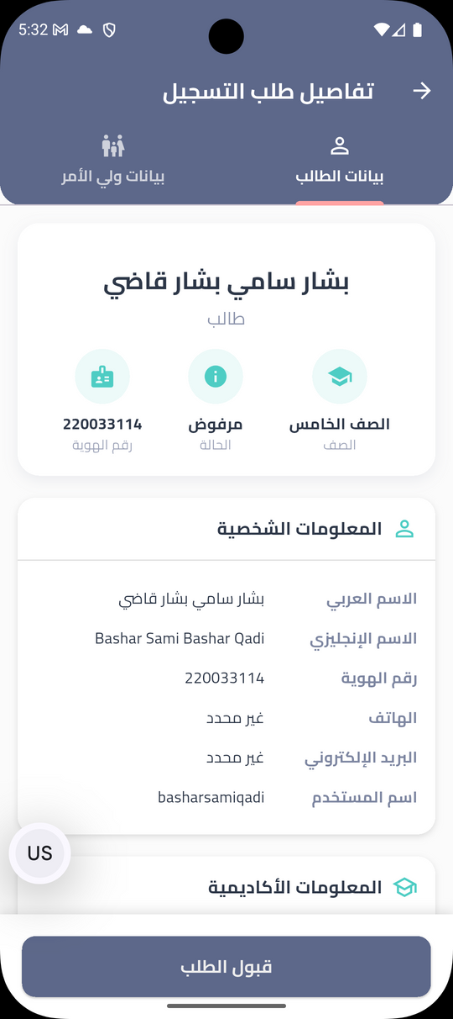
TRANSFER AND REJECTED REQUESTS SCREEN

Slide 18

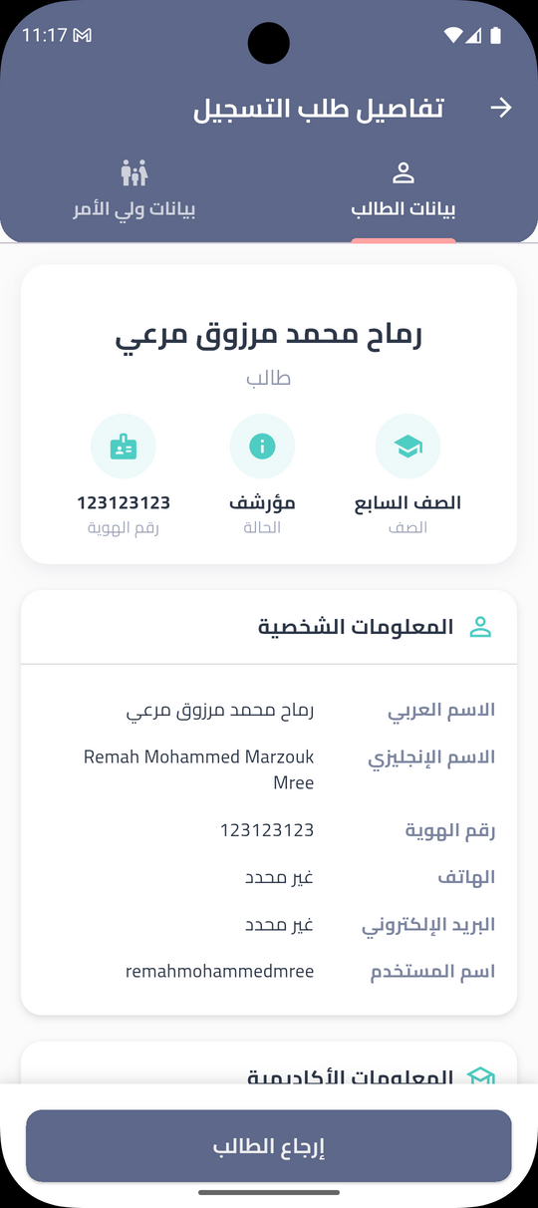
ARCHIVE SCREEN

Slide 19
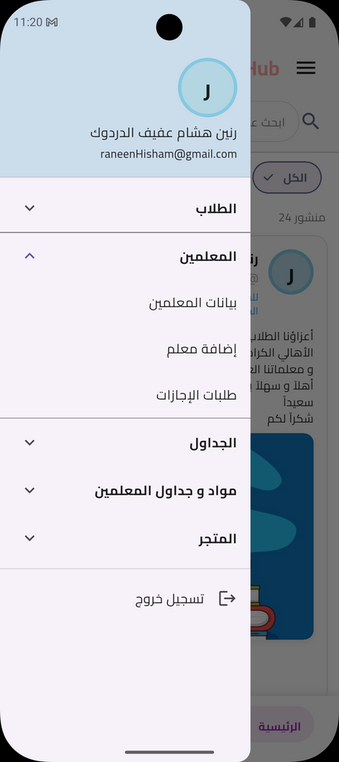
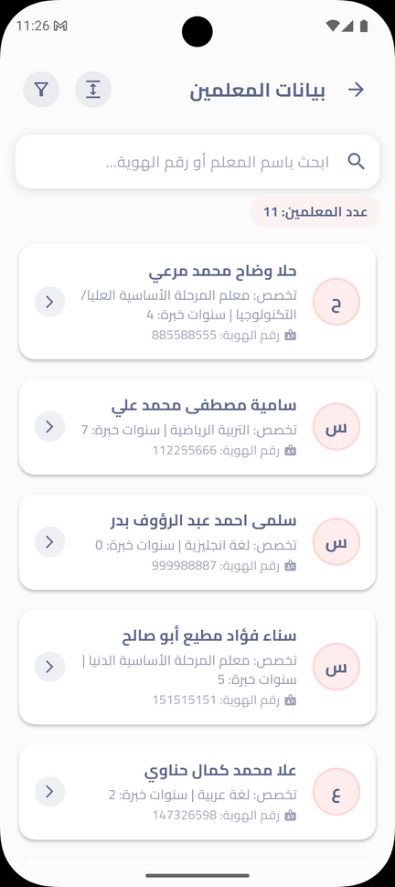
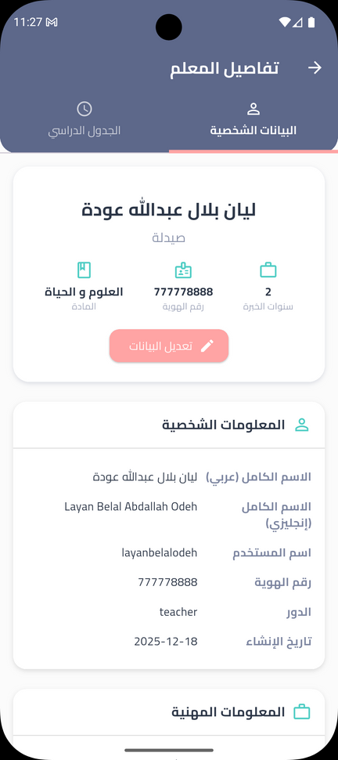
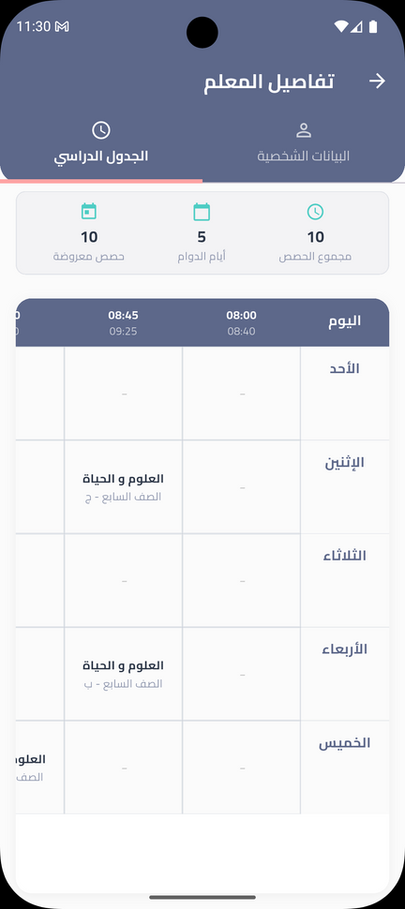
TEACHERS’ DATA SCREEN

Slide 20
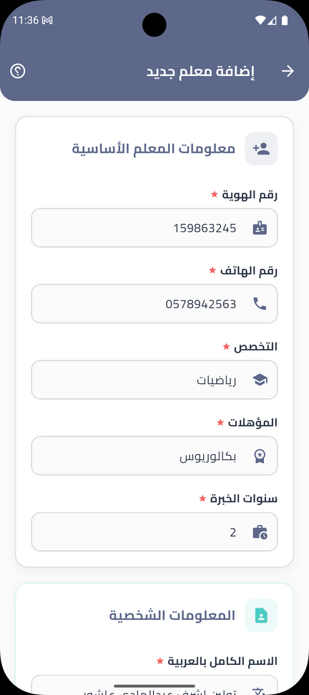
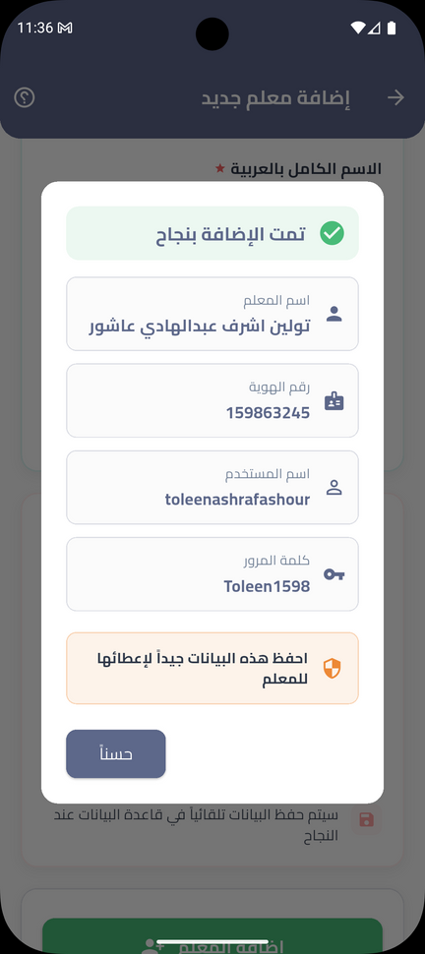
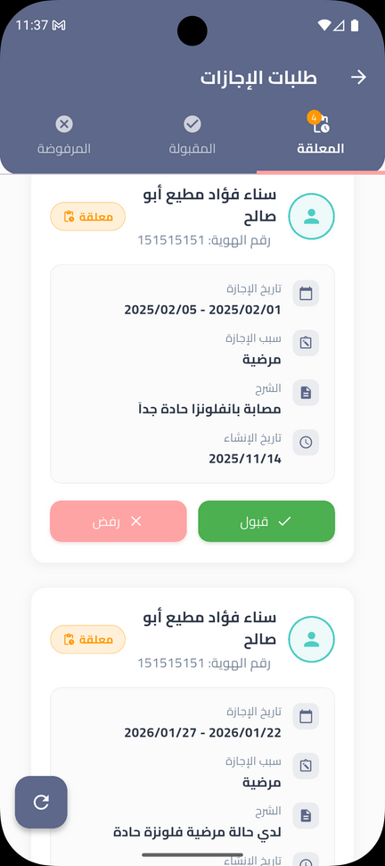
ADD TEACHER AND TEACHERS’ LEAVE REQUESTS

Slide 21
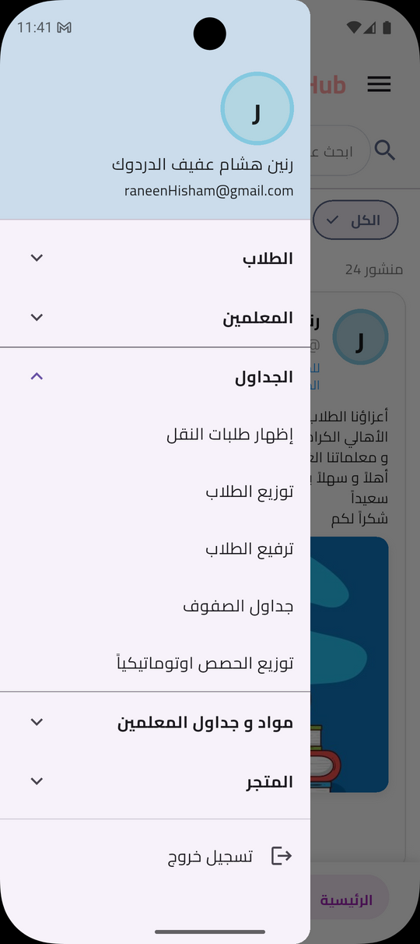
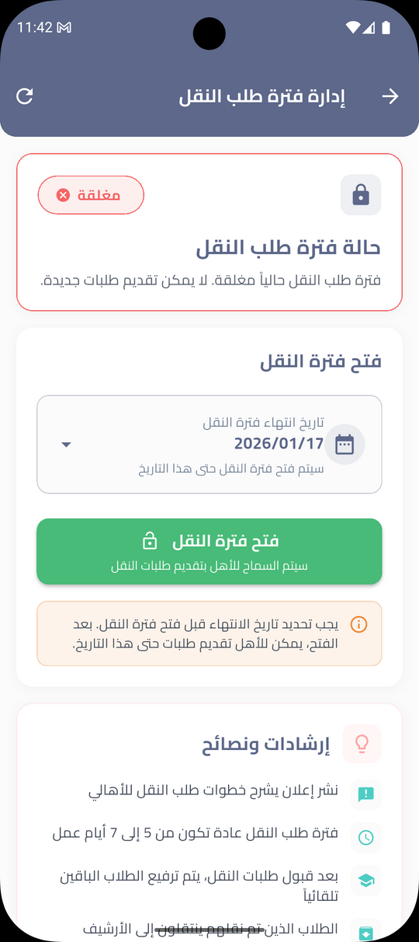
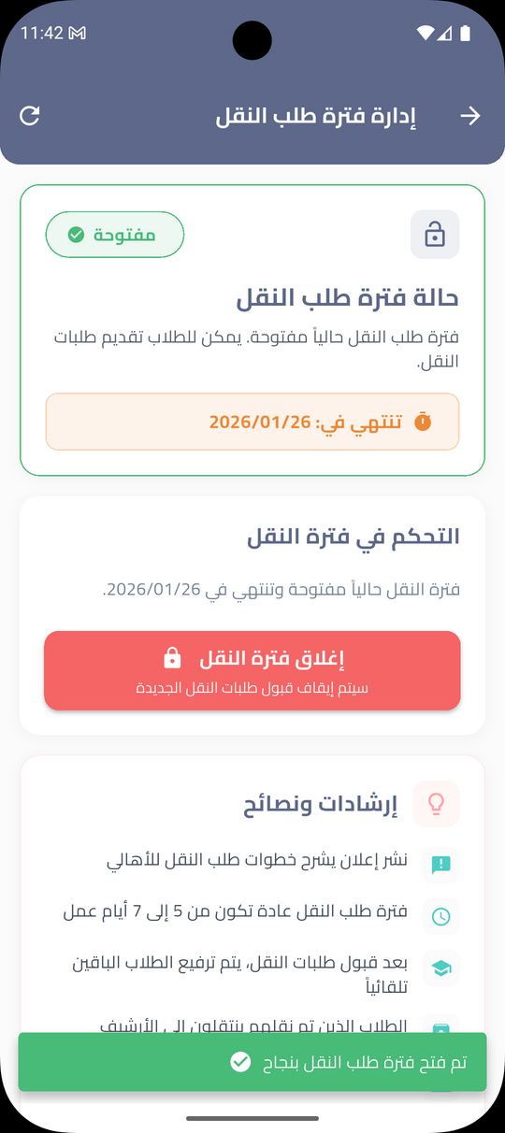
TRANSFER PERIOD SCREEN

Slide 22
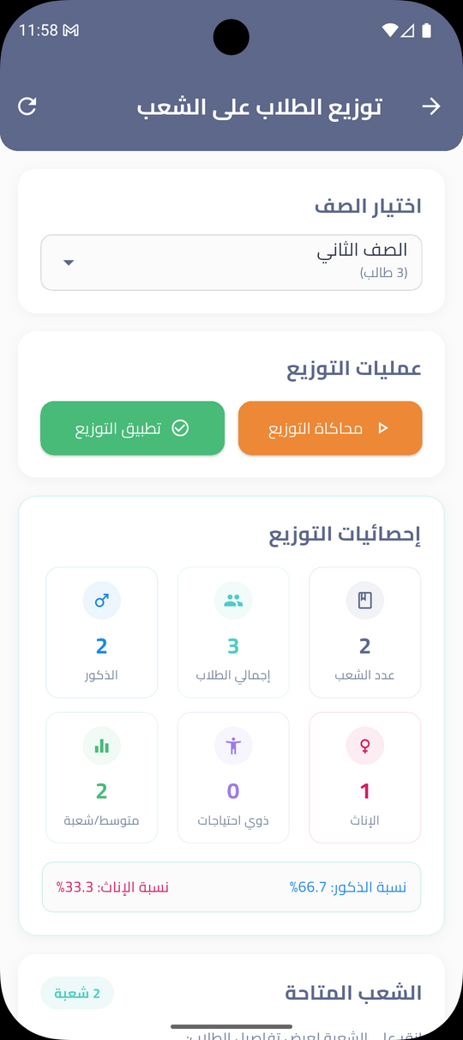
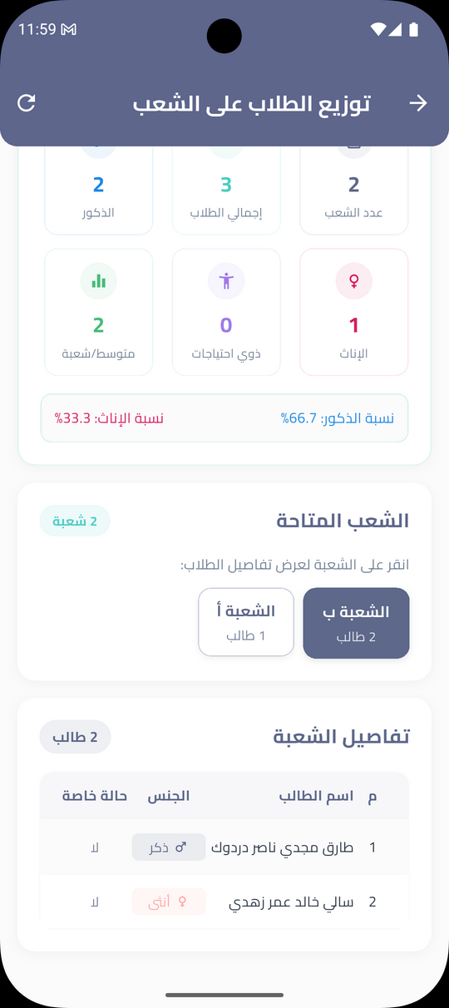
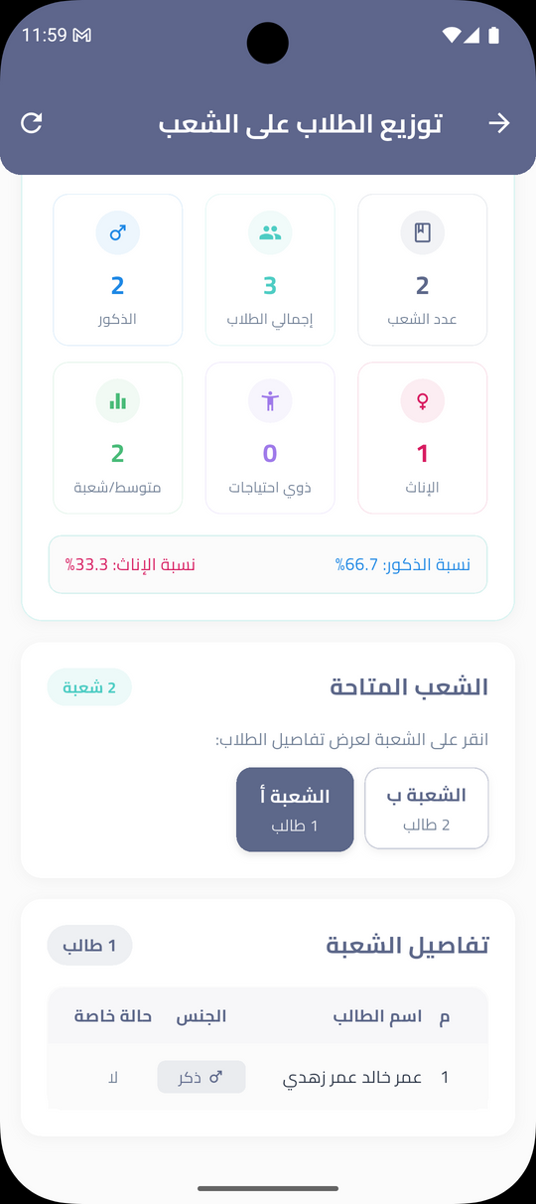
DISTRIBUTE STUDENTS
ON CLASSROOMS SCREEN

Slide 23
1
MAXIMUM NUMBER OF STUDENTS IS 30
DISTRIBUTE STUDENTS
CONSTRAINTS
2
MAXIMUM 2 SPECIAL NEEDS
3
NO SIBLINGS IN THE SAME CLASS
4
PERCENTAGE OF FEMALE TO MALE IS 50%

Slide 24
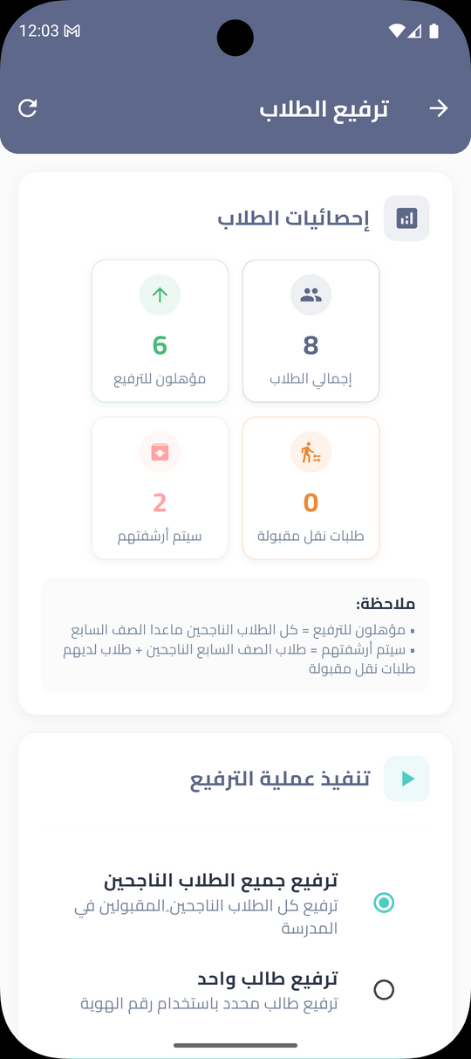
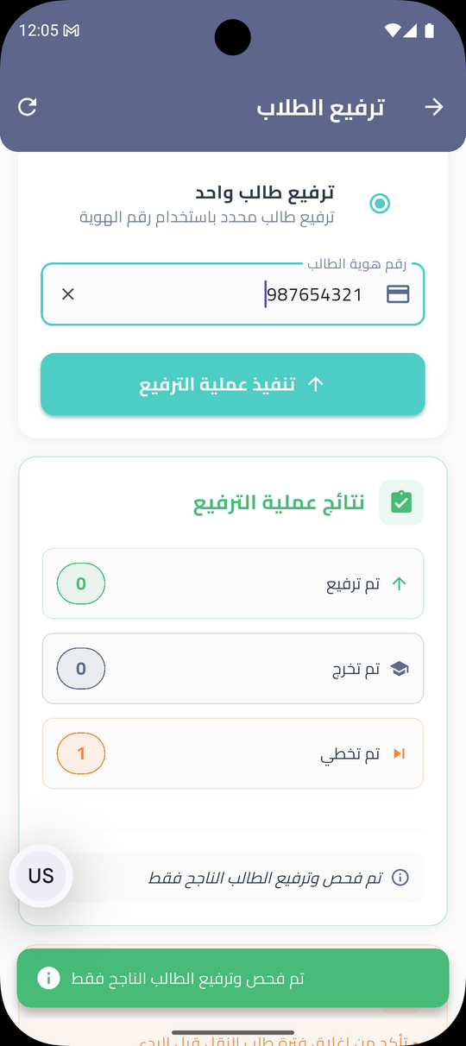
PROMOTE STUDENTS SCREEN

Slide 25
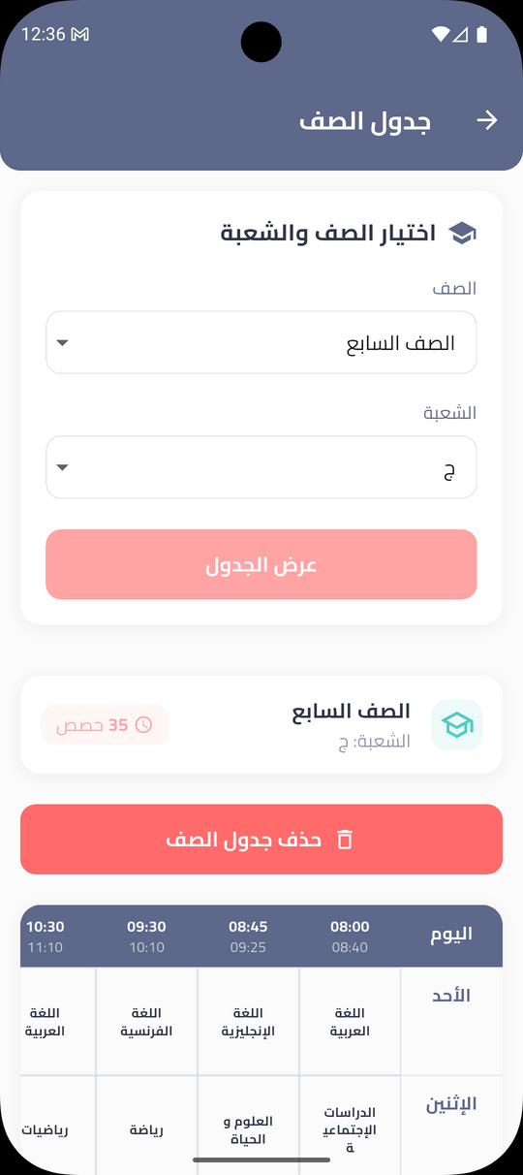
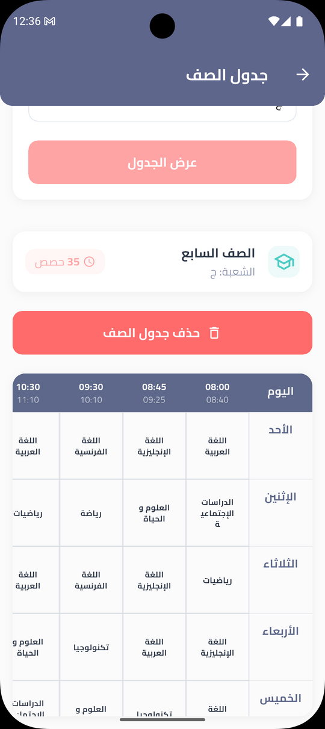

CLASSES TIMETABLE SCREENS

Slide 26
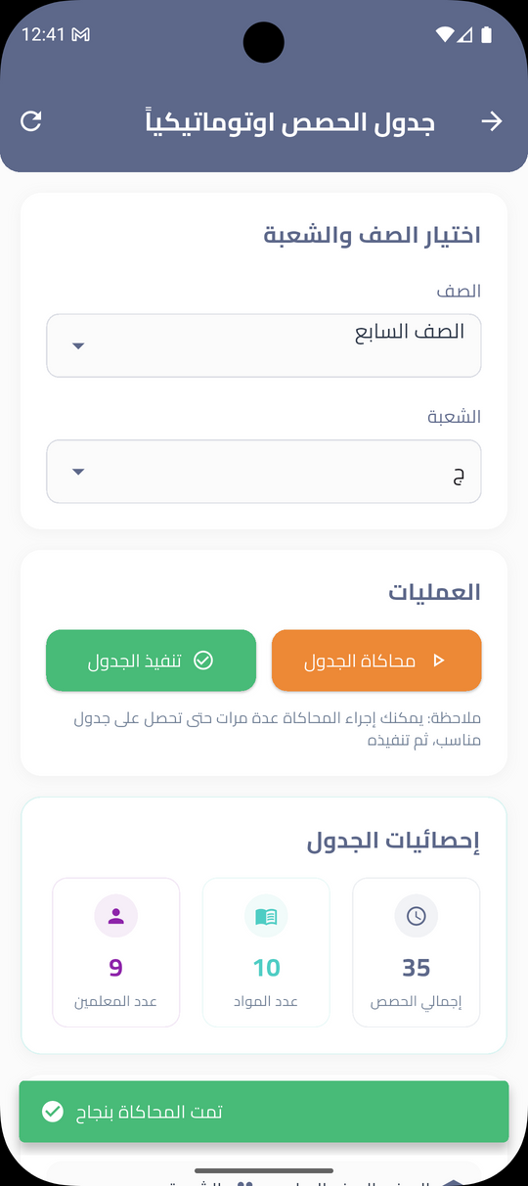
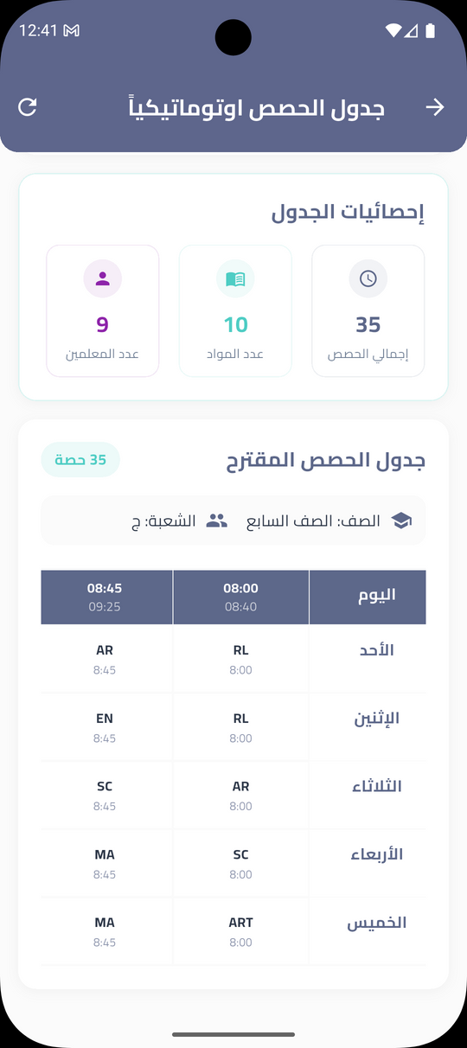
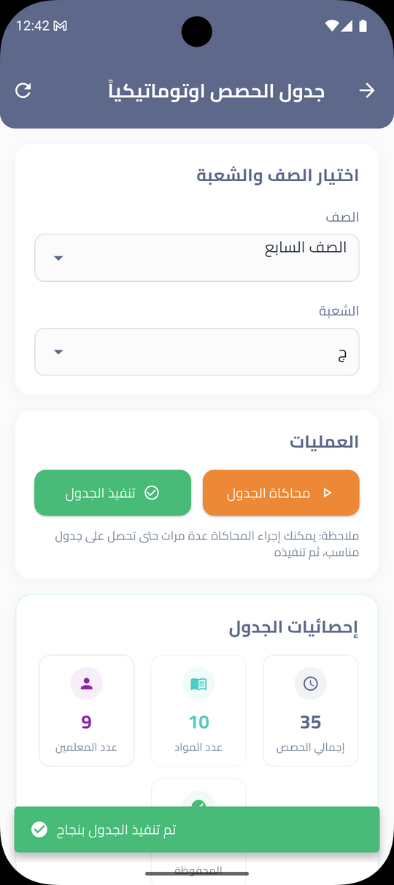
DISTRIBUTE SCHEDULE SCREENS

Slide 27
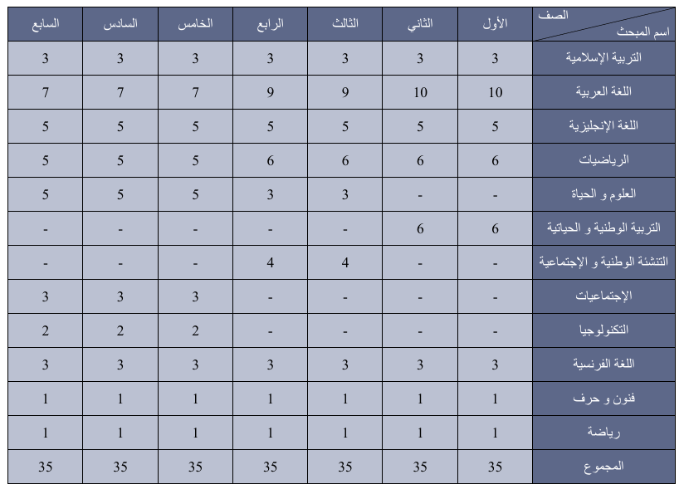
NUMBER OF LESSONS PER WEEK

Slide 28
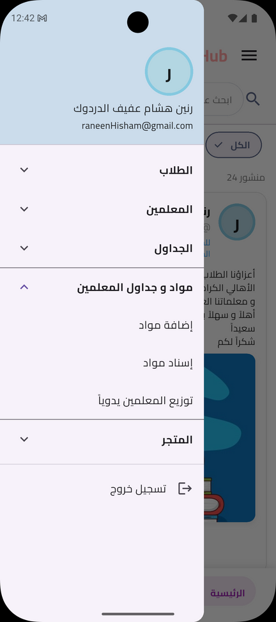
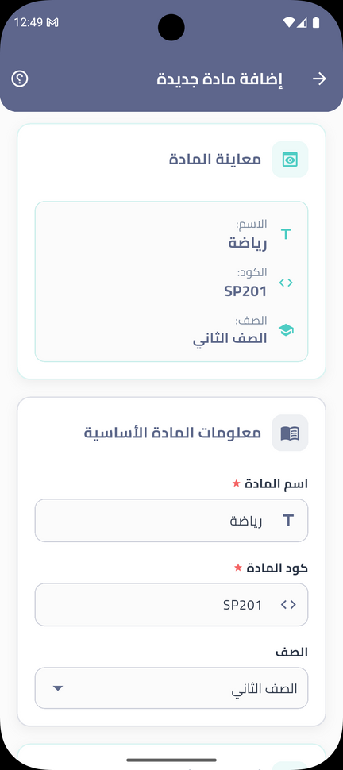
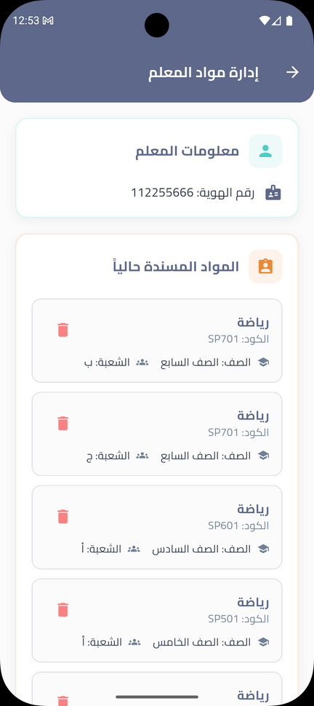
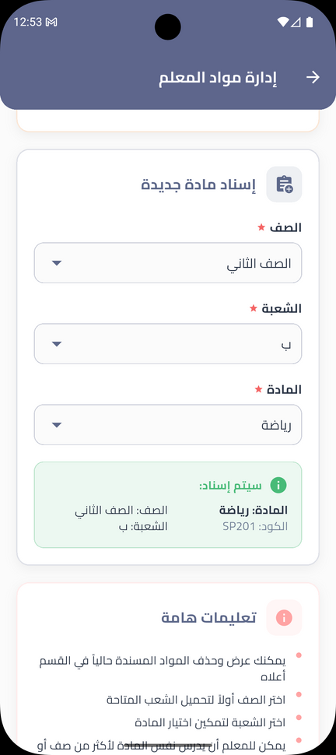
ADD AND ASSIGN SUBJECTS
SCREENS

Slide 29
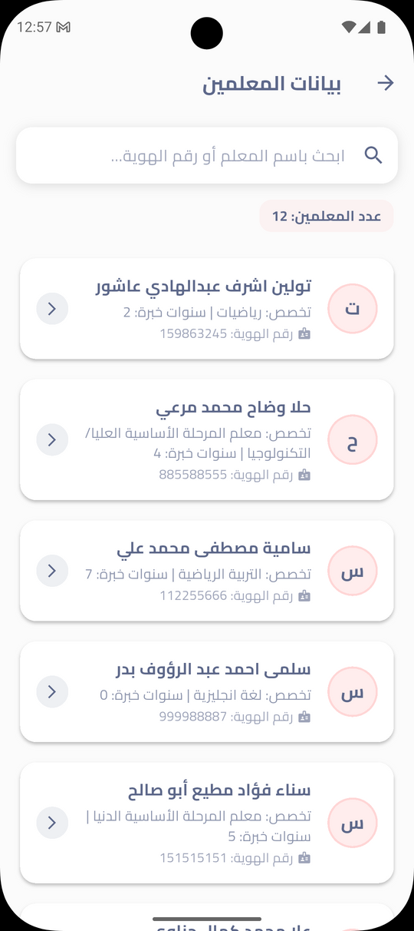
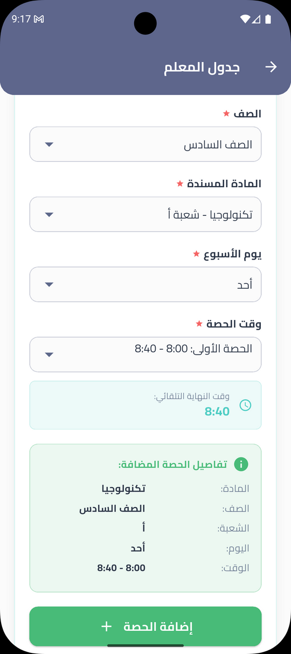
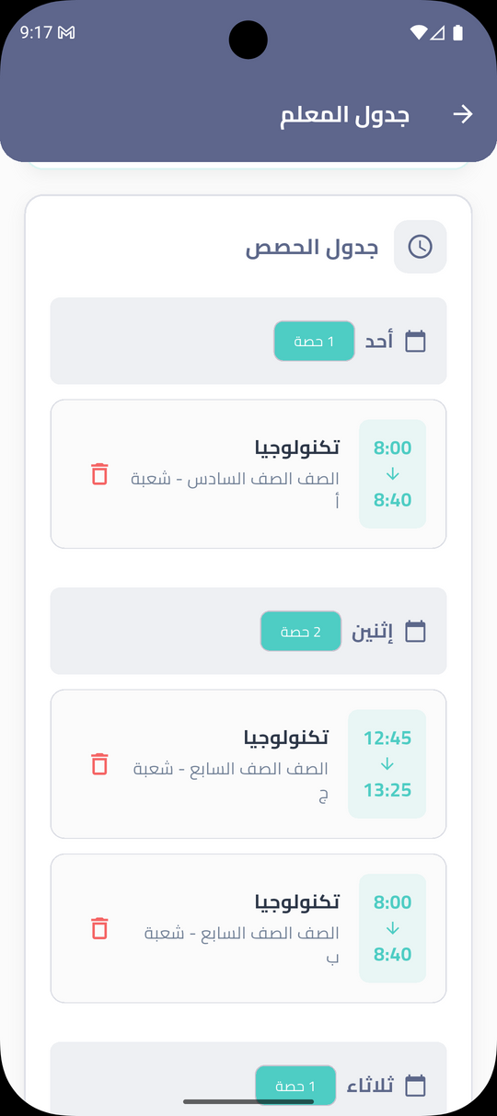
DISTRIBUTE TEACHERS’ TIMETABLE MANUALLY
SCREENS

Slide 30

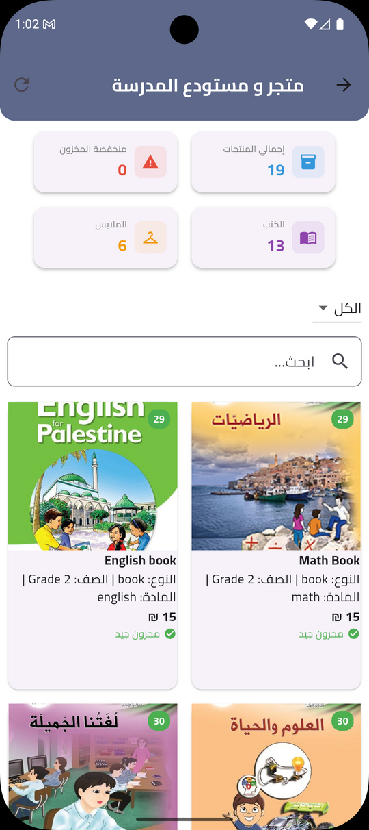
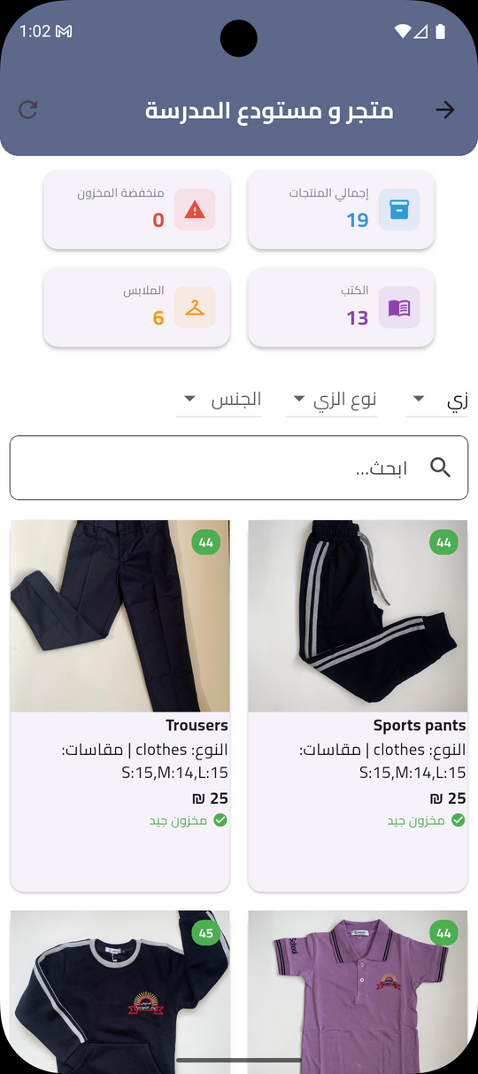
WAREHOUSE
SCREENS

Slide 31
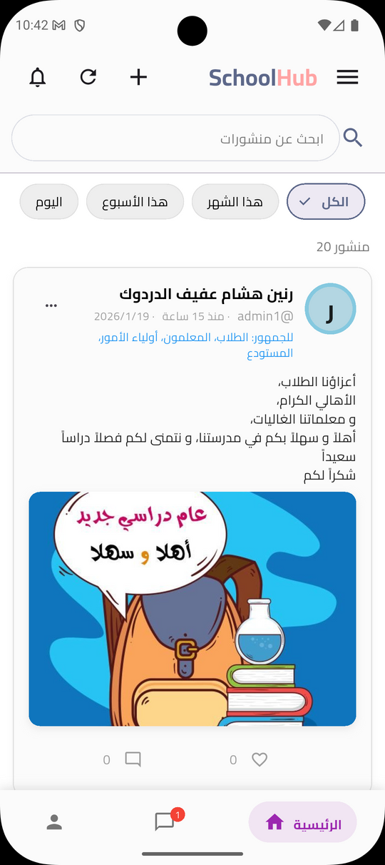
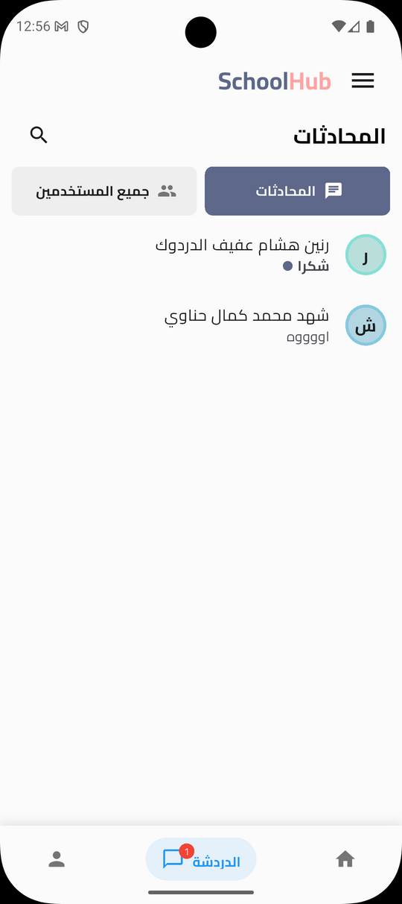
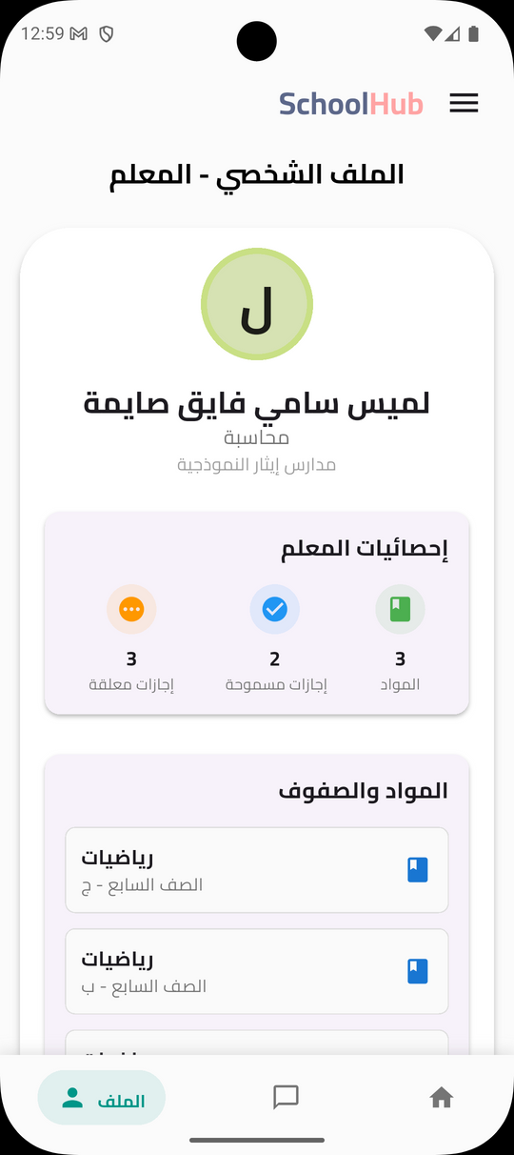
TEACHER
SCREENS

Slide 32
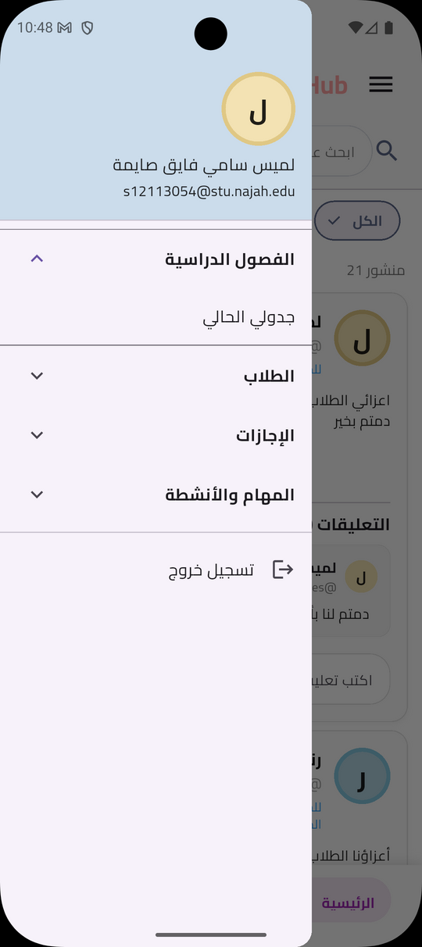

TEACHERS’ TIMETABLE
SCREENS

Slide 33
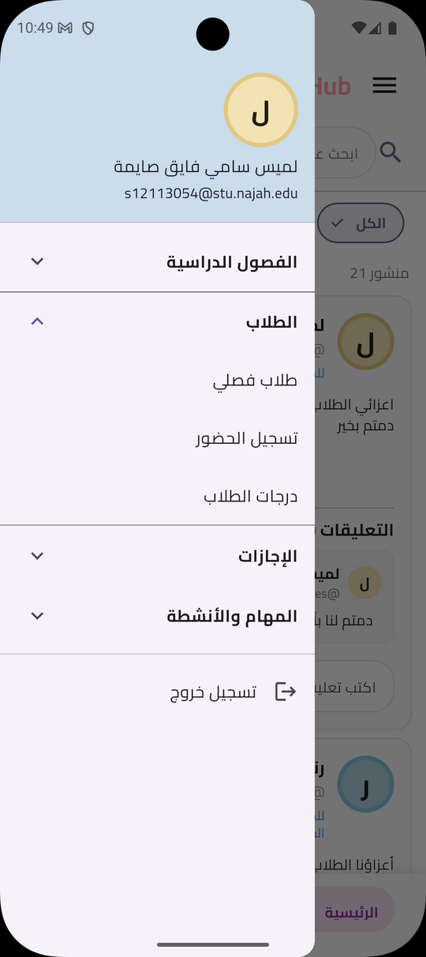
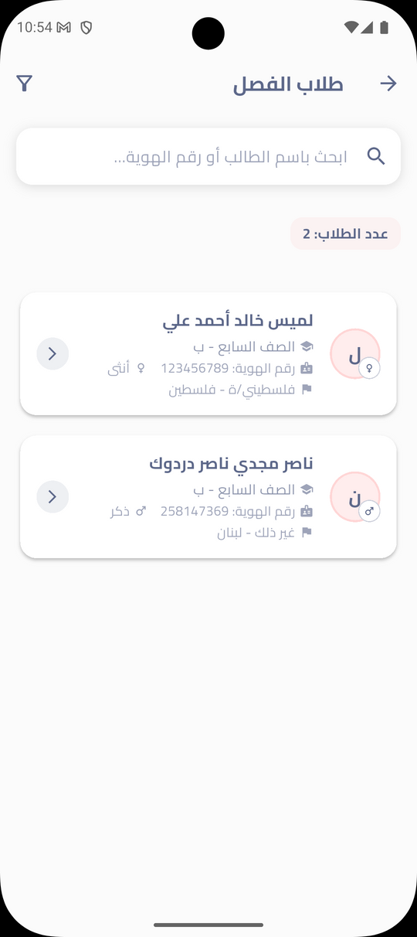


HOMEROOM STUDENTS AND ATTENDANCESCREENS

Slide 34



STUDENTS’ MARKS
SCREEN

Slide 35



LEAVE REQUESTS
SCREENS

Slide 36




HOMEWORKS AND EXAMS
SCREENS

Slide 37


TRAINING TEST
SCREENS

Slide 38



AI QUESTIONS
SCREEN

Slide 39



MANUAL QUESTIONS SCREENS

Slide 40




WORKSHEETS
SCREENS

Slide 41





PARENT
SCREENS

Slide 42



WAREHOUSE SCREEN

Slide 43



PARENTS’
ORDERS

Slide 44




STUDENT SCREENS

Slide 45



STUDENT
SCREENS

Slide 46


TRANSFER STUDENT SCREEN

Slide 47




STUDENT
SCREENS

Slide 48


SCHOOL SCREEN
HOMEWORKS &
EXAMS SCREEN

Slide 49



TRAINING TEST
& WORKSHEETS SCREEN

Slide 50


STUDENTS’ MARKS & CERTIFICATE SCREEN

Slide 51

STUDENTS’ TIMETABLE
& CALANDER SCREEN

Slide 52




WAREHOUSEADMIN
SCREENS

Slide 53




WAREHOUSE
SCREENS

Slide 54




ADD & EDIT ITEM

Slide 55



DELETE ITEM

Slide 56
CONSTRAINTS
1
3
ANDROID STUDIO EMULATOR LAGGING AND CRASHED OFTEN
LIMITED EXPERIENCE WITH MOBILE APP DEVELOPMENT
2
4
INTEGRATION OF MULTIPLE USER ROLES
SEARCHING FOR REAL INFORMATION
55

Slide 57
FUTURE WORK
1
4
SUPPORTING ONLINE CLASSES
ADVANCED ADMINSTRATIVE REPORTING
2
5
ADVANCED FILE MANAGEMENT AND EXPORTING
DIGITAL RESOURCES MANAGAMENT
3
BUS AND STUDENT TRACKING
6
SMART SCHOOL STORE EXPANSION
7
ADD MULTILINGUAL SUPPORT.
56

Slide 58
CONCLUSION
SCHOOLHUB BRINGS ALMOST ALL SCHOOL SERVICES INTO ONE CONNECTED DIGITAL SYSTEM.
ENABLES REAL-TIME COMMUNICATION AND ACADEMIC TRACKING FOR FAMILIES AND TEACHERS.
SUPPORTS BETTER COORDINATION BETWEEN ALL SCHOOL STAKEHOLDERS.
REDUCES MANUAL WORK AND SIMPLIFIES ADMINISTRATIVE TASKS.
SUCCESS DEPENDS ON USER FEEDBACK AND ADAPTABILITY.
57

Slide 59
THANK YOU

