Slide 1
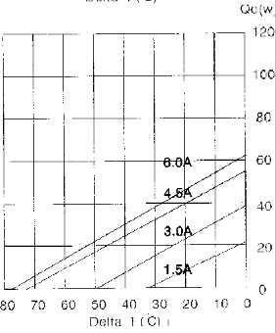
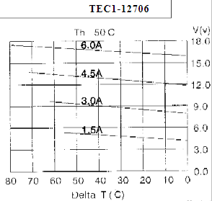
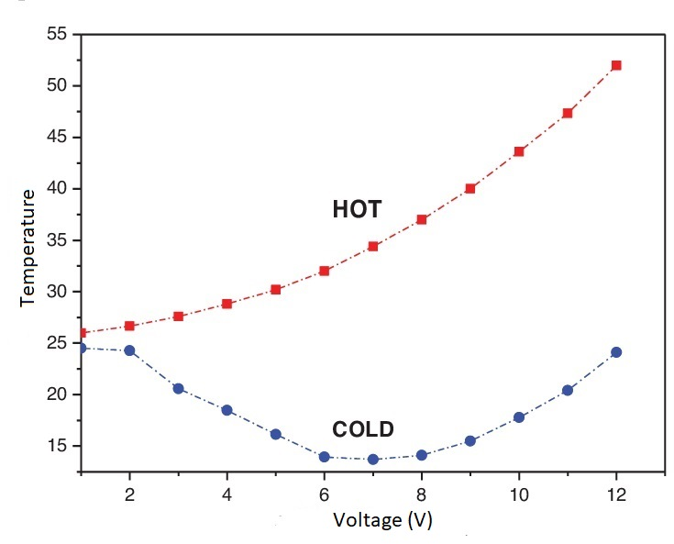
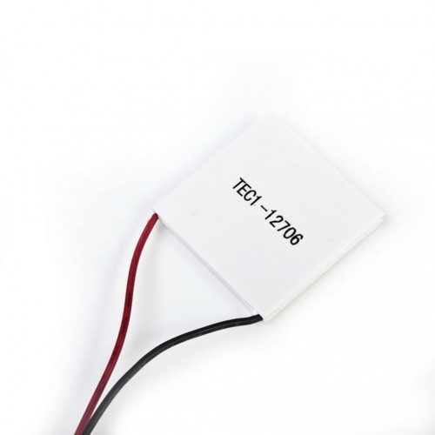
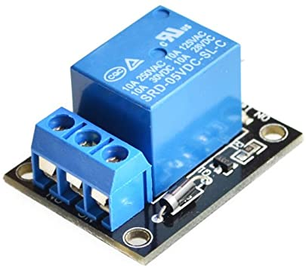
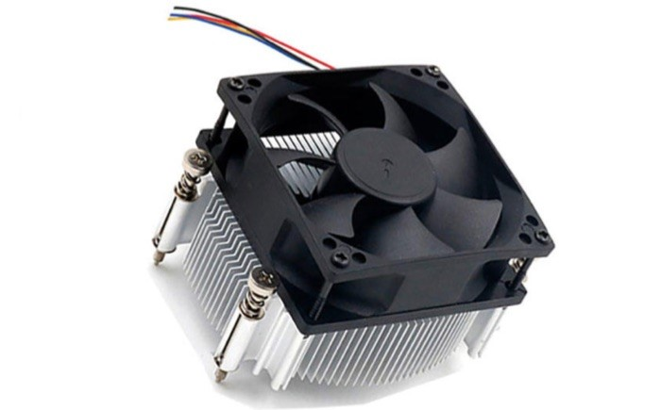
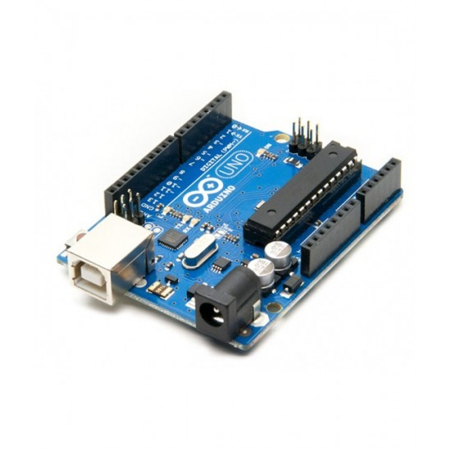
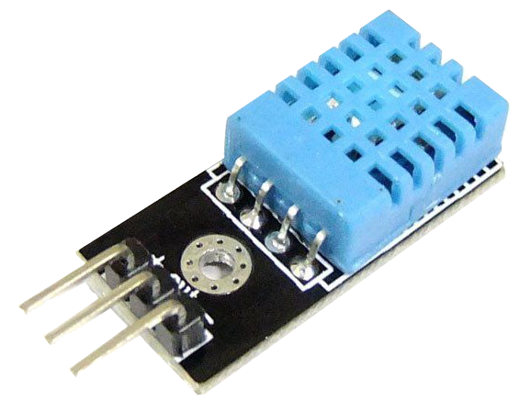
Design and control of thermoelectric peltier refrigerator powered by PV panels
Names: Ali Halabe,Rezeq Qatuni,Saleh Hassan Dr.Moien Omar
Abstract
Advantages
Relay and Software
This project aims to design, implement and test an automotive thermoelectric refrigerator Peltier module power by solar PV cells. Thermoelectric cooling is a strong candidate to replace the traditional refrigeration cycles because of its low maintenance and long life up to 200,000 working hours; it transforms electrical energy to produce a cooling effect directly without the need of the traditional refrigeration cycle components. The project will specify the size of the refrigerator, the required PV watt, controllers used for efficient operation.
1.Longer lifetime
2.Less maintenance
3.Needless of Freon gas
4.Needless of electric grid
5.Don’t need to high space unlike conventional system
if ((int)temperature >=15){
digitalWrite (10 , LOW);
digitalWrite (11 , LOW);
lcd.setCursor(0,0);
lcd.print( "Temp=" );
lcd.setCursor(7,0);
lcd.print( (int)temperature );
delay(1500);
else if ((int)temperature <15 && (int)temperature >10 ){
digitalWrite (10 , LOW);
digitalWrite (11 , HIGH);
lcd.setCursor(0,0);
lcd.print( "Temp=" );
lcd.setCursor(7,0);
lcd.print( (int)temperature );
delay(1500);}
else if ((int)temperature <=10){
digitalWrite (10 , HIGH);
digitalWrite (11 , HIGH);
lcd.setCursor(0,0);
lcd.print( "Temp=" );
lcd.setCursor(7,0);
lcd.print( (int)temperature );
delay(1500);
}
}
disadvantages
Cooling capacity = 66W, two TEC-module is required each 33W
From curves one TEC-module current = 5A and voltage = 13 V
1.Less coefficient of performance (COP)
2.Limited cooling area
Thermoelectric (TEC) module
Existing problem
The problem of electricity access to remote areas is difficult. For example when medical staff goes into these areas to give vaccines they need to suitable place to save vaccines
Heat sink
Solving problem
Cooling system has been made to keep vaccines using a Peltier. It is a piece that works without the need for utility. Where it will be supplied with electricity through solar energy. When a direct electric current passes through it, one end of it becomes cold and the other end is hot, as we used solar energy as a source of electric current.

