Slide 1
Assessment of Water Consumption for Different Sectors
In Salfit Governorate
Prepared BY:
Dana I. Alzeer-11210808
Thana'a R. Bouzia-11214502
Under supervision of: Dr. Mohammad N. Almasri

Slide 2

:Out line
Background.
Objectives.
Description Of The Study Area.
Methodology.
Patterns Of Water Consumption.
Results & conclusion.

Slide 3

Background:
Water is vital for people existence, since life itself is sustained by water through the fact that without water there is no development or growth. therefore the needs for water increase closely with the development of the different aspects. And for the importance of knowing how water is consumed we have done this project.

Slide 4

Water is one of the biggest problems that Palestinian face. This is not for scarcity of water sources, but because of controls of Israeli occupation on the greater part of these sources.
we have selected the city of Salfit and two villages which called (Bidia, Kifil Hares) to study the different consumption patterns in the Governorate.

Slide 5

:Objectives
Assessment of the current situation of water in the Governorate according to the consumption.
Determine if we have gap between consumption and supply, and if we have a gap how we can solve this problem.
Compare the current water consumption for different sectors in the governorate with standard one and with consumption for the same sectors in other governorates.

Slide 6

Compare the current water consumption for different sectors in the governorate with consumption for Israeli citizens and Israeli settlers.

Slide 7
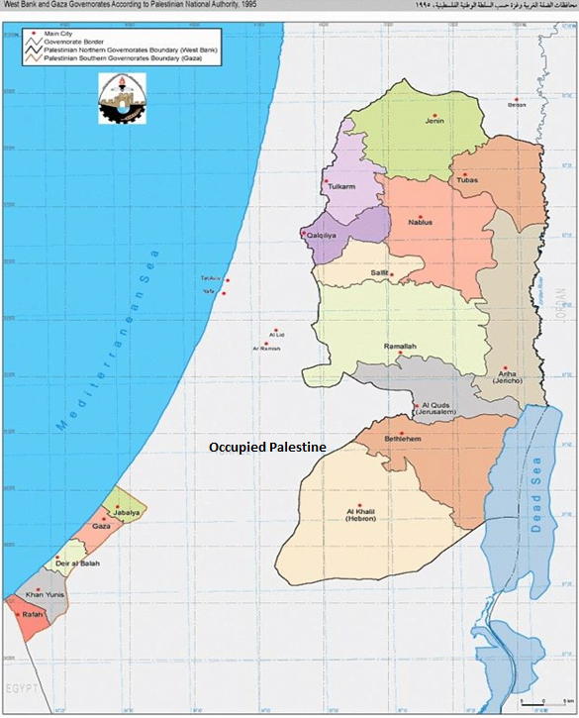
Description Of The Study Area:

Slide 8
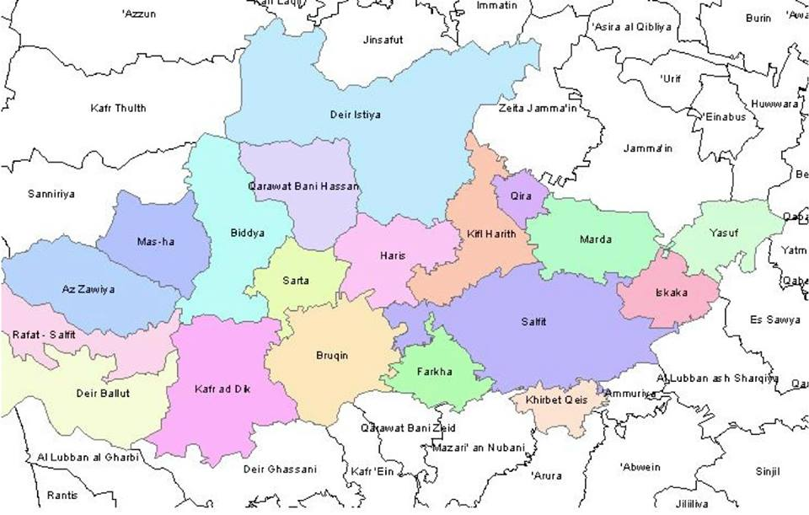
study area map

Slide 9
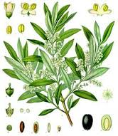
Land Use
Salfit Governorate area is 204 km²or about 3.6% of the total West Bank area.
Cultivated Area : total land area planted with olive trees in the Salfit region is about 73,000 acres.
Palestinian Built-up Areas : there are 19 Palestine built-up areas in the Governorate.
Israeli Settlements : there are 24 Israeli settlements on the Salfit Governorate.

Slide 10

Segregation Wall
Salfit is the largest affected of the Segregation Wall after Jerusalem, where It held on approximately 27 km of the territory of the Governorate, which includes the fertile agricultural land, as well as many archeological sites and water springs.

Slide 11
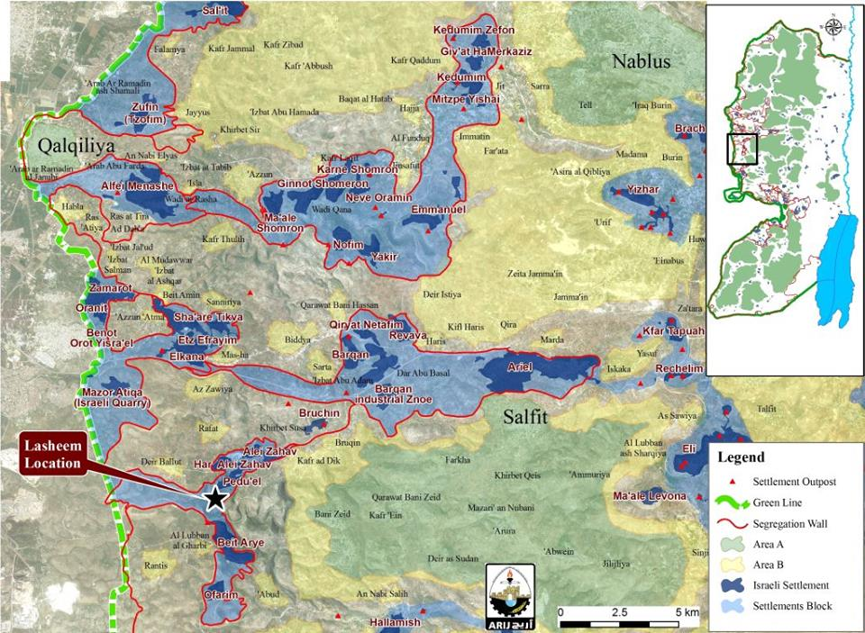

Slide 12

Water Resources
The main source of water in Salfit is the Israeli company Mekorot, which pumps water from a well called Alzawiah well.
The number of springs in Salfit 99 spring. Two of these springs are used only, which called Almatwee spring and Sekka spring. Other springs are contaminated by the remnants of settlements, as was control of a large number of them behind the segregation wall by the occupation.

Slide 13
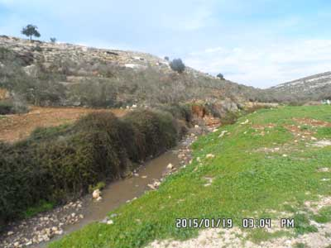
Al - Matwee, which is contaminated with Israeli sewage

Slide 14

Methodology

Slide 15

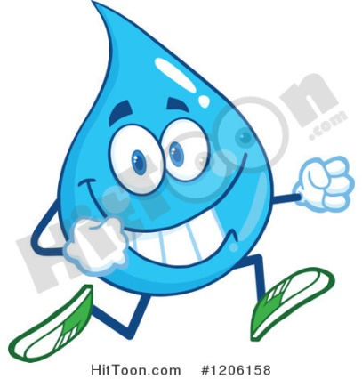
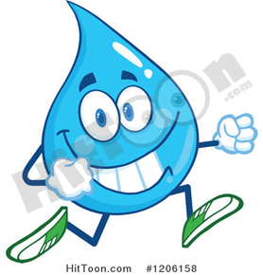
Problem Identification

Slide 16
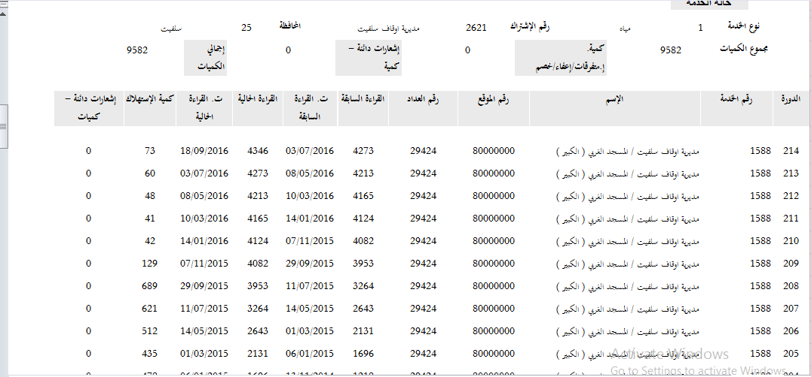

Data Collection

Slide 17

Data Classification
Sectors
Domestic
Medical
Industrial
Commercial
Services
Others

Slide 18
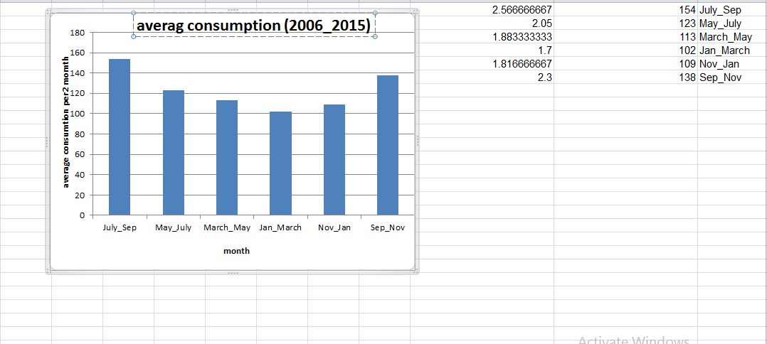

Data Analysis

Slide 19
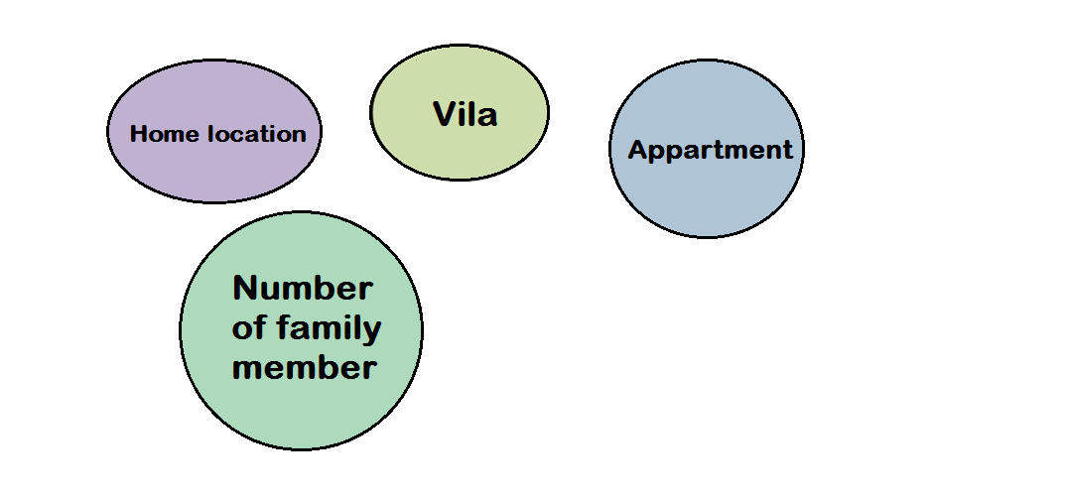
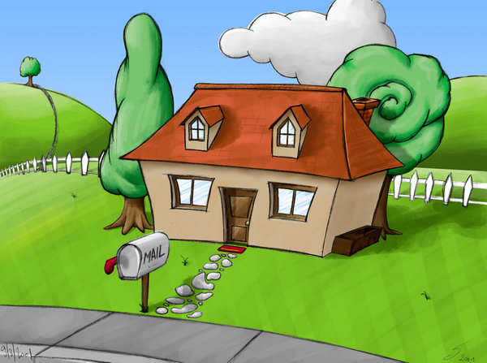
Domestic Consumption

Slide 20
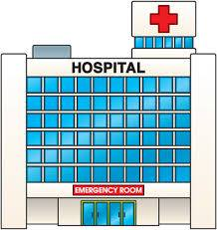
Medical Sector
pharmacy
Laboratory
Clinics
Cluster
Hospital

Slide 21
Industrial Sector
Concrete
Tile
Stone
Carpentary
Olive Press
Marble

Slide 22
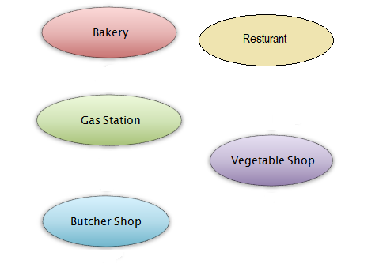

Commercial Sector

Slide 23
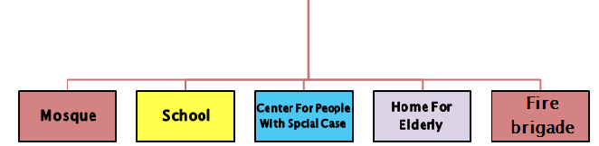
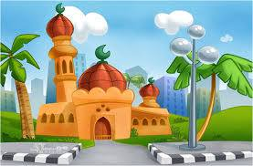
Service Sector

Slide 24

Other Classification
Others
Ministries Offices
Military Facilities
Kindergartens
Park
Wedding hall

Slide 25

Comparison of consumption values in Palestine with consumption values in the United States and with provisions of WHO.

Slide 26

Comparison of Palestinian consumption with Israeli consumption.

Slide 27

Results and Discussion
After analyzing the water consumption data for various sectors. We got a huge number of graphic curve.
We summarized some of this
results as the following figures.

Slide 28
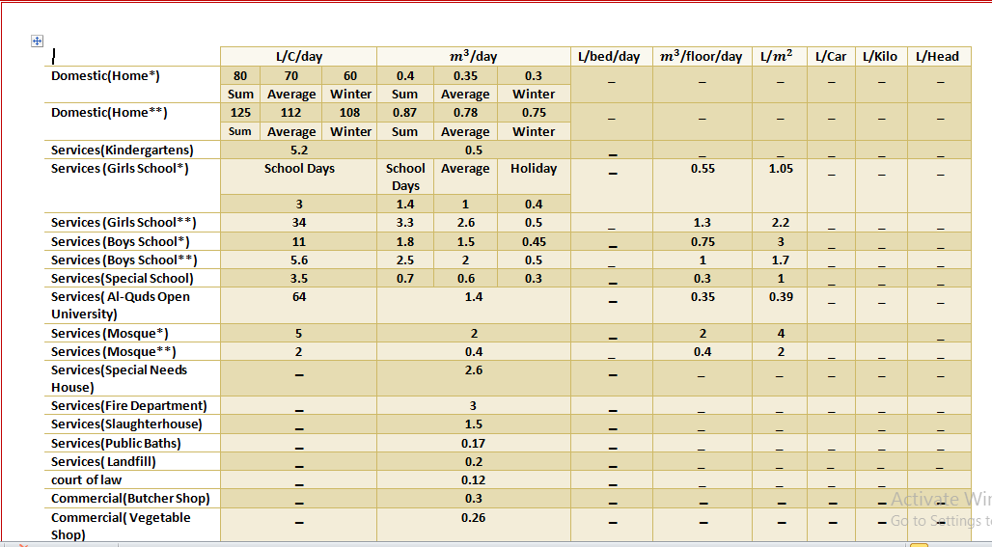

Slide 29
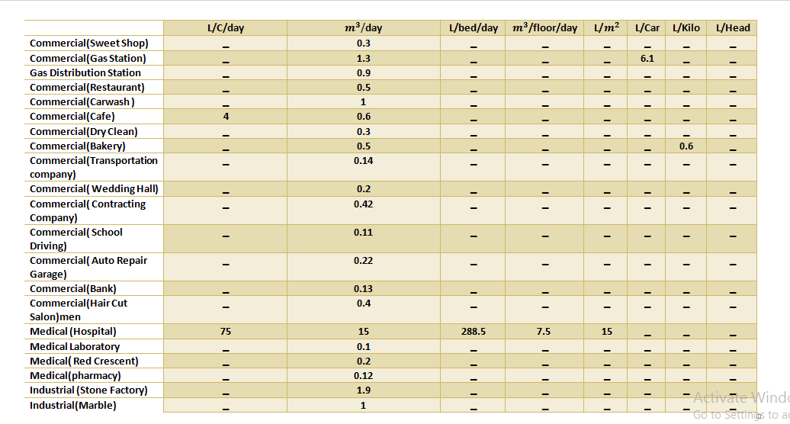

Slide 30
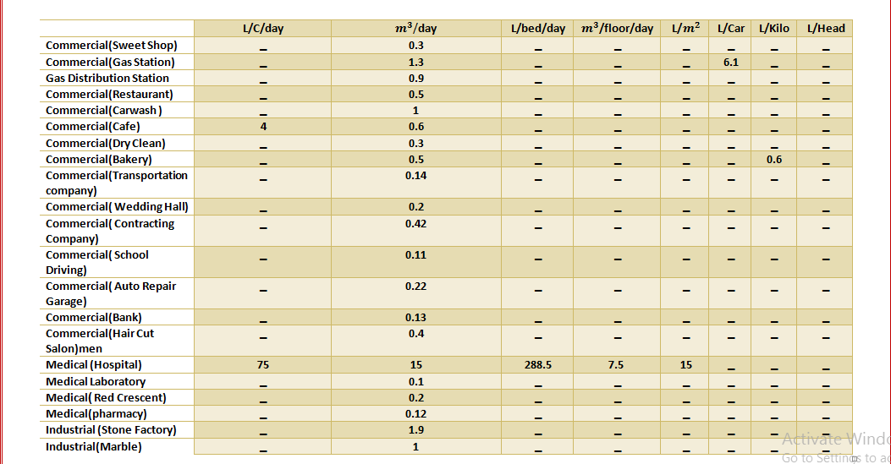

Slide 31
Schools
Boys
Secondary
Basic
Girls
Basic
Secondary

Slide 32

School Of Girl
Salfit
3L/capita/day
Kifil Hares
3L/capita/day
Bedia
6.6L/capita/day

Slide 33

Boy School
Salfit 11L/capita/day
Kifil Hares
4.35L/ capita/day
Bedia
4.L/capita/day

Slide 34

Domestic
Salfit
70L/C/day
Kifil Hares
74L/c/day
Bedia
46L/c/day

Slide 35
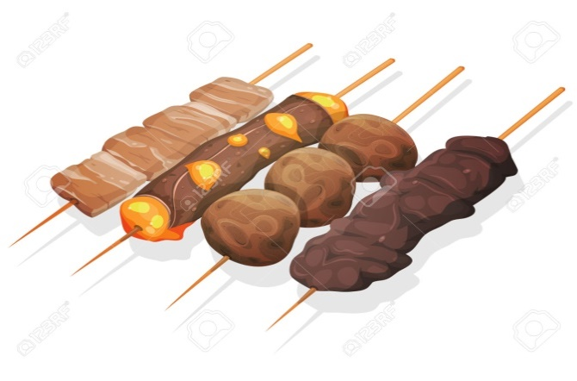
Commercial
Butcher Shop
Salfit
.3 m^3/day
KifilHares
.4 m^3/day
Bedia
.6 m^3/day

Slide 36
Medical
75 L/capita/day
288.5L/Bed/day

Slide 37
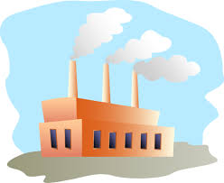
Industrial
24.8m^3/day
1.9m^3/day

Slide 38
Water Consumption Sectors In Salfeet 2016
Percentage | Consumption Sectors
78.70% | Domestic
2.53% | Military
3.41% | Services
4.15% | Industrial
2.40% | Agricultural
1.44% | Commercial
0.11% | Tanks
7.62% | Village Gathering
15% | Losses

Slide 39
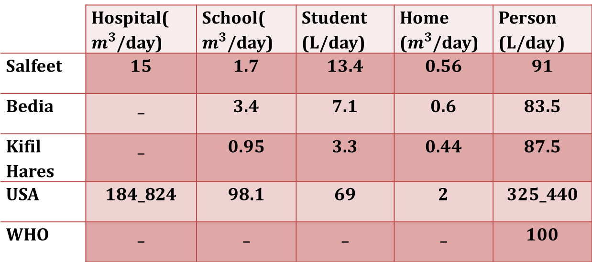
Comparison of consumption values in Palestine with consumption values in the United States and with provisions of WHO.
 | Hospital( $m^{3}$/day) | School( $m^{3}$/day) | Student (L/day) | Home ($m^{3}$/day) | Person (L/day )
Salfeet | 15 | 1.7 | 13.4 | 0.56 | 91
Bedia | _ | 3.4 | 7.1 | 0.6 | 83.5
Kifil Hares | _ | 0.95 | 3.3 | 0.44 | 87.5
USA | 184_824 | 98.1 | 69 | 2 | 325_440
WHO | _ | _ | _ | _ | 100

Slide 40
Israeli citizen consumes 4 times what the Palestinian citizen consumes. Israeli settler consumes 7to9 times more than what the Palestinian citizen consumes.

Slide 41


Conclusion

Slide 42


